Slide 1





Production of secondary fuels from MSW for utilization in power –thermal applications
Case study of Sofia Municipality MBT
БЪЛГАРСКИ ЕНЕРГИЕН И МИНЕН ФОРУМ
BULGARIAN ENERGY & MINING FORUM
in co-operation with Sofia Municipality
International Conference
WASTE-TO-ENERGY – TECHNOLOGIES, PROJECTS, NEW OPTIONS FOR MUNICIPALITIES AND BUSINESS
22-23 March 2016, Sofia
Ioannis Boukis, Chem-Eng, MSc, PhD Georgios Koufodimos, Mech-Eng, MSc, PhD
Head of R&D, HELECTOR SA Technical dept., HELECTOR SA
DESIGN AND CONSTRUCTION OF SOFIA MBT PLANT FOR PROCESSING WASTE AND PRODUCTION OF REFUSE DERIVED FUEL
SOFIA MUNICIPALITY / CONSORTIUM AKTOR S.A. – HELECTOR S.A.

Slide 2
Presentation overview
Short presentation of MSW management experience
The Sofia MBT plant overview (sections and functions, results achieved)
Selected marketing applications for Refuse Derived Fuel (RDF)
- Waste-to-Energy (combustion and gasification)
- Cement industry & other thermal applications
- lignite- & coal-fired plants
Conclusions

Slide 3
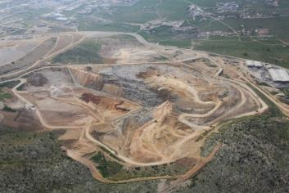
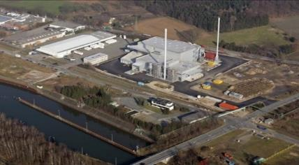
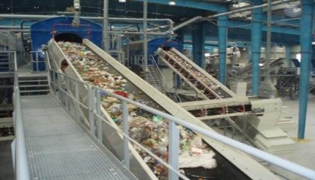
Experience on waste management
Overall MSW handling capacity: 600.000 t/a in Greece, Cyprus and Germany
Landfill site operation: 200.000 t/a
Renewable electricity production: 200.000 MWh/a
CO₂ savings: >170.000 t/a
Recyclables recovery: 45.000 t/a
Secondary fuels (SRF/RDF) production: 200.000 t/a

Slide 4
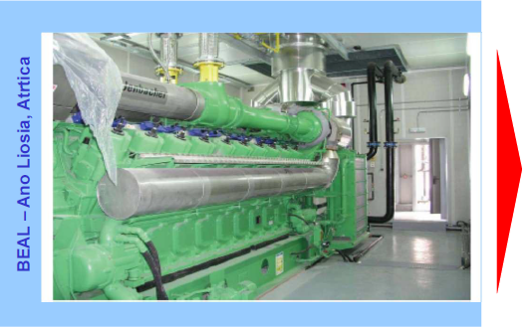
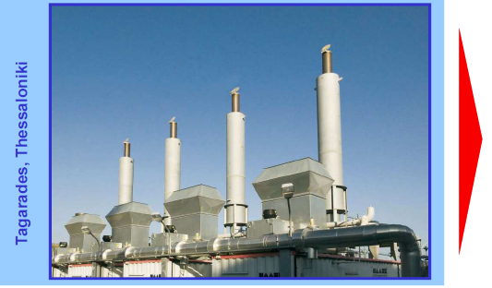
Energy generation from Sanitary Landfills
Helector – EDL (Australia) joint venture
Largest landfill gas power plant in Europe
Installed power: 23,5 MW_{e}
In operation since 2001
Planned power increase: 2,35 MW_{e}
El. generation: 170.000 MWh_{e}/a
CO₂ savings: 145.000 t/a
Design, construction, operation
Installed power: 5 MW_{e}
In operation since 2007
El. generation: 30.000 MWh_{e}/a
CO₂ savings: 24.000 t/a

Slide 5
Sofia Project Outline
Project | Design and construction of Sofia MBT plant for processing waste and production of refuse derived fuel (RDF)
Employer | Sofia Municipality
Contractor | Consortium Aktor SA – Helector SA
Location | 22 km east of Sofia (area Yana Village, Sadinata)
Population | 1,2 mil (2012)
Input waste | Municipal Solid Waste (MSW) 20 03 01
Capacity | 410.000 t/a
Output (end use) | Recyclables (re-use), RDF (to be utilized in municipal district heating, cement plants, WtE)
Duration | 19 months (12.2013 – 09.2015)
Trial Operation | 12 months (10.2015 – 09.2016)
Tender goals | Maximum RDF production Recyclables recovery Minimum residue

Slide 6
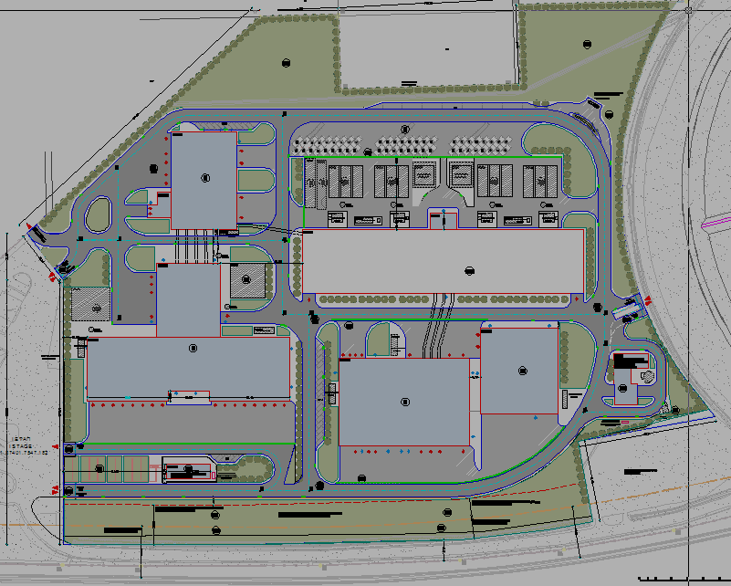
General site plan
MECH.
SEPARATION
BIODRYING
WWR
P
RDF STORAGE
RECEPTION
RDF PRODUCTION
SUBSTATION

Slide 7
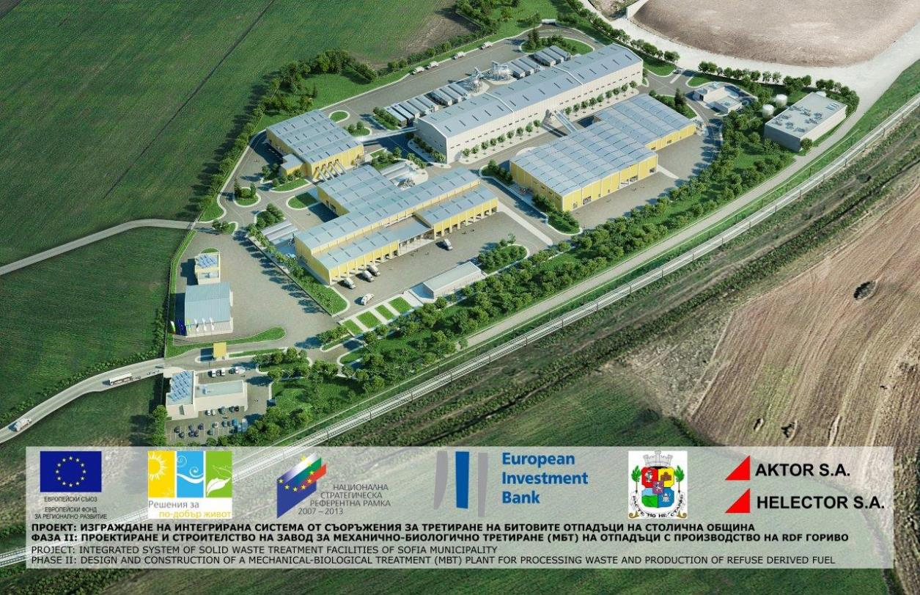
MBT plant (3D view)

Slide 8
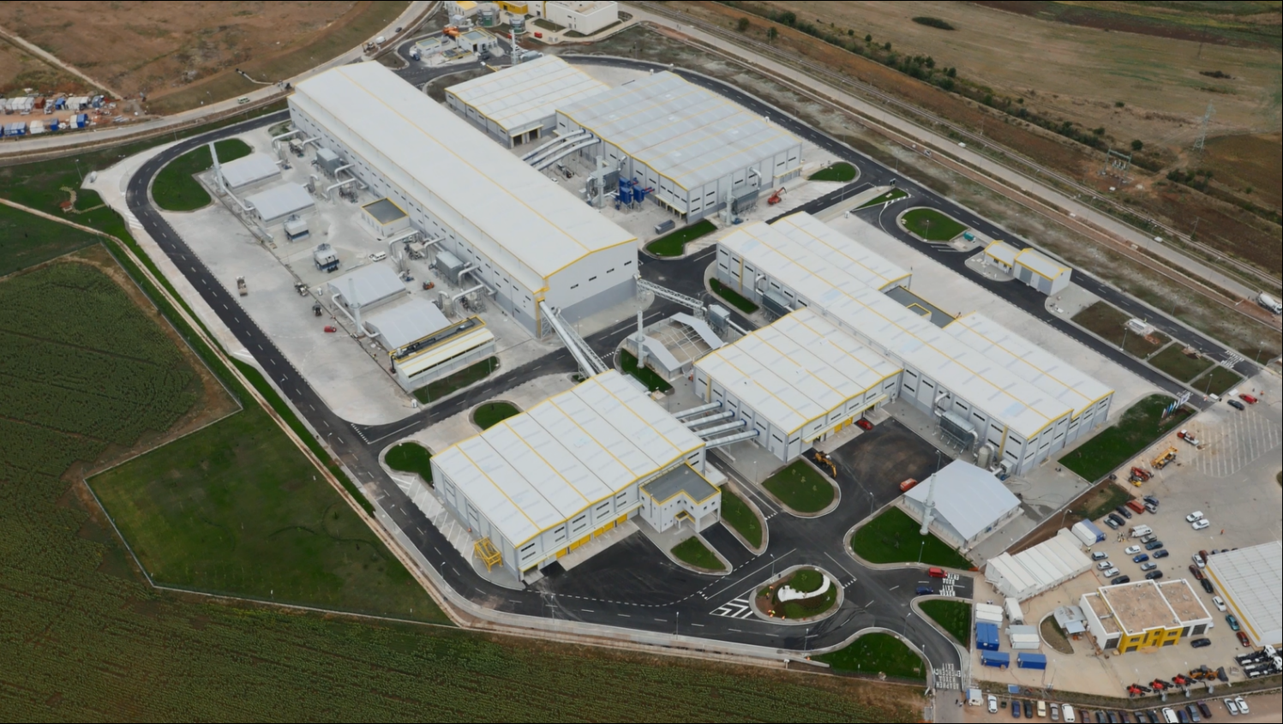
Sofia MBT Plant (aerial view)

Slide 9
Input waste composition (based on Tender Documents)
Fraction | Mass (t/a) | %
Food waste | 141.450 | 34,50%
Garden green waste | 10.250 | 2,50%
Plastics | 58.630 | 14,30%
Paper | 39.360 | 9,60%
Cardboard | 33.620 | 8,20%
Textile | 16.400 | 4,00%
Rubber | 2.870 | 0,70%
Leather | 3.690 | 0,90%
Wood | 7.790 | 1,90%
Glass | 21.320 | 5,20%
Metals | 4.920 | 1,20%
Inert | 67.650 | 16,50%
Hazardous waste | 2.050 | 0,50%
Total | 410.000 | 100%

Slide 10
Conceptual process flow diagram
Input MSW
Reception
Glass / Fe
Bulky residue
Mechanical Separation
Paper/plastic
composting
Process losses
CLO refinery
CLO (traces)
Residue
Biodrying
Process losses
RDF Production
RDF
FE / NE / Glass
Residue

Slide 11
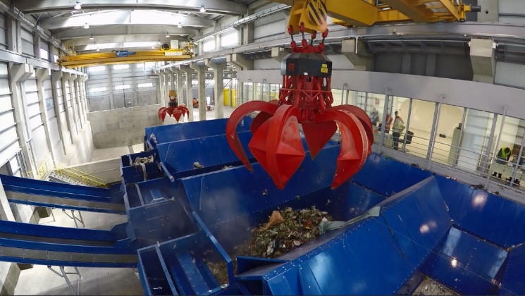
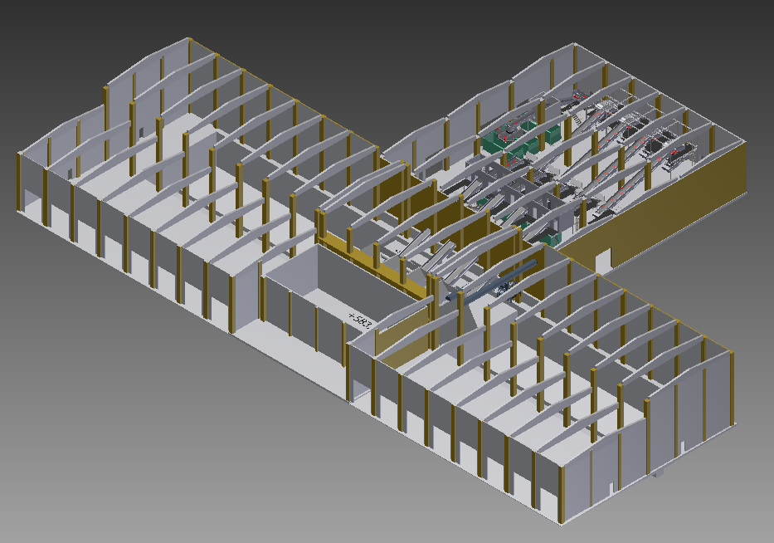
MSW reception building
16 waste truck unloading positions
2 deep bunkers
4 process lines
Glass / FE recovery
Material preparation for the forthcoming Mechanical Separation

Slide 12
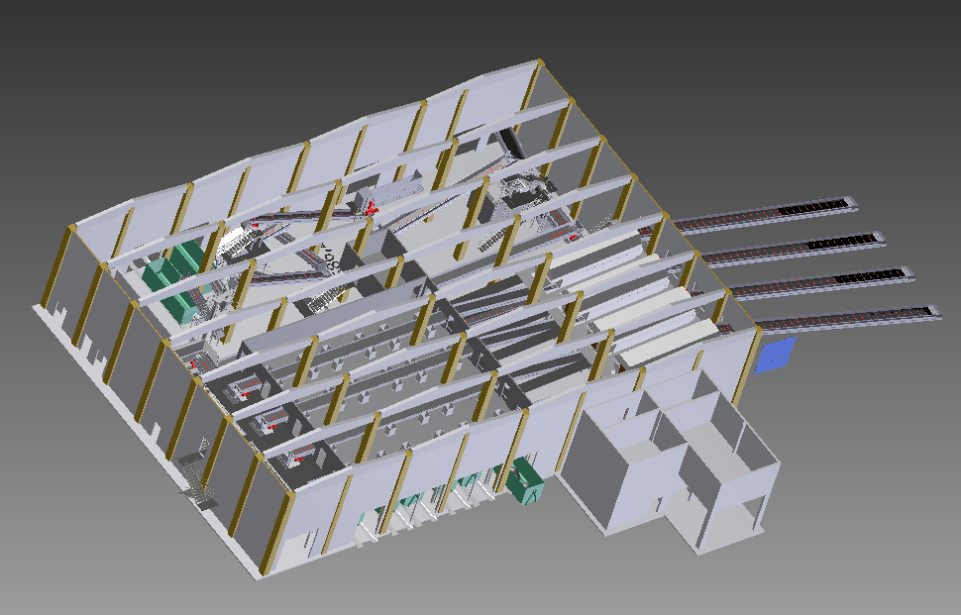
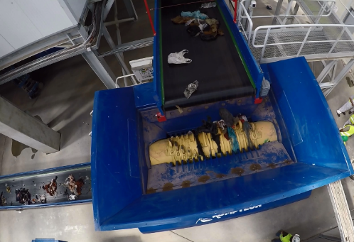
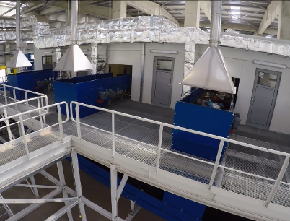
Mechanical Separation building
Material preparation for biodrying
Material preparation for composting
Plastic / paper recovery

Slide 13
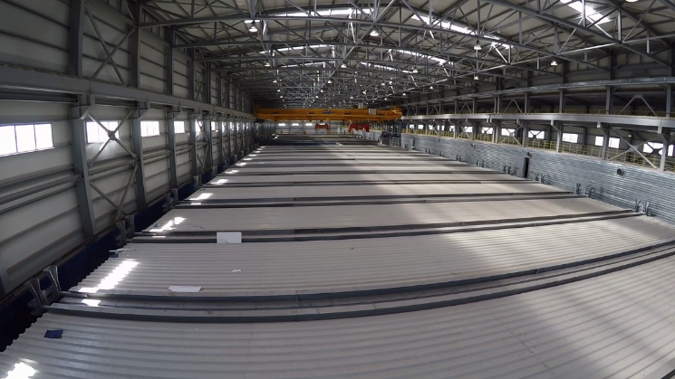
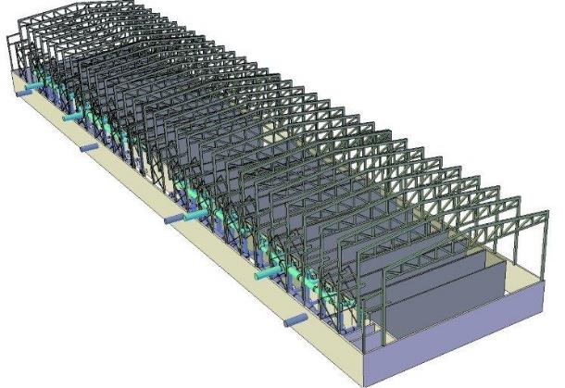
Biodrying building
26 bioreactors
Automatic bioreactors’ loading and unloading by 2 bridge cranes
Facilities for air emissions control and WWTP
3 process lines to transfer the bio-dried material to the RDF production building

Slide 14
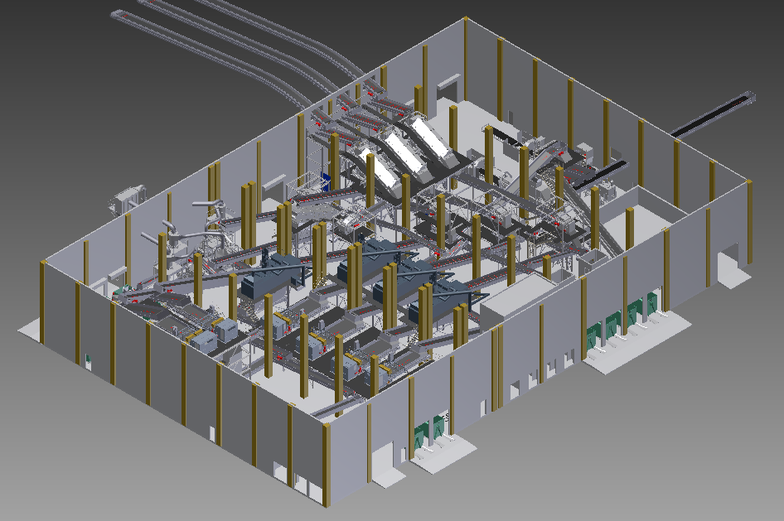
RDF production building and equipment (3D view)

Slide 15
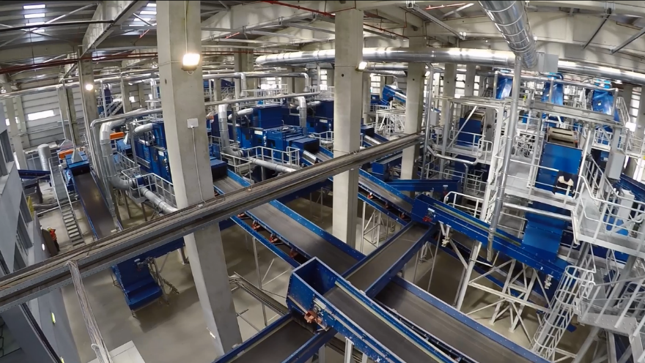
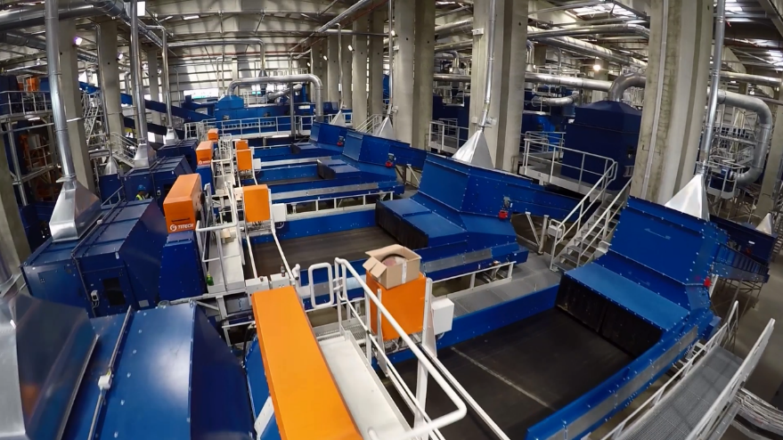
Optimized RDF production process
Upgraded quality
Exhaustive recovery of
combustible materials
PVC removal by optical separators
Organics removal out of the residual fraction
Optimized overall process
Size control
RDF Baling
Bale Wrapping
Metals recovery
Glass recovery

Slide 16
Products as designed
Products (code) | t/a
RDF (19 12 10) | 180.000
Recyclable materials | 40.000
Paper and cardboard (10 12 01)
Plastic and rubber (19 12 04)
Ferrous metals (19 12 02)
Non-ferrous metals (19 12 03)
Glass (19 12 05)
CLO (19 05 03) | 500
Residue (19 12 12) | 74.500
Process losses | 115.000
Total | 410.000

Slide 17
RDF Properties (confirmed values, analysis is continued)
Parameter Value
Calorific value 14 – 17 MJ/kg
Moisture content < 20% w/w
Particle size 30 -200mm
Ash 15 – 20 % w/w
Sulphur S < 1,00% w/w
Chlorine Cl < 0,75% w/w
Fluorine F < 0,03% w/w
Mercury Hg < 0,60 ppm (actually less than 2,00 ppm due to measurement restrictions)

Slide 18
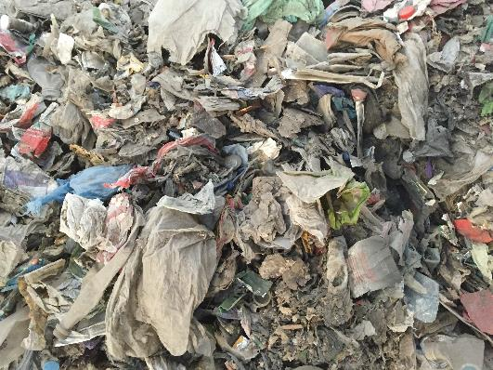
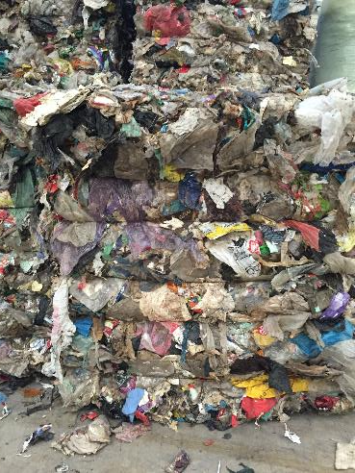
Produced RDF
RDF as produced
Baled RDF

Slide 19
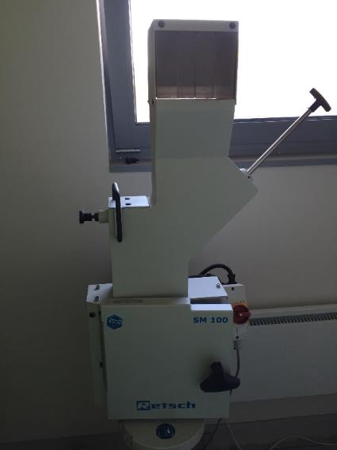
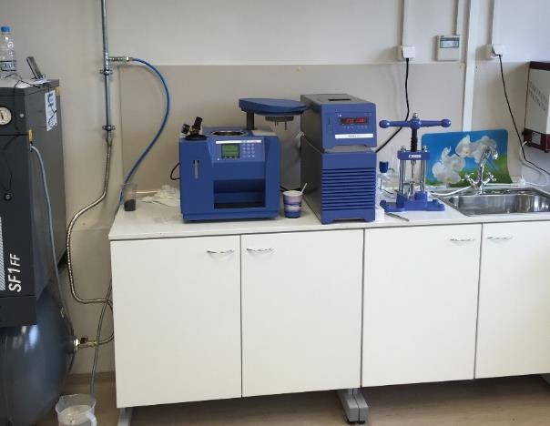
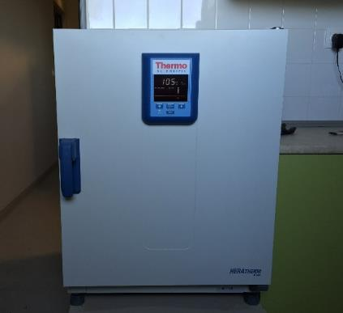
RDF continuous quality monitoring
Sampling
Sample preparation
Physical and chemical properties measurement
Delivered material with laboratory analysis certificate

Slide 20
Commercial features
Trading issues related to RDF
  Fluff form
  Baled
  Baled and wrapped
  Lab analysis certificate (certified marketable fuel)
Cement industry
  Devnya Cement S.A. (Italcementy Group)
  Zlatna Panega Cement S.A. (Titan Cement)
  Holcim (Bulgaria) S.A.
Heat and power plants
  Sofia Municipality (CHP)
  Maritsa Iztok TPP
  Potential thermal applications (WtE)

Slide 21
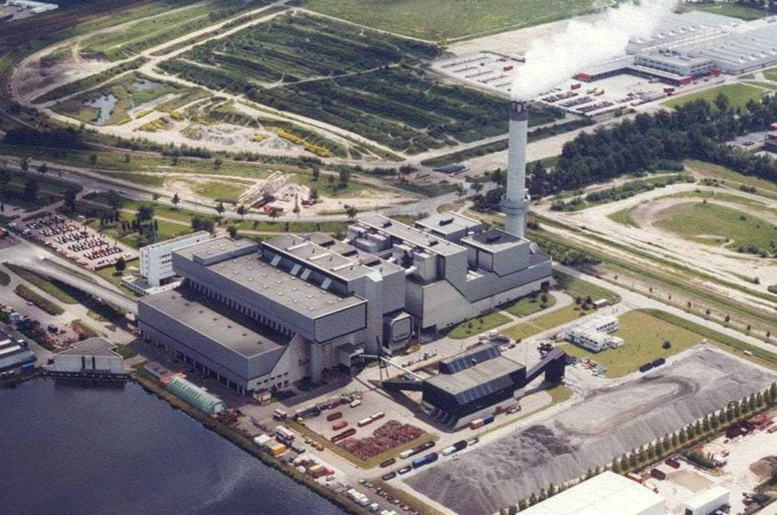
WtE - mixed MSW combustion in Amsterdam
(the Netherlands, Hitachi Zosen)

Slide 22
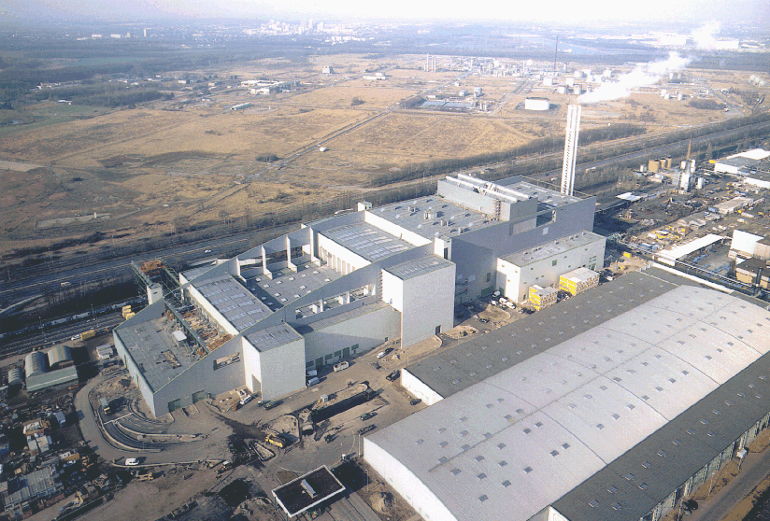
WtE - mixed MSW combustion in Cologne
(Germany, Fisia Babcock)

Slide 23
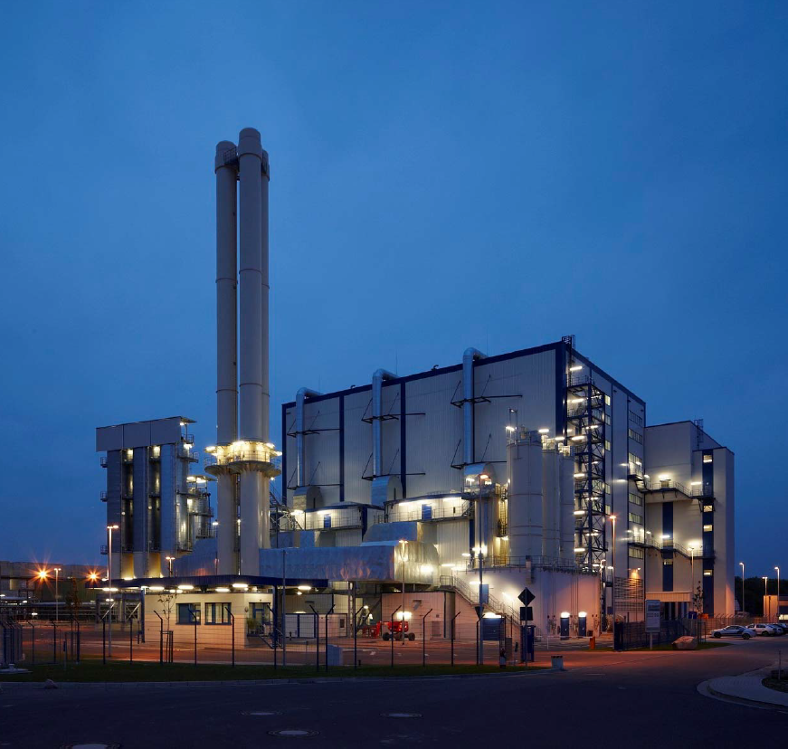
WtE - RDF combustion in Bernburg
(Germany, Baumgarte-JFE group)

Slide 24
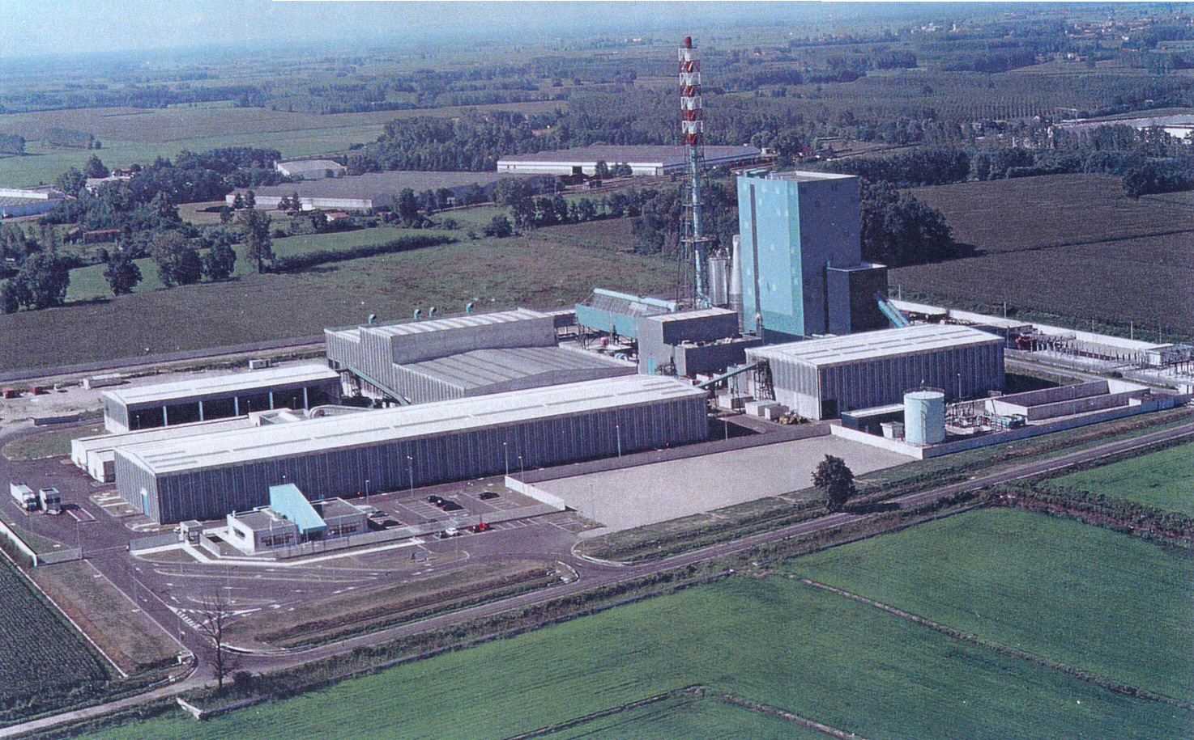
Recycling of MSW and combustion of produced SRF/RDF in Lomellina II (Italy, Foster Wheeler)

Slide 25
Energy utilization of secondary fuels (RDF, SRF) in the cement industry
The quantities of secondary fuels and biomass (~63:37) used in the cement industry worldwide were quadrupled within 15 years (1990-2005), from 3 to 12 million tons/year (data from CSI, CEMBUREAU) with EU-countries to absorb the majority of these quantities.
The 50% of thermal load in the German
Cement industry is covered by SRF
and biomass.
Only in Germany approx. 2 million
tons SRF per year are utilized in the
cement industry (2008 data).
The most significant problems for
such applications are the lack of fuel
standardization, existence of long-term
fuel contracts, the institutional
framework and environmental opposition.
Fuel mix in the German cement industry (Neovis, 2008)

Slide 26
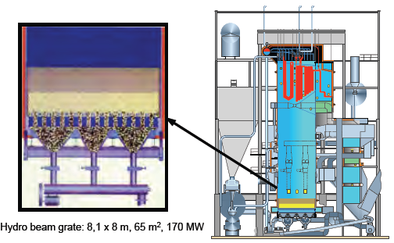
Energy utilization of SRF & biomass in a co-generation combustion plant, in the pulp & paper mill of Stora Enso (Finland)
Paper industry application: The Stora Enso unit in Antijalankoski utilizes SRF÷biomass mixture (40÷60), with 135.000 t SRF/a and 90.000 t biomass/a
Fluidized bed combustion (BFB) with steam production (500 ^{ο}C, 80 bar), advanced environmental performance and >90% availability

Slide 27
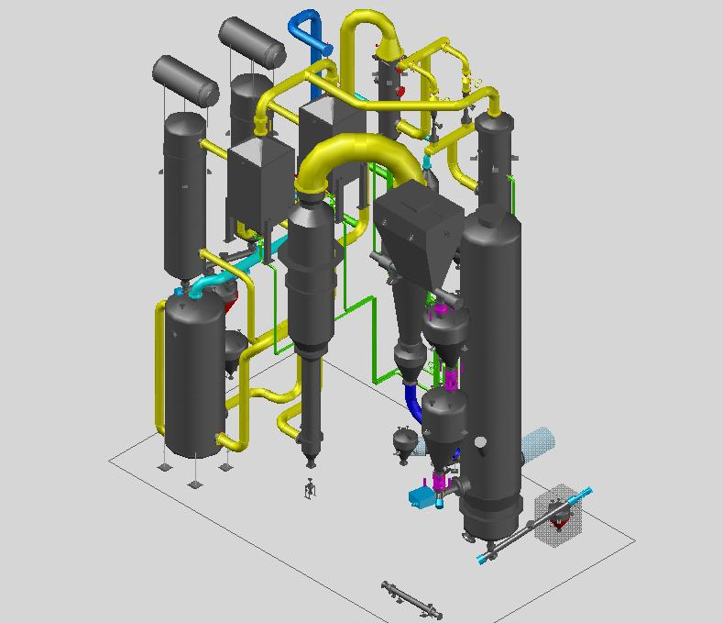
Small scale gasification applications is the forthcoming trend
FUELS successfully tested
woodchips, capacity up to 20 MW_{e}
difficult biomass fuels (olive husks and wheat straw), capacity: up to 5 MW_{e}
RDF and SRF, capacity up to 1 ton/hour
Benefits
higher efficiency than combustion
small scale applications with reasonable CAPEX
coupling of power generation with fuel (RDF, SRF) production to incorporate near-zero waste applications
Very good CHP potential
Flexible utilization of produced syngas
(power, natural gas grid, liquid biofuels)

Slide 28
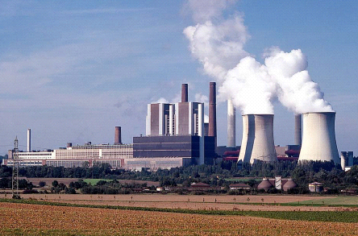
Co-combuction of SRF in lignite-fired plants in Germany
Trial test of SRF co-combustion in RWE lignite fired power plants in Berrenrath (CFB- 65.000 t/a) and in Weisweiler (PC-100.000 t/a), in the framework of RECOFUEL project. The substitution of lignite with SRF resulted in positive results (no operational problems, CO₂ emissions reduction).
The increased % Cl in the boiler input gases does not cause technical problems as long as the % of SRF in the input lignite fuel does not exceed 6% (on an energy basis).
Regarding the environmental performance, no change was observed in the air pollutants emitted, while ash properties secure its safe disposal.
Sole requirement is the upgrade of SRF storage and feeding systems in the power stations.

Slide 29
SRF co-gasification coupled to large PC coal-fired power plants (Lahti, Finland)
SRF gasification and produced syngas thermal utilization in a near-by coal fired power plant Pilot plant from Foster Wheeler in Lahti FI
In operation since 1998
Capacity: ~20 t SRF/h
Availability: >90%
Comparison of 160 MWth fuel input
Combined gasification – coal fired power plant (57 MW_{e})
Coal fired power plant (40 MW_{e})

Slide 30
Conclusions
The new MBT plant in Sofia is the largest in Europe and employs a state-of-the-art MSW processing technology.
The MBT plant contributes positively to the solution of chronic waste management problems in Sofia.
The Sofia MBT plant complies with EU hierarchy waste management, producing mainly a standardized secondary fuel (RDF) and recyclables.
The produced RDF can be utilized in a variety of thermal applications (autonomous Waste-to-Energy plants, cement industry, energy-intensive industries and lignite plants) successfully substituting fossil fuels.

Slide 31
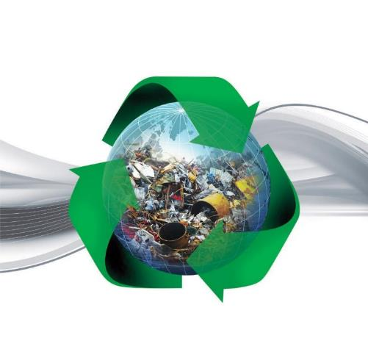

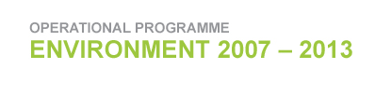
Thank you for your attention!

