Slide 1

Liberalization in Turkish Electricity Market
Mr. Nezir Ay,
Head of Electricity Market Service and Financial Settlement Dept, TEİAŞ
24 June 2011

Slide 2
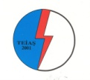
Main Activities of Turkish Electricity Transmission Company (TEİAŞ)
Managing Turkish Electricity Transmission System
Preparation of Generation Capacity Projection
Operation and Maintenance of Turkish Electricity Transmission System
Operation of Day Ahead Market and Financial Settlement System
Turkish
Electricity
Transmission
Company
Making Investments for Renewal and Extension of Turkish Electricity Transmission System
Performing Regarding International Interconnections

Slide 3
Agenda
Current Situation of Turkish Electricity Market
Privatizations in Turkey
Statistical Indicators

Slide 4
Installed Capacity and Generation Development in Turkey
MW Installed Capacity Development
Share of Generation in 2010
As of July 2011, total installed capacity in Turkey is 50,494.5 MW.
Since 2000, share of public sector (EUAS and EUAS affiliates) regarding installed capacity is decreasing. Share of public sector in the year 2011 is 47.85%, whereas its share in the year 2000 is 77.95%.
On the other hand, when BO/BOT/TOR power plants that are owned by state-owned TETAS and operated by private sector are considered, share of public sector is around 75%.
Source: TEIAS

Slide 5
Reform Process in Turkish Electricity Market
Renewable Energy Law Amendment
Electricity Market Law (Law No:4628)
Strategy Document
BOT Law
(Law no: 3996)
F-BSR
Law no: 3096
T-BSR
Start F-BSR Application
100% Fully Liberalization
BO Law
(Law no :4283)
1984
1994
1997
2001
2003
2004
2006
2008
2009
2010
2011
2013
Private sector is allowed to operate in generation, transmission and distribution of electricity
Start of Privatization of Distribution Companies
Start of 52 small HEPPs Privatization
AMR System
EMRA
Financial Settlement Communique
TEK
EUAS
Start T-BSR Application
Day Ahead Market
Collateral Mechanism
TEDAS
TEAS
TEIAS
TETAS
The Turkish electricity sector is undergoing a reform and restructuring process in order to create a liberalized, efficient and economic market.

Slide 6
Phased Transition to the Competitive Market Structure
Market Development Stages
Current
Stage
(Stage 1)
Stage 2
T-BSR
•
Day Ahead Planning
•
Day Ahead Market
•
Balancing Mechanism
•
Balancing Power Market
•
Balancing Power Market
•
Monthly Period Settlement
•
Hourly Settlement
•
Hourly Settlement
•
Collaterals Mechanism
December 1, 2009
December 1, 2011
Currently, Day Ahead Planning is being used for day ahead trading and balancing activities,
Balancing Power Market is being used for real-time balancing,
Imbalances is being settled hourly,
In the final situation, only day ahead planning will be replaced with day ahead market,
Additionally, daily advance payments and collateral mechanism will be implemented.

Slide 7
Renewable Energy Law
Renewable Law Energy (Law no: 5346), was enacted in May 2005 and amended in December 2010.
Turkey employs feed in tariff as the incentive method.
Renewable Energy Law does not oblige all facilities that generate electricity based on renewable resources to participate in the Renewable Energy Resources (RER) Support Mechanism, that is electricity generated from renewable energy resources can also be sold in spot market or through bilateral contracts.

Slide 8
Renewable Energy Resources Support Mechanism
Source: Deloitte
Renewable Energy Law defines RER Support Mechanism and suppliers are obliged to purchase renewable energy through the Market Financial Settlement Center (MFSC or PMUM in Turkish).

Slide 9
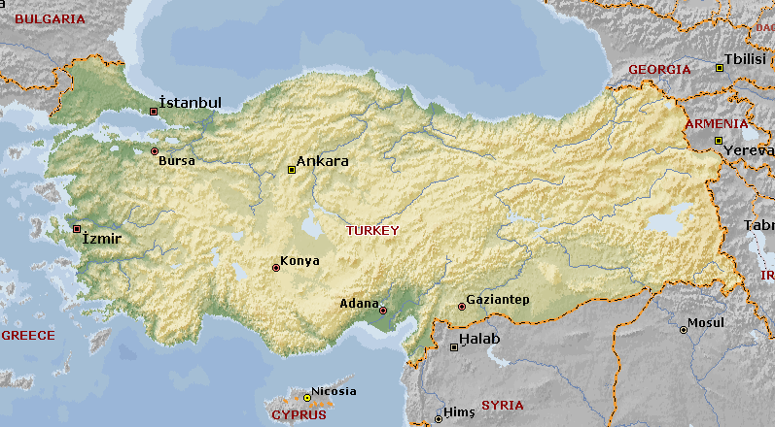
Turkish Electricity System Interconnections
BULGARIA
145 km 1510 MVA
136 km 995 MVA
GEORGIA
28 km 287 MVA
GREECE
130 km 1510 MVA
ARMENIA
80,7 km 574 MVA
NAHÇEVAN
87 km 2x132 MVA
IRAN
73 km 204 MWA
100 km 581 MVA
IRAQ
42 km 408 MVA
400 kV Installed
220 kV Installed
154 kV Installed
SYRIA
124 km 1005 MVA
KKTC
KIBRIS RUM KESİMİ

Slide 10
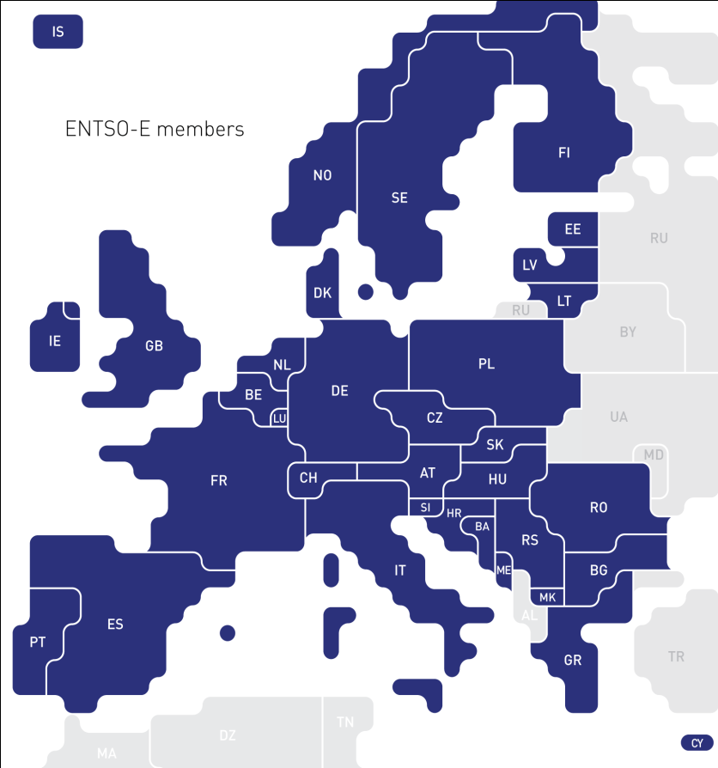
ENTSO-E Connection
UCTE/ENTSO-E
  Studies regarding the feasibility of synchronized interconnection between Turkish and European Electricity System commenced on 28th September 2005 with the contract signed in Brussels among TEIAS and UCTE.
  In 18th September 2010, synchronized parallel connection was provided with ENTSO-E Europe.
  In June 2011, commercial trade has started with Bulgaria and Greece.
With the system and software infrastructure operated by MFSC (PMUM), day ahead market coupling with other countries will be possible to manage congestions.
Source: ENTSO-E

Slide 11
Agenda
Current Situation of Turkish Electricity Market
Privatizations in Turkey
Statistical Indicators

Slide 12
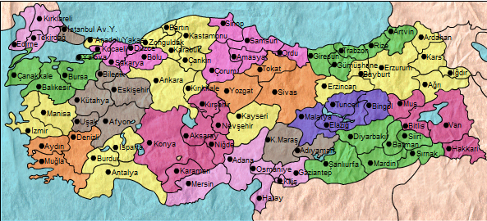
Privatization of Distribution Companies
There are 21 distribution regions in Turkey.
Although tenders for privatization are completed in all of the regions; currently 12 regions are operated by private sector. For the remaining 9 regions privatization process is still going on.
 | Distribution Company | Highest Bid | Privatized |  | Distribution Company | Highest Bid | Privatized
1 | Aras | Kiler |  | 12 | Osmangazi | Eti Gümüş | Yes
2 | Ayedas | MMEKA |  | 13 | Sakarya | Akenerji-Cez | Yes
3 | Akdeniz | Park Holding |  | 14 | Toroslar | Yıldızlar SSS Holding
4 | Baskent | Enerjisa-Verbund | Yes | 15 | Trakya | Aksa
5 | Bogazici | MMEKA |  | 16 | Uludağ | Limak | Yes
6 | Camlibel | Kolin | Yes | 17 | Vangölü | Aksa
7 | Coruh | Aksa | Yes | 18 | Yeşilırmak | Çalık Holding | Yes
8 | Dicle | Ceylan-Karavil JV |  | 19 | Kayseri | - | Yes
9 | Fırat | Aksa | Yes | 20 | AYDEM | - | Yes
10 | Gediz | MMEKA |  | 21 | Göksu | - | Yes
11 | Meram | Alarko-Cengiz | Yes

Slide 13
Privatization of Generation Power Plants in Turkey
ADÜAŞ
  First privatization in electricity sector by Privatization Administration was performed in 2008. Zorlu Energy won the tender of ADUAS (Ankara Doğal Elektrik Üretim ve Ticaret A.S), which consist a portfolio of hydro, geothermal and thermal power plants, with an installed capacity of 141 MW.
  52 small HEPP of EUAS (as 18 group), with total installed capacity being142 MW, was being privatized through Transfer of Operating Rights method. Privatization of 18 group was approved by Privatization High Council Decision in August 2010
  It is expected that privatization of a new hydro portfolio of 20 MW installed capacity in total; will start in the following months.
  In addition there are 9 portfolio groups of EUAS to be privatized. On the other hand, there are 4 power plants that will be prior in privatization, that are Hamitabat, Kangal, Seyitömer, Soma A-B.
EUAS Small HEPPs
EUAS Portfolio Groups

Slide 14
Privatization of Generation Power Plants in Turkey
Portfolio Groups of EUAS to be Privatized
Portfolio Power Plant Fuel Type Installed Cap (MW)
Portfolio Power Plant Fuel Type Installed Cap (MW)
1
2
3
4
5
Afşin-Elbistan A
Afşin-Elbistan B
Lignite
Lignite
1355
1440
6
7
8
9
Altınkaya
Hirfanlı
Kesikköprü
Derbent
Kapulukaya
Hydro Reservoir
Hydro Reservoir
Hydro Reservoir
Hydro Reservoir
Hydro Reservoir
702,55
128
76
56,4
54
Ambarlı D.Gaz
Ambarlı F.Oil
Natural Gas
Fuel Oil
1350,9
630
Aliağa
Çan
Tunçbilek
Çatalağzı
Natural Gas
Lignite
Lignite
Coal
180
320
365
300
Hasan Uğurlu
Kılıçkaya
Köklüce
Suat Uğurlu
Çamlıgöze
Almus
Hydro Reservoir
Hydro Reservoir
Hydro Reservoir
Hydro Reservoir
Hydro Reservoir
Hydro Reservoir
500
120
90
69
32
27
Bursa D.Gaz
Orhaneli
Gökçekaya
Sarıyar
Yenice
Natural Gas
Lignite
Hydro Reservoir
Hydro Reservoir
Hydro Reservoir
1432
210
278,4
160
37,89
Karkamış
Çatalan
Aslantaş
Menzelet
Hydro Reservoir
Hydro Reservoir
Hydro Reservoir
Hydro Reservoir
189
168,9
138
124
Kemerköy
Yatağan
Yeniköy
Gezende
Demirköprü
Adıgüzel
Kemer
Karacaören-1
Lignite
Lignite
Lignite
Hydro Reservoir
Hydro Reservoir
Hydro Reservoir
Hydro Reservoir
Hydro Reservoir
630
630
420
159,4
69
62
48
32
Özlüce
Kürtün
Tortum
Doğankent
Hydro Reservoir
Hydro Reservoir
Lake
Run of river
170
85
26,2
74,5

Slide 15
Agenda
Current Situation of Turkish Electricity Market
Privatizations in Turkey
Statistical Indicators

Slide 16
Development of Market Prices
Weighted Average System Day Ahead December 2009 – April 2011
  Comparing to 2009, demand is much higher in 2010, however, electricity prices are lower both in the balancing market and day-ahead market. This is due to hydro generation in 2010 is much higher than in 2009 .
  Average prices from December, 2009, when the Day Ahead Planning has commenced, to the mid of April, 2011 is 120.05 TL/MWh ( around €70) .
  Realized average of SDAP in 2010 is 121.6 TL/MWh and 113.44 TL/MWh for the first three and a half month of 2011.

Slide 17
Market vs. Bilateral Contracts Volume
Between Dec 2009 and April 2011
  Total cash flow in MFSC (debits and credits without VAT): 19.628.876.506 TL
  Monthly average cash flow (debits and credits without VAT) : 1.090.493.139 TL
  Monthly total volume of energy supplied+withdrawn from the system: 31,74 million MWh.
Following implementation of hourly settlement, most of the cash flow resulted from day ahead operations (~%59), wheras remaining is from real time activities.
Nearly 27,45% of total energy consumption is sold through balancing market, whereas the remaining portion is through bilateral contracts.

Slide 18
Development of Number of Eligible Customers
  Currently eligible customer limit is 30.000 kWh/year.
  As of April 2011, number of eligible customers increased to 12443.
Currently, theoretical market opening is 70%. It is expected per Strategy Document and to Electricity Market Law that 100% market opening will be starting from 2013.
The main reason of increase in number of eligible consumers is increasing retail sale prices and decreasing eligible customer limit.

