Slide 1

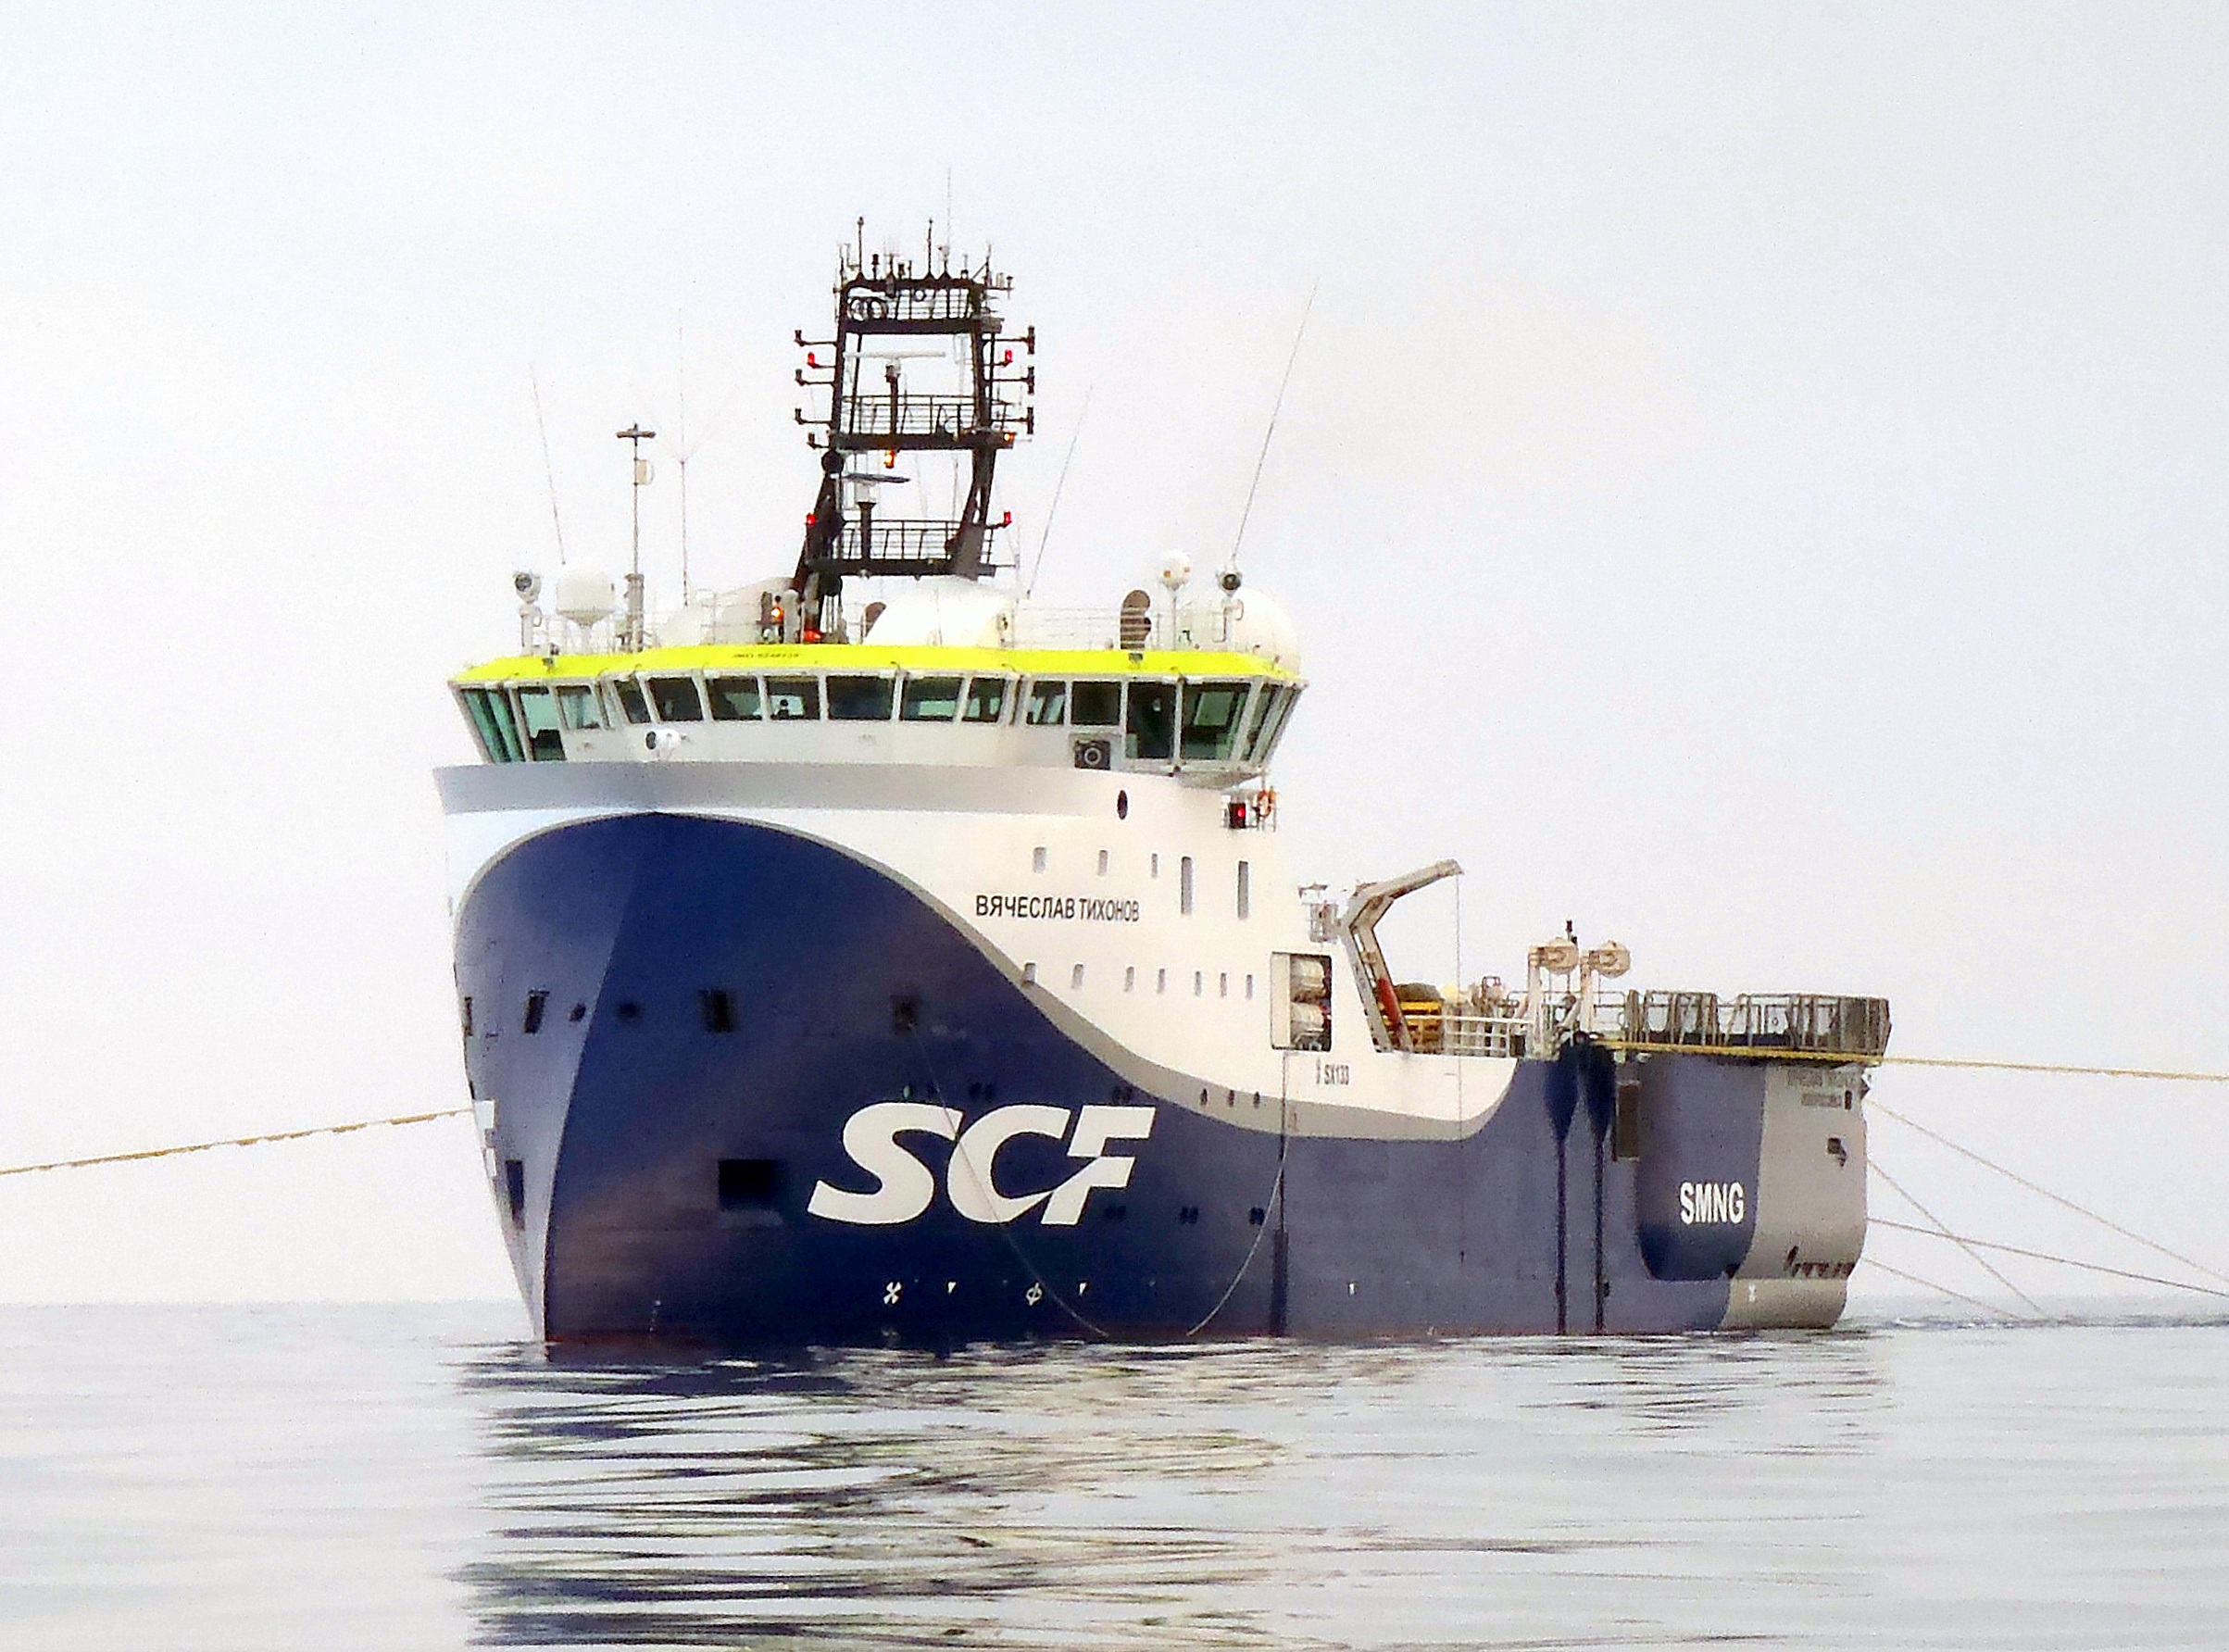
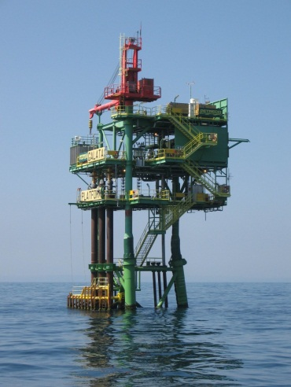
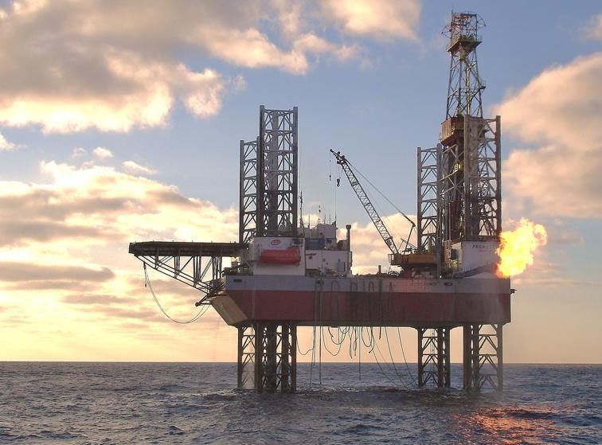

Black Sea Potential
Melrose
Resources
Bulgaria / Romania
David Archer
Managing Director Black Sea

Slide 2
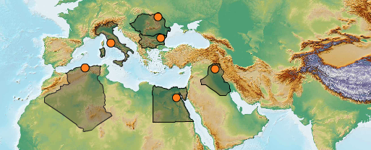
Group Overview – The Merger
Melrose has recently merged with Petroceltic International plc.
Creating a company with a balanced portfolio of exploration, development and production assets.
Production of 28 Mboepd underpinning strong operational cashflows to fund future development and exploration.

Slide 3
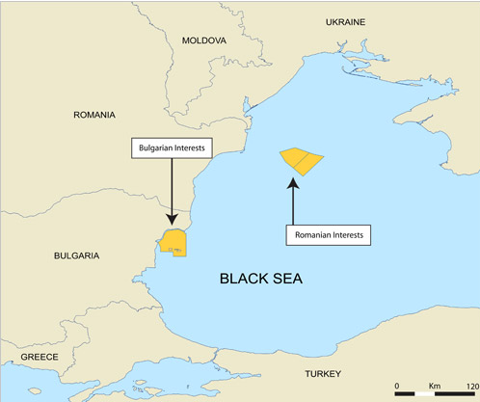
Offshore Black Sea
Bulgaria
  Melrose has been investing in Bulgaria since 1998.
  In 2003 developed the Galata gas field.
  Kaliakra and Kavarna satellite field development 2010.
  Local fabrication of Egyptian production facilities.
  Future development and exploration.
Romania
  Melrose awarded two offshore licenses in 2011.
    Block EX-27 Muridava and EX-28 Est Cobalcescu.

Slide 4
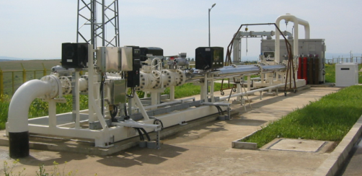
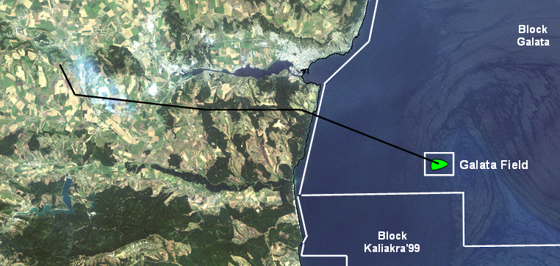
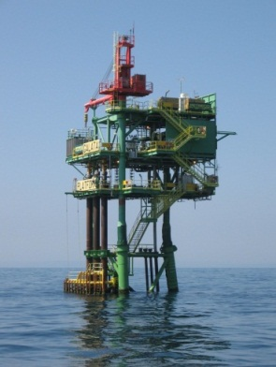
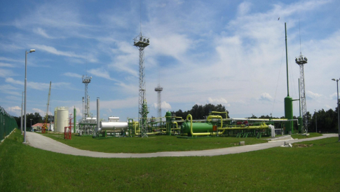
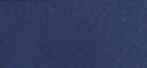
Galata Field development 2003/2004
Agenda

Slide 5
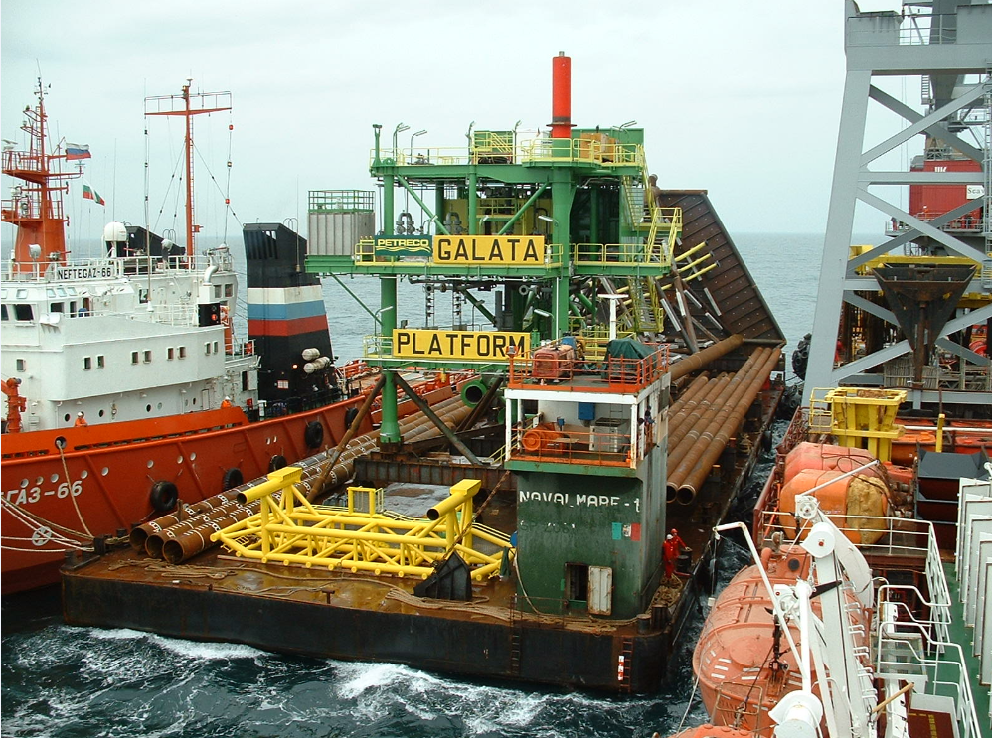
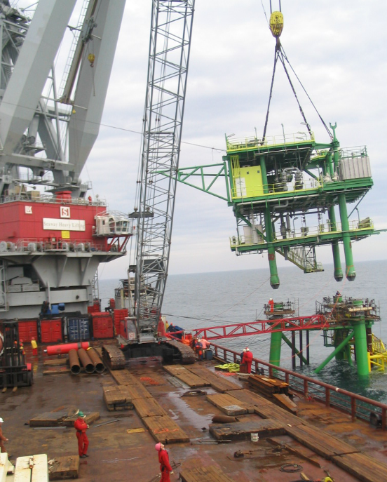
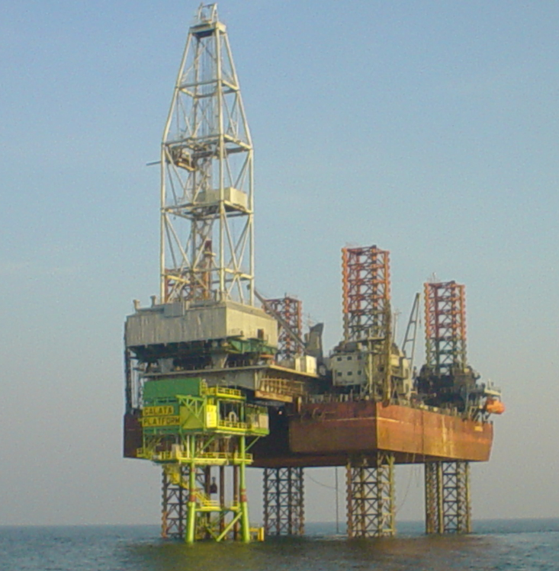
Galata Field offshore development – 2003
The Galata platform was fabricated in Varna utilising local contractors and labour.
Platform was transported offshore and installed in 35 water depth.
Two deviated exploration wells were drilled from the platform using the Ukrainian Tavrida jack up cantilever rig.

Slide 6
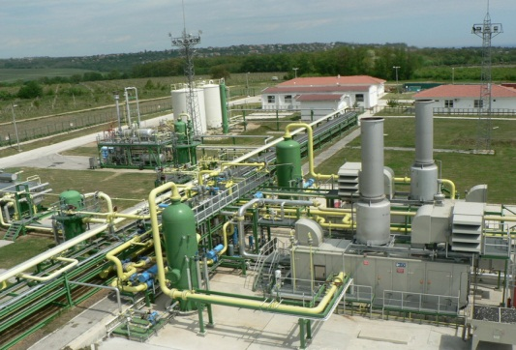
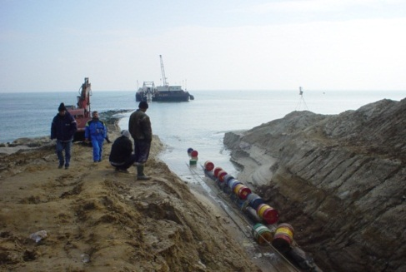
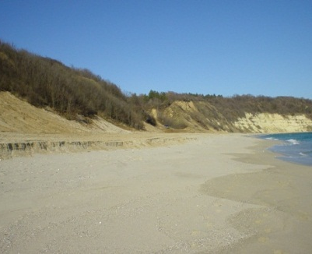
Galata Field onshore development – 2003/2004
25km of 14” offshore pipeline.
Onshore Processing Plant (OPP) was designed and built south of Varna.
A 63km onshore pipeline from the OPP to a metering station at Provadia where the line ties-in to the national distribution system.
Production from the Galata Gas Field commenced in June 2004.

Slide 7
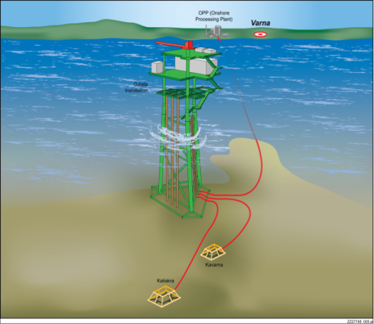
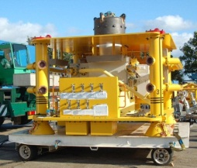
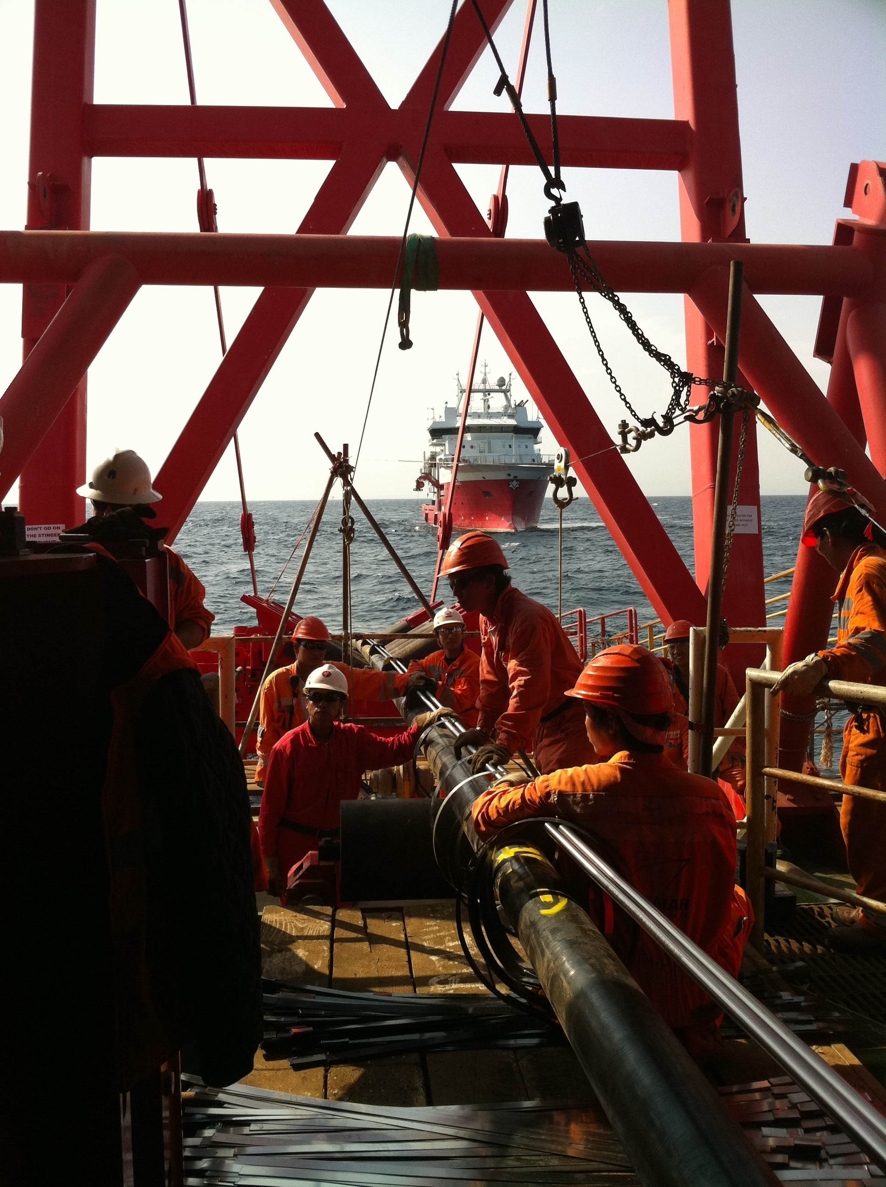
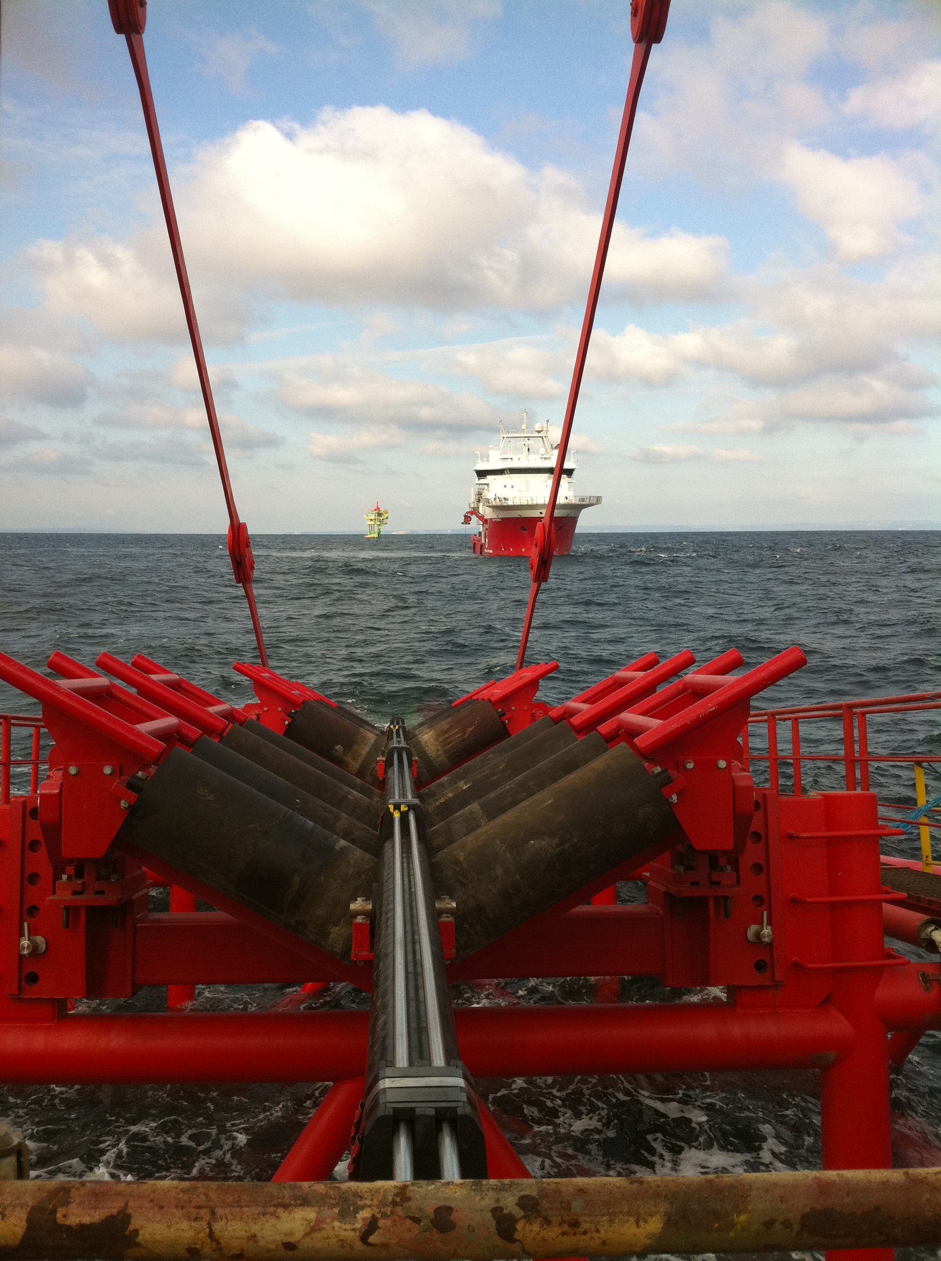
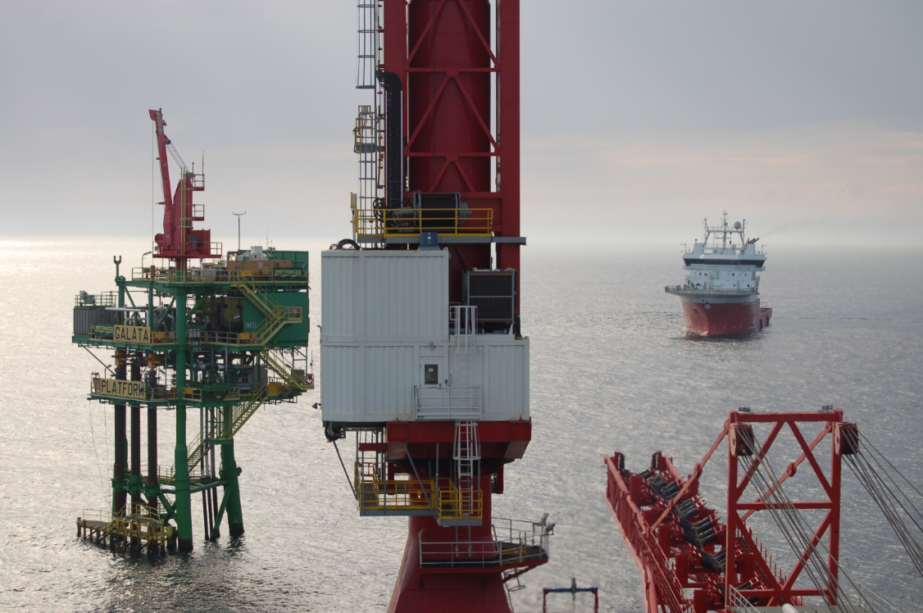
Satellite field development (Kaliakra and Kavarna Fields)
In 2010 Melrose developed the Kaliakra and Kavarna Gas fields with a subsea tieback to the main Galata Field infrastructure
These were the 1st Subsea production wells in the Black Sea.
A second subsea production well will be completed in the Kaliakra Field in 2013.
Currently the twofields produce around 15% of Bulgaria’s domestic gas needs.
To maintain this a third field, Kavarna East is planned to be brought on production in 2014.

Slide 8
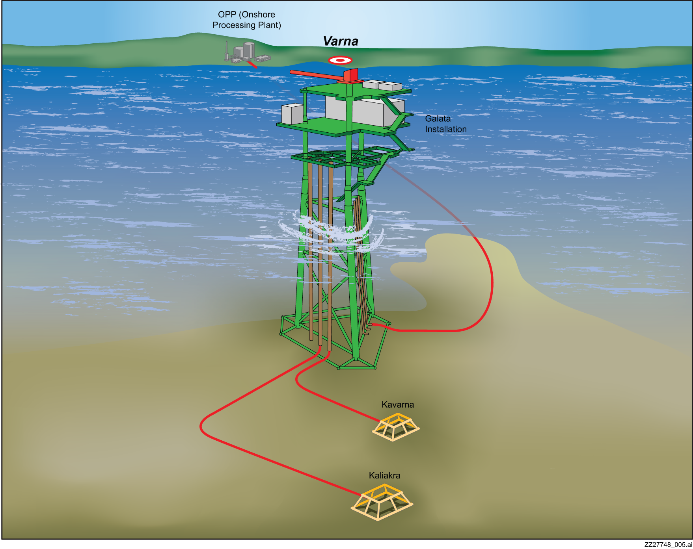
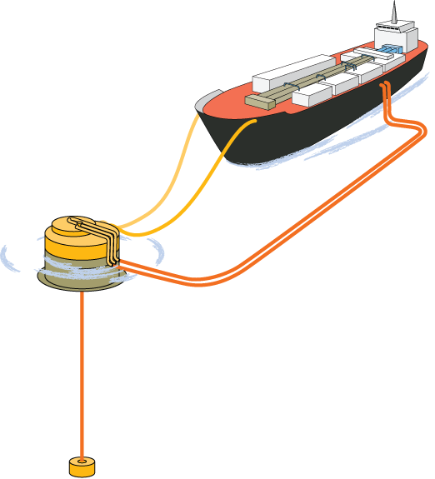
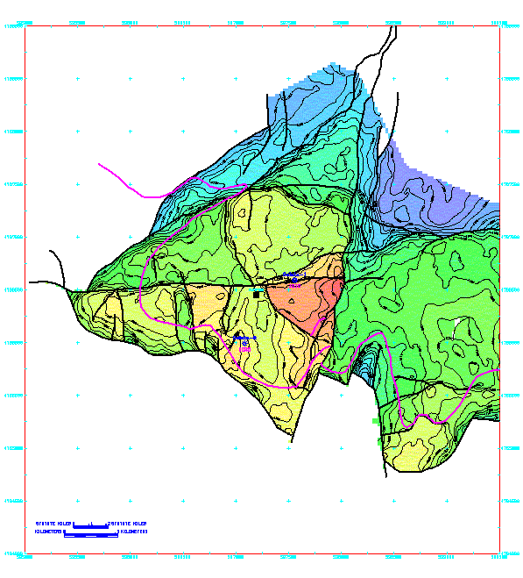

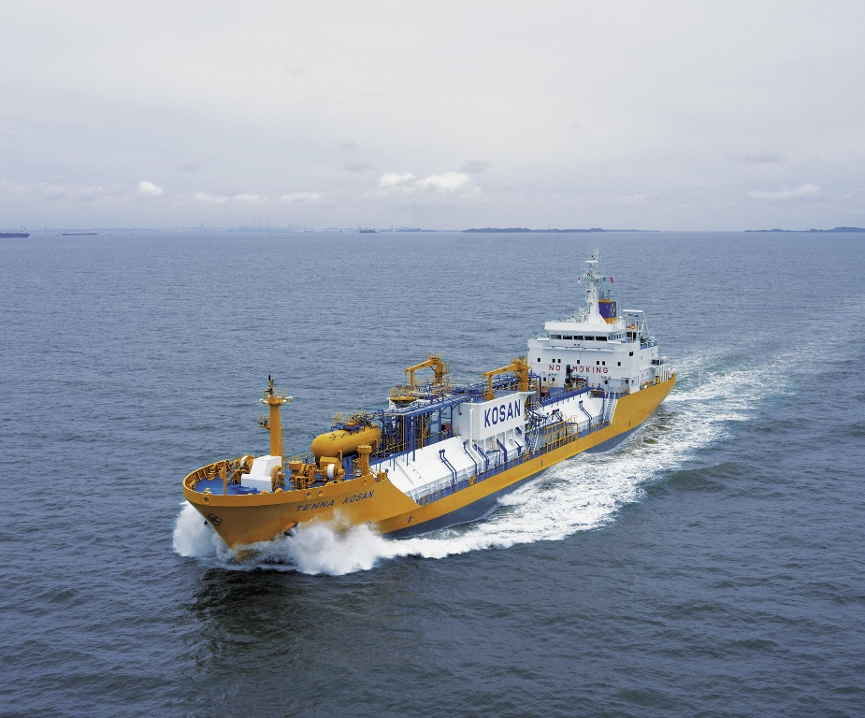
Other Development Possibilities
Galata is presently a ‘hub’ for production, it could be used as a ‘hub’ for storage with offshore loading from ‘Compressed Natural Gas Vessels’.
In an emergency such a system could charge the national distribution system and Chiren.
Kavarna East

Slide 9
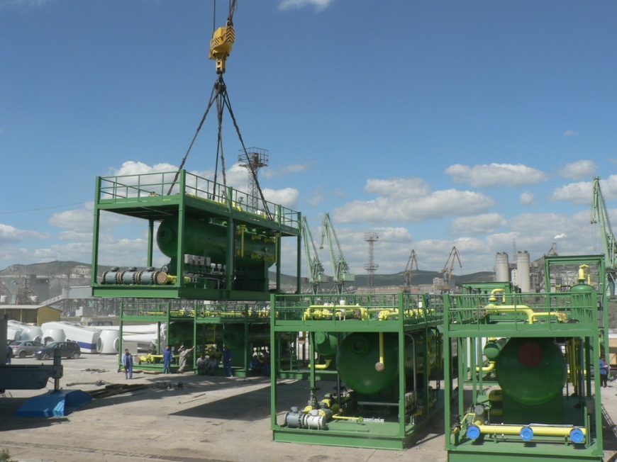
Fabrication and assembly of production equipment in Varna for the West Dikirnis Field, Egypt
Fabrication of production equipment in Bulgaria and Ukraine.
Assembled in Varna and shipped to Egypt for construction and commissioning.
Bulgarian team worked closely with Egyptian colleagues to assemble and commission the production facilities.

Slide 10
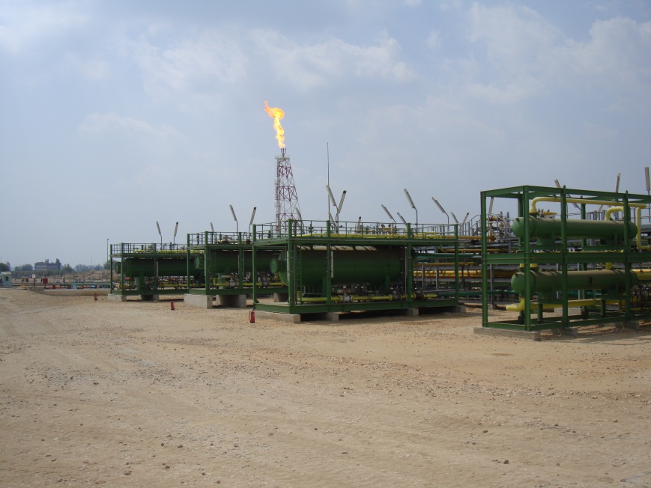
Fabrication and assembly of production equipment in Varna for the West Dikirnis Field, Egypt
Fabrication of production equipment in Bulgaria and Ukraine.
Assembled in Varna and shipped to Egypt for construction and commissioning.
Bulgarian team worked closely with Egyptian colleagues to assemble and commission the production facilities.

Slide 11
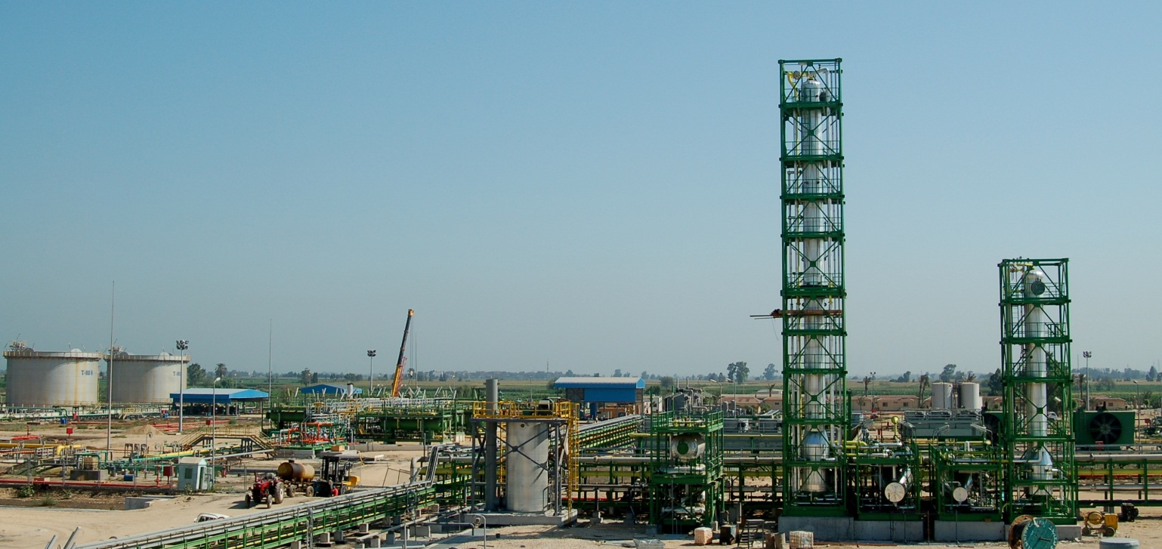
Fabrication and assembly of production equipment in Varna for the West Dikirnis Field, Egypt
Fabrication of production equipment in Bulgaria and Ukraine.
Assembled in Varna and shipped to Egypt for construction and commissioning.
Bulgarian team worked closely with Egyptian colleagues to assemble and commission the production facilities.

Slide 12
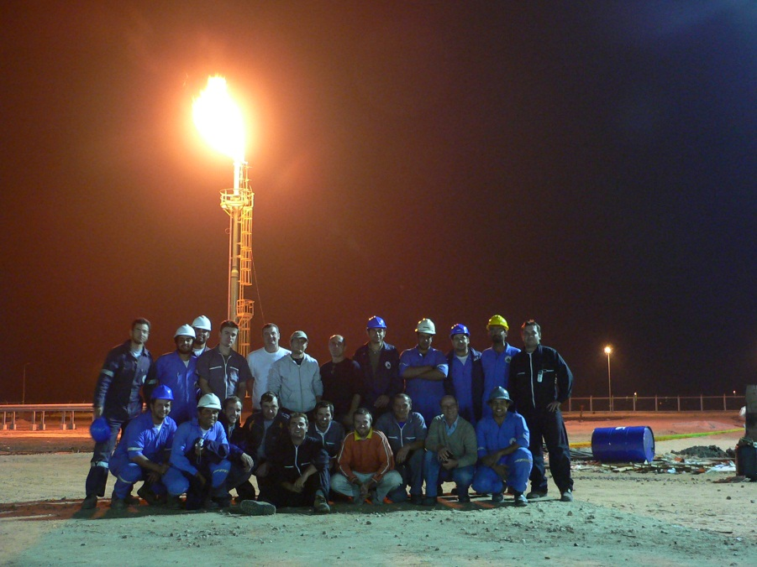
Fabrication and assembly of production equipment in Varna for the West Dikirnis Field, Egypt
Fabrication of production equipment in Bulgaria and Ukraine.
Assembled in Varna and shipped to Egypt for construction and commissioning.
Bulgarian team worked closely with Egyptian colleagues to assemble and commission the production facilities.

Slide 13
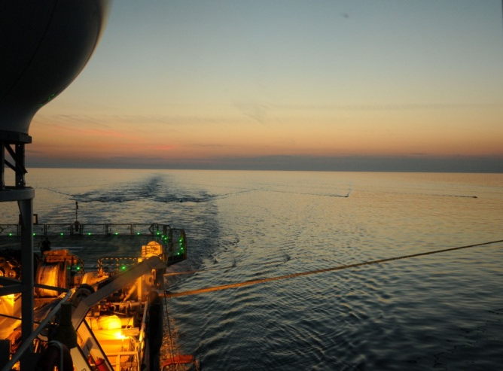
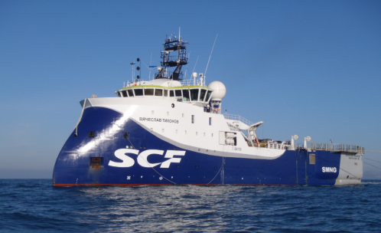
Exploration – 2D & 3D Seismic acquisition
Melrose has acquired a total of 3500km2 3D in Bulgaria The most recent in in 2011(500km2)
In Romania 3000km2 of 3D seismic was acquired between June and August 2012 using the high specification m/v Vlaycheslav Tickhonov.
We are presently extending our Bulgarian Environmental Coastal study to include the Romanian coastline.

Slide 14
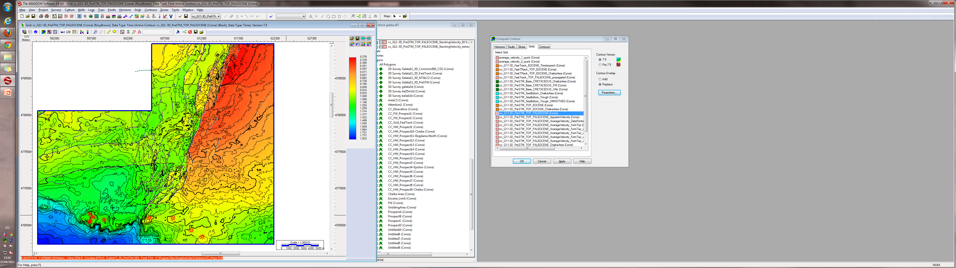

GALATA
Prospect H
Chaika NE
Prospect A
Chaika NW
Chaika South
Prospect E
Kamchia
Prospect F
Top Paleocene TWT Map C.I. 40 ms
Melrose Resources Bulgaria

Slide 15
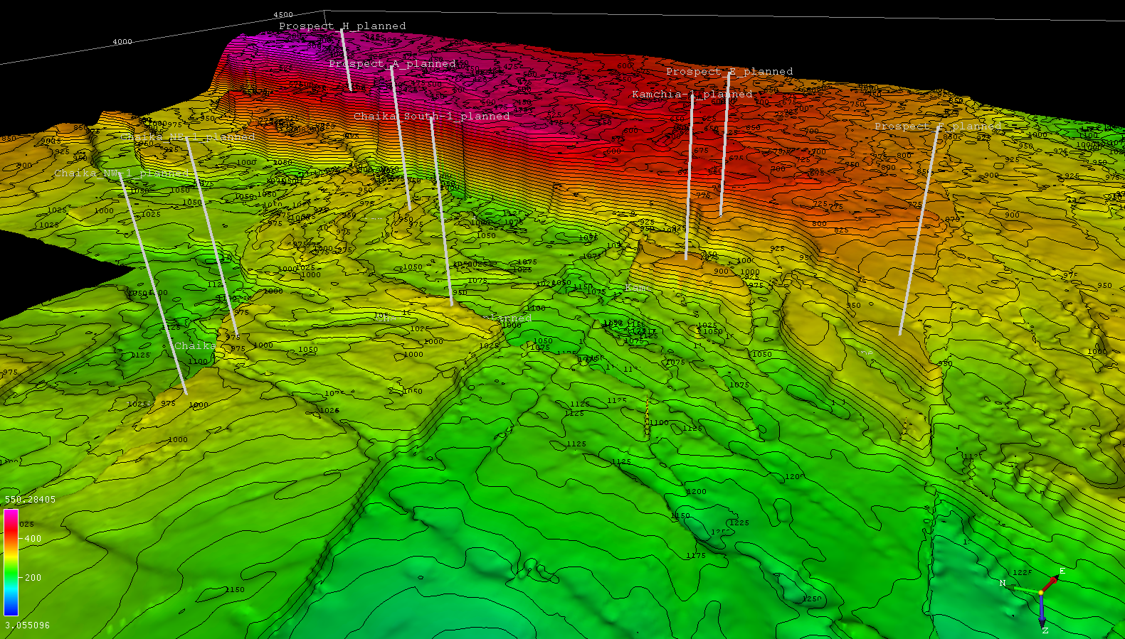
Melrose Resources Bulgaria

Slide 16
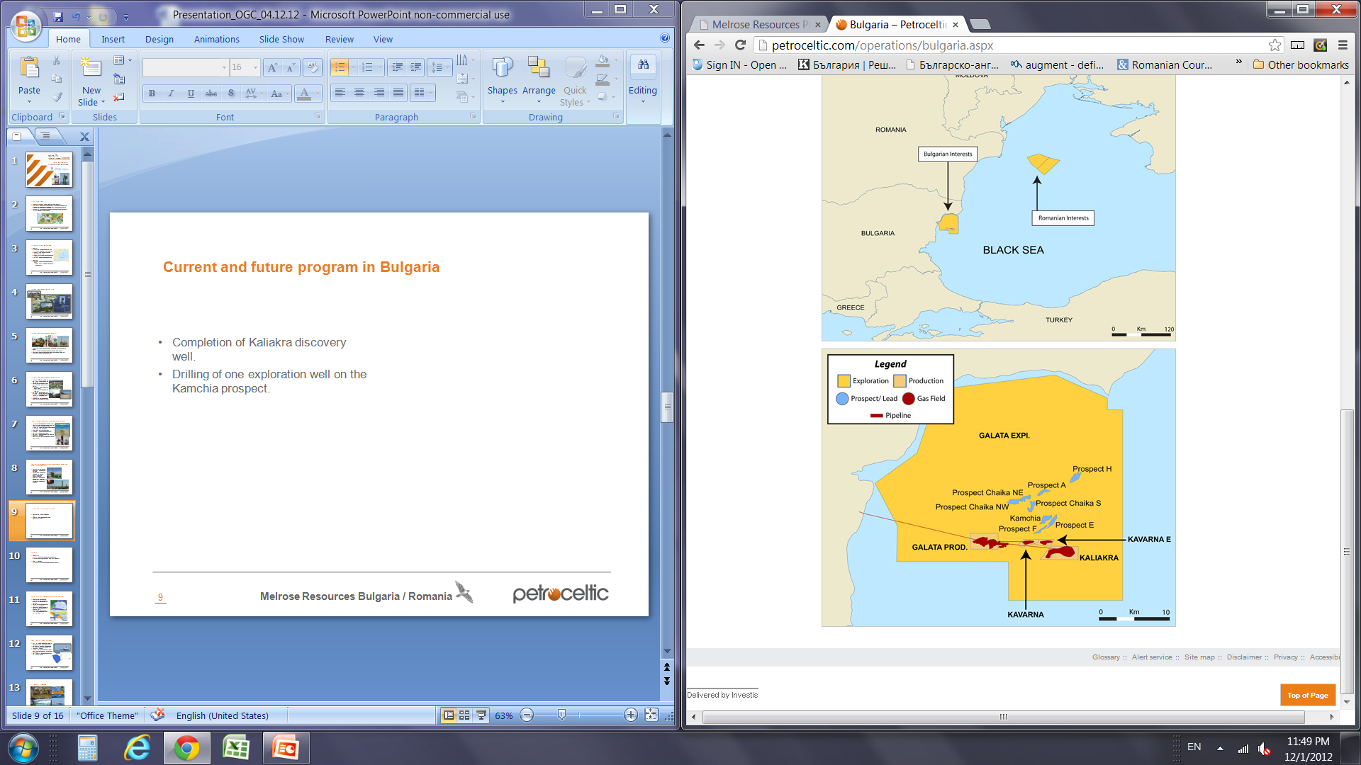
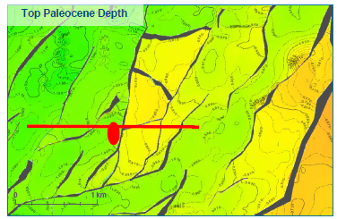
Current and future program in Bulgaria
Completion of a second production well on the Kaliakra field.
Drilling of one exploration well on the Kamchia prospect - identified on new 3D seismic.
Kamchia well success opens up new northern play fair way on the Galata trend.
Planned 2014 development of the Kavarna East field.
Kamchia Prospect

Slide 17
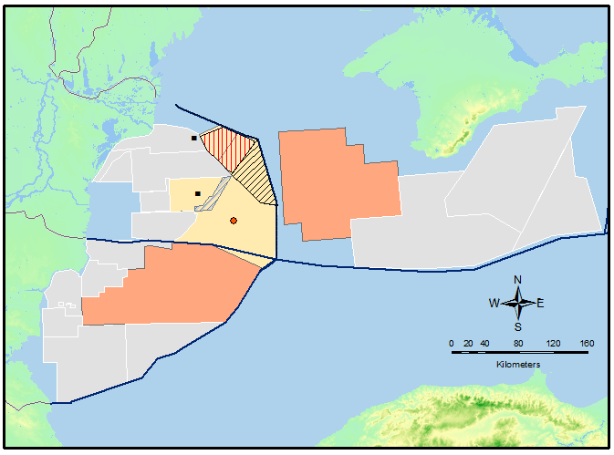
Western Black Sea 2012 activity
Skifska
Khan Asparuh

Slide 18
Conclusion
Melrose/Petroceltic is an experienced company who;
  Operates the Galata, Kaliakra and Kavarna fields with 100% Bulgarian Management and Staff.
  Continues to actively explore with new 2011 and 2012 3d seismic in Bulgaria and Romania to process and interpret.
  Has an active Black Sea drilling program in 2013 and 2014:
    7 exploration wells.
    1 new completion.
  Has a new field development scheduled for 2014 with third subsea tieback from Kavarna East.
Black Sea has real Exploration Potential.
  Busy upcoming exploration and development programs for the Region.
    Deep water for the medium to long term.
    Near shore shallow water for the immediate future.
    Local Production is the Key to a successful Energy Strategy

