Slide 1

®
Maritsa East 3
from a Success Story to a Progress Story
Bulgaria Energy Forum, Sheraton Hotel Balkan,
Sofia, 11-12 December 2012
Garry K. Levesley
Executive Director

Slide 2
Table of Contents
Who we are
Project History and Development
Future Developments

Slide 3
ContourGlobal at a Glance
We are a power company, a global independent power producer;
We develop, acquire and operate large, long-term contracted power generating stations for national grids and utilities primarily in developing markets;
We develop and operate innovative energy solutions for multinational companies in developing markets (ContourGlobal Solutions);
Increasingly, we also pursue opportunistic acquisitions and development where we leverage our regional operating presence.
Key facts and figures:
  Company headquartered in New York City
  Significant U.S. investor base (educational endowments, pension funds and individual investors)
  2012 Revenue budget of $1.0 billion
  1,500 employees globally at year-end 2011
3
Notes:
Extensive development, technical and operating capabilities used to create a diverse blend of power businesses across a range of fuels and technologies
Hydro, gas, wind, solar, coal, fuel oil
Non-recourse, project debt financing used for development and acquisitions—traditional debt financing sources as well as less common sources of multilateral and development bank financing from institutions such as: Overseas Private Investment Corporation (OPIC), a U.S. government agency dedicated to development in Africa and other emerging markets, IFC of the World Bank Group, the African Development Bank, BNDES, BNB, FMO (the Dutch national development bank)
Markets with a growing middle‐class and significant growth potential
Provide customized quad‐generation solutions to improve energy efficiency of production facilities
Cheaper, more reliable, and environmentally friendly power
Single point of contact for all energy needs
Partnership with Coca‐Cola Hellenic Bottling (CCH); negotiations in process with other multinationals

Slide 4
Company History and Milestones
SD II, Brazil begins Commercial Operations
Acquisition of additional interest in Sochagota
Completion of second boiler overhaul in KTE, Ukraine
Rwanda PPA and concession
Ploiesti, Romania Quad-Gen begins Commercial Operations
Begin construction of Lomé Plant, Togo
Acquisition of Arrubal, Spain
Acquisition of Maritza East 3, Bulgaria
Begin Commercial Operations of the five Rooftop Solar projects , Italy
Begin construction of Asa Branca , Brazil
Begin construction on Kivuwatt Phase I, Rwanda
Begin construction on Oricola Solutions, Italy
Fibrominn, US begins Commercial Operations
Agreement with Coca-Cola Hellenic
Begin construction of SD II run-of-river hydro
ContourGlobal founded by Joseph Brandt and Reservoir Capital
2005
2006
2007
2008
2009
2010
2011
2012
Acquisition of Termoemcali, Colombia
Acquisition of Energies St. Martin & Energies Antilles, Guadeloupe– French Territories
Togo Plant begins Commercial Operations
Nogara and Knockmore Hill enter Quad-Gen Commercial Operations
Begin construction of Galheiros run-of-river hydro, Brazil
Begin construction of Nigeria, Radzymin and Kiev CHPs
Completion of construction on five Rooftop Solar projects in Italy
Acquisition of Gladiator, CG’s 1st ground mounted solar project in Italy
Acquisition during construction of Sicily Solar, Italy
Award of PPA for Asa Branca Wind, Brazil
Acquisition of Fibrominn during construction, US
Acquisition of Sochagota, Colombia
Begin development of Togo Project
Acquisition of Kramatorsk Heat and Power CHP, Ukraine
Completion of first boiler overhaul in KTE, Ukraine
Apapa Solutions, Nigeria begins Commercial Operations
Benin Solutions, Nigeria begins Commercial Operations
Kiev Solutions, Ukraine begins Commercial Operations
4

Slide 5
Global footprint: presence in 4 continents and 15 countries
N. Ireland
Romania
Italy
Poland
Ukraine
    Capacity: 15.2MW
    Natural gas
    Capacity: 6.1MW
    Natural gas
    Capacity: 12.8MW
    Solar
    Capacity: 6.1MW
    Natural gas
    Capacity: 120.0MW
    Natural gas / coal / heavy fuel oil
USA
Italy
Ukraine
    Capacity: 62.3MW
    Biomass
    Capacity: 12.2MW
    Natural gas
    Capacity: 6.1MW
    Natural gas
Guadeloupe
Togo
    Capacity: 21.4MW
    Heavy fuel oil
    Capacity: 99.7MW
    Tri fuel
St. Martin
Bulgaria
    Capacity: 13.8MW
    Light fuel oil
    Capacity: 908.0MW
    Lignite
Colombia
Rwanda
    Capacity: 405.0MW
    Coal, natural gas
Gross capacity
by fuel type & region
    Capacity: 26.2MW
    Methane / biogas
Brazil
Spain
    Capacity: 196.6MW
    Hydro and wind
    Capacity: 800.0MW
    Natural gas
Total
Nigeria
    Gross capacity: 2,733MW
    Capacity: 21.3MW
    Natural gas
Offices
Business
IPP business (2,661MW)
Solutions business (68MW)
Note: Considers operational assets and projects in construction only.

Slide 6
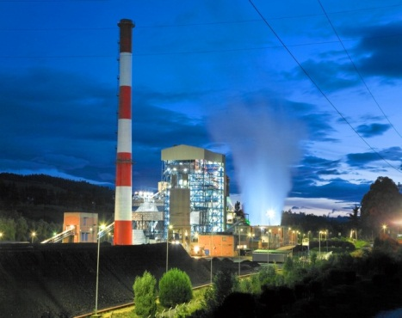
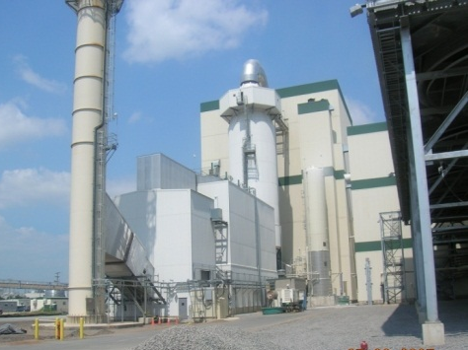
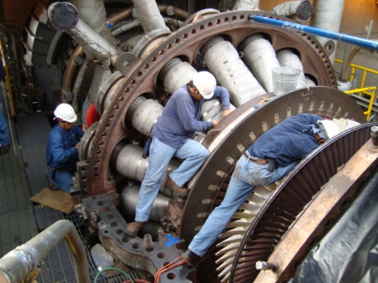
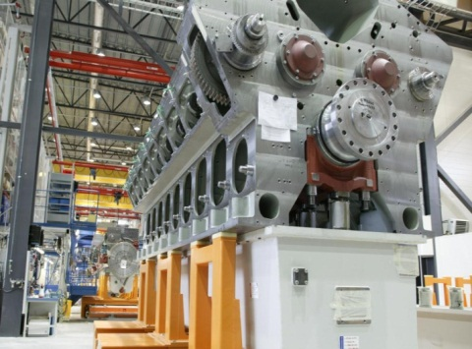
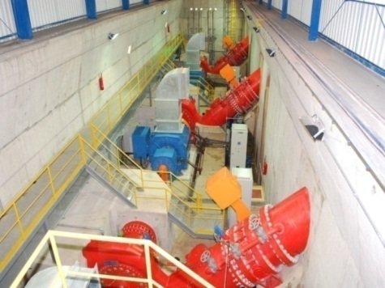
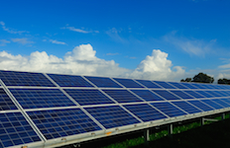
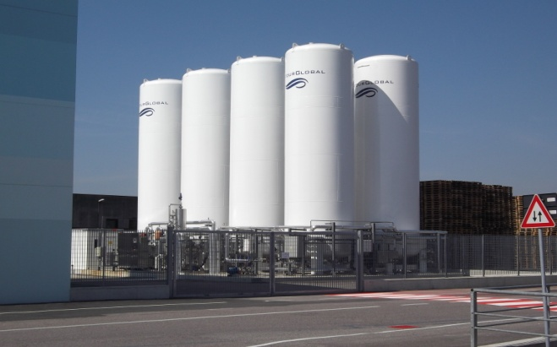
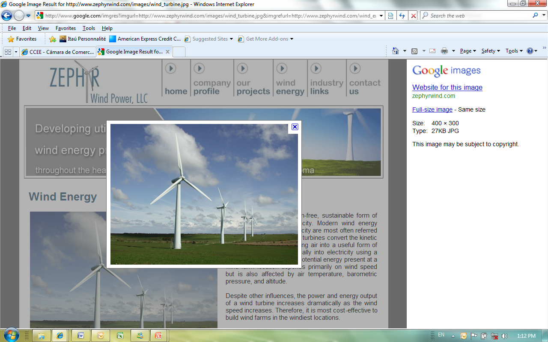
ContourGlobal Power Plant Technologies
Sochagota - Coal
PowerMinn – Poultry litter
Termoemcali – Natural Gas /Fuel Oil
Saint Martin – Fuel oil
Sao Domingos - Hydro
Sabaudia – Solar
Nogara - Natural Gas
Asa Branca - Wind

Slide 7
Table of Contents
Who we are
Project History and Development
Future Developments

Slide 8
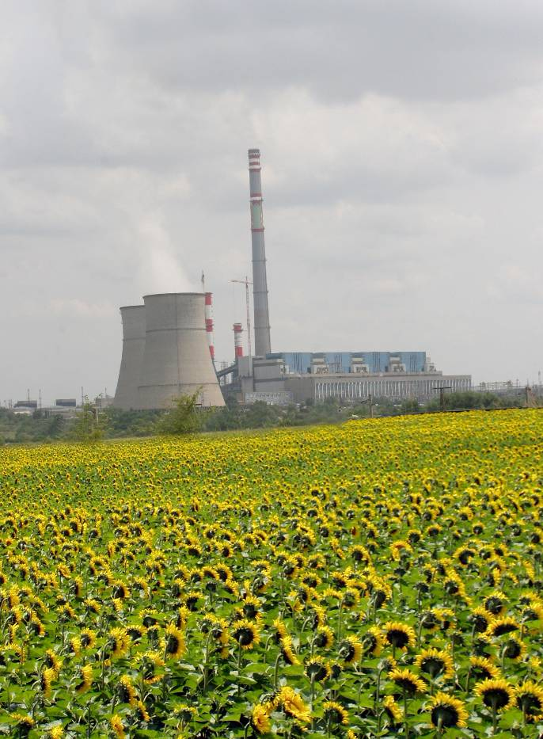
Project History
    1978
    Plant Construction
    2001
    PPA with NEK signed
    2002
    EPC Contract signed
    2003
    Financial Close
    Start of rehabilitation and modernization works
    2003
    The construction of FGD1 begins
    The rehabilitation of Unit 2 begins
    2004
    The rehabilitation of the first cooling tower completed

Slide 9
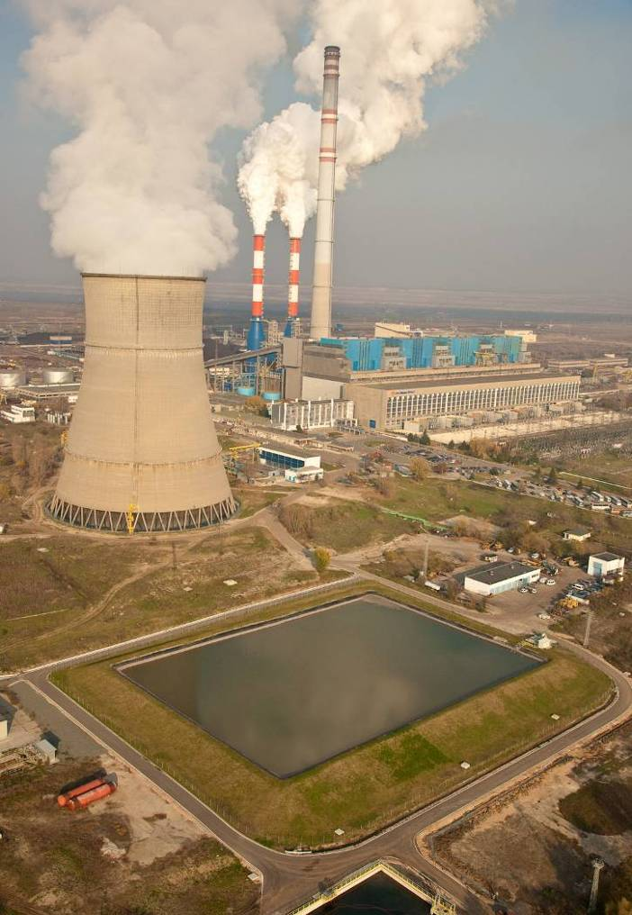
Project History
    2006
    The rehabilitated Unit 2 and FGD 1 commissioned with a new computer system for management of the processes in the power plant
    Rehabilitation works on Unit 1 begin
    2007
    Effluent waters treatment plant commissioned
    Unit 1 rehabilitation completed and unit connected to FGD 1
    2008
    Unit 3 commissioned and connected to the newly constructed FGD 2
    Unit 4 shut down for rehabilitation
    2009
    Unit 4 is rehabilitated and connected to FGD 2, which marks the completion of the Project for rehabilitation and modernization of Maritsa East 3 TPP

Slide 10
The Goals of the Rehabilitation
  Extension of the operational life of the plant by minimum 15 years
  Increase of the capacity of each of the units:
  from 210 MW to 227 MW
  Increase of the efficiency and availability of the plant
  from 30% to over 35%
  Improve the plants’ reliability
  Full compliance with the requirements of the European Environment Legislation now and for the foreseeable future
  Improve the Health and Safety Environment for Workers and Contractors

Slide 11
ContourGlobal Maritsa East 3 TPP before and after Rehabilitation
Gross Capacity 840 MW
4 Units: 210 MW each
Efficiency ca. 30%
Availability ca. 75%
Expected life: ca. 2008
Particulate: 1.1 g/kWh
CO2: 1500 g/kWh
SOx: 72 g/kWh
NOx: 2.5 g/kWh
Gross Capacity 908 MW
4 Units: 227 MW each
Efficiency over 35%
Availability over 85%
Expected life: 2030
Particulate: 10.2 g/kWh
CO2: 1330 g/kWh
SOx: 4 g/kWh
NOx: 1 g/kWh

Slide 12
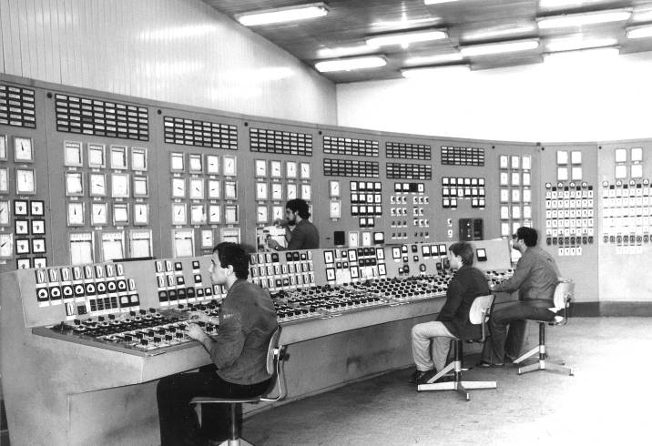
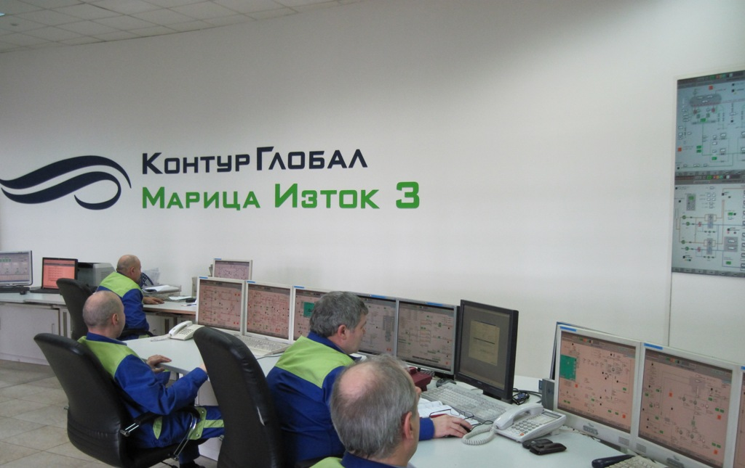
Control Room before and after

Slide 13
Dramatic improvements
Before
After
Gross Power 840MW 908 MW
Net Efficiency 30% 35%
The first lignite
power plant at the
Balkans in full
compliance with the
European
Environmental
Standards
CO₂(g/kWh)
SOx (g/kWh)
NOx (g/kWh)
Particulate (g/kWh)
Drastic Emissions Reduction

Slide 14
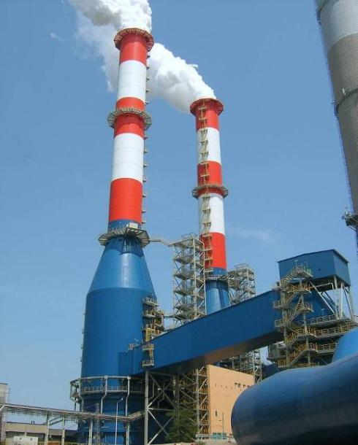
Environment Compliance
The environmental management system has been ISO14001-2004 certified in 2009
Electrostatic precipitators purify the flue gasses from dust ensuring efficiency of over 99,96%
Flue Gas Desulphurization Units: 2 FGDs connected with 4 units (as per design)
The wet process of the FGD provides a further decrease of the dust content in the gases ensuring a level of dust far below the law limit of 50 mg/Nm3

Slide 15
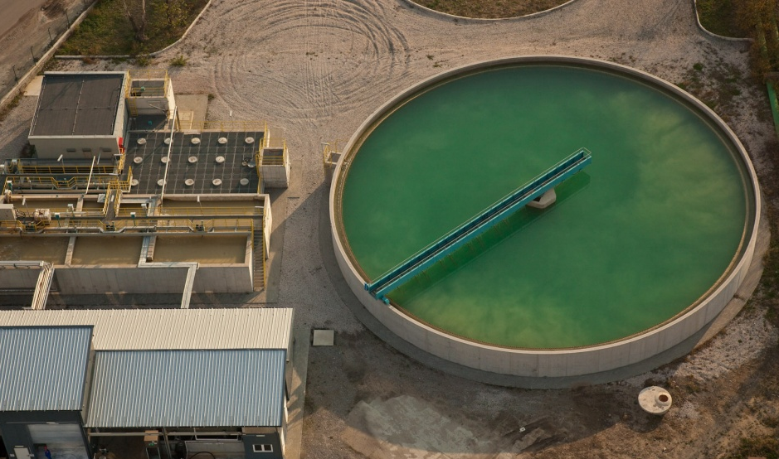
Environment Compliance
A new Effluent Treatment Plant purifies all the process water before discharging it in the nearby river. It processes effluent waters up to 1000 m3/h with final sand filtration to meet the highest standards;
A new Sewage Plant treats the sewage water, which in the past was discharged directly in the river;
New oil water separators treat the water from any contamination of oil;
New precipitation basins remove suspended coal dust from stockyard drainage;
A new first flushing basin removes oil from rain water before discharge.
Before the implementation of the plant program,
all water used was discharged without any treatment

Slide 16
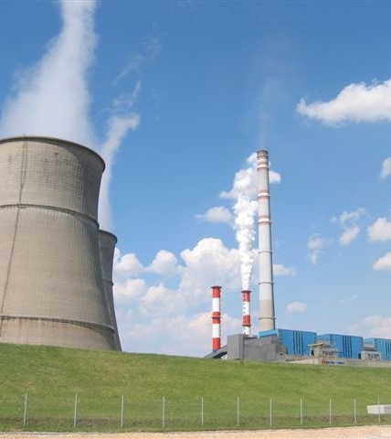
Environment Compliance
Water Management and Water Consumption Reduction
Two new make up water lines from Rozov Kladenets lake to cooling towers have been installed - 8 km each; the old ones had a leak rate of 50% of the flow
A new Water management system recycles the water, which was previously in open circuits, in order to minimize consumption and discharge
A new Buffer Pond with capacity of 30.000 m3 has been constructed in the ash handling water management system to equalize the peaks and reduce the consumption of water

Slide 17
Table of Contents
Who we are
Project History and Development
Future Developments

Slide 18
Adapting to the EU Internal Energy Market requirements
“When it comes to gas and electricity, citizens and businesses are interested in two things – security of supply at any time and affordable price.”
Günther H. Oettinger,
EU Commissioner
Having completed successfully the first private large scale modernization in the Bulgarian energy sector in 2009, CG Maritsa East 3 is presently an important long term, secure, low-emission, low cost provider of power to the Bulgarian market;
The robust and sustainable suite of project agreements, including the PPA, the Lignite Supply Agreement, and the EPC Contract made possible both the financing from EBRD and other multilateral financing institutions as well as the investment;
The refurbishment of an existing asset contributed favorably to achieving an affordable PPA tariff.
Currently CG Maritsa East 3 accounts for 12% of net generation in Bulgaria, produced from local lignite, using environmentally compliant technology.

Slide 19
Challenges Before Bulgarian Energy Sector
Successful implementation of 3rd Liberalization Package, including:
Completion of the unbundling of TSO from NEK;
Introduction of effective market mechanism for balancing energy;
Adoption of revised Electricity Trading Rules;
Effective and sustainable regulatory framework addressing RES and high efficiency CHPs.
CG Maritsa East 3 has hired, a leading international consultant on energy market reform, to assure the best fit of the Maritsa East 3 plant with the ongoing market reform in strict compliance with the 3rd Liberalization Package

Slide 20
Next steps – Proactive Collaborative Engagement
ContourGlobal is committed to being a long term, secure, low-emission, low cost provider of power to the Bulgarian market. This is due to the strength of the agreements between us and the Bulgarian government, and the investments these agreements have made possible.
ContourGlobal is actively working with the government, the regulator, and other stakeholders in the development of a functioning electricity market that will benefit all Bulgarians and in compliance with the objectives of the EU Third Energy Directive.

