Slide 1
About power exchange, OTC trading and other “small” elements of Bulgarian power market puzzle
Plamen Popov,
Statkraft
4th Regional Energy Conference
„ENERGY DEVELOPMENT AND INTEGRATION OF REGIONAL ENERGY MARKETS”
8 October 2013
Sofia, Sheraton Hotel Balkan

Slide 2
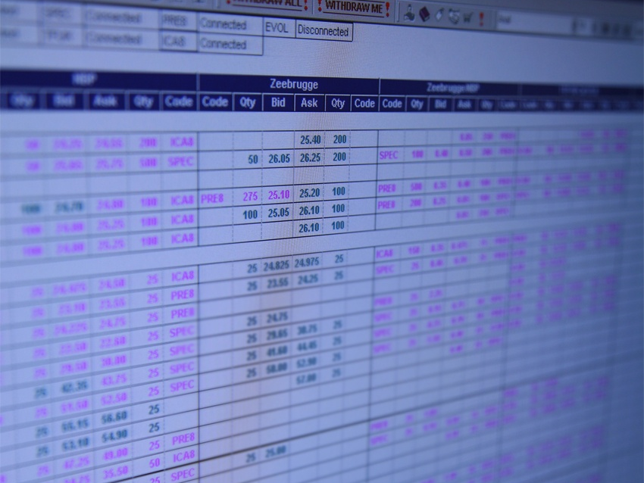
OVERVIEW
1.
2.
3.
Power exchange vs. OTC
Do we need any transparency ?
Future market coupling
Page 2
PRICE DEVELOPMENTS IN CEE AND SEE

Slide 3
Some monthly base load prices, EUR/MWh

Slide 4

Fundamental Price Influencing Factors

Slide 5
Fundamental Price Influencing Factors
Generation
  Power plant availability
  Run-off river, precipitation
  Hydro storages
  Wind speeds
  Sky (sun radiation)
Fuel prices
  Oil & gas
  Hard coal
  Lignite
  CO2
Demand
  Temperature
  Cloudiness
  Day type / holidays
  School vacation
Transmission
  Available cross-border capacities
  Price expectations in the neighbouring markets

Slide 6
… to create
Price
DEMAND
SUPPLY
Generation
  Power plant availability
  Run-off river, precipitation
  Hydro storages
  Wind speeds
  Sky (sun radiation)
Fuel prices
  Oil & gas
  Hard coal
  Lignite
  CO2
Demand
  Temperature
  Cloudiness
  Day type / holidays
  School vacation
Transmission
  Available cross-border capacities
  Price expectations in the neighbouring markets
Volume

Slide 7



Trading Channels
via OTC Counterparts:
via Broker :
via Exchanges :
  EEX
  EXAA
  South Pool
  Nord Pool (NO, SE, FI, DK)
  OPCOM (RO)
  HUPX (HU)
  PMUM (TR)
PX

Slide 8
Power Exchange
Central market place;
Less bilateral agreement;
Reduced credit risk;
Collaterals – only to the exchange (clearing house);
Invoicing – only against the exchange;
High automation and standardization degree.
PX
Transparency
Short term: Optimal and Efficient generation utilization
Competition
Price (Index)
Mid/Long term: Right signals to the industry
Flexibility
Credit Protection
Instrumentation for Risk mitigation and hedging
Liquidity

Slide 9
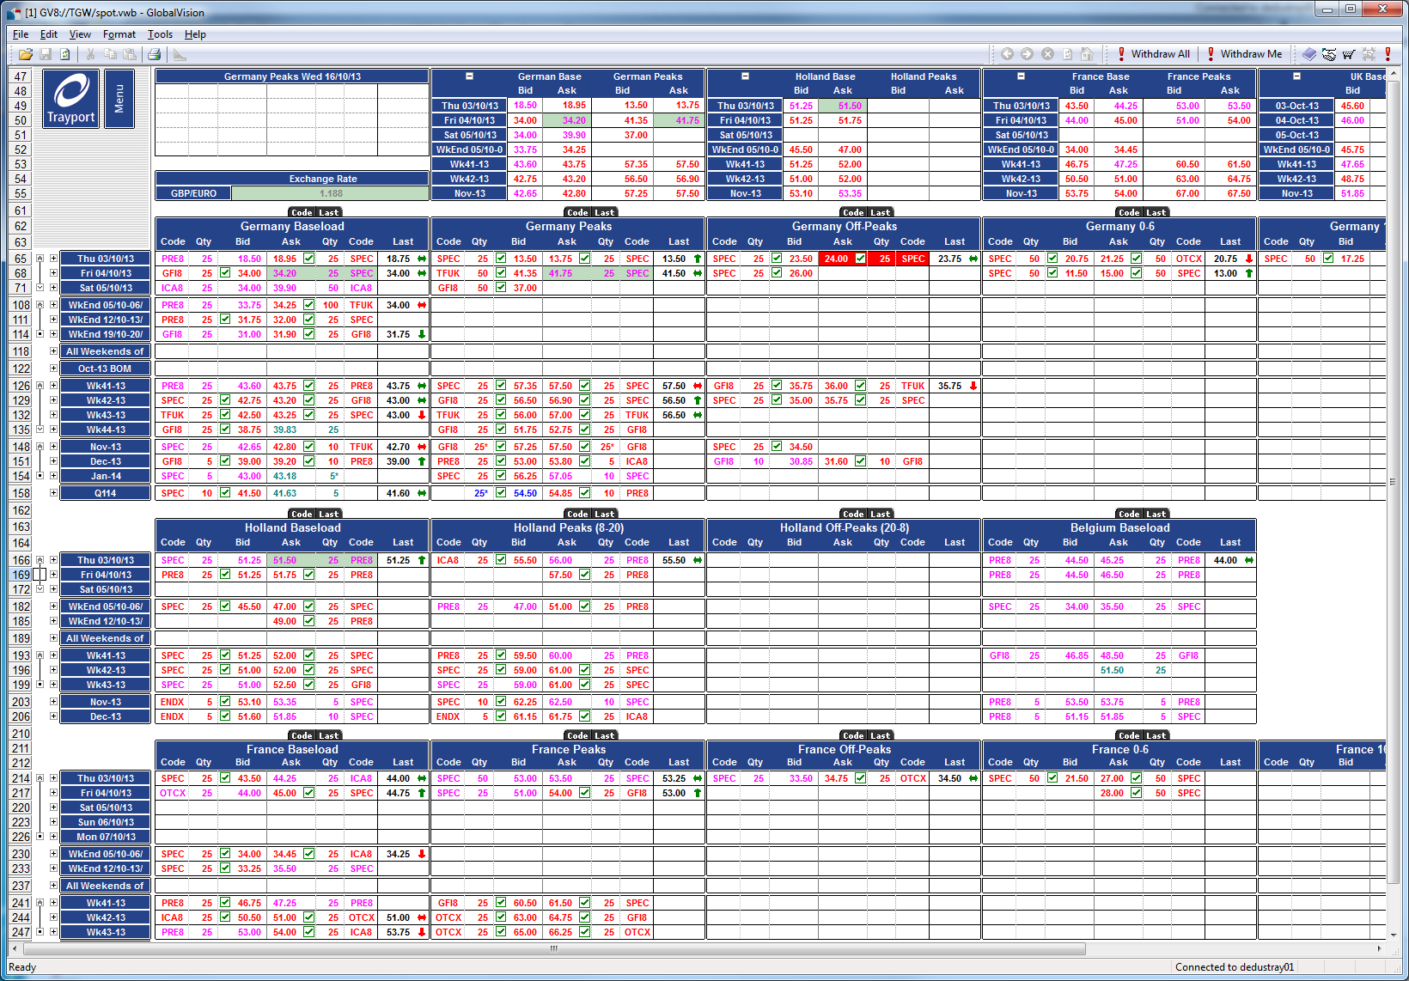
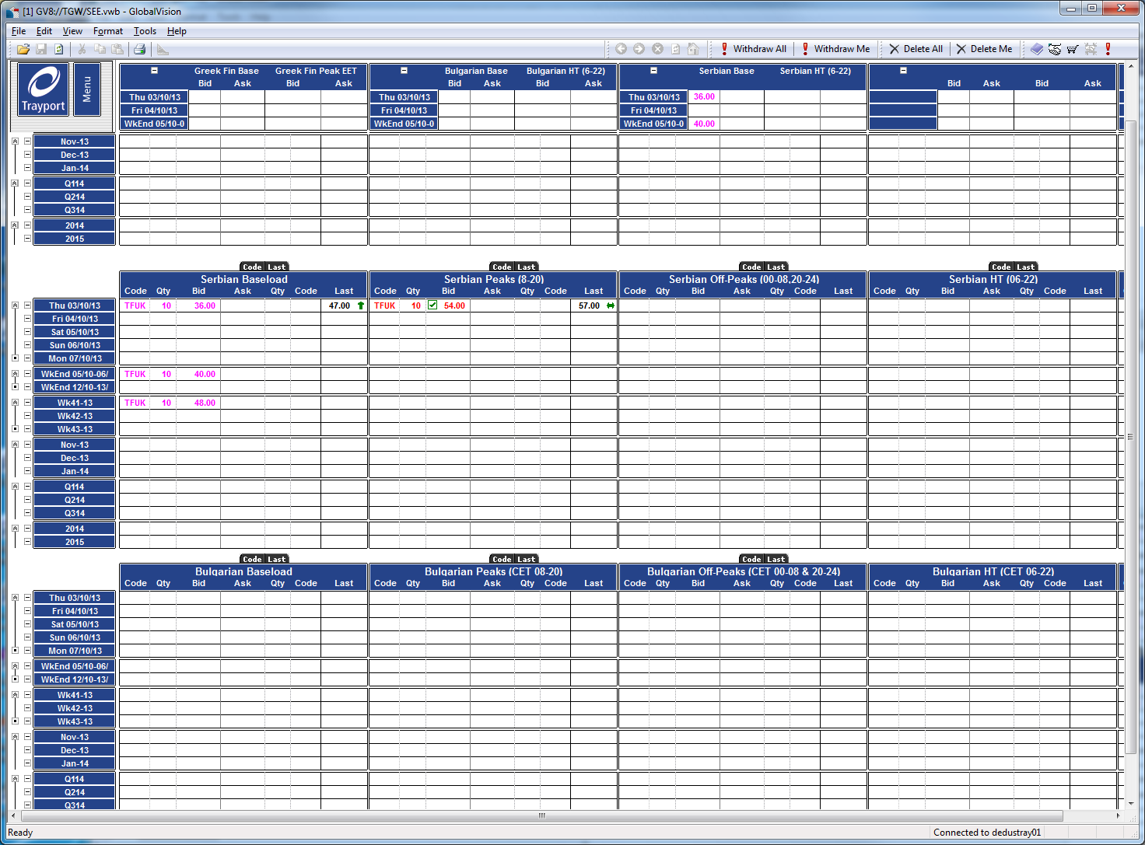
OTC via brokers
Brokers support trading: They look for a Seler for every Buyer and vice versa;
Brokers are interested in meeting the highest bid Buyer with the lowest offer Seller, thus forcing all market participants to improve their prices;
Improve liquidity and trading transparence.
Tools: Phone, Screens, Yahoo messenger.
Better feeling of market movements;
Flexible products and conditions;
Brokerage facilitate trader’s life;
Counterparty selection depends on the credit risk estimation;
...... and where the power exchanges are not operational yet.

Slide 10

SPOT & TERM trading
SPOT markets provide day-ahead balancing between supply (production) and demand;
TERM markets provide long term price stability (= hedging) for producers and consumers;
Forward contract
  An agreement between two parties for a commodity/payment exchange in a future period. The price and payment methods are set when the agreement is concluded.
 | Forward | Futures
Product | Standard on non-standard | Standard only
Trading via | OTC | Exchange
Credit risk | Counterparty risk | Counterparty risk limited
Nature | Physical | Financial

Slide 11
Modern trading practices for generators
Different products – delivery profiles (base, peak, off-peak….) + Non-standard profiles and different durations (hours, days, weeks, months, quarters, years;
Electronic trading platforms to replace paper bids;
Fast evaluation of bids and announcement of results;
Use broker screens;
Use standard trading agreements – EFET;

Slide 12




… to eliminate
Rumours and unclear information
MARKET
POWER
ABUSE
MARKET
POWER
MARKET
POWER
MARKET
POWER
Uncertainty about reasons of observed prices
MARKET
POWER
Missing market transparency
Generation
Fuel prices
Demand
Transmission

Slide 13
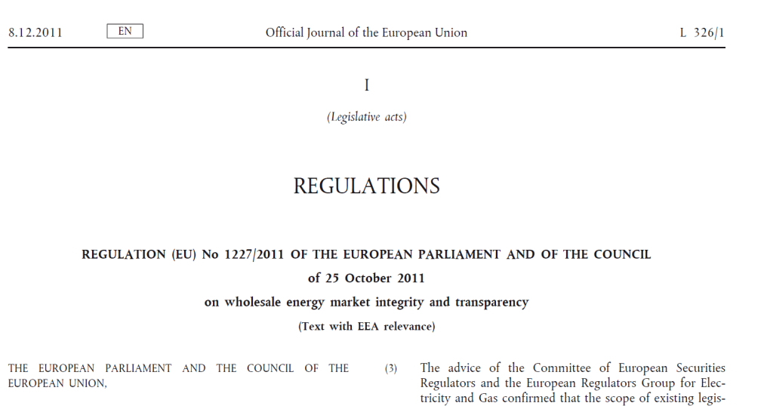
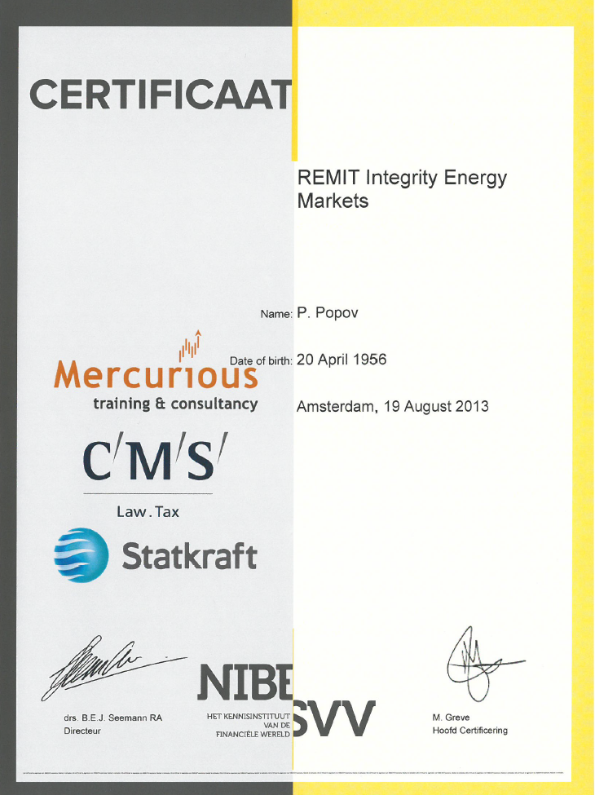
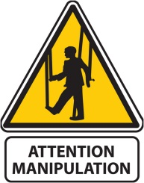

Market transparency - REMIT
Regulation on Energy Market Integrity and Transparency
(similar to Market Abuse Directive for financial markets)
Prohibition of insider trading;
Obligation to publish inside information;
Prohibition of market manipulation;

Slide 14
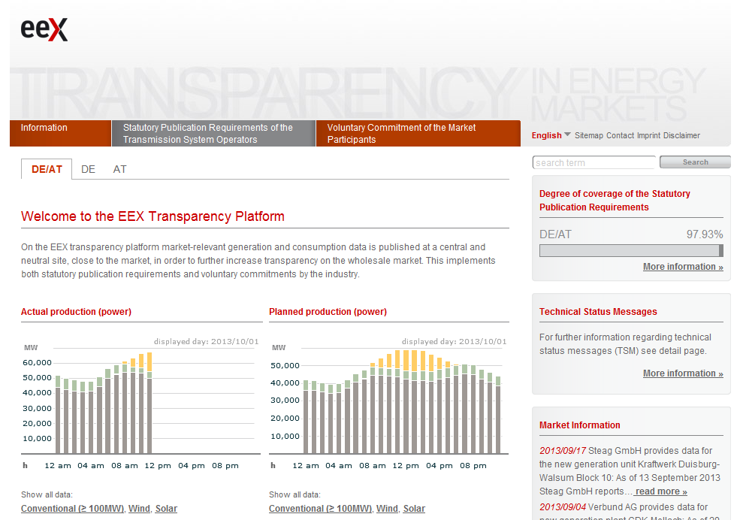
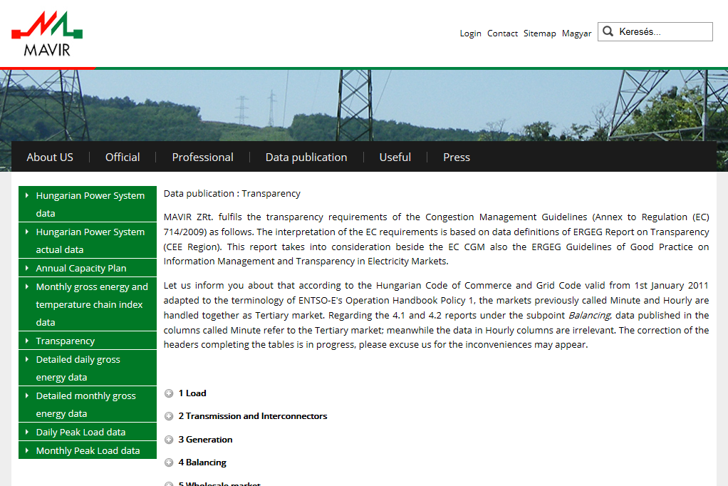
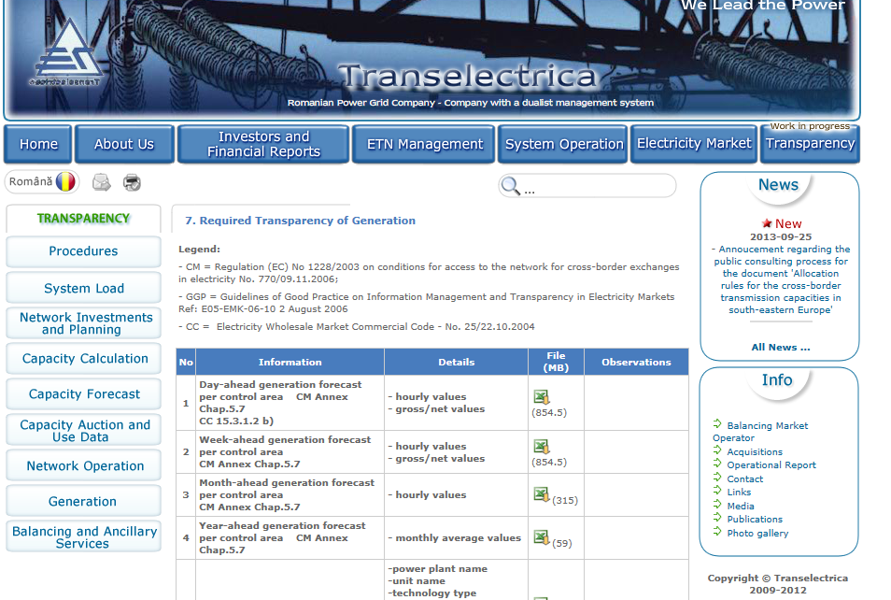
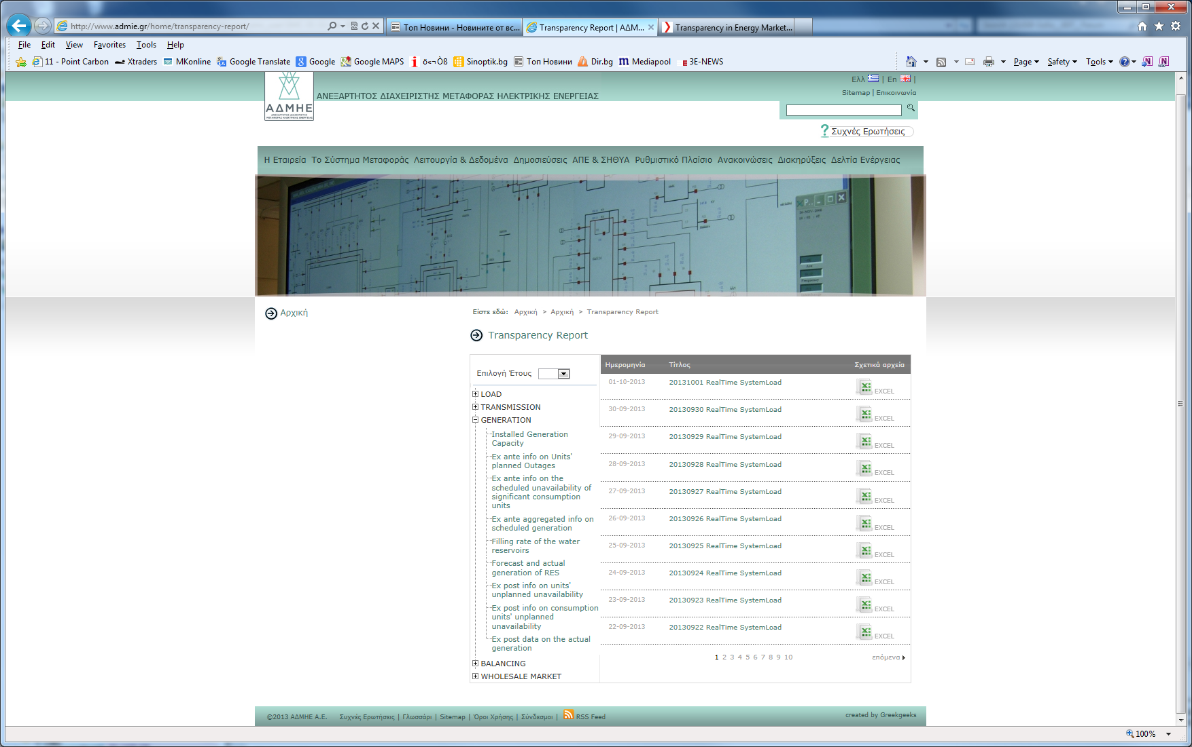
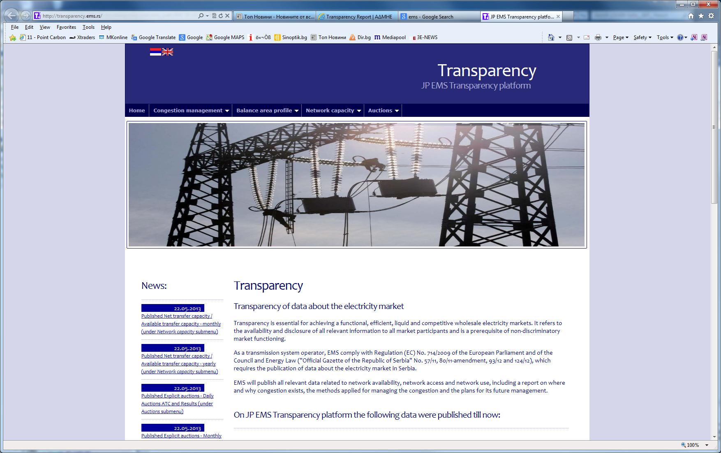
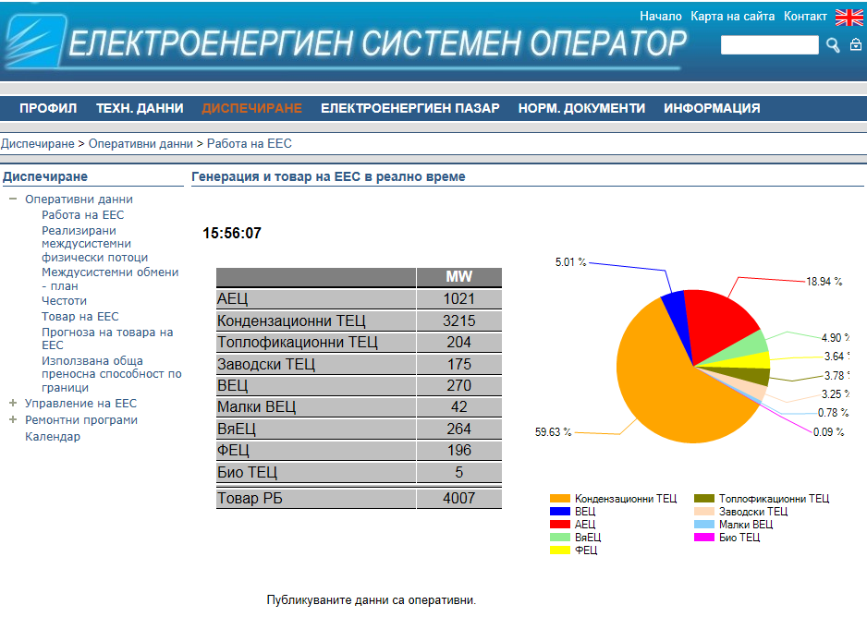
Transparency in practice

Slide 15
Market coupling scenarios
Notes:
From dark to light colour
Statkraft: Norway
Statkraft: Germany, UK, Sweden, Finland, Turkey, Laos
SN Power: Brazil, Peru, Chile, India, Sri Lanka, Nepal, Philippines
Agua Imara: Panama (Joint venture company i Panama ), Zambia
Brazil: 40% ownership in Desenvix is 90MW in total 8 hydropower plants. Two wind farms under construction.
290 MW THXP project in Laos 20% owned by Statkraft SF to be finished in 2012

Slide 16
Market coupling scenarios
Notes:
From dark to light colour
Statkraft: Norway
Statkraft: Germany, UK, Sweden, Finland, Turkey, Laos
SN Power: Brazil, Peru, Chile, India, Sri Lanka, Nepal, Philippines
Agua Imara: Panama (Joint venture company i Panama ), Zambia
Brazil: 40% ownership in Desenvix is 90MW in total 8 hydropower plants. Two wind farms under construction.
290 MW THXP project in Laos 20% owned by Statkraft SF to be finished in 2012

Slide 17
Market coupling scenarios
Condition
Bulgarian case
Functioning national day-ahead markets
Set and run a power exchange
Liquidity
Remove the quota and open the market completely
Maximum utilization of the ATCs
Implicate allocation within the coupling
+ Day-ahead and Intraday at all other borders
Removal of all Imp/Exp fees
Completely remove all grid fee components over the export
Quotation in single currency
EUR/MWh
Synchronization of times and procedures between exchanges and TSOs
ESO + TEL, EMS, MEPSO, ADMIE, TEIAS to work together
Notes:
From dark to light colour
Statkraft: Norway
Statkraft: Germany, UK, Sweden, Finland, Turkey, Laos
SN Power: Brazil, Peru, Chile, India, Sri Lanka, Nepal, Philippines
Agua Imara: Panama (Joint venture company i Panama ), Zambia
Brazil: 40% ownership in Desenvix is 90MW in total 8 hydropower plants. Two wind farms under construction.
290 MW THXP project in Laos 20% owned by Statkraft SF to be finished in 2012

Slide 18
EFET letter to SEWRC 15/Apr/2011
Who
Problem
EFET Proposal
Result
Regulator
Obligatory quota to sell to NEK
Elimination the obligatory quota.
Regulator
Regulatory period starting on 1st July.
Use calendar year or ideally for several years
Regulator
Licensing regime.
Eliminate the link between the annual fee and turnover. Simplification of annual reporting
Regulator
Separate sale for “local” and “export” market.
Equal treatment of all consumers on the territory of the ЕU.
Regulator
Application of different fee components to exported power
Complete elimination of transaction-based grid fees to export.
Regulator
Lack of a power exchange with hourly day-head settlement.
Establishment of a functioning power exchange.
ESO
Non functioning balancing market.
Apply the principle of balancing groups and inclusion of producers in the balancing market.
ESO
Different “intern” and “extern” nomination systems.
Apply system and the codes accepted by ENTSO-E .
ESO
Too early gate closure on day D-1.
Change in the gate closure time for nomination to 13:00 СЕТ.
ESO
ЕSО refuses to register non-balanced schedules on D-2.
Elimination of the restrictions.

Slide 19











Not only one MARKET
Transparency
&
Predictability
Competition
& Liquidity
Standardization
Protection & Surveillance
Balancing
Market
Ancillary Services
X-border
rights
Power
Exchange
Financial Market
OTC Market
Intraday Market
SOLID FUNDAMENTALS

Slide 20
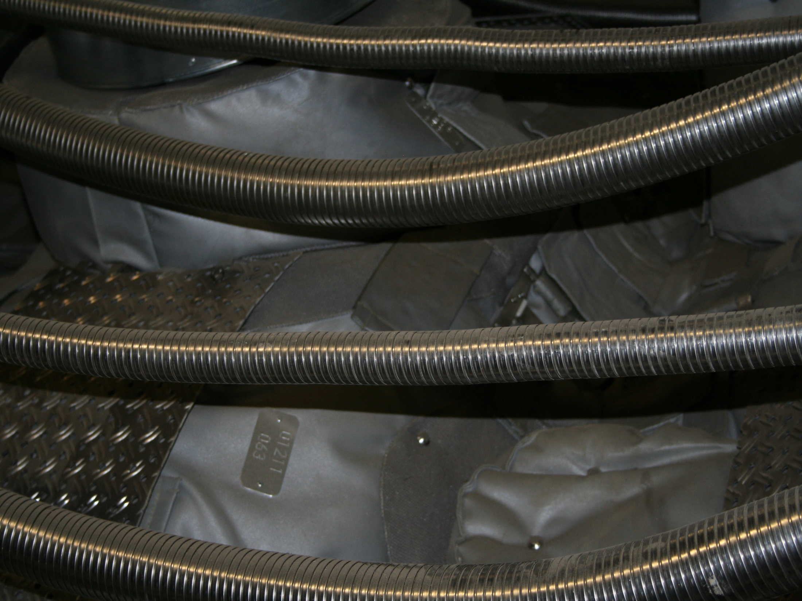
Thank you!
Пламен Попов
plamen.popov@statkraft.com
www.statkraft.com
page 20

