Slide 1

The Environmental Realities of Hydraulic Fracturing (Fracking):
Fact versus Fiction
Terry Engelder, Distinguished Lecturer
Department of Geosciences
The Pennsylvania State University

Slide 2
Objective: To understand the political, social, economic, environmental, and geological background associated with fracking myths.
Warning: It is very, very difficult to discover the truth!

Slide 3
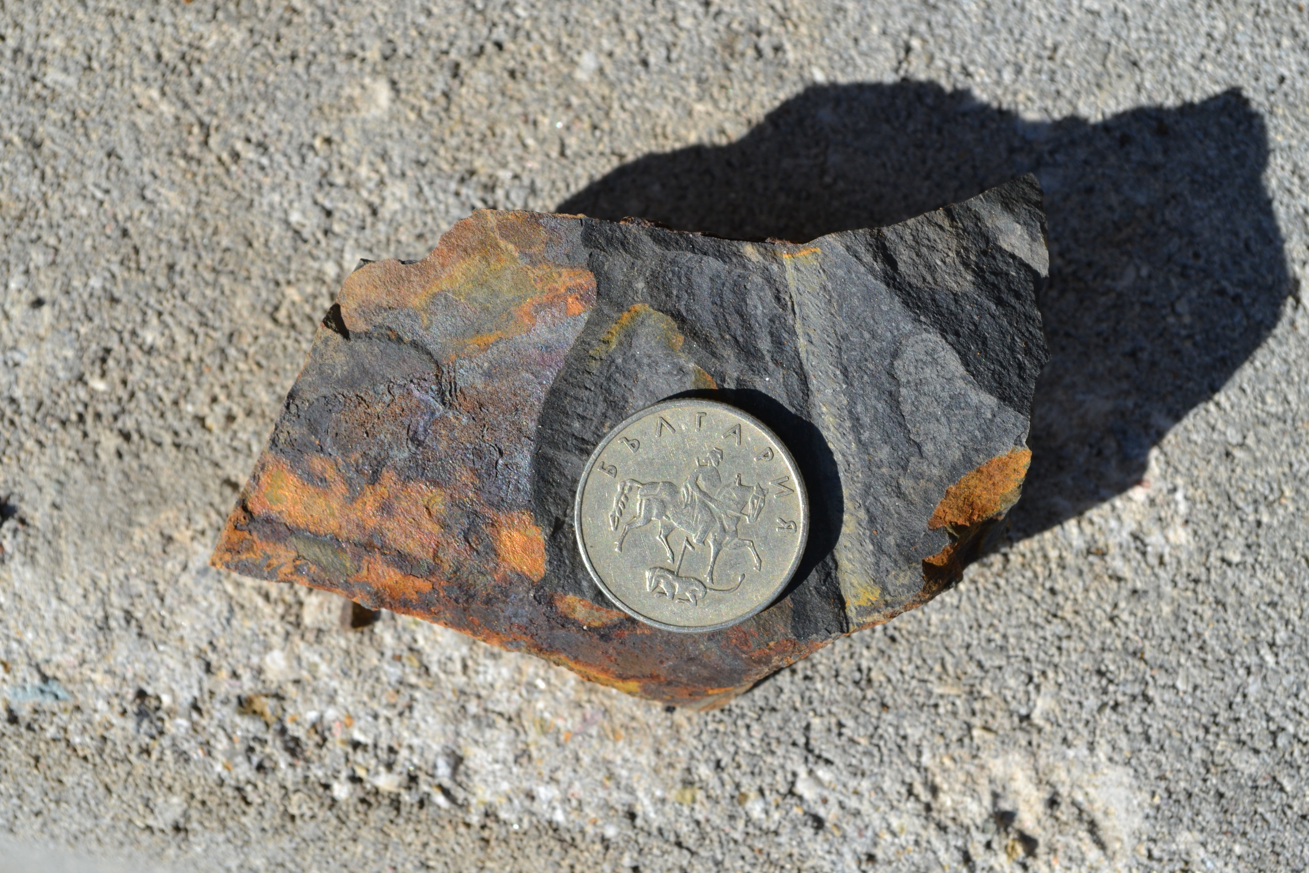
The Fracking Debate in Bulgaria
Mala Reka Formation
(Iskar Gorge)
Black Graptolite Siltstone

Slide 4
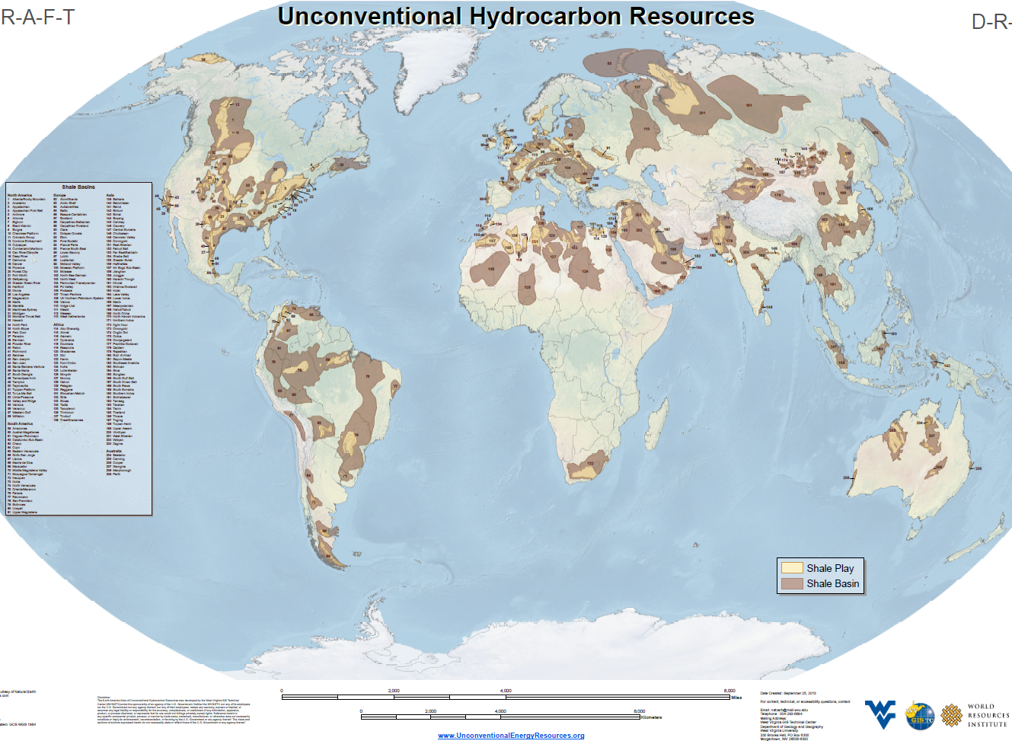

Marcellus Gas Shale
Town of Dimock
Many of the fracking myths come from Pennsylvania, home to the Marcellus gas shale and the town of Dimock.

Slide 5

Fracking Myth
“The public understands fracking!
Christopher Joyce
Correspondent: Science Desk
National Public Radio (NPR)
I have been in science journalism for more than 30 years and I have never seen more scientific disinformation on any topic as fracking. I am amazed at the level of both inadvertent and purposeful disinformation.
There is such an agenda on everyone’s mind.
http://www.youtube.com/watch?v=giCRpuI-YBA

Slide 6

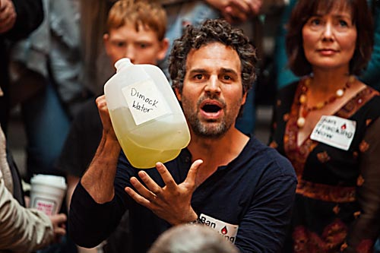

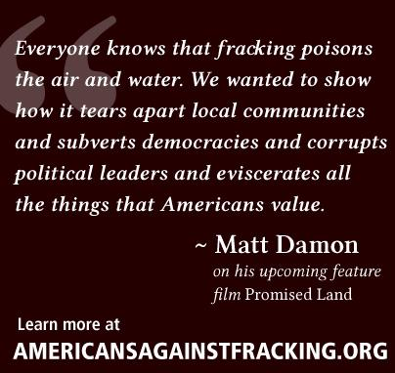

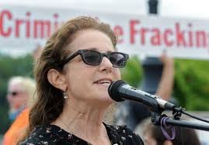
Fracking Myth
“As a group, movie stars are fracking experts”
Mark Ruffalo
Yoko Ono
Sean Lennon
Susan Sarandon
Debra Winger

Slide 7
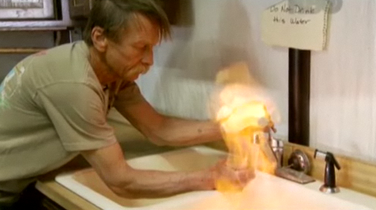

Fracking Myth
“Flaming faucets are caused by fracking!”
    Josh Fox, producer of the movie ‘Gasland’..
Weld County, CO, water well drilled into coal beds!
The Colorado Oil & Gas Conservation Commission (COGCC) sent a letter to Mike W. Markham in Weld County, Colo. After extensive sampling and testing, COGCC finds “no indications of any oil & gas related impacts” to Mr. Markham’s well.

Slide 8


Methane is commonly dissolved in groundwater
Methane (CH₄) must have a concentration of 28 mg/L to exsolve from groundwater.
methane saturation level
mg/L = milligrams per liter

Slide 9
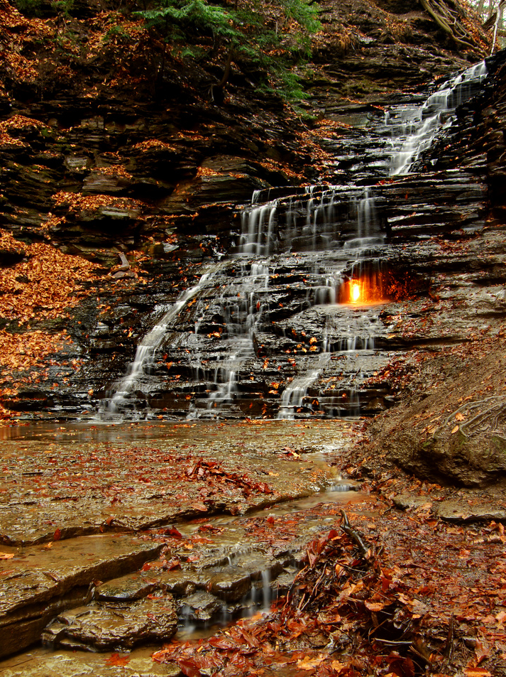
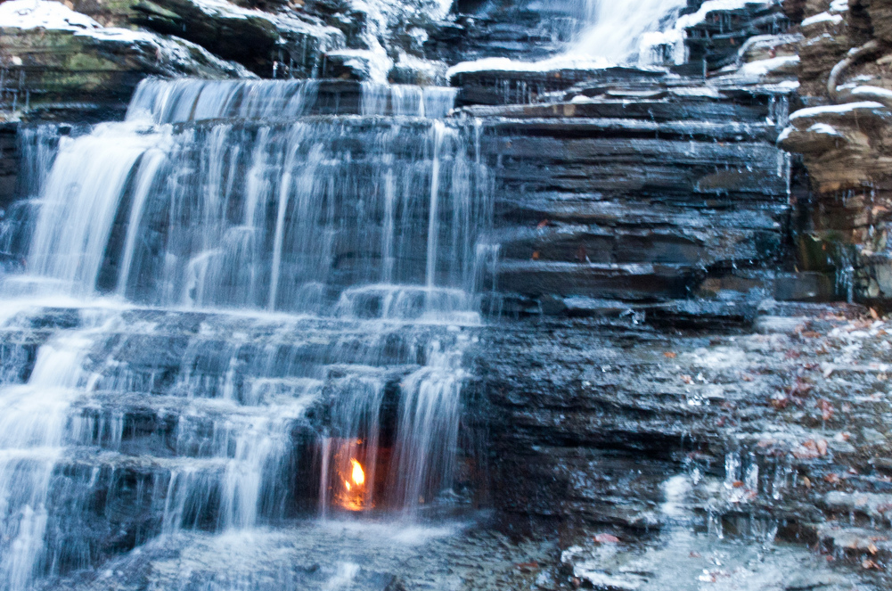
Occasionally methane leaks rapidly enough from gas shale along natural pathways that, once ignited, it may burn continuously!
Eternal Flame Falls
Erie County, NY

Slide 10
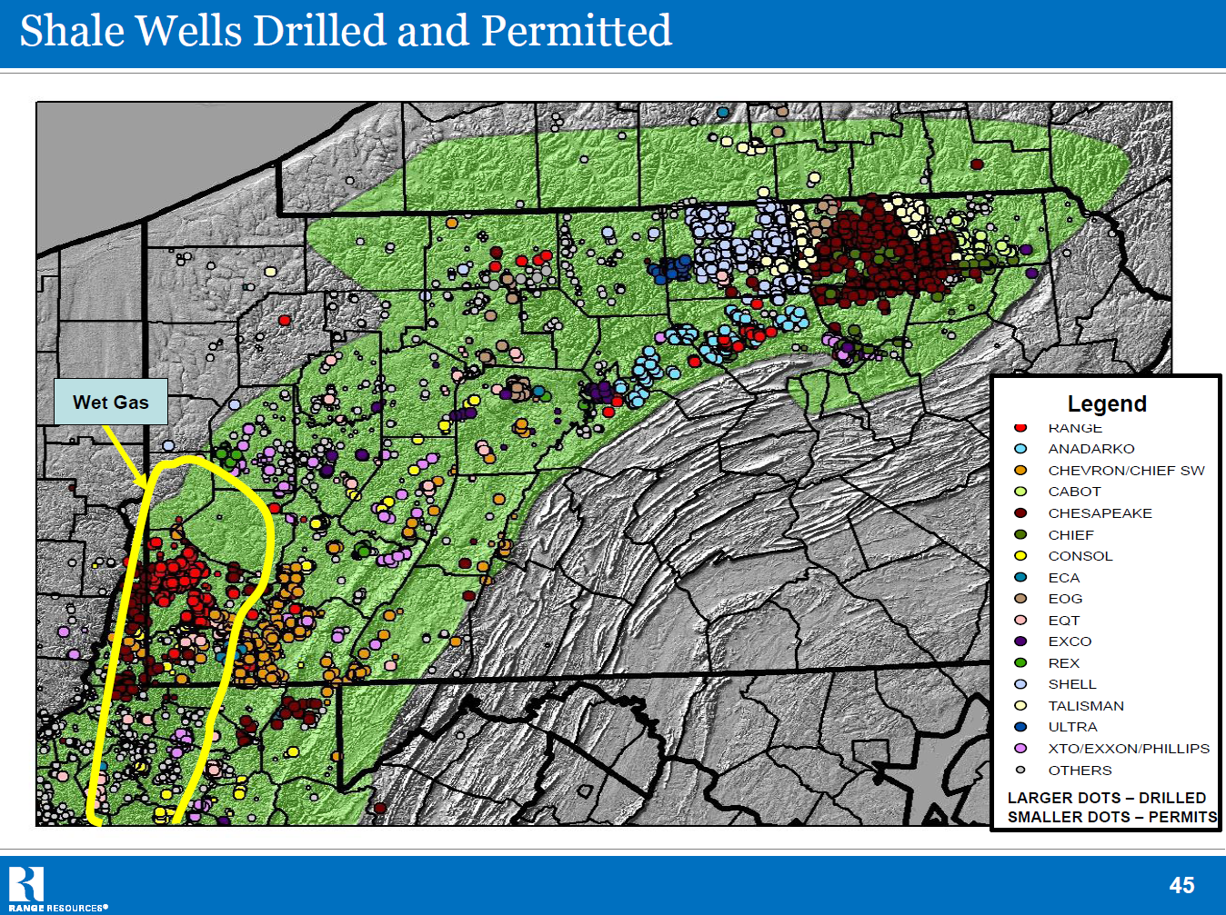
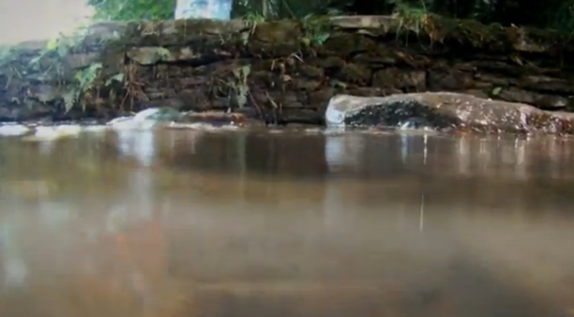
3,689 horizontal wells in production in PA!
(June, 2013)
Dimock & Salt Springs State Park
Pennsylvania
Prehistoric:
Methane bubbling from the water at Salt Springs State Park:
concentration of CH₄ > 28 mg/L

Slide 11
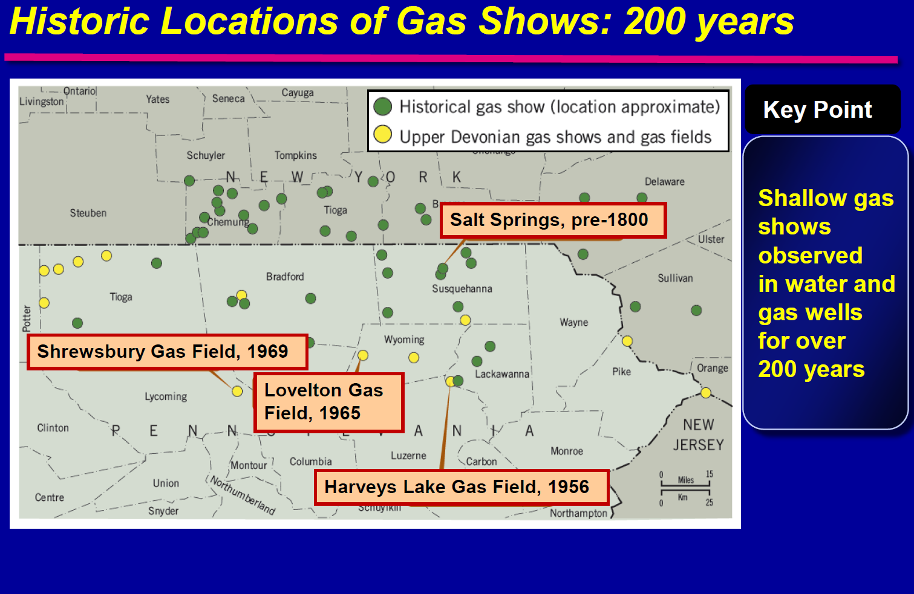
Dimock
Molofsky, et al., 2012, Presentation at GWPC Stray Gas Forum, Cleveland, OH

Slide 12
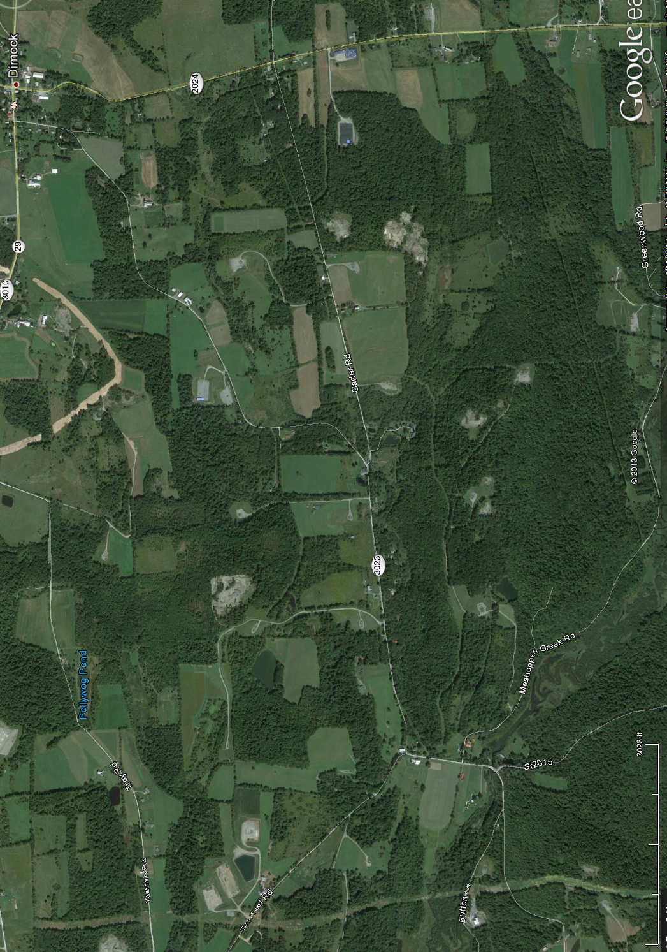
Fracking Myth
“All that is said about Dimock is gospel truth!”
    Protest rally after protest rally indicates this is so.
Fiorentino
1000 feet
Sautner
Baker 1
Bluestone Quarry
Bluestone Quarry
Gesford 2
Gesford 1

Slide 13
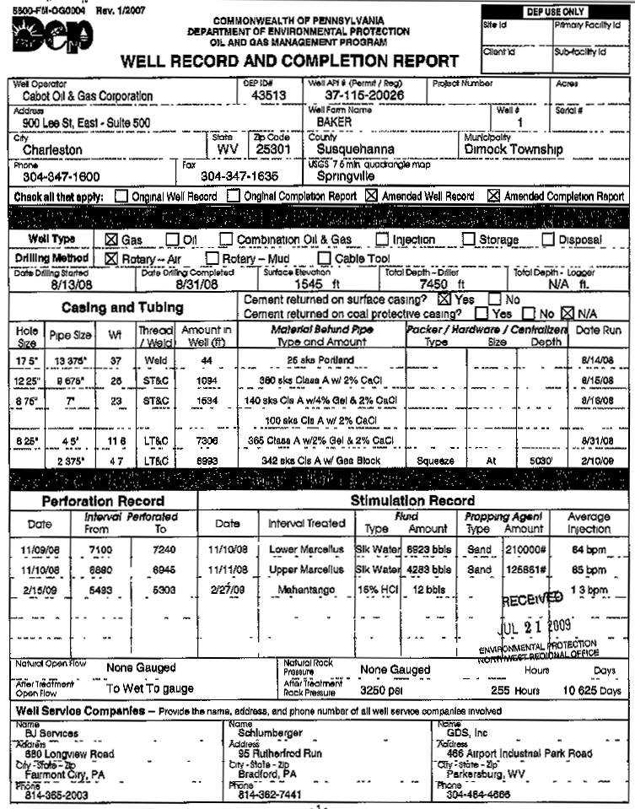

Slide 14
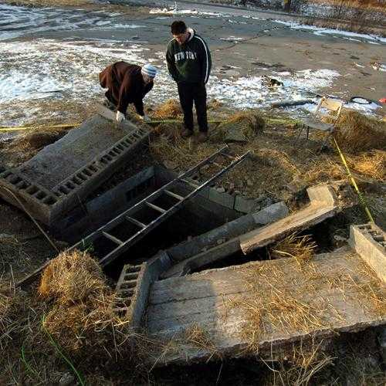
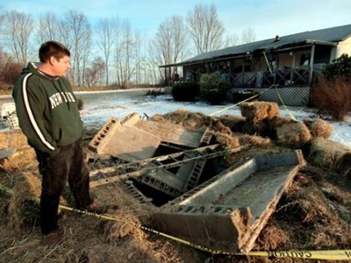

Dimock: Fiorentino’s well housing
On Jan. 1, 2009, it was presumed that methane in the subsurface housing of Norma Fiorentino’s water pump exploded.
At that moment, Dimock, PA, became famous.
Norma Fiorentino’s water-pump housing
(January 1, 2009)

Slide 15
Dimock: First Media Report
The explosion's cause has not been determined.
County emergency management coordinator, Charlene Moser, said she suspects that a concentration of something flammable spontaneously combusted when the water well pump in the manhole turned on.
Neither the Springville Volunteer Fire Company nor Cabot's gas response crew detected the presence of natural gas when they tested the site on Thursday.
Laura Legere – Scranton Times Tribune (January 3, 2009)

Slide 16
Fiorentino’s well: Some Facts
No witness to explosion
Equipment not disturbed.
No evidence of fire in underground housing.
No hay burned.
28 mg/L of CH₄ never measured in water.
Worker with blowtorch in well housing days before.
No scorching of cement.
Pennsylvania DEP (water samples)
 |  | Methane μg/L | Ethane μg/L | Propane μg/L | Water Appearance | Depth
1/18/2009 | Ely - Bill | 47700 | 2780 | 132 | turbid with effervescence | 250 | pressure tank | complaint
1/18/2009 | Hubert | 42700 | 2730 | 126 | clear | 250 | kitchen sink | complaint
2/4/2009 | Ely - Nolan | 20900 | n/a | n/a | visibly cloudy and effervescent | 500 | kitchen sink | complaint
1/12/2009 | Sautner | 17600 | 924 | 39.2 | turbid |  |  | complaint
2/3/2009 | Fiorentino | 12300 | 502 | 19.8 | clear |  | pressure tank
1/26/2009 | Switzer | 8200 | 538 | 31.9 | clear |  |  | complaint
1/12/2009 | Maye | 7790 | 86.6 | 19.8 | clear |  | kitchen sink | complaint
1/5/2009 | Fiorentino | 4010 | 86.1 | n/a | clear |  | pressure tank | complaint
1/27/2009 | Ely - Bill | 2140 | 105 | 19.8 | clear |  | pressure tank | complaint
1/20/2009 | Schneider | 618 | n/a | n/a | clear | 288 | pressure tank
1/27/2009 | Cohen | 385 | n/a | n/a | clear |  | kitchen sink | complaint
1/13/2009 | Brown | 321 | n/a | n/a | clear |  | kitchen sink | complaint
1/21/2009 | Hein | 66 | n/a | n/a | clear |  | kitchen sink | complaint
1/26/2009 | Kemble | 15.9 | n/a | n/a | clear |  | kitchen sink | complaint
1/13/2009 | Farnilli | 8.03 | n/a | n/a | clear |  | bathroom sink | complaint
1/12/2009 | Burke | 7.92 | n/a | n/a | clear |  | pressure tank | complaint
2/4/2009 | Gesford | 7.92 | n/a | n/a | clear |  | kitchen sink | complaint
1/22/2009 | Marazzo | 7.92 | n/a | n/a | clear | 420 | bathroom sink | complaint
2/4/2009 | Mills | 7.92 | n/a | n/a | clear | 500 | kitchen sink | complaint
1/27/2009 | Scartozzi | 7.92 | n/a | n/a | clear |  | kitchen sink | complaint
2/4/2009 | Sipe | 7.92 | n/a | n/a | clear |  | kitchen sink | complaint
1/5/2009 | Weaver | 7.92 | n/a | n/a | clear |  | pressure tank
1/21/2009 | Baker | 7.29 | n/a | n/a | clear |  | kitchen sink | complaint

Slide 17

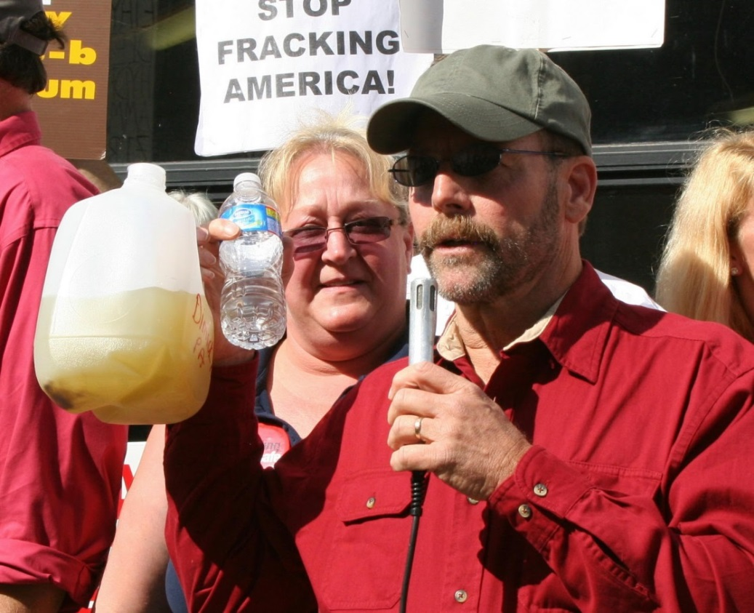
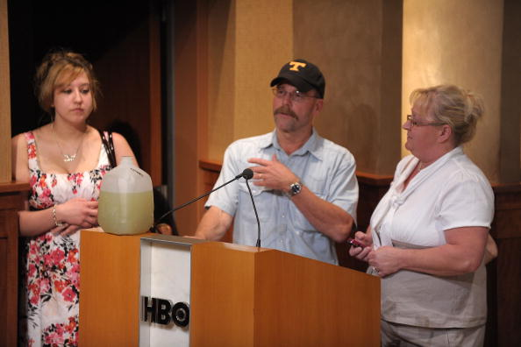
Fracking Myth
“Brown water near Dimock is caused by fracking”
    Craig & Julia Sautner – their drinking water was tested by both PA-DEP and US-EPA.
Craig & Julia Sautner’s turbid water

Slide 18
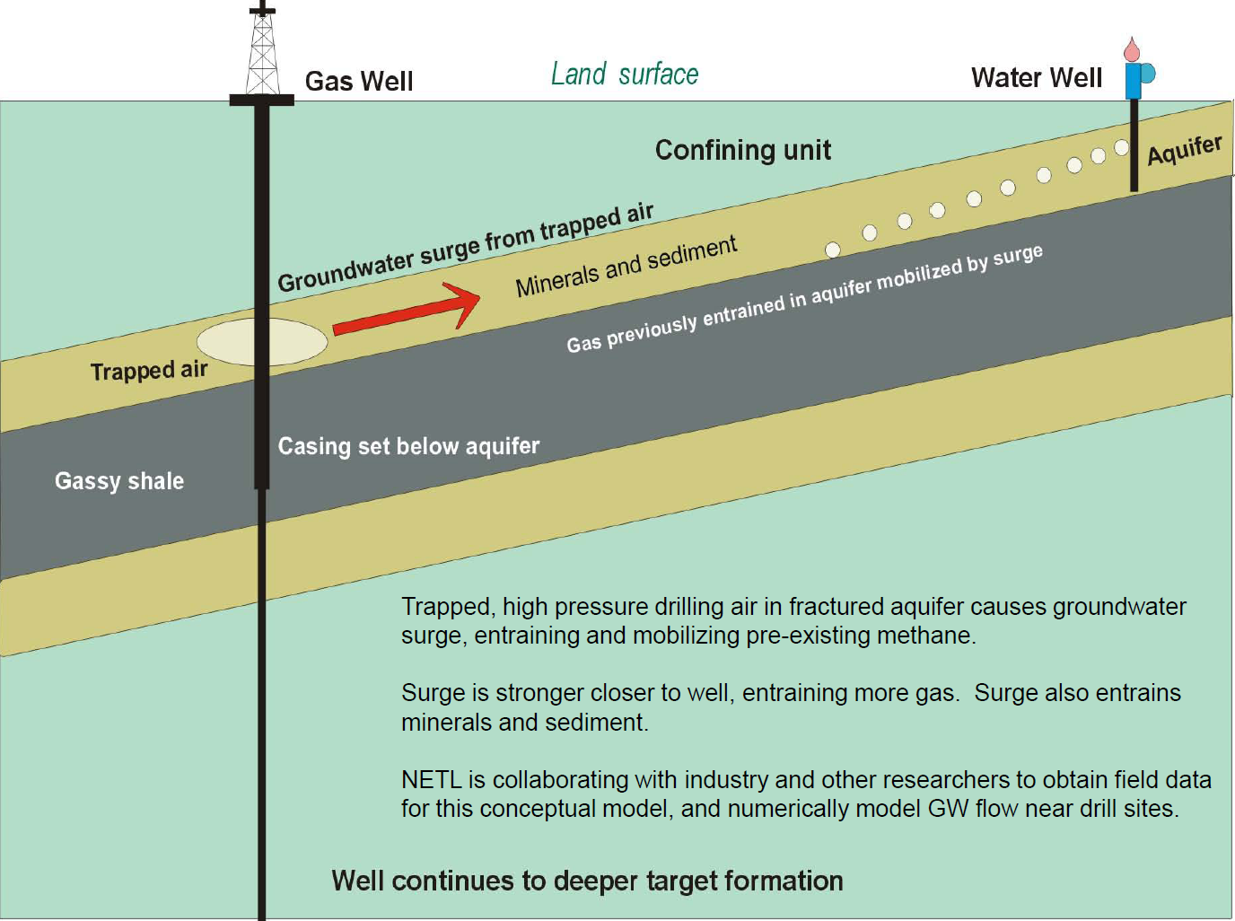
Soeder, 2012, Presentation at GWPC Stray Gas Forum, Cleveland, OH

Slide 19
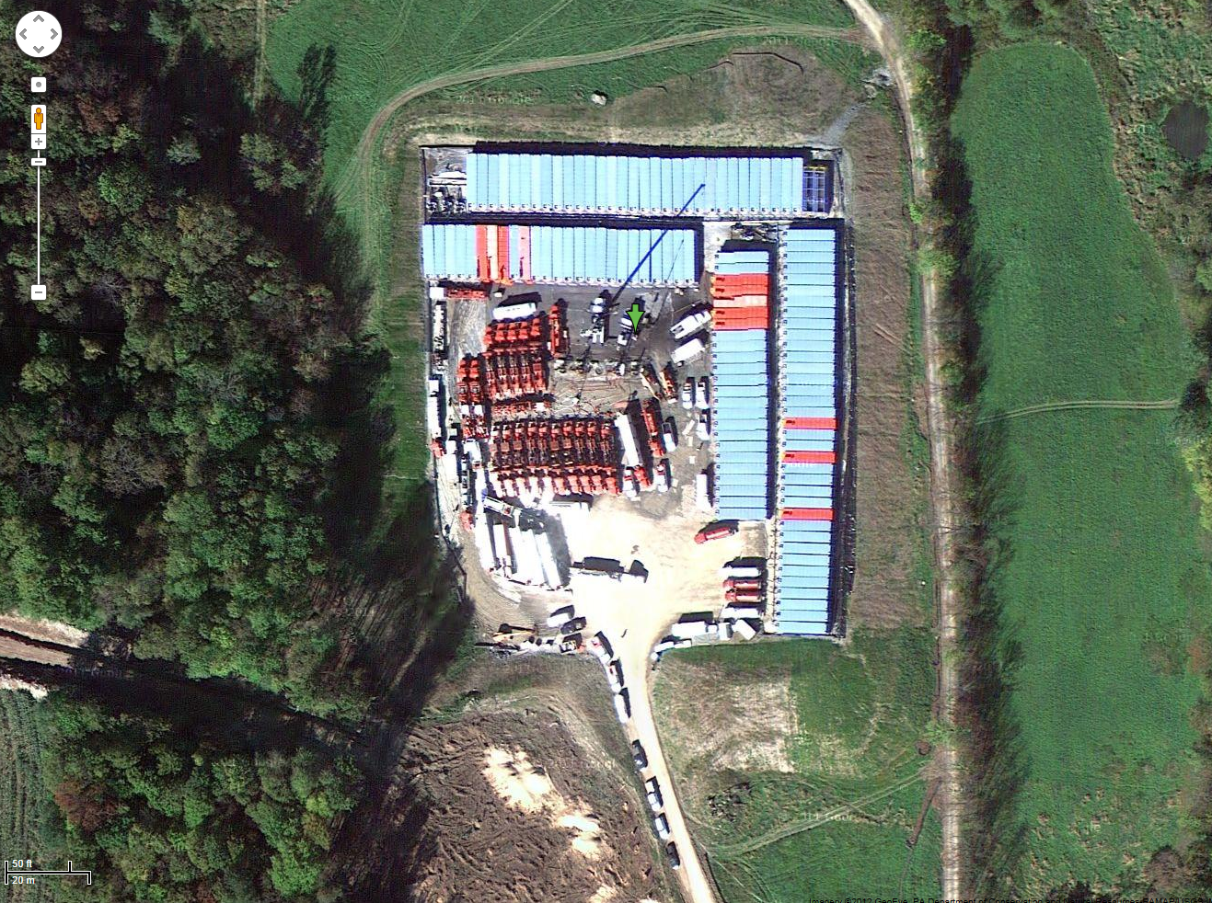
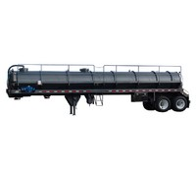
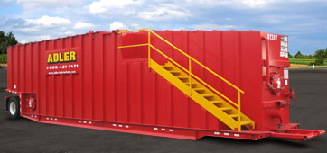
Fracking Myth
“Water that flows back from Dimock wells enters rivers, streams and drinking water!”
    Industry has corrected an early practice!
    .
8H Stimulated:
5,040,726 gallons in 21 stages
118 frac tanks
21,000 gal frac tanks
130 bbl/5460 gal.
923 truck trips per well

Slide 20
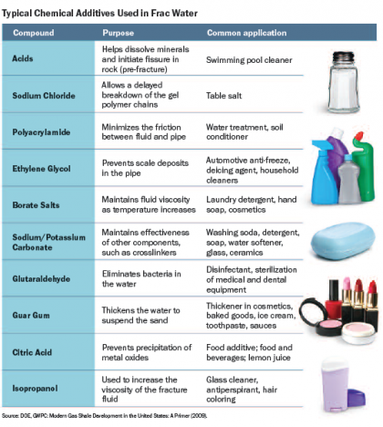
Fracking Myth
“Chemicals used in Dimock fracking are a secret!”
    Industry has corrected this problem! (see www.fracfocus.org)
    .
Corollary #10: Something that was once a fact is now a myth!

Slide 21
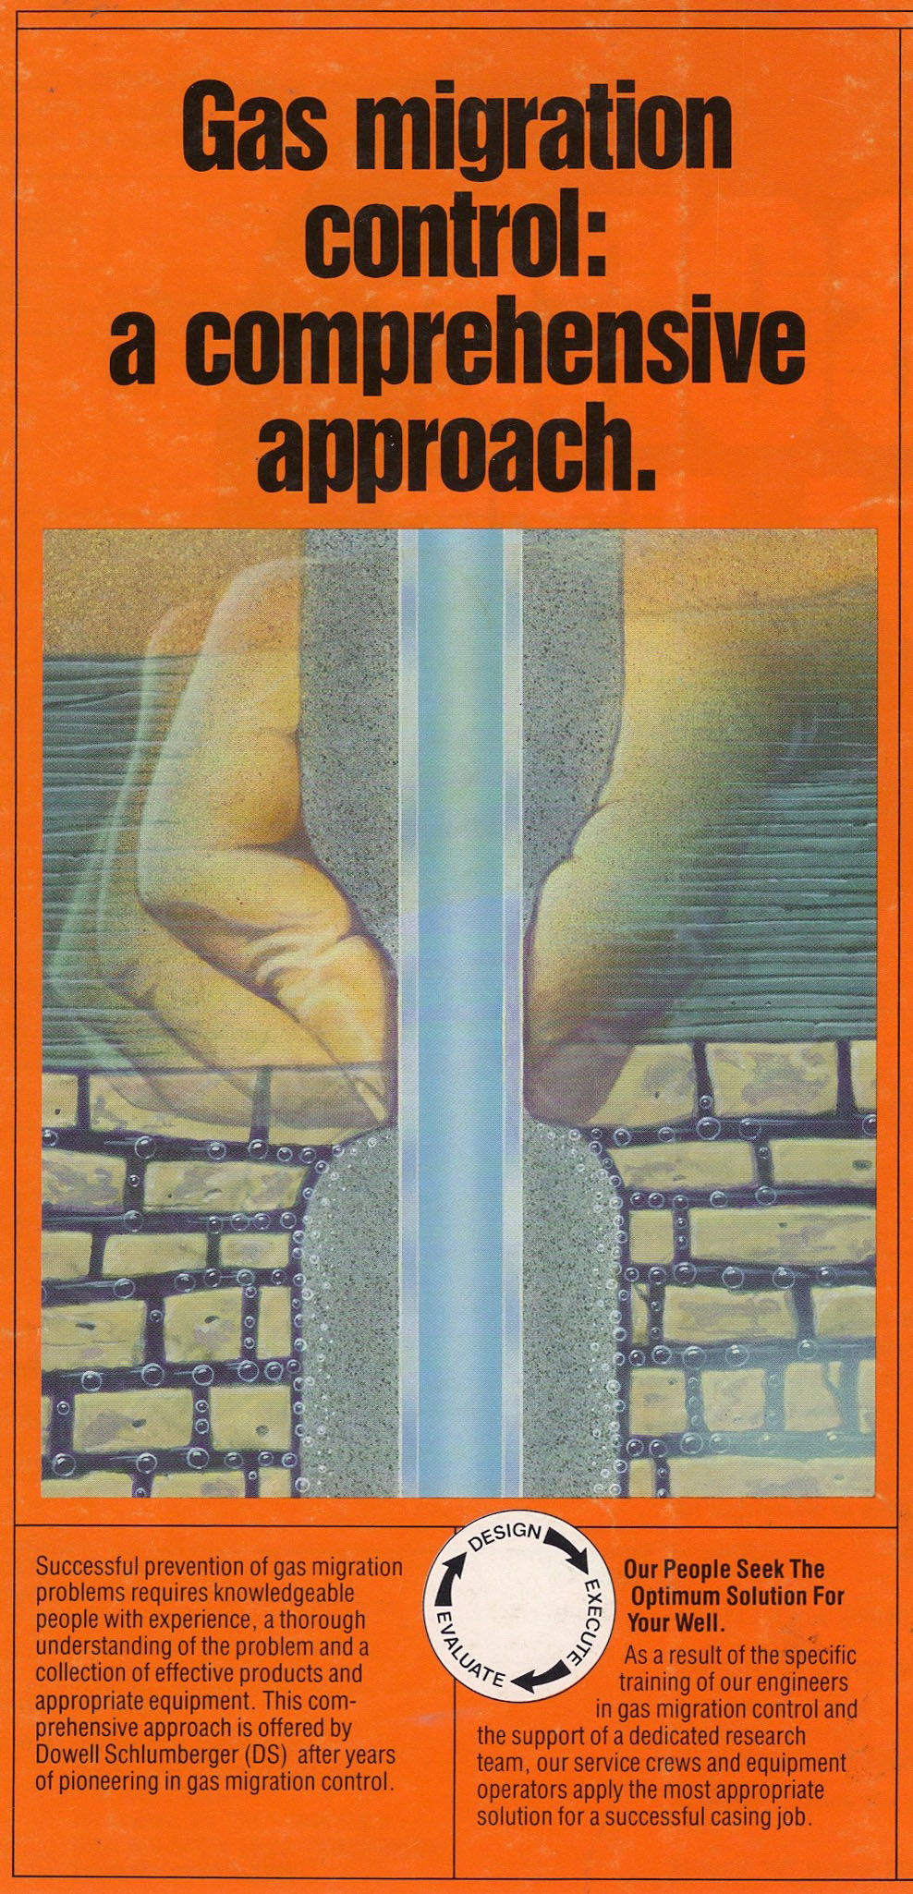
Fracking Myth
“Dimock fracking contaminates groundwater with toxic chemicals!”
    Shouts of many early activists!
    .
There is complete confusion among layman about the difference between faulty well construction and groundwater flow along natural pathways!

Slide 22
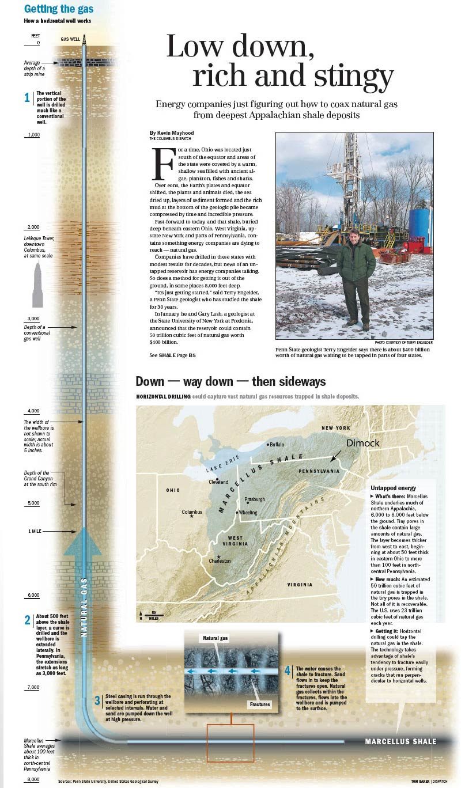
Typical Marcellus horizontal well
Domestic Well (801’)
EPA MW02 (981’)
Shallowest Hydraulic Fracturing (1220’)
Pavillion, WY
v.
Dimock, PA
The impact of exhumed gas fields
8000 feet
Maximum Vertical Growth: Hydraulic Fracturing (1000’)
Marcellus (7500’)

Slide 23

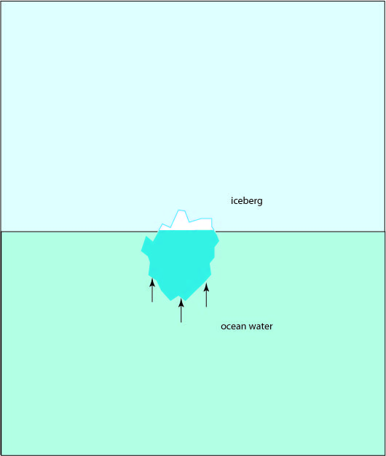
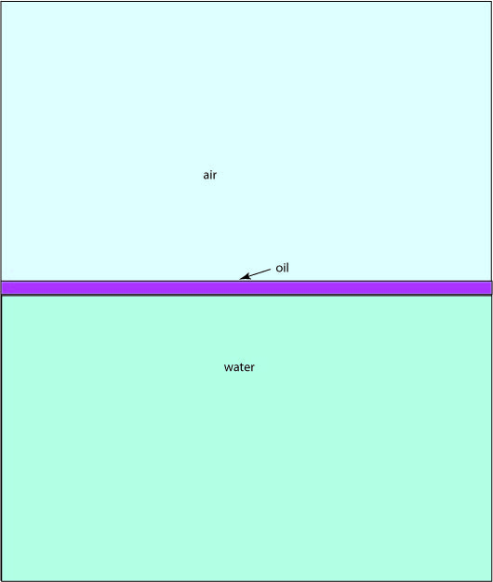
The Principle of Buoyancy
Background for understanding Fig. 4-1:
Water within the earth is stratified by buoyancy
Lesson: Fluids stack by density with less dense fluids rising to the top.
Safe Drinking Water v. Shale Gas

Slide 24
Ground Water (drinking)
1.00 g/ml
Lesson: Stacking of fluids by density is stable as indicated by the persistence of fresh water in wells.
Ground Water
(drinking but mineralized & tastes bad)
1.002 g/ml
Salty Water
(unfit for drinking)
1.02 g/ml
8000 feet
1.03 g/ml
Brine
(saturated with salt & unfit for drinking)
1.2 g/ml
Frac Fluid
(sand, acid, polymers, organic compounds)
> 1.3 g/ml

Slide 25
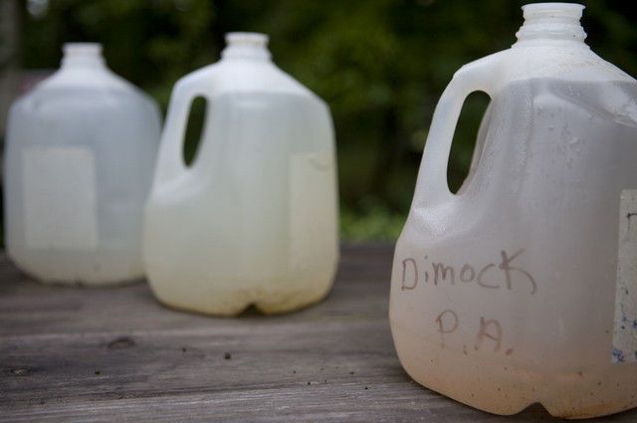
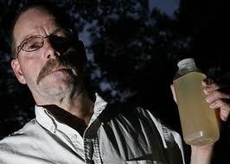

Bloomberg News
March 16, 2012
EPA Clears Water in Pennsylvania Fracking Town After Complaints
Craig Sautner Huffs and Puffs and Flails About with Jug of Water as EPA Gives Up and Leaves (29:50)

Slide 26


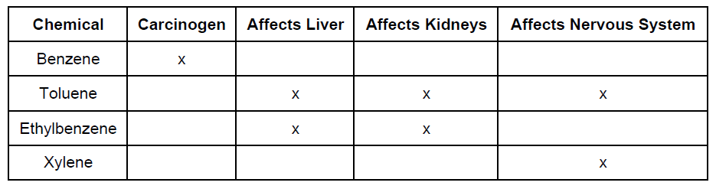
Harmful
Persist
Although 750 different chemical compounds have been tried in hydraulic fracturing only about a half dozen exhibit these overlapping characteristics!
Joseph Ryan, Ph.D. U of Colorado
Transport

