Slide 1
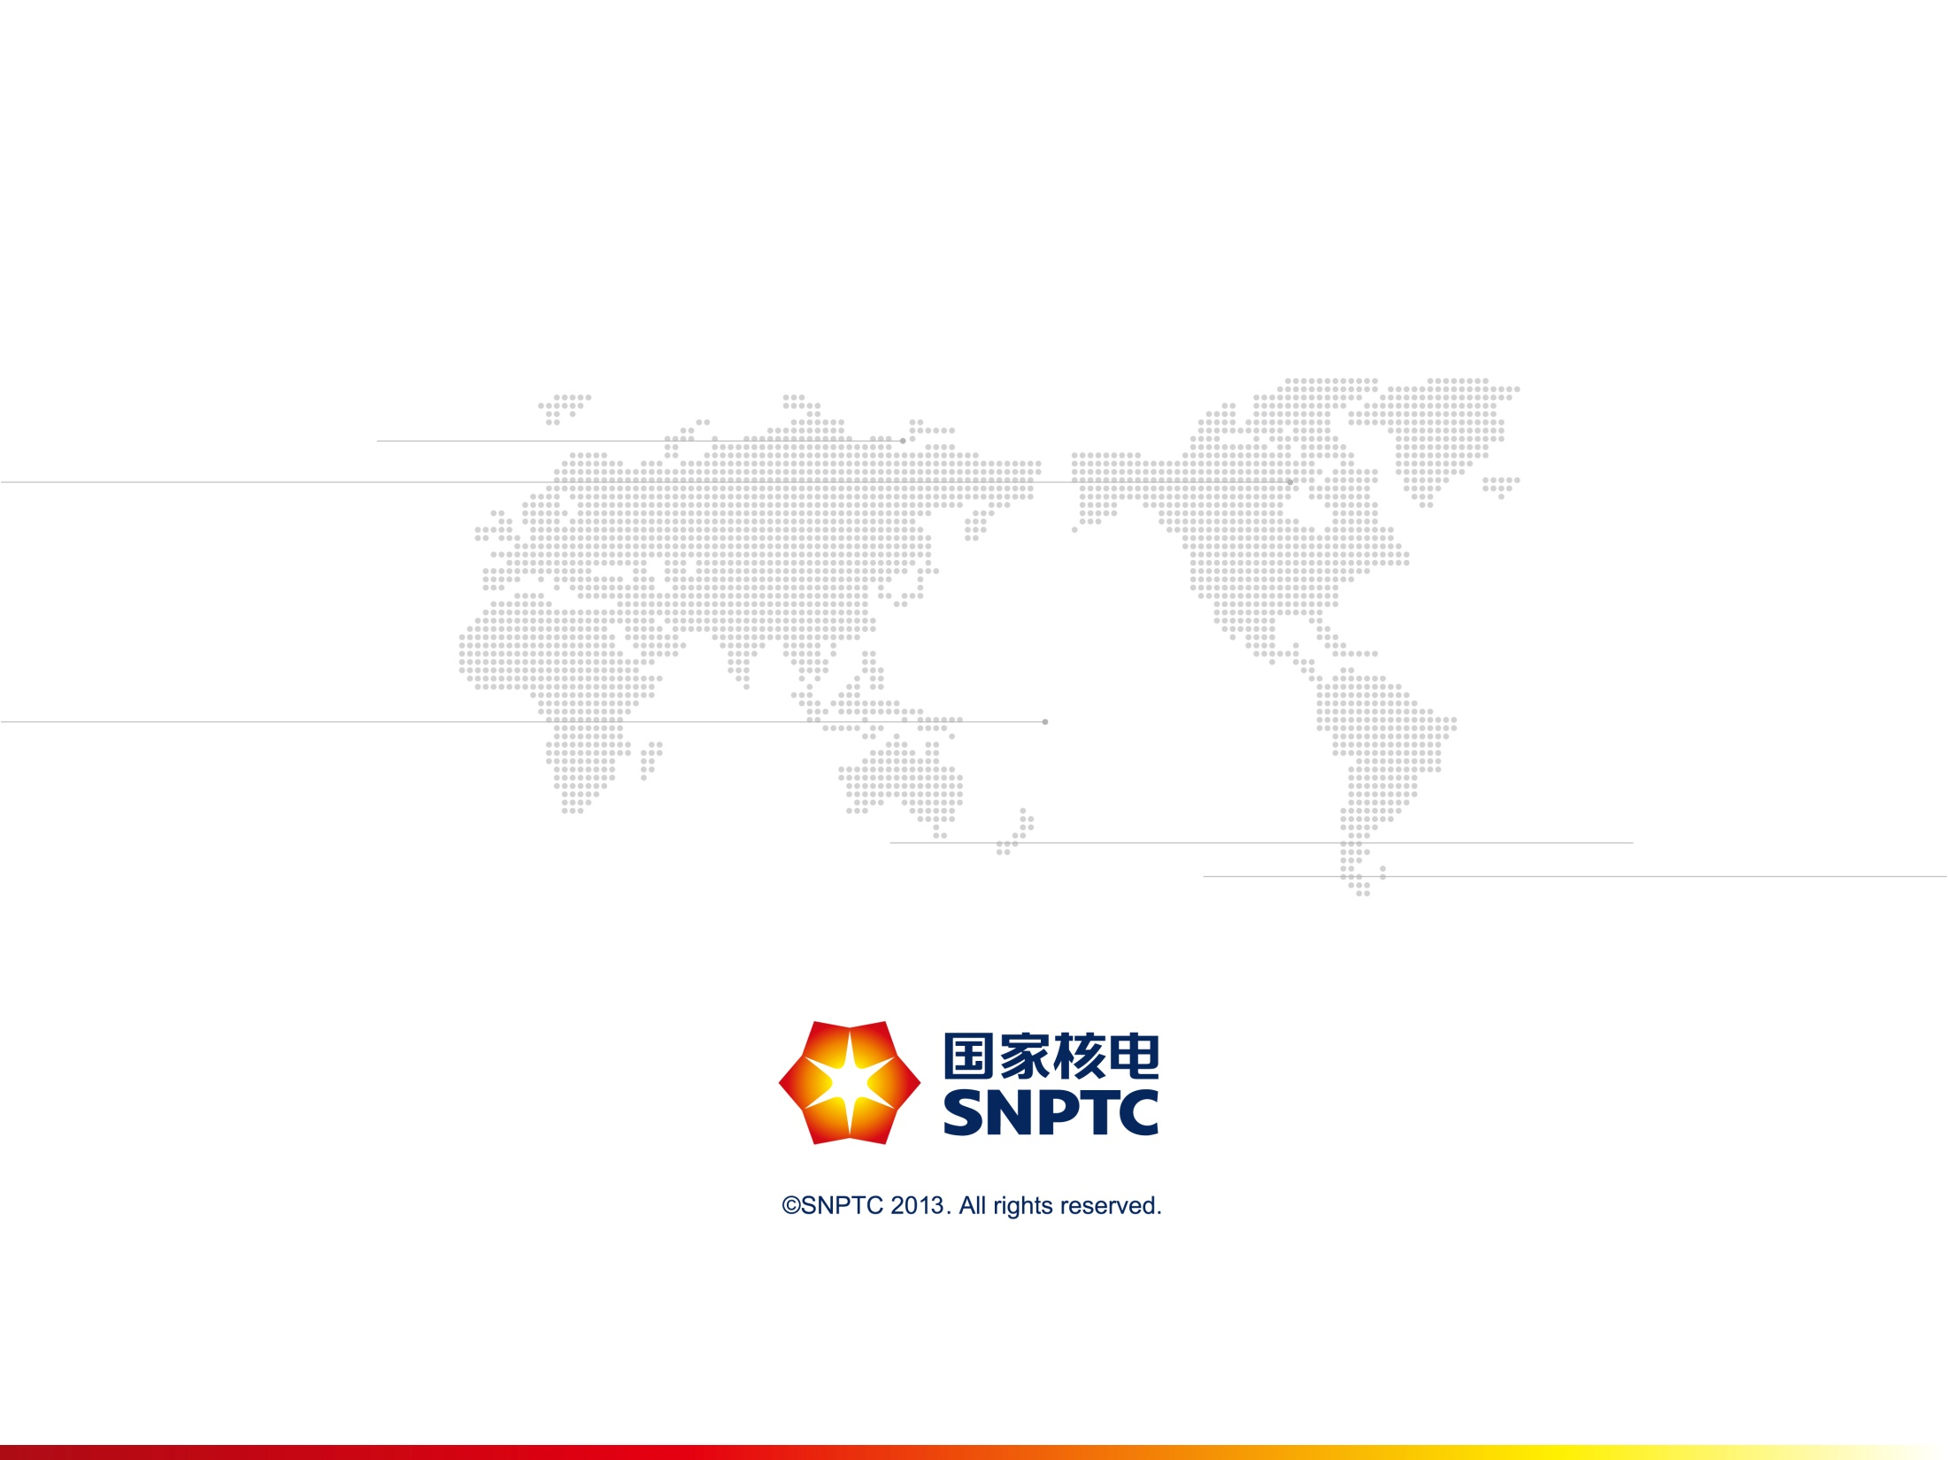


Technology Innovation:
SNPTC’s Practice and Prospect
索菲亚，2015年3月26日
Sofia, March 26th，2015

Slide 2
主要内容
CONTENTS
1400项目最
1. Nuclear Power Development in China
2. SNPTC’s Technology Innovation Practice
3. Characteristics of CAP1400 NPP
4. Future Prospect of SNPTC
2

Slide 3
NPPs in China Mainland
In commercial operation: 22
Xudapu
Under construction:28
Under preparation: 14
Hongyanhe
黑龙江
Haiyang
Shidaowan
吉林
新疆
Tianwan
辽宁
甘肃
内蒙古
北京
河北
天津
Qinshan&Fangjiashan
宁夏
山西
山东
Qinshan 2
青海
Qinshan 3
陕西
河南
江苏
Sanmen
西藏
上海
Ningde
四川
湖北
安徽
重庆
Fuqing
浙江
贵州
湖南
江西
Lufeng
福建
云南
广西
广东
DayaBay/LinAo
台湾
Taishan
Fangchenggang
海南
Yangjiang
Changjiang

Slide 4
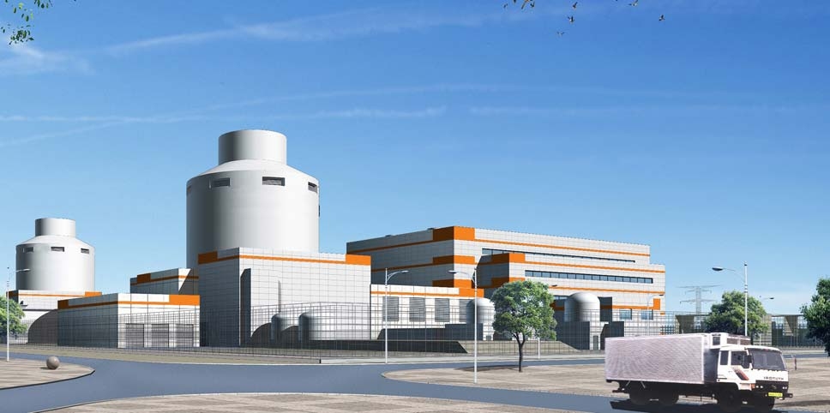
  Nuclear Development Strategy
  in China
Development Plan:
Mid to long term nuclear development plan
Development Principle:
Safe and Efficient
Highest safety standard and most advanced technology
GIII NPP Technology(AP1000 and its innovative design based)
  Hold Public in high regards
CAP1000
CAP1400

Slide 5
  Nuclear Safety Requirements
  and Standards in China
  Basic principle: Quality First, Safety First
  Chinese nuclear safety regulations are based on IAEA nuclear safety standards and combined with the other international practice.
  The safety goal, safety requirements and methodology are consistent with the international safety standards and practice.
  Since Fukushima accident, Chinese Regulator has issued a lot of new or revised regulations to enhance the safety standard.
  Chinese Government issued two plans for nuclear safety. The safety goals for nuclear power plant are follows:
  The NPPs constructed before 2015 shall satisfy CDF<10⁻⁵, LERF<10⁻⁶
  The NPPs constructed after 2015 shall be practical elimination of large scale radioactivity release to environment.

Slide 6
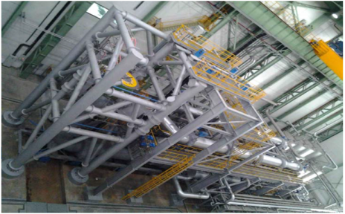




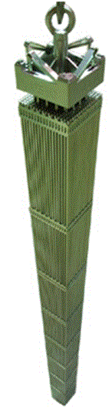
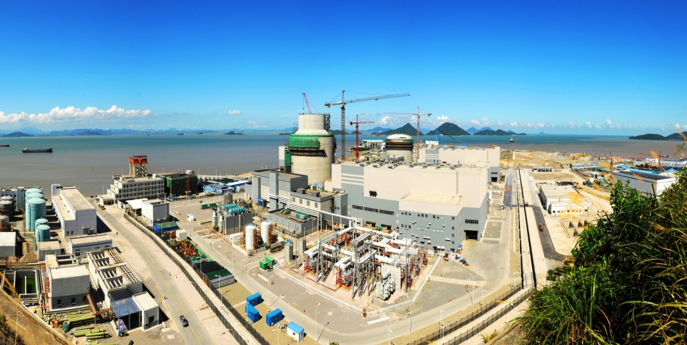
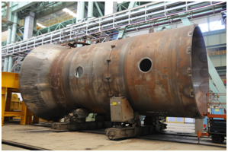
China Nuclear Power Development Capability
NPP
Regulation
R&D
O&M
Fuel supply
Construction
Manufacture
CP300, CP600,
CP1000, ACP1000, ACPR1000,
CAP1000, CAP1400
Hualong 1, HGTR, ……….
-6-
Notes:
强化核电行政管理和研发机构
改组能源局，新设核电司
大规模扩编核安全局与核与辐射安全中心
高规格重组 中科院核安全技术研究所，专攻基础、理论和应用深度研究

Slide 7
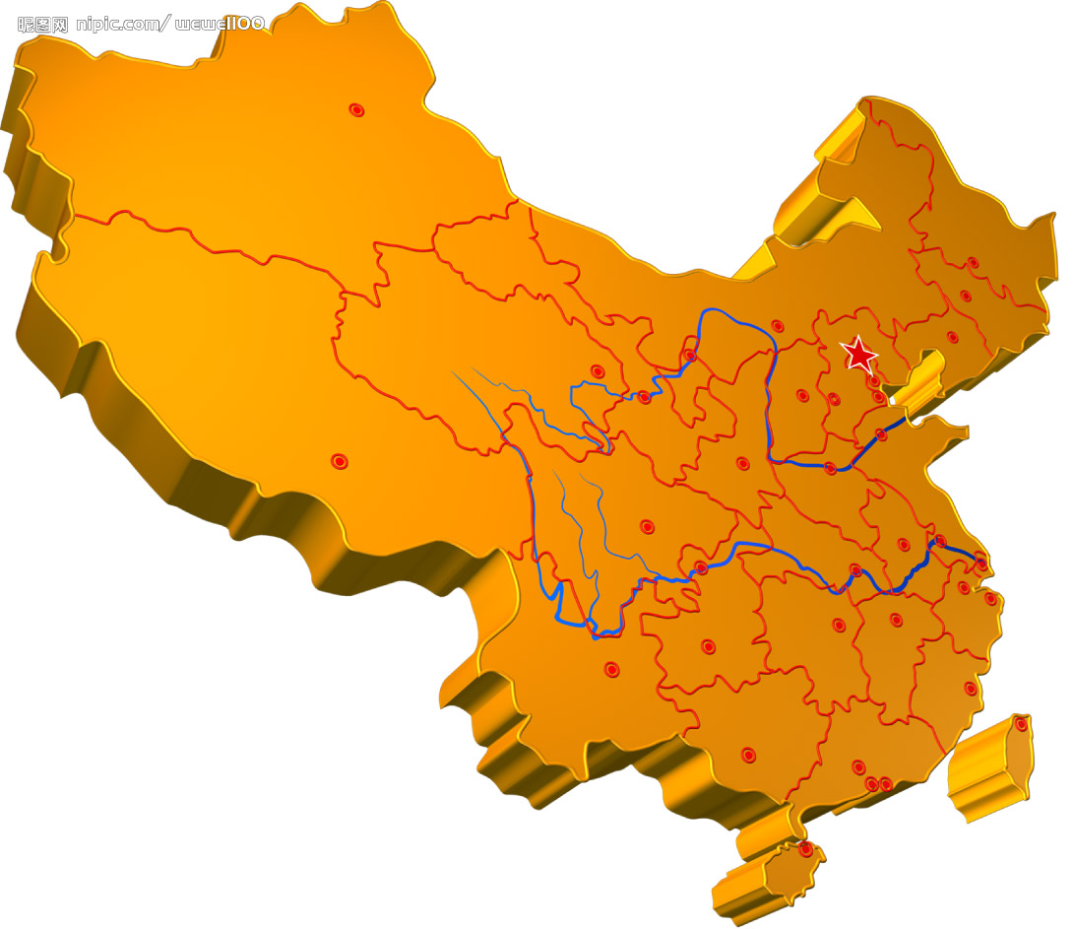
SNPTC: State Nuclear Power Technology Company
SNPTC have 14 subsidary corporations。
SNPTC covers R&D, NPP design, NPP EPC, Key equipment Manufacture, NPP O&M, Lifetime service, Fuel, etc..
SNPTC Provides Design, EPC, Maintenance for conventional electrical power and new energy.
中核包头燃料元件股份有限公司（参股） CBNF（share holding）
公司总部 Headquarters
国核电力院 SNPDRI
国核研发中心 R&D Center
国核软件中心 Software Center
国核大学 SNP Univ.
国核服务 SWSC
工程设计
Design
设备制造
Manufacture
工程管理
EPC
运行服务
Service
研究开发
R&D
国核山东院 SDEPCI
国核山东核设备厂 SNPEMC
国核示范工程 SNPDP
国核锆业SNZ
国家能源核级锆材研发中心
Zirc Research Center
上海核工院 SNERDI
国核工程公司SNPEC
国核自仪 SNPAS
国核运行服务公司 SNPSC
湖南核电有限公司（参股）
Hunan Nuclear Power Company（share holding）

Slide 8
Human Resource
    SNPTC employees has reached about 9000.
    Among them,
    中高级技术人才为主体,占56%；
    Mid and high technical staff 56%
    高学历员工为主体,本科及以上学历占87%；
    Bachelor degree and above 87%
-8-

Slide 9
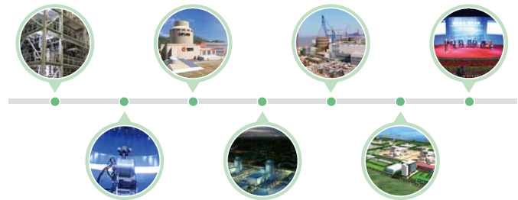

SNPTC’s technology Capability
科研创新能力
R&D
工程设计能力
Engineering
工程建设管理能力
Construction Management
合格供应商体系
Qualified Suppliers
Industrial System
寿期服务能力
Life Service
电站运行能力
Plant Operation
核电标准体系
Standard System
产业基础I ndustrial Base
技术平台Technical Platform
试验验证平台
Test and Verification
软件开发平台
Software
设备材料鉴定平台EQ
燃料开发平台
Fuel R&D
技术经济平台 Economics

Slide 10

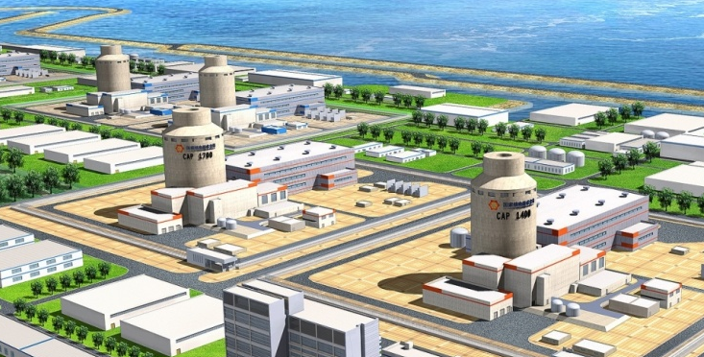
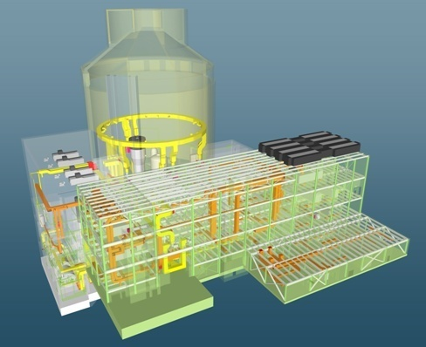
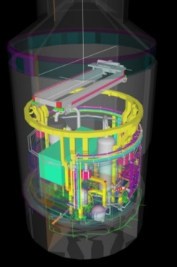
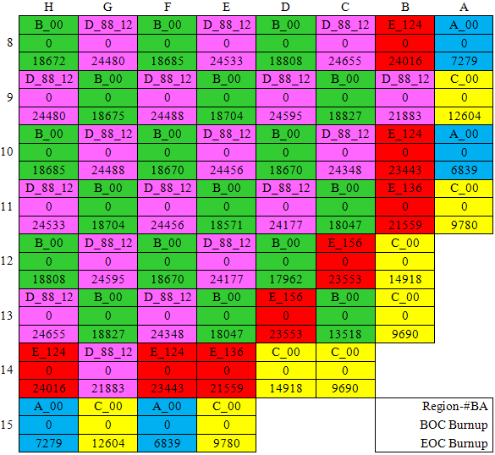
七个方面的产业基础 7 Industrial Bases
科研开发
R&D Innovation
国核北京研究院
CAP1400
CAP1700
小型模块化反应堆 SMR
第四代核电技术 G4 NPP Technology
10

Slide 11
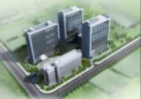
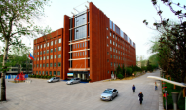
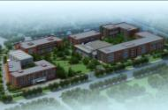
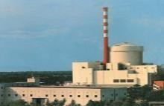
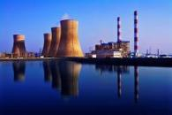


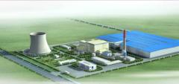
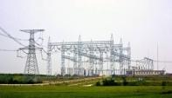
七个方面的产业基础 7 Industrial Bases
上海院
工程设计
Engineering
CAP1000电厂设计
CAP1000Full Plant Design
CAP1400电厂设计
CAP1400 Full Plant Design
其他 Others
山东院
国核院
核电 Nuclear
火电 Thermal
风能 Wind
太阳能 Solar
生物质 Bio
电网 Grid
11

Slide 12
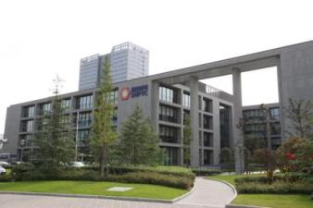

七个方面的产业基础 7 Industrial Bases
工程建设
Project Construction
国核工程
三代核电总承包管理体系和能力
EPC Capability for Gen III NP Projects
火电总承包能力
EPC Capability for Thermal Power Projects
新能源总承包能力
EPC Capability for New Energy Projects
12

Slide 13
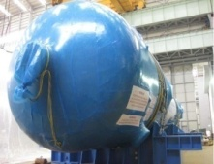
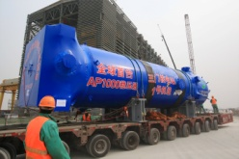
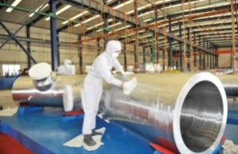
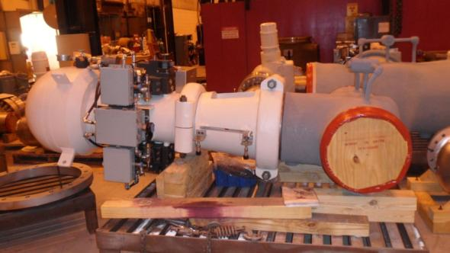
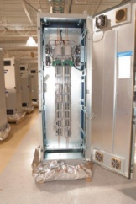
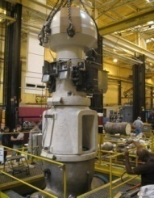
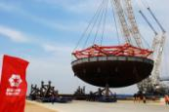
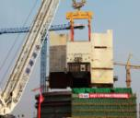
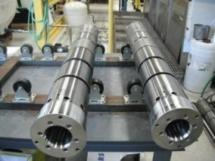
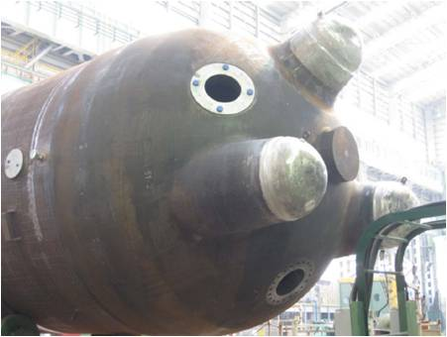
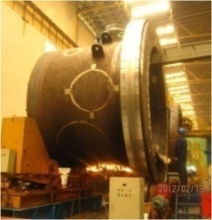
七个方面的产业基础 7 Industrial Bases
合格供应商体系
Qualified Supplier System
More than 700 qualified suppliers were certified
Gen III NP supply chain could support 6-8 AP/CAP units annually.
2-5 suppliers for each key equipment
13

Slide 14

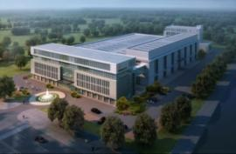





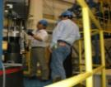
七个方面的产业基础 7 Industrial Bases
电站寿期服务
Plant Life Service
国核运行
在役和役前检查 Pre/In-service Inspection
CV性能验证 CV Performance Test
换料服务 Refueling
寿命评估和老化管理 Life & Aging Management
特种维修 Special Repair
14

Slide 15
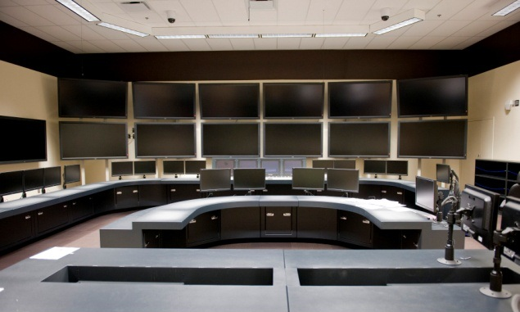
七个方面的产业基础 7 Industrial Bases
电站运行
Plant Operation
首批AP1000机组调试
Commissioning of First AP1000 Units
CAP1400示范电站运营管理
Operation & Management of CAP1400 Plant
AP1000模拟机
15

Slide 16
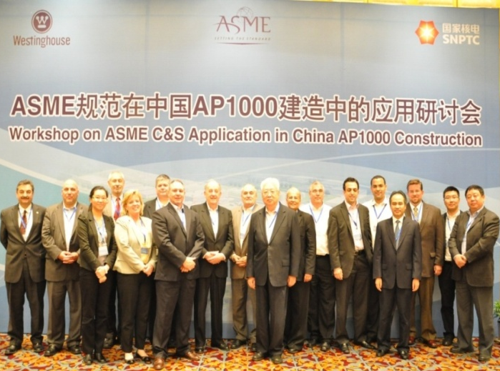

七个方面的产业基础 7 Industrial Bases
核电标准体系
NP Standard System
牵头建立ASME中国国际工作组，最终目标建立中国先进核电标准体系.
Leading ASME CIWG to set up China’s own advanced NP standards and codes system.
16

Slide 17
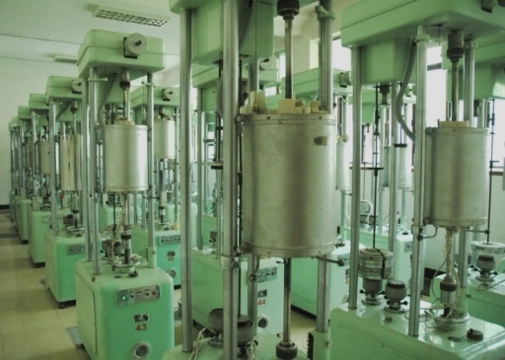
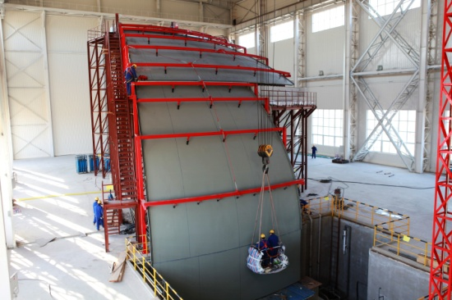
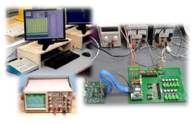
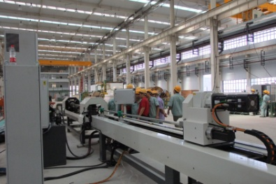
五个方面的技术平台 5 Technical Platforms
试验验证平台
Test and Verification Platform
软件开发平台
Software Development Platform
设备材料鉴定平台
EQ Platform
燃料研发平台
Fuel R&D Platform
技术经济研究平台
Economic Research Platform
17

Slide 18
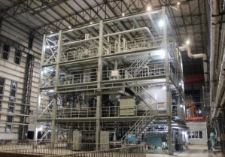
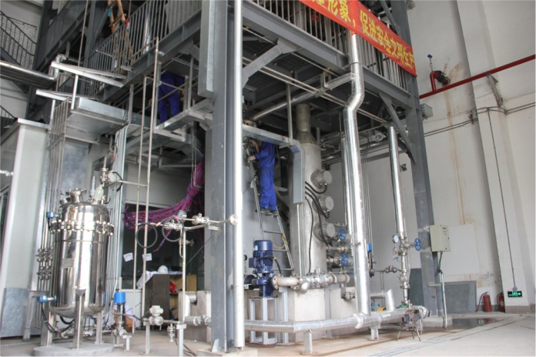
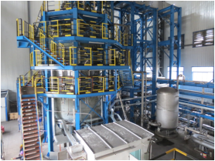
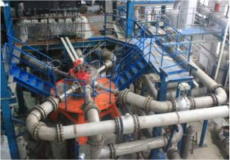
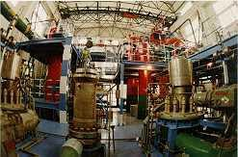
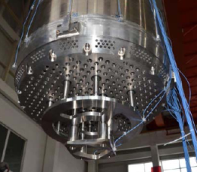
五个方面的技术平台 5 Technical Platforms
Gen III Passive NP Technology Test and Verification Platform
Based on 6 CAP1400 test and verification facilities.
ACME
（Qinghua university）
IVR （Shanghai Jiaotong University）
CERT tests
（kaifeng Plant）
Hydraulic Simulation test
（NPIC/CNNC）
SG hot performance test
（Rinpo/CNNC）
FIV test（NPIC/CNNC）

Slide 19
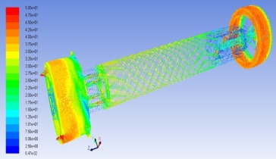
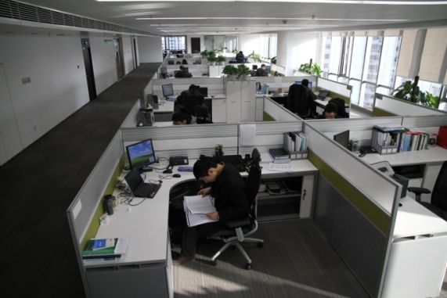
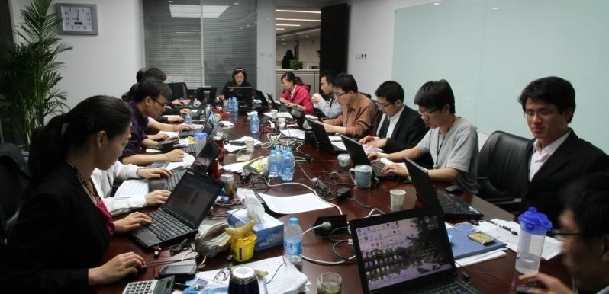
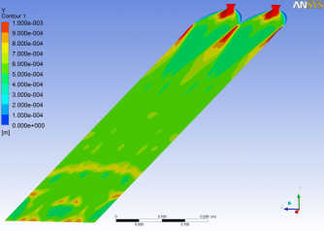
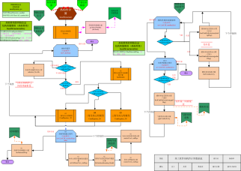
五个方面的技术平台 5 Technical Platforms
软件开发平台
Software Development Platform
核电设计软件 NP engineering software
运行支持软件 Operation support software
先进数值模拟技术 Advanced numerical simulation technology
19

Slide 20








五个方面的技术平台 5 Technical Platforms
设备材料鉴定平台
EQ Platform
核电设备材料鉴定中心。
NEQ
20

Slide 21






五个方面的技术平台 5 Technical Platforms
燃料元件包壳材料研发平台
Fuel R&D Platform
Fuel R&D and design
Manufacturing technology of fuel cladding
R&D of SiC and other nonmetallic materials for fuel

Slide 22




五个方面的技术平台 5 Technical Platforms
技术经济研究平台
Technical Economic Research Platform
三代核电成本与电价、财税保险等产业政策、三代核电技术经济标准和建设定额等
Cost and pricing of Gen III NP, taxation and fiscal policies, economic standards and construction norms etc

Slide 23



  CAP1400 Nuclear Power Plant
  Based on AP1000
  Passive Safety Feature
  Verified and Validated
  Complete Intellect Property
23 / 33

Slide 24
R&D innovation: CAP1400 Development
1.AP1000引进技术消化吸收
AP1000 TT
4.关键设备材料及共性技术
Key Equipment, Material& Tech
2.CAP1400技术研发
CAP1400 Development
压水堆
重大专项
PWR LPP
3.CAP1700技术预研
CAP1700 pre-study
5.条件保障
Guarantee of conditions
中国30多年压水堆研发设计、建设和运行经验
30 years of PWR R&D, construction& operation experience of China
安全性、可靠性进一步提升
Safer & More Reliable
CAP1400
世界首批AP1000机组建设中积累的经验和教训
Lessons learned in the FOAK AP1000 construction
基于日本福岛核事故的核安全裕度增强措施
Nuclear safety enhancement measures based on Fukushima

Slide 25
Feature of CAP1400 NPP
Feature/Parameter | CAP1400
Thermal Power，MWt | 4040
Electric Power，Mwe | ~1500
TAVG of RCS，℃ | 304
Pressure of RCS，MPa(a) | 15.5
Number of Fuel Assembly | 193
Type of Fuel Assembly | CAP1400 type
Linear power density W/cm | 181
Type of SG | New Developed
Pressure of SG outlet MPa(a) | 6.02
Flow of SG(each loop) kg/s | 1122
Flow of RCP m3/h | 21642
DNBR Margin | >15%
25 / 33

Slide 26





Characteristics of CAP1400 NPP
    CAP1400, Based on AP1000 design, has all features of AP1000, and
    20%+ output than AP1000
    New configuration of the plant
    Enhance the RNS,CCWS,EWS,SFS.
    Enhance the capability after 72 hrs without human intervention
    Enhance the capability against extreme external events
    Enhance the Volume of containment
26

Slide 27
Characteristics of CAP1400 NPP
    CAP1400, Based on AP1000 design, has all features of AP1000, and
    Take a more reliable and more efficient containment venting and filtering system to ensure the integrity of containment after sever accident.
    Modified Reactor Internals
    Modified SG, Coolant piping, Squib valves
    Optimized waste system；
    Better human-machine interface& layout
    ………..
27

Slide 28
General Performance of CAP1400 NPP
  Safety performance
  Satisfy the international advanced nuclear-safety standard, achieving the advanced safety objective
  72 hours without operator action to sustain intact core and integral containment by adopting passive safety design;
  Over 15% reactor core thermal margin
  Core damage frequency less than 1.0×10⁻⁶/yr
  Large release frequency less than 1.0×10-7/yr
  Design base SSE 0.3g
28

Slide 29
General Performance of CAP1400 NPP
  Safety performance
  Occupational radiation expose dose less than 1.0 person•Sv/yr
  Super capability against Blackout and other External Events by adopting mobile power and pumps
  Resistance to a commercial aircraft impact
  Containment integrity after severe accident kept by combination of IVR, Hydrogen control and Containment Venting and Filtering System.
  Minimization of the radioactive waste by Optimized radioactive waste handling system
29

Slide 30
General Performance of CAP1400 NPP
  Economy performance
  High Capacity : ~1500MWe(gross)
  High Availability: 60 years lifetime, 93% unit target availability
  Shorter construction period: Parallel construction by modularization
  Simplification: Less components( Piping/Cable/Valve)
  Localization: Key equipment and material localized
  Standardization : standard Design for batch construction
  Competition: Decrease the construction price
30

Slide 31

Specific Features of CAP1400 NPP
Passive feature design
  Passive containment cooling system
  Passive Residual Heat Removal System:
  Passive Safety Injection System: CMT, ACC, IRWST
  Additional Passive Hydrogen Recombiner
  Passive MCR Emergency Habitability System
  Automatic Depressurization Subsystem: ADS1-3, ADS4

Slide 32

Specific Features of CAP1400 NPP
Passive containment cooling system
Remove the heat through the steel containment wall by water spraying and natural air circulation.
during an accident, the PCS condenses steam inside containment, which provides a constant source of long-term make-up to the Reactor Coolant System.
72 hr water supply of PCCWST and 4 days of PCCAWST.
Movable water pump and alternative water source are considered for long-term cooling in some BDBA.

Slide 33

Specific Features of CAP1400 NPP
In-Vessel Retention (IVR)
IVR retains the core debris inside the vessel and remove the core heat through the vessel wall by natural water circulation in case of unlikely core damage events.
The reactor internals are optimized designed, to assure the IVR margin

Slide 34


Specific Features of CAP1400 NPP
Hydrogen Control
Hydrogen Concentration Monitoring Subsystem,
Hydrogen Recombination Subsystem,
Hydrogen Ignition Subsystem.
Additional Passive Auto-catalytic Hydrogen Recombiner

Slide 35
Specific Features of CAP1400 NPP
Enhancement of Safety Margin
The PXS tanks/piping/valves is with the bigger margin. ADS4 Valve is designed as 18 inch.
The steel containment of CAP1400 is with bigger margin in the free volume.
The pumps, valves, piping and supports of ESWS, CCWS, RNRS and Spent Fuel Pool Cooling System are enhanced.
Containment Capability
Term | CAP1400 Value
Designed Internal Pressure | 0.443MPa
Deterministic Severe Accident Capacity | 0.832MPa
Maximum Pressure Capability | 0.946MPa

Slide 36
Specific Features of CAP1400 NPP
Enhancement of Safety Margin
— Against External Events
Safety Shutdown Earthquake (SSE) for Safety-related SSC, and the Peak Ground Acceleration (PGA) is 0.3g.
Seismic margin assessment is also considered, that is, HCLPF activity level shall be no less than 0.5g ( failure probability less than 5% with 95% confidence).
Plant layout satisfies “Dry Site” Criterion: site drainage system is designed for the storm of once of 1000 years, and assessed by the maximum rain.
A lot of measures are taken in design to prevent the internal flooding.

Slide 37


CAP1400 Project Progress in China
烟台市
直线距离111公里
直线距离98公里
石岛湾
直线距离127公里
海阳
直线距离217公里
青岛市
2014，Bird`s-Eye View
37

Slide 38





CAP1400 Project Progress in China
CAP1400 Site
NI
CVBH
NI Steel Binding
CA20 Assembly
Module

Slide 39

Prospect of SNPTC
    1. fundamental R&D for nuclear power
    Key materials, I&C, Advanced fuel design, etc.
    Verification and Validation platform for advanced NP technology Based on CAP1400 six major test facilities.
    2. Software development
    Taking COSINE software as the leading products, to establish a nuclear power software system which covers nuclear power plant lifetime.
    3. New NPP design
    CAP1000 and CAP1400 standard design
    CAP1700 development
    Gen 4 NP technology development,
    including MSR, TWR, Fast Reactor, HTGCR,
39

Slide 40

Prospect of SNPTC
    4. Engineering Management
    Based on the experience from AP1000, CAP1400 Projects, to establish systematic, high efficient and advanced Passive
    NPP engineering management system.
    5. Lifetime Service
    Full capability to serve all lifetime of the NPPs
    Key supplier of resolution for NPP complex issues
    6. Supplier System
    A complete Gen 3 Nuclear Power Qualified Supplier
    System for whole plant equipment and component
    of AP/CAP NPPS.
40

Slide 41

International Cooperation
    Closely cooperate with WEC for enhancement of passive NPP technology and for global market.
    Cooperate with the organizations and institutes around the world on R&D of nuclear power technology.
    Cooperate with ASME, IEEE and the other international organizations for better use and participation in international code and standards.
    Actively participate in international activities related with nuclear power technology.
41

Slide 42



International Cooperation
    Establish the platform for international industry to share our experience and knowledge from Gen 3 AP1000 and CAP1400 projects.
    Provide assistance to the newcomer of nuclear power, including training, joint research, etc.
    Actively participate in global nuclear power market, including EPC of NPPs, equipment supply, lifetime service, EQ, technology cooperation, etc.
42

Slide 43



结语 Conclusion
SNPTC has a sound capability for nuclear power technology development and abundant advanced NPP engineering and construction experience. We are looking forward to enhancing international cooperation and to making greater contribution to the nuclear industry.

Slide 44







Thanks!

