Slide 1
Small Module Rectors: Advantages and Future
Nucleon Consulting

Slide 2
Small Module Reactors
What they are?
Small
From 2 to 300 MWe
Module
All active equipment in one module
Reactors
Different technologies: thermal and fast neutrons, molten salt reactors, high temperature reactors

Slide 3
Small Module Reactors
Where are they coming from?
Aircraft carriers
Submarines
Icebreakers

Slide 4
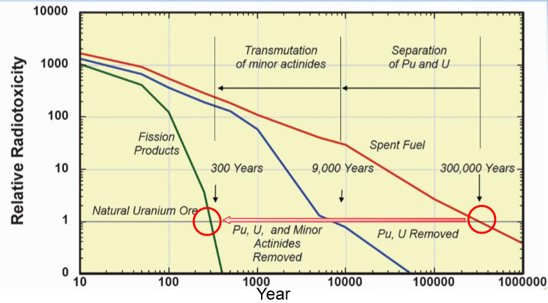
Small Module Reactors
Advantages
Security
Passive cooling and protection
Few parts to fail
Ambient pressure in the reactor
No LOCA and fuel melt down
Burning spent nuclear fuel

Slide 5
Small Module Reactors
Advantages
Manageable Investments
Small initial funds
Short construction schedules
Incremental increase
Serial production
Low cost per installed kWe

Slide 6
Small Module Reactors
Advantages
Operating
Load following
No large backup power is required
Low operating costs

Slide 7
Small Module Reactors
Advantages
New Markets
District heating
Hydrogen production
Desalination of sea water
Backup power for RES
Heat source in chemical plants

Slide 8
Small Module Reactors
Future
Project statuses around the globe
Licensing: one PWR is South Korea, one FNR in USA ready to be licensed, licensed sites for FNRs in Russia and Romania
Detailed technical drawings and testing: one FNR in Russia, one PWR in USA, one FNR in Japan, and one PWR in China
In construction: one HTR in China, one PWR in Russia, and one PWR in Argentina
Concepts: more than 60 projects for all type of reactors around the world

Slide 9
Small Module Reactors
Future
Obstacles
No suitable regulatory environment

Slide 10
SMR have huge potential to reshape the nuclear industry and restart the Nuclear Renaissance

Slide 11
Thank you!
Nucleon Consulting
www.nucleon.info
iordanov@nucleon.info
yankov@nucleon.info

