Slide 1
Poland’s First Nuclear Plant – History and Status Quo
dr Andrzej Błach Partner
„Nuclear Energy on Liberalized Energy Markets: Technology, Financing, Planning”
Sofia, 26-27 March 2015

Slide 2
Nuclear Energy in Poland – Last Century
1971:
a decision to build a 1600 MW four-unit NPP at Żarnowiec Lake (Pomerania) (WWER-440)
Overall plan called for 10(!) nuclear reactors; relevant locations were chosen
1982:
Construction commenced
50 companies, 6.5 thousand people employed
Plant scheduled to open in 1991

Slide 3
Nuclear Energy in Poland – History (Dis)continued
16 April 1986:
Chernobyl disaster
Poland still under Communist regime: no immediate response
4 September 1990:
Project discontinued: environmentalists and celebrities (including Lech Wałęsa) strongly opposing the plant
Official Government position:
„Żarnowiec NPP will be unnecessary for the Polish power system for the next 10-20 years, and even after such time there is no certainty that nuclear energy generation would be needed”
One of the reactors sold to Finland (Lovissa), another used in a training centre in Hungary...
Poland left with a construction site covering hundreds of hectares

Slide 4
Nuclear Energy in Poland – Revival
2009:
The Government decides to re-start nuclear energy program with an aim to have an NPP operational by 2020.
PGE S.A. (the largest utility Polish power generator and the largest utility) chosen as the main investor
A special Government Plenipotentiary for Nuclear Energy appointed
A multi-year time schedule adopted
A EPC contract to be concluded by 31 December 2013
Design to be ready by 31 December 2015
Commencement of construction by 1 January 2016

Slide 5
Nuclear Energy in Poland – Revival
Memoranda regarding cooperation signed by PGE
with EDF (November 2009)
with GE Hitachi Nuclear Energy (March 2010)
with Westinghouse (April 2010)
with Chugoku Electric Power Company (partially related to nuclear)(May 2010)

Slide 6
Investment Vehicle; Co-investors
2009: PGE Energia Jądrowa registered to coordinate nuclear efforts within the PGE group
2010: PGE EJ1 sp z .o.o. (a limited liability company) registered to act as a direct developer of the first Polish NPP
2013: PGE Energia Jądrowa merged with PGE
2014: the following shareholding structure is approved by the Polish Antimonopoly Office
PGE – 70%
Tauron (the second largest utility) – 10%
ENEA (the third largest utility) – 10%
KGHM (leading copper producer) – 10%

Slide 7
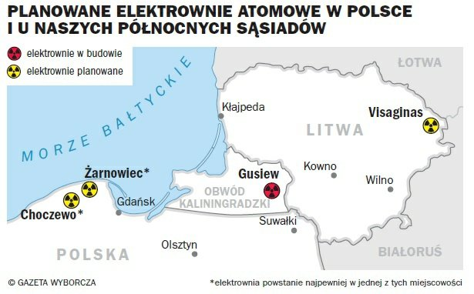
Possible Locations

Slide 8
Site Characterization, Licensing and Permitting
WorleyParsons
Chosen in August 2013
Contract value of PLN 252 mln
Contract terminated in December 2014 „due to improper performance of its obligations by WorleyParsons
According to PGE EJ only a couple of months delay
PGE to continue studies on its own
Reasons for „divorce”?

Slide 9
Owner’s Engineer
AMEC
Signed in September 2014
Initial contract value: GBP 39 million
If optional work undertaken: GBP 255 million
In the tender AMEC assisted by CMS Poland

Slide 10
Legal Advisor
Previous tender (public procurement) cancelled
New tender for Project lawyers commenced by PGE (on behalf of EJ1) in February 2015
Very complex tender requirements

Slide 11
General Contracting Concept
Integrated procedure (one tender for the following):
Delivery of reactor technology
Engineering, Procurement and Construction services
Operation and Maintenance support
Debt financing package including ECAs’ commitments
Fuel supply (long term)
Equity involvement
Energy offtake (?!?)
Is this realistic???

Slide 12
Financing concept
Role of the State Budget?
Support Mechanism
Hinckley Point C – type „investment contract” – contract for differences
Export Credit Agencies
Expectations as to equity financing

Slide 13
Legal Environment
Atomic Law
Adopted in 2000 but based largely on 1986 legislation
Most recent amendment in 2014 – incorporates European regulations on nuclear waste management and disposal
A special NPP law (2011)
What is regulated
Does anybody need a special purpose law?
Key secondary legislation in place

Slide 14
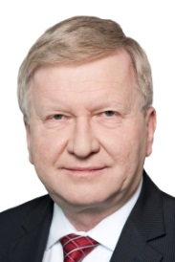
Thank you
dr Andrzej Błach
Partner
T +48 22 520 55 09
E andrzej.blach@cms-cmck.com

