Slide 1
NIKOPOL-TURNU MAGURELE and GORNA ARDA HYDROPOWER PROJECT
STATUS AND PRELIMINARY PROJECT CHARACTERISTICS
Dimitar Popov/ Georgi Evstatiev
by Dimitar Popov
Executive Director of
Sweco Energoproekt

Slide 2
Nikopol-Turnu Magurele Hydrotechnical Complex
Danube River Importance
European development of the river
Project multifunctionality
Gorna Arda Hydropower Project
Project history
Complex economic and social effect

Slide 3
Nikopol-Turnu Magurele Hydrotechnical Complex
The new opportunity 21 century

Slide 4
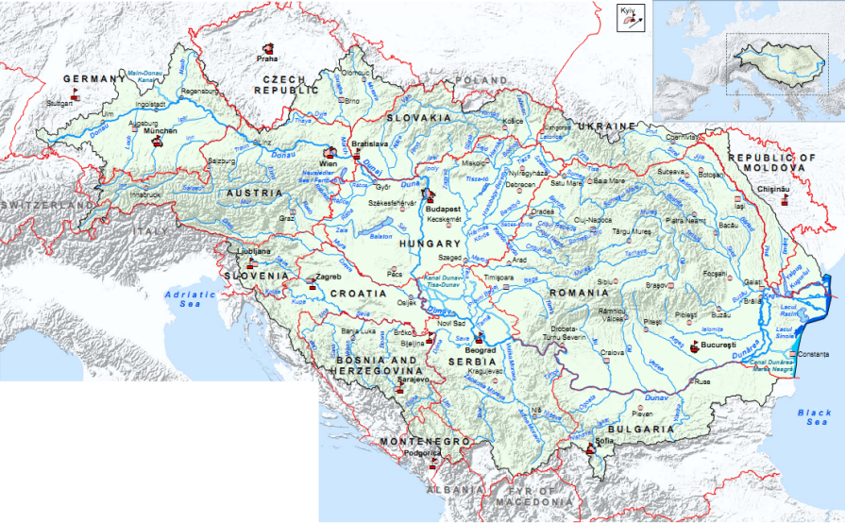
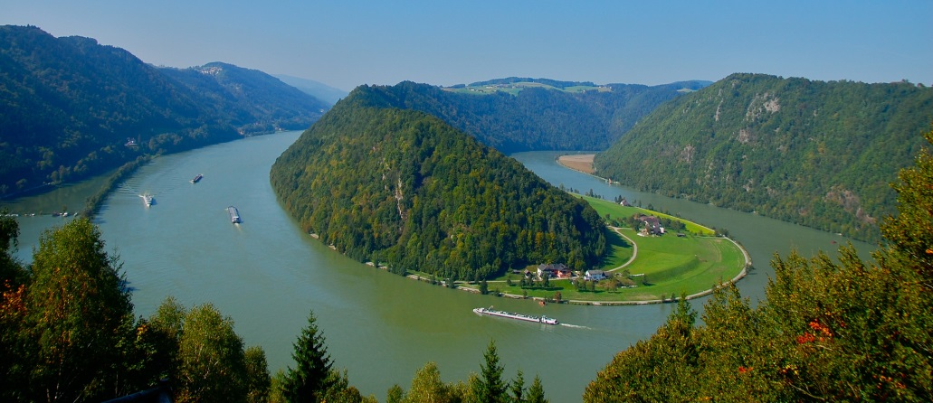
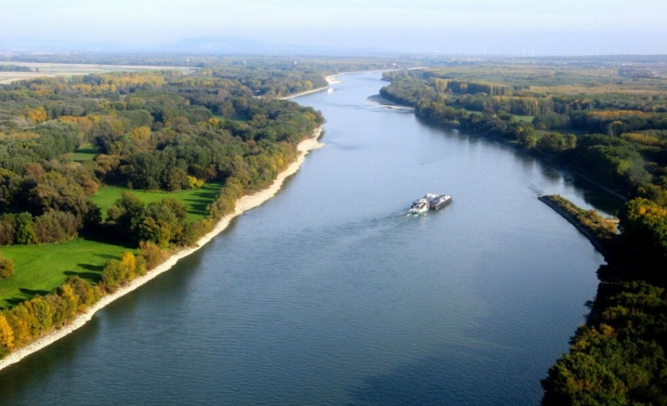
Danube River Importance
Danube River is second longest river in Europe – length 2857 km.
Danube River is the biggest international river in the world.
Danube springs from the Black Forest (el.1078) in Germany and flows into the Black Sea in Romania, as on his way it runs through 10 countries: Germany, Austria, Slovakia, Hungary, Croatia, Serbia, Bulgaria, Romania, Moldova and Ukraine.

Slide 5
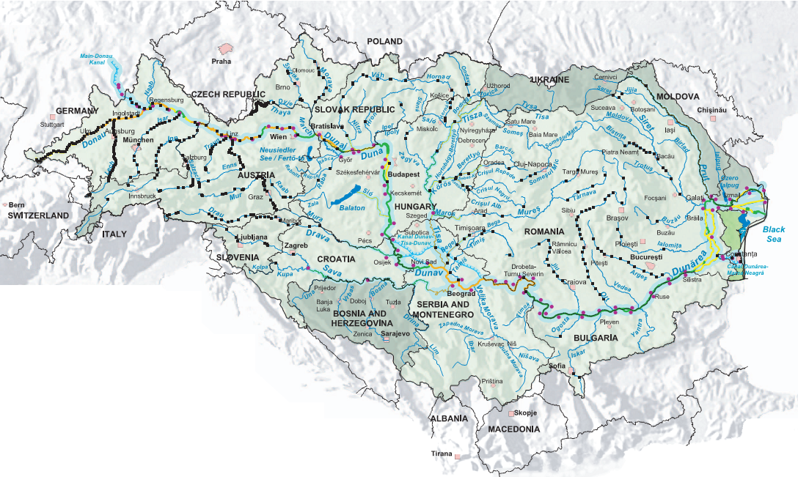
Danube River Importance
Along the upper river course (from springs to Bratislava, app. 1000 km) are built approximately 60 barrier structures, as 17 of them are hydrotechnical complexes. These structures, intended primarily for navigation, perform also many other functions.
River water is used for potable and industrial water supply, irrigation, fishing, tourism, power generation, inland navigation, etc.

Slide 6
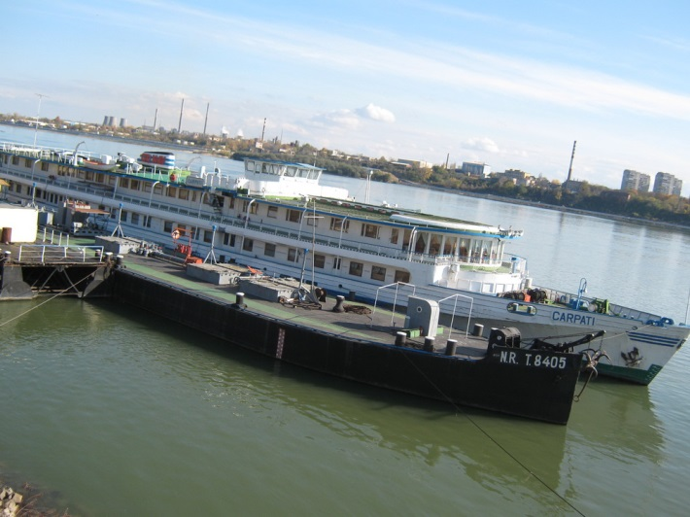
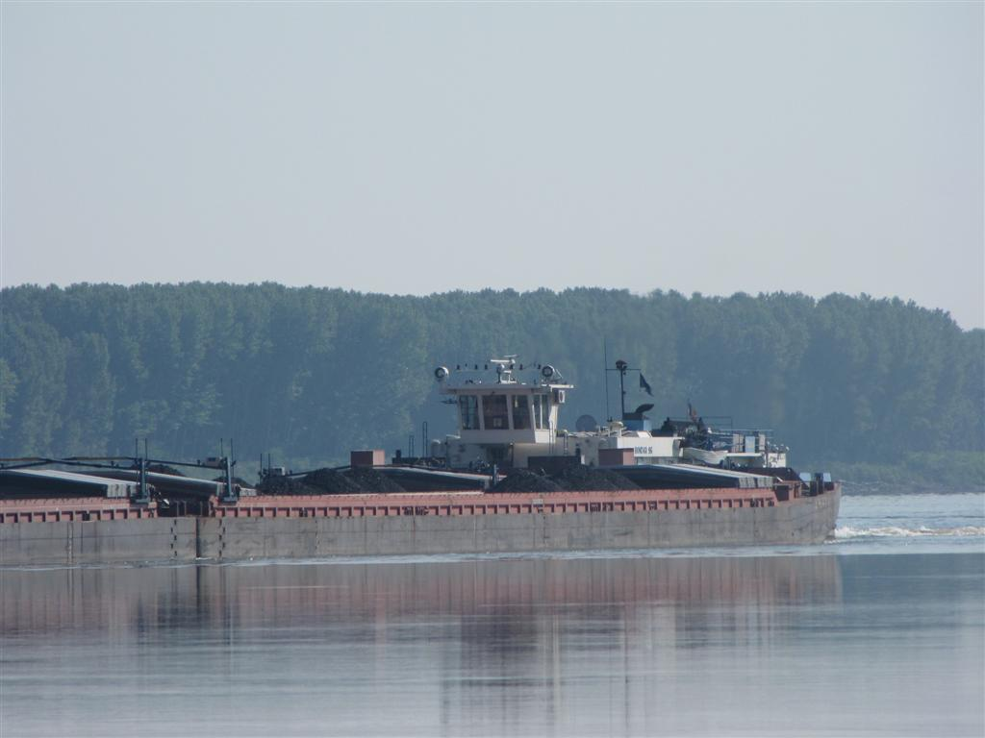
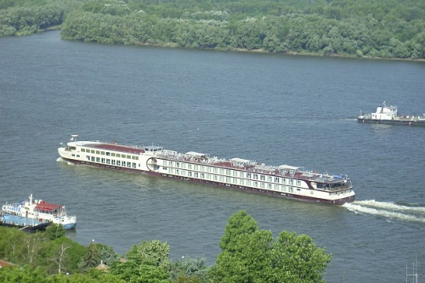
Danube River Importance
Navigation
Danube River is an important international waterway. River boats are able to move along the Danube River from km 2411 all the way down to the river delta - 87% of the total river length.
With the completion of the Rhine–Main–Danube Canal in 1992, the Danube became part of the trans-European waterway from Europe’s largest port of Rotterdam on the North Sea to Sulina on the Black Sea.

Slide 7
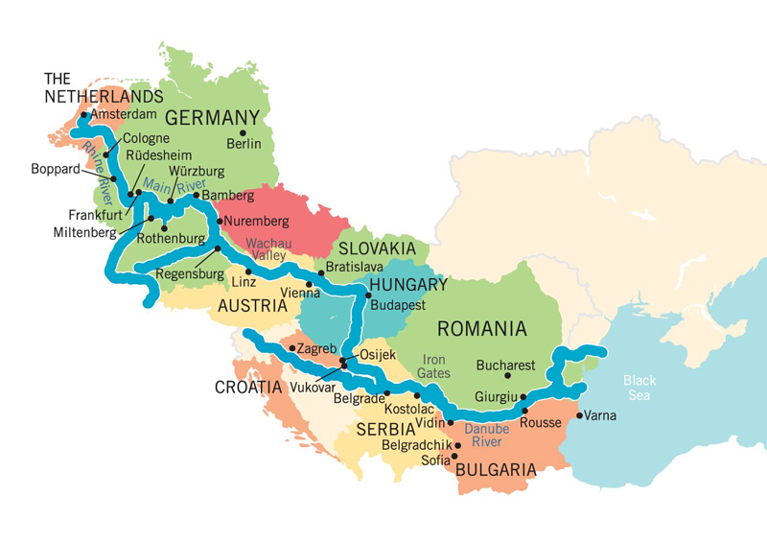
European development
Transport waterway corridor
To improve transport in Europe, the European Commission (EC) has developed the Trans-European Transport Networks (TEN-T)
In TEN-T Danube is designated as “Pan-European Transport Corridor VII”.
The guideline is this water corridor to become “the backbone of a waterway link between eastern and western Europe”, providing, along with Rhine River, a link between the North Sea and the Black Sea.

Slide 8
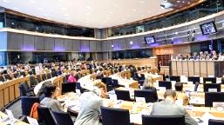
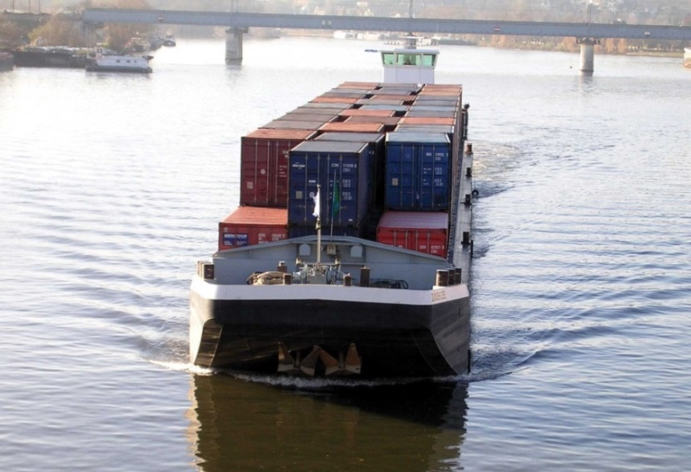
European development
Inland waterway transport is regulated by: Integrated European Action Programme for inland Waterway Transport - NAIADES.
NAIADES is focused on five strategic areas:
Infrastructure
Market
Fleet
Jobs and skills
Information exchange and sharing
Programme’s activities are carried out through the implementation platform PLATINA.
880 Mio EUR are foreseen from the Structural and Cohesion Funds in the programming period 2007 – 2013 for inland waterways.

Slide 9
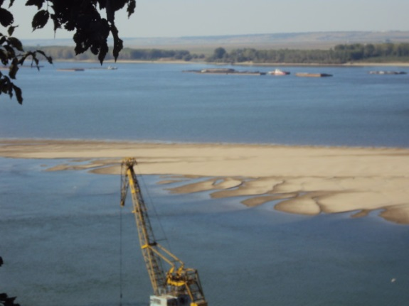
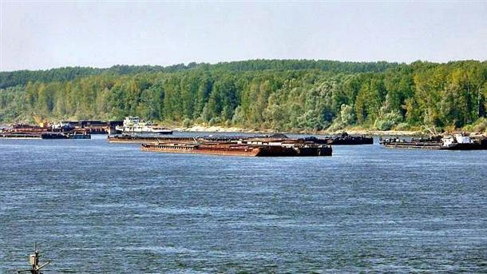
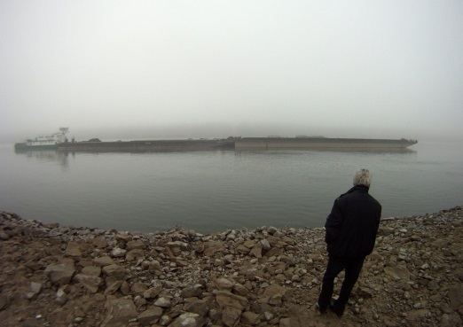
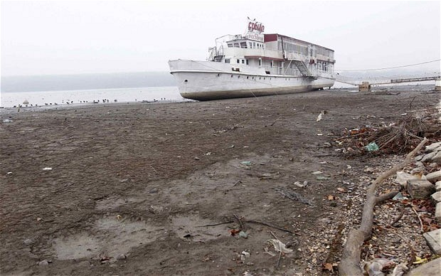
European development
Efficient use of inland waterways requires the elimination of existing bottlenecks. In the Bulgarian-Romanian section these are the river rapids.
According to the recommendation of the Danube Commission, the minimum water level, that is necessary to ensure normal navigation, is 2,50 m along the entire river length.
A complete solution of this problem, of the infrastructural problems, and an overall improvement of the area along the Bulgarian-Romanian Danube River section can be achieved through the building of two hydrotechnical complexes.

Slide 10
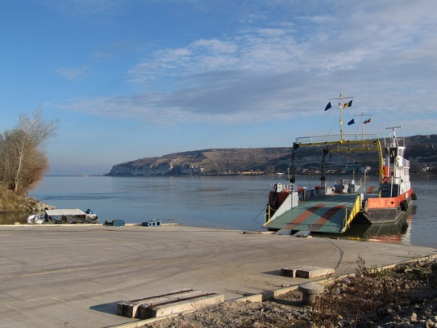
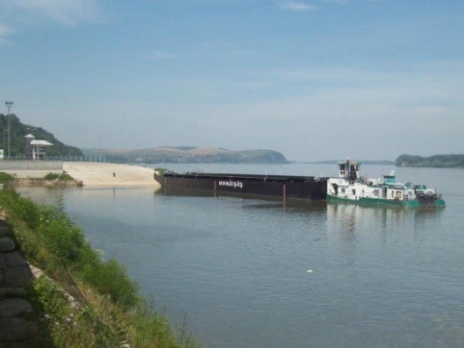
Nikopol – Turnu Magurele Hydrotechnical Complex
In the middle of river section (Nikopol – Turnu Magurele)
At the end of river section (Silistra – Calarasi)

Slide 11
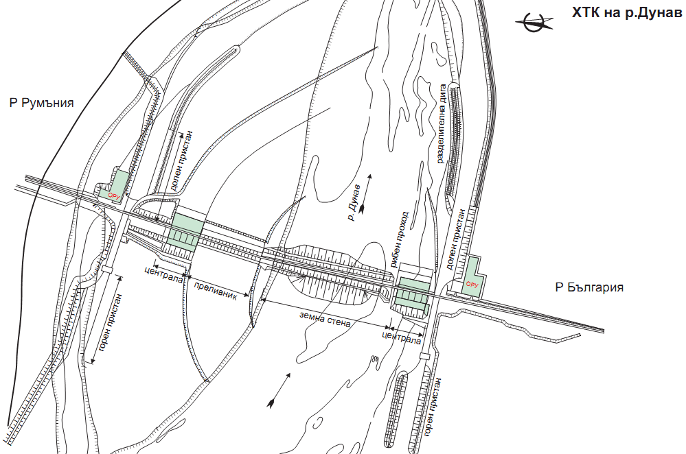
Nikopol – Turnu Magurele hydrotechnical complex
Hydrotechnical part: Power plant, lock, spillway with segment gates, earthfill dam and fish passage.
Infrastructure facilities: Railway infrastructure, road infrastructure, telecommunications, and power connections.

Slide 12
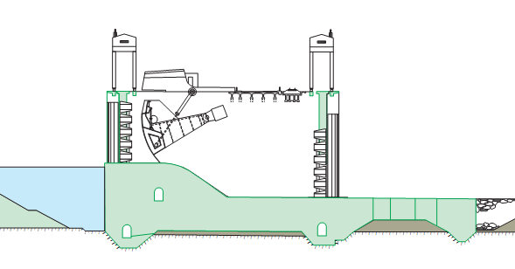
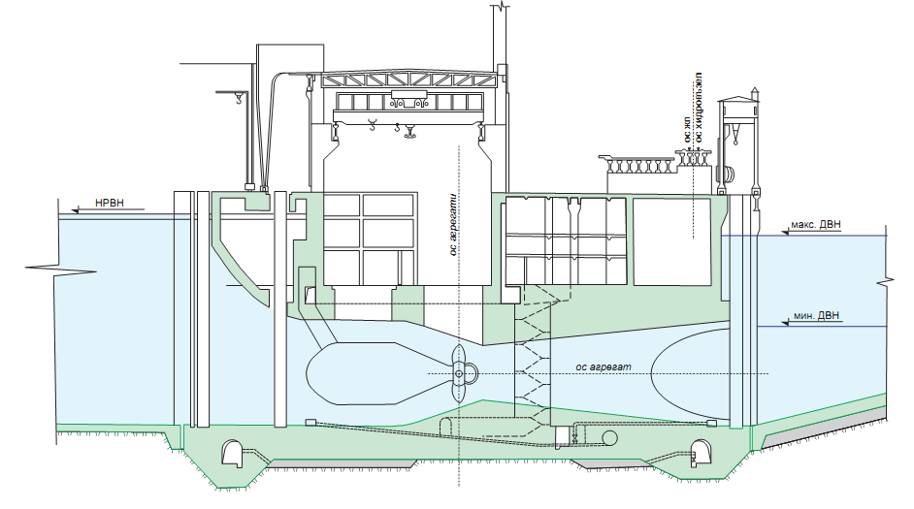
Nikopol – Turnu Magurele hydrotechnical complex
Main technical parameters
Spillway dam section
Reservoir length: 282 km
Average reservoir width: from 1.5 to 2.0 km
HPP
HPP installed capcity: 2 х 400 MW (possible 2 х 500 MW)
Turbines: 20 (22) nos. x 40 MW
Annual power generation: 2 х 2200 GWh

Slide 13
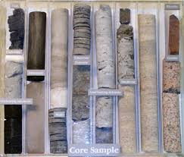
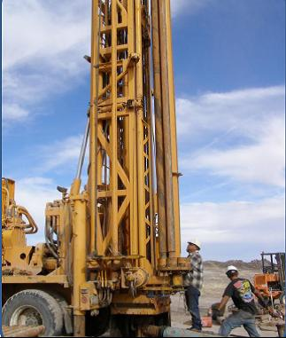
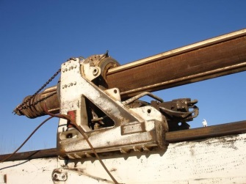
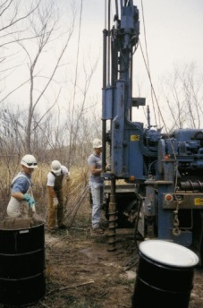
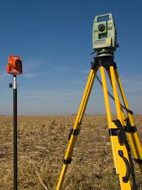
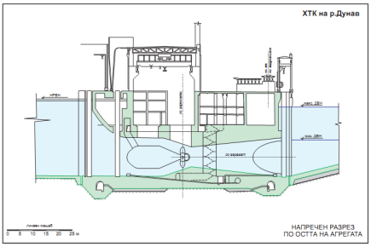
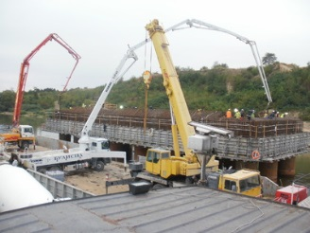
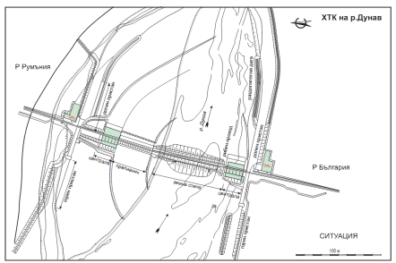
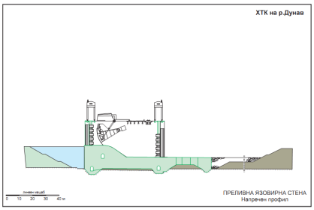
Nikopol – Turnu Magurele hydrotechnical complex
Current status
Geological surveys as well as relevant field studies have been performed up to the 80s of 20th century.
Basic Designs and partial Detailed Designs have been prepared together with the Romanian side.
Preliminary constructions works were started, mainly by the Romanian side – the 80s of 20th century.

Slide 14
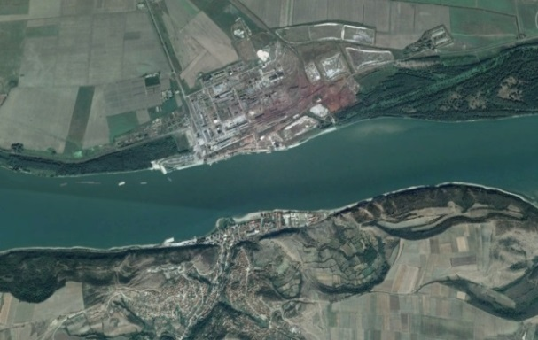
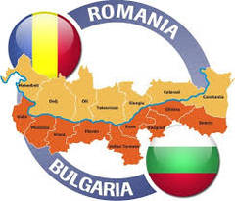
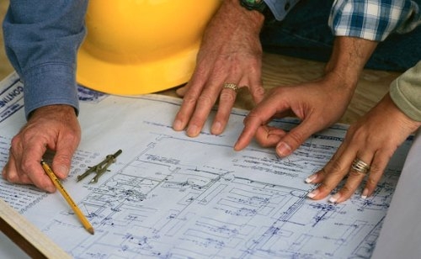
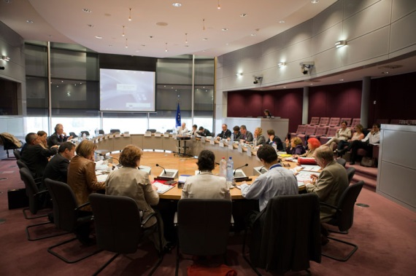
Nikopol – Turnu Magurele hydrotechnical complex
Development
Intensification of bilateral cooperation between Bulgaria and Romania.
Danube Strategy.
Overall re-evaluation of the project is required.

Slide 15
Nikopol – Turnu Magurele hydrotechnical complex
Financing
At present, the project has no defined value. In the public space are present prices from 1 - 2 billion to 3 - 3.5 billion EUR for the implementation of the whole project.
Financing sources
Financing could be sought once the project is clearly structured, as for this purpose multiple sources and mechanisms may be used.
TEN-T programmes
European Structural and Cohesion funds
Development of Danube River municipalities
Public-private partnership, etc.

Slide 16
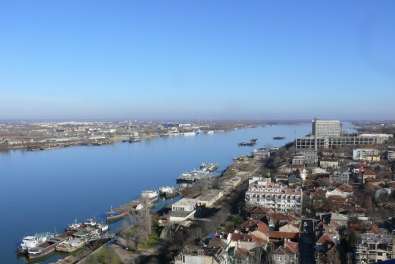
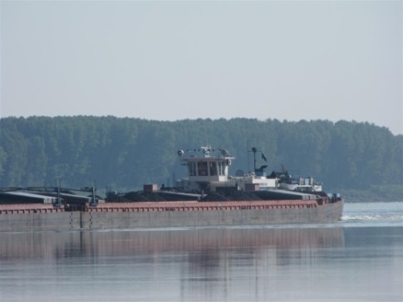
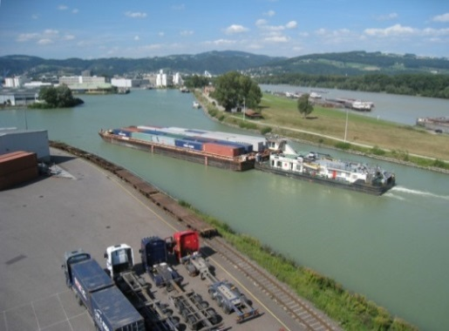
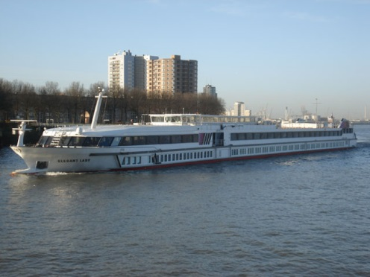
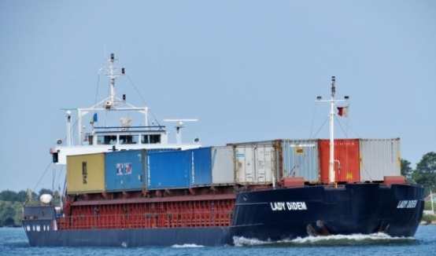
Nikopol – Turnu Magurele hydrotechnical complex
NAVIGATION?
Transport corridor, multimodal facilities

Slide 17
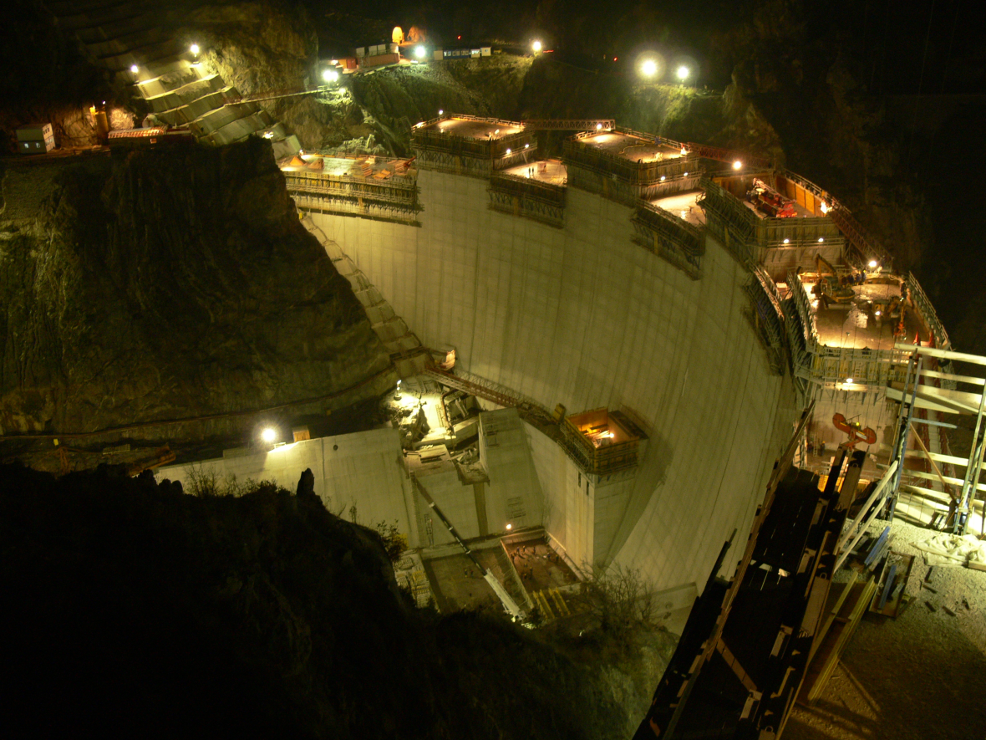
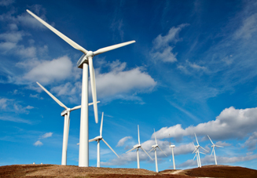
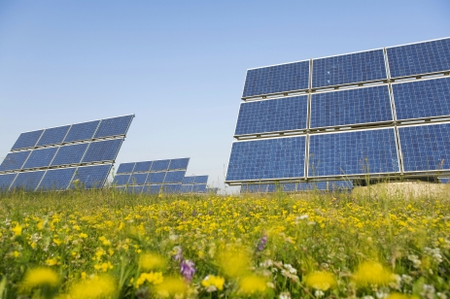
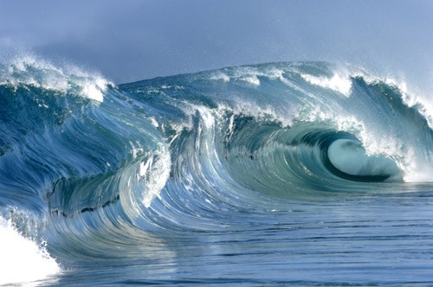
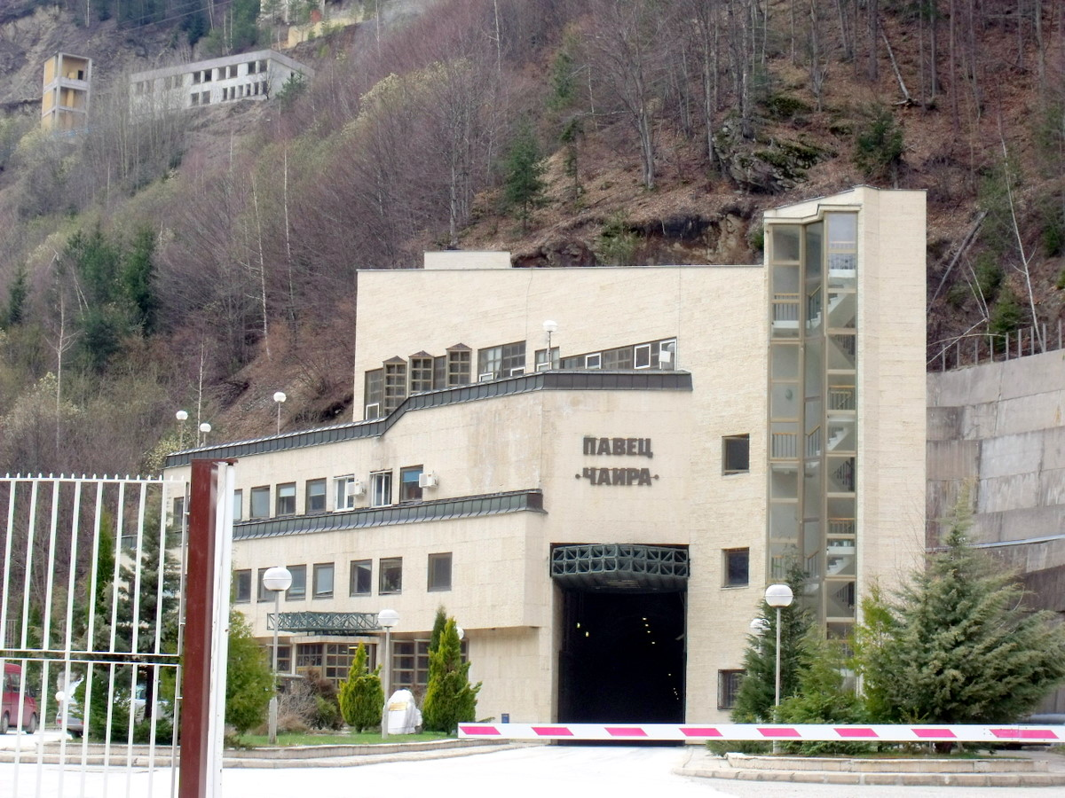
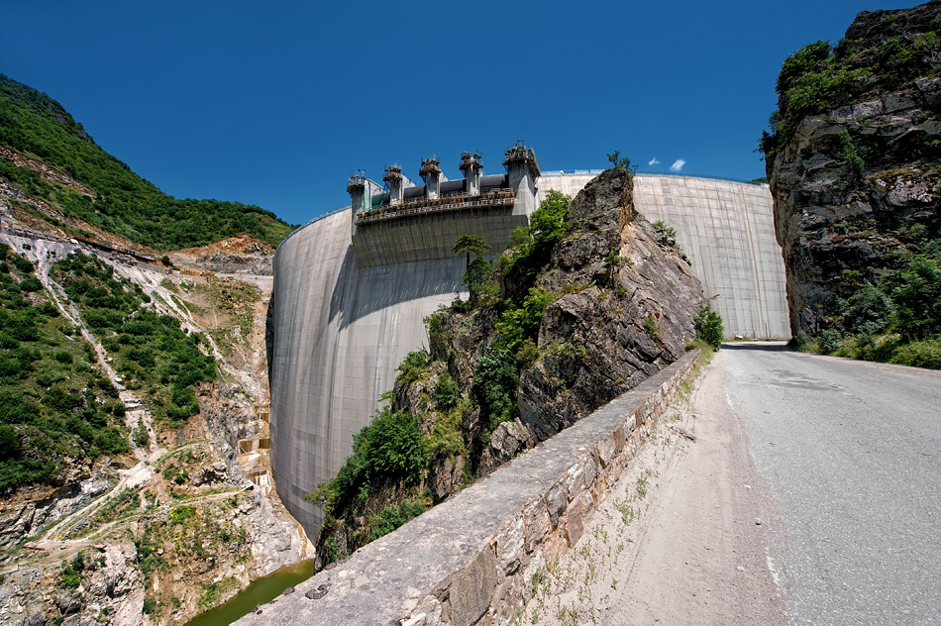
Nikopol – Turnu Magurele hydrotechnical complex
POWER? Renewable energy sources, fight against climate changes.

Slide 18
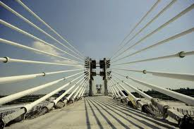
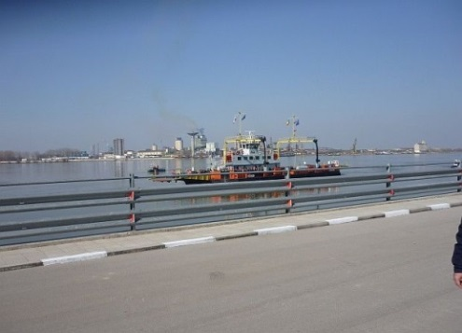
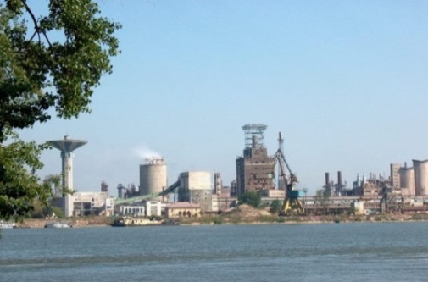
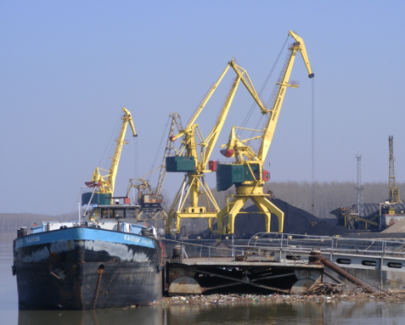
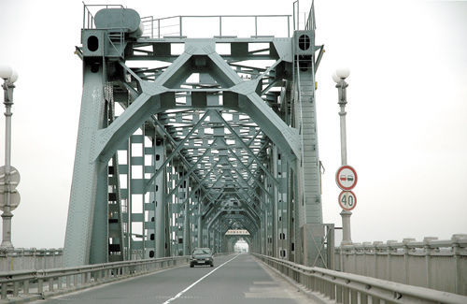
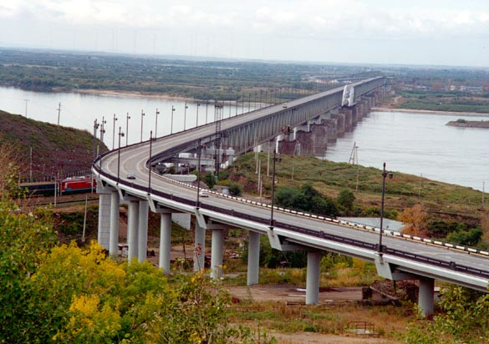
Nikopol – Turnu Magurele hydrotechnical complex
INFRASTRUCTURE? International and domestic transport links, modernization of 6 ports and 11 wharfs

Slide 19
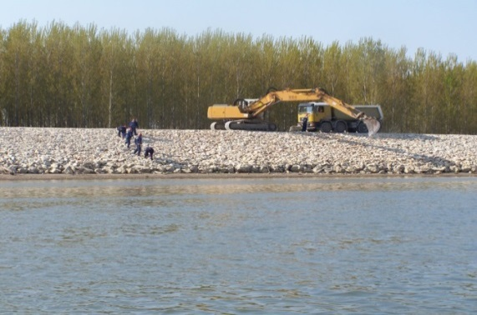
Nikopol – Turnu Magurele hydrotechnical complex
FLOOD PROTECTION?
New dikes along the river and its tributaries.
EROSION CONTROL?
River banks strengthening.

Slide 20
Nikopol – Turnu Magurele hydrotechnical complex
Tourism, Fishing, Sports, Water supply, and Irrigation?

Slide 21
Nikopol – Turnu Magurele hydrotechnical complex
SOCIAL ASPECTS:
New jobs (in thousands), overall development of the whole region, foreign investment in the renovated environment.

Slide 22
Nikopol – Turnu Magurele hydrotechnical complex
Complex economic and social project

Slide 23
Nikopol – Turnu Magurele hydrotechnical complex
Main impacts on environmental components
Positive effects
Reduction of carbon dioxide emissions.
Improving the state of dikes in Bulgarian and Romanian section of the Danube.
Reduction of floodplain areas in the Danube river terrace.
Power production from renewable energy sources.

Slide 24
Nikopol – Turnu Magurele hydrotechnical complex
Potential problems
Affecting the protected areas.
Rising up the groundwater level in adjacent areas outside the dikes.
Reduction of sediment influx in the Black Sea.
Re-activation of existing landslides.
Erosion processes along the lower course of Danube River
Freudenau Hydrotechnical complex, Vienna
Solving potential problems

Slide 25
Nikopol – Turnu Magurele hydrotechnical complex
Acquainting the public with the benefits of implementing a project of this size and scale.

Slide 26
Gorna Arda Cascade
Three-stage Scheme

Slide 27
ARDA CASCADE

Slide 28
Arda Cascade
Dolna Arda Cascade
Studen Kladenets Hydropower Project
Ivaylovgrad Hydropower Project
Kardzhali Hydropower Project
Gorna Arda Cascade
Madan Hydropower Project: Madan Reservoir and Bial Izvor HPP;
Ardino Hydropower Project: Ardino Reservoir and Ardino HPP;
Sarnitsa Hydropower Project: Sarnitsa Reservoir and Kitnitsa HPP.

Slide 29
Arda Cascade
Project history
In 1949 was prepared a long-term plan and a feasibility report was prepared in 1951 consisting a scheme for development of the whole river course of Arda River.
In the mid-50s began the construction of the lower part of the cascade, as the following hydropower projects were built and commissioned:
Kardzhali Hydropower Project (in operation since 1971)
Studen Kladenets hydropower Project (in operation since 1958)
Total installed capacity of the built-up cascade is 270 MW; recorded power generation is 440 GWh.
Ivaylovgrad Hydropower Project (in operation since 1967)

Slide 30
Gorna Arda Cascade
Gorna Arda Cascade is located in southeastern Bulgaria, in Arda River valley, western Rhodopes mountain.
The cascade is foreseen to utilize the hydropower potential of the upper section of Arda River (between the town of Srednogortsi and Kardzhali Reservoir).

Slide 31
Gorna Arda Cascade
Project history
In the late 80s and early 90s, the utilization of the power potential of the river section of Gorna Arda Cascade came on the agenda again.
Based on the extensive study of Gorna Arda Cascade, performed in 1991, and on the subsequent optimization design studies, carried out in 1997, an optimum scheme of Gorna Arda Cascade was selected: a three-stage scheme including the following three hydropower projects: Madan, Ardino and Sarnitsa.
In 1998 started the implementation of Gorna Arda Cascade project. Basic designs were prepared and preliminary construction works were carried out for Madan Hydropower Project. Project implementation was suspended in 2002.

Slide 32
Gorna Arda Cascade

Slide 33
Gorna Arda Cascade
According to the latest approved project scheme, that has been started to be implemented, the cascade consists of three hydropower projects:
Madan Hydropower Project
Ardino Hydropower Project
Sarnitsa Hydropower Project
Dams | Madan Dam | Ardino Dams | Sarnitsa Dam
Type | Rockfill dam with reinforced-concrete face |  | Concrete gravity RCC dam
Maximum dam height (m) | 92.40 | 100.10 | 97.40
Parameter | HPP | Madan Hydropower Project | Ardino Hydropower Project | Sarnitsa Hydropwoer Project
Average available capacity, MW | Total for the hydropower project | 47,0 | 58,0 | 69,2
Average annual power output, GWh / year | Total for the hydropower project | 107,2 | 151,1 | 183,6
Gorna Arda Cascade | Average available capacity, MW |  | 174,2
 | Average annual power output, GWh/year |  | 441,9

Slide 34
Gorna Arda Cascade
Complex economic and social effect
Energy effect:
Total installed capacity of Gorna Arda Cascade is 174 MW.
Expected average annual power generation is 440 GWh.
Additional energy effect from the operation of the existing Arda Cascade.
Intensification of regional infrastructure development and a significant social effect.
Clean, renewable energy source.
Independence of Bulgarian energy sector.
Development of recreation and tourism characteristics of the region.

Slide 35
Gorna Arda Cascade
Over the years, interest in building the project, besides NEK, has been manifested also by:
Turkish companies
ENEL, Italy
ЕVN, Austria (expressing interest at present)

Slide 36
Gorna Arda Cascade
Financing
At present we have no data on updated assessment of the project.
Over the years this assessment varied between 220 million USD and 360 – 400 million EUR, as this evaluations have been made on the basis of direct costs.

Slide 37
Thank You!

