Slide 1
Shale gas development in Poland Sofia, October 2014

Slide 2
Agenda
1. Shale gas reserves in Poland
2. Challenges related to shale gas development
3. Shale gas drilling activities and main players
4. Regulatory environment
5. Conclusions and future outlook
2

Slide 3
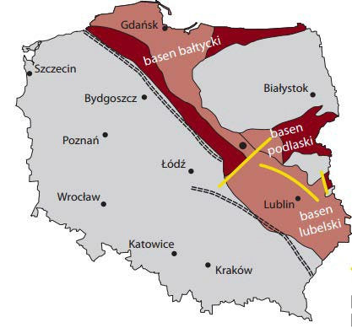
Shale gas reserves in Poland (1/2) General overview
Estimates of shale gas resources in Poland* [bcm]
Prospective areas of shale gas in Poland
4,6 – annual gas production in Poland
15,9 – annual gas consumption in Poland
132,07 – documented conventional gas resources in Poland, PGI, 2013
I
38 – USGS – the most probable recoverable resources, 2012
116 – USGS – max. estimates, 2012
I
[bcm]
346 – PGI – optimum estimates (acreage 18500 km²), 2012
I
865 – PGI – max. estimates (acreage 18500 km²), 2012
1000 – Rystad Energy, 2010
1000 – Lane Energy (3Legs), 2011
I
I
I
1370 – Wood MacKenzie, 2009
1870 – EUCERS, 2011
2830 – Advanced Resources Int., 2009
5300 – EIA, 2011
Uncertain estimates and low accuracy – available data is based on 20 years old data from test wells. PGI is going to publish an updated report next year.
The USGS forecast is 140-times lower than EIA’s one – accurate forecasts will be available only after drilling a significant amount of wells.
Shale gas production will have impact not only on Polish energy security but also may affect gas market in Central and Eastern European
– prospective areas of shale gas
– areas of uncertain or a lower potential of the prevalence of natural gas in the Lower Paleozoic shales
Lower Paleozoic – the most prospective basins are:
Baltic,
Podlasie,
Lublin.
A relatively simple structural setting – it is favorable opportunity for shale gas exploration and exploitation.
Estimated start of shale gas production is at the turn of 2015/2016.
*Source: Polish Geological Institute, Energy Information Administration, U.S. Geological Service , Wood MacKenzie, Advanced ResourcesInt., Rystad EnergyEuropean Centre for Energy & Resource Security, Lane Energy.
3

Slide 4
Shale gas reserves in Poland (2/2) PGI 2012 approach to shale gas resources estimation
Recoverable resources of shale gas in the Lower Paleozoic basin* [bcm]
A few alternative models of assumed values of key parameters, including in particular surface of the acreage incorporated into calculations and adopted EUR.
Very broad ranges of values onshore & offshore from 34,6 bcm at minimum to 1 919,7 bcm at maximum. These extremes are characterized by low probability.
The most probable shale gas recoverable resources for the both onshore and offshore part of the basin are in a range of 346,1 bcm to 767,9 bcm.
EUR – Estimated Ultimate Recovery.
1919,7
1548,6
865,2
767,9
576,2
619,4
289,0
371,1
346,1
230,5
148,4
115,6
61,9
76,8
23
11,6
14,8
34,6
onshore basin
acreage min.
12 347,3km²
offshore acreage
min. 6192,4km²
onshore basin
acreage max.
33 183,3km²
Offshore acreage
max. 7 952,4km²
Onshore&offshore
acreage min.
18 539,7km
onshore&offshore
acreage max.
41 135,7km²
EUR min - 1,13MMcm EUR optimum - 11,3MMcm EUR max - 28,3MMcm
Source: Polish Geological Institute Report „Assesment of shale gas and shale oil resources of the Lower Paleozoic Baltic-Podlasie-Lublin Basin in Poland”, 2012
4

Slide 5
Challenges related to shale gas development The biggest challenge – is shale gas production possible in Poland?
Poland vs USA
TOC indicator [%]
TOC indicator (Total Organic Carbon) – describes the amount of organic matter in the rock – indicates how much gas can be obtained from the deposit. The average TOC in Poland is app. 2-5% and in the USA 2-14%.
Thickness – thickness of bedrock layer – with higher thickness the posibility of obtainnig hydrocarbons raises. The average thickness in Poland is app. 30-70 m and in the USA 20-200 m.
Deposit depth – depth at which the production of deposit is possible. In Poland shale gas deposits are usually 3000-4000m and in the USA are app. 400-4600 m.
Mineralogical composition – indicates the content of mineral composition in the bedrock. In Poland there is mainly mudstone and clay which are more difficult
16%
14%
12%
10%
8%
6%
4%
2%
0%
Thickness [m]
Depth [m]
200
180
160
140
120
100
80
60
40
20
0
5000
4500
4000
3500
3000
2500
2000
1500
1000
500
0
[m]
[m]
- average estimated value in Poland
Source: US Energy Information Administration
5

Slide 6
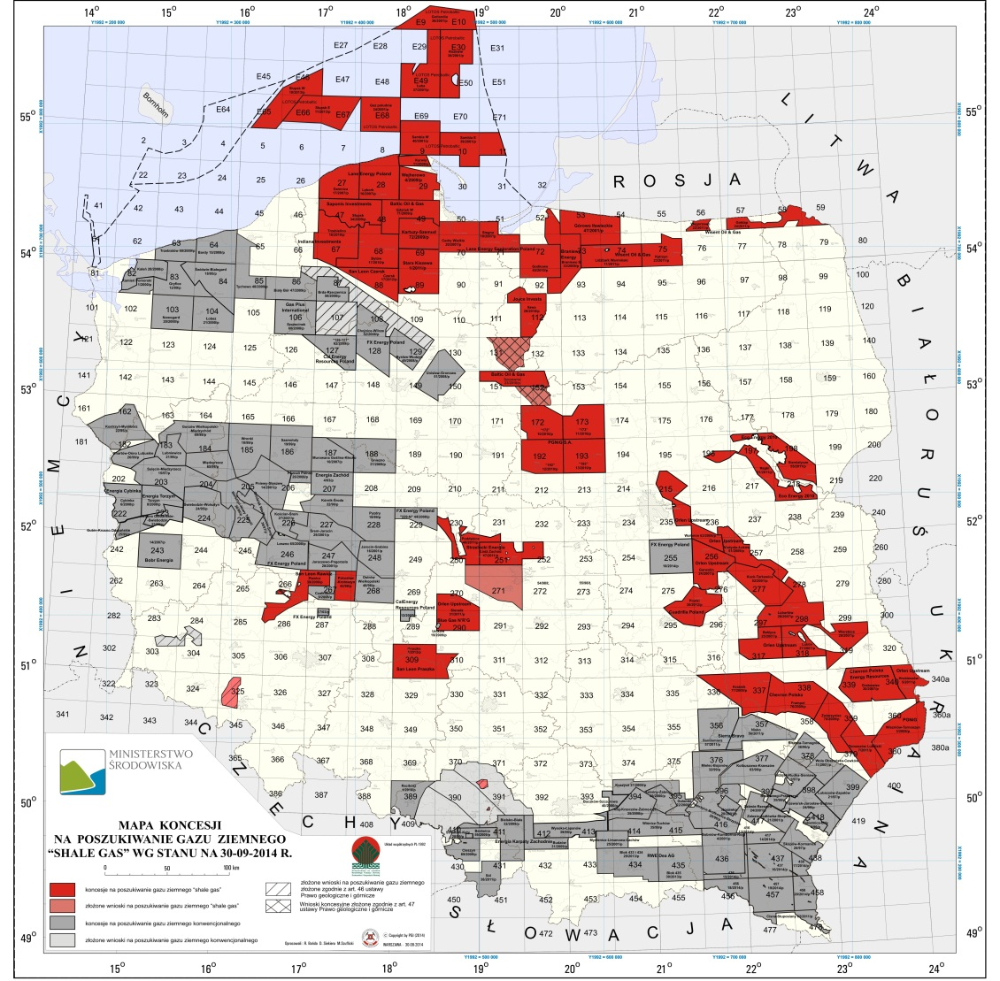
Shale gas drilling activities and main players (1/2)
Shale gas concession map as at 01.10.2014
Red blocks represent ’shale gas’ licenses.
Grey blocks represent conventional gas licenses.
As at 30 June 2014 there were 76 concessions granted to 28* entities.
From 2012, the number of concessions decreased gradually. Until 30 June 2014, majors including Marathon Oil, Talisman Energy, Eni, Total and ExxonMobil pulled out from Poland.
Polish national companies as at 30.06.2014 held 29 concessions.
Number of concessions for shale gas exploration in Poland
1 July 2010 1July 2011 1 July 2012 1 July 2013 1 July 2014
11
Shale gas concessions per company as at 30.06.2014
9
8
6
5
4 4 4 4
3
2 2 2
1 1 1 1 1 1 1 1 1 1 1
Source: www.mos.gov.pl
*Including 2 entites controlled by Lane Energy and 4 entites controlled by
San Leon
Source: www.mos.gov.pl, www.polskielupki.pl
6

Slide 7
Shale gas drilling activities and main players (2/2)
Number of exploration wells drilled in Poland as at 30.06.2014
Source: www.mos.gov.pl
24
As at 30 June 2014 there was a total number of 65 shale gas exploration wells drilled in Poland.
The highest drilling activity was in 2012 when 24 wells (ca. 38% of total number) were drilled.
In the first half of 2014 the drilling activity in Poland increased compared to first half of 2013 (12 vs. 7 wells drilled).
In 2014, 12 wells were drilled by:
PGNiG – 5 wells;
Lane Energy – 3 wells;
Orlen Upstream – 2 wells;
Indiana Investments and Wisent Oil & Gas – 1 well each.
In Q4 2014, PGNiG started drilling Majdan Sopocki well on the Tomaszów Lubelski concession.
Since 2010, 14 companies drilled at least 1 exploration well.
PGNiG is the leading company in terms of the number of wells drilled – 16 wells; 12 in Pomerania region (including 2 horizontal) and 4 in Lublin region.
Companies which withdraw from shale exploration activites in Poland drilled a total number of 16 wells.
∑ = 65 wells
12
14
12
3
2010 2011 2012 2013 2014
Exploration wells drilled in Poland per company as at 30.06.2014
16
10
8
6
4
3
3
3
3
3
2
2
2
1
Source: www.polskielupki.pl
Companies holding concessions as at 1 July 2014
Companies without concessions as at 1 July 2014
* Includes: Lane Energy Poland sp. z o.o. and Lane Energy Exploration Poland sp. z o.o.
** Includes: ExxonMobil Exploration and Production Poland Sp. z o.o. and ExxonMobil Exploration and Production Poland Sp. z o.o. Energia Chełm Sp.j.
7

Slide 8
Regulatory environment (1/2) Recent amendments to The Geological and Mining Law
Concession
Extraction royalties
Single concession for prospecting and exploration, and exploitation of hydrocarbons. Up to now, separate concessions were required for each of these activities.
Concessions will be issued for a period of 10 – 30 years:
Prospecting and exploration phase can last up to 5 years and can be extended once for 2 years period;
Production phase can last 5 – 25 years and can be extended repeatedly for up to 5 years each time.
Transition from prospecting and exploration phase to exploitation phase depends on obtaining an investment decision.
The bill makes extraction royalties dependent on classification of a field - it can be classified as marginal or non-marginal.
Marginal fields are those which produce less than:
ca. 88,3 mmcf of gas per six months (accounting period);
ca. 6 844 boe of crude oil per six months (accounting period).
Extraction royalties remain at the same level as they are now for marginal fields, but increase for non-marginal ones.
Increase in extraction royalties for non-marginal fields
Tenders for entrepreneurs
Previous royalties and new
royalties for marginal fields
New royalties
+36%
The concessions can be obtained either individually or jointly by interested parties with the indicated operator.
Concessions will be granted by the Minister of the Environment subject to an ex officio tender procedure.
An entity interested in obtaining a concession will be verified in the qualification procedure with regard to its experience in the appraisal and documentation of at least one hydrocarbon deposit or carrying out production for at least 3 years (applicable only to an individual entity or an operator).
New obligation to establish a collateral for non-performance or undue performance of duties stipulated in the concession. The collateral shall not exceed the equivalent of 20% of costs of geological works.
2,39
1,76
+285%
+286%
0,06
0,22
0,05
0,19
High-methane gas
USD / mcf
Nitrogen-rich gas
USD / mcf
Crude oil
USD / bbl
Other changes
All geophysical surveys will be conducted solely on the basis of a notification (a concession will no longer be necessary).
Main environmental procedures are moved to the pre-drilling stage.
8

Slide 9
Regulatory environment (2/2) The bill on taxing hydrocarbon extraction and fiscal regime
Timeline of works on the bill
Publication of the bill draft
Public conslutation
Adoption of the draft by the Government
Parliamentary work
President’s signature
February, 2013
March, 2013
March 11, 2014
The lower house (Sejm) approved the bill July 25, 2014
August 25, 2014
General information about the bill
Special hydrocarbon tax
Sejm, the lower chamber of Polish parliament, approved a government- proposed bill on taxing hydrocarbon extraction on 21st July, 2014.
The bill was approved by the Senate and signed by the President in August 2014.
The tax burden (Government Take) on hydrocarbon exploitation amounts to 40% on average[1], including i.e. special hydrocarbon tax, tax on extraction of certain minerals, extraction royalties, CIT, real estate tax and local taxes.
The taxes would be introduced in 2016, with a tax holidays till 2020.
Tax chargeable on a cash basis (cash flow tax).
Imposed on an excess of revenues over eligible expenses in a given year in the hydrocarbons extraction business (both onshore and offshore), with rates linked to investor returns.
Tax rate depends on the ratio of cumulative revenue over cumulative eligible expenses (i.e. R-factor):
0% if the ratio is lower than 1,5;
a progressive rate between 12.5% and 24.9% if the ratio is higher than 1.5 and lower than 2.0
25% if the ratio is higher than 2.0.
Tax on extraction of certain minerals
Other applicable taxes
Tax chargeable as an ad valorem royalty (i.e. on the value of the extracted minerals).
Royalty rate depends on the type of deposit and hydrocarbon:
The general fiscal regime that also applies in Poland to the oil and gas industry consists of a combination of corporate income tax (CIT), capital
gains tax (CGT), VAT, excise duty and real estate tax (RET), as follows:
Unconventional:
gas: 1,5%
crude oil: 3%
Conventional:
gas: 3%
crude oil: 6%
CIT rate, CGT rate and branch tax rate - 19%
VAT rate - 23%
RET rate - 2%
[1] In nominal terms.
9

Slide 10
Conslusions and future outlook
Conclusions
Long-term outlook
Shale gas reserves
Reserves estimates differ from each other significantly and are still uncertain. PGI is going to publish an updated report on shale gas reserves in Poland next year.
Drilling Activities
The highest level of activity in shale gas exploration in Poland was in 2012 – 110 concessions granted (as at 1 July 2012) and 24 wells drilled.
Despite the decrease in the number of concessions (to 76 as at 1 July 2014) it seems that drilling activity in Poland is picking up when compared to 2013 – 12 wells drilled and more pending or planned in 2014.
Challenges
Geology is more challenging than expected. Unconventional deposits are different from those present in the USA in terms of i.e. deposits depth, thickness, pressure, TOC content.
On the one hand, the new Geological and Mining Law introduces some new obligations, but on the other hand it brings also new opportunities.
According to the bill on taxing hydrocarbon extraction, which is currently during the parliamentary work, the Government Take will amount to 40% on average.
PGNiG’s view
Despite the exit of some major players from Poland, PGNiG remains bullish on Polish shale gas. This is a generational opportunity for both Poland and the company, and we are committed to frack it.
More time and knowledge needed to gain better understanding of the basins and its properties.
We are open for cooperation and know-how sharing with experienced international players, as we want to de-risk our exploration program and challenge our views and opinions with partners.
We are committed to R&D initiatives (such as Blue Gas), which have the potential to help unlock Polish shale.
Presence of Polish players in most advanced shale producing regions, such as USA or Canada, may in the long term lead to know-how transfer and better results achieved domestically.
Baltic Ceramics – specializes in production of ceramic proppants
United Oilfeld Services – company focused on providing hydraulic fracturing, drilling, and seismic data acquisition services.
NovaSeis - seismic company focusing on technology solutions for improving acquisition methodology.
Developments in OFS market
In 2015 Polish Geological Institute intends to issue new report on shale gas reserves in Poland based on the data from already completed wells
10

Slide 11
Thank you for your attention!
Dawid Jaworski
Chief Specialist for Upstream Projects
E&P Division
PGNiG S.A.

