Slide 1
Unconventional resources – Shale gas
Varinia Radu
Partner
CEE Head of Oil and Gas
Deputy CEE Energy Coodinator
CMS Bucharest

Slide 2
Shale gas
Shale gas is considered an unconventional gas resource because in conventional exploration and development it is understood that natural gas originates in shale as a "source rock" but that it must migrate into porous and permeable formations (termed "reservoirs"), such as sandstones, in order to be produced economically.
Shale gas production involves going directly to the source rock to access the resource. Such production from shale units was not considered economically feasible before application and refinement of horizontal drilling and hydraulic fracturing.

Slide 3
Technology
Hydraulic Fracturing
Grew rapidly starting in the late 1940s and continues to be used routinely for reservoir stimulation
Used to stimulate approx a million oil and gas wells.
Chemical makeup of fluids
Romania has in the mid 1990’s carried out a fracking campaign in Transylvanian Basin with some positive results as a pilot project
Horizontal drilling
Downhole drilling motors and telemetry equipment
Also used in conventional drilling starting in the early 1980s.

Slide 4
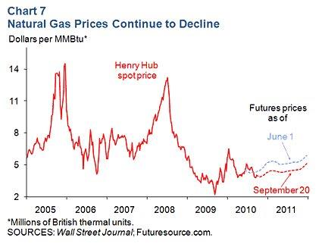
North America Shale Revolution
Natural gas prices - which were rising, are now falling
Oil production - which was falling, is now rising
Since the early 2000s, when exploiting shale gas through hydraulic fracturing, the United States has increased gas production by 24%
Utilities and manufacturers have started to use more gas
Companies are planning several projects to export liquefied natural gas to Asia and Europe
Typical shale gas wells have an average field decline of 29-52%+ per annum

Slide 5
Shale gas
Largely due to shale gas discoveries, estimated reserves of natural gas in the United States in 2008 were 35% higher than in 2006
The economic success of shale gas in the United States since 2000 has led to rapid development of shale gas in Canada, and, more recently, has spurred interest in Europe, Asia, and Australia. It has been postulated that there may be a 100-year supply of natural gas in the United States, but only 11 years of gas supply is in the form of proved reserves

Slide 6
Import of American shale gas to Europe
Exports from USA may result in increasing prices
May be more expensive than the Russian gas
New pipelines and infrastructure needed

Slide 7
Development
Jurisdictions are in various stages of development of unconventional resource operations
The starting point for licensing of rights to hydrocarbon exploration and development start with existing licensing arrangements and granting instruments which are applied to conventional activity

Slide 8
Shale gas in Europe – potential
First place is shared by France and Poland, each with reserves estimated at about 5,000 billion cubic meters.
Norway ranks second and could extract more than 2,200 billion cubic meters of shale gas.
Romania ranks third in Europe in terms of potential shale gas. Exploiting could result in 1,440 billion cubic meters of gas.
France has banned the exploitation of shale gas.

Slide 9
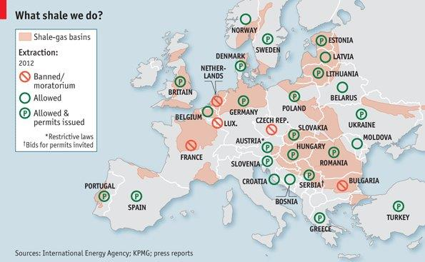
Shale gas in Europe

Slide 10
Shale gas in Europe - exploration
Countries including Poland, the United Kingdom, Ukraine and Romania are keen to develop shale gas resources as a way to lower energy costs and reduce imports.
Europe is trying to manage energy prices to protect growth and reduce the cost gap with the U.S., where a shale-gas revolution has cut prices.
There are 65 shale gas wells and drills in Poland, more than any other European country with focus on exploration.
United Kingdom has only a couple of wells.
Poland plans to build 50 new shale wells every 12 months over the next few years but currently. It has granted 82 concessions to prospect for unconventional hydrocarbons, 72 of those are shale gas related.

Slide 11
Romanian Gas Legal Framework Overview
(including unconventional) I
Royalty based concession regime
Concession Agreement between the Agency for Mineral Resources and one or more private companies
Exclusive title to explore for and produce in the area covered by the Concession Agreement
30 years (15 years extension)
Option to relinquish all or parts of the block after the exploration phase or extend it by undertaking additional work obligations

Slide 12
Romanian Gas Legal Framework Overview
(including unconventional) II
Obtaining exclusive title to explore and produce hydrocarbons:
i) tender organized by the Agency for Mineral Resources
ii) transfer of interests under an existing Concession Agreement
iii) transfer of shares in an entity that is party to a Concession
Agreement

Slide 13
Definitions
Unconventional resources – is not specifically mentioned/ defined separately in Romanian sector legislation
Petroleum Law 238/2004, mentions that:
oil represents fuels consisting in mixtures of natural hydrocarbons accumulated in the Earth's crust and which in the surface conditions are present in gaseous form, in the form of natural gas or liquid as crude and condensate oil.
natural gas include free gas from methane, gas dissolved in crude oil, the gas from the well head associated to crude oil deposits, as well as the gas resulting from the extraction of gas condensate mixtures.
An inter-ministerial comission is working on ammending the legislation in the oil and gas sector. Is expected to have a separate system for shale gas/ unconventional resources
Currently, in some of the Romanian concessions agreement concluded after 2010, it’s stipulated that the natural gas is the free gas from the methane, gas dissolved in crude oil, the gas from the well head associated to crude oil deposits, gas resulted from the extraction of condensate gas mixtures as well as unconventional gas.

Slide 14
Romania – Concession Agreements

Slide 15
Romania – Areas of interest
The two most important areas of interest in Romania are Dobrogea and Moldova
(East and South East of Romania)
Chevron holds title on four blocks deemed to have shale gas resources and is the only company currently in the exploration phase on a block located in Eastern Romania
Several issues with land owners and public protests postponed the Chevron’s operations after drilling one exploration well.
Approx. 1,444 billion cubic meters of shale gas according to a report issued by the American Administration of Energy

Slide 16
Creating a legal framework
The Association of International Petroleum Negotiators met in October 2014 in Budapest, trying to create a framework for unconventional gas operations
Need to reflect different physical requirements of unconventional operations
Incorporate unconventional resource methodologies including horizontal well techniques
Identify provisions in the standard JOA to be modified

Slide 17
New definition proposed
Unconventional resource = an accumulation of hydrocarbons with low permeability and porosity that consequently is difficult to exploit commercially without unconventional methods, such as drilling horizontal wells and/ or hydraulic fracturing

Slide 18
Romania – short term expectations
Round XI – The Romanian National Agency for Mineral Resources
The Romanian National Agency for Mineral Resources is preparing round XI for awarding consessions for 36 petroleum blocks, out of which 8 will be offshore, including in deep waters areas. In the ideal case when these blocks become operational, provided the necessary investment will be attracted, the resources energy fund being restored, Romania will could achieve energy independence and might become an oil land gas exporter from 2019 -2020.
Legislation amendements
An inter-ministerial comission is working on ammending the legislation in the oil ang gas sector.
Expected to have a different system of royalties depending on exploitation area (onshore-offshore – offshore-deep) and a separate system for unconventional gas/shale gas

Slide 19
Romania – middle and long term strategy
Internally – increasing domestic production
Discovery of new resources/ reserves considering especially the 10% depleting level
Rehabilitation of mature fields
Black Sea operations
Externally – Russian gas
Interconnectors finalized Bulgaria, Hungary, Moldova (Becoming regional hub )
Potentially importing gas from Austrian Hub – Baumgarten
Black Sea pipeline potentially feeding the gas into the centre Europe starting 2019-2020 (if domestic production exceeds internal demand)
Externally – Non – Russian gas
- Sourcing LNG from terminals in Greece or future terminal in Croatia

Slide 20
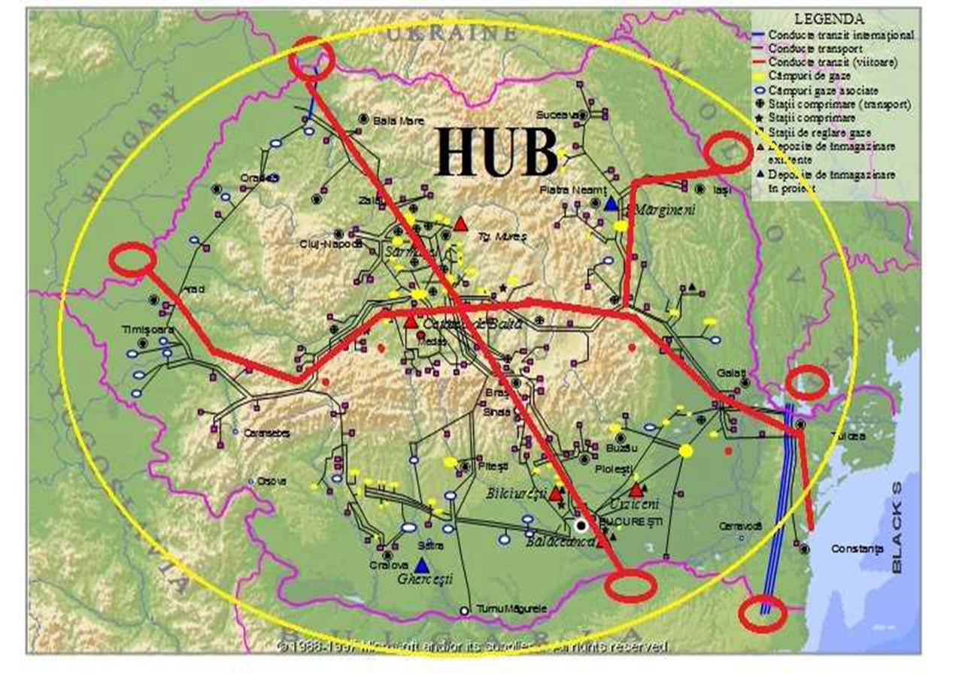
Romania

Slide 21

Contact
Varinia Radu
Partner
CEE Head of Oil and Gas
CMS Cameron McKenna
M +40 72 255 1216
T +40 21 407 3870
F +40 21 407 3900

