Slide 1
han asparuh - exploration
Paul Sexton – Exploration Manager Total Bulgaria
28th October 2014

Slide 2
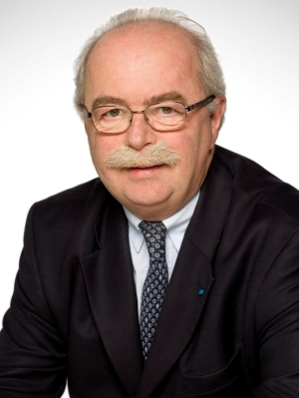
1951-2014

Slide 3
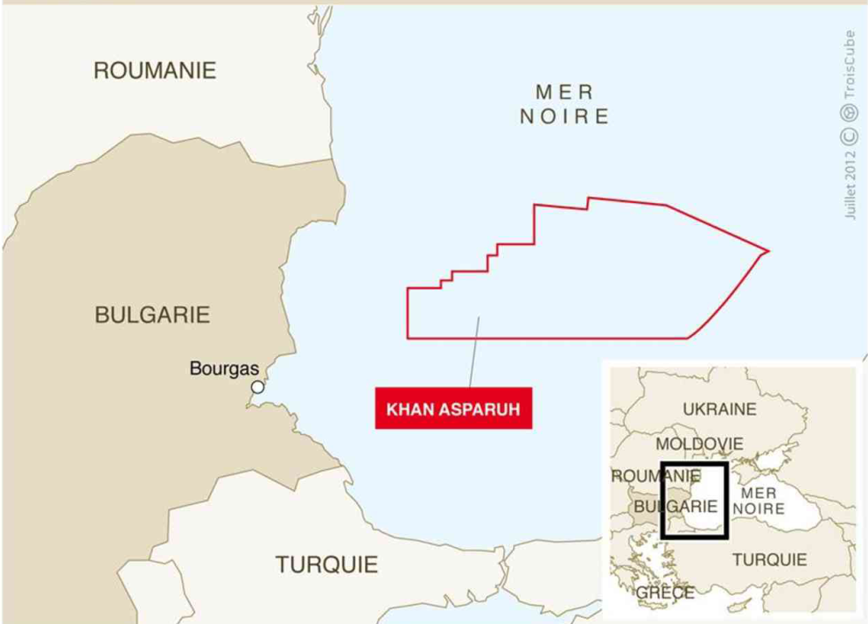
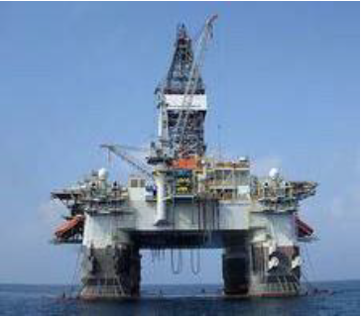
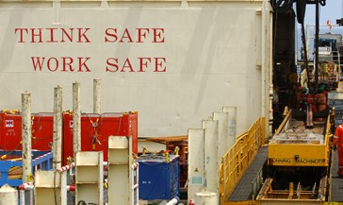
Block 1-21 han Asparuh
Awarded on July 26th 2012
Contract signed on August 29th for 5 years
Interest: Total 40% (Operator since 04/14), OMV 30%, Repsol 30%
14 220 km²
120 to 2 200 m water depth
Work Program
Geoscience: Heavy Data Acquisition
Drilling Operations
H S & Environment Program

Slide 4
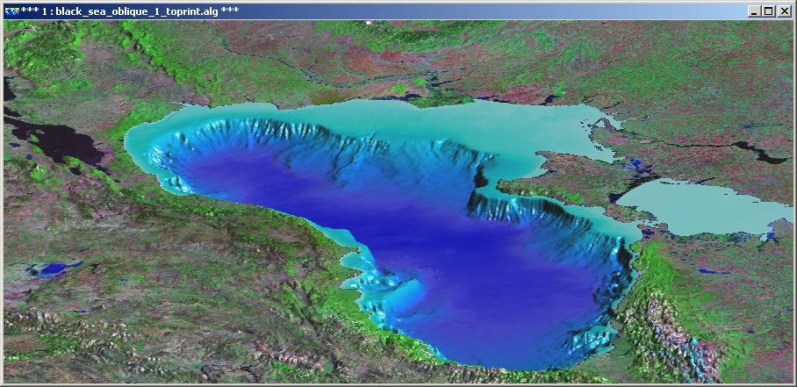
The Black Sea Basin – Deep Water wells
Sofia
Dry well, shows
Domino gas discovery
Khan Asparuh
Only 7 wells over 200,000 km²
28th October 2014
Courtesy of GeoLogic Data Systems

Slide 5
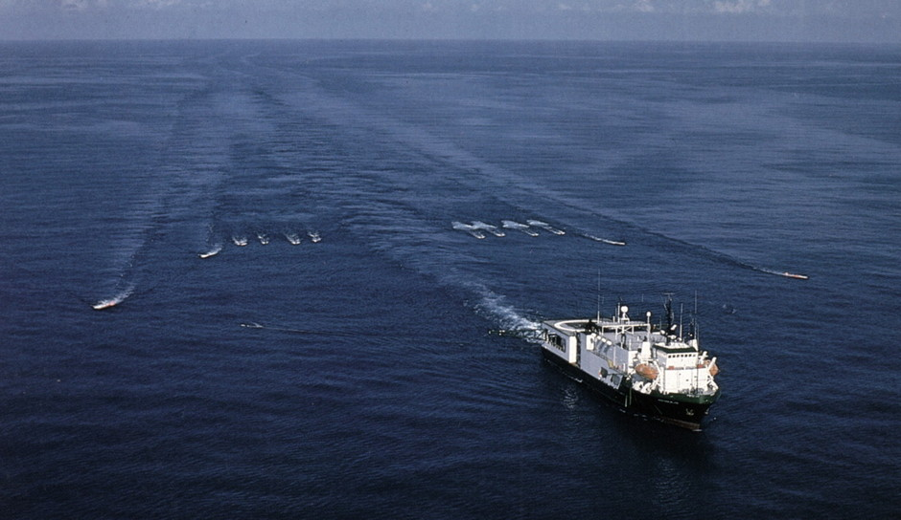
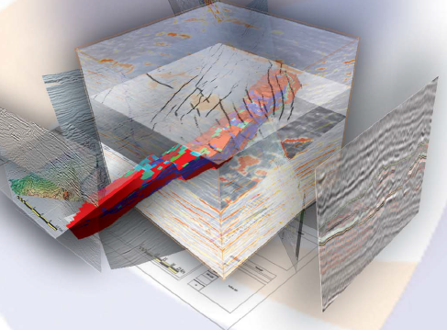
GEOSCIENCE PROCESS
Data Acquisition
Interpretation & Analogs
Today
Geological Model
PANGEA
Potential Hydrocarbon
Volumes
Geological Risk
What probability that our
model is correct?
SISMAGE
FROntier exploration
Probability of success low (Presence, Volumes and type of HC)

Slide 6
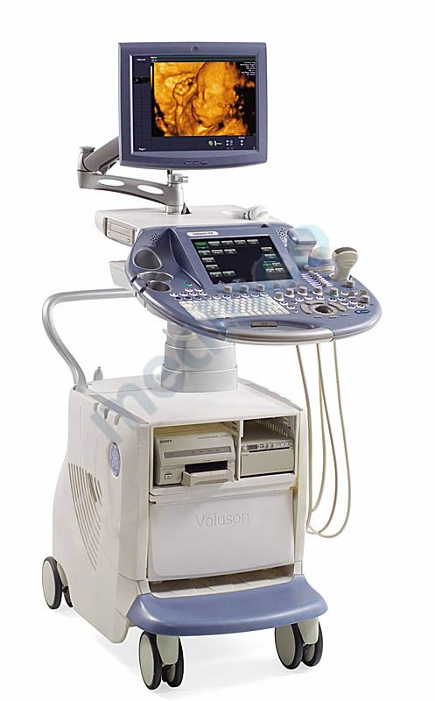
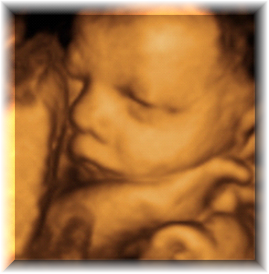
The Seismic Experiment: An analogy
Echography to image babies is well known.
Seismic Imaging is similar but on
on a vastly different scale…. And
with an unknown model …
Top Reservoir
10 cm
10 km
28th October 2014

Slide 7
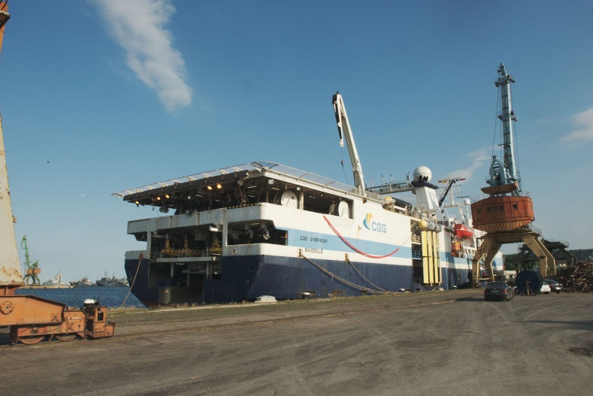
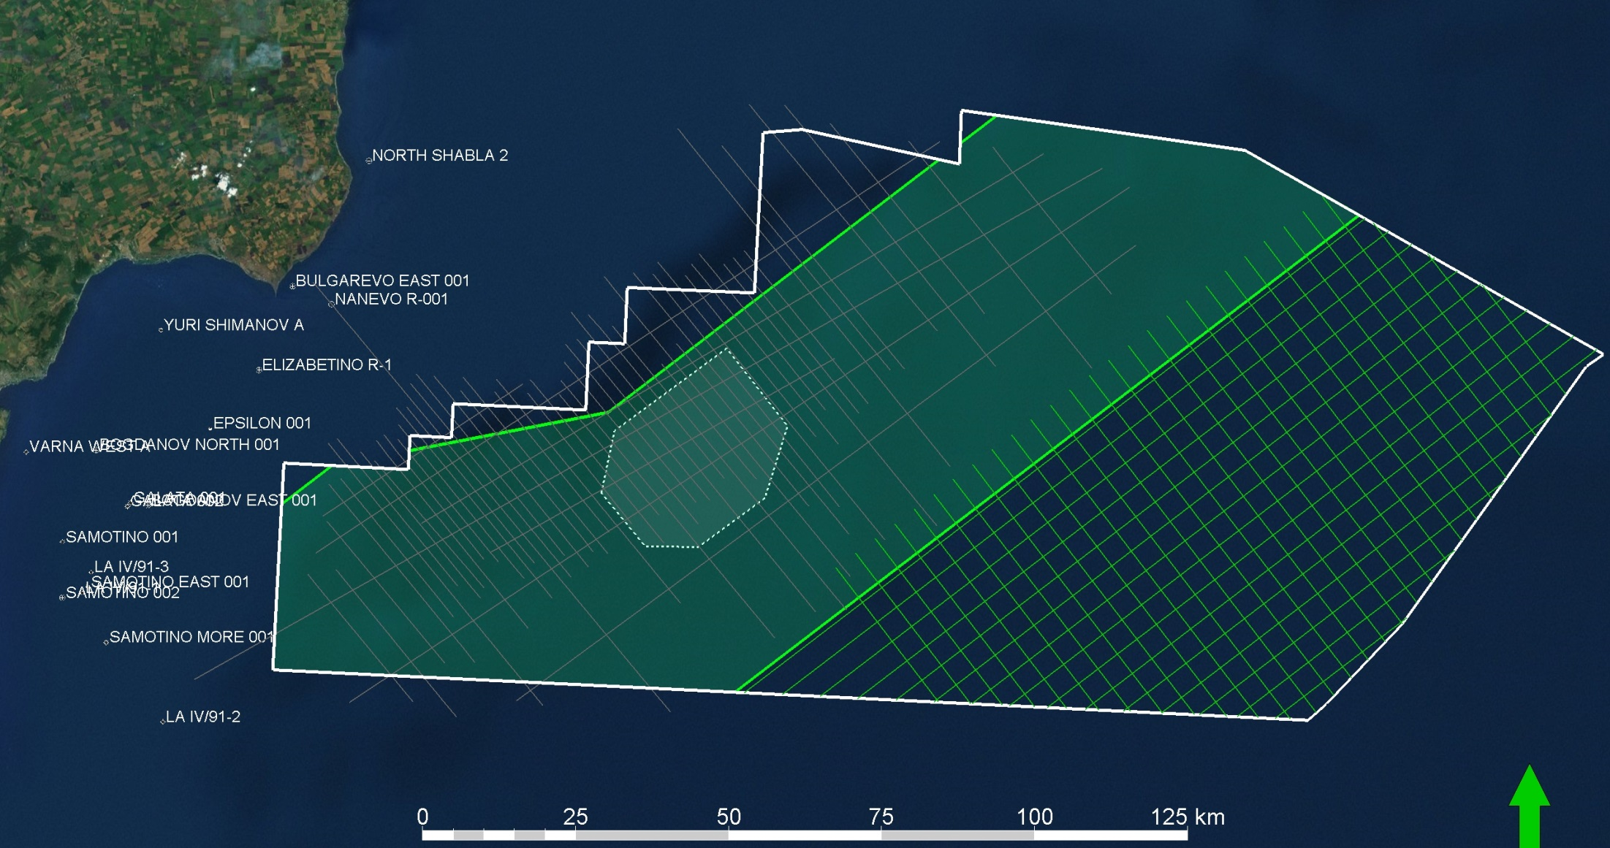
New 3D & 2D Seismic completed
CGG Symphony
Area: 14,220 km²
Water Depth: 95% > 500 m, max 2200 m
Vessel sailed 22,000 km in 210 days
2D Han Asparuh, 3000 km,
4x4 km grid size
3D Han Asparuh, 7800 km2,
Largest 3D in the Black Sea
28th October 2014

Slide 8
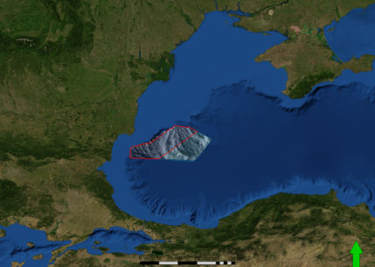
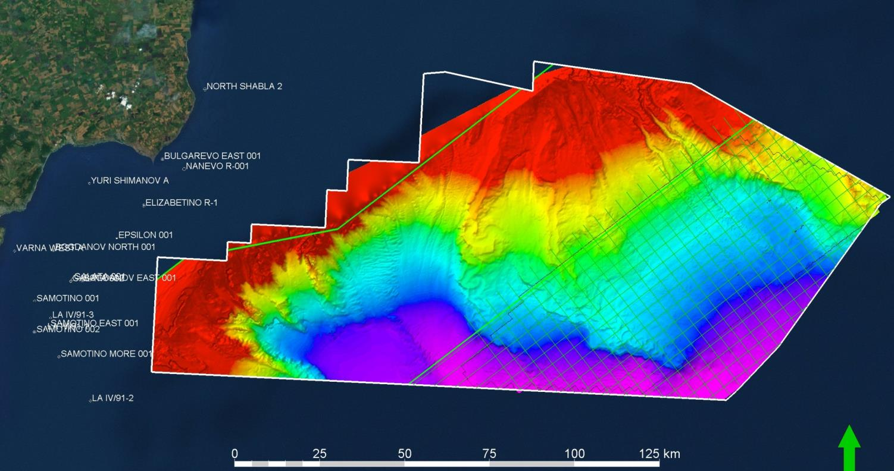
Present-Day Seafloor
Danube delta
Romania
Bulgaria
Turkey
Canyon scours
Mass flows
Combined 3D seismic and swath bathymetry across ~13000 km²
Distal edge of Danube sediment supply
28th October 2014

Slide 9
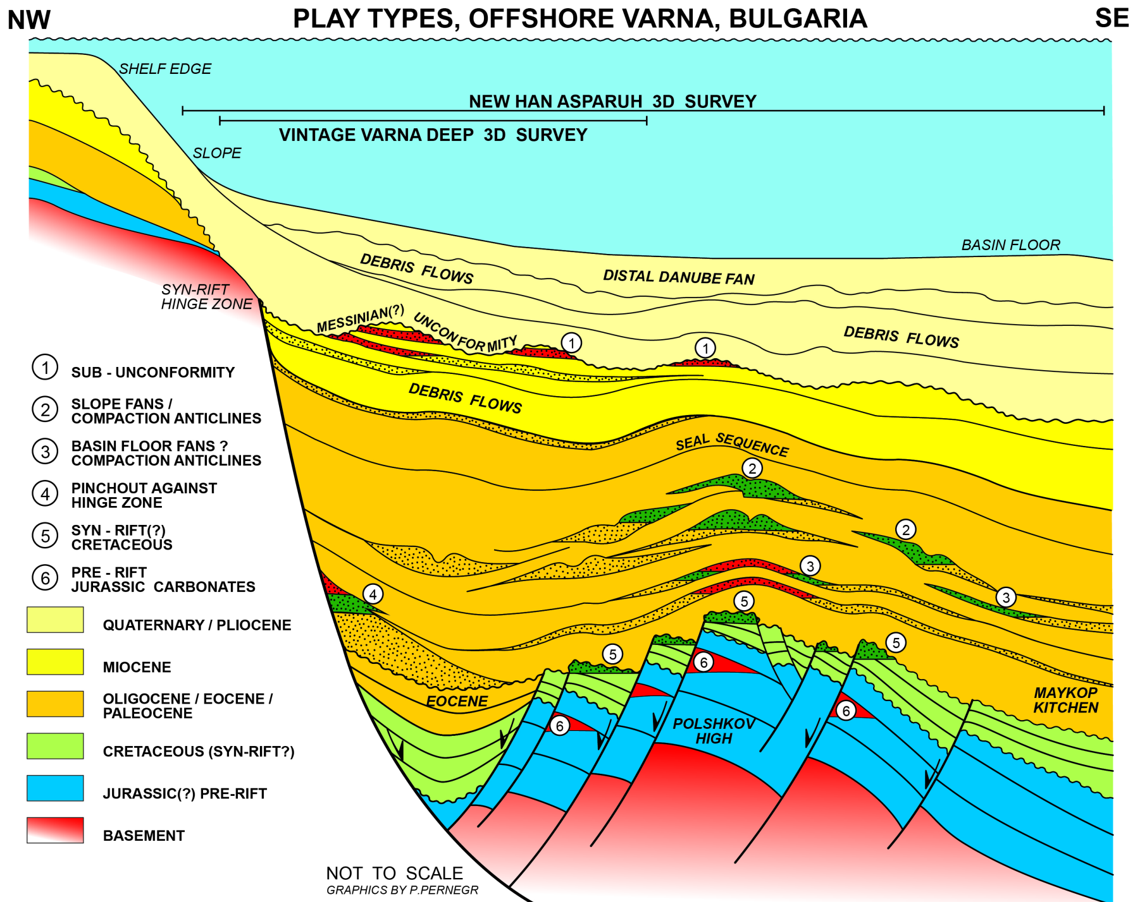
Play types AROUND the Polshkov High, Bulgaria
Tari et al. (2009)

Slide 10
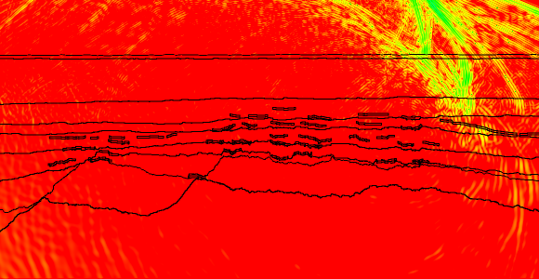
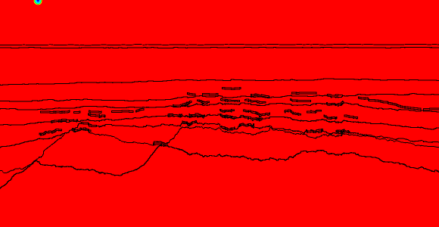
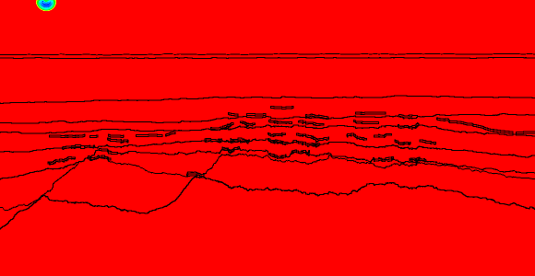
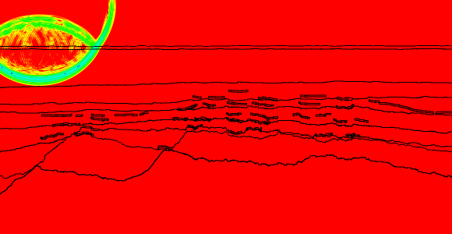
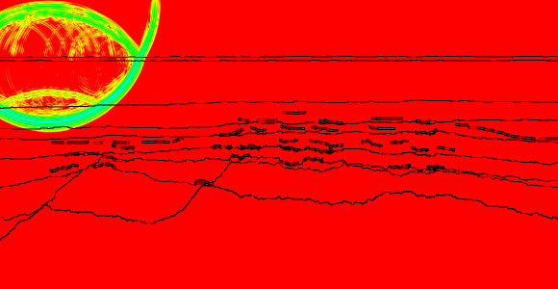
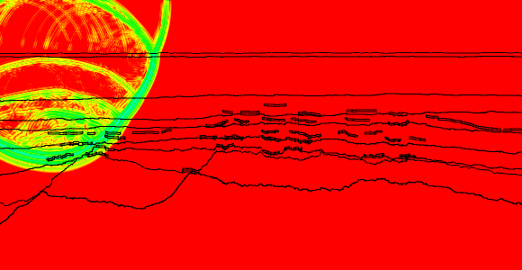
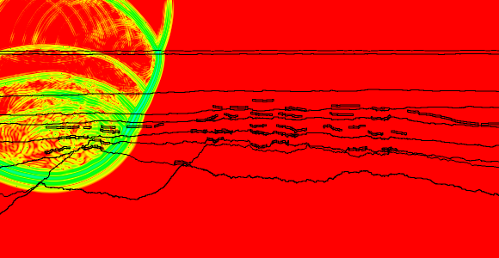
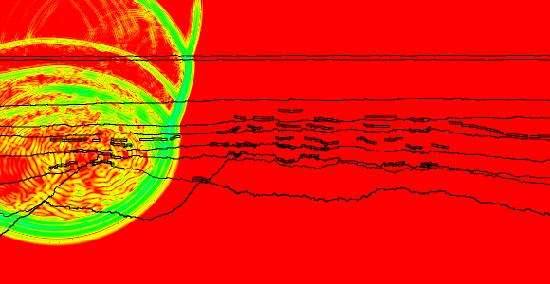
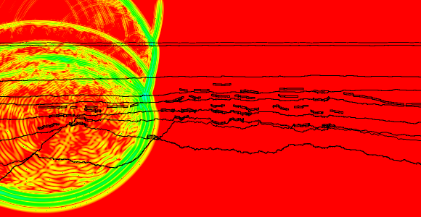
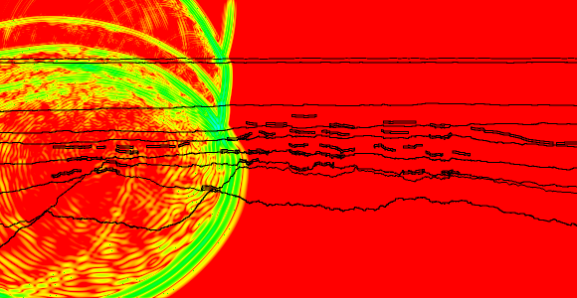
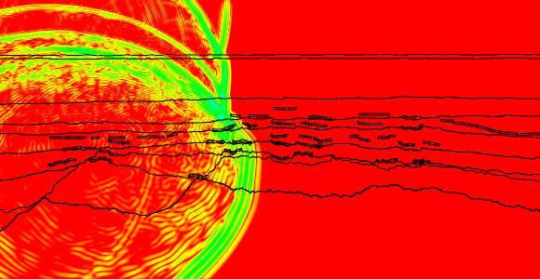
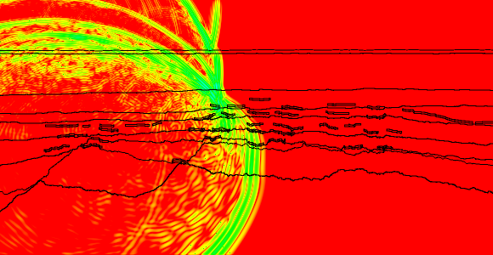
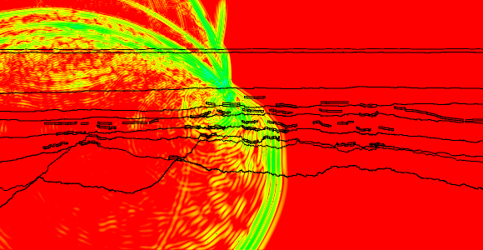
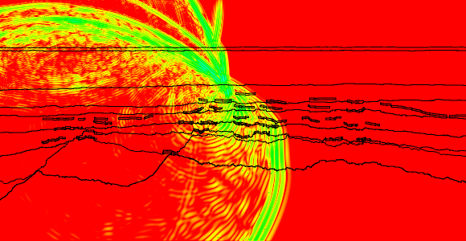
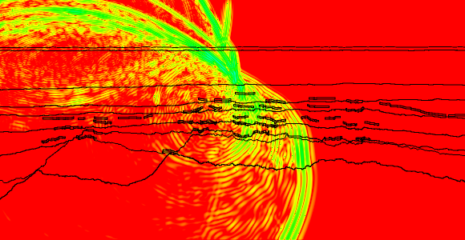
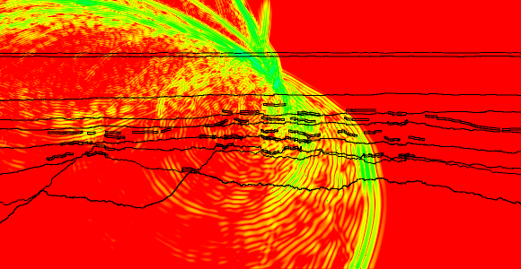
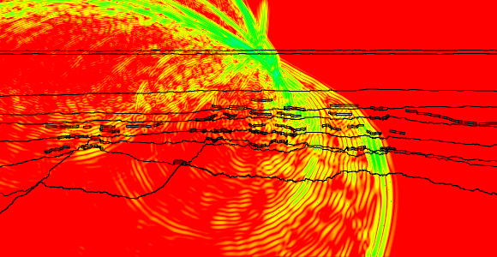
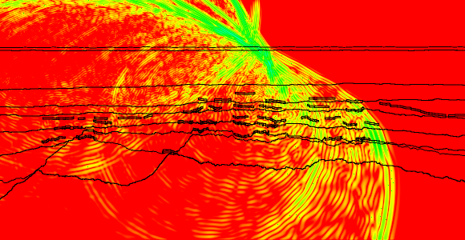
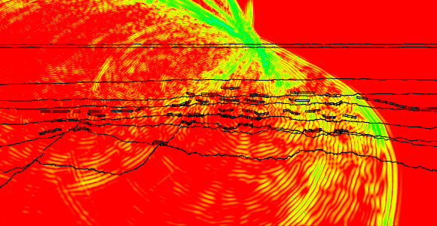
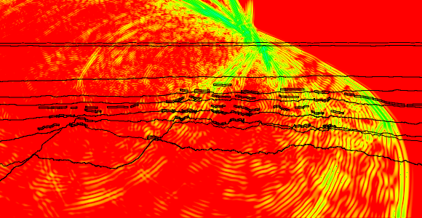
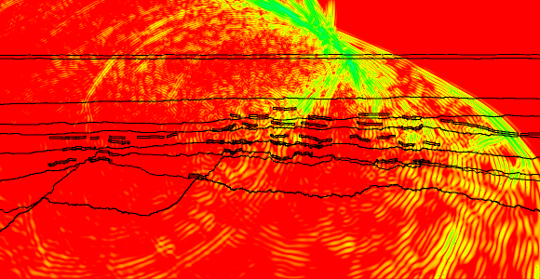
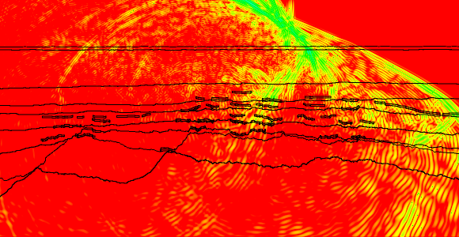
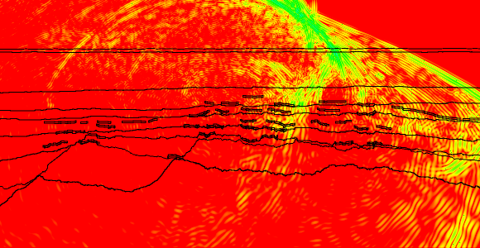
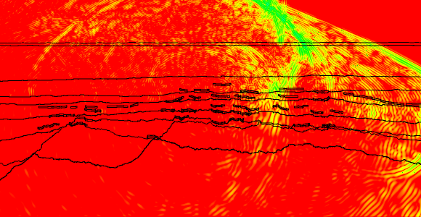
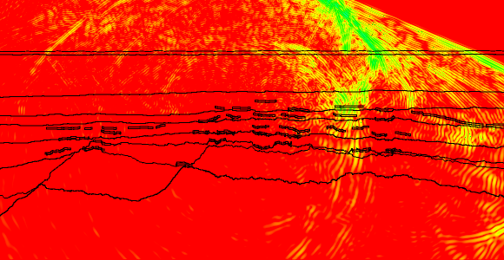
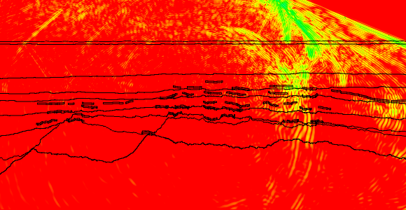
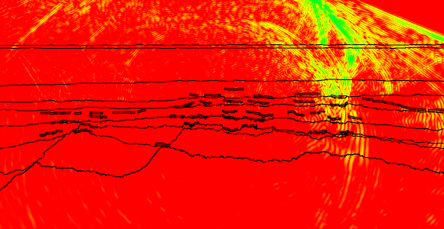
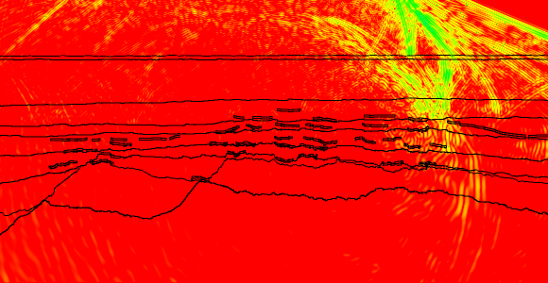
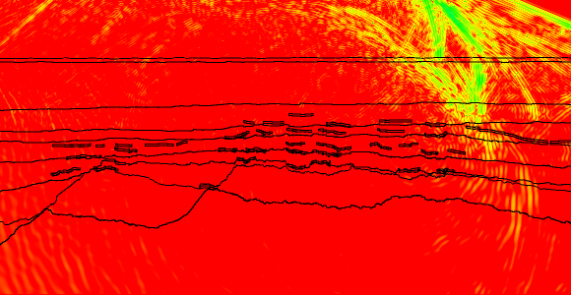
SEISMIC MODELLING TO CORRECT FOR NEAR SURFACE
8 km
Position
Interface:
Change in rock properties;
seismic velocity and/or density
Time
Depth

Slide 11
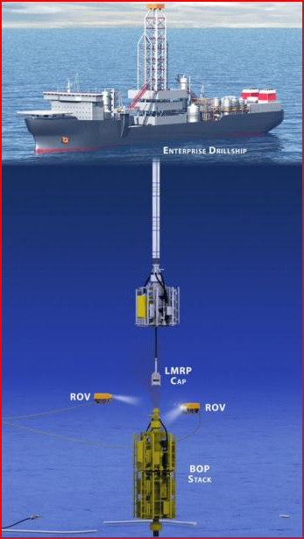
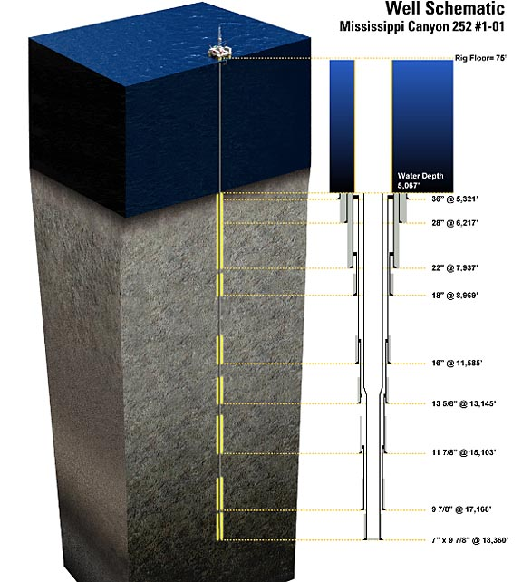
DEEP Water DRILLING
Well Schematic
WELL-1
1st Deep water well in Bulgaria
Long & Heavy Marine Riser
~1,900m water depth
Planned final well depth
6,000m
0m Sea level
Marine Riser
~1,900 Seabed

Slide 12
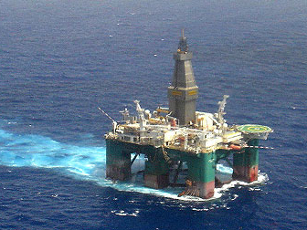
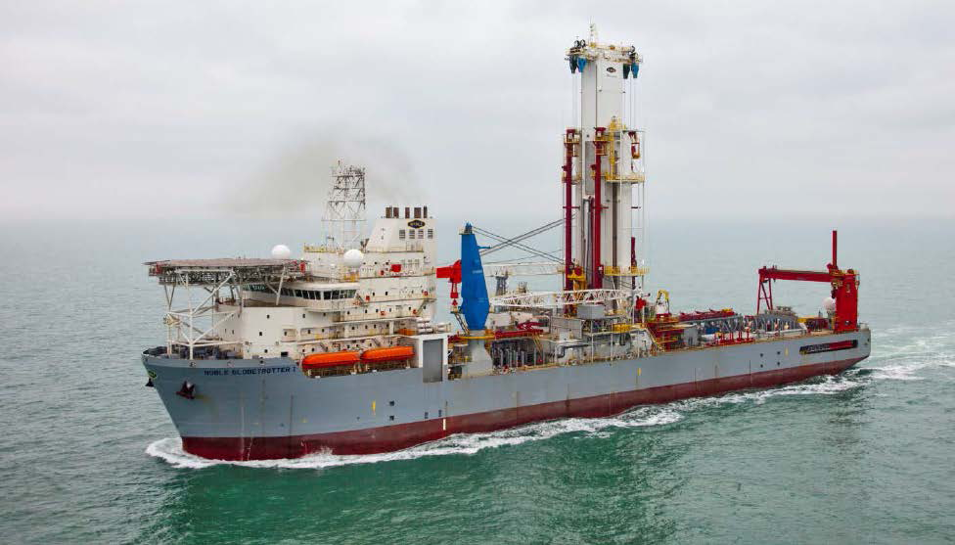
Deep Water rigs
2 possible types of Rigs:
Semisubmersible
or
Operating water depth: ~ 2,500m
Dynamic Positioning
Personnel on Board: 160 to 180
Drill ship
Operating water depth: ~ 3,300m
Dynamic Positioning

Slide 13
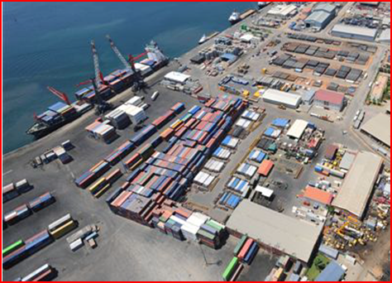
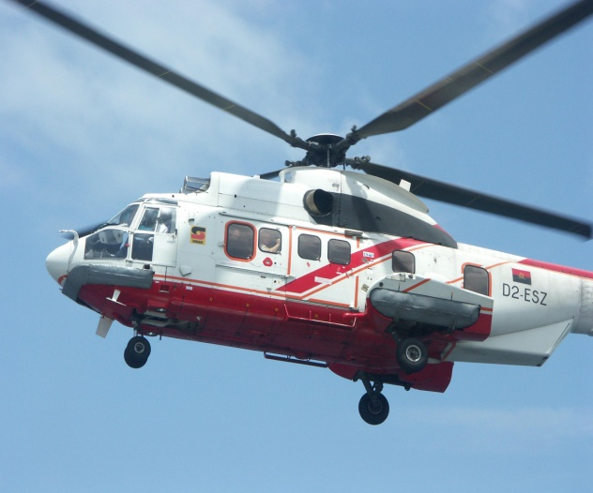
Logistic support
Need direct access to Black Sea
Storage base
6,500m² logistic base (Yard & Warehouse)
cranes, trucking, personnel
diesel fuel, water, bulk materials (cement, barite, bentonite) – large quantities
importation of goods
back up equipment available
2 supply vessels
jetty with 100m berthing capacity
(minimum water depth 7.5m)
1 permanent helicopter
+ 1 back-up
HEAVY Call for tenders PROCESS

Slide 14
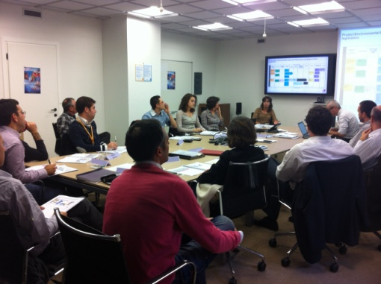
Total E&P Bulgaria B.V. is committed to conducting its business in a responsible manner: with a particular focus on Health, Safety, Environment and creating value for all its Stakeholders
« H » for Health
« S » for Safety
« S » for Societal
« E » for Environment
Mission
IDENTIFY
Objectives
Implement HSSE Management System
Effective Emergency Response Organisation
MANAGE
Compliance with Bulgarian regulation and Total Group Policies
Ensure an open dialog with Stakeholders and outside parties
HSSE risks

Slide 15
Exploration start of a process to bring production to the consumer
Exploration
Development
Production
Regional Evaluation
Prospect generation
Evaluation of the reservoir in static condition
Evaluation reservoir in dynamic condition
Duration
(years)
2 - 5
2 - 4
3 - 6
20 - 30
1 - 3
Obtain licence
Discover
Decision to develop
Start production
End
production
Site restitution

Slide 16
Conclusions
The Black Sea basin is a Frontier Exploration area
Presence & Type of hydrocarbons still uncertain
A heavy data acquisition program is almost finished
The operatorship was handed over to TOTAL from OMV in April 2014
Drilling planned to start in 2015 with emphasis on HSE
Deep Offshore Projects take 5-10 years after discovery before production starts
10th October 2014 - CEEC Scouting Meeting

Slide 17
DISCLAIMER and COPYRIGHT RESERVATION
The TOTAL GROUP is defined as TOTAL S.A. and its affiliates and shall include the person and the entity making the presentation.
Disclaimer
This presentation may include forward-looking statements within the meaning of the Private Securities Litigation Reform Act of 1995 with respect to the financial condition, results of operations, business, strategy and plans of TOTAL GROUP that are subject to risk factors and uncertainties caused by changes in, without limitation, technological development and innovation, supply sources, legal framework, market conditions, political or economic events.
TOTAL GROUP does not assume any obligation to update publicly any forward-looking statement, whether as a result of new information, future events or otherwise. Further information on factors which could affect the company’s financial results is provided in documents filed by TOTAL GROUP with the French Autorité des Marchés Financiers and the US Securities and Exchange Commission.
Accordingly, no reliance may be placed on the accuracy or correctness of any such statements.
Copyright
All rights are reserved and all material in this presentation may not be reproduced without the express written permission of the TOTAL GROUP.

