Slide 1
ContourGlobal Maritsa East 3 – Energy security for Bulgaria – Clean Coal
October 2014

Slide 2
ContourGlobal at a Glance
We are a global independent power company;
We develop, acquire and operate power generating stations for national grids and utilities primarily in developing markets;
We develop and operate innovative energy solutions for multinational companies (Coca-Cola) in developing markets (ContourGlobal Solutions);
Key facts and figures:
  Company headquartered in New York City
  Founded in 2005 Significant U.S. investor base (educational endowments, pension funds and individual investors)
  In 2014 we have $3bn of assets, $1bn of revenues and almost 2,000 employees in 20 countries
1
Notes:
Extensive development, technical and operating capabilities used to create a diverse blend of power businesses across a range of fuels and technologies
Hydro, gas, wind, solar, coal, fuel oil
Non-recourse, project debt financing used for development and acquisitions—traditional debt financing sources as well as less common sources of multilateral and development bank financing from institutions such as: Overseas Private Investment Corporation (OPIC), a U.S. government agency dedicated to development in Africa and other emerging markets, IFC of the World Bank Group, the African Development Bank, BNDES, BNB, FMO (the Dutch national development bank)
Markets with a growing middle‐class and significant growth potential
Provide customized quad‐generation solutions to improve energy efficiency of production facilities
Cheaper, more reliable, and environmentally friendly power
Single point of contact for all energy needs
Partnership with Coca‐Cola Hellenic Bottling (CCH); negotiations in process with other multinationals

Slide 3
Global Footprint with Presence in 20 Countries and 4 Continents
LATAM and Caribbean: 1,157 MW
Africa: 203 MW
Europe: 2,491 MW
Saint Martin (100%) 14 MW
Guadeloupe (100%) 21 MW
Knockmore Hill (100%)
15 MW
Radzymin (100%)
6 MW
Bonaire (100%) 28 MW
Austria Wind (100%) 203 MW
Kiev (100%)
6 MW
São Domingos II (77%) 25 MW
Galheiros (88%) 12 MW
Sochagota (46%) 165 MW
Nogara (100%) 9 MW
Kramatorsk (60%)
120 MW
Solar Plants Italy (100%) 18 MW
Termoemcali (35%) 240 MW
Arrubal (100%) 800 MW
Maritsa East 3 (73%)
908 MW
Ploiesti (100%)
6 MW
Asa Branca (79%) 160 MW
Inka (93%) 114 MW
Chapada (33%) 205 MW
Oricola (100%) 3 MW
Emperor (43%) 173 MW
Vorotan (80%)
404 MW
KivuWatt
(100%)
26 MW
Golf
(100%)
55 MW
Togo
(80%)
100 MW
Legend:
Asset (Total Stake)
Installed Capacity
Status
Nigeria
(3 plants)
22 MW
Wind
Thermo
Hydro
Solar
¹ Denotes ContourGlobal Solutions plant

Slide 4
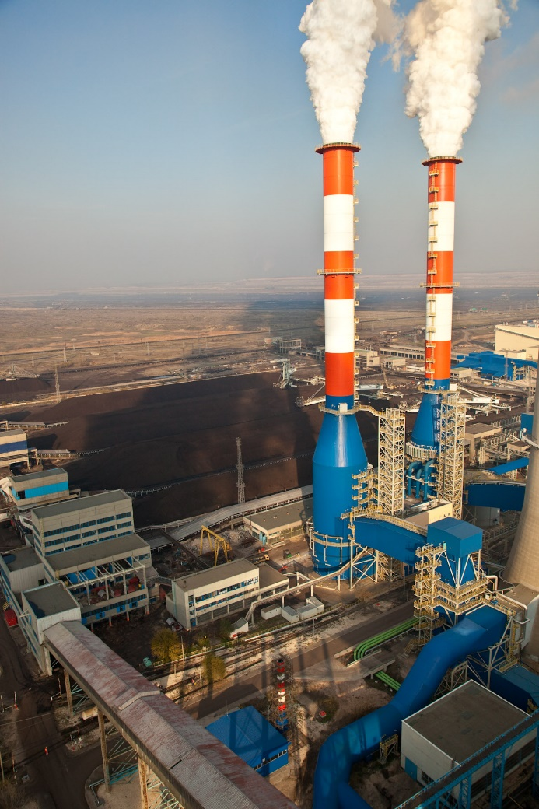
ContourGlobal Maritsa East 3 TPP - Project History
    1978 – 81 Plant commissioned
    2001 Long term agreement signed with NEK
    2003 Start of Rehabilitation and Modernization Project, amounting EUR 650m
    2009 Completion of modernization works
    2012 – today NOx Reduction and FGD Efficiency Increase Projects per 2016 EU Directive almost complete
    Results of Refurbishment
    8% Output increase
    17% Efficiency increase
    20 times reduction in Sulfur Dioxide Emissions
    2.5 times reduction in Nitrous Oxide emissions
    25 year lifetime extension

Slide 5
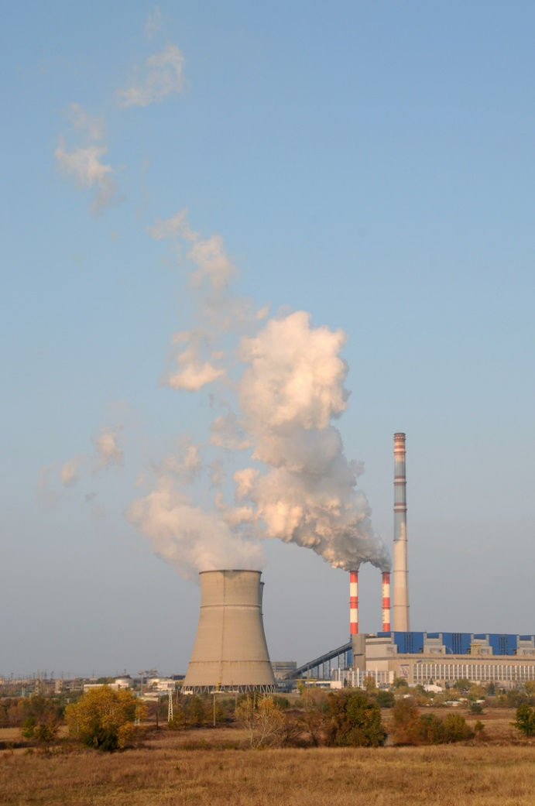
ContourGlobal Maritsa East 3 TPP - Today
Installed Capacity - 908 MW
4 Units: 227 MW each, Lignite fired boilers
Efficiency over 36%
Availability over 88%
  Electrostatic precipitators efficiency - over 99,96%
  In combination with the FGDs wet process ESP ensures a level of dust emission app. 3 mg/Nm3: far below the actual law limit (50 mg/Nm3) and the future limit (20 mg/Nm3)
  Low NOx firing system installed on 3 Units with NOx emissions below 180 mg/Nm3. Last Unit Nox system to be upgraded in 2015.
  2 FGDs: each one serving 2 units with actual SOx removal efficiency of 96%.

Slide 6
Success Indicators – Before, After, and Today
Before
After Refurbishment
After Further Optimization
Gross Power 840MW 908 MW 908 MW
Net Efficiency 30% 35% 36%
The first lignite
power plant in the
Balkans in full
compliance with
the EU
Environmental
Standards
1 075
0,5
0,15
2,5
CO₂(g/kWh)
SOx (g/kWh)
NOx (g/kWh)
Particulate (g/kWh)
Drastic Emissions Reduction

Slide 7
What benefits to Bulgaria?
    Eur 650m of Foreign direct investment in to Bulgaria between 2004-09 just for this one project
    No cost to the State Budget
    100% locally sourced fuel hence no security of supply issue or payments to import fuel from other countries
    A very reliable fully environmentally complaint large power plant with a useful life of a further 25 years.
    How are such investments possible?
      Predictable revenue streams are the only way to realistically raise project finance in todays environment
      Hence why the Governments of Spain, France, UK and Italy either have or are introducing capacity mechanisms, all with the support of the EU
      UK has just had approved for it to give a contract for differences so a new Nuclear plant can be built, again with EU approval
      HEP the Croatian Utility is offering a 100% PPA for an investor to build a new coal fired plant (Plomen C)
Notes:
If no Rehabilitation of ME3:
No clean air, and continuous pollution, increase of illnesses, damage on people’s health, future and the environment
Lack of reliable power supply
No collateral jobs and businesses, no development of the energy sector of Bulgaria
Sanctions to the state
No or slow accession in EU
Polluting TPPs:
Why they are presented as victims, and their workers are always taken on the streets to defend their management and plants?
The our price includes elements which can be witnessed easily like cleaner environment, and environment leadership, like jobs and technical progress, but also with features which can not be grasped by a by-stander’s eye: good governance, sustainability and CSR in particular, transparent procurement, business ethics, and continuous improvement.

Slide 8
How CGME3 is structured to support the investment
Illustrative schematics of contracts
NEK
Technical
Services
Agreement
Letter
of support
PPA,
Ancillary
Services
Agreement
and ACMA
Bulgarian Government
CG Operations Bulgaria AD
Maritsa East Mines
O&M
Agreement
Lignite Supply Agreement
and Waste Disposal and
Transportation
Agreement
Technical
Services
Agreement
ContourGlobal Maritsa East 3
Limestone
Supply
Agreement
ContourGlobal
Local Limestone Suppliers
SocGen – EUR 450 mln Loan
Fully Guaranteed by SACE

Slide 9
Financial Deficit of the Energy System – Strategy?
      The problems in the energy sector are widely discussed and reported. Most of these problems lead to a situation where NEK has expenses significantly in excess of its income. While there is lots of discussion there is little action, decisive action has frozen by political paralysis for almost 2 years
      What needs to be done is obvious:
      Shut down the old environmentally non complainant plants that are expensive and not needed
      Introduce more transparency in the power sales of the state-owned plants so that large profits are not transferred to middle men taking much needed liquidity out of the power sector
      A way needs to be found to reduce the burden on the sector of the excessive RES capacities caused by the lack of control of the state of the amount added in a short space of time
      Gradually increase end user prices to a sustainable level while protecting the energy poor
      Work with the plants with PPA’s to find agree measures to reduce the short term burden on NEK
      What needs to be done is obvious but that does not mean it is easy to do
      CGME3 is only a small part of the problem and hence can only be a small part of the solution
Notes:
The new Government needs to provide bold and decisive leadership, coalition talks so far don’t bode well for having that type Government
The Energy Board may help

