Slide 1
Polish energy strategy and the role of local coal resources in the national power generation structure of Poland
- challenges and options
Sylwia Sikora
Mining Department
Ministry of Economy
Sofia, October 28-29, 2014

Slide 2
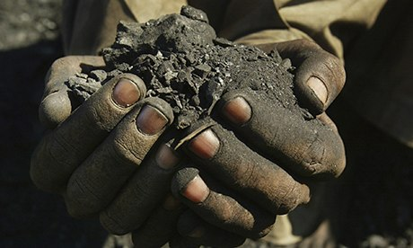
Agenda
1
The role of coal in the polish energy policy
2
Scenarios for different fuel demand in the current
Energy Policy of Poland until 2030 (still force)
3
Energy mix of Poland in 2050
4
Conclusions
Notes:
2

Slide 3
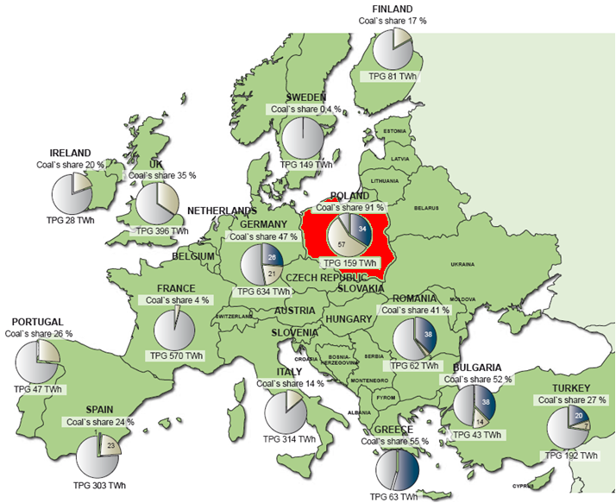
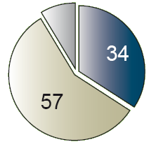
Electricity generation sector in Poland is based on coal …
POLAND
Lignite
35%
53%
88%
Hard coal
Coal’s share 88%
EU 27
Coal’s share 29 %
Notes:
Coal has been for many decades a fundamental source of primary energy and for electricity production on the global scale. Thus, It is undisputable that coal due to the availability of its global resources make him predominant fuel for the electricity production for the long term. Poland as a country with the biggest coal reserves in the European Union, traditionally depended on coal. Presently, Polish energy sector in 90% is based on coal fuel as most of the capacity is installed in coal fired power plants. It should be emphasize that Polish energy sector has the largest share of coal in the European Union's countries.

Slide 4
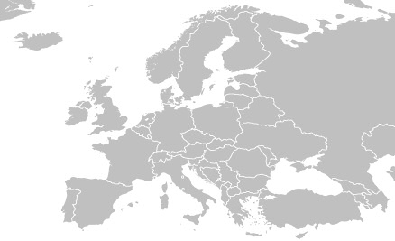
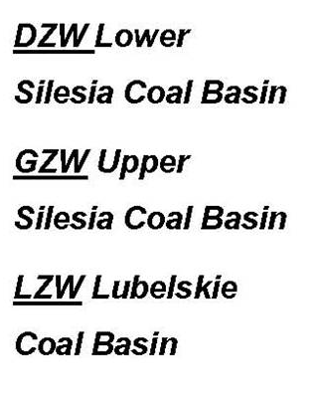
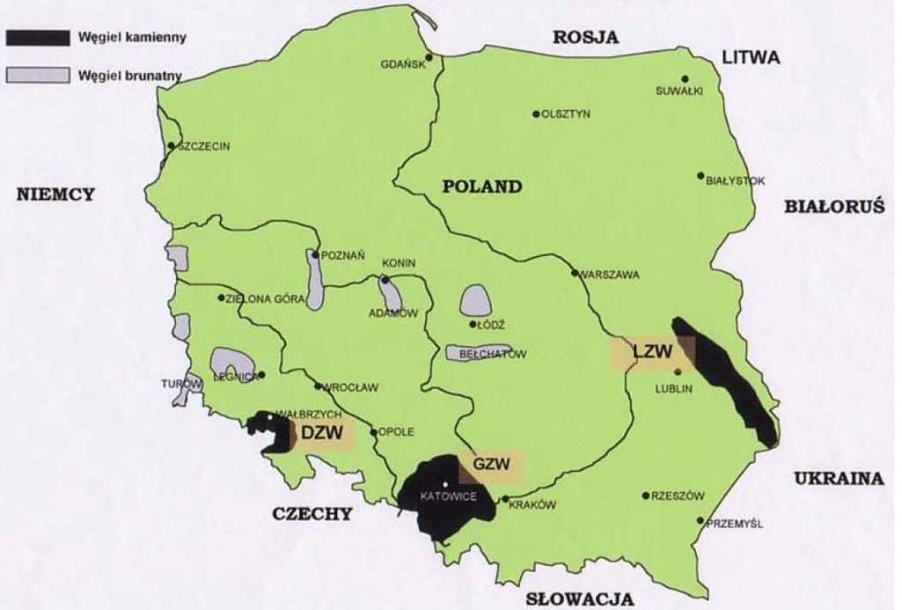
Polish coal basin
Notes:
Development of the polish coal mining industry have a long established connection with the availability of its geological resources.
In this map we can see the three coalfields of hard coal in the country, Upper Silesia, Lower Silesia and Lublin, marked in black. Hard coal extraction is being presently conducted in two mining basins - in Upper Silesian Coal Basin with its 94 % share in the total production and in Lublin Coal Basin – i.e. in „Bogdanka” mine with its 6% share in the coal production.
Lignite extraction is mainly located in four areas: Adamów, Belchatów, Konin, and Turów, marked in gray.

Slide 5
Achievements of Polish hard coal sector in years 2012, 2013 ans 8 months of 2014
2012
2013
8 months of 2014
Output: 78.1 mln tones
74.9 mln tones
45.8 mln tones
Sale: 71.2 mln tones
75.7 mln tones
43.2 mln tones
Export: 7.4 mln tones
10.4 mln tones
5.5 mln tones
Import: 10.1 mln tones
10.8 mln tones
5 mln tones
Use: 74.7 mln tones
79.2 mln tones
42.2 mln tones
employment: 113 thous. p.
107 thous. p
103 thous. p
Investments: 4.0 bln PLN
3.2 bln PLN
1.7 bln PLN
Outcome: 1.6 bln PLN
-0.3 bln PLN
-0.9 bln PLN
Notes:
The state policy towards hard coal mining sector will ensure its competitiveness and successful operation in the
market economy. After years of restructuring process of the hard coal mining industry in Poland is currently in good condition.
Investments are an essential element included in the sector strategy. They should allow to maintain coal production
at a level corresponding to the domestic demand and economically justified export, at the same time taking into
account quality improvement of coal produced as an environmentally friendly fuel in terms of clean combustion
technologies.

Slide 6
Energy Policy of Poland until 2030
The demand for primary energy by type of fuel
 | Unit | 2006 | 2010 | 2015 | 2020 | 2025 | 2030 | Change of the demand 2006-2030 [%]
Hard Coal | Mtoe | 12,6 | 11,22 | 12,16 | 9,39 | 11,21 | 9,72 | -23%
 | mln tonnes | 59,4 | 52,8 | 57,2 | 44,2 | 52,7 | 45,7
Lignite | Mtoe | 43,8 | 37,9 | 35,3 | 34,6 | 34 | 36,7 | -16%
 | mln tonnes | 76,5 | 66,1 | 61,7 | 60,4 | 59,3 | 64
Crude oil and fuels | Mtoe | 24,3 | 25,1 | 26,1 | 27,4 | 29,5 | 31,1 | 28%
 | mln tonnes | 24,3 | 25,1 | 26,1 | 27,4 | 29,5 | 31,1
Gas | Mtoe | 12,3 | 12 | 13 | 14,5 | 16,1 | 17,2 | 40%
 | bln m³ | 14,5 | 14,1 | 15,4 | 17,1 | 19 | 20,2
Renewable Energy | Mtoe | 5 | 6,3 | 8,4 | 12,2 | 13,8 | 14,7 | 194%
Other fuels | Mtoe | 0,7 | 0,7 | 0,9 | 1,1 | 1,4 | 1,6 | 129%
Nuclear fuel | Mtoe | 0 | 0 | 0 | 2,5 | 5 | 7,5
Export of electricity | Mtoe | -0,9 | 0 | 0 | 0 | 0 | 0
Primary Energy in total | Mtoe | 97,8 | 93,2 | 95,8 | 101,7 | 111 | 118,5 | 21%
Notes:
The 1990 Polish Energy Policy estimated that in 2010 hard coal production would be at the level of 145-162 million tonnes, and the production of lignite at the level of 55-88 million tonnes (depending on variant). By contrast, according to the policy of 1995, the demand for hard coal in 2010 was to be at the level of 115 million tons, and the demand for lignite in 2010 at the level of 61-77 million tonnes (depending on variant).
Another document of the government from 2000 predicted that the demand for hard coal in 2020 will be at the level 82-83,5 million tonnes tonnes (depending on the variant), and the demand for lignite in 2020 at the level 65.6 million tons (in depending on the variant). The current energy policy of 2009 assumes a gradual fall of the demand for coal, both hard coal and lignite. Nevertheless I would to emphasize that the actual coal consumption in recent years is much bigger than the consumption volumes according to this very document. Currently, the new energy policy of Poland until 2050 is in the last phase of preparation.

Slide 7
Energy Mix of Poland in 2050
Summary results of selected scenarios
REF – Sc. 1
STATUSQUO – Sc. 7
GAS-CO2WYS – Sc. 10
NUCLEAR-MIX – Sc. 11
Notes:
The study considered 16 possible scenarios. Basically, the main purpose was to study the demand for hard coal and lignite but also, scenarios involving the development of gas and nuclear energy were taken into account. On 28 January this year, Polish government approved a nuclear energy program, assuming that electricity from the first nuclear power plant will enter into the system in 2025. Due to time constraints, It is not possible present the results of calculations carried out for the 16 scenarios today, thus in the next slides of the presentation i will show the results for four scenarios: REF - Sc. 1 (assumes investments in new capacity in the mining of coal and lignite), STATUSQUO - Sc. 7 (none of these investments), GAS-CO2WYS - Sc. 10 (low gas prices + high CO2 prices) and NUCLEAR-MIX - Sc. 11 (the construction of three nuclear power plant : obligatory operation of three nuclear power plants at 1.5 GW each in the years of 2025, 2030 and 2035).

Slide 8
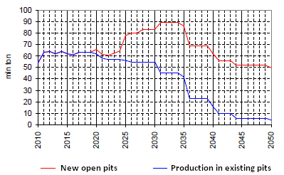
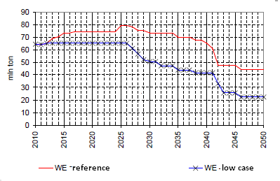
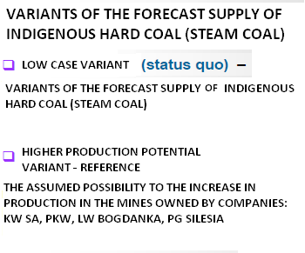
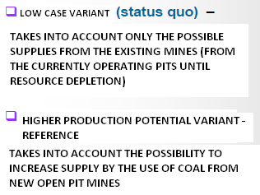
Energy Mix of Poland in 2050
Forecast supply of hard coal and lignite
Notes:
Graphs illustrate the assumption of the future supply of hard coal and lignite. As you can see, without successful finalization of investments in the coming years, the extraction from existing fields significantly decreases after 2030 both in case of coal and lignite (blue lines). The level of coal stocks held in Poland, in conjunction with investments in mining sector will allow for many years to support the national energy balance of the solid fuel.

Slide 9
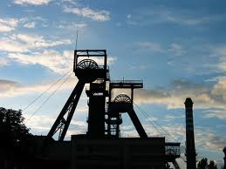
Future of hard coal sector
It should be:
competitive,
operate in market economy
Coal companies should be:
at high level of safety,
modern and innovated
have low impatc on enviroment ,
offer stability and flexibility of employment
Notes:
The goal of the State policy towards the hard coal mining industry is to rationally and effectively manage the coal
deposits located in the territory of the Republic of Poland so that these resources serve next generations of Poles.
Hard coal may still constitute a valuable contribution to ensuring security of energy supplies and into the EU and whole world economy, provided technologies enabling radical reduction of CO2 emission, which is generated at combustion, are applied.

Slide 10
Conclusions
The share of coal and lignite in the structure of primary energy depends primarily on the development of prices of CO2 emission allowances, coal supply capabilities and development of the domestic gas sector.
Regardless of the level of domestic supply of coal , the power sector will use coal to produce electricity and heat. If the domestic supply is to be reduced, imported coal will be used.
Power based on brown coal remains the cheapest option of electricity generation depending on the low price of CO2 emission allowances . In the case of high prices of CO2 emission rights, power plants equipped with CCS technology are needed.
The development of new capacity in the mining of lignite in the coming years should focus on providing fuel for existing (retrofit and upgraded) power. Commissioning of all planned new pits in the years 2025-2035 , will result in an excess supply of brown coal.
In the analyzed period, demand in the power sector will exceed supply capabilities of currently operating mines. It is therefore appropriate to further develop the industry of coal mining of coal and lignite .

Slide 11
Thank you for your attention!
Sylwia Sikora
Chief Expert
Mining Department
Ministry of Economy
sylwia.sikora@mg.gov.pl

