Slide 1
The European Energy Transition: which place for Bulgaria?
Susanne NIES
Head of Unit Distribution, EURELECTRIC
snies@eurelectric.org
5th Regional Energy Conference
October 28-29th 2014, Sofia
Notes:
1
EU policies and thinking to get to a truly integrated EU market
Carbon-neutrality by 2050: Power Choices study and CEO Declaration of 2008. IPCC has indicated a need for OECD countries to reduce emissions by 60-80% to limit temperature rise to 2°C. Consequence: OECD power sector has to be virtually carbon-free by 2050. Power Choices therefore assumes a reduction target for the whole EU economy of 75% versus 1990 levels by 2050 (conform to European Council choice to go minus 80-95%, with offsets)
“Electricity – especially when becoming carbon-neutral - is the solution” to decarbonise most of Europe’s economy (adopt electricity on the demand side: heating/ cooling, transport etc).

Slide 2
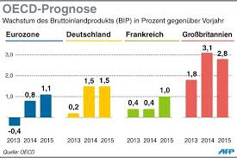
EU Economy set for stagnation.. Energy is decisive

Slide 3
New Commission (2014-19)
Jean-Claude JUNCKER’s 5 priorities
Growth and Jobs
Energy
TTIP
Reform Monetary Union
“Answer the British question”

Slide 4
Current main topics EC
Security of Supply -SoS
Internal Energy Market -IEM
2030
Retail Market Communication
! EC all in all much more supportive to regional approach, to ETS approach, as well as customer centric approach.

Slide 5
The right discussion is…
About investments in liberalized and regulated environments, not about public against private
About flexible system, not about RES OR conventional until 2030 at least..
Future beyond RES: Energy Efficiency, Smart Meters, New Downstream etc. Not about RES only, nor the merits of yesterday
The most cost efficient way to get the transition right, supporting energy poor in an adequate way, without compromising the European industry, and economy!

Slide 6
European electricity market today:
Key challenges
-Costs! Energy Transition is an alpine project! Take the right face!
-Regulatory intervention! Growing national and EU regulatory intervention and less market (U turn from liberalization agenda, and from EU market integration)
-System approach is lost! Progress in market integration and necessary system solutions (grids …) is too slow to accommodate growing share of variable renewables : system risks and costs growing
-Lack of European and market perspective in defining energy policies by Member States resulting in sub-optimal and costly policy choices

Slide 7
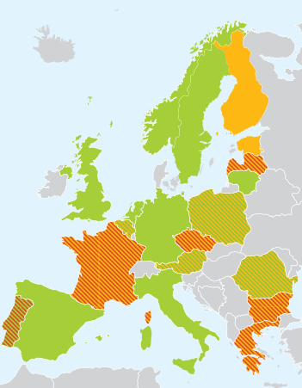
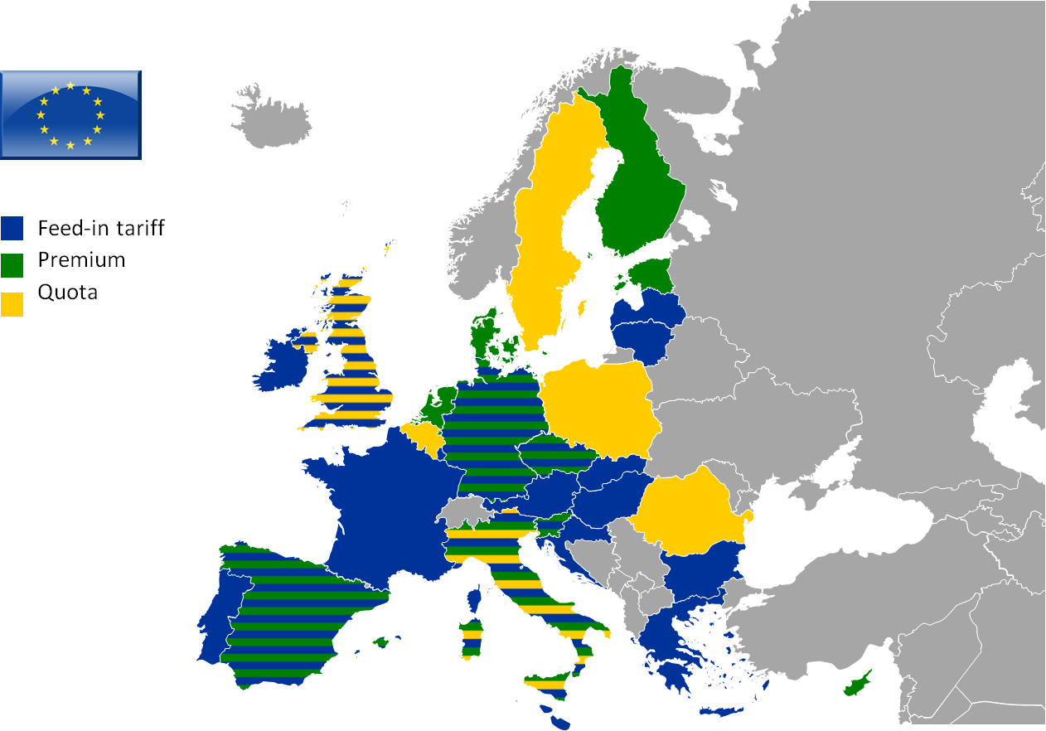
Reform RES Policies and link up with ETS and innovation
Huge amount of RES-E support schemes
Overcompensation passed on to consumers
- RES support changes in Europe
SOURCE: EURELECTRIC
Notes:
Only immature technologies could continue to receive specific support in their research, development and deployment phase and following strictly defined requirements.
For that purpose, a definition for mature and immature technology should be developed.
Existing commitments directly related to the support renewables must be respected until the foreseen time horizon.
Not the case today: 13 EU member states have opted for retroactive changes or moratoria to their RES support schemes

Slide 8
A Dynamic Approach to Technology Support !
Less Deployed RES Technologies
Deployed RES Technologies
Research, Development and Innovation State Aid Guidelines
Environmental and Energy State Aid Guidelines
Direct R&D grants
Grey zone
R&D risk sharing and loan guarantees
R&D tax credits or rebates
Demonstration funding
FIT
FIP
Green certificates with technology banding
Technology neutral Green Certificates
Tenders for RES production (with FIP €/MWh)
Tenders for RES capacity (€/MW)
Investment aid
Operational aid
Tax incentives, loans, grants
Technology risk
Regulatory risk
Market risk
1. Basic Research
2. R&D
3. Demonstration
4. Deployment
5. Commercialisation

Slide 9
Promote innovation in technologies, products, services and business models
1
2
Source: McKinsey Industry vision team analysis
Notes:
- Full value chain
- Systems approach

Slide 10
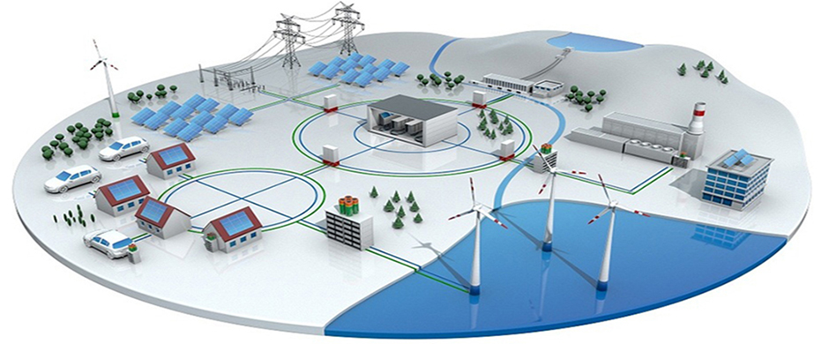
What about grids?
Distribution is key…

Slide 11
RELIABLE
In the future:
Distribution network investments share within overall network investment is expected to rise from 2/3 by 2020 to 4/5 by 2050
Replacement and extension
Smart metering & data handling
Integration of distributed energy sources
Notes:
To maintain the current reliability substantial investments in distribution networks will be needed in the future:
To replace ageing infrastructure
To connect and manage distributed energy resources
To install smart meters & data handling

Slide 12
Energy Policy in Bulgaria
Bulgaria’s power system based on Nuclear (14.5%), fossil fuels (mostly coal) (50%) and RES. (35.5%)
Significant structural overcapacity- export market before crisis Greece, but partly lost (replaced by local hydro in Greece)- Turkey as an option?
Highest energy intensity in the EU- no price signal, no policy on Energy efficiency in residential, services, transport (only in industry)
Huge regulatory intervention into the market leading to distortions, high costs, inefficiency: cross subsidization, regulated prices
In gas (14% of energy mix=below EU average) full dependency on Russian imports. Alternatives could be Southern corridor, in emergency LNG from Greek LNG terminal through pipeline
RES development as an ‘overshooting’ strategy with too generous FIT: Bulgaria has a target of 16% RES- reached in 2013! Export through cooperation mechanisms?
1/5th of the population below poverty line : 1.5 million from 7.3!

Slide 13
Energy poverty in Bulgaria- how to tackle
There is no evidence that regulated prices or cross subsidization reduce energy poverty!
Social policy can not be made through electricity tariffs!
The right way is social targeting, infrastructure, energy efficiency loans, as well as regional internal market!
Increase of power prices on October 1st is a right step, but there is a need for setting up sound energy regulation for Bulgaria.

Slide 14
Need for action now! Bulgaria fit for purpose
Short Term measures and long term measures needed!
Develop a dedicated welfare policy on energy poverty, separate from the energy policy! Well targeted, adequate, effective.
Develop a clear overall energy policy plan- using the energy board as set up by the Caretaker Government
Develop a sound regulatory framework and in particular a fully independent energy regulator, instead of regulated market go to market! Use the experience of other EU members. (twinning)
Shape the market according to the principles of non-discrimination, transparency and objectivity
Facilitate exports of electricity in particular to Turkey: interconnection
Tap the potential of energy efficiency!
IMPLEMENT THE RECOMMENDATIONS OF THE EU COMMISSION FROM 2013 WITH NO DELAY!
Published on Website of Bulgarian Energy Ministry http://www.mi.government.bg/bg/theme-news/konstatacii-na-evropeiskata-komisiya-i-svetovnata-banka-za-balgarskiya-energien-sektor-1194-m0-a0-1.html

Slide 15
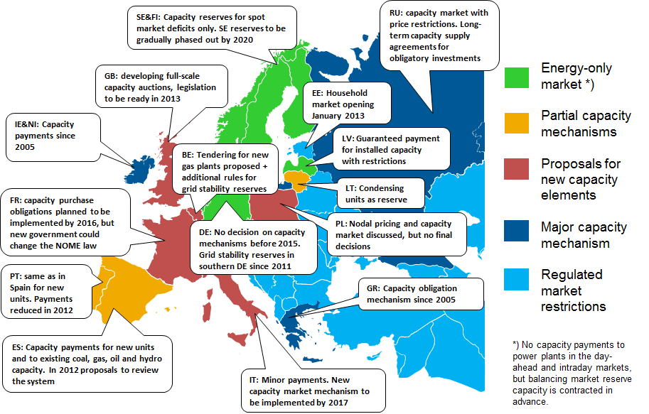
EU Transition can only be successful with a regional approach, not a national one
A national patchwork of CRMs, RES support, and even CO2 regimes in Europe: this is not the way forward
Completion of the EU energy market requires a European-wide coordinated energy policy
(improve Lisbon’s Treaty Article 194)

Slide 16
Bulgaria- a main player in a highly dynamic region of tomorrow
As Poland has developed to a regional central player, Bulgaria has to exploit its potential: in benchmarking, improving, leading
Regional conferences like this very relevant. Work continues after event!
EURELECTRIC and its regional members, IME, are in for support and expertise and encourage the government to work with EU and national stakeholders, ACER, ENTSO-E

Slide 17
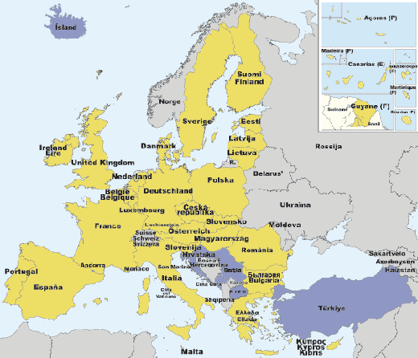
Thank you for your attention!
Susanne Nies
Head of Unit Energy Policy EURELECTRIC
snies@eurelectric.org

