Slide 1
Cyber security through the user eyes. Good practices.
International Conference “Energy Security of South Europe and the National Security”
Atanas Radev
Expert
15.06.2018 Sofia
Center for National Security and Defense Research, Bulgarian Academy of Sciences

Slide 2
Good practices
Information security framework
Stop data loss
Detection of Internal threats
Always back up your data
Beware of Social engineerng

Slide 3
Good practices
User training and education
Make a good and clear policy for new employees and third parties
Regularly update your system
Create a list of incidents and how to deal with them
Maintenance of certificates and security standards.

Slide 4
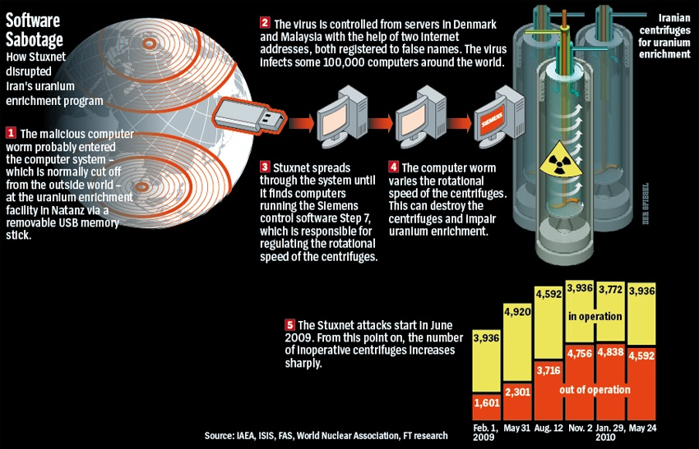

Slide 5
Thank you for your attention!

