Slide 1
Rosatom: market solutions for EU customers
Ilya Solovyev
General Manager Central Europe, Rusatom International Network

Slide 2
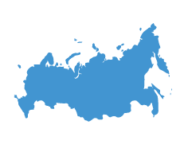

ROSATOM: Energy Major with Global Outreach
30.1 GW
№1-36 UNITS
OF installed capacities operated in Russia
By npp units
in international backlog
18.9 %
36 %
Of total russian electricity generated by rosatom
Of global enrichment market
U-235
Of global
uranium extraction
14 %

Slide 3

Rosatom Integrated Offer
Nuclear
Infrastructure Development
Public Acceptance
Back End
Human Resources Development
60%
Operation & Maintenance
Industrial solution
local industry Involvement
Fuel Supply
Energy
Solution

Slide 4
Rosatom references: Global VVER Fleet
Finland
Russia
Germany
2
1
3
21
Belarus
6
6
Czech
Republic
2
Ukraine
Armenia
6
15
Slovakia
1
1
1
Turkey
Uzbekistan
Rosatom Success Story:
2
4
Iran
2
China
4
4
4
Hungary
Bulgaria
1
8
Shutdown
4
2
4
India
16
4
2
Egypt
2
4
Bangladesh
operational
2
2
62
Nigeria
42
In implementation
Total: 120

Slide 5
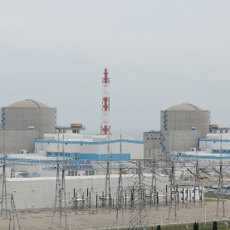
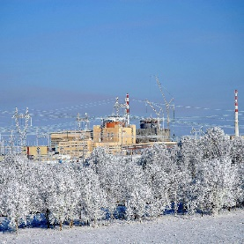
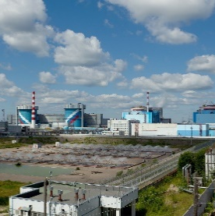
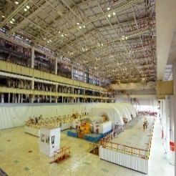
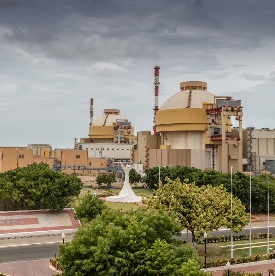
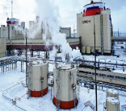
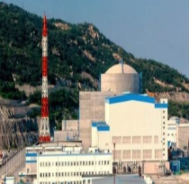
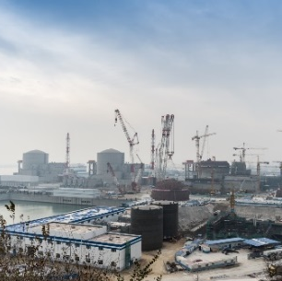
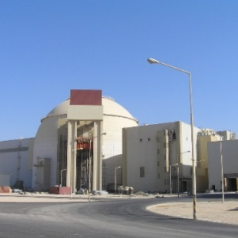
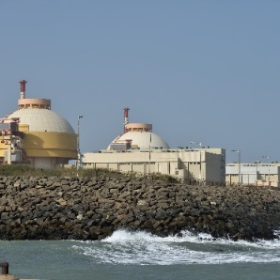
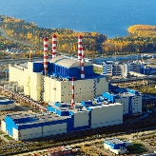
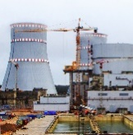
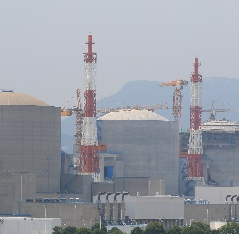
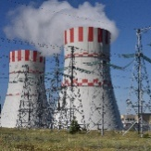
ROSATOM: THE ONLY COMPANY IMPLEMENTING
SERIAL NPP CONSTRUCTION DOMESTIC AND ABROAD
Continuous success: 14 NPPs in 12 YEARS
Rostov 4
Rostov 3
Kudankulam 2
Tianwan 4
Tianwan 1
Rostov 2
Kalinin 4
2006
2007
2008
2009
2010
2011
2012
2013
2014
2015
2016
2017
2018
Tianwan 2
Kudankulam 1
Beloyarsk 4
Leningrad 2-1
Busher 1
Tianwan 3
Novovoronezh 6
NPP construction abroad
NPP construction in Russia

Slide 6








IMPLEMENTING VARIOUS MODELS: FLEXIBILITY FOR PROJECTS
EPC Model
Engineering, procurement, Construction
FINANCIAL FLEXIBILITY:
Egypt
Hungary
Belarus
Bangladesh
Rosatom provides opportunity to implement VARIOUS FINANCIAL MODELS depending on the special features of the partner country
ВОО MODEL
BUILT, OWN, OPERATE
Finland
Turkey
MULTIPLE Subcontracts MODEL
FRAMEWORK CONTRACT, Technical
Design Contract, General contract etc
China
India

Slide 7
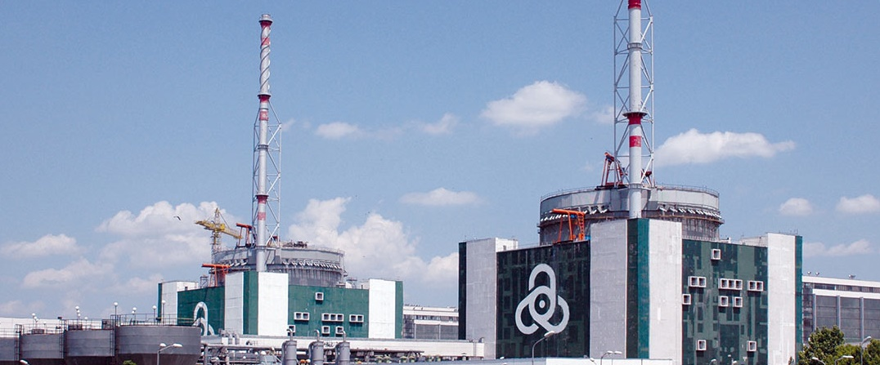
Kozloduy NPP, Bulgaria
Service, Life-time extension, Fuel supply
Reactor type: VVER-1000
Capacity: 2 x 1000 MW
Operating reactors - Russian design
Supplies of nuclear fuel by TVEL
Cooperation in Lifetime Extension project Rusatom Service

Slide 8
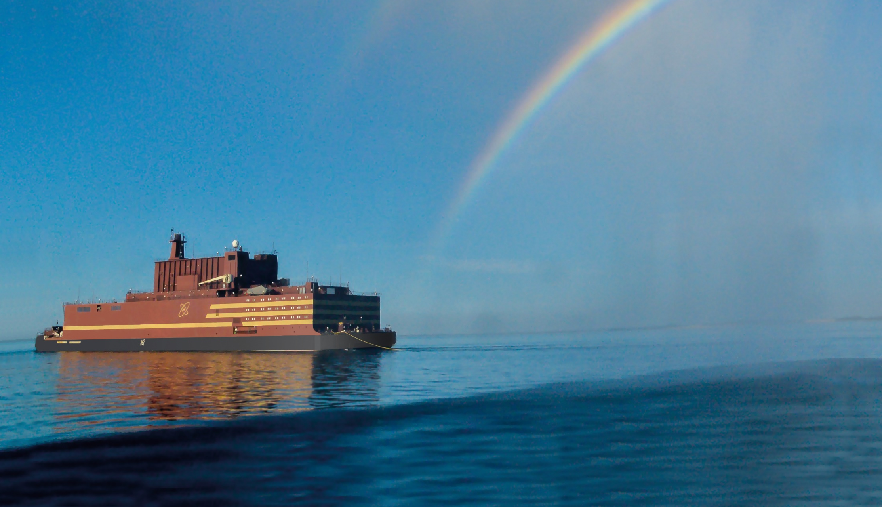
  World’s first floating nuclear power plant FNPP Akademik Lomonosov
AKADEMIK LOMONOSOV
FNPP
    THE FIRST-OF-A-KIND PROJECT
2019
  COMMISSIONING DATE:
After commissioning FNPP will replace aging power generating capacities providing electrical power to the city of Pevek, one of the major Arctic ports in the North-East of Russia

Slide 9
Thank you for your attention!

