Slide 1
Public Power Corporation
and the
Energy Transition
8th Regional Energy Conference
“Today’s Agenda of The Regional Energy Development – Priorities, Technologies, Markets”
Sofia Hotel Balkan
17 May 2019
1

Slide 2

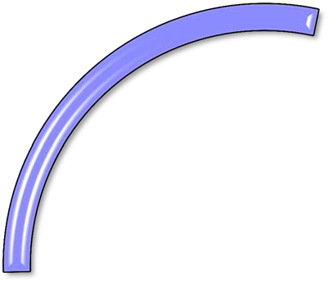
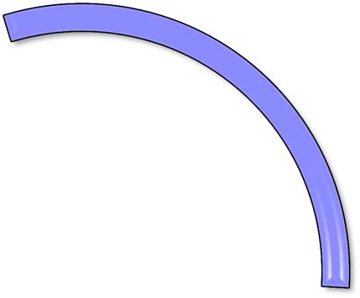
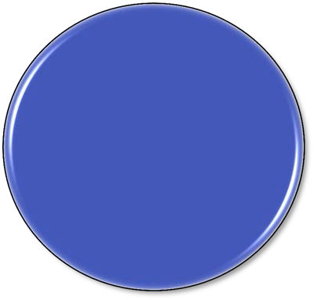


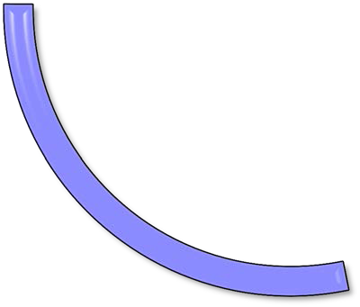


PPC’s PROFILE
Mines
35 million tons of lignite/year
€ 1,6 billion fixed assets
Generation
12,1 GW
Installed capacity 13 steam electric
plants, 16 hydroelectric
plants, 32 stand-alone power plants
€ 6,1 billion fixed
assets
Turnover:
€ 4.944 million
Personnel: 17.519 Annual production: 33 TWh
Distribution
238,219 km of low/medium voltage lines and 989 km of high voltage lines 3,7 billion fixed assets
Supply 7,2 million customers
112 branches

Slide 3
PPC Group Structure
PPC S.A.
MINES
GENERATION
SUPPLY
100%
HEDNO S.A.
100%
LIGNITIKI
MELITIS S.A
100%
PPC Elektrik Tedarik Ve Ticaret A.S.
100%
PPC
Renewables S.A
100%
LIGNITIKI MEGALOPOLIS S.A.
85 %
PPC Bulgaria JSCo
10%
To be divested
90%
PPC FINANCE PLC
100 %
PPC Albania
100 %
EDS
3

Slide 4
PPC’s installed generation capacity
Power Plants | Installed Capacity (MW)
Interconnected System | 9,335
Thermal | 6,096
Lignite ^{(*)} | 4,337
Natural Gas | 2,689
Hydro | 3,171
Renewables | 68
Non-Interconnected Islands | 1,827
Oil | 1,769
Renewables | 58
Total Installed Capacity | 12,092
Asset Portfolio
59 major power plants (excluding RES and the units of the Lignite Subsidiaries to be divested), of which 36 located in the Non-Interconnected Islands
^{(*)} Including lignite subsidiaries “Lignitiki Melitis S.A.” and “Lignitiki Megalopolis S.A.” (930 MW in total)
Lignite Power Plant
Hydro Power Plant
Gas-fired Power Plant
Oil Power Plant
Lignite Mine Center
Small Hydro Power Plant
Photovoltaic Power Plant
Wind Park
4

Slide 5
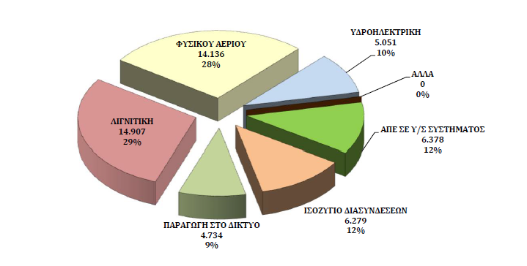
Generation (2018, interconnected system)
NATURAL GAS
HYDRO
OTHER
LIGNITE
RENEWABLES (H/V)
Total: 51,5 TWh
INTERCONNECTIONS BALANCE
Source: IPTO
GENERATION IN THE NETWORK
«…In fact, lignite-fired generation still plays an essential role on the wholesale electricity market and is crucial for the security of supply in Greece. Based on the current market circumstances, all interested parties recognize that the current level of lignite-fired generation will still be heavily needed to balance the Greek wholesale market …»*
* European Commission Decision of 17.4.2018, Case AT.38700, – Greek lignite and electricity markets

Slide 6
Key Strategic Priority:
Significant increase of RES installed capacity
(MW)
Total capex for RES (2018–2022): ca. € 700 mln
6

Slide 7

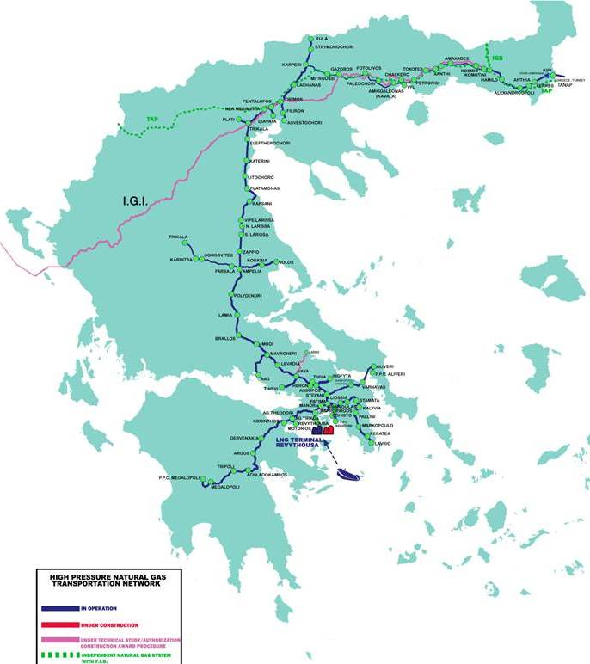
Natural gas: A transitory fuel in PPC’s Portofolio
Bulgaria (“Strimonochori”) entrance point
Komotini
NATURAL GAS POWER PLANT | CAPACITY [MW] | CONSUMPTION 2018 (bcm) | ESTIMATED CONSUMPTION 2019 (bcm) | ESTIMATED CONSUMPTION AS FROM 2021 (bcm)
ALIVERI | 426,9 | ~0,40 | ~0,40 | ~0,50
LAVRION | 945,2 | ~0,23 | ~0,42 | ~0,20
MEGALOPOLIS | 832 | ~0,33 | ~0,35 | ~0,90
KOMOTINI | 484,6 | ~0,29 | ~0,23 | ~0,10
TOTAL | 2.688,7 | ~1,25 | ~1,45 | ~1,7
Turkey (“Kipoi”) entrance point:
Current Operational capacity: ~1,5 bcm/year
Aliveri
Lavrion
LNG Terminal (“Revithoussa”)
Operational Capacity: ~4,4bcm / year
Storage: 225.000 m³
Re-gasification Capacity :
12,47 mcm/d
Megalopolis
PPC is currently the largest natural gas consumer in the country and the Balkans, using gas for power generation.

Slide 8
Transition of PPC to a cleaner energy mix
(MW)
Reduction of installed lignite-fired capacity by c.50% by 2022
Lignite-fired generation vital for the security of supply during the energy transition
8

Slide 9
Reduction of carbon intensity of PPC generation
Drastic reduction of CO₂ emissions by approximately 57% until 2022, bringing about significant decrease of carbon intensity of PPC generation.
9

Slide 10
Overcoming the energy transition challenges in Southeastern Europe
Geographical specificities
Security of supply issues
Energy poverty
Social aspect of the transition within the coal intensive regions
Geopolitical challenges
PPC is ready and willing to proactively engage in systematic cooperation with all Southeastern European stakeholders to facilitate the transition in the region

Slide 11
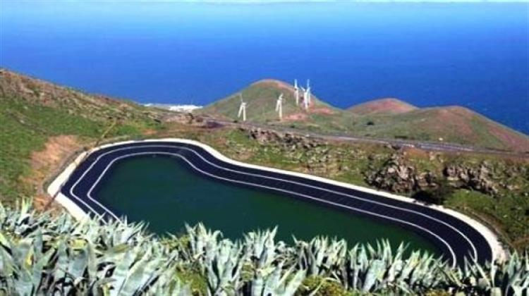
PPC’s Hybrid RES Plant on the island of Ikaria
Thank you for your attention

