Slide 1


Horizon 2020
The biggest EU Research and Innovation programme ever
€80 billion of funding available over 7 years (2014 to 2020)
More breakthroughs, discoveries and world-firsts by taking great ideas from the lab to the market

Slide 2
ESO participate in three Horizon 2020 projects:
SDN MicroSENSE
EnergyShield
FORESIGHT

Slide 3

SDN MicroSENSE
Project SDN-microSENSE – SDN – microgrid reSilient Electrical eNergy SystEm (SDN-microSENSE):
Funded by the multiannual program of the European Union for Research and Innovation - Horizon 2020
Consortium of 31 organizations
Project coordinator the Spanish company AYESA ADVANCED TECHNOLOGIES SA and ESO EAD as a partner.
Three Transmission System Operators - from Bulgaria, Greece and Slovenia.

Slide 4
General information
SDN-microSENSE intends to provide a set of secure, privacy-enabled and resilient to cyberattacks tools, thus ensuring the normal operation of EPES as well as the integrity and the confidentiality of communications.

Slide 5
Objectives
Objective 5
To provide a robust, distributed and effective IT cyber-defence system for large-scale EPES ecosystem
Objective 6
To design and deploy an anonymous channel of EPES which will allow secure and privacy-preserving information sharing among energy operators and actors
Objective 7
To deliver a privacy-preserving framework for enhancing EPES against data breaches
Objective 8
To design and develop a policy recommendation framework based on the SDN-microSENSE results
Objective 9
To demonstrate five large-scale pilots across Europe
Objective1
Objective 2
Objective 3
To design and provide a new resilient, multi-layered and SDN-enabled architecture
Objective 4
To design and develop a risk assessment and management framework
Applications which exploit direct networking controllability and programmability for going toward achieving resilient and secure operations
Deliver a blockchain-based energy trading platform for secure and flexible trading management

Slide 6
Deliverables
Providing and demonstrating a secure, resilient to cyber-attacks, privacy-enabled, and protected against data breaches solution for decentralised Electrical Power and Energy Systems (EPES)
Strengthening EPES domains with self-healing capabilities based on islanding and fast grid recovery processes exploiting renewable sources
Enabling effective energy exchange between microgrids and residential prosumers
Security information and event management (SIEM) tool for anomaly detection and response with advanced machine learning capabilities
Blockchain-based energy trading system, that will offer a decentralised, trusted, and auditable exchange of energy trading transactions between parties

Slide 7
Conclusion
SDN-microSENSE brings together key players in Smart Grid and energy systems - suppliers, manufacturers and integrators of research centers, academia and high-tech SMEs. The primary goal of SDN-microSENSE is to make innovative products and services researched as a market-friendly offer for markets across Europe.

Slide 8
EnergyShield Project
Integrated Cybersecurity Solution for the Vulnerability Assessment, Monitoring and Protection of Critical Energy Infrastructures
Funded by the European Union’s multinational research and innovation program – Horizon 2020
Budget – € 7,4 million
10 countries
18 partners
Start date: 1st of July 2019
Duration: 36 months
Notes:
EnergyShield proposal was submitted for a Innovation Action initiative under Cyber security in the Electrical Power and Energy System (EPES)

Slide 9
Energy shield
EnergyShield project aims at testing small-scale and large-scale disruption attack scenarios in a live cyber-defence exercise
  Cybersecurity in the Electrical Power and Energy System (EPES): an armour against cyber and privacy attacks and data breaches
  EnergyShield captures the needs of Electrical Power and Energy System (EPES) operators and combines the latest technologies for vulnerability assessment, supervision and protection to draft a defensive toolkit.
Notes:
EnergyShield is a H2020 project with 18 partners aiming at creating a toolkit that has the capabilities of defending the smart grids.

Slide 10


















Consortium and Pilots
Romania: Software Imagination & Vision
Germany: PSI Software AG
Israel : SI-GA Data Security (2014) LTD
Luxemburg L7 Defense Luxembourg SARL
Sweden: foreseeti AB
Kungliga Tekniska Hoegskolan
UK: Tech Inspire LTD
City University Of London
Ireland: Konnekt Able Technologies
Greece: National Technical University Of Athens
Bulgaria: Software Company EOOD
Kogen Zagore EOOD
MVETS Lenishta OOD
Elektroenergien Sistemen Operator EAD
CEZ Distribution Bulgaria AD
MIG 23 LTD
DIL DIEL
Italy IREN SPA
Italy- small cale offline demonstrator focuses on DSO infrastructures
Bulgaria – a city-level online demonstrator analyses cybersecurity risks related to the energy supply chain
Notes:
EnergyShield is a H2020 project with 18 partners aiming at creating a toolkit that has the capabilities of defending the smart grids.
In order to respond to these new threats, the EnergyShield project will develop an integrated toolkit covering the complete EPES value chain (generator, TSO, DSO, consumer
This project will be carried out by a Consortium of 18 partners from 10 different EU Member States and Associated Countries.
The consortium consists of 2 large industrial partners (SIVECO and PSI), whereof SIVECO is taking the lead supported by 6 innovative SMEs, 3 academic research organizations and 7 end-users representing various parts of the EPES value chain.

Slide 11
concept and objectives
Deploy best practices, guidelines, methodologies and encourage the adoption of
EnergyShield results.
Adapt and improve available tools to support Electrical Power and Energy System (EPES) in fighting against cyber attacks.
Adapt
CONCEPT
Deploy
Integrate
Integrate the cybersecurity tools in a holistic solution with assessment, monitoring, protection and learning capabilities.
Validate the practical value of the EnergyShield toolkit with EPES stakeholders.
Validate
Notes:
Adapt and improve available building tools (assessment, monitoring & protection, remediation) in order to support the needs of the Electrical Power and Energy System (EPES) sector
Integrate the improved cybersecurity tools in a holistic solution with assessment, monitoring/protection and learning/sharing capabilities that work synergistically
Validate the practical value of the EnergyShield toolkit in demonstrations involving EPES stakeholders
Develop best practices, guidelines and methodologies supporting the deployment of the solution and encourage widespread adoption of the project results in the EPES sector

Slide 12
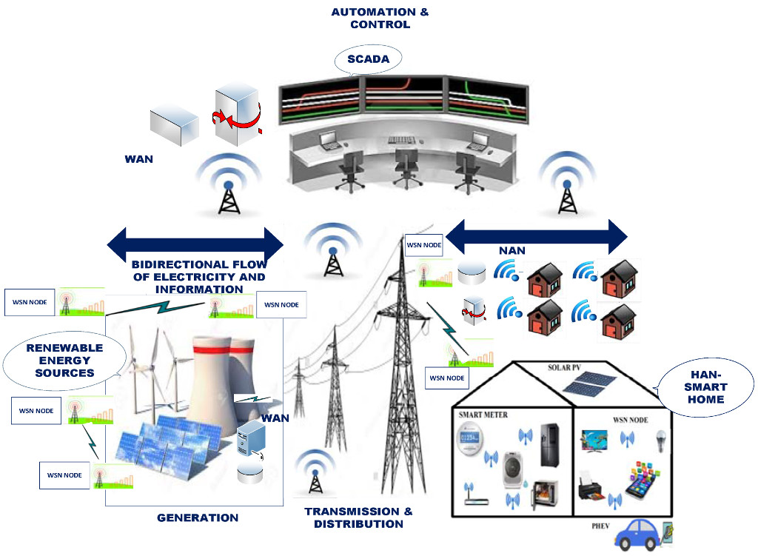
Bulgarian pilot
Aim
  to evaluate the most effective solutions to prevent, detect, and mitigate malicious cyber-attacks
Scenarios
  Attacks on Substation Infrastructure
  Attacks on Consumer / Prosumer networks points
Infrastructure
  a SCADA system installed and operated in the various substations connecting the 400,220,110 kV lines network.
  PLC/RTUs and measurement systems (energy meters, PMUs, DLR sensors) are interconnected by using the DNP3/IEC60870-5/IEC61850 protocols.
Notes:
The Bulgarian Pilot which involves all stakeholders of the EPES value chain (generator, TSO, DSO, Prosumer)
Aims to evaluate the most effective solutions to prevent, detect, and mitigate malicious cyber-attacks.

Slide 13
    FORESIGHT - Advanced cyber-security simulation platform for preparedness training in Aviation, Naval and Power-grid environments
    Funded by the European Union's multiannual research and innovation program - Horizon 2020
    Budget of € 7.3 million
    21 partners
    9 countries
    Electricity System Operator EAD will have key role in a Power-grid domain part of the project

Slide 14
    Cyber-security as a major challenge:
    Continuously raising numbers of cyber-attacks in the last few decades.
    Cyber-security is vital for critical infrastructure’s operators.
    Potential breakthrough in their operating networks (OT) could have huge impact, including interruption or even inability to provide their supplies.
    To meet this challenge, companies need well-trained professionals who can handle cyber-threats and protect infrastructure and systems from cyber-attacks.
    Cyber Ranges (CRs) - virtual environments that integrate simulation models which are fully corresponding to the organization's local networks, systems, tools and applications. This environment allows training and testing of these systems to increase their readiness to counter a real threat.

Slide 15
    FORESIGHT
    Aims to develop a common federated platform to connect existing Cyber Ranges in aviation, naval and power domains.
    The platform will include simulation models of administrative and operational networks for each of the three sectors.
    This will allow to perform vulnerability tests on these networks in a simulated and secure environment without disrupting the proper functioning of the real systems.
    A key function of the common platform is to increase the preparedness of cyber-security professionals at all levels (from beginner to expert) and to expand their knowledge of prevention, detection, counteraction and handling with the growing number of cyber-attacks.

Slide 16
    FORESIGHT Training module
    It includes innovative curricula which main purpose is to be kept up-to-date to address the latest known vulnerabilities.
    It will be focused on various areas of cyber-security - system security, network security, web applications.
    Each user will be able to choose the level of skills they want to acquire and they will be loaded with educational content that they need to master.
    Finally, the users will be able to apply the acquired knowledge through realistic threat scenarios to some of the interconnected CRs and be prepared to respond adequately in the event of a real threat to operating networks and systems.

Slide 17
    FORESIGHT Power-grid pilot
    Pilot demonstration will be organized with several organization and volunteers (academic partners, operators, etc.).
    During the event a combination of virtual and physical infrastructures will be provided for the training audience.
    The Blue Team will implement security measures and the Red Team (attackers) will provide predefined attack campaign towards SCADA system.
    Such activities could not be experimented in real operational conditions.

Slide 18
Thank you for your attention!

