Slide 1
Cybersecurity treatment practices at AES Bulgaria
Olivier Marquette

Slide 2
Agenda
Cyber at full speed
Global risks
Global examples
IT and OT go hand in hand
Cybersecurity is an issue of Safety
AES Response/ Strategies
In terms of administration
In terms of practical actions
AES Bulgaria
Implementation of Cybersecurity by design
Cybersecurity is managed centrally for IT and OT
Readiness and Compliance with Local and Regional legislation

Slide 3
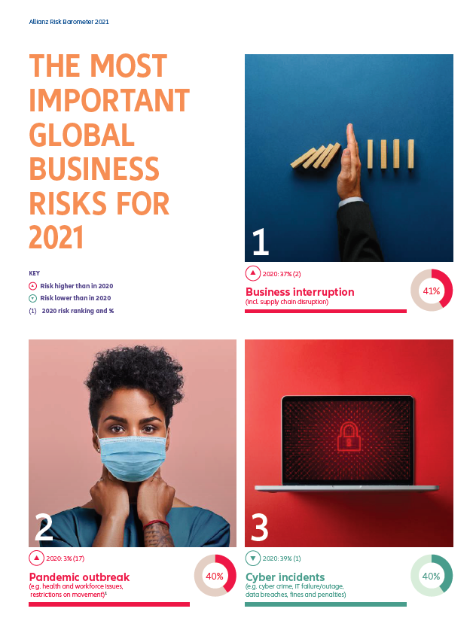
Risk and Cyber
Cybersecurity risk is #3 out of top 5 business risks worldwide*
Business interruption
Pandemic outbreak
Cyber incidents
Market developments
Changes in regulation and legislation
Beginning of 2020 Cybersecurity related risks were ranked #1 before Covid 19 pandemic crisis
* Allianz Risk Barometer 2021

Slide 4
Risks come true
Examples of Cybersecurity Incidents
French distiller shares fell as much as 2.1 percent to an intraday low of 116.9 euros in Paris after news of the attack.
Aluminum producer Norsk Hydrohas been cyber attacked that paralyzed its IT systems.
The attack is estimated to have total cost of the attack is set to be 63.5 million-$75.0 million.
Nivea-maker Beiersdorf AG said that an IT disruption caused about 35 million euros ($41 million) in lost sales in the first half.
https://www.datacenterknowledge.com/security/pernod-ricard-maker-absolut-vodka-suffered-cyberattack-london
https://www.insurancejournal.com/news/international/2019/07/24/533763.htm

Slide 5
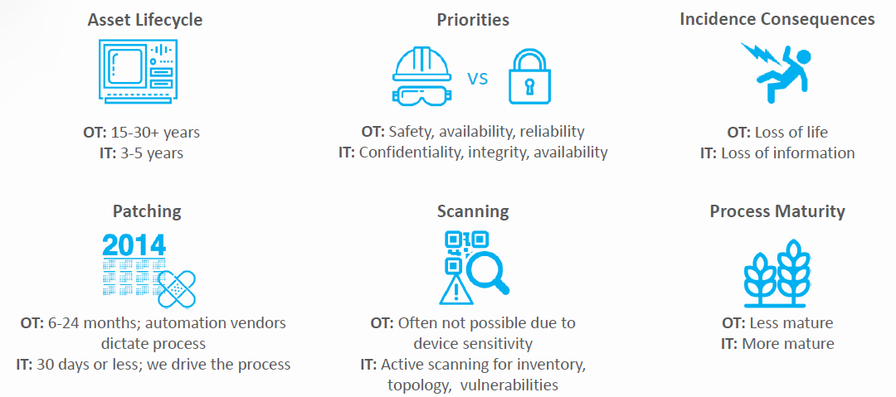
IT and OT - the challenge in a picture
IT and OT go hand in hand still are different

Slide 6
Cybersecurity protects people
Cybersecurity is a Safety issue
Cybersecurity attacks when successful have effect on the whole community or even country:
Lives
Healthcare
Major utilities – water, electricity, air
Transportation
Communication
Privacy

Slide 7
AES Response
Administrative efforts - AES Global Cybersecurity policy
Developed in partnership with Global leading consultants
Covering all Cybersecurity domains
Patch management
Vulnerability management
Awareness and trainings
Focus is the same for Operational and Informational Cybersecurity
Dedicated Cybersecurity Manager role
Aligned with European legislation
ENISA - European Union Agency for Network and Information Security
NIS Directive
EU Cybersecurity Act
GDPR
Aligned with corresponding ISO standards (ISO 27000)

Slide 8
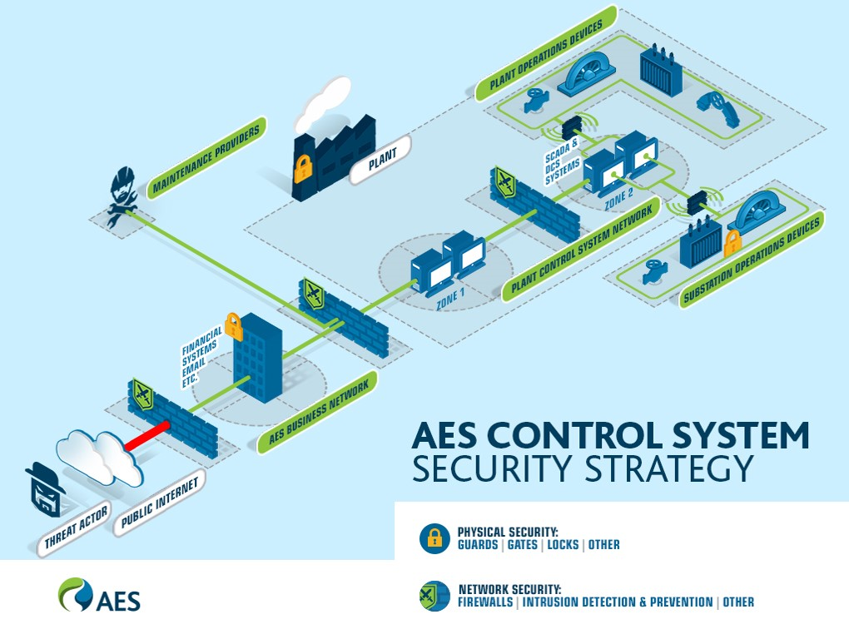
AES Response
By design
Practical efforts - AES Global Cybersecurity program
Security Operations Center – 24/7 monitoring
Cybersecurity by design
Annual Internal and External audits
Annual Penetration tests
Patch management and Vulnerability management
Enterprise toolsets and devices
Cybersecurity awareness program
Phishing trainings and functionalities
Global Safety day
Online training program

Slide 9
AES Bulgaria
Full alignment with AES Global Cybersecurity program plus:
Cybersecurity at all organizational levels
Senior country management
Plant management
Department leads
Dedicate role for a Centralized Cybersecurity manager
Any new implementations follow best practices
Activities related to alignment with MIMIS (МИМИС – Минимални изисквания за мрежова и информационна сигурност)
External dedicated audit – gap analysis
Alignment with governmental partners
Cybersecurity Roadmap (gap closing)
Monitoring and Control

