Slide 1
Rolls-Royce SMR
Clean, Affordable Energy for all
Nuclear Power Conference, Sofia
12th January 2023
Ed Coxon – Senior Customer Engagement Manager
ed.coxon@rolls-royce-smr.com

Slide 2
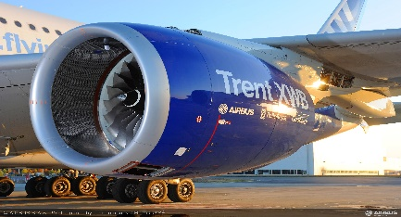
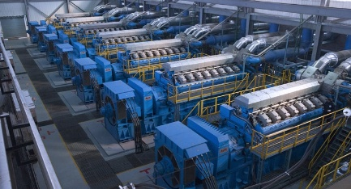

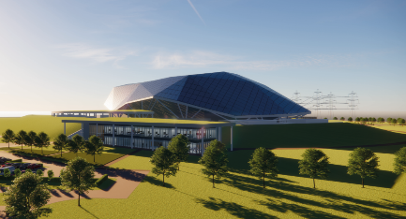
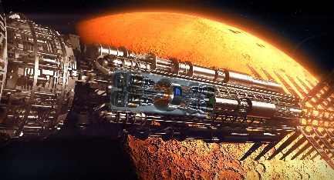
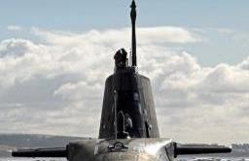
    Rolls-Royce is one of the world’s leading industrial technology companies pioneering cutting-edge technologies that deliver clean, safe and competitive solutions
Rolls-Royce’s
Nuclear Heritage
Civil Aerospace
Power Systems
Defence
Strong nuclear heritage with roots in defence and civil development
Designing, manufacturing and supporting small reactors for over 60 years
Rolls-Royce is a globally recognised and trusted partner
    Strong nuclear heritage with roots in defence and civil development
Nuclear Business Experience
Civil Nuclear
Defence Nuclear
Rolls-Royce SMR
Innovation & Future Programs
Submarines
Notes:
RR is a power generation company
Routed in the gas turbine
BUT – always had a strong nuclear heritage

Slide 3
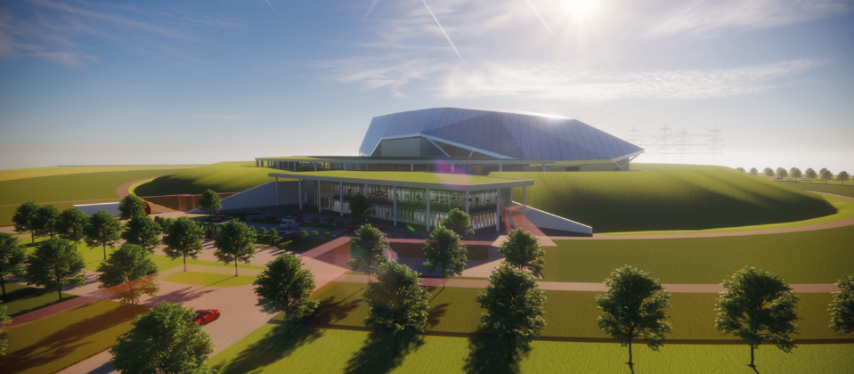



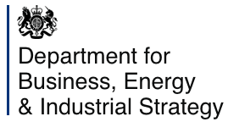

Rolls-Royce SMR Ltd is a technology vendor offering a complete SMR power plant on a turnkey basis.
Our development programme is fully funded with €565m through commercial equity and UK Government grant funding
Rolls-Royce SMR Ltd Shareholders
Constellation Energy (previously Exelon Generation Ltd)
Operates the largest U.S. fleet of zero-carbon nuclear plants with over 18.7GW from 21 reactors at 12 facilities
Rolls-Royce Group
60 years designing, manufacturing, supporting and operating nuclear technology
BNF Resources UK Ltd
Extensive investments in the energy space and represented and advised by BNF Capital Limited, an FCA regulated UK-based investment advisory
Qatar Investment Authority
Invests in the energy transition and funds technologies that enable low carbon electricity generation
UK Government Grant Funding
UK department of Business Energy and Industrial Strategy
Rolls-Royce SMR Ltd received the Low-cost nuclear (LCN) grant award by UK Research and Investment (UKRI)
Notes:
Just over 1 year ago RR SMR launched as a standalone business to do one thing

Slide 4
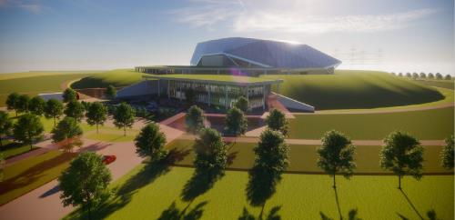




Rolls-Royce SMR is a totally new way of building nuclear to meet Net Zero needs
~470 MWe net output
Enhanced safety and security
50 Hz design
1st unit on grid early 2030s
Proven PWR Technology & Standard Fuel
Capital cost under €2.1bn*
Power station turnkey delivery
Adaptable, multi-use power & heat output
4 yr on-site Construction (Fleet unit)
LCOE range €50- €70 per MWh**
* 2021 economics, fleet unit; £1:€1.1406 (5yr average), costs based on UK labour rates
** 2021 economics, 2 unit plant, range dependent on financing mechanism
Notes:
So in that context, why do we think SMRs have such a significant role to play?
Because they seek to address the main barriers to deployment of nuclear power today
Cost
Certainty
Time
While adding flexibility of deployment options and applications

Slide 5
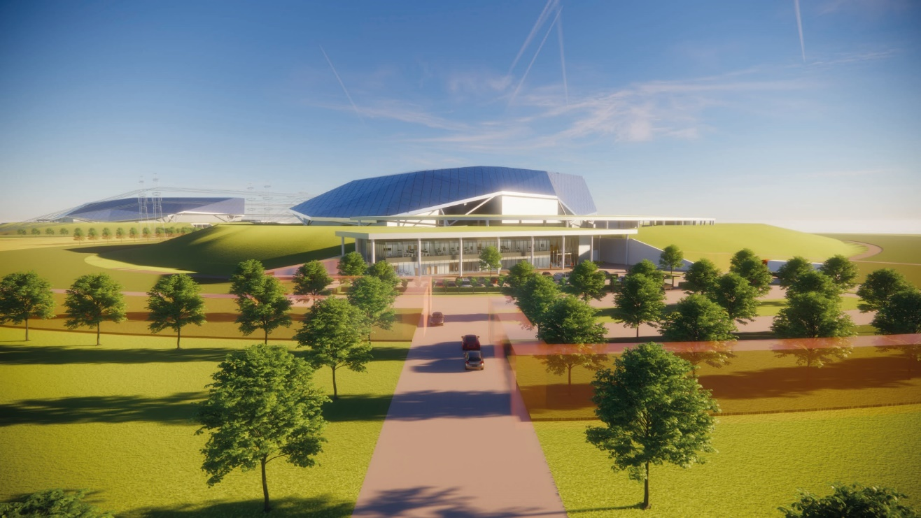
Power Station Overview
- Performance and Characterisation
The key performance parameters and characteristics that define the power station.
MAJOR TECHNICAL PARAMETERS:
Parameter | Value
Reactor Type | Pressurised Water Reactor
Electrical Capacity (MWe) | 470
Thermal Capacity (MWth) | 1358
Expected Capacity Factor (%) | >95
Design Life (years) | 60
Primary Plant Footprint (m²) | 45,000
Power Conversion Process | Rankine cycle
Cogeneration Capability | Optional configuration
Passive Safety Features | Yes
Active Safety Features | Yes
Fuel Type / Assembly Array | Industry Std UO₂ in 17x17 array
Fuel Cycle (months) | 18 – 24
Emergency Safety Systems | Passive
Refuelling Outage (Days) | 18
Seismic Design (g) | 0.3
Core Damage Frequency (per yr) | <1 x 10⁻⁷
An integrated whole power station approach focused on standardisation, repeatability and commoditisation

Slide 6
The SMR design has been driven by market requirements from conception
Those that we can control within the design
Those that we must recognise as key influencing factors on design and technology choices
Regulatory / Safety
Proliferation Resistant
Market Timing
Code Compliance
Reduce
Capex & Opex
Remove /
Reduce Risk
Minimise
Time to Build
LCOE
Levelized Cost of Electricity
(EUR/MWh)
Capex + total O&M + Decom + Fuel + Financing
=
Power Generation x Capacity factor
Maximise
Power
Maximise
Reliability
Maximise Efficiency
Compatibility with support Infrastructure and Sites
Public Perception
Utility Familiarisation / Selection of Technology
Delivery Partnership Potential
Global Market
Notes:
This simple equation has driven our design choices from day one
Get the top line down and bottom line up

Slide 7
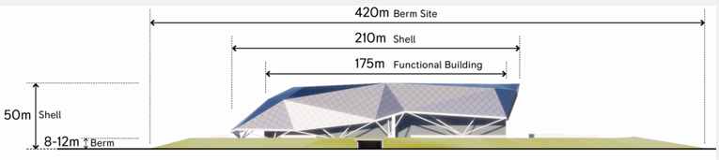
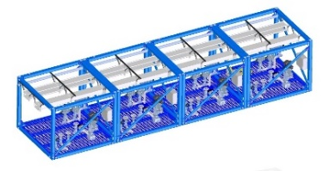
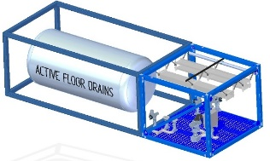
Not all SMRs are the same - to deliver cost reduction, schedule reduction, and certainty we must not reproduce a “small” large plant
Small
  Maximise power for physical constraints around manufacturability and transportability
  Not about designing around an arbitrary power level
Modular
  Standardisation, factory repeatability in a production line approach.
  Avoidance of large modules that must be disassembled for transportation - defeats the benefits of modularisation
  Modules tested in factories to reduce site activity
Reactor
  RR provides the power plant, not just the reactor
  Reactor is ~20-25% of the power plant by capital
  Modularisation of the full power plant including civil construction
  Enables delivery, by Rolls-Royce SMR under single EMA contract

Slide 8

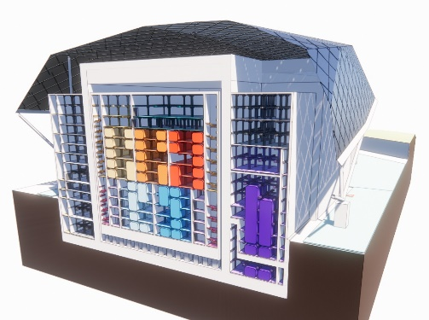
5) Management of all delivery risk
4) Full Plant incl. Site works & infrastructure
More than a reactor - a complete and operational power plant with all aspects designed together from the outset
Increased customer confidence - All technical and commercial interface risk managed and owned by Rolls-Royce SMR, ensuring a 4-year build time
3) Full provision of plant equipment
2) Turbine Island & balance of plant
1) Reactor only
Our Turnkey Solution
Reducing risk, increasing customer confidence
Contracted through an Engineering, Manufacture and Assembly (EMA) contract:
Simple contracting mechanism
Standardised product purchase
Transparent pricing
Minimised cost and schedule risk to developer
Manufacturing innovation – use of factory build and modular assembly for the entire power plant.
Cost fidelity - Priced certainty from use of off-the-shelf equipment and decades of learning in the manufacture of the UK nuclear submarine reactors

Slide 9
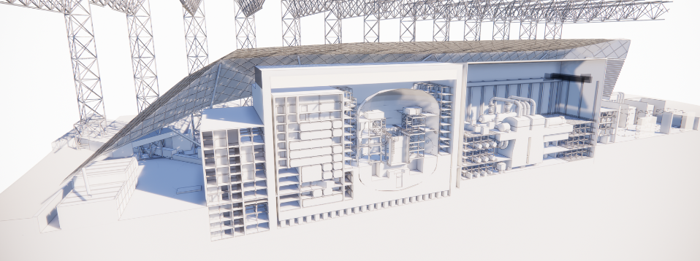
A whole power plant approach focused on standardisation, repeatability, commoditisation where allowable
Site
Factory
Transmission
Compound
Turbine Island
Turbine Hall
Reactor Island
Containment
Notes:
How?
By producing a standardised, factory built, site assembled commodity.
This picture starts to give you a view of the modular approach

Slide 10
A Factory Fabricated Product
Road transportability of modules is a pre-requisite, reducing Capex per MW and improving delivery time & certainty

Slide 11
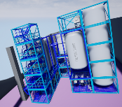
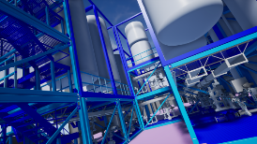








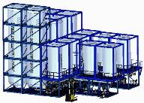

Standard Kit of Parts / Modular Architecture Development
Module kit of parts categories:
  Vertical and Horizontal MEP Modules
  Vertical and Horizontal Tank Modules
  Personnel Access
  Pipe Cable and Utility Routing
  Shielding and Segregation
  Structural Module
  EC&I Modules
All based on a standard reference grid system
Notes:
At the heart of our design
All to a standard pattern
Road and rail transportable

Slide 12
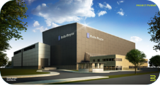
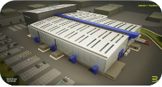
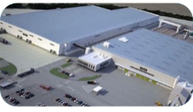
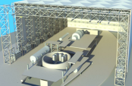
Rolls-Royce SMR is a factory fabricated product
Modularisation of the whole power station, not just the nuclear island
Module Factories
Site Assembly
Primary Plant Modules
Mechanical, Electrical & Plumbing Modules
Civil Modules
Site Assembly Factory
Improves reliability
Improves economies of scale
Creates stable long term jobs
Provides schedule certainty
Reduces build time
Modularisation drives down cost
Notes:
Manufactured in 3 main factories
The 4th is then the on-site factory
Manufacturing hubs around the world

Slide 13
Rolls-Royce SMR Vision - European Strength in Depth
Utilising the continents best capabilities with multiple layers of redundancy
SMR(s) - Potentially multiple SMRs in each country
Factories - Potential factories manufacturing modules and delivering them to sites across the region
Supply Chain - Potential supply chain entities delivering components to all factories in region, providing multiple layers of redundancy

Slide 14
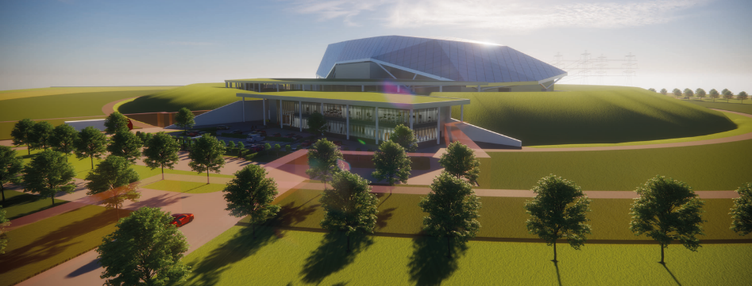



Turning nuclear into a product not a one-off mega infrastructure project
✗
✓
  EPC (mega project)
  EMA (factory product)
Conventional EPC (e.g. Large nuclear)
Mega project GBP10bn+
Reactor only, not whole plant
Government driven
Commercially complex
Designed for market requirements
  Engineering
  Manufacturing
  Assembly
Reducing Project Risk
Much lower risk
Reduced Capital
Shorter Time to Build
= Reduced financing cost
Factory Product
Standardization
Schedule certainty
Commercial simplification
Non-Confidential
© 2022 Rolls-Royce SMR | Not Subject to Export Control

Slide 15




SMR Program - Timeline and Key Milestones
1) Assessment
2) Development and Investment
3) Commercialisation
Today
Secure first SMR orders
Basis of Design
Finalized program funding
Licensing
start
Verification
and
validation
process
Site
development
support
Regulatory design approval for fleet deployment
Module manufacture
Installation
Commissioning
First SMR unit operational
(Early 2030s in UK)
2019 - 2021
2022 - 2025
2025 onwards

Slide 16
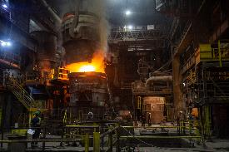
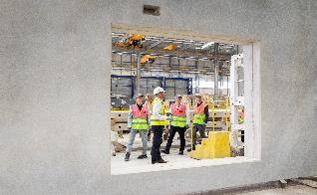
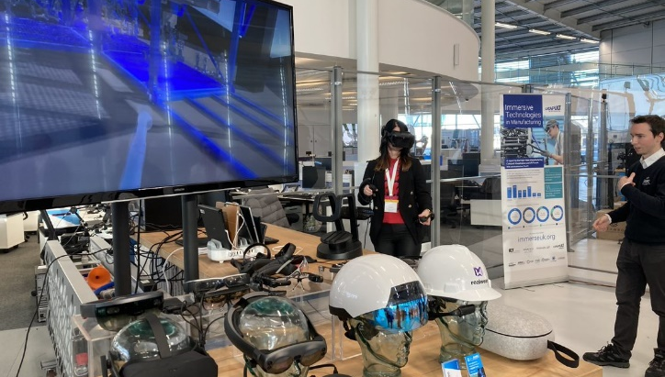
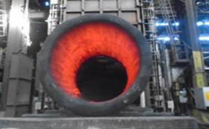
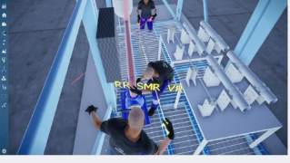
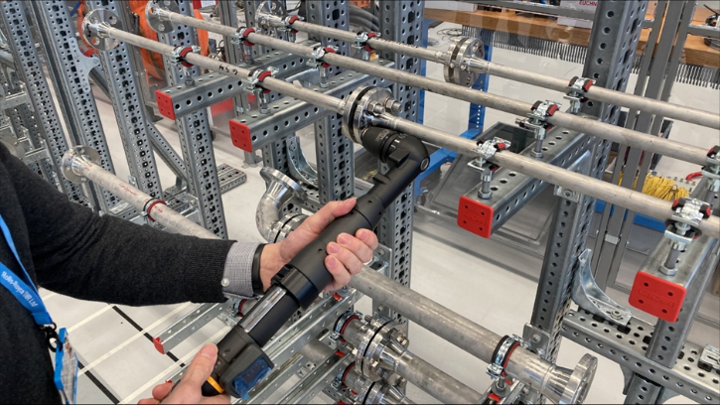

Progress to date – Production Readiness
©SFEL: Rolls-Royce SMR VAMP Head Ingot Production
©SFEL: Rolls-Royce SMR VAMP shell after heat treatment

Slide 17
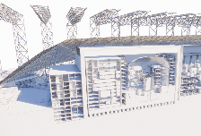
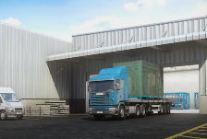
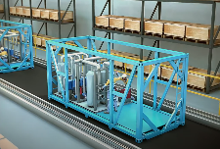
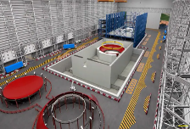

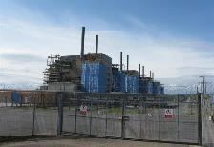

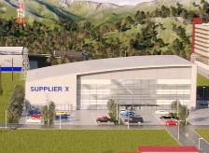
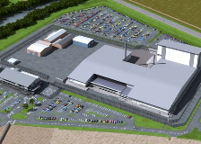
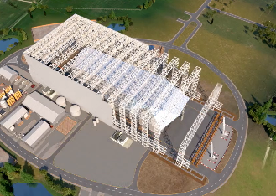
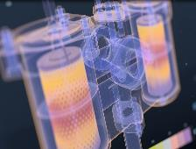
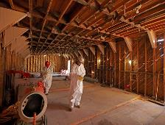
Our Digital Twin
Exploit Data as an Asset to Provide Cost and Programme Certainty
Digital Thread
Integrated Digital Design
Connected Supply Chain
Digital Manufacturing
Digital Construction and Assembly
Digital Optimised Power Generation
Data Driven End-of Life Decommissioning

Slide 18







Energy Park
Rolls-Royce SMR’s small footprint allows co-location: clean energy located with the industry that needs it
A magnet for industry and high skilled jobs desiring carbon free energy
Removes the need for costly transmission of electrical power over large distances
Electrical Power
Excess
Power
Clean Backup
Power
Hydrogen
Thermal Power
Potential for 100% availability
Grid
District Heating
Heavy Users
H₂ storage & market place
Fuel Cell
H₂
Rolls-Royce SMRs
470MW each unit
95%+ availability
PPA
($/ MWh)
H₂ / Ammonia / e-fuel users
Electrolysis
small
H₂
Electrolysis
large
Non-Confidential
© 2022 Rolls-Royce SMR | Not Subject to Export Control

Slide 19
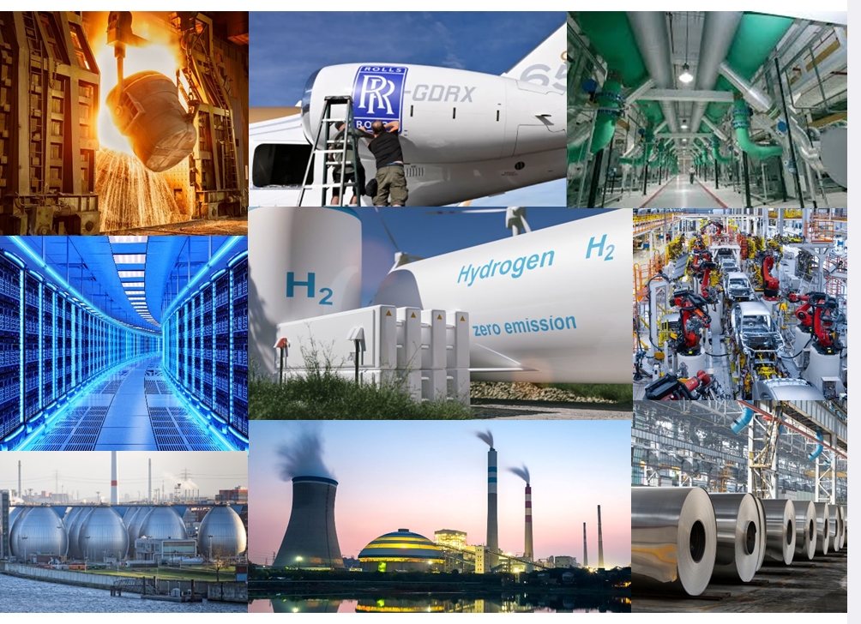
The energy markets of the future will need clean power that can deliver 24/7 – the Rolls-Royce SMR offers a solution
Global energy by source, 2020
There are many solutions to decarbonize
But most need clean electricity at a vast scale
13%
Only 13% of
global energy is low carbon
today

Slide 20
Ed Coxon
Senior Customer Engagement Manager
ed.coxon@rolls-royce-smr.com

