Slide 1
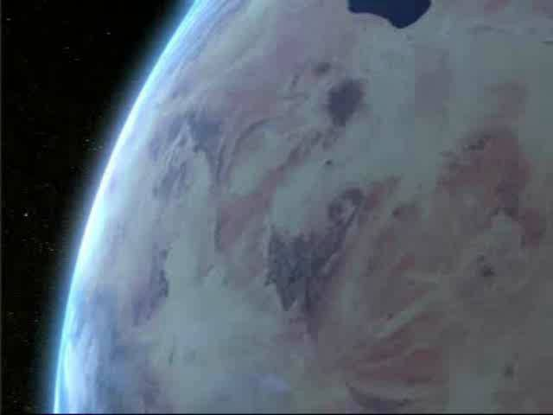
The MARTIN WTE System
Modern Technology for Waste treatment

Slide 2
Contents
MARTIN company / References
Typical WtE plant
The MARTIN combustion system
Summary

Slide 3
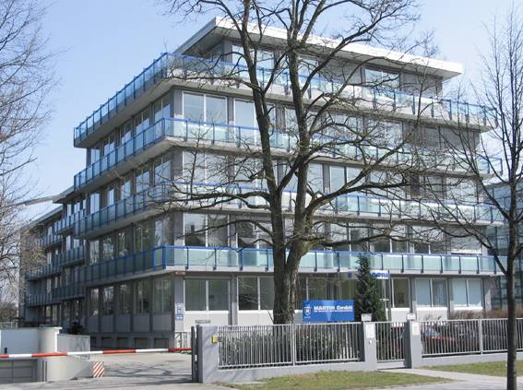
Company profile
Foundation: 1925 (as Josef Martin Feuerungsbau)
Legal form: GmbH
Owner: Martin family (100%)
Nom capital: 10 million Euro
Employees: 220 (about 150 engineers)
Turnover: approx 75 million Euro
Locations: MARTIN GmbH in München, DE
MARTIN AG in Wettingen, CH
MARTIN Kesselservice AG, CH
MARTIN Services SAS in Lyon, FR

Slide 4
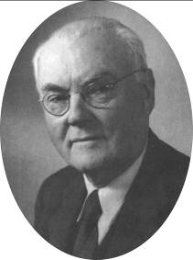
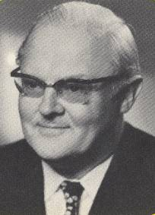
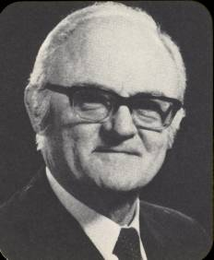
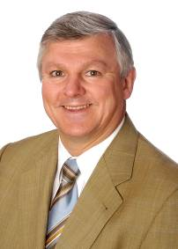
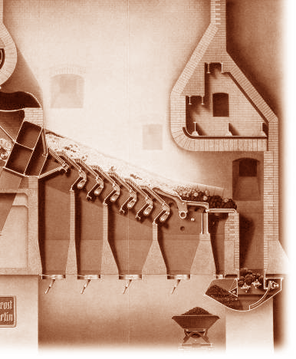
Tradition and progress since 1925
Third generation family business
Entirely independent
MARTIN technologies have
proven successful for decades
Extensive experience base
Innovative development activity
References and contacts
worldwide

Slide 5
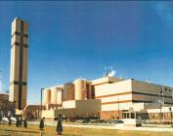
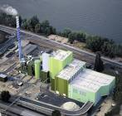
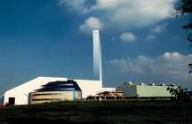
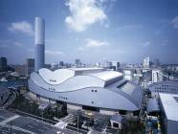
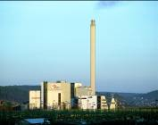
MARTIN GmbH
MARTIN is an engineering company
MARTIN does not have its own manufacturing facilities
MARTIN is highly specialised in waste incineration
MARTIN acts as
  General contractor
  Consortium leader
  Contractor for stoker / boiler units
  Engineering provider for cooperation partners
  Engineering provider for license partners
MARTIN is active worldwide

Slide 6



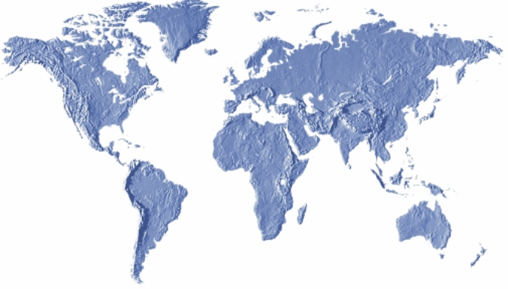
Cooperation partners
Constructions Industrielles
de la Méditerranée
Paris and La Seyne-sur-Mer
FRANCE
Mitsubishi Heavy Industries
Environmental & Chemical Engineering Co., Ltd.
Tokyo and Yokohama
JAPAN
COVANTA Energy
Morristown, New Jersey
USA

Slide 7


Licence partners
Chongqing Sanfeng Covanta
Environmental Industry Co., Ltd.
Chongqing
China
Sumitomo Heavy Industries, Ltd.
Tokyo
Japan

Slide 8

Worldwide cooperation
Well-known companies have placed their
trust in MARTIN know-how for decades
Close to the market
via regional partners
Worldwide
experience
Our partners are our clients,
Our clients are our partners

Slide 9
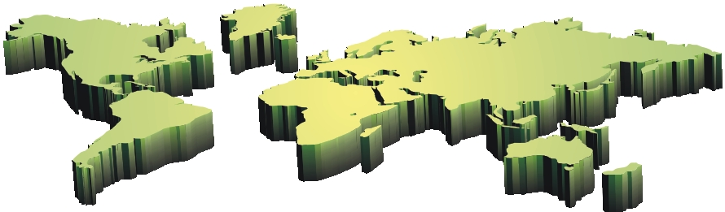
MARTIN plants in 31 countries worldwide
Europe in 20 countries
214 plants
352 lines
110,725 Mg/d throughput
Asia in 8 countries
126 plants
288 lines
76,286 Mg/d throughput
North America in 2 countries
34 plants
75 lines
32,312 Mg/d throughput
South America in 1 country
2 plants
4 lines
600 Mg/d throughput
Total: 376 Plants 719 Lines 219,923 Mg/d throughput
Status: 23 February 2011

Slide 10
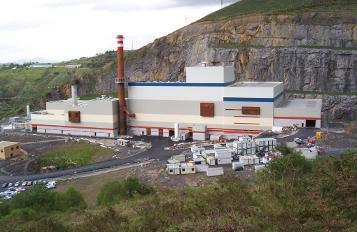
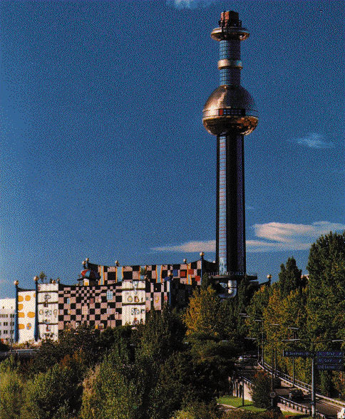
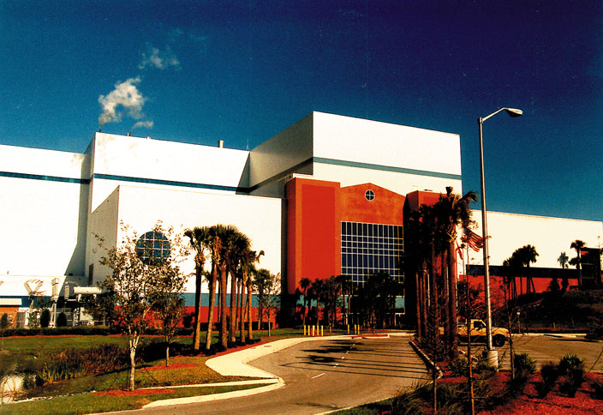
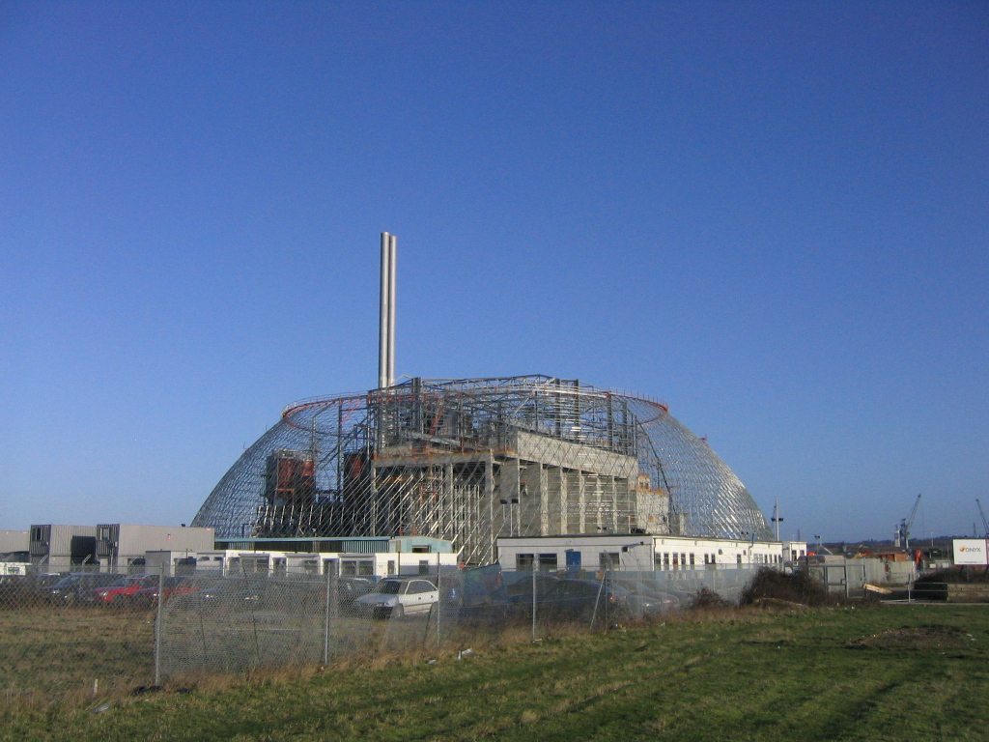
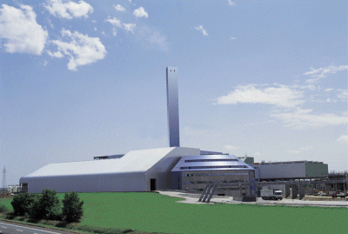
Global market share of WtE plants using
MARTIN systems
≈
33 %

Slide 11
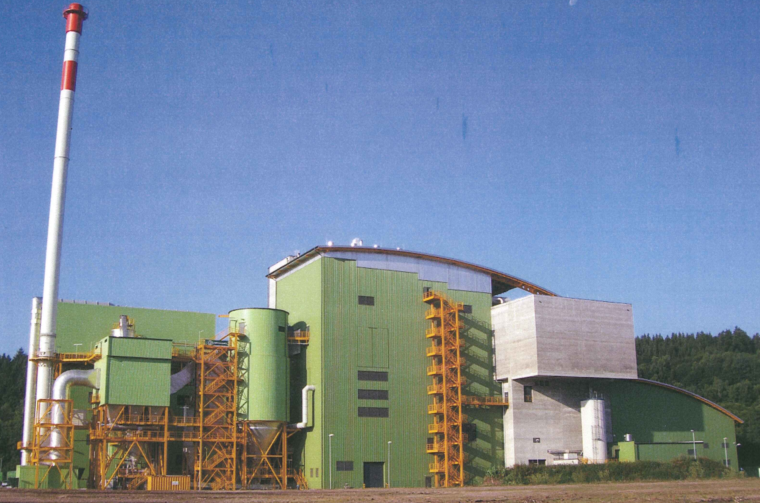
Zella-Mehlis (DE)
1 x 518 t/d
Reverse-acting grate

Slide 12
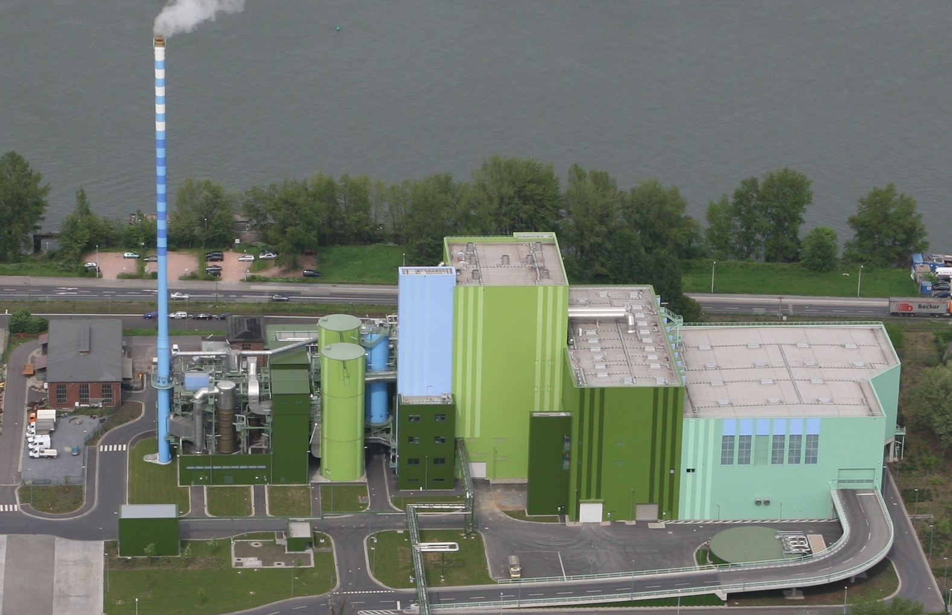
Mainz (DE)
2 x 367 t/d
Reverse-acting grate

Slide 13
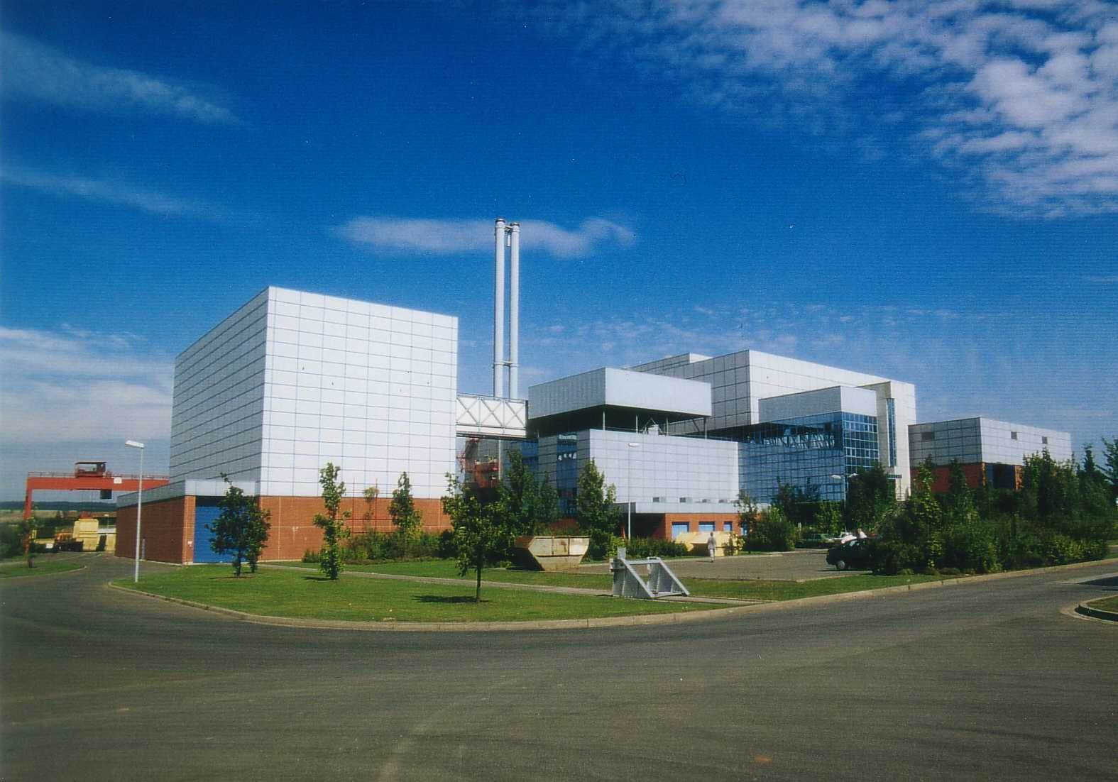
Coburg (DE)
2 x 264 t/d
Reverse-acting grate

Slide 14
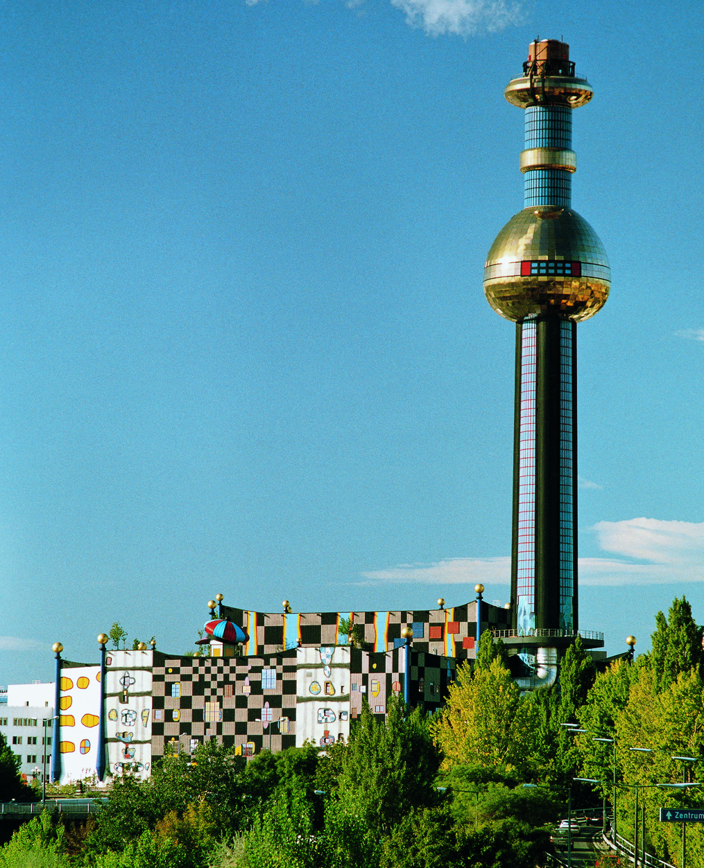
Wien Spittelau (AT)
2 x 360 t/d
Reverse-acting grate

Slide 15
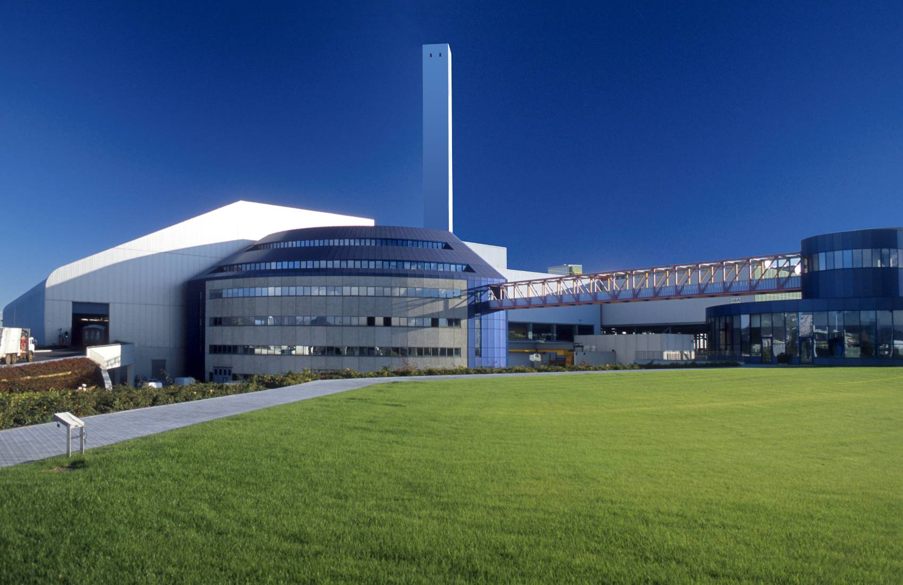
Brescia (IT)
2 x 552 t/d
1 x 552 t/d
Reverse-acting grate

Slide 16
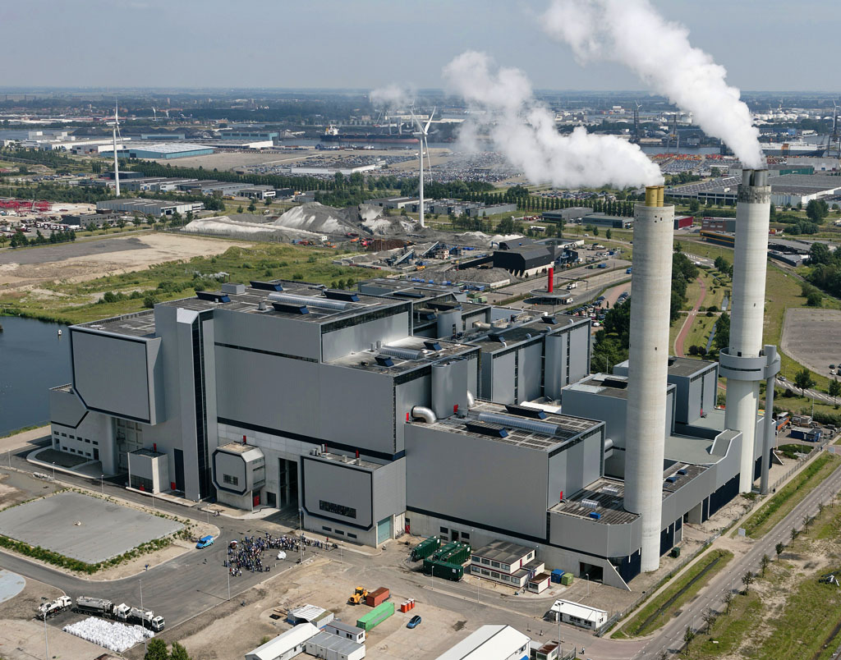
Amsterdam (NL)
4 x 720 t/d
2 x 806 t/d
Horizontal grate

Slide 17
Contents
Modern Technology for Waste treatment
MARTIN WTE System
MARTIN company
Typical WtE plant
The Martin combustion system
Summary

Slide 18
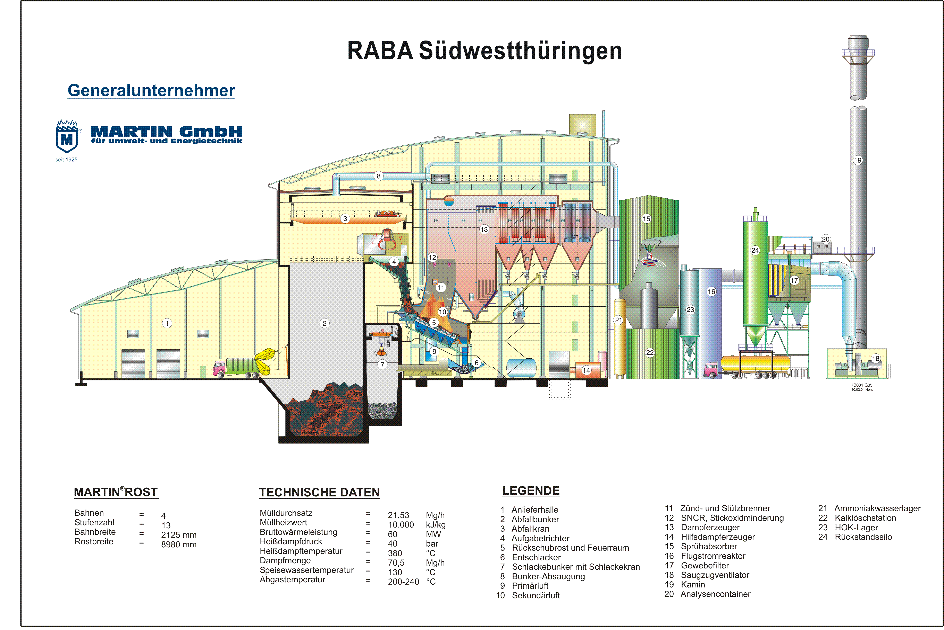
Longitudinal Section WtE Plant
Waste
Handling
Incinerator / Boiler
Flue Gas
Cleaning
Tail-end boiler
Spray absorber
Fabric filter
Transportreaktor
Ash storage
Tipping hall
Waste bunker
MARTIN grate
Storage
Chemicals
Slag discharge

Slide 19
Energy Recovery
Boiler
Superheated steam
Extraction condensing
turbine
Generator
Low pressure steam
Air cooled condenser
Primary air preheater
Feedwater pumps
Condensate system
Feedwater system
Feedwater tank
Local heatingsystem

Slide 20
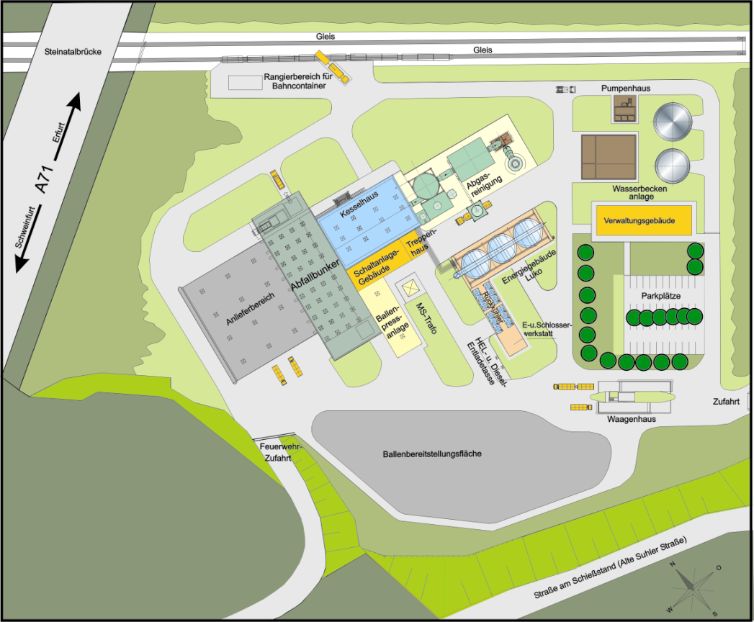
Horizontal Section WtE Plant
Processwater, water for fire fighting
Fluegas treatment
Boiler house
Administration
Control+
Switchgearrooms
Turbinehouse
Waste Handling
Storage area

Slide 21
Contents
Modern Technology for Waste treatment
MARTIN WTE System
MARTIN company
Typical WtE plant
The Martin combustion system
Summary

Slide 22
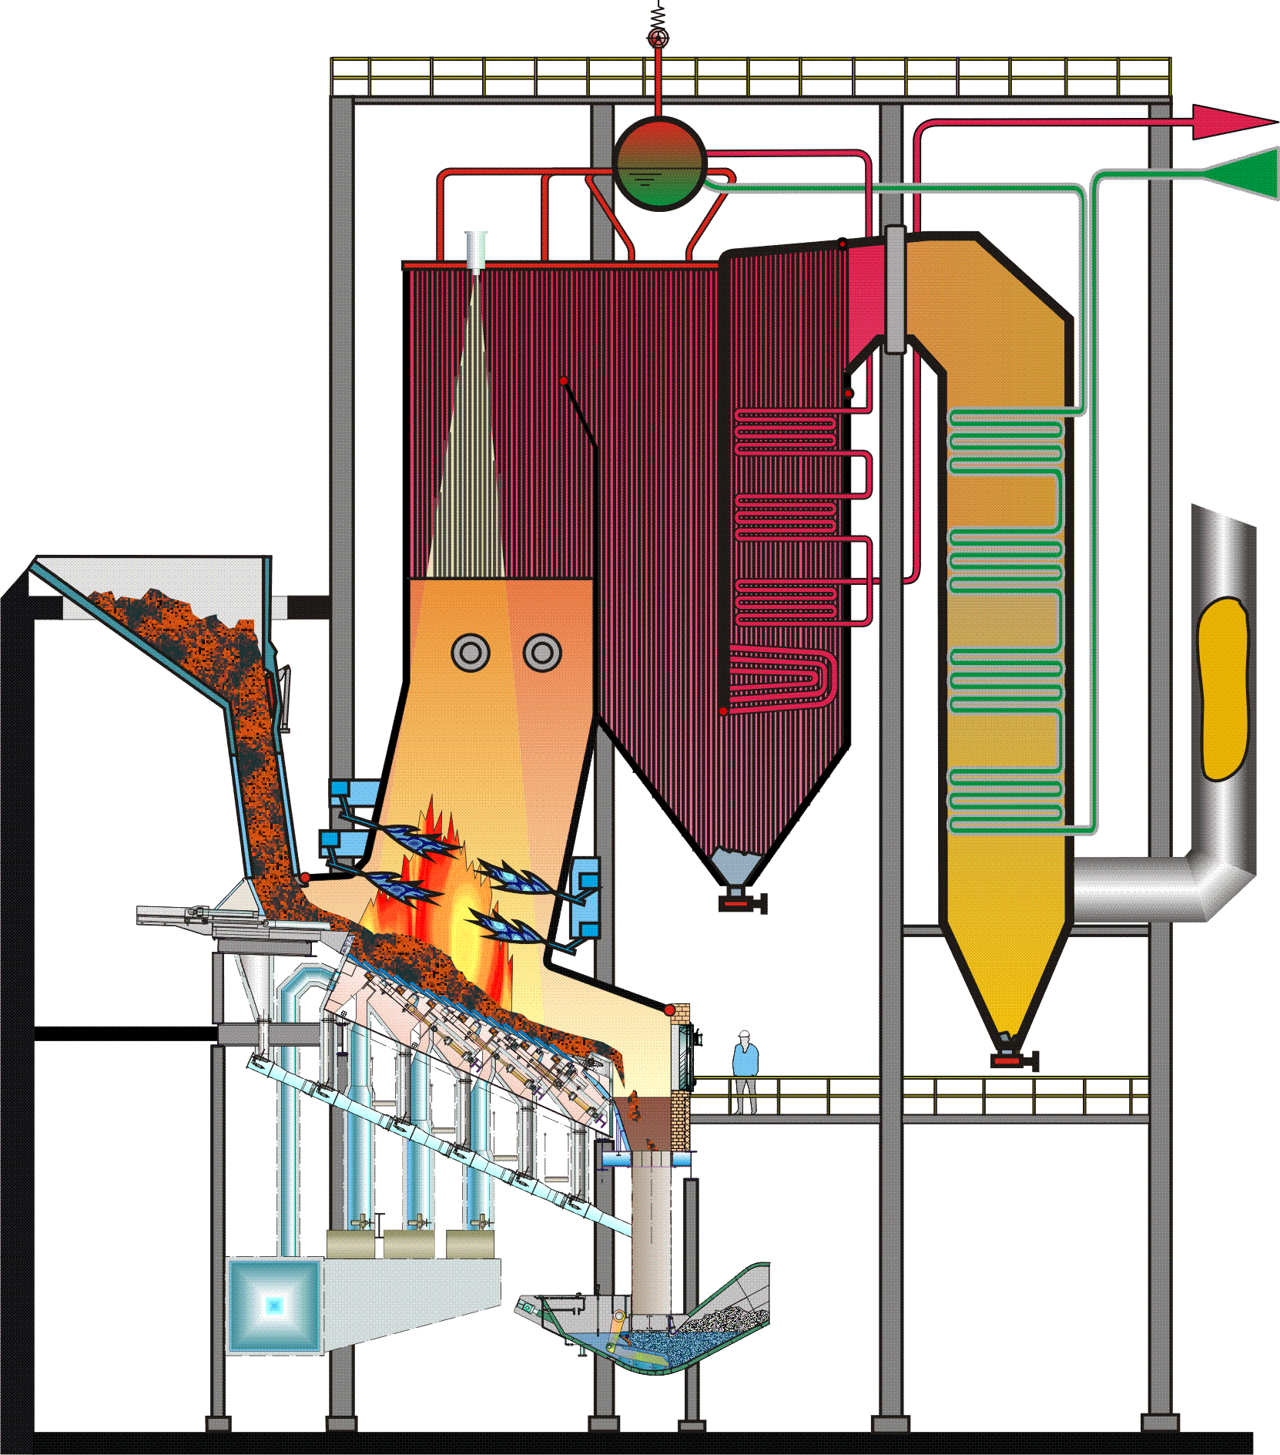
MARTIN reverse-acting grate system
9
Feed hopper
Feeder
MARTIN reverse-acting grate Vario
MARTIN discharger
Furnace
Primary air preheater
Primary air
Secondary air
9. IR camera
1
5
8
2
3
7
6
4

Slide 23
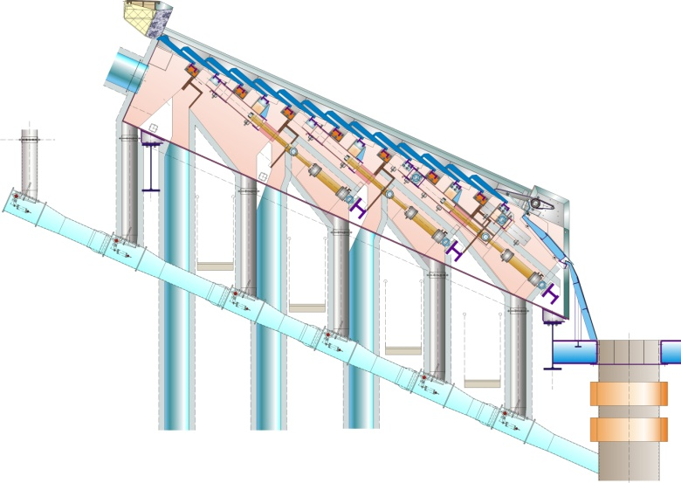
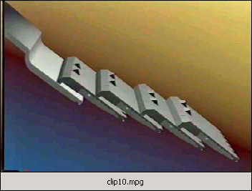
MARTIN reverse-acting grate Vario
Stoking motion acts against the direction of the waste flow
Evenly covered grate surface
Protection against intense heat radiation
Protection against thermal wear
Long service lives
Highly effective agitating motion and mixing of the fuel

Slide 24
Mixing phases of the fuel on the reverse-acting grate Vario
Pushing motion
of the grate steps
Gravitational
force
Stoking motion
of the waste layer

Slide 25
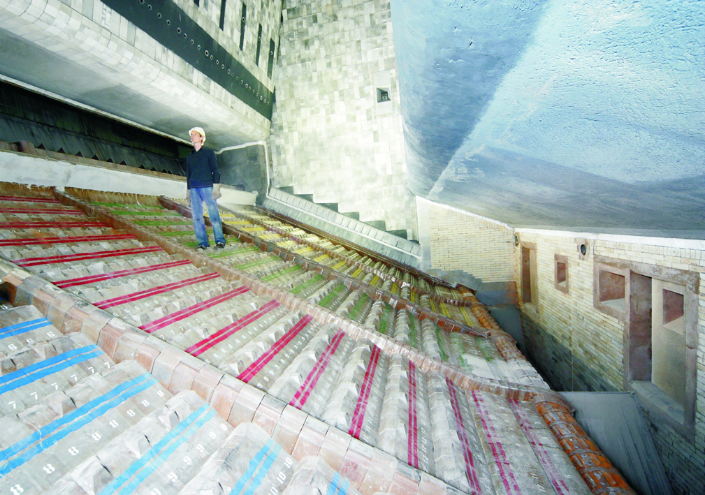
Furnace with 5 runs

Slide 26
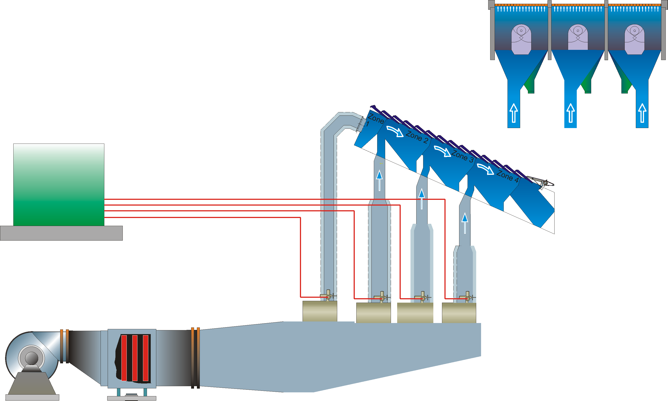
Underfire air distribution system
Hydraulic
Clinker weir
pumping
station
Underfire air fan
Air preheater
UFA control unit

Slide 27
Underfire air supply and relative stroke

Slide 28
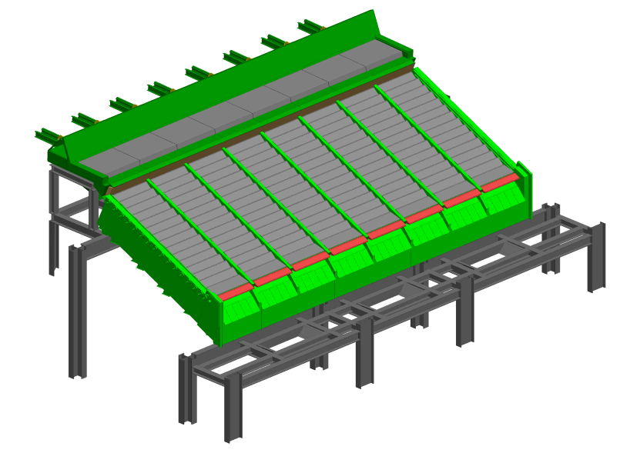
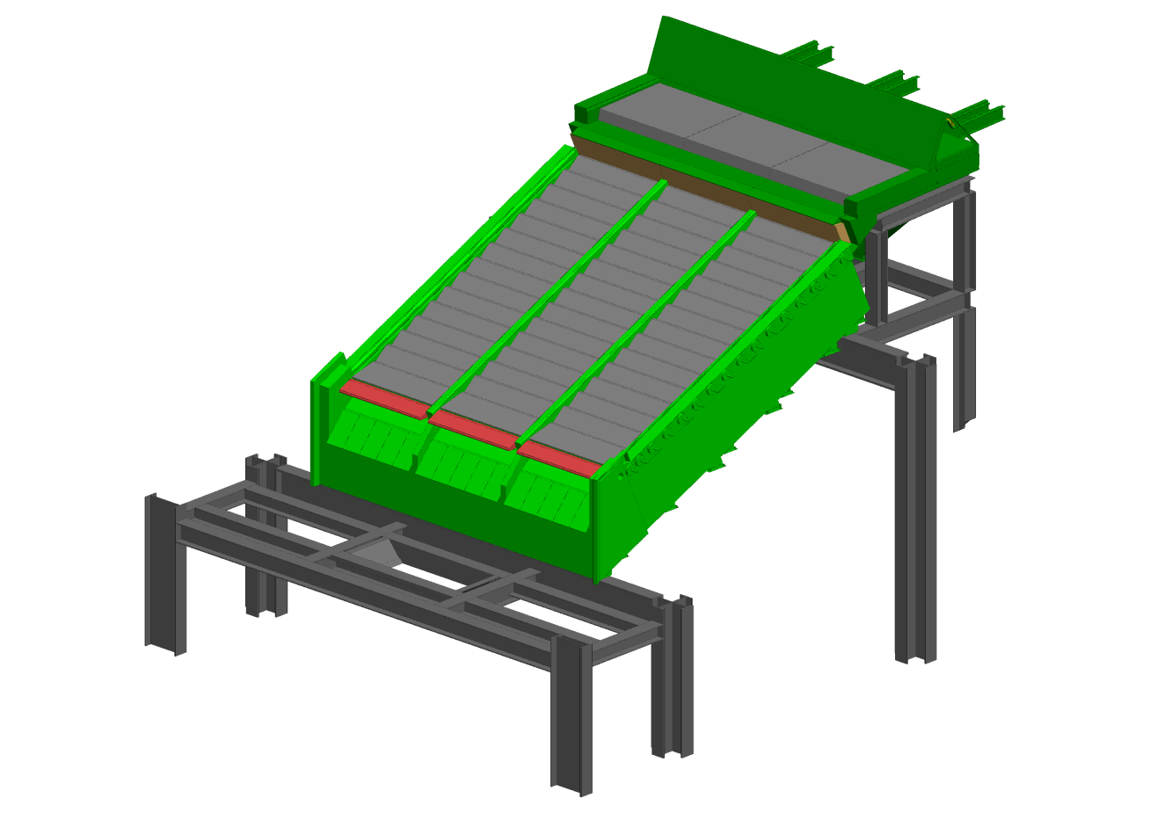
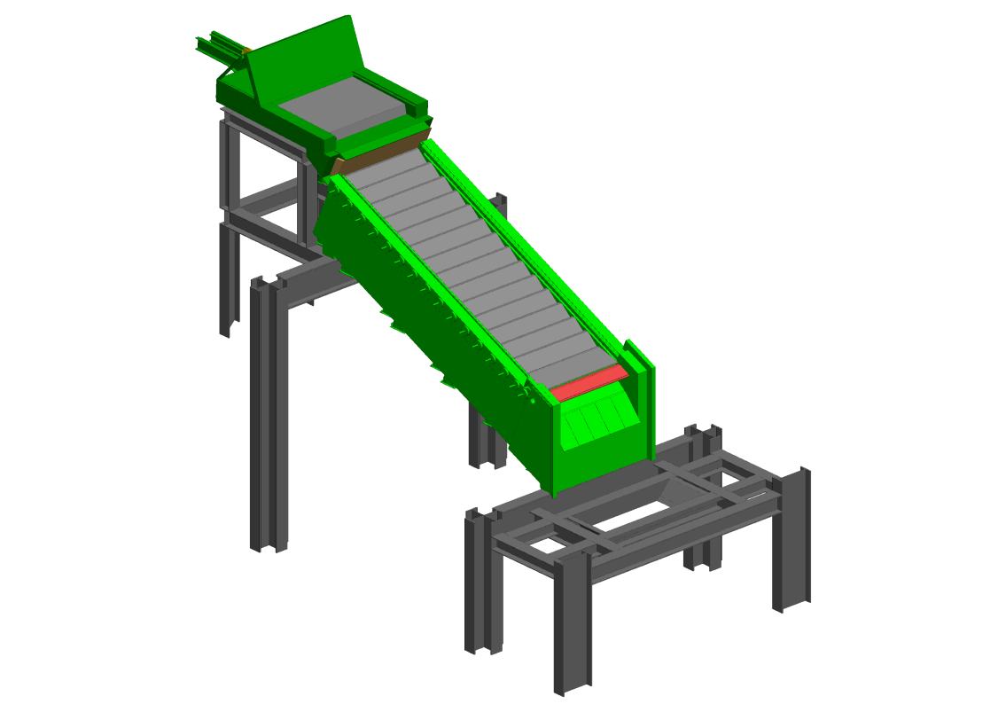
MARTIN reverse-acting grate Vario
Modular design in runs (1 - 8 runs)

Slide 29
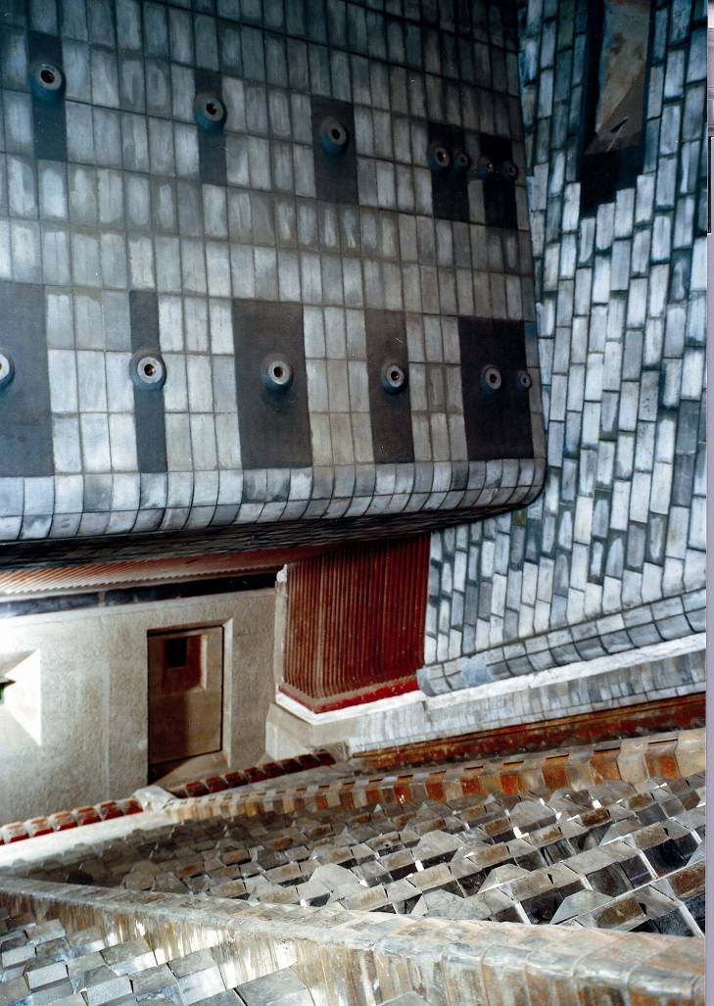
Positioning of overfire air nozzles

Slide 30
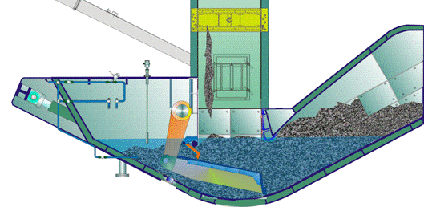
MARTIN discharger
Ash pit slide gate
Connecting piece
Inlet section
Drive shaft
Electrically controlled level measurement device
Water level
Discharging ram
Discharger tub
Outlet chute
Drop-off edge
1
2
9
4
5
10
6
3
7
8

Slide 31
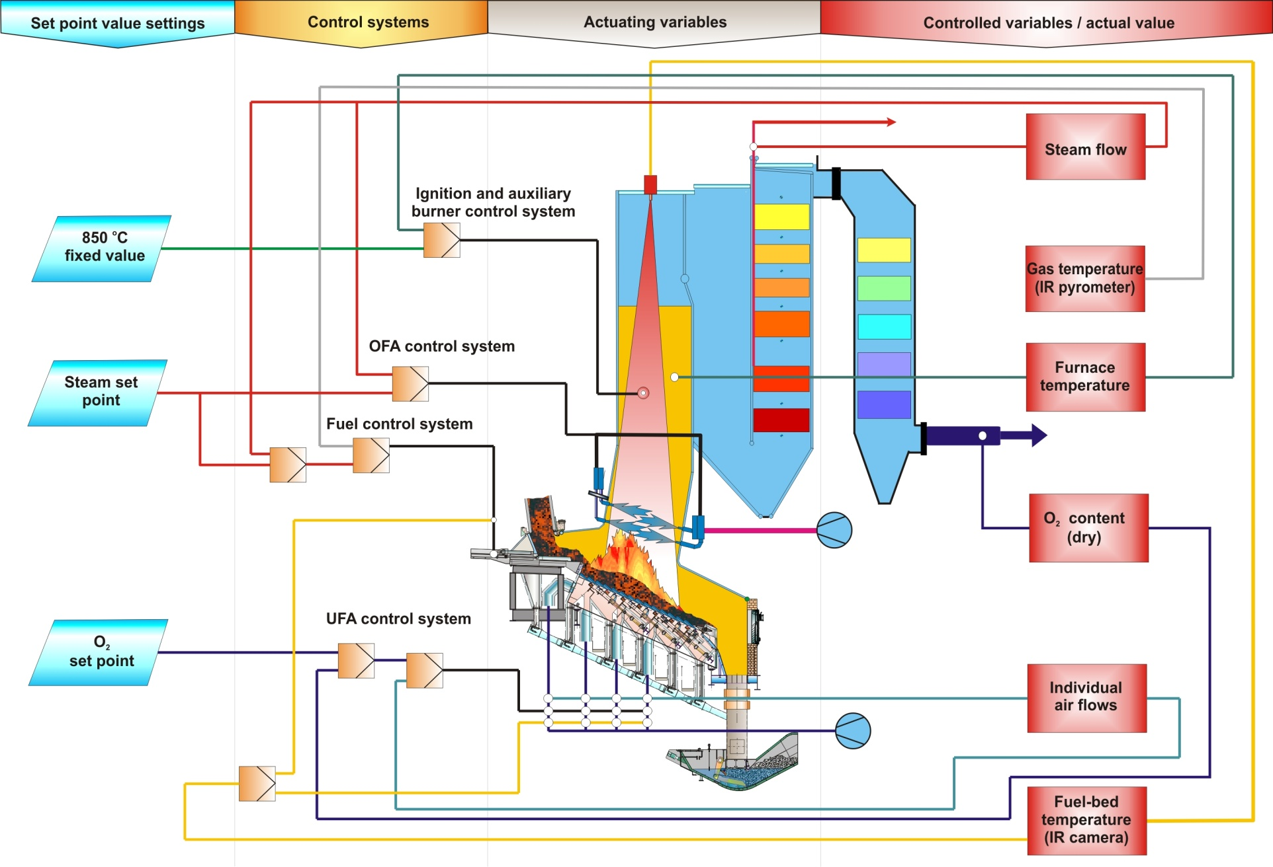
MARTIN combustion control system with IR camera

Slide 32
Features of the MARTIN reverse-acting grate
Variable grate speed in each drive zone
Independent undergrate air zones for
defined combustion air supply
Compact, modular design,
easily accessible and easy to maintain
Excellent characteristics with regard to
mixing and burnout of solids and gases
Service life of grate bars exceeds 50,000 hours
High availability
Bottom ash can be recycled (metals and building materials)
System has been proven in over 550 lines world wide

Slide 33
Contents
Modern Technology for Waste treatment
MARTIN WTE System
MARTIN company
Typical WtE plant
The Martin combustion system
Summary

Slide 34
Summary
MARTIN is the most experienced and specialised company in the market of planning and construction of Waste to Energy plants
Technologies of MARTIN have proven successful for decades globally
As independent mid-sized company flexible in the market
System is high sophisticated and robust
System with low emissions and residues are recyclable
System with a high flexibility and reliability

Slide 35
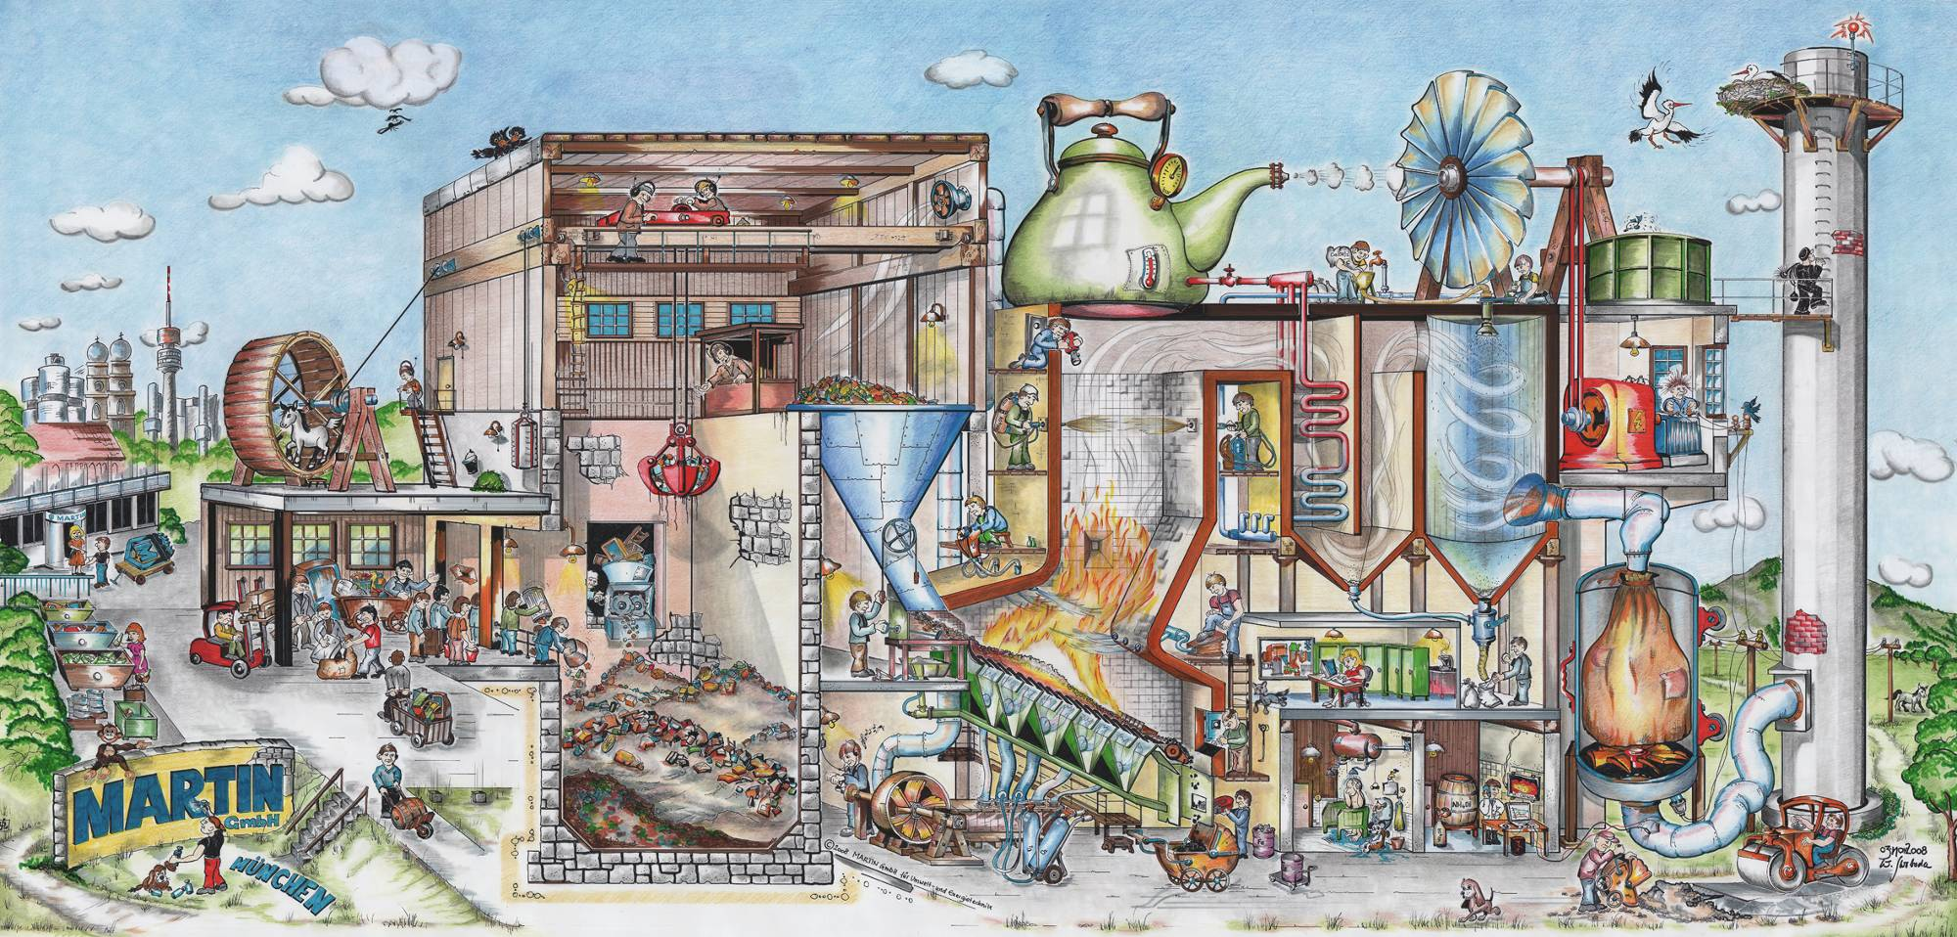
Thank you for your attention !
MARTIN®, MARTIN Rückschub® and SYNCOM® are registered trademarks in selected countries.
The MARTIN technologies described in this presentation are protected by numerous patents in many countries.

