Slide 1

Possibilities and limits of energetic use of biomass
Viessmann Bioenergy
Dipl. Ing. Markus Kornfehl
Köb Holheizsysteme
Mawera Holzfeuerungsanlagen
Austria

Slide 2

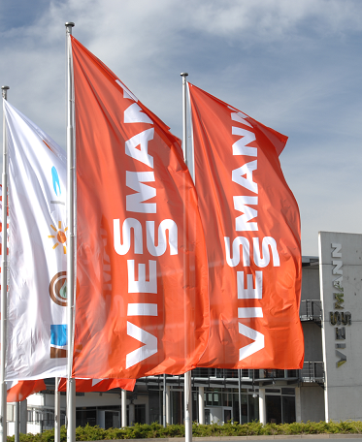
Viessmann Group
Workforce: 9,400
Turnover: approx. 1.7 Bil. Euro
Export-share: 56 %
Founded: 1917
Headquarters: Allendorf (Eder)
The Viessmann Group is one of the internationally leading manufacturers of heating technology systems.

Slide 3

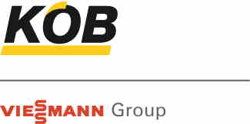






Acquisitions since 2006
The additional purchase of key technologies has allowed us to broaden our technological base and has made the access to additional markets possible.

Slide 4






















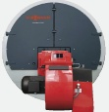
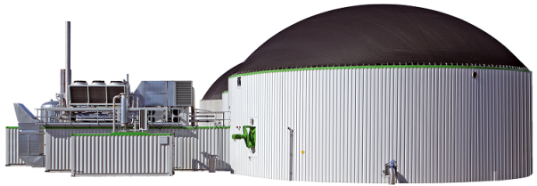




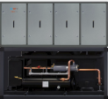


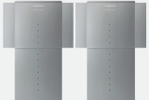
Comprehensive Range
1.5 kW – 116,000 kW
Broad Distribution
Systems Engineering
System solutions for all energy sources and areas of application in the field of heating, air conditioning and CHP.

Slide 5









Viessmann full-range supplier for energy centrals
Multivalent with oil/gas, solar, biomass/biogas, geothermal

Slide 6
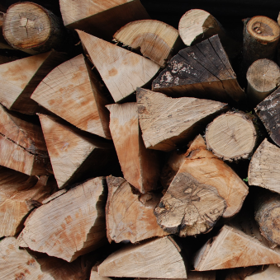
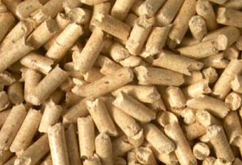
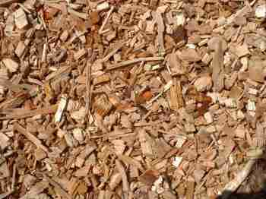
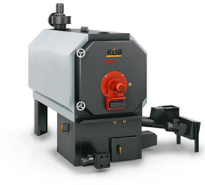
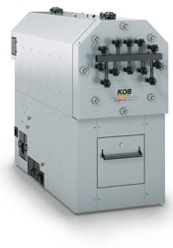
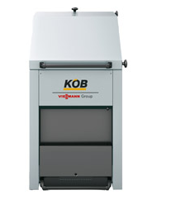
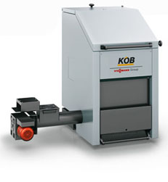
Biomass furnance up to 1.250 kW
Product range
Logs
Pellets
Wood Chips
Pyromat ECO
40 – 170 kW
Pyromat DYN
35 – 100 kW
Pyrot
90 – 480 kW
Pyrotec
390 – 1250 kW
Pyromat ECO
40 – 170 kW

Slide 7
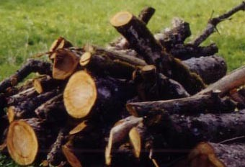
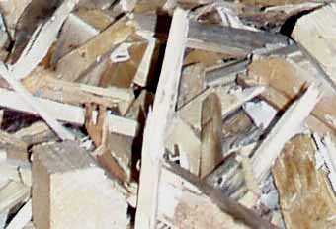

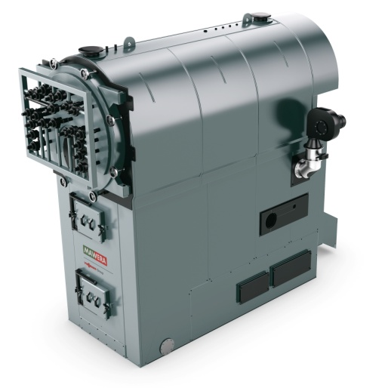
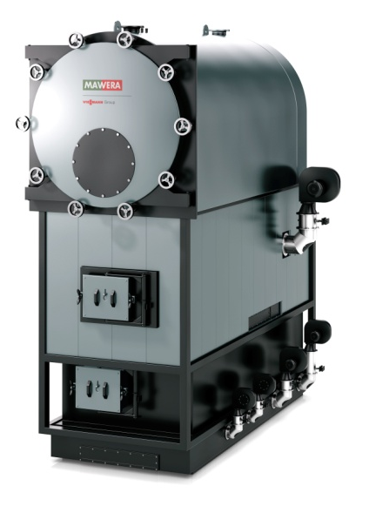
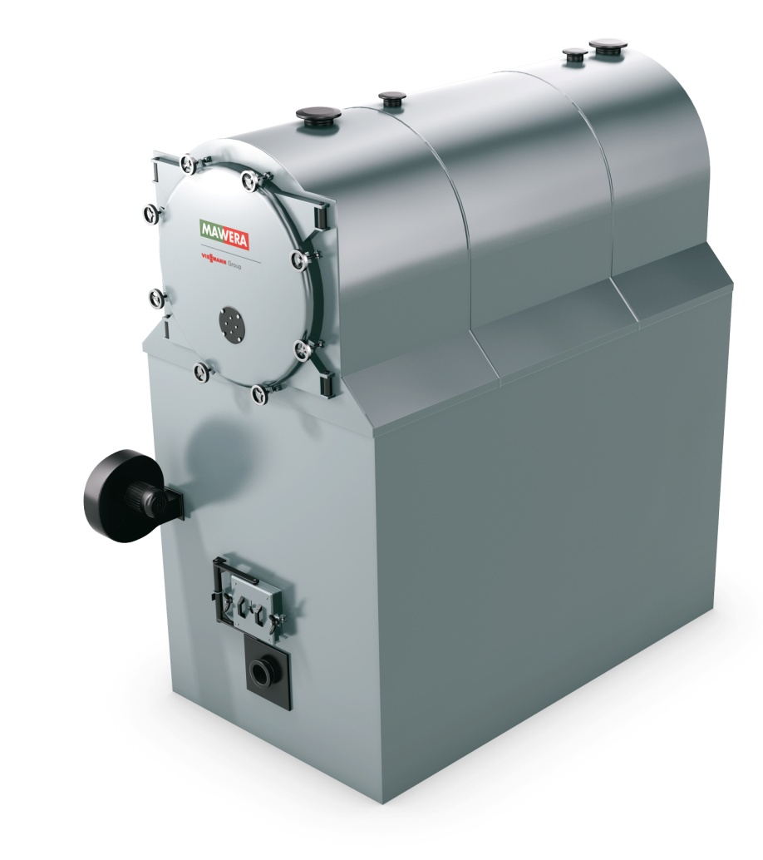
Biomass furnace up to 13.000 kW
Grate furnance
Blowing in firebox
Wood Chips
Wood from Landscaping
Construction remnants
Sawdust
Pyroflex FSB
180 – 1700 kW
Pyroflex FSR
850 – 13.000 kW
Pyrovent FR
850 – 13.000 kW

Slide 8
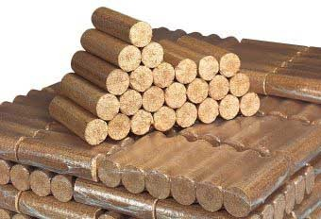
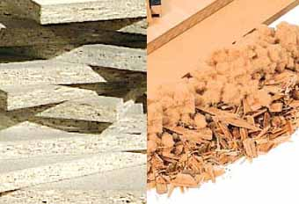
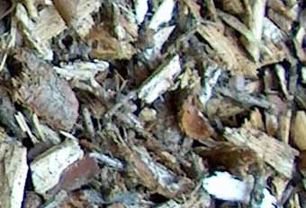
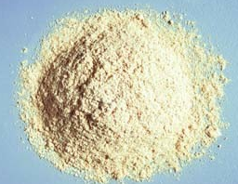
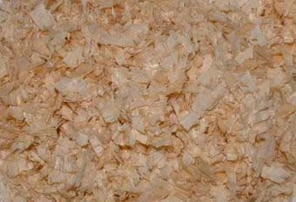
Woody Biomass – a vast Field of Opportunity
Briquettes
Wood from Landscaping
Chip boards
Chopped Bark
Wood Chips
Pellets
Residue
Construction remnants
Plane chippings
Sawdust

Slide 9
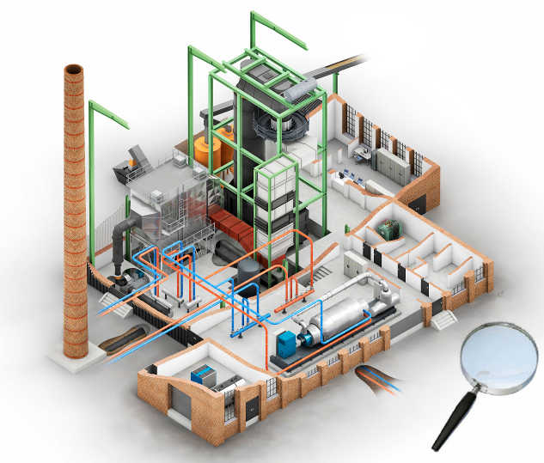
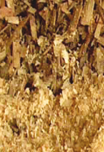
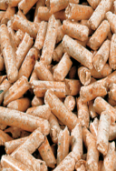
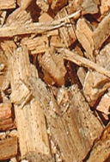

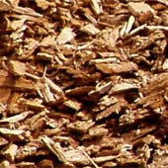
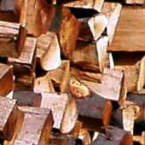
Combined heat and power plants via ORC process electrical output from 300 kW to 2000 kW
Power plant
Electric energy
fuel
BHKW
1.
2.
3.
Wood chips
dust
Construction remnants
Wood from landscaping
heat
4.
Anlagentechnik:
fuel logistic => transport of fuel to firebox
2 Furnance and flue gas cleaning=> combustion
3 Thermal oil boiler=> transport of heat energy to ORC module
4 ORC-module => transfers heat energy in electric energy
1.
2.
3.
4.

Slide 10
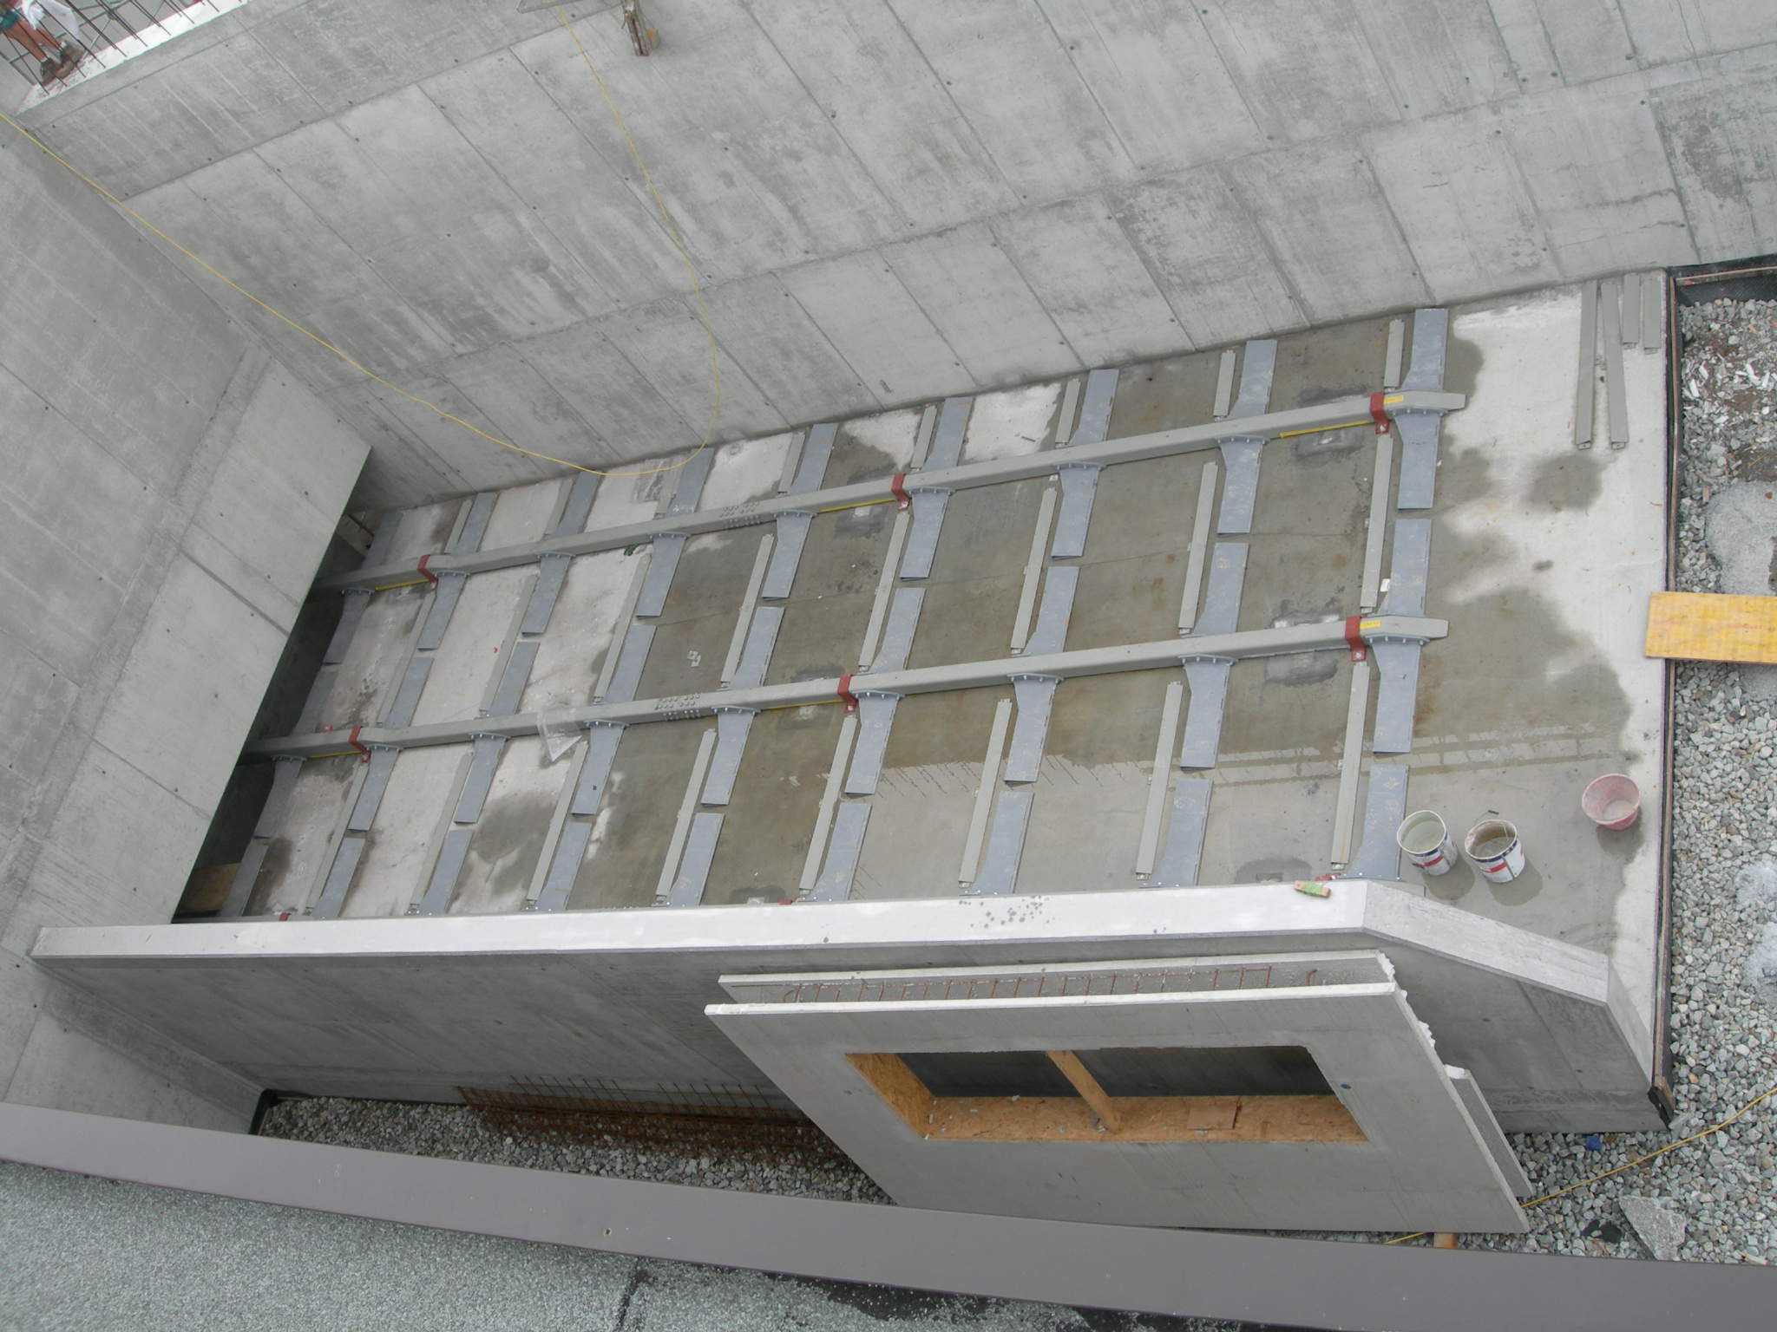
Example: FSR6000 ORC powerplant (1000 kW electric) in Olang – Italy build up

Slide 11
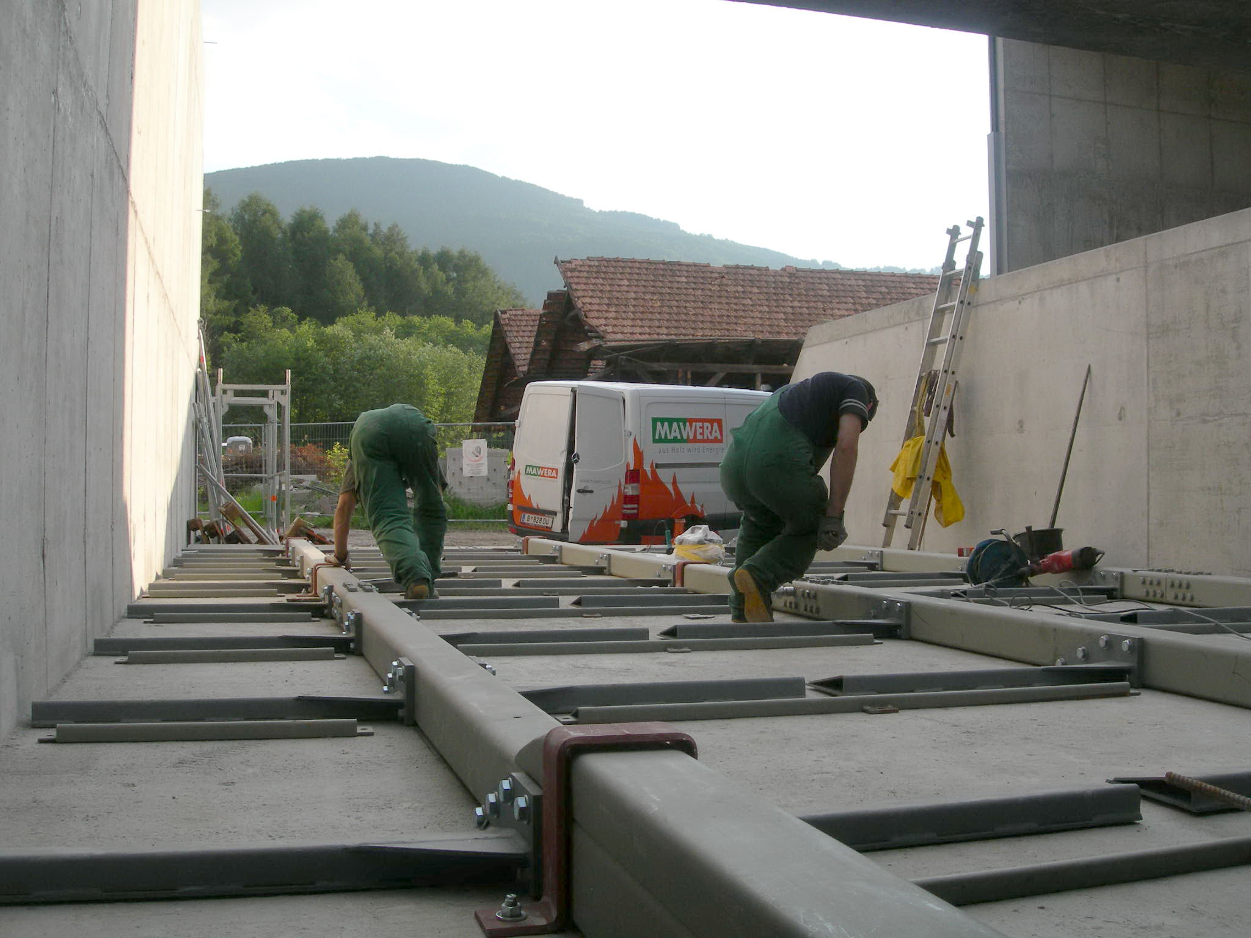
Example: FSR6000 ORC powerplant (1000 kW electric) in Olang – Italy build up

Slide 12
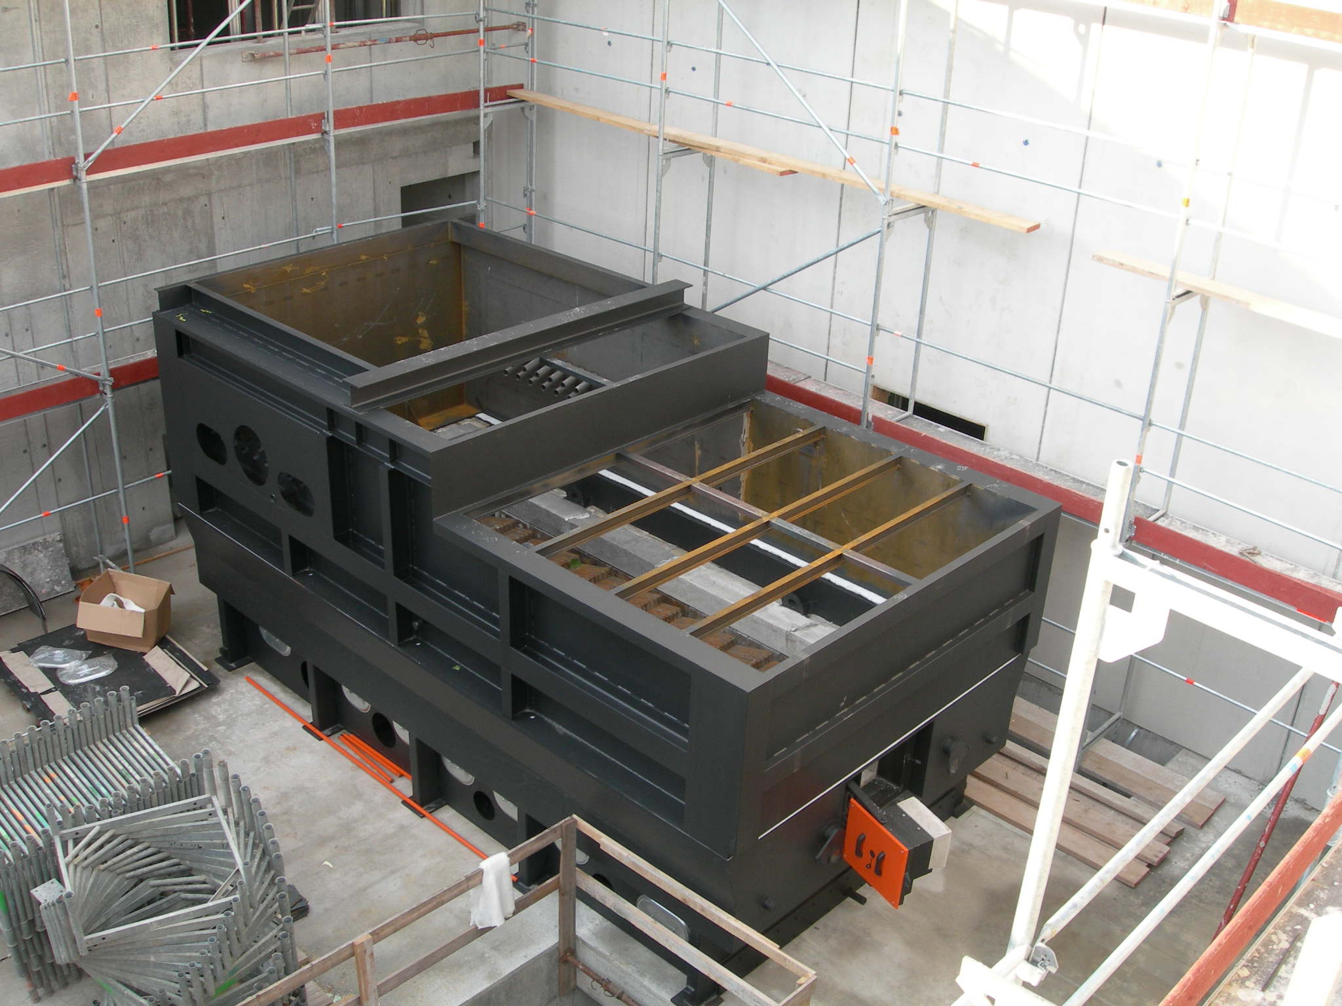
Example: FSR6000 ORC powerplant (1000 kW electric) in Olang – Italy build up

Slide 13
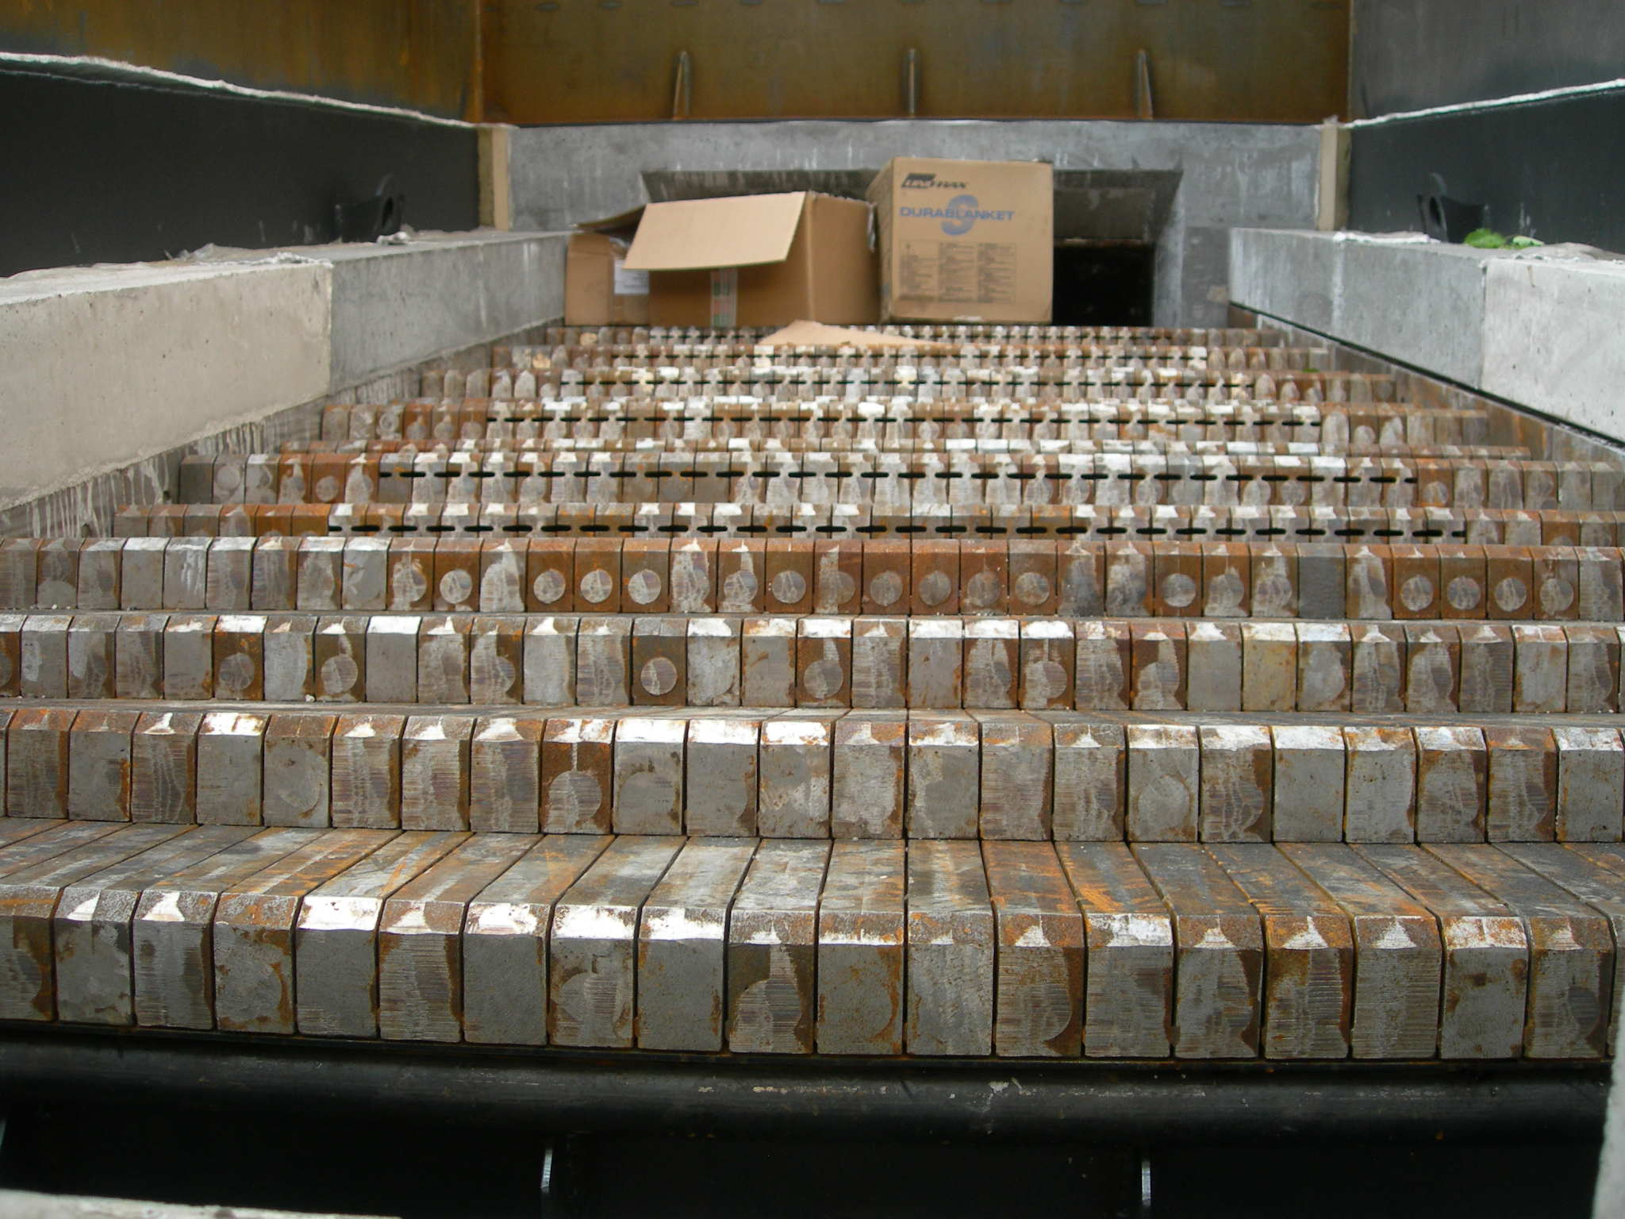
Example: FSR6000 ORC powerplant (1000 kW electric) in Olang – Italy build up

Slide 14
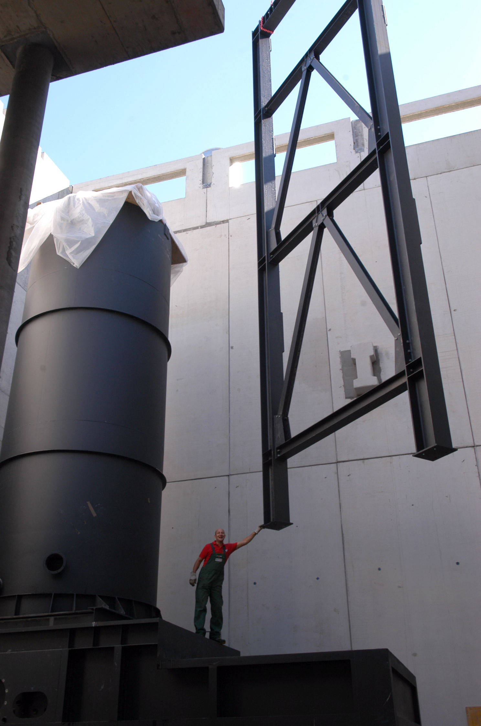
Example: FSR6000 ORC powerplant (1000 kW electric) in Olang – Italy build up

Slide 15
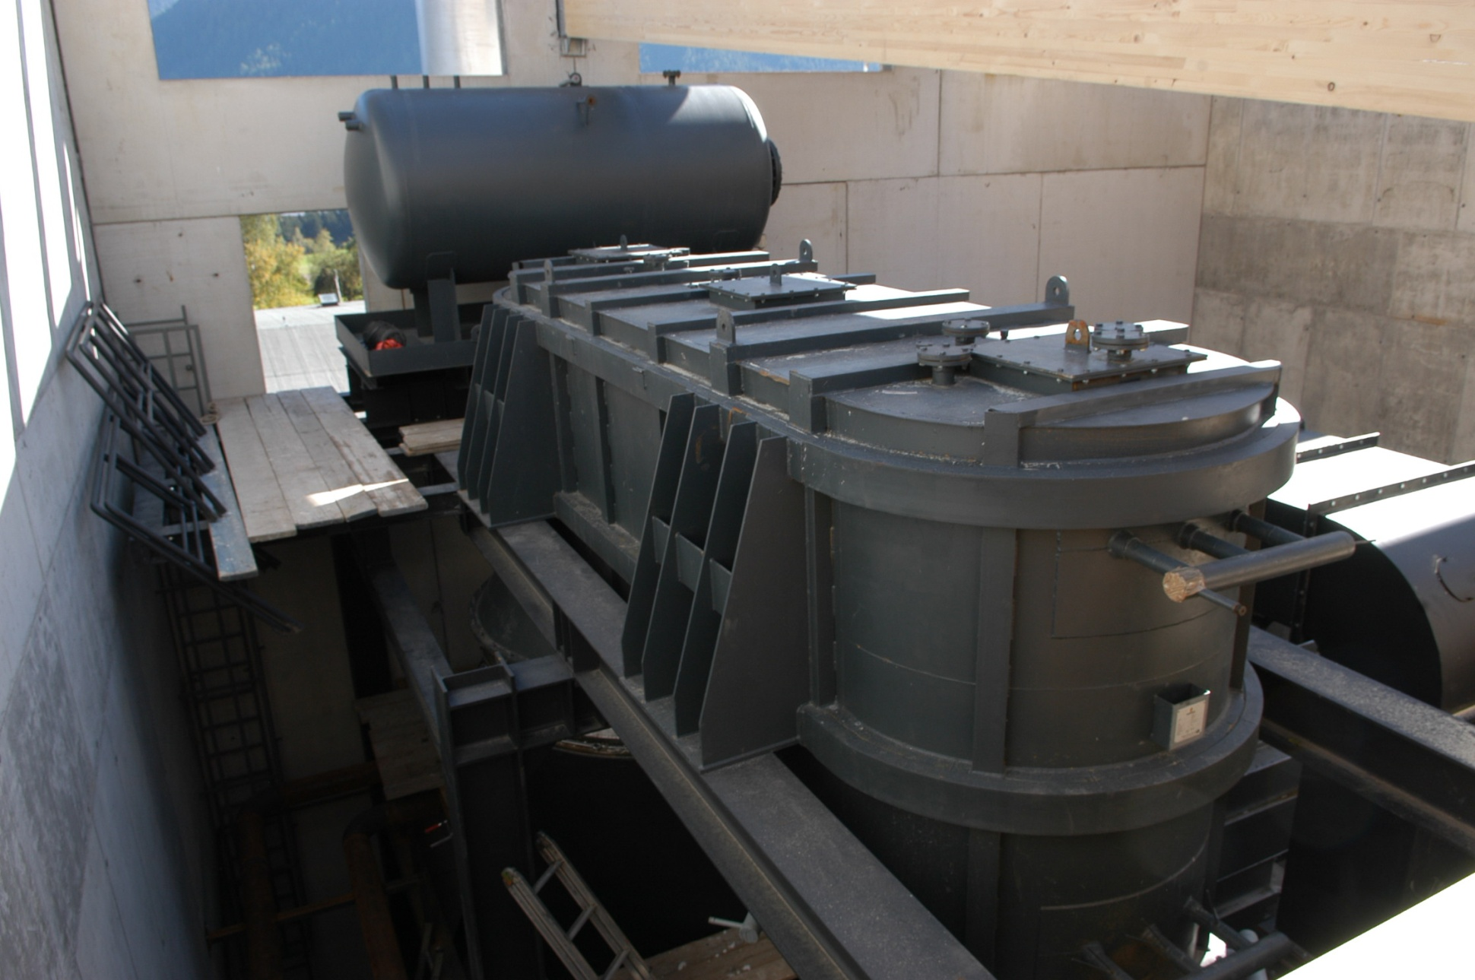
Example: FSR6000 ORC powerplant (1000 kW electric) in Olang – Italy build up

Slide 16
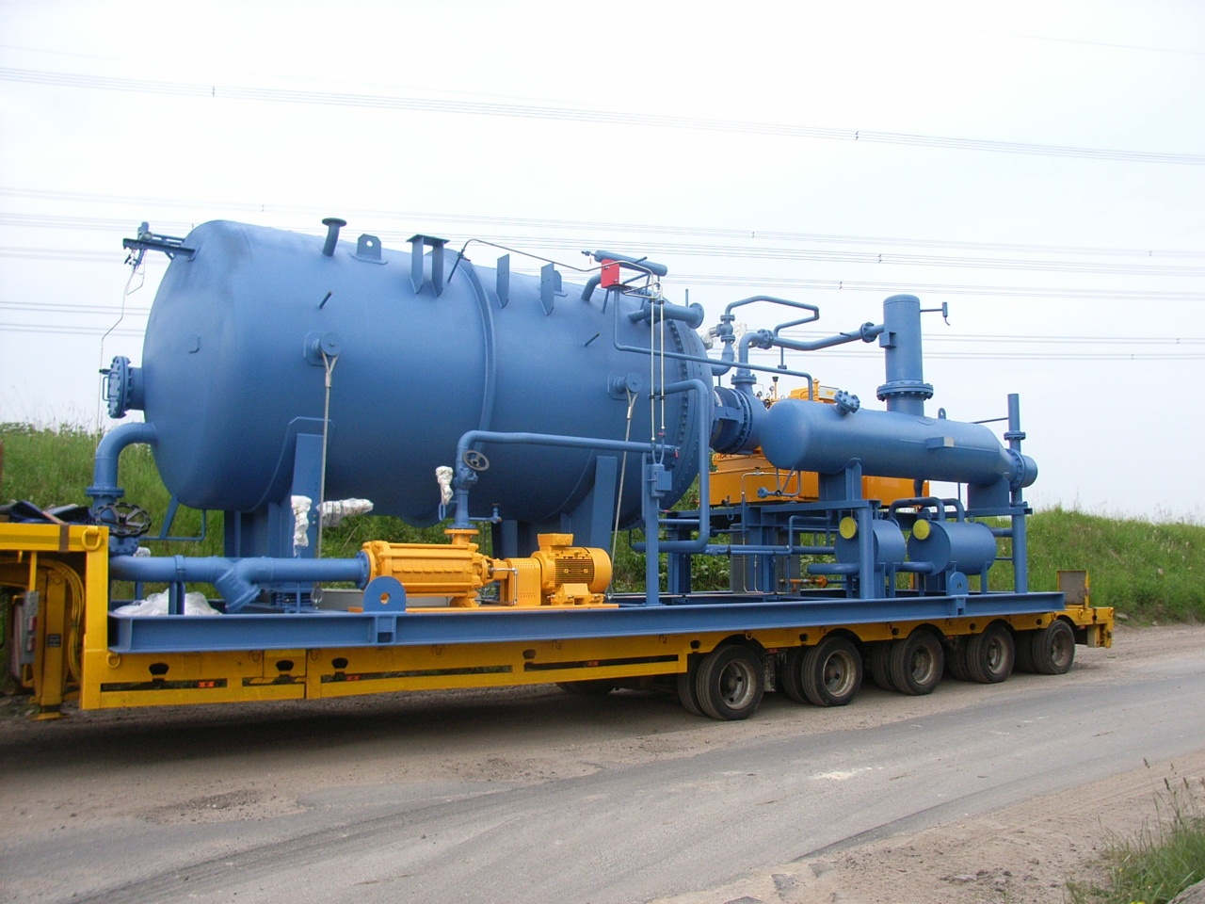
Example: FSR6000 ORC powerplant (1000 kW electric) in Olang – Italy build up

Slide 17
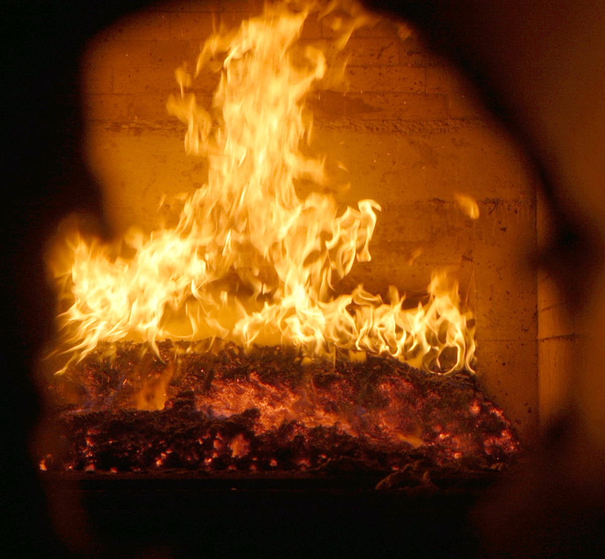
Example: FSR6000 ORC powerplant (1000 kW electric) in Olang – Italy build up

Slide 18
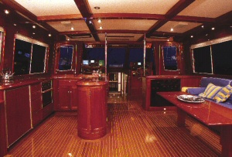
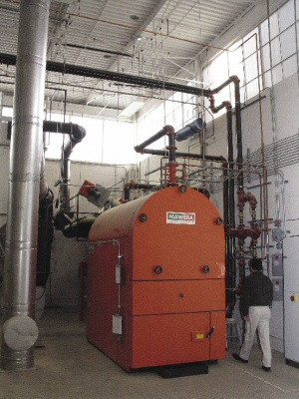

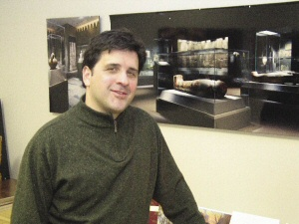
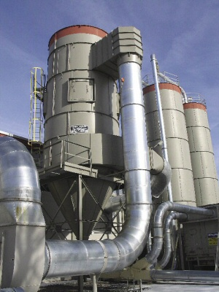
Example: FU 700 RIA
Richey Woodworking, Massachusetts/USA
environment:
furniture industry – heating and process energy
Underfeet Stocker
FU 700 RIA (0,8 MW)
controls:
Mawera Logic and remote control
Heated area:
9.000 m2

Slide 19
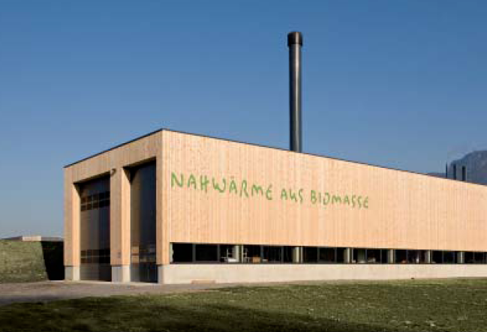
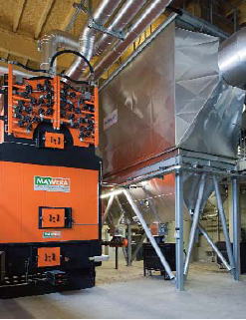

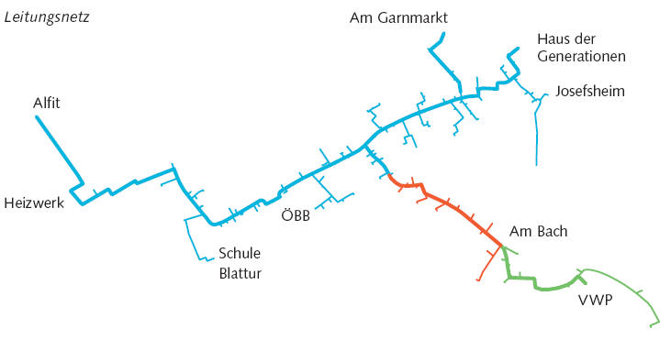
Example: FSB 3300
Nahwärme Götzis, Vorarlberg/Österreich
environment:
district heating network 150 consumers, lenght of net 8 km
Biomass System (power):
firebox with moving grate FSB 3300 (3,3 MW)
controls:
MaVis mit Fernwartung
Fuel consumption p.a.:
18.000 m3
Multivalent system:
oilboiler (3,7 MW)
BHKW (0,1 MW)

Slide 20
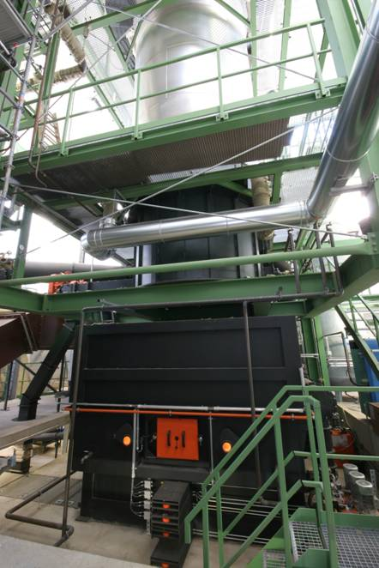

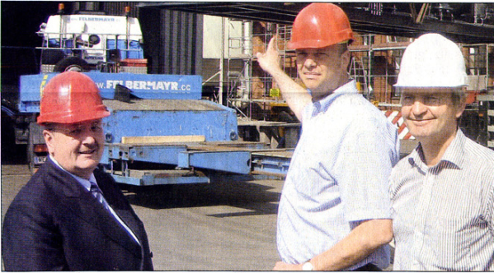
Example: FSR 7000 (CHP)
Holzheizkraftwerk Hövelhof, Germany
environment:
process heat
Biomass System (power):
firebox with moving grate FSB 7000 (6,5 MW)
controls:
MaVis with remote control
Fuel consumption p.a.:
10.500 tons
ORC-modul (0,8 MW electric energy)

Slide 21
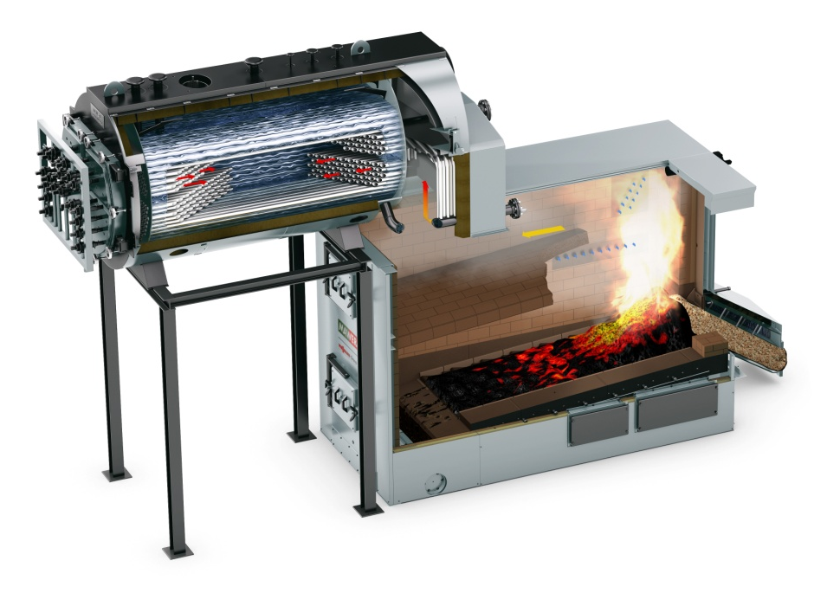
Example: FSR 10.000 sarurated steam
Maritza Olio, Bulgaria
environment:
process heat
Sun flower oil production
Biomass System (power):
firebox with moving grate FSB 10000 (10 MW)
controls:
MaVis with remote control
Saturated steam production
(15,3 to/h, 8 bar)

Slide 22
Thank you for your attention!
DI Markus Kornfehl
Email: KofM@viessmann.com

