Slide 1

Load management and grid stability maintenance in the conditions of liberalized market of Romania
Nicolae Opris - Corporate Strategy and Relations with Regulatory Authorities

Slide 2

Romanian Power Sector – the structure
Ministry of Economy
ANRE
The Regulatory Authority
Parliament
Ministry
ANRE
A fully unbundled and liberalized electricity market (legally 100 % ) since 1.07.2007
Areas: GENERATION TRANSMISSION DISTRIBUTION SUPPLY USE
Licenses: 87/20 (DU) 1 (TSO) 34/8-incumbent 136 N/A
Hidroelectrica
ENEL Distribution Banat
TRANSELECTRICA
Transmission and System Operator
-a regulated natural monopoly-
Created in 2000/ on BSE since 2006
An ENTSO-E member
Nuclearelectrica
ENEL Distributon Dobrogea
ENEL Energy
Termoelectrica
ENEL Distribution MS
Consumers
(all eligible)
Electrocentrale Bucuresti
E.ON Moldova Distribution
EON Supply
Electrocentrale Deva
CEZ Distribution (Oltenia)
CEZ Sales
CE Turceni
OPCOM
The Market Operator
(TEL 100% subsidiary)
Electrica MN - Distribution
Electrica - Supply
CE Rovinari
Electrica TS - Distribution
Electrica
( state owned )
CE Craiova
Electrica TN - Distribution
New GENCO’s -RES
Other Private DISCO’s
Private suppliers

Slide 3
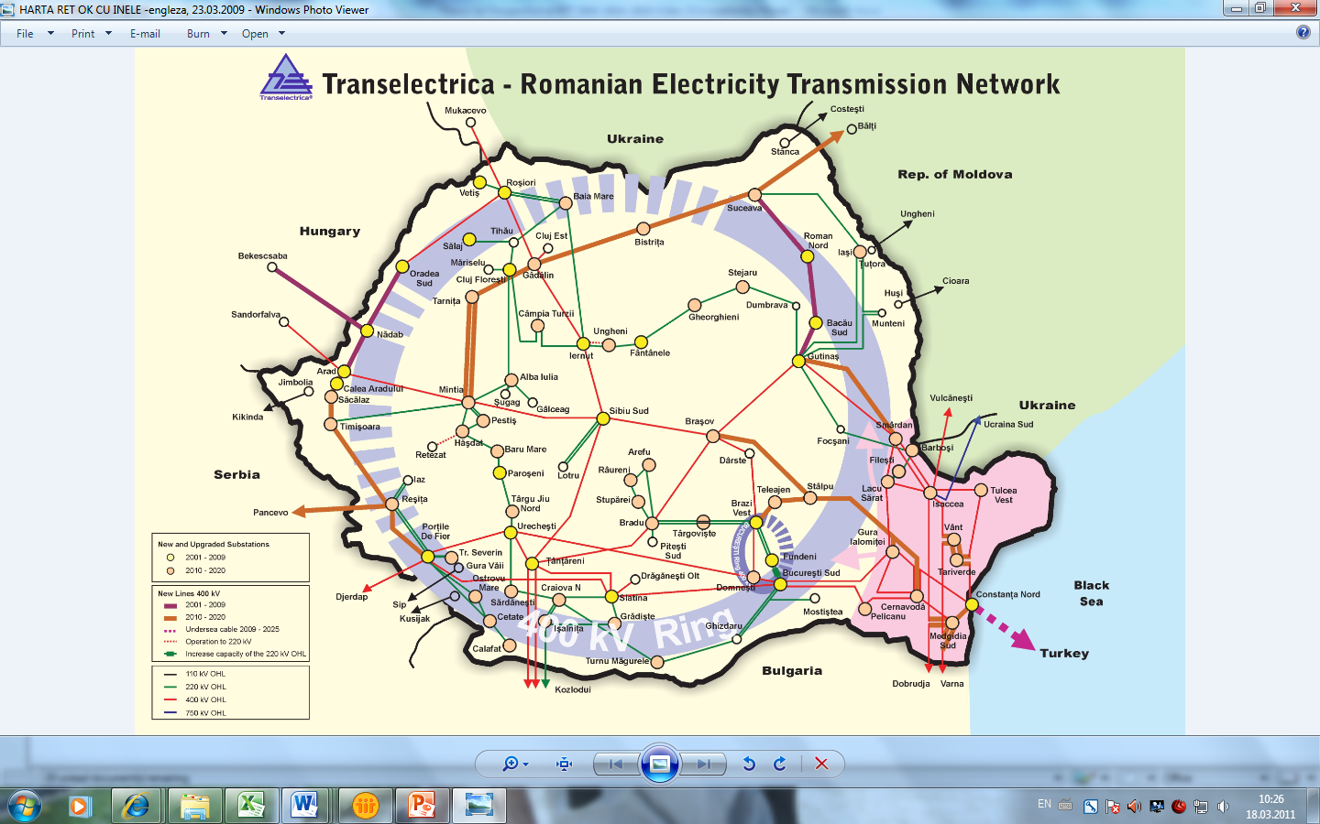
Electricity transmission grid

Slide 4

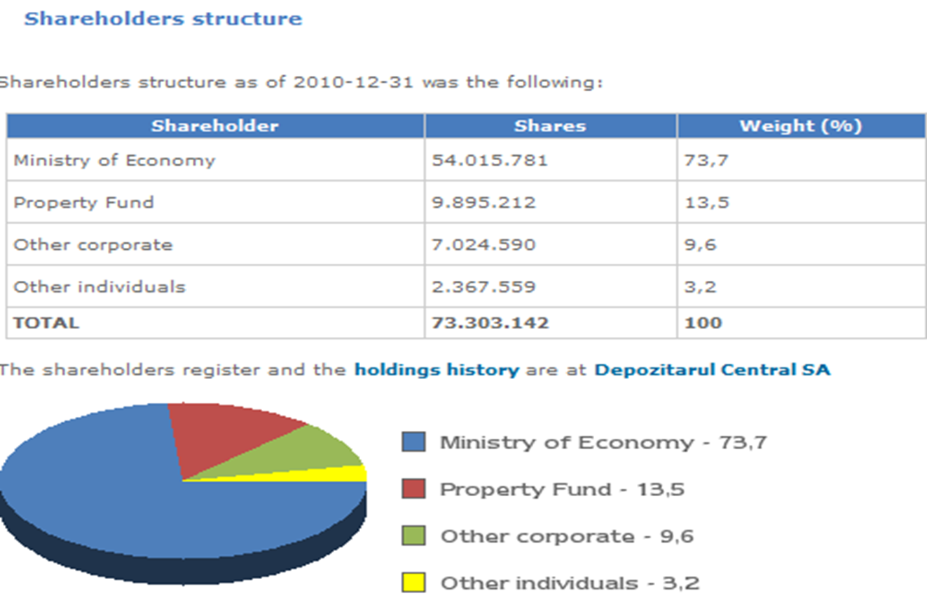

Slide 5
Current situation - 2010 –
The Romanian Electricity Generation
Current situation - 2010 –
MW | December 2010
Total Net Generating Capacity | 16998
Nuclear | 1300
Fossil Fuels | 9167
• Lignite | 4134
• Hard coal | 1325
• Gas | 1065
• Oil | -
• Mixed fuel (gas & oil) | 2642
Renewables | 444
• Wind | 423
• Biomass | 22
• Solar | 0
Hydraulic power | 6087
• storage | 3810
• run-of-river | 2277
• pumped storage | -
Structure of the net generating capacity
TWh | Total 2010
Net Consumption | 53.4
Pump Consumption | 0.3
Exchange Balance (Import-Export) | -2.9
Net Production | 56.6
Nuclear | 10.7
Fossil Fuels | 25.3
• Lignite | 16.0
• Hard coal | 2.5
• Gas | 0.6
• Mixed fuel (gas & oil) | 6.1
Renewables | 0.4
• Wind | 0.3
• Biomass | 0.1
• Solar | 0.0
Hydro | 20.2
Structure of the net electricity production

Slide 6
The Romanian Electricity Generation
Forecast for 2020
MW | 2020
Total Net Generating Capacity | 25910
Nuclear | 2630
Fossil Fuels | 9721
Renewables (according to NREAP) | 4860
• Wind | 4000
• Biomass | 600
• Solar | 260
Hydraulic power | 8699
• storage & ror (according to NREAP) | 7729
• pumped storage | 970
Structure of the net generating capacity
TWh | 2020
Net Consumption | 68.0
Pump Consumption | 0.7
Exchange Balance (Import-Export) | -3.9
Net Production | 72.5
Nuclear | 18.3
Fossil Fuels | 21.9
Renewables (according to NREAP) | 11.8
• Wind | 8.5
• Biomass | 2.9
• Solar | 0.3
Hydro (including pumping) | 20.6
Structure of the net electricity production

Slide 7

Planning the Romanian Transmission Grid
Electricity transmission grid development should be in line with Romanian Power System development. Its purpose is to cover electricity consumption at least cost, under safe conditions and in compliance with the Romanian Energy Policy.
Transelectrica responds for Romanian transmission grid planning in cost efective conditions and by informing all the interested license holders in the electricity sectors. Every two years Transelectrica revises the Prospective Plan of the Transmission Grid for the following ten years. The Plan is a comprehensive survey of the operating characteristics and performances of the electricty transmission grid and is based on the best assessment of the main financial and economic evolutions, electricity production and consumption included. Upon getting authorisation from ANRE and approval from the Ministry of Economy , the 10 years Prospective Plan becomes a public document. The Prospective Plan of the Transmission Grid for 2008-2012 with an outlook for 2017 was already carried out

Slide 8
Integration of POWRSYM3 Model
Into Generation Capacities Planning -1
In today's competitive environment, the need for greater detail in system planning analyses has become increasingly important.
PowrSym3 is a multi-area, chronological, Monte Carlo simulation model capable of :
detailed, short-term studies with high levels of optimization
long-term system planning studies representing chronological system operating conditions.
PowrSym3 algorithm features:
Preservation of the chronological
sequence of events
Combined heat and power simulation
Accurate unit dispatch
Monte Carlo/derating options for forced
outage simulation
Emission influenced commit / dispatch
Complex fuel contract model with fuel
blending
Multi-area power transport model
Integrated reliability model
Maintenance schedule optimization
multi-year system operation is simulated over sequential weekly optimization horizons with a time step of one hour.
ability to compare alternatives under ‘real’ system operating conditions

Slide 9
Integration of POWRSYM3 Model
Into Generation Capacities Planning -2
PowrSym3 report categories:
System reliability
Reserve margin
Capacity factors
Energy generation
Fuel consumption
Number of unit starts
Startup costs
Fuel costs
Power plant emissions
Purchased power
Total costs
Inter-area transfers and wheeling charges
Marginal costs
Cogeneration heat reports
Operation and maintenance costs
PowrSym3 applications include:
Generation expansion studies
Integrated resource planning
Real time resource scheduling
Fuel burn and fuel contract evaluation
Near term operational studies
Maintenance scheduling options
Hydro power evaluations
Hourly marginal cost evaluations
Notes:
Romania is mostly an exporting country. Electricity exchanges (import/export/transit) with the interconnection partners are achieved on the basis of competitional gained contracts between licensed suppliers in the Romanian market with their external partners.
Physical power exchanges with other systems in 2010 represented an export balance of 2.919 GWh (average capacity 333 MW).

Slide 10
Romanian wholesale electricity market
Transelectrica
Transmission
Operator
System
Operator
Balancing Market
Operator
Metering Operator
Wholesale Electricity Market
Green
Certificates
Market
Capacity Allocation
Markets (on iOHL’s)
Co-ordinated Alocationl.
Main Electricity
Market
Ancillary Services
Market
(Mandatory)
Balancing market
(Mandatory)
~5% *
Bilateral Contracts
Market
Day Ahead Market
(P/X)
Dispatchable
Units
Balacing
Responsible
Parties
TEL - BRP 1
grid losses
~10%
Bilateral contracts
OTC
Bilateral contracts
through OPCOM
TEL - BRP 2
Exchanges on
Int. OHLs
TEL buyer of power reserves
(Technological system services)

Slide 11
Romanian Wholesale Electricity Market Structure
Bilateral Contracts Market - decentralized and centralized market
- regulated and free market
Day Ahead Market – voluntary centralized market
Balancing Market – mandatory centralized market
Market for cross border capacity allocation – voluntary centralized market
Ancillary Services Market – voluntary centralized market
Green Certificates Market – according to EU Directives
ADVANTAGES
System balancing – using market based mechanisms
  balancing energy suppliers receive at least the offered price
  the imbalances are penalized (imbalance price)
  contractual obligations are guaranteed (bilateral and day ahead contracts)
  congestion management – costs supported by TSO
Flexible offers on DAM (portfolio offers – 25 pairs price/quantity).
Self-scheduling

Slide 12
Romanian electricity market
BILATERAL CONTRACTS
DAY AHEAD
ON THE DAY
SETTLEMENT
Market Operator
S
S
Day Ahead Market
Firm Volumes by Company
Imbalance volumes by BRP
Simple Bids
TSO-market operator
P
MP
Simple Bids
Q
Balancing Market
BM Volumes
G
G
Q
Simple bids by unit
Meter data
Adjustments to Day Ahead schedule
G - generators
S - suppliers
Metered Volumes
Physical Notifications
Balancing Responsible Parties
TSO

Slide 13
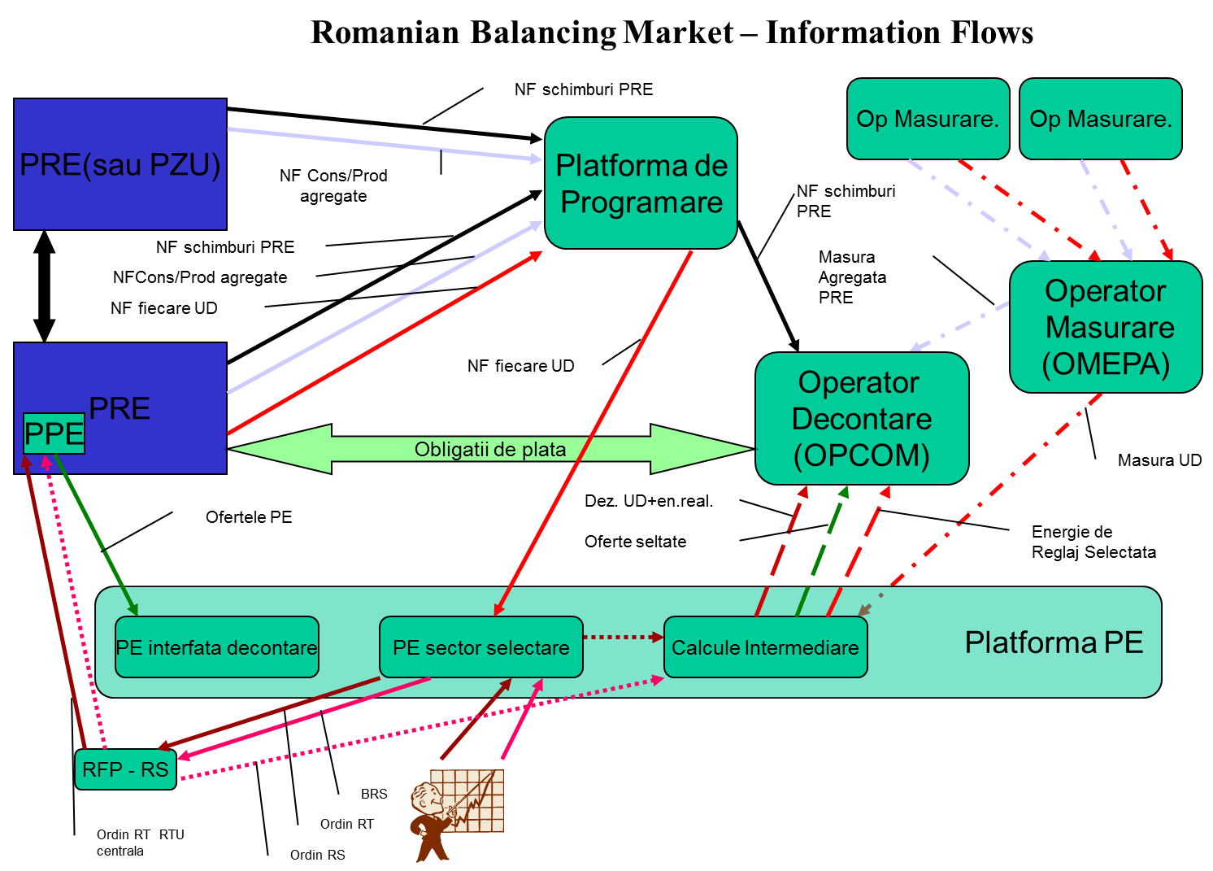

Slide 14
Balancing Electricity Market Platform
BRP interface
web-interface, xml files
Notified
  Contracts
  Block exchange
Validation:
  Formal
  Block exchange
Internet access
BRP interface
web-interface, xml files
Notified
  production
Validation:
  Formal
Internet access
BMP interface
web-interface, xml files
Notified
  Availability
Validation:
  Formal
  Technical
Internet access
Operator Interface
Html files
Monitor the xml files transfer
Allocates the deposit rights
Intranet access only for the operator
Scheduling
Platform
BRP
Physical Notification
Interface
DU
Physical Notification
Interface
Availability
Declaration
Interface
Operator
Interface
BMP interface
web-interface, xml files
Offered regulation energy:
  Secondary
  Fast Tertiary
  Slow Tertiary
Offers for upward and downward regulation
Internet Access
Dispatcher Interface
EAIMS type
Generate a Merit Order
Selection
Access only on Intranet
Access based on a USB key
ORACLE data base
Calculates:
Delivered regulation energy
DU imbalance
Market Surveillance data
Only Intranet Access
Operator Interface
Html files
Monitor the xml files transfer
Intranet access only for the operator
Balancing
Platform
Offer Interface
Selection
Interface
Provisional
Calculation
Interface
Operator
Interface

Slide 15
Balance Management
In 2010 the market share of Balancing Market was of 5.12 % from the total gross consumption, 0.65 % less than in 2009. There were 2.96 TWh traded on the balancing market (with an average power of 388 MWh/h), from which the energy used for congestion management was about 0.001 TWh (with an average power of 0.12 MWh/h).
During winter, especially from October till December, the sum between notified production and total scheduled exchanges with the neighbouring power systems was smaller than the actual consumption with monthly average values up to 420 MW, leading to high levels of costs on balancing market. In November and the first half of December, were registered many cases when these differences were bigger than the actual consumption at night off-peak hours and smaller at evening peak hours. Thus upward selected energy on balancing market for slow tertiary was comparable to the energy selected downward for slow tertiary.
Beginning with first half of March and until September, the sum between notified production and total scheduled exchanges with the neighbouring power systems was bigger than the actual consumption with monthly average values up to 226 MW. Therefore, the volume of downward energy selected on balancing market has increased during these months, leading to lower costs on this market.
The analysis of market structure / concentration indicators (Herfindahl – Hirschman Index, S1 - market share of the largest market participant (%)) shows that the market is still highly concentrated and competition level reduced, especially for secondary upward and downward regulation and fast tertiary upward regulation.

Slide 16
Capacity Allocation at Borders
According to the agreements between Transelectrica and neighbours for 2010, the transfer capacity allocation market allows performing explicit yearly, monthly, daily and intra-day auctions as it follows:
on the Bulgarian border, the bilateral coordinated allocation is done for 100% of total capacity:
by ESO EAD for long term auctions;
by Transelectrica for daily and intra-day auctions. At daily and intra-day auctions it is applied the “netting” principle.
on the Hungarian border, the bilateral coordinated allocation, is done for 100% of total capacity:
by Transelectrica for long term and intra-day auctions;
by MAVIR for daily auctions. At daily and intra-day auctions it is applied the “netting” principle.
on the Serbian border, long term auctions for 50% of total net transfer capacity are held by Transelectrica, the remaining of 50% being allocated by the neighboring TSO.
The market monitoring results show that the market is still highly concentrated, with a low level of competition on each border. Compared to the previous year, an improvement of market indicators was noticed, especially on the import direction from Hungary. For example, the lowest values of market indicators were obtained in August 2010 (C1 = 19%, C3 = 43%, HHI = 1009), showing a moderate level of concentration on this border direction.

Slide 17
Market Players -1
The number of balancing responsible parties (BRPs) increased in 2010, reaching a maximum of 120 BRPs in April and June, but at the end of the year the number of BRPs decreased to 115, the same amount as in 2009. In 2010, 19 market participants, holding 137 dispatchable units were operating on Balancing Market.
* BRPs number at the end of each year

Slide 18
Market Players - 2
Ancillary Services Market
Although the number of participants has increased in 2010 compared to 2009, it is still reduced, leading to a highly concentrated market with a reduced competition level, especially for secondary and fast tertiary reserves. In 2010, capacity reserve was no longer purchased.

Slide 19
Market Players - 3
Capacity Allocation Market
Similar to last years, for long term auctions, the number of capacity holders remained reduced, on every border and direction (export / import). It can be noticed that on the Hungarian border (both import and export) the average number of participants at monthly auctions has increased.
In case of daily auctions, maximum number of capacity holders it was higher on the Hungarian border (10 export / 11 import) than on the Bulgarian border (4 export / 4 import), while for intra-day auctions there where few cases when capacity was requested and only on the Bulgarian border, by no more than one participant in a day.

Slide 20
Trading Volumes - 1
Balancing Market
The annually share of traded balancing energy from the total gross consumption has decreased continuously since the beginning of Balancing Market operation, this being a step forward in reaching the initial goal of this market: real time generation - consumption balance.

Slide 21
Trading Volumes - 2
Ancillary Services Market
The total contracted quantities in 2010 covered 92.54% from TSO’s necessary volume.
Ancillary Services 2010 | Volumes [hMW] |  |  |  | Percentage of Contracted versus |  | Percentage of Realized versus
 | Necessary | Regulated | Contracted | Realized | Necessary | Regulated | Necessary | Contracted
Secondary Regulation Band | 3505000 | 3505000 | 3505000 | 3401336 | 100.00% | 100.00% | 97,04% | 97,04%
Fast Tertiary Reserve | 7008000 | 6376265 | 6376265 | 6318059 | 90.99% | 90.99% | 90,15% | 99,09%
Slow Tertiary Reserve | 6132000 | 5522840 | 5522840 | 5522536 | 90.07% | 90.07% | 90,06% | 99,99%

Slide 22
Trading Volumes - 3
Capacity Allocation Market
As it can be observed from the chart bellow almost entire value of NTC was allocated in long term auctions. The capacity demand is usually much higher than the offered capacity and because of this, frequency of congestion occurrence on interconnections is very high.
* Average weighted values in correlation with total number of allocation hours
Notes:
The average level of usage for total allocated capacity on export direction has values between 30-52 %, depending on border, except on the border with Ukraine where the value is only 7,44 %. For import the values are lower than the values for export, except on the border with Bulgaria, where the average level of usage was the highest one.
* The allocated capacity level of usage on one border and direction represents the percentage ratio between the energy associated with the commercial transactions, notified during a month, and the energy associated with the allocated capacity by the Romanian and by the neighboring side, to all participants, no matter if they have counterparties on the other side of the border or not
Transelectrica implemented daily and intra-day capacity auctions that offer an effective way of using the interconnection in order to meet the intra-day needs of the participants.
On the Hungarian border, capacity allocated through long-term auctions is nominated more on export direction, which leads to higher volumes of offered capacity for daily auctions for import direction than for export. Even if the amount of allocated capacity is higher on import direction, the level of usage is lower than for the export direction.
On the Bulgarian border capacity allocated through long-term auctions is nominated both for import and export and volumes of offered capacity for daily auctions are quite similar for both directions, usually higher for export. The amount of allocated capacity is higher for import direction and also the level of usage.
In general, the level of usage for daily allocated capacity is lower than the one for long term allocated capacity and the congestion cases are more frequent for Romanian -Hungarian and Bulgarian - Romanian border directions.
Similar to daily auctions, the amount of offered capacity for intra-day auctions on Hungarian border is higher for import than for export and vice versa on Bulgarian border.
In general in 2010, there were no requests for capacity in intra-day auctions, one of the causes being that for the moment it hasn’t been implemented an intra-day energy market.

Slide 23
Promoting renewable energy sources
Targets – share of renewables
Directive 2001/77/EC (amended by 2006/108/EC) :
33 % of gross electricity consumption in 2010
Romanian energy strategy 2007 – 2020:
33 % of gross electricity consumption in 2010
35 % of gross electricity consumption in 2015
38 % of gross electricity consumption in 2020
Directive 2009/28/EC
24 % of gross energy consumption in 2020 (+6.2 % from 2005)

Slide 24
Market facilitator –green certificates (GCs)
Based on primary & secondary European legislations and internal laws (HG. 443/2003), in 2004 Romania adopted the green certificates schemes to support electricity generation from renewable energy sources (RES). Transelectrica was appointed as the Issuing Body for Green Certificates (GCs) to electricity generators from renewables. In the support scheme there are also included small hydro energy produced in power stations commissioned or modernised since 2004, with an installed capacity equal or lower to 10 MW (wind, solar, geothermal and tide energy, biomass, hydrogen produced from RES).
No. of GCs. on E-SRE Type | 2005 | 2006 | 2007 | 2008 | 2009 | 2010
wind | 71 | 87 | 869 | 1.615 | 13.577 | 290.045
water | 578 | 667 | 9.239 | 12.057 | 197.751 | 274.439
Biomass | 0 | 0 | 0 | 0 | 30.192 | 112.115
Solar | 0 | 0 | 0 | 0 | 0 | 7
Total | 2.654 | 2.760 | 12.115 | 15.680 | 243.529 | 678.616
Producers of E_SRE | 2005 | 2006 | 2007 | 2008 | 2009 | 2010
Wind | 2 | 3 | 11 | 12 | 15 | 26
Water | 1 | 4 | 9 | 11 | 14 | 18
Biomass | 0 | 0 | 0 | 0 | 1 | 3
Solar | 0 | 0 | 0 | 0 | 1 | 1
Total | 3 | 7 | 20 | 23 | 31 | 48
Notes:
1 (one) GC represents 1 MWh (one megawatt-hour) of renewable power delivered to the transmission or distribution grid. Transelectrica is monthly issuing GCs for the renewable electricity produced in the previous month, based on the declarations made by renewable power producers for each power unit and confirmed by the electricity distributor. After issuing the GCs, the producers may sell the certificates in the GC market (bilateral or through OPCOM platform) to suppliers in order to meet the yearly GCs target. According to regulations,1 GC trading price is set in-between 24-42 €/GC as an incentive to promote electricity generation from RES.
At the beginning of each year, ANRE calculates and publishes the suppliers list which did not meet the GCs target based on the volumes of electricity supplied to their customers. The suppliers that did not meet the GCs target have to buy the GCs unpaid for at a price of 426.7lei/GC to Transelectrica. The lump sum is shared among the network operators as an additional incentive to promote investment in RET/RES.
As of December-2010, 48 RES producers where registered in the Annual Register of RES producers: 26 wind electricity, 18 hydro power, 3 biomass and 1 photovoltaic cells producers for which Transelectrica issued 676.606 GCs, out of which 250.045 GCs for wind, 274.439 GCs for hydro, 112.115 GCs for biomass and 7 GCs for photovoltaic cells
As compared with the previous years (2009 vs.2010) the total number of GCs increased as of December, 2010 about 3 times (21 times for wind and about 1.4 times for water).
This means that the investments in RES network power units are growing faster in Romania leading to the climate change reduction as well as the importing fuel sources dependency.

Slide 25
Fine Tuning Generation - Demand
Demand Covering by Contractual Obligations
P [MW]
Forecast
Physical Notifications
DAM aquisition
DAM Sales
Bilateral Contracts
1
2
3
4
5
6
7
8
9
10
11
12
13
14
15
16
17
18
19
20
21
22
23
24
timp

Slide 26
Fine Tuning Generation - Demand
Generation Control Using BM
Registred Demand
Physical Notifications
BM Control
1
2
3
4
5
6
7
8
9
10
11
12
13
14
15
16
17
18
19
20
21
22
23
24

Slide 27
Monitoring Results - 2010
Balancing Market

