Slide 1
The performance of Austrian balancing market, challenges and expected impact of the upcoming European Network Codes
Sofia, 8.4.2014, guenter.bramboeck@evn.at

Slide 2
Topics alluded:
Market organization in Austria, key players
Data processing essentials: data collection, clearing & settlement, balancing price
Most relevant market data: size, performance, congestions, transparency
Strengths, weaknesses, concerns, lessons learnt
Key new ENTSO-E Network Codes
Network Code “Electricity Balancing”: recent ACER Opinion and the consequences
Main requests and challenges for Bulgaria and the regional market
Conclusions

Slide 3
Market structure in Austria
Regulated Sector
(licensed)
Power Stations
Competion Sector
(market)
System Operator
Demands
Balancing Energy
Power Exchange
Clearing & Settlement Coordinator of BG
Physical
connection
Imbalance settlement
Imb-sttlmt
Balancing Group
Aggregates data to
Balancing Group
Spec. BG
Supplier
Procurement
of grid losses
Contract
Network Operator
Netzbetreiber
Netzbetreiber
Meter data for each Consumer/Producer
And also aggregated to supplier
Supplier
Supplier
Netzbetreiber
Netzbetreiber
Energy supply
Physical connection via
Metering Point
Network Customer
(Consumer, Producer)
Netzbetreiber
Netzbetreiber
Netzbetreiber
Netzbetreiber
Minister for Economy, Energy
Regulator

Slide 4
Historical balancing responsibility in a monolithic structure
Single supply/
consumption
Own generation
CAM/PP

Slide 5
… becomes a risk in open market because of diverging economic interests, therefore:
Competing suppliers
competing generation companies
CAM/PP

Slide 6
… sharing balancing responsibility brings back the stability of the system (self-dispatching)
CAM/PP
BGn
BG1
BG3
BG2

Slide 7
Unbundling and consequences
Tight planning and forecasting process on accounts
Credit
Debit
Gen. BG1…n
Supply BG1…n
Buying BG1…n
Sale BG1…n
CAM/Market Operator
Credit
Debit
Credit
Debit
Gen.
Buying
Supply
Sale
Gen.
Buying
Supply
Sale
BGn
BG1
Credit
Debit
Credit
Debit
Gen.
Buying
Supply
Sale
Gen.
Buying
Supply
Sale
BG2
BG3

Slide 8
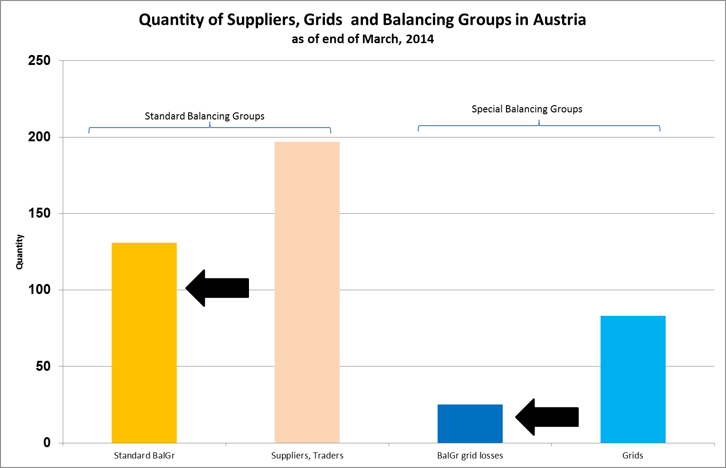
Many market participants active in Austria

Slide 9
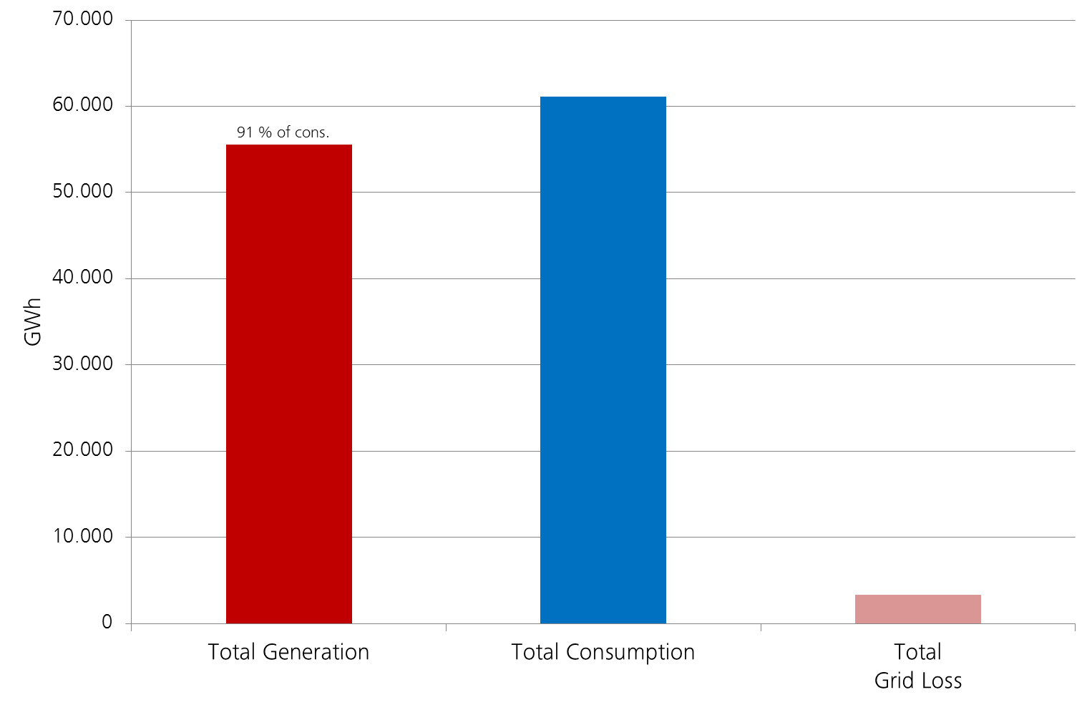
Austria 2013: Gross energy data
Source: APCS clearing data statistics

Slide 10
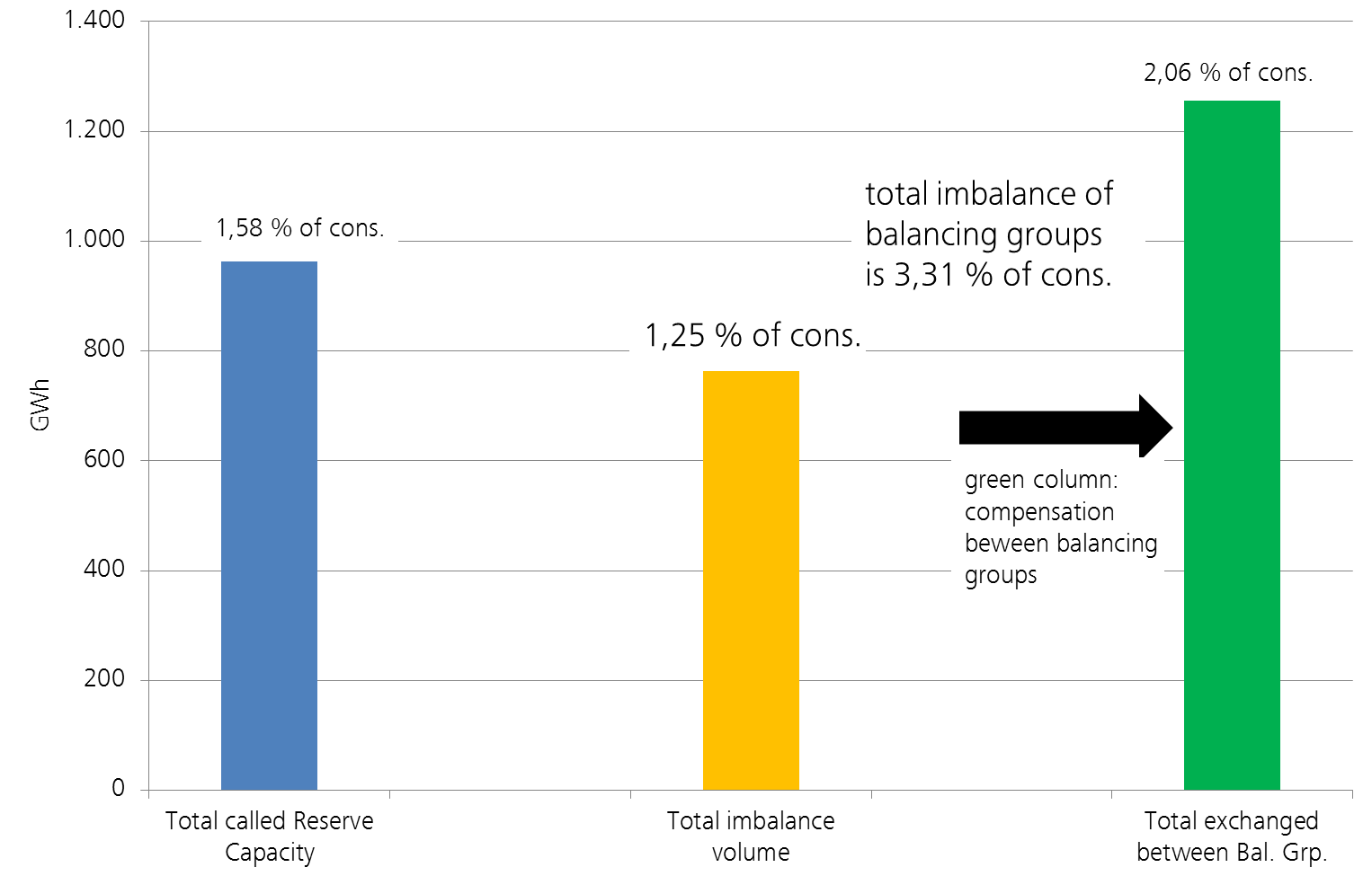
Austria 2013: One-price imbalance system effectively lowered power reserve capacity needed
Source: APCS clearing data statistics

Slide 11
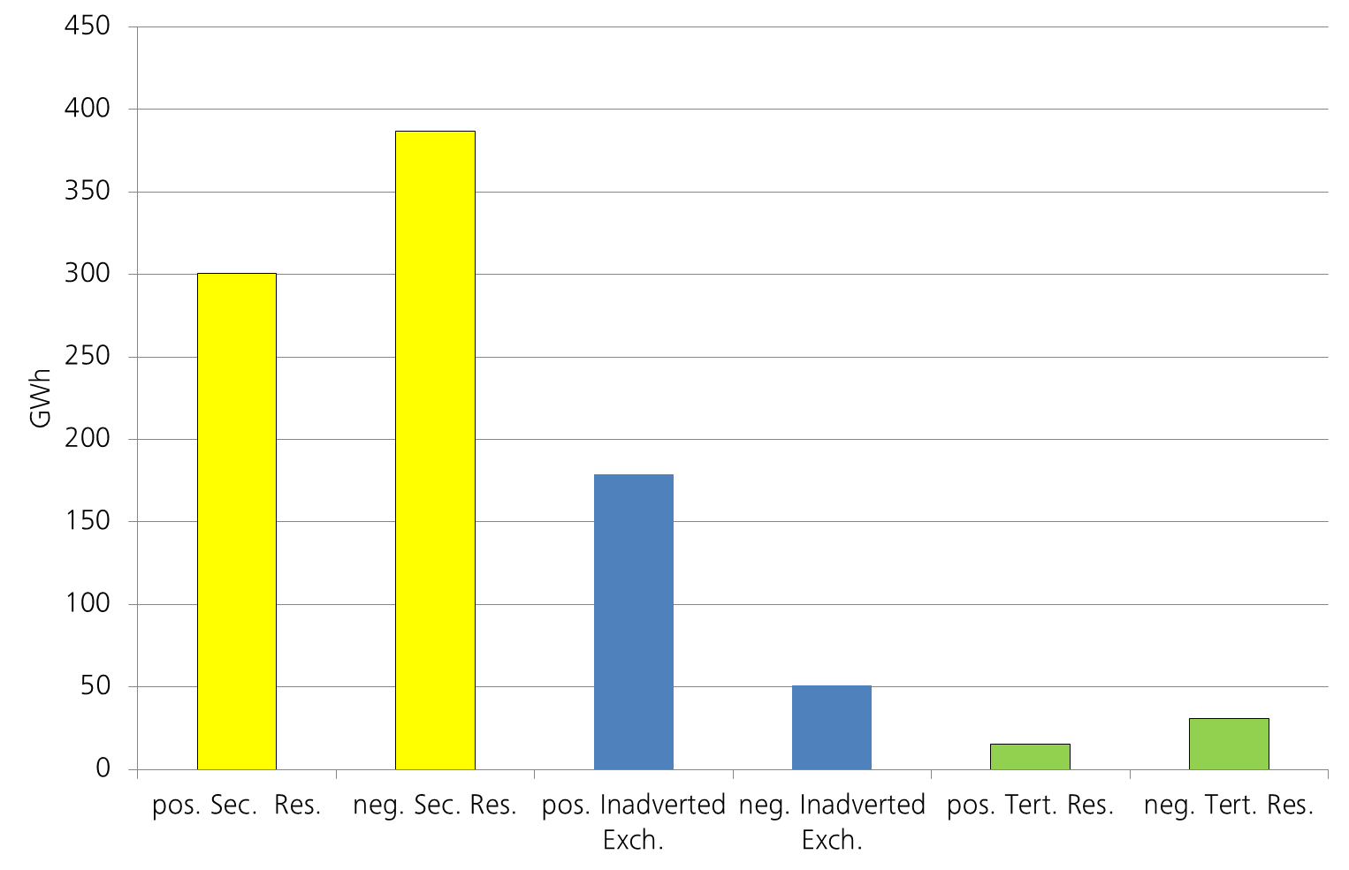
Austria 2013: dominant power reserve is Secondary Reserve (aFRR)
Source: APCS clearing data statistics

Slide 12
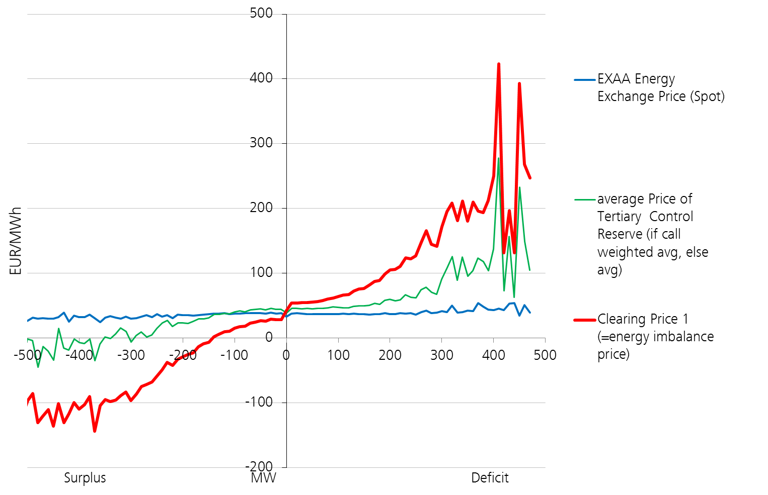
Austria: single price model based on deviation helps to stabilize the system by activating more reserves
Source: APCS clearing data statistics

Slide 13
Market risks Austria 2013: doubled price in Sec. Res. in autumn

Slide 14
Market risks Austria 2013: quintupled price in Tert. Res. in autumn

Slide 15
Austria 2013: price hikes didn’t fully hit imbalance price, because ca. 75% of costs borne by generators
Source: http://www.energymonitor.at/em/ae_reports/power/2013/em_power_report_year_2013.pdf

Slide 16
Austria: quite good model – but several opportunities for further significant improvement
Strengths
Weaknesses
  Single imbalance price stabilizes
  Comprehensive data collection
  Fully integrated clearing system
  Distributed responsibility avoids risks of system
  Cost allocation not satisfying
  Transparency high but more would level the playing field
  Not open to all potential offers
  Still national market except Prim. Res.
Balancing
system
Austria

Slide 17
Complexity of market rules for an internal market
(has to be reflected in national markets)

Slide 18
Three main fields of interest

Slide 19

ACER rejected draft ENTSO-E Network Code „Electricity Balancing“: main shortcomings
Several methodologies missing
Missing integration of central dispatch and self -dispatch systems
Insufficient standardization in core elements of a competitive integrated market (esp. product specification and harmonization)
Transparency and information for market participants widely neglected
Timelines not ambitious, behind Framework Guideline
Coordinated balancing areas have to be enhanced
DSO integration and data collection not satisfying

Slide 20
Lessons learnt so far
Balancing has to include invariably all energy flows in a sound clearing & settlement system
Full transparency is inevitable precondition of a well-functioning balancing system providing the security of the system
Cost allocation, pricing of imbalances and especially a single price system is essential for stabilizing the system in a self-dispatching market model
A sound pricing is possible only in a balance of insurance (cushioning) to causation (incentives) model
A liquid market for power reserves can be established only on a regional scope (AT and BG alone are too small)
Legal principles have to be observed (unbundling)

Slide 21
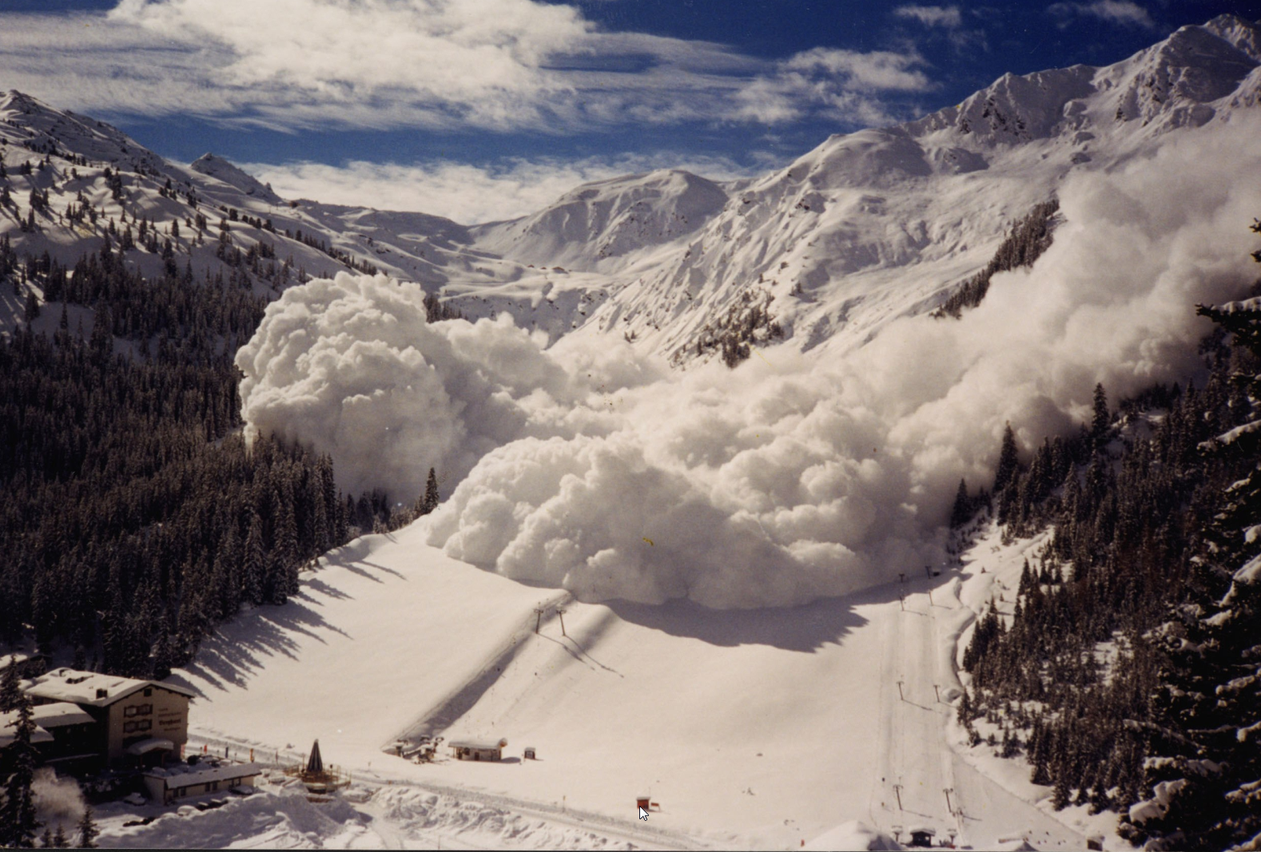
No snowflake in an avalanche ever feels responsible.

