Slide 1
MIT-Sabancı University Energy and Security Workshop
Istanbul, 30-31 March 2012
Climate change
Energy equity
Gas resource
holders
US Shale Gas Experience: Are There Lessons for European Shale Development?
MIT Energy Initiative
Security of supply
Gas pricing
Cost of alternatives
Demand
growth
Stranded gas, gas transport
Melanie Kenderdine
Bulgarian Energy Forum
Sofia, Bulgaria
December 12, 2012
e
i
MIT
Notes:
Thank you so much for inviting me to talk today. It is a pleasure to be here in this beautiful city. I would like to give a special thanks to Igor for his persistence and patience in getting me here and for allowing my father and his wife Phyllis to join the class for the day.
I am going to start by reading you a quote from a 2012 article by three MIT researchers called the The Influence of Shale Gas on U.S. Energy and Environmental Policy” published recently by the International Association for Energy Economics.
“The emergence of shale gas supplies is a boon to the U.S. economy and an aid to potential climate policy. The lower-cost energy is projected to stimulate greater economic growth over the period to 2050, and to ease the task of GHG control over coming decades. Under regulatory constraint, one instance of which is analyzed here, the shale eases the task and provides an important source of flexibility when other sources of base-load power are under threat. Under a stringent target, implemented by emissions price, the economic benefits are even greater.”
Today I would like to discuss the US shale experience, largely outlined in the MIT Future of Natural Gas study released last year, the possibilities and challenges for shale development in Europe ,and how this might contribute to the EU’s energy security and climate goals.

Slide 2
MIT Energy Initiative
  Context: Global Energy Challenges, Trends
e
i
MIT
Notes:
I would like to first place these issues in the context of larger energy challenges and issues. In my view, global shale gas opportunities address several key needs:
First shales have the potential to provide energy for an energy-needy planet.
Second, they could bring new players into global energy production markets
Third, shale gas could diminish tensions and reduce the trend towards ever-longer supply chains that are vulnerable to malevolent attacks
In addition, shale gas, to the degree that it displaces other, more carbon intensive fuels, has the potential to aid countries and regions in meeting climate change goals.
Finally, and I know it’s stating the obvious , the geopolitics of climate change and the geopolitics of energy security are inextricably linked – along with responses to climate change, competition for energy supplies will likely alter long-standing geopolitical alliances. This is especially important for European/Russian relationships.
Shale gas technologies can provide solutions and serve as tools for relationship building as well as for conflict resolution in both the climate change and energy security contexts. Scalability, affordability, environmental performance and abundance are key drivers for the use of natural gas as a bridge to a low carbon future. Consistent with the quote I just read you from the MIT paper, I view the development of natural gas resources as a key element of a sensible climate strategy, a view that is reinforced by some of the data and information I will provide you in this lecture.

Slide 3
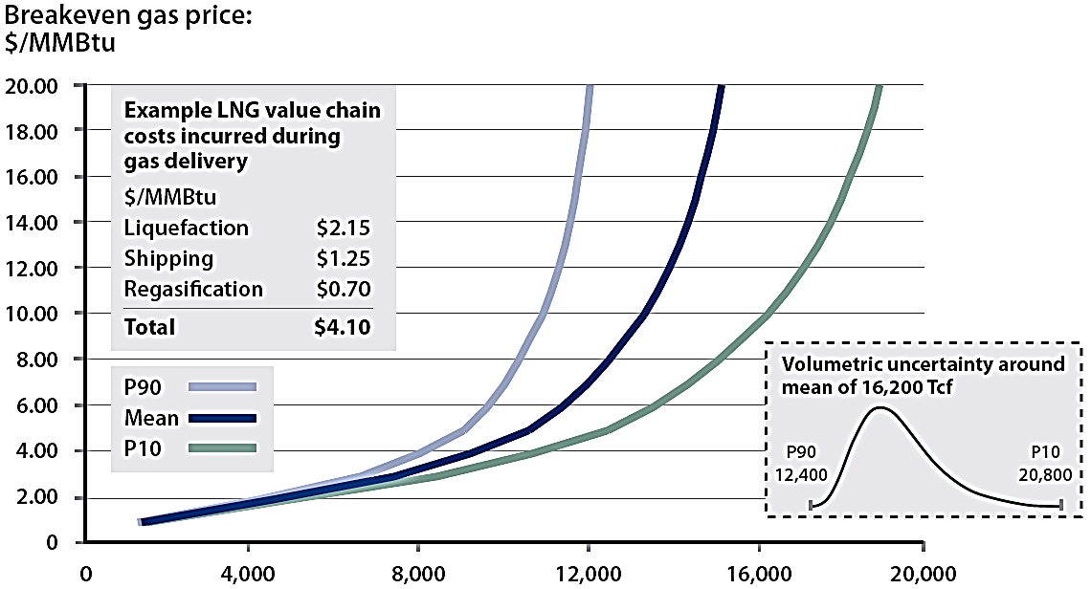
Global Gas Supply Cost Curve*
Breakeven Gas Price**
$/MMBtu
Even with uncertainty, there is a significant amount of low cost gas resources
MIT Energy Initiative
Tcf of Gas
* Excludes unconventional gas outside North America
** Cost curves based on 2007 cost bases. North America cost represent wellhead breakeven costs. All curves for regions outside North America represent breakeven costs at export point. Cost curves calculated using 10% real discount rate, ICF Hydrocarbon Supply Model
e
i
MIT
Source: MIT Future of Natural Gas Study, 2011
Notes:
Gas resources are an economic concept — a function of many variables, in particular the cost of exploration, production and transportation relative to the price of sale to users.
This is a global cost curve.
CLICK
Dark blue line is the mean, significant amounts of gas at under $4 9000 tcf
Lower right is the probability curve I mentioned previously
CLICK
Upper left is an illustrative LNG chain cost around $4 exclusive of the cost of the gas.
As I noted there is significant unused LNG import capacity in the US; also, you can see on this slide there is 4000 tcf of gas in the world at under $2.
If I was a US gas producer, I would keep that $4.10 figure + $2 or around $6 in mind in terms of an upper limit on my domestic production costs.

Slide 4
CO2 Mitigation with Carbon Price to 2050
Electric Sector
MIT Energy Initiative
Gas
Coal
e
i
MIT
Notes:
This graph from the study shows you the role of natural gas in a carbon constrained world.
Scenario 2050 assumes 50% CO2 emissions reduction from 2005 baseline for industrialized nations in 2050 and from emerging economies in 2070.
EPPA model, using the supply cost curves that I showed you previously.
The model looks at all global regions but the results are for the US.
CLICK for arrows
Cross hatched area is reduced use through efficiency/conservation
As you can see, gas demand increases substantially and replaces coal in the power generation sector by 2035. I note that this scenario includes CCS for but it remains too expensive and can’t compete with natural gas.
You can also see here however that gas demand in power generation decreases sharply around 2045. This is because at some point, gas becomes too carbon intensive as well.
There is more granular information in the study about coal to gas fuel switching
Just saw a relevant story in the FT, May 23rd . According to IEA, US energy-related emissions of carbon dioxide have fallen 450m tonnes over the past five years – the largest drop among all countries surveyed.
Fatih Birol, IEA chief economist, attributed the fall to improvements in fuel efficiency in the transport sector and a “major shift” from coal to gas in the power sector. “This is a success story based on a combination of policy and technology – policy driving greater efficiency and technology making shale gas production viable,”

Slide 5
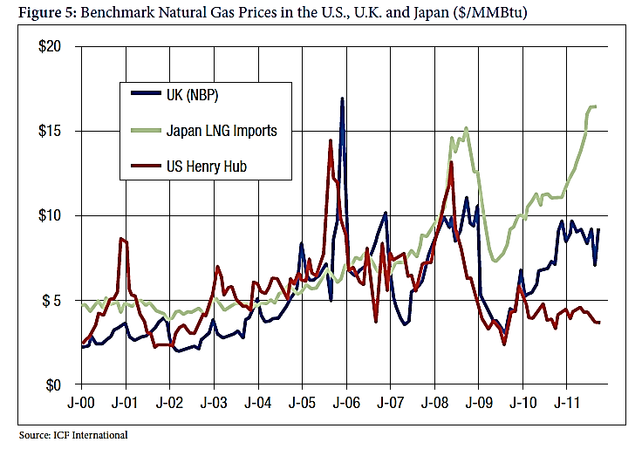
Benchmark NG Prices in US, UK, Japan
Approx. $14
MIT Energy Initiative
Approx. $9
Approx. $4
e
i
MIT
Sources: IEA, Natural Gas Information, 2011;
Liquid Markets: Assessing the Case for U.S. Exports of Liquefied Natural Gas, Brookings, May, 2012
Notes:
CLICK, all automatic
A few things to note on this slide. First set of data are from 2010 and represent averages for the year. EU LNG prices are 53% higher than the US, Asian prices are 225% higher than US.
Note in US, this is a very small amount of LNG. Provide LNG 2000-2010 stats.
Worth noting very briefly different pricing mechanism in world’s three very loosely connected gas markets.
US gas on gas competition with transparent prices at many regional hubs. Usually indexed to Henry Hub or NYMEX
Europe long term oil product indexed prices for pipeline gas: Europe has a mix of gas price drivers. First there are long term contracts from Russia and North Africa. These contracts typically include six to nine month rolling average gasoil/fuel oil prices, reviewed every 3 years . These are take or pay contracts – typically the buyer agrees to take 85% of the Annual Contract Quantity. Second, there are rapidly growing gas hubs, primarily in Western Europe. The growth in the LNG trade has helped the expansion of these hubs.
Asian LNG markets are supplied by long term contracts indexed to oil. Some contain provisions for extremely high and low oil prices but there is no periodic price review like in Europe – prices are generally fixed for life of the contract. There are also spot cargoes with a wide range of prices from a low of $4 /mmbtu from Qatar to Japan in 2004 to around $23 mmbtu for cargoes from Qatar to S. Korea in December of 2008. In September of last year, the JCC -- Japanese clear customs price -- was close to $20.
CLICK
Navy blues is NBP
Green Japan LNG Imports
Red US
X Axis 2000-2011
Y Axis Dollars per mmbtu
CLICK These two points look like to me 1) fallout from Hurricane Katrina – a lot of US offshore production was damaged and LNG arbitrage in the Atlantic basin drove up prices, 2) economic recession which coincided with the takeoff in shale production.
CLICK January 2011 US $4, NBP $9, Japanese LNG $14 (some Fukushima here)
CLICK What you can also see here is the impacts of shale gas on US prices , from $14 to $4 in three years, it’s now about $2.50
Another thing this slide shows is why all potential LNG exporters, including the US and Eastern Mediterranean, are interested in Asian markets – represents competition with Europe for supply

Slide 6
MIT Energy Initiative
  Shale Gas: the US Experience
e
i
MIT
Notes:
I would like to first place these issues in the context of larger energy challenges and issues. In my view, global shale gas opportunities address several key needs:
First shales have the potential to provide energy for an energy-needy planet.
Second, they could bring new players into global energy production markets
Third, shale gas could diminish tensions and reduce the trend towards ever-longer supply chains that are vulnerable to malevolent attacks
In addition, shale gas, to the degree that it displaces other, more carbon intensive fuels, has the potential to aid countries and regions in meeting climate change goals.
Finally, and I know it’s stating the obvious , the geopolitics of climate change and the geopolitics of energy security are inextricably linked – along with responses to climate change, competition for energy supplies will likely alter long-standing geopolitical alliances. This is especially important for European/Russian relationships.
Shale gas technologies can provide solutions and serve as tools for relationship building as well as for conflict resolution in both the climate change and energy security contexts. Scalability, affordability, environmental performance and abundance are key drivers for the use of natural gas as a bridge to a low carbon future. Consistent with the quote I just read you from the MIT paper, I view the development of natural gas resources as a key element of a sensible climate strategy, a view that is reinforced by some of the data and information I will provide you in this lecture.

Slide 7
Shale Gas RD&D Spending and Supporting Policy Mechanisms
Gas produced after tax credit
MIT Energy Initiative
GRI Funding
Steady over 16 years
Federal Funding
Time limited tax credit
Gas produced under tax credit
e
i
MIT
Notes:
This graph depicts the research history of shale development in the US. Because all shale basins are different and Europe is at the very early stages of development, I think this slide is instructive about the levels of investment and time scales for technology development.
Of course, in many ways this experience moves the starting point for European and global shale technology development. On the other hand, we now know much more about the environmental impacts of shale development and need new technology-based solutions to these problems. Nevertheless, this history may provide some insights into the innovation process that are replicable for European shale development.

Slide 8
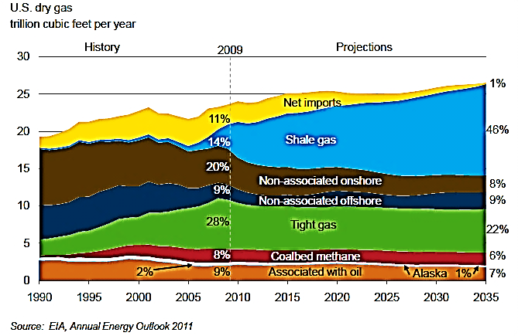
EIA Forecast – US Gas Production to 2035
MIT Energy Initiative
e
i
MIT
Source: EIA, Richard Newell Presentation, 2010
Notes:
8
Start back in the US to give you an overview of what shale gas means to US supply – US became the number one gas producer in the world a couple of years ago and remember in 2003 Alan Greenspan told Congress North America was running out of gas.
This is from EIA this year. Projections to 2035, sources of gas supply in the US
CLICK Shale gas is about 20% of production now, goes to 46% by 2035
CLICK Imports have already declined from 16% a few years ago to around 10% now and are expected to go to 1% by 2035
CLICK Enormous decline in offshore production. This has implications for the pipeline infrastructure and perhaps even the relevance of Henry Hub as a price point going forward
CLICK Coalbed methane and tight gas will be 28% of production in 2035
CLICK This combined with 46% shale gas means that by 2035, 74% of US production will be unconventional gas, a stunning change in the US gas production profile in about 25 years.

Slide 9
Variation in Shale Well Performance/ Economics
Impact of IP Rate Variability on Breakeven Price (BEP)*
(2009 Well Vintages)
P20
P50
P80
Barnett
IP Mcf/d
2,700
1,610
860
BEP $/Mcf
$4.27
$6.53
$11.46
MIT Energy Initiative
Fayetteville
IP Mcf/d
3,090
1,960
1,140
BEP $/Mcf
$3.85
$5.53
$8.87
48%
Haynesville
IP Mcf/d
12,630
7,730
2,600
BEP $/Mcf
$3.49
$5.12
$13.42
Marcellus**
IP Mcf/d
5,500
3,500
2,000
BEP $/Mcf
$2.88
$4.02
$6.31
Woodford
IP Mcf/d
3,920
2,340
790
BEP $/Mcf
$4.12
$6.34
$17.04
e
i
MIT
* Breakeven price calculations carried out using 10% real discount rate
** Marcellus IP rates estimated based on industry announcements and available regulatory data
Source: MIT, HPDI production database and various industry sources
Source:MIT Future of Natural Gas Study, 2011
Notes:
9
This provides a much more granular view of US shale gas production costs – these are break even costs for the various shale basins in the US. (listed on left)
Note first there is a high level of variability in individual well productivity that clearly has consequences with respect to the variability of individual well economic performance.
This is illustrated in this table which shows the variation in breakeven gas price as a function of initial productivity for the five major U.S. shale plays.
The P20 30-day initial production rate represents the rate that is equaled or exceeded by only 20% of the wells completed in 2009; the P80 represents the initial rate that would likely be exceeded by 80% of the wells.
CLICK
If you look here at the P50 column, you see there is significant range in breakeven cost for the various basins in the US.
CLICK
The difference between the highest – the Barnett and the lowest – the Marcellus – is 48%. I just show this to demonstrate that there is great variability in shale plays, this will certainly be the case in Europe as well.

Slide 10
US: Coal to Gas Fuel Substitution Benefits
Nationwide, coal generation displacement with surplus NGCC would:
      reduce CO2 emissions from power
      generation by 20%
      reduce CO2 emissions nationwide
      by 8%
      reduce mercury emissions by 33%
      reduce NOx emissions by 32%
      cost roughly $16 per ton/CO2
MIT Energy Initiative
e
i
MIT
Notes:
IAmong the study's other key findings:
Unconventional gas activity accounted for 53 percent of total U.S. natural gas production in 2010 and is projected to rise to 79 percent of total U.S. natural gas production by 2035.
Nearly $3.2 trillion in cumulative investments in the development of unconventional gas are expected to fuel the increase in production between 2010 and 2035.
By 2015, the annual contribution of unconventional gas activity to U.S. gross domestic product is projected to reach nearly $197 billion, more than $22 billion of which will be from non-producing states. In total, the annual contribution is expected to more than double by 2035 to almost $332 billion.
Government revenue from unconventional gas activity is projected to reach more than $49 billion annually by 2015 and will continue to rise, to just over $85 billion by 2035. Over the study's entire 25-year horizon, unconventional gas is expected to generate nearly $1.5 trillion in total government revenue.
The Economic and Employment
Contributions of Unconventional Gas
Development in State Economies
Prepared

Slide 11
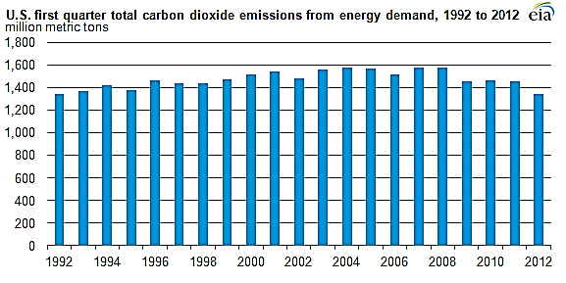
Coal to Gas Fuel Substitution Benefits, contd.
US CO2 emissions lowest in 20 years
MIT Energy Initiative
A mild winter that reduced household heating demand
A decline in coal-fired electricity generation, due largely to historically low natural gas prices
Reduced gasoline demand
e
i
MIT
Source: EIA Website
Notes:
I would like to first place these issues in the context of larger energy challenges and issues. In my view, global shale gas opportunities address several key needs:
First shales have the potential to provide energy for an energy-needy planet.
Second, they could bring new players into global energy production markets
Third, shale gas could diminish tensions and reduce the trend towards ever-longer supply chains that are vulnerable to malevolent attacks
In addition, shale gas, to the degree that it displaces other, more carbon intensive fuels, has the potential to aid countries and regions in meeting climate change goals.
Finally, and I know it’s stating the obvious , the geopolitics of climate change and the geopolitics of energy security are inextricably linked – along with responses to climate change, competition for energy supplies will likely alter long-standing geopolitical alliances. This is especially important for European/Russian relationships.
Shale gas technologies can provide solutions and serve as tools for relationship building as well as for conflict resolution in both the climate change and energy security contexts. Scalability, affordability, environmental performance and abundance are key drivers for the use of natural gas as a bridge to a low carbon future. Consistent with the quote I just read you from the MIT paper, I view the development of natural gas resources as a key element of a sensible climate strategy, a view that is reinforced by some of the data and information I will provide you in this lecture.

Slide 12
US Unconventional Gas: Economic Benefits
$80 billion in new investment in energy-intensive industries **Petrochemicals**Aluminum**Steel**Rubber** Fertilizer**Glass
2015 $197 billion
2035 $332 billion
MIT Energy Initiative
Contribution to GDP
Contribution to Industry
2015 $49 billion
2035 $85 billion
Contribution to Govt. Revenues
e
i
MIT
Source: Dow Chemical, “Industrial Demand and LNG Exports”, SNL Energy interview, Oct. 3, 2012
Notes:
Over the study's entire 25-year horizon, unconventional gas is expected to generate nearly $1.5 trillion in total government revenue.
On the consumer side, estimate that Ohio businesses and consumers saved over $1.5 billion on
their natural gas bills in 2010 because of lower wellhead natural gas prices. The average
residential customer, for example, burned 88 Mcf of natural gas and saved $214 in 2010. The
average commercial customer used 562 Mcf and saved $1,366, while the average industrial
customer used over 35,000 Mcf and saved almost $87,000.
There is also a down side. We find that both proximity to the drilling site, and
the intensity of drilling activity have a negative impact on housing values. We find that the marginal effect of an
additional well within 0.5 miles of a property is a 5% reduction in property value. This effect drops to approximately 3%
as we include wells located further away (1 mile) and we find no effect of an additional well located more than 2 miles
away from the property.
As shale gas activity moves forward, both in the region and nationally, understanding the potential for and
Measuring the Economic Impact of Shale Oil Exploration
on Housing Value in Pennsylvania
H. Allen Klaiber, AEDE Assistant Professor
klaiber.16@osu.edu
Sathya Gopalakrishnan, AEDE Assistant Professo

Slide 13
  Environmental Impacts of Shale Production, US Regulation
MIT Energy Initiative
e
i
MIT
Notes:
Turn next to a discussion of some of the highlights of the MIT Future of Natural Gas Study released last summer.
One in a series of studies at MIT, preceded by the Future of Coal, the Future of Nuclear, the Future of the Nuclear Fuel Cycle. We recently released the Future of the Electric Grid and are working on the Future of Solar Energy, probably be released in the summer of 2013.

Slide 14
Key Shale Gas Environmental Issues
Breakdown of Widely-Reported Environmental Incidents Involving Gas Drilling; 2005-2009
Primary environmental risks associated with shale gas development
Contamination of groundwater aquifers with drilling fluids or natural gas
On-site surface spills of drilling fluids, fracture fluids and wastewater
Contamination as the result of inappropriate off-site wastewater disposal
Excessive water withdrawals for use in high-volume fracturing operations
Excessive road traffic and degraded air quality
MIT Energy Initiative
e
i
MIT
14
Notes:
This slide shows the number of incidents over the last five years , incidents are defined as widely reported. You can see how they breakdown and what is noteworthy is that in 20,000 shale wells drilled, the total number of incidents is 42.
CLICK While there are 20 incidents of shallow groundwater contamination (47%) , this is methane contaminations associated with poor drilling practices in shallow zones; there are no demonstrated incidents of groundwater contamination from frac fluids.
CLICK Surface water contamination is an issue , particularly in the Marcellus where there is no disposal well infrastructure like there is in the historical producing regions of the Southwest. Public water treatment facilities in the Marcellus have been overwhelmed -- produced and flowback water is being trucked to disposal wells in Ohio. There are recycling efforts being undertaken as well.
These are findings from a UT Austin study earlier this year consistent with ours.
Key findings:
• Researchers found no evidence of aquifer contamination from hydraulic fracturing chemicals in the subsurface by fracturing operations, and observed no
leakage from hydraulic fracturing at depth.
• Many reports of groundwater contamination occur in conventional oil and gas
operations (e.g., failure of well-bore casing and cementing) and are not unique to hydraulic fracturing.
• Methane found in water wells within some shale gas areas (e.g., Marcellus) can most likely be traced to natural sources, and likely was present before the onset of shale gas operations.
• Surface spills of fracturing fluids appear to pose greater risks to groundwater sources than from hydraulic fracturing itself.
• Blowouts — uncontrolled fluid releases during construction or operation — are a rare occurrence, but subsurface blowouts appear to be under-reported
Much has been made about two other impacts which were not included in the MIT study. These are radioactive surface water and induced seismicity. There is no evidence that exposure to wastewater is any more hazardous than exposure to other kinds of rock. PA Dept of Environ Protect 3/11 all water samples were below federal drinking water standards.
Induced seismicity, discuss this a little later.

Slide 15
Comparative Water Use, US Shale Plays (%bbl/year)
Basin | Public Supply | Mining/ Industrial | Irrigation | Livestock | Shale
Barnett | 82.7% | 3.7% | 6.3% | 2.3% | 0.4%
Marcellus | 12.0% | 71.7% | 0.1% | <0.1% | <0.1%
MIT Energy Initiative
e
i
MIT
Source: MIT Future of Natural Gas Study, 2011
Notes:
15
Another concern about shale production is that it “uses massive amounts of water.
It’s true that shale production uses large quantities of water. My question is always, “compared to what?”
This table is from the MIT Gas Study comparing water uses in the Barnett shale and the Marcellus. Numbers are % of water consumption per year.
CLICK
Look first at the Barnett where water for shale production represents .4% of total compared to around 83% for public supply and 4% for mining.
In the Marcellus, a region where there is significant coal mining, water for shale represents less than .1% of the total compared to almost 73% for mining.
The shale gas industry uses about 1.5 million gallons of water per well but this is not a large amount compared to other industries. Gas drilling in PA for example uses less than 60 million gallons per day compared to 1.5 billion for public water systems, 1.7 million by other industries and 5.9 million in power generation (USGS)
Episodic not constant --

Slide 16
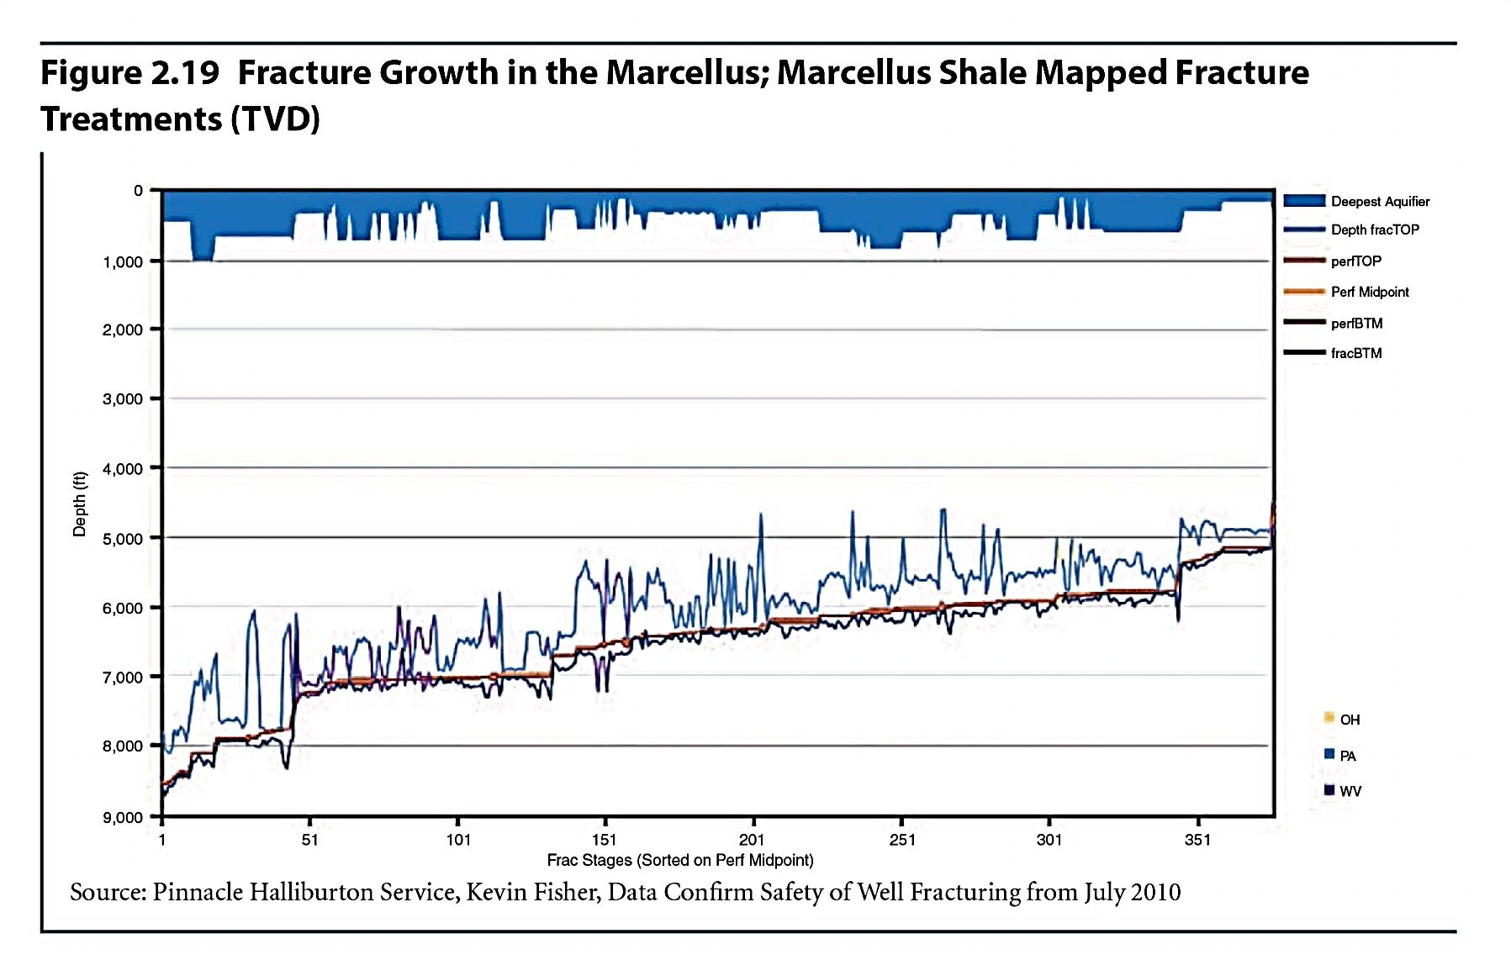
Mapped Fracture Growth in the Marcellus
MIT Energy Initiative
Around 1,000 ft.
Around 4,000 ft.
Around 2,000 ft.
e
i
MIT
Notes:
This is a map of fracture growth at different perforations stages in a shale well in the Marcellus.
CLICK The lighter blue at the top is the water table depth, at no time does it exceed 1000 feet, typically it’s 200-300 feet.
CLICK maximum depth of fracture 8000 feet but the spread of the frac is never more than 2000 feet at this depth, above and below the perforation
CLICK shallowest depth of the frac is 5000 feet, leaving 4000 feet of impermeable rock between the frac and the water table.
I know there has been a debate on the propagation of fractures. I did a little more reading and research. Two out of three of the researchers or groups of researchers were skeptical about fractures reaching groundwater.
Marine and Petroleum Geology, April 2012: Davies, et al According to their abstract, they found that the maximum reported height of an upward propagating hydraulic fracture in the Marcellus, Barnett, Woodford, Eagleford, and Niobrara is approximately 588 meters (1929 feet).
Ground Water, April 2012: Tom Myers, lead author, reported that the process of fracture propagation to groundwater could take less than 100 years. The study was conducted by Dr. Tom Myers, an independent hydrogeologist, and paid for by Catskill Mountainkeeper and the Park Foundation, two upstate New York organizations opposed to natural gas drilling and hydraulic fracturing (fracking) in the Marcellus formation
Penn State’s Terry Engelder Engelder said Myers used an “unrealistically high” number for permeability of rock above the shale layer that contains gas. That produced results that greatly exaggerated the time it could take for fluid to migrate from the fracking zone. Myers also assumed that pressures created by fracking will drive fluids away from the gas-bearing rock when in fact they will do the opposite, Engelder said. “In my view the issue is settled, which is that it can’t happen on a time scale that is important to mankind,” Engelder said in an interview. Engelder says the timeframe is increased to 100,000 years.
http://www.businessweek.com/news/2012-05-03/fracking-fluids-may-migrate-to-aquifers-researcher-says

Slide 17
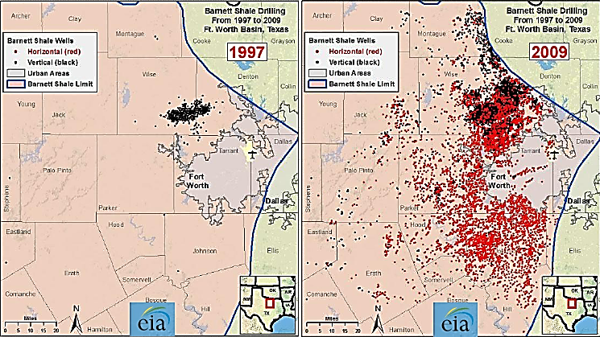
Barnett Shale: 13,5000 Wells Drilled in 12 Years
MIT Energy Initiative
e
i
MIT
Sources: EIA, Richard Newell Presentation, 2010
Notes:
17
Focus on European population density for a moment. First, this is two pictures of development in the Barnet shale.
CLICK
The left side is the Barnett in 1997 – the black dots are vertical wells.
On the right side is the Barnett in 2009. The red dots are horizontal wells, most all of them shale wells.
Wanted to show you what the scale of this development looks like.

Slide 18
Illustrative Operational Requirements for Shale Development
Wells and pads per year | Rigs | New land surface per year | Net water consumption per year
Between 700 and 1000 wells and 70 to 100 pads | Around 150 | Between 226 to 324 km2 | 70 to 200 million barrels per year
MIT Energy Initiative
28 bcm/yr production (1 tcf), operational requirements over 15 year period
e
i
MIT
Source: Geny, OIES, 2010, Honore, OIES Gas Research Program, 2011
Notes:
18
In addition to the population density issue, the sheer size of shale production enterprise is a concern.
CLICK
The numbers you are looking at here are estimates for production of 28 bcm or 1 tcf of shale gas per year
70-100 well pads, 150 rigs, 226 -324 square kilometers per year and 70 to 100 million barrels of water.
I know this sounds like a lot of activity – it is a lot of activity ---- and I personally think that the root of much of the opposition in the US has much more to do with community disturbance than actual environmental impacts.
Having said that, as I noted earlier, this amount of water is not nearly as large as other uses. It is however episodic --- you need it all at once and you need all the trucks that transport it and the equipment all at once. in the end you are just left with a gas field.
The acreage sounds like a lot but compared to a wind or solar farm, on a per unit of energy basis, it is relatively small in comparison

Slide 19
Induced Seismicity and Hydraulic Fracturing
Some Induced Seismic Events
Rangely, CO, injection experiments (M4.9, 1995), 1945-1995
Rocky Mountain Arsenal (M5.3, 1967), fluid injection, 1962-1966
Gazli, Uzbekistan, gas recovery (M7.2), 1976-1984
Water Reservoirs: Lake Mead (M5), Koyna (M6.3), Oroville (6.1) Tadjikistan, Italy and many others
Geysers Geothermal Field (M4.6), injection-enhanced production
Dallas Airport (M3.3), fluid injection, 2008-2009
Arkansas (M4.7), fluid injection, 2010-2011
Youngstown, Ohio (M4.0), fluid injection, 2011
Managing Induced Seismicity
Avoid injection into active faults
Minimize pore pressure changes at depth
Install local seismic monitoring arrays;
Establish modification protocols in advance
Be prepared to alter plans or abandon wells*
MIT Energy Initiative
Induced Seismicity Research Needs
Data Collection
Instrumentation
Hazard and Risk Assessment
Modeling
e
i
MIT
Sources: Managing the seismic risk posed by wastewater disposal, Zoback, 2012; I Induced Seismicity Potential in Energy Technologies, National Research Council, 2012
Notes:
Data Collection—Field and Laboratory
1. Collect, categorize, and evaluate data on potential induced seismic events in the field. 2. Conduct research to establish the means of making in situ stress measurements non-destructively.
3. Conduct additional field research n natural fracture systems including field-scaleo bservations of the very small events and their native fractures.
4. Conduct focused research on the effect of temperature variations on stressed jointed rock systems.
=
5. Conduct research that might clarify the in situ links among injection rate, pressure, and event size.
Instrumentation
Conduct research to address the gaps in current knowledge and availability of instrumentation:
Hazard and Risk Assessment
1. Direct research to develop steps for hazard and risk assessment for single energy development
projects (as described in Chapter 5, Table 5.2).
Modeling
13. Use currently available and new geomechanical and earthquake simulation models to identify the most
critical geological characteristics, fluid injection or withdrawal parameters, and rock and fault properties
controlling induced seismicity.
1 Microseisms designate seismic events that

Slide 20
it is also clear is that the production of shale gas
and
Methane Emissions from Shale Production
Methane Emissions from Shale Gas Wells (mg/well)
MIT Energy Initiative
228
12 mg/well
“…the production of shale gas and specifically, the associated hydraulic fracturing operations have not materially altered the total GHG emissions…for the vast majority of contemporary shale gas wells, the revenues gained from using reduced emissions completions…cover the cost of executing such completions.”
216
e
i
MIT
Shale gas production: potential versus actual greenhouse gas emissions O’Sullivan & Paltsev, Environmental Research Letters, 11/12
Notes:
IAmong the study's other key findings:
Unconventional gas activity accounted for 53 percent of total U.S. natural gas production in 2010 and is projected to rise to 79 percent of total U.S. natural gas production by 2035.
Nearly $3.2 trillion in cumulative investments in the development of unconventional gas are expected to fuel the increase in production between 2010 and 2035.
By 2015, the annual contribution of unconventional gas activity to U.S. gross domestic product is projected to reach nearly $197 billion, more than $22 billion of which will be from non-producing states. In total, the annual contribution is expected to more than double by 2035 to almost $332 billion.
Government revenue from unconventional gas activity is projected to reach more than $49 billion annually by 2015 and will continue to rise, to just over $85 billion by 2035. Over the study's entire 25-year horizon, unconventional gas is expected to generate nearly $1.5 trillion in total government revenue.
The Economic and Employment
Contributions of Unconventional Gas
Development in State Economies
Prepared

Slide 21
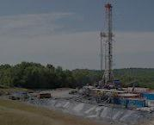

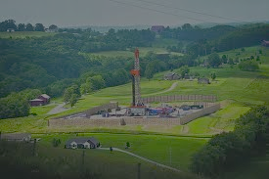
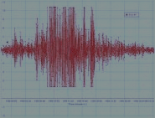

US Shale Gas Regulation: A Work in Progress
Four major areas of environmental concern with shale gas production:
        Water use and contamination
        Air emissions
        Site disruptions
        Seismic activity
MIT Energy Initiative
e
i
MIT

Slide 22
US Federal Regulation/Mgmnt of Shale Gas
Environmental Protection Agency
  Authorities: Clean Air Act, Safe Drinking Water Act, Clean Water
  Act, Toxic Substances Control Act
Bureau of Land Management
  Land and water best practices for production on federal land
White House Executive Orders
  Inter-agency task force on shale gas production
+
Regional and state regulation
  Delaware River Basin, Texas, Pennsylvania, New York, Colorado,
  Wyoming, West Virginia….
MIT Energy Initiative
e
i
MIT
Notes:
22
Primary regulatory authority for shale gas is at the state level, and many federal requirements have been delegated to the states. But you can see here there is also coverage or partial coverage provided by a range of federal authorities.
EPA has developed draft UIC Class II permitting guidance specific to oil and gas hydraulic fracturing activities using diesel fuels.
In many regions of the U.S., underground injection is the most common method of disposing of fluids or other substances from shale gas extraction operations. Disposal of flowback and produced water via underground injection is regulated under the Safe Drinking Water Act's Underground Injection Control (UIC) program.
EPA announced a schedule to develop standards for wastewater discharges produced by natural gas extraction from underground coalbed and shale formations. EPA expects to issue a rule for coalbed methane in 2013 and a proposed rule for shale gas in 2014.
EPA and states share responsibility for implementing treatment and disposal of wastewater from shale gas extraction under the National Pollutant Discharge Elimination System (NPDES)
EPA recently issued regulations from methane capture from shale wells going into full effect in 2015, where all wells will be required to have so-called green completions.
Also, the Interior Department which has jurisdiction over production on federal lands recently issued a rule requiring disclosure of the composition of frac fluids but after the fact!
31 states with current or near future shale gas development
Some states have extensive experience (TX, OK); others no or outdated regulatory regime (OH, NY)Over 20 regulatory elements including
Site development and preparation
Well drilling and production
Flowback/wastewater storage and disposal
Well plugging and abandonment
Well inspection and enforcement

Slide 23
MIT Energy Initiative
  European Shale Gas: Issues, Potential
e
i
MIT

Slide 24

Potential, Issues with Development of European Shale Basins
Population density
Higher drilling costs
Deeper deposits, smaller basins
compared to US
Subsurface ownership
Lack of infrastructure
Legal frameworks inadequate
More stringent environmental
regulations
Industry structure
Lack of experienced, skilled workers
MIT Energy Initiative
e
i
MIT
Notes:
READ
A few words about some of these points. According to Schlumberger, the cost of drilling a 2,000-meter horizontal well in the U.S. averages $3.9 million, compared with $11 million in Poland, Peter Richter, global unconventional technology and marketing manager at the company, said in November. Some Polish wells have been as deep as 3,600 meters.
Industry analysts have concluded that globally by 2015, total onshore drilling demand may require more than 7,300 active rigs with 52% of that demand from outside North America and 80% of this demand will be for high horsepower rigs. I have been saying it for years – we need more rigs. Tell Brazil story.
On the high horsepower rig point: according to Halliburton, deep, multi-stage fracking needs drilling rigs with at least 2,000 brake horsepower. They report there are only 78 rigs in western Europe, and only 12 with greater than 2,000 BHP.
Subsurface ownership is another major difference. In the US the landowner owns both the surface and subsurface rights. There is a significant royalty incentive for landowners to work with producers. In the EU however, the state generally holds the subsurface rights so the incentives for landholders are not great.
Also, the industry structure for onshore production in the US is very different than the structure in Europe which has tended to focus on large, offshore production. It’s also worth noting that many countries in Europe -- outside of the Netherlands, Denmark, Norway, UK -- have limited experience with gas production and regulation of gas. This is important for mitigating public concerns with shale gas production.
I am going to discuss infrastructure , environment and population density in more detail.

Slide 25
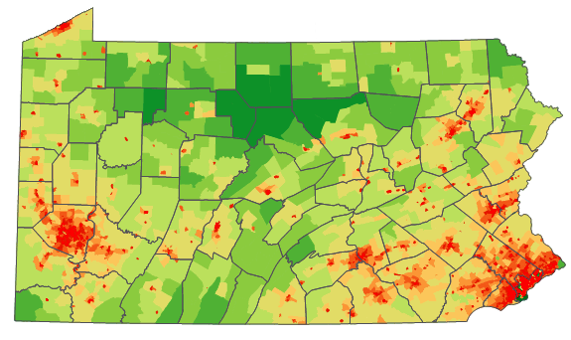
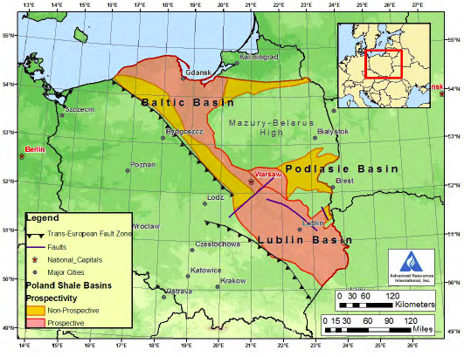

Marcellus/Pennsylvania
Population Density & European Shale Development
MIT Energy Initiative
Poland Shale Basins
Poland Population Density
e
i
MIT
Source: EIA, World Shale Resources , 2011
Notes:
25
On the lower left is a map of Poland. The red and yellow areas are shale basins.
Lower right is a population density map I pulled off the internet, I apologize for its poor quality. The darkest red portions are the most densely populated up through yellows which are the least densely populated.
CLICK Also apologize for my poor, powerpoint drawing trying to replicate the shape of the shale basins and superimpose them over the population density map.
CLICK Upper right I did the same thing with the Marcellus shale in Pennsylvania. In this map the red is the most densely populated, the dark green is the least. As you can see, much of the Marcellus is in the less populous areas of Pennsylvania but there has still been significant opposition to development in the state. I would note that there is also a great deal of support for development as well.
This just provides some way to visualize how it will be relatively more difficult to deal with population issues in Poland.

Slide 26
European Pipeline/LNG Import Infrastructure
9.5/1
Europe Regasification Capacity
Current: 187.4
Under construction: 23.0 Subtotal 210.4
Planned: 260.6
TOTAL 471.0
LNG Consumption 79 bcm
Capacity factor: 42%
Existing regas
Proposed reasg
Existing liquefaction
Proposed liquefaction
54/4
MIT Energy Initiative
Nord Stream
3
Bcm per yr/ # import facilities
Yamal-Europe
4
1
1
5
Existing
Proposed
21
2
25/3
Working storage, bcm
2.5
6
6
0.5
3
South Stream
0.5
5.5/1
12
0.5
Blue Stream
63/6
12/2
0.5
14
2
Nabucco
2
5.3/1
13/2
e
i
MIT
Source: IEA, Natural Gas Information, 2011
Notes:
This is a cartoon of natural inter-country natural gas infrastructure in Europe.
Solid red lines are existing transmission pipelines, dotted lines are proposed pipelines
CLICK
These are the existing regasification import facilities
CLICK
Volumes of imports by country plus number of regas units in operation
CLICK
Proposed regasification import facilities
CLICK
Liquefaction facilities in Mediterranean region, including a proposed offshore liquefaction facility in Cyprus
CLICK
Locations of storage by country and volume
Summary of LNG import capacity. Proposed facilities are always very uncertain but actual consumption of imported LNG is 79 bcm, capacity factor of units is 42%. I understand that LNG import facilities have to have relatively low capacity factors because of import schedules, off-loading, etc. but even without additions, there’s unused capacity.

Slide 27
MIT Energy Initiative
  Conclusions
e
i
MIT

Slide 28
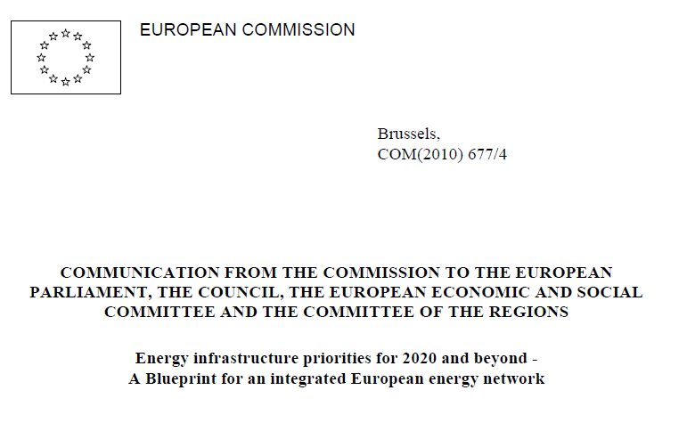
EU Communication on Energy Security, 2010
Natural gas…. will gain importance as the back-up fuel for variable electricity generation
…in the medium term depleting indigenous
conventional natural gas resources call for
additional, diversified imports [of natural gas]
Gas networks face additional flexibility requirements in the system, the need for bi-directional pipelines, enhanced storage capacities and flexible supply, including liquefied (LNG) and compressed natural gas (CNG)
MIT Energy Initiative
Single-source dependency, compounded by a lack of infrastructure, prevails in Eastern Europe. A diversified portfolio of physical gas sources and routes and a fully interconnected and bidirectional gas network, where appropriate, within the EU are needed already by 2020
e
i
MIT
Notes:
Read
Reguatory lag fragmentation still exists

Slide 29
100%
>50%
Germany Increased imports from Norway, Netherlands, used storage
Poland
½ cut covered by Yamal, gas from Norway, gas storage used
Crisis Response: Roadmap for Greater European Energy Security/Integration
Response Options
Alternative fuel redundancy
Interconnections
Reverse flows
Storage
Increased pipeline gas
Increased LNG imports
Eastern Mediterranean gas development
Shale gas development
Main Beneficiaries
Interconnected countries with adequate storage and fuel redundancy fared the best
Moral of the Story: relatively inexpensive energy security can be achieved with more storage, interconnections, increased imports
Anatomy of European Response to Supply Lost in Russia/Ukraine Disruption, 2009
Slovakia Used storage for several weeks, covered 75% of demand, alternative fuel used
<50%
Hungary Increased gas from Norway, gas storage, alternative fuel used
Netherlands flows to UK decreased
UK interconnector reversed
Yamal flows increased
Blue Stream flows increased
Hungary increased pipeline flows to Serbia, Bosnia
% of Gas Supply Lost in Disruption
Czech Republic
Increased imports from Norway, used storage, increased production
Romania Increased production, used storage
Austria Increased imports from Norway, Germany, used storage
MIT Energy Initiative
United Kingdom
Serbia Used fuel oil for 20 days
Belarus
Netherlands
Poland
Immediate
Germany
Day 11
Day 3
Day 9
Ukraine
Slovenia
Increased gas from Algeria/Austria, storage in Austria
Belgium
Czech Rep.
Bulgaria Used storage for 2-3 days, covered 35% of demand, alternative fuel used
France
Slovakia
Moldova
Austria
Hungary
Switzerland
Slovenia
Romania
Croatian production/ offtake increased
Additional spot LNG to Turkey, Greece
Croatia
Flows reversed from Czech Republic to Bosnia
Flows reversed from Greece to Bulgaria
Italy
Increased imports from Libya, Norway, Netherlands, used storage
Serbia
Bosnia/H.
Bulgaria
Italy
Macedonia
Macedonia Used fuel oil for industry
Spain
Albania
Greece
Turkey
Croatia Increased production, used storage
Greece Increased LNG shipments, one gas plant switched to oil
Bosnia Herzegovina
Used fuel oil for 21 days
e
i
MIT
Source: Vulnerability and Bargaining Power in EU-Russia Gas Relations, Christie, et al, 2011
Notes:
With the available infrastructure as context, I would like to take a detailed look at the 2009 Ukraine/Russia supply disruption as it is instructive about both the actions taken and the infrastructure utilized to respond to the crisis and help ensure the security of gas supply in Europe.
CLICK
Green 100%
Blue >50%
Blue/green < 50%
5 countries lost 100% of gas supply Bulgaria Serbia Bosnia Herzegovina, Macedonia, etc.
Several other countries with major impacts, Austria, Greece, Czech Republic, Macedonia
Let me say however that this was a problem for all countries who lost this much of their gas supply (Croatia 40%, this is not trivial
CLICK Fuel switching was the option used by those who lost all their gas, interesting to me that this option still exists at these levels, would not be possible in US, one Bulgaria used storage
CLICK Next set of countries relied on storage, increased imports
CLICK Storage, imports, 2 increased production Croatia, Romania
CLICK Different take – what happened over time, here you see the role of pipelines – increases, interconnectors, reverse flows, LNG import increases, production increases
CLICK
A few comments.
Putin quote when this occurred Ukraine has stolen 65.3 million cubic meters of our gas on its territory.
Russian dispute 65 mmcm $26 million
Loss to Gazprom $2 billion
In 2011, the European Commission estimated in its Infrastructure Package that gas infrastructure would require investments totaling 70 billion Euros.
Gas infrastructure offers great flexibility in transport and storage and it is more cost-effective; it is around 10 times cheaper than transport by electricity. Technically, implementing reverse flow is not difficult. In a study conducted after the January crisis, Gas Transit Europe, a pipeline industry trade group, identified 45 reverse flow projects that could be carried out within a year or two and at reasonable cost.

Slide 30
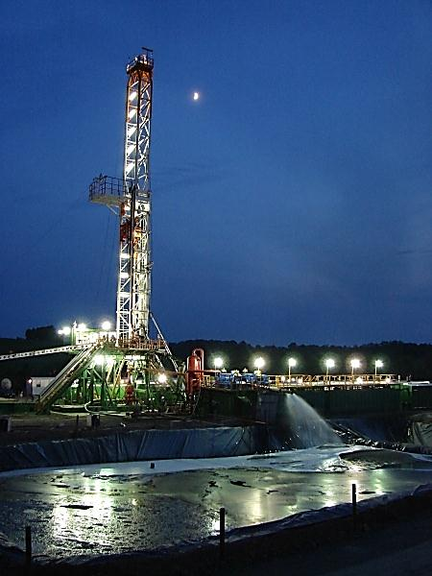
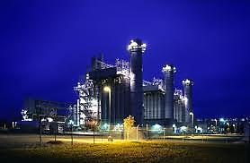
Uncertainties in European Gas Supply/Demand
Higher demand/prices in Asian markets
Arab spring
Reduced indigenous production
Caspian geopolitics
Shale gas development
Arctic development
North African demand
Eastern Mediterranean development
Global economy
S u p p p l y
MIT Energy Initiative
Reduction in renewable subsidies
Aftermath of Fukushima
German policy decisions
Plans for life extension of old nuclear plants
Impacts of EU policy – “20% by 2020”
Global economy
D e m a n d
e
i
MIT
Notes:
Close by noting that there are significant uncertainties for European natural gas policy going forward.
CLICK On supply side --
First higher demand in Asian markets puts pressure on supply. I showed you the price differences btwn the US, European and Asian markets. The high prices in Asia are a huge magnet for LNG supplies. Wild card is Chinese shale development -- Wanted in China(Chinese speaking is must) Geologist, Geophysicist, Petrophysicist, Reservoir, Data management, Seismic, Production technologist, Contract and procurement, Drilling, Completion, Cementing, Fracturing and acid,
Progress of the Arab Spring. We saw that Algeria is 2nd largest supplier of EU gas imports. Egypt exports LNG, Tunisia, gas pipeline to Italy, Libya uncertain, shale gas development in Algeria/Libya should be encouraged
Reduced indigenous production
Caspian geopolitics, discussed earlier
Shale gas development. US spent 25+ years on characterization, technology development. Our experience could accelerate this but still needs methodical investment. Europe could benefit from our missteps on environmental regulation, do it better
Arctic development
N. African demand – again it’s in Europe’s interest to help expand the gas resource base in Algeria/Libya
Eastern Med development, Cyprus, Israel, no geopolitics there! Turkish shale development is interesting,
CLICK Demand
Reduction in renewable subsidies Spain and Germany could increase gas demand
Next three are all about the future of nuclear power in Europe post Fukushima. If Germany moves forward with its phase out of nuclear and discontinues its solar subsidies, it might need substantially more gas for power generation.
Also the plans for life extension of older nuclear plants in Europe will affect gas demand
Europe, the major PLEX markets are France, the UK, Russia and the Ukraine, with respective market values of $10,044m, $1,870, $1,784m and $1,728m. Numerous extensions were planned in Europe; however, as a result of the 2011 Fukushima disaster, some countries are now phasing out nuclear power from their energy mix.
20% renewables, 20% emissions reduction by 2020 -- EU policy could also affect gas demand, up or down. Up if 20% renewables wins out, need gas for firming intermittents, up if switching from coal to gas gets the 20% reduction in CO2
NOTE this policy creates disincentives for investing in hugely expensive gas pipelines

Slide 31
European Gas Supply to 2020 -- Illustrative
Current production (2010): 298 bcm
Current consumption (2010): 570 bcm
Current gap between EU 27 production and consumption (2011 est) is met as follows:
  115 bcm/Russia
  90 bcm/Norway
  50 bcm/Algeria
  45 bcm/LNG
EU 27 gas production expected to decrease 100 bcm by 2020
Gas demand could remain flat or increases slightly under 20-20-20 but…
….20% renewables mandate could actually increase gas demand
Expected volumes from new pipelines:
  50 bcm/Nordstream
  8 bcm/Medgas
  31 bcm/Nabucco (highly uncertain, 7.9B Euros) or 61 bcm/South Stream (highly uncertain, 19-24 B Euros) or other
  Shale gas and additional LNG imports could make up the difference in 2020
MIT Energy Initiative
via pipeline
e
i
MIT
Sources: EIA, Richard Newell Presentation, 2010
Notes:
31
Other IGTI pipeline Interconnector Greece, Turkey, Italy 2 billion euros from Shah Deniz field in Azerbaijan , apparently this is dead in favor of TAP
The Trans Adriatic Pipeline (TAP) project is aimed at supplying 16 billion cubic metres (bcm) of gas a year from the Azeri Shah Deniz 2 gas field to Europe.
It calls for building a 520 km gas pipeline via Greece and Albania and across the Adriatic Sea to Italy.
10 billion cubic metres (350 billion cubic feet) of natural gas per year, with the option to expand the capacity up to 20 billion cubic metres (710 billion cubic feet).^{[2]} The total length of the pipeline is 520 kilometres (320 mi) and the length of the offshore section is 115 kilometres (71 mi). TAP also plans to develop an underground natural gas storage facility in Albania and offer a reverse flow possibility of up to 8.5 billion cubic metres (300 billion cubic feet). These features will ensure additional energy security for the Southeastern Europe.^{[14][15]} Total construction costs are expected to be about €1.5 billion.^{[2]} TAP is ready to commence pipeline operations in time for first gas exports from Shah Deniz II (expected in 2017–2018).[

