Slide 1

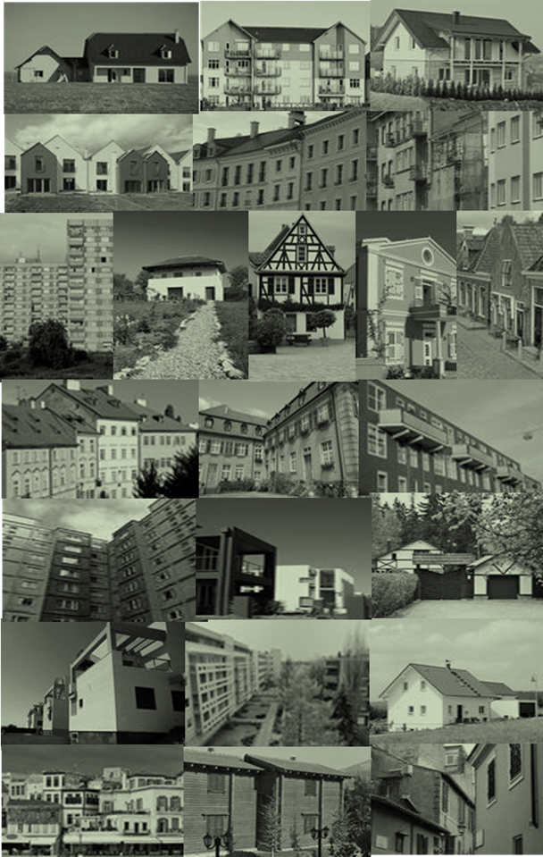
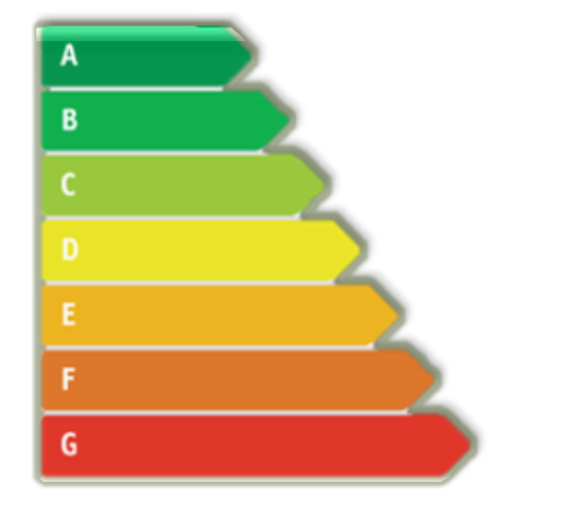
Why (and How) Building Renovation should be a Key Component of Energy Policy
Dan Staniaszek
Buildings Performance Institute Europe
5th Regional Energy Conference:
„Regional Energy Development and Energy Security“
28-29 October 2014
Sofia, Bulgaria

Slide 2









Multiple Benefits of Building Renovation
Economic activity
Reduction in social
security costs
Reduction in energy
consumption
Job creation
Property values
Regeneration of urban areas
Energy security
Comfort and indoor
climate
Increased
purchasing
power
Improved
productivity
Fuel poverty
alleviation
Reducing CO2

Slide 3
Energy Efficiency “the first fuel”
Energy efficiency savings from investments
in IEA countries (1974-2010)
exceed the energy supplied
from any individual source:
oil, coal , gas or electricity
Source: IEA 2014 “Capturing the Multiple Benefits of Energy Efficiency”

Slide 4
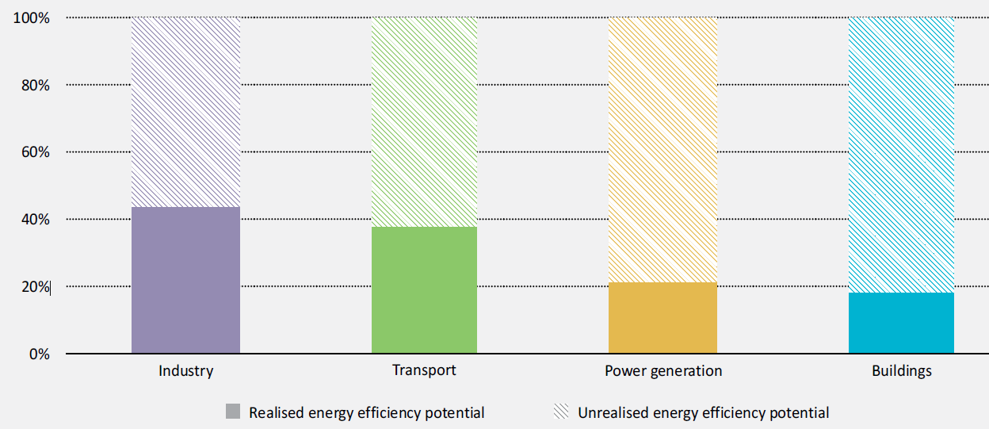
Over 80% of saving potential in building sector remain untapped
Source: IEA “Capturing the Multiple Benefits of Energy Efficiency”

Slide 5
IEA Multiple Benefits
– 5 key areas examined
Macroeconomic development
Public budgets
Health and well-being
Industrial productivity
Energy delivery

Slide 6
1. Macroeconomic development
analysis of GDP changes due to large-scale energy efficiency policies show positive outcomes:
economic growth 0.25-1.1% p.a.;
8 to 27 job years per €1M invested

Slide 7
2. Public Budgets
Value to public budgets of energy efficiency investments in EU buildings = €30-40 bn
Adding tax revenues and reduced unemployment payments increases benefit by factor of 2-3 = €67-128 bn
Reduced energy demand also lowers subsidy payments in countries where energy is subsidised

Slide 8
3. Health and well-being
Potential benefits include reduced symptoms of respiratory and cardiovascular conditions, rheumatism, arthritis and allergies, improved mental health as well as fewer injuries.
Benefit:cost ratio as high as 4:1, with health benefits representing up to 75% of overall benefits.
Addressing indoor air quality through energy efficiency measures could save the EU €190 bn/a.

Slide 9
4. Industrial productivity
The value of the productivity and operational benefits derived can be up to 2.5 times (250%) the value of energy savings

Slide 10
5. Energy delivery
Direct benefits
lower costs for energy generation, transmission and distribution,
improved system reliability,
dampened price volatility in wholesale markets
possibility of delaying or deferring costly system upgrades.
Indirect benefits
improved consumer affordability of energy services can reduce arrears and the associated administrative costs
NOTE – benefits yet to be quantified on a systematic basis

Slide 11
EU Legislative Context
DIRECTIVE 2002/91/EC 16 December 2002 on the energy performance of buildings
EPBD: DIRECTIVE 2010/31/EU 19 May 2010 on the energy performance of buildings (recast)
DIRECTIVE 2001/77/EC 27 September 2001 on the promotion of electricity produced from renewable energy sources
RED: DIRECTIVE 2009/28/EC 23 April 2009 on the promotion of the use of energy from renewable sources
DIRECTIVE 2003/30/EC 8 May 2003 on the promotion of the use of biofuels or other renewable fuels for transport
DIRECTIVE 92/42/EEC 21 May 1992 on efficiency requirements for hot-water boilers
DIRECTIVE 2005/32/EC eco design
Ecodesign: DIRECTIVE 2009/125/EC 21 October 2009 establishing a framework for the setting of ecodesign requirements for energy-related products (recast)
DIRECTIVE 2004/8/EC 11 February 2004 on the promotion of cogeneration
EED: DIRECTIVE 2012/27/EU 25 October 2012 on energy efficiency
DIRECTIVE 93/76/EEC 13 September 1993 to limit carbon dioxide emissions by improving energy efficiency (SAVE)
DIRECTIVE 2006/32/EC 5 April 2006 on energy end-use efficiency and energy services
DIRECTIVE 92/75/EEC of 22 September 1992 on labelling and standard product information of the consumption of energy and other resources by household appliances
Energy labelling: DIRECTIVE 2010/30/EU 19 May 2010 on labelling and information on product energy consumption (recast)
LIGHT BLUE = SUPERCEDED DIRECTIVE ; GREEN = CURRENT DIRECTIVE

Slide 12
Article 4, Energy Efficiency Directive
Member States shall establish a long-term strategy for mobilising investment in the renovation of the national stock of residential and commercial buildings, both public and private. This strategy shall encompass:
An overview of the national building stock based, as appropriate, on statistical sampling;
Identification of cost-effective approaches to renovations relevant to the building type and climatic zone;
Policies and measures to stimulate cost-effective deep renovations of buildings, including staged deep renovations;
A forward-looking perspective to guide investment decisions of individuals, the construction industry and financial institutions;
An evidence-based estimate of expected energy savings and wider benefits.
A first version of the strategy shall be published by 30 April 2014 and updated every three years thereafter.

Slide 13
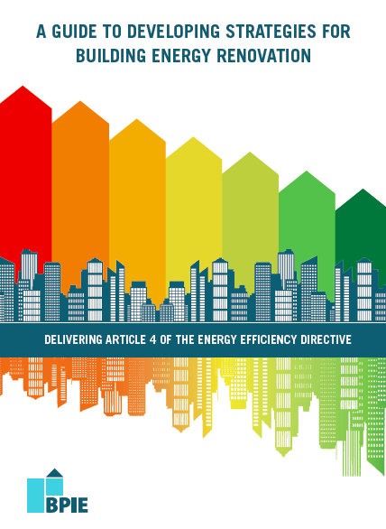
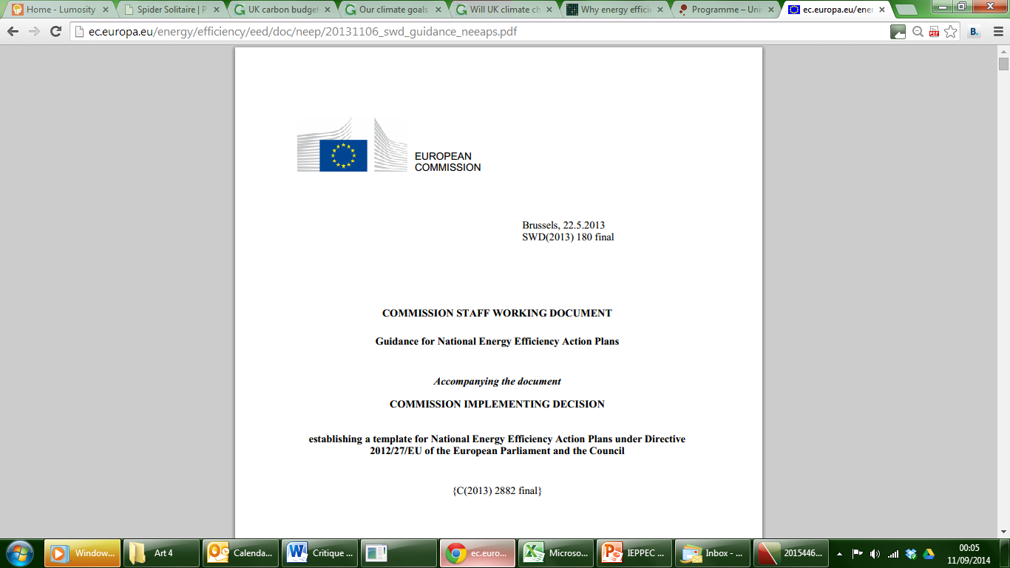
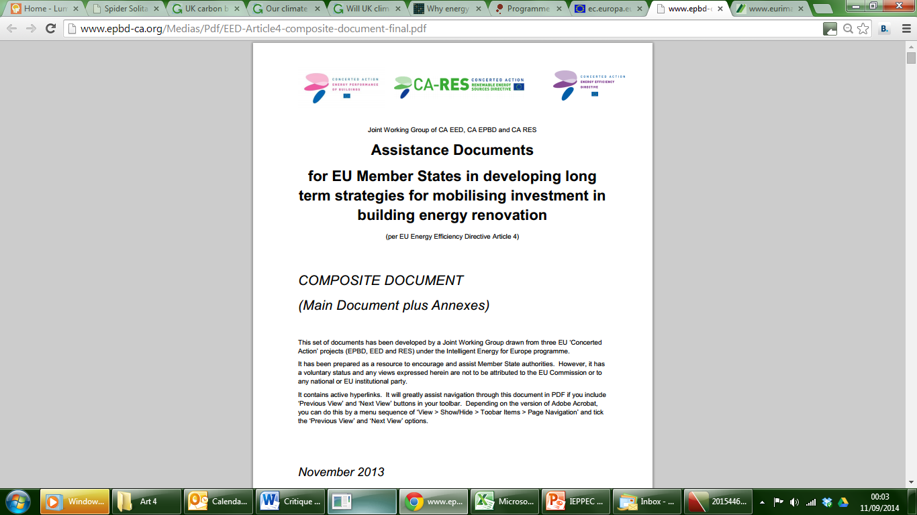

Available Guidance

Slide 14
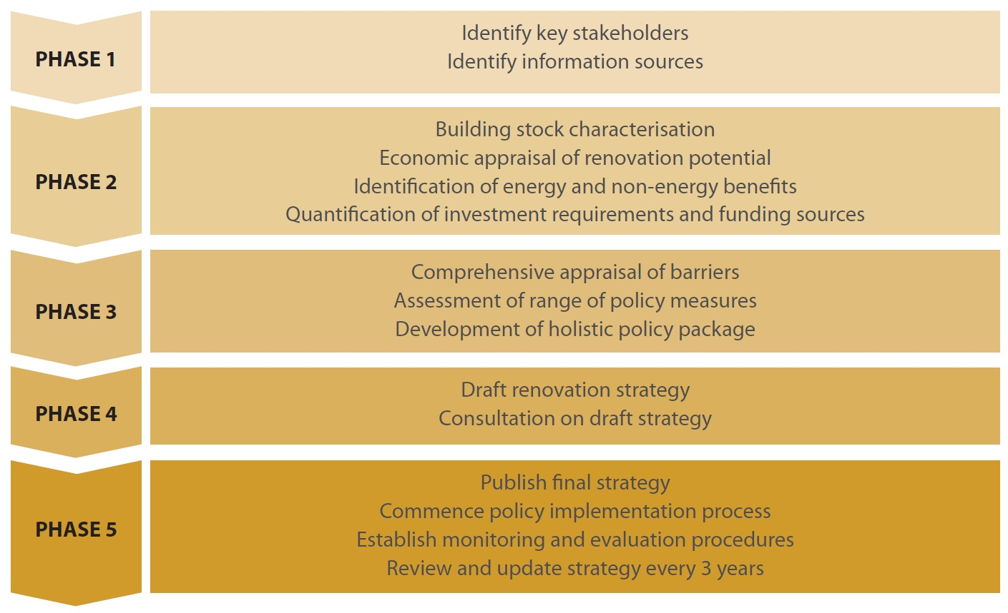
BPIE’s strategy development process http://bpie.eu/renovation_strategy.html

Slide 15
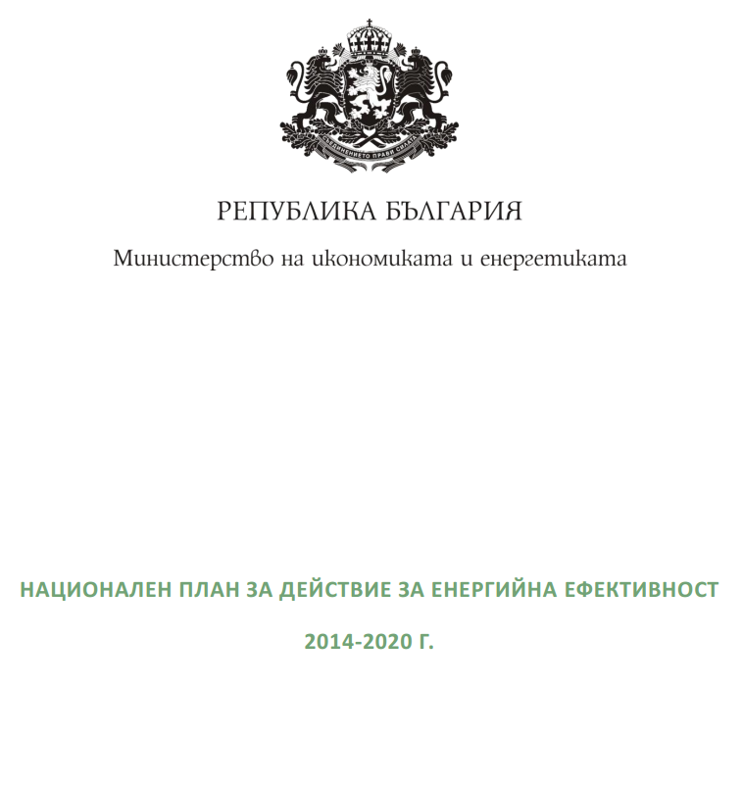
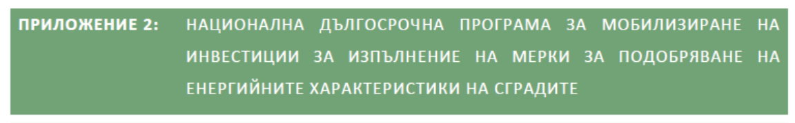
Bulgarian
National Energy Efficiency Plan, including the Building Renovation Strategy

Slide 16
The construction sector
Key structural role in the Bulgarian economy
  almost 7% of GDP
  over 5.5% of employment
Accounts for over 40% of investment in fixed capital.
Is decisive for national competitiveness and attract foreign investment.
However, it is highly fragmented - over 96% of construction enterprises are mainly micro and small enterprises.

Slide 17
Residential Energy Use
Increased from 0,553 toe/dwelling in 2007 to 0,567 toe/dwelling in 2009
Main factors:
  increasing size of new homes,
  increasing levels of thermal comfort, lighting, air conditioning
  increased use of household appliances and electronics.
Issues:
  low efficiency of household stoves and fireplaces
  cost of energy is a heavy burden on household budgets
  global effort to save energy in the context of sustainable development

Slide 18
Initial Assessment of Bulgarian Renovation Strategy
Lacks detail
Largely focused on restating existing regulations
Forward plan is simply a description of existing source of funding
No quantification of energy saving or wider benefits
NOT A COMPLIANT STRATEGY
DOES NOT RECOGNISE STRATEGIC IMPORTANCE OF BUILDING RENOVATION TO BULGARIAN ECONOMY AND ENERGY POLICY

Slide 19


Recommendations
Stakeholder involvement: valuable input (improved quality and easier delivery and implementation)
Building stock: detailed breakdown is fundamental for next steps in the strategy (ideally online)
Cost-effective approaches to renovation: summary of cost-optimality analysis (c.f. EC guidelines)
Policies: holistic coverage and geared towards achieving deep renovations
Provide appropriate long term signals to the market
Forward-looking perspective: long-term signals, roadmap (key dates, targets, milestones).

Slide 20






Recognition of building market dynamics, adapted to needs, desires and motivations of building owners.
Quantification of benefits (economic impact, societal benefits and environmental improvements)
Healthy buildings: daylight, ventilation and good IAQ for well-being of occupants
Implementation and enforcement of strategies at MS and EU level to ensure practical achievement
Recommendations
Ongoing review and revision: update and resubmission every 3 years
Notes:
Test

Slide 21



Modeling policy effectiveness to mobilize investment in energy renovation of buildings
Project supported by and implemented with The World Bank
The market for energy renovation of buildings in Bulgaria is weak. Potential investors will only commit resources if they see a financial rationale
Willingness to invest is constrained by significant policy barriers, such as energy price distortions, high transaction costs, regulatory risks and other institutional hurdles. These increase investment risk and decrease IRRs
The Investors’ Marginal Energy Saving Cost Curve has been devised in order to identify impact of policy options on economic attractiveness of building renovation as an investment opportunity.
More details to follow in upcoming World Bank report, present modeling results of several scenarios

Slide 22
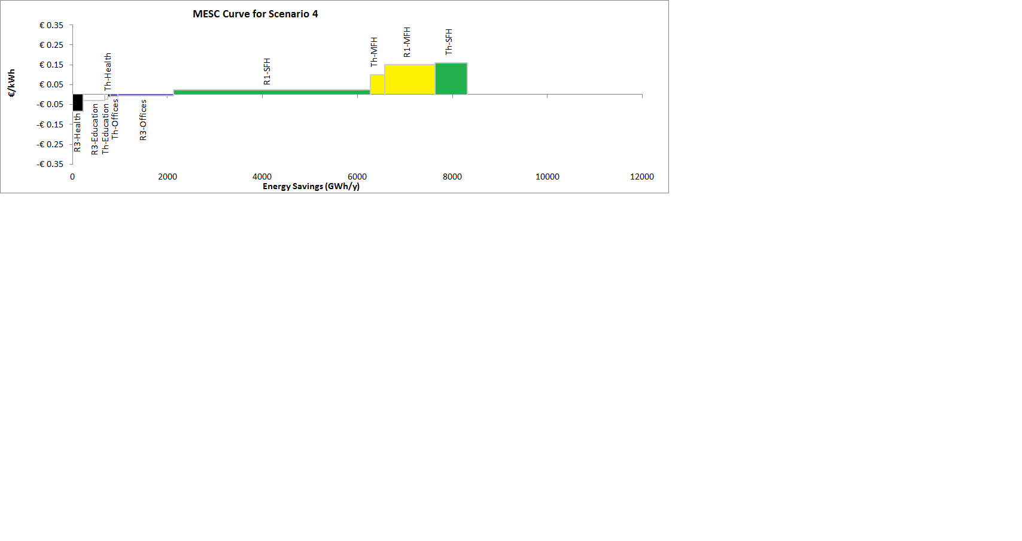
EXAMPLE Scenario 4. Baseline with utility benefits & grants
SAMPLE RESULTS

Slide 23
Five Pillars of the Energy Union
Maroš Šefčovič, Commission’s new Vice-President
energy security - reduce EU’s energy bill of €400bn per year
a competitive and integrated market, boosted by infrastructure investment
reduce EU energy consumption, including an energy saving target
decarbonise the EU energy mix
research and innovation

Slide 24

Dan Staniaszek
Buildings Performance Institute Europe
Dan.Staniaszek@bpie.eu
www.bpie.eu
www.buildingsdata.eu

