Slide 1

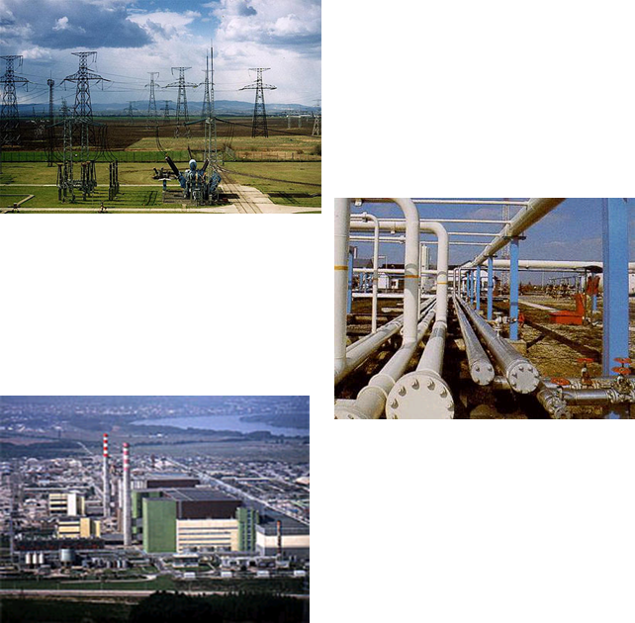
HUNGARIAN EXPERIENCE
IN THE ELECTRICITY MARKET LIBERALIZATION :
LESSONS LEARNED
Homepage: http://www.mekh.hu/en
Hungarian Energy and Public Utility Regulatory Authority
Péter Tilesch
DIRECTOR
ELECTRICITY AND DISTRICT HEATING
SUPERVISION AND REGULATION

Slide 2
Hungarian Energy and Public Utility Regulatory Authority
OUTLINE
The Hungarian Electricity Market
  General information
Regulation of the electricity industry
  Legal framework
  Hungarian Energy and Public Utility Regulatory Authority (HEA)
  Liberalization
    Market structure
    Operational model
Balancing Market
Cross border capacity auction
Czech-Slovak-Hungarian-Romanian Market Coupling
Lessons learned

Slide 3
Data of the Hungarian Electricity System (2013)
Hungarian Energy and Public Utility Regulatory Authority
Characteristic Data on Capacities
  Total of domestic power plants (Installed capacity): 9 113.1 MW
  Available capacity: 7 521.1 MW
  Import/Export balance: 11 877.7 GWh
  Maximum peak load (04/12/2013): 6 307 MW
Power Generation by Energy Sources (GWh)
  Domestic energy production: 30 311.5
    Lignite/Coal: 5 880.4
    Oil: 54.6
    Natural gas: 6 668.5
    Nuclear: 15 367.9
    Wastes and renewables: 2 340.1
      of which Wind: 697.2
      Hydro: 212.2
      Biomass: 1 151.8
Traded Electricity (GWh)
  HUPX DAM: 9 074 (around 23% of gross consumption)
  HUPX PhF: 7 147
  OTC: appr. 150 000 (according to the data supply of the traders)

Slide 4
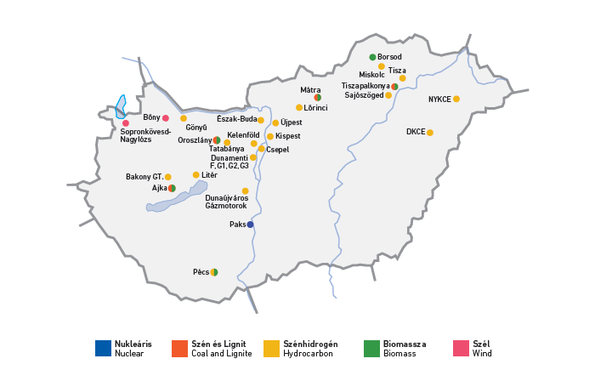
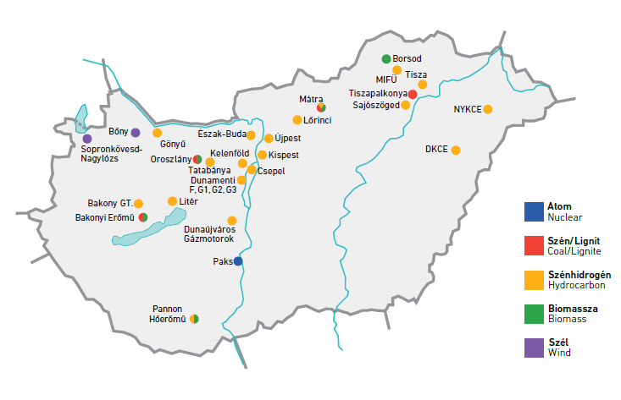
Hungarian Energy and Public Utility Regulatory Authority
Power Plants in the Hungarian Power System, 2013

Slide 5
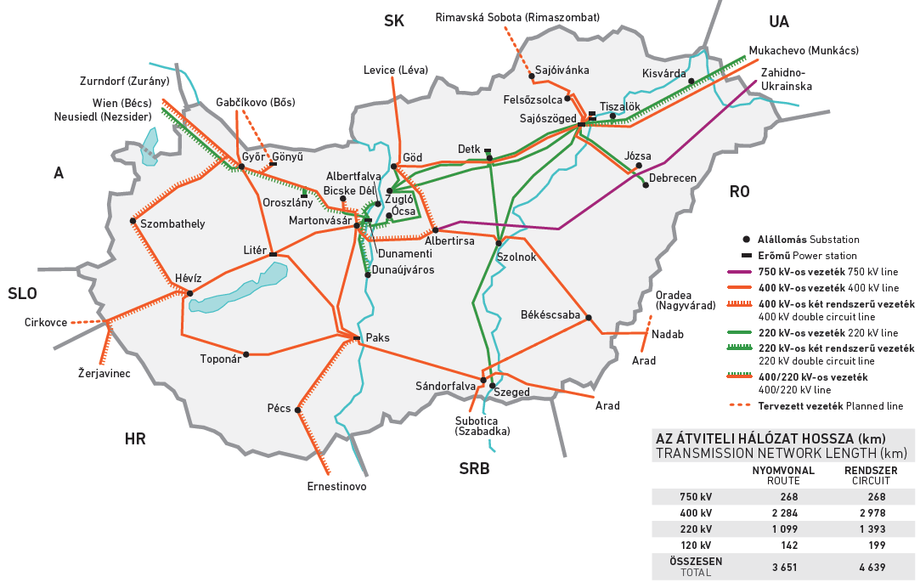
Hungarian Energy and Public Utility Regulatory Authority
The Hungarian Transmission Network

Slide 6
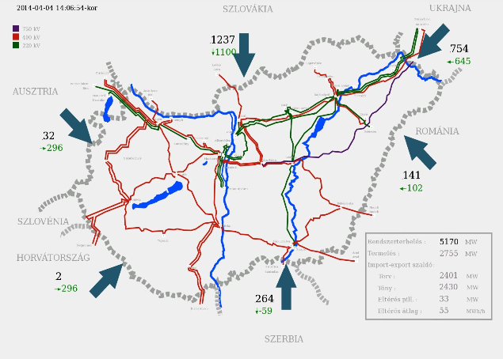
Hungarian Energy and Public Utility Regulatory Authority
Overview: Most Important Data of the Hungarian Electricity Network by MAVIR

Slide 7
Hungarian Energy and Public Utility Regulatory Authority
Regulation of the Electricity Industry
Legal Framework
Act on Electricity (AE) (Parliament)
Enforcement Decree (ED) (Government)
Secondary Legislation (Ministry of National Development, Ministry of National Economy, Ministry of Rural Development, Ministry of Public Administration and Justice, HEA)
Licenses (HEA)
Codes (Grid, Commercial, Distribution – TSO and DSOs)
Market Rules (PX)
Business Conduct Rules (TSO, DSO, PX, traders)

Slide 8
Hungarian Energy and Public Utility Regulatory Authority
Hungarian Energy and Public Utility Regulatory Authority (HEA)
Earlier Hungarian Energy Office (HEO)
Year of establishment: 1994
Staff number: 235 (end of 2013)
Yearly budget (2013): 4.732 billion HUF (≈ € 15.2 million)
Supervised sectors: electricity, natural gas, district heating (partly), water public utility
Competences and tasks | Licensing, monitoring, enforcement Price preparation, network tariff regulation Market monitoring, promotion of competition Customer protection Support of preparation of energy legislation Promotion of sustainable development Data management, statistics, reporting Participation in regional and European institutions
Number of Licenses
Electricity: 585
Natural gas: 70
District heating: 274
Water public utilities: 46
Number of issued resolutions (2013): 2 281
Number of customer protection related cases (2013): appr. 5 800

Slide 9
Hungarian Energy and Public Utility Regulatory Authority
Licensing of Electricity Trading
General documentation:
Deed of association or articles of incorporation
Original copy of the company register
Payment confirmation
Annual business plan (actual and next year)
All-inclusive
  Draft business conduct rules
Limited
  Statement on authority or license in the country of registration (EU or EEA)
  Hungarian representation
Market information
Investor’s decision
Direct sale for end-users
Only wholesale trading
HEA licensing
„All-inclusive” trading license
6M HUF + 1M HUF
Deadline: 3 months
Supervisory fee: 0.06% of Net Sales Revenue
„Limited” trading license
6M HUF
Deadline: 30 days
Supervisory fee: 0.06% of Net Sales Revenue

Slide 10
Hungarian Energy and Public Utility Regulatory Authority
Restructuring of the Hungarian Electricity Sector
I. Phase
  1992 Dismantling (Legal separation)
  1994 Legal framework (Act on Electricity (AE ’94), etc.), licensing
  1995-96 Privatization
  1994-2001 Operation and regulation according to AE ‘94
II. Phase
  2002 “New” legal framework (EU Directive 96/92 → AE ’01)
  2002 - … Gradual opening the competitive market, limited competition
  2004 Accession to the EU
III. Phase
  2007 “New” legal framework (EU Directive 2003/54 → AE ’07)
  2007 New market model, fully opening the market
IV. Phase
  - 2009-… Harmonization of EU third energy package → upgrading AE ’07

Slide 11
Hungarian Energy and Public Utility Regulatory Authority
Basic Idea of the 1994 Electricity Law
Operational Model of the Electricity System
Operational (Grid) Code
Business Conduct
Rule
Business Conduct
Rules
Import
Export
Power Plant
Companies
Electricity
production
Transmission
Company
- Single Buyer
- Dispatching,
- Transmission,
- Capacity balance,
- Export, Import
Distribution
& Supply
Companies
Distribution
Supply
Consumers
Producer
price
Wholesale
price
End-user
price
Operational
licences
Operational
licence
Operational
licences
Electricity flow

Slide 12
Hungarian Energy and Public Utility Regulatory Authority
The Hungarian Electricity Model in 2001
Public Service Generators
Import-export
Generators
Regulated
price (- 2004)
Public Service
Wholesaler
Regulated
price
Public Service
Supplier(s)
Energy
Trader (s)
Regulated
price
Public Service
(„captive”)
Customers
Eligible
Customers

Slide 13
AE 2007 Free Market Model
Capacity & Energy Flows
Hungarian Energy and Public Utility Regulatory Authority
Generators
Import-export
Organized
Market
(OM)
Energy Traders
Universal Service
Provider(s) (USP)
Regulated
Price
Household & Small Enterprise Customers
(Universal Service)
Eligible Customers
(Excludes Households prior to 1 July 2007)

Slide 14
Hungarian Energy and Public Utility Regulatory Authority
Existing Model of the Hungarian Power Market
Domestic
generators
Market Coupling
OTC Market
Import - Export
Medium-term contracts
TSO
(Ancillary Services – Balancing Energy & GCC, Purchase obligation – RES)
Traders
Universal suppliers
MVM as trader with significant market power
Auction/Powerforum
Organized Market (Power Exchange)
Organized Market
Regulated prices
Household consumers and consumers entitled to universal service
Competitive market consumers

Slide 15
Hungarian Energy and Public Utility Regulatory Authority
Balance Circle (BRP) System
Contract between the System Operator and Balance circle:
Balance Responsible party
BRP 1
External trade
System Operator
Balance circle contracts
BRP
Member of balance circle contract
Interior trade
Balance Responsible party
Generators
Auction stakeholder
BRP 2
Trader
Consumer
Number of Balance Circles: around 100
Source: MAVIR
Notes:
Auction stakeholder is any trader including BRP to obtain cross border capacity.

Slide 16
Hungarian Energy and Public Utility Regulatory Authority
Ancillary Services market
Generators shall be accredited by TSO. (Operational Code)
It contains technical details like:
      gradient [MW/minutes]
      balancing command response time
      TSO tested the generators carefully before giving accreditation.
The energy fee is included separately in generator’s technical bid.
Details are included in the Operational and Commercial Codes and the TSO’s Competition Documentation.

Slide 17
Hungarian Energy and Public Utility Regulatory Authority
Ancillary Services categories
Primary Control
Single tender for yearly period, only capacity fee (no energy fee)
Yearly tenders 2011-2013:
Amount of necessary Primary Control based on ENTSO-E Operational Handbook.
Primary Control | 2011 |  |  | 2012 |  |  | 2013
 | Amount | Capacity fee (average in Ft/MW/h) | Number of Competitors | Amount | Capacity fee (average in Ft/MW/h) | Number of Competitors | Amount | Capacity fee (average in Ft/MW/h) | Number of Competitors
Up | 40 | 2230 | 2 | 40 | 2600 | 4-5 | 36 | 8150 | 4-5
Down | 40 | 2230 | 2 | 40 | 2600 | 4-5 | 36 | 8150 | 4-5

Slide 18
Hungarian Energy and Public Utility Regulatory Authority
Ancillary Services categories
Secondary Control
  Asymmetrical: upwards: 242-310 MW (in yearly average)
  downwards: 121-145 MW (in yearly average)
  Based on a contract type „market maker”
  Capacity fee and energy fee (if activated)
Tender periods:
        yearly tender: price-descending online auction (organized by TSO)
        quarterly tender: only upwards, price-descending online auction (organized by TSO)
        weekly tender: single pay-as-bid tenders (organized by TSO)
Yearly tenders 2011-2013:
Amount of necessary Secondary Control based on ENTSO-E Operational Handbook.
Secondary Control | 2011 |  |  | 2012 |  |  | 2013
 | Amount | Capacity fee (average in Ft/MW/h) | Number of Competitors | Amount | Capacity fee (average in Ft/MW/h) | Number of Competitors | Amount | Capacity fee (average in Ft/MW/h) | Number of Competitors
Up | 310 | 7260 | 7 | 150 | 9170 | 8 | 100 | 4400 | 13
Down | 145 | 12560 | 5 | 137 | 10100 | 8 | 100 | 6000 | 12

Slide 19
Hungarian Energy and Public Utility Regulatory Authority
Ancillary Services categories
Secondary Control
Quarterly tenders 2011-2013: only upwards
Secondary Control | 2011 |  |  | 2012 |  |  | 2013
 | Amount | Capacity fee (average in Ft/MW/h) | Number of Competitors | Amount | Capacity fee (average in Ft/MW/h) | Number of Competitors | Amount | Capacity fee (average in Ft/MW/h) | Number of Competitors
Q1 | - | - | - | 110 | 5920 | 8 | 100 | 4100 | 8
Q2 | - | - | - | 106 | 18120 | 10 | 100 | 14000 | 10
Q3 | - | - | - | 106 | 18120 | 10 | 100 | 6500 | 9
Q4 | - | - | - | 106 | 18120 | 10 | 100 | 3700 | 10
Weekly tenders 2011-2013:
SecondaryControl | 2011 |  |  | 2012 |  |  | 2013
 | Amount | Capacity fee (average in Ft/MW/h) | Number of Competitors | Amount | Capacity fee (average in Ft/MW/h) | Number of Competitors | Amount | Capacity fee (average in Ft/MW/h) | Number of Competitors
Up | - | - | - | - | - | - | 48 | 2000 | 6
Down | - | - | - | - | - | - | 28 | 3000 | 6

Slide 20
Hungarian Energy and Public Utility Regulatory Authority
Ancillary Services categories
Tertiary Control
  Asymmetrical: upwards: 500 MW (the largest power plant block in the Hungarian system)
  Based on a contract type „market maker, both capacity fee and energy fee (if activated)
  downwards: 80-130 MW optional
  mostly based on a contract type „optional”
Tender periods:
        yearly tender: price-descending online auction (organized by TSO)
        OR
        quarterly tender: price-descending online auction (organized by TSO)
Yearly tenders 2011-2013:
Tertiary Control | 2011 |  |  | 2012 |  |  | 2013
 | Amount | Capacity fee (average in Ft/MW/h) | Number of Competitors | Amount | Capacity fee (average in Ft/MW/h) | Number of Competitors | Amount | Capacity fee (average in Ft/MW/h) | Number of Competitors
Up | 320 | 2600 | 8 | 500 | 2690 | 12 | 500 | 3120 | 12
Down | - | - | - | - | - | - | 84 | 9500 | 10

Slide 21
Hungarian Energy and Public Utility Regulatory Authority
Virtual Power Plant/Control Centre
Business entities being entitled to act on behalf of voluntarily associated small-scale power plants of 0.5 MW or higher capacities connected to the distribution or transmission network, network users and storage systems in contact with the TSO in order to be able to jointly participate in the market of ancillary services.
VPPs participating in the Hungarian market of ancillary services:
    Primary Control: future plans to participate (price-lowering effect)
    Secondary Control: significant participate, price-lowering effect
    Tertiary Control: no significant participate
Total capacities of Hungarian VPPs approximately 470 MW

Slide 22







Hungarian Energy and Public Utility Regulatory Authority
International Cooperation in Balancing – GCC in Europe
GCC = Grid Control Cooperation
German GCC
4 German TSOs
1.
It means imbalance netting in order to avoid counter activation of secondary control power (SCP) in neighboring control areas.
At present there are 4 balancing cooperation in Europe
2.
4.
INC
Austria and Slovenia
International GCC (IGCC)
Denmark, the Netherlands, Switzerland, Czech Republic, Belgium
France
3.
e-GCC
Czech Republic, Slovakia and Hungary
Notes:
If there is available capacity at the relevant border.

Slide 23
Hungarian Energy and Public Utility Regulatory Authority
The GCC Model and its Goal
Control Area A
Schedule A
Imbalance A
Demand of SCP A
Demand of SCP B
Imbalance B
The total system imbalance and the demand of SCP is counteractive.
The equal part can be saved.
Schedule B
Control Area B
It is system inherent that there are time periods when the Secondary Control Power (“SCP”) demand in some control area is positive while at the same time there is negative secondary control power demand in another control area.

Slide 24
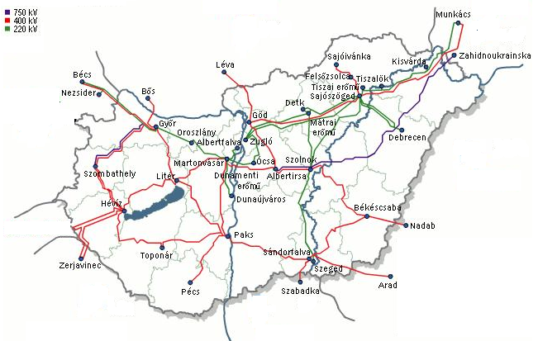
Hungarian Energy and Public Utility Regulatory Authority
Cross-border Capacity Allocation 2014
CZ-SK-HU
Market (price)
coupling
Ukraine
Slovakia
One-sided auction:
MAVIR: M, D
Common:
CAO: Y, M
CEPS: ID
Austria
Common:
CAO: Y, M, D
CEPS: ID
Romania
Common:
MAVIR: Y, M
TRANSELECTRICA: D, ID
Slovenia
Explanation:
Y= Yearly auction
M= Monthly auction
D= Daily auction
ID=Intraday allocation
Croatia
Serbia
Common:
CAO: Y, M, D
Common:
MAVIR: D
EMS: Y, M, ID

Slide 25
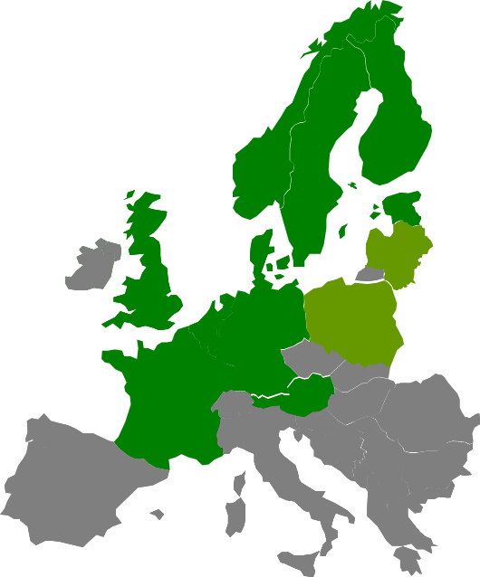
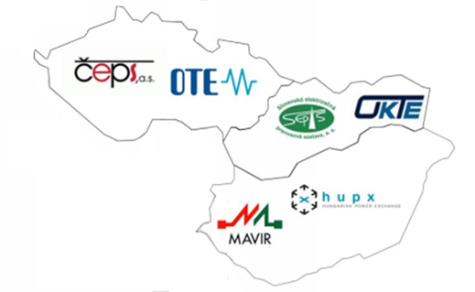
Hungarian Energy and Public Utility Regulatory Authority
CZ-SK-HU Market Coupling
The NWE Region in November 2013
CZ-SK-HU Market Coupling 11th September 2012

Slide 26
Hungarian Energy and Public Utility Regulatory Authority
4 Markets Market Coupling – 4M MC
  Main goals:
  Extension of CZ-SK-HU MC to Romania
  4M countries wish to introduce benefits of market integration to market participants as soon as possible
  Get prepared for and closer to European Price Coupling – implement MC based on PCR solution
  Context:
Stepwise market integration is the only way forward due to a blocked situation and slow progress in the CEE region
  Flow-based capacity calculation methodology
  Overlapping regions and other integration activities
CEE regional solution is not agreed yet
  The extension does not hinder the regional development as it is an intermediate step towards European Price Coupling
Notes:
PCR= Price Coupling regions (PX cooperation).

Slide 27
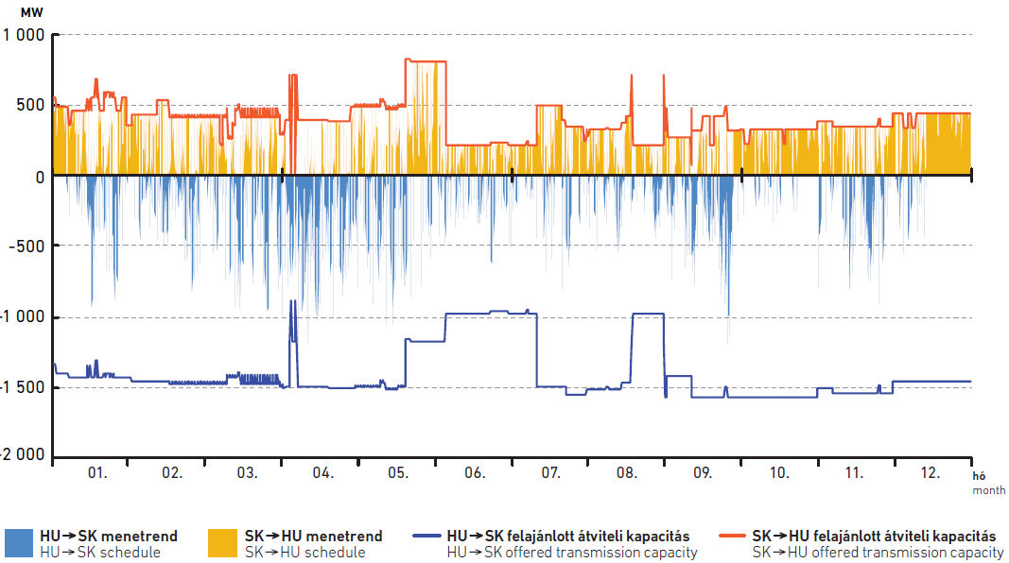
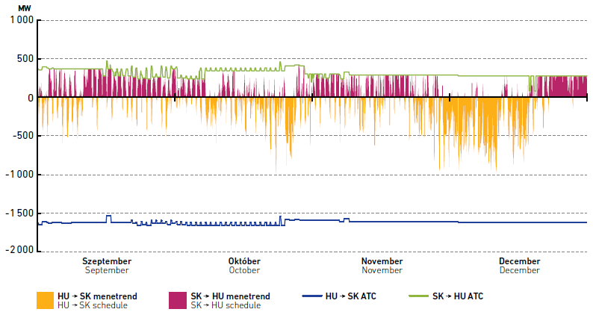
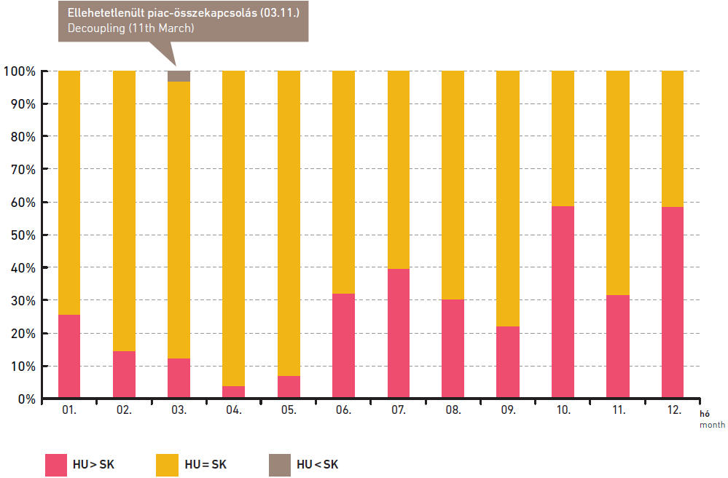
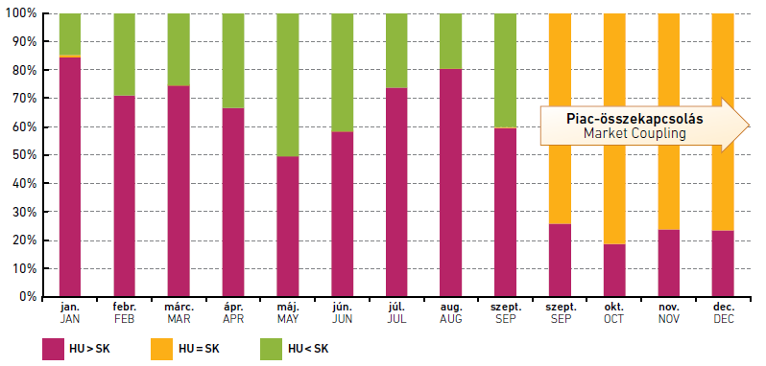
Hungarian Energy and Public Utility Regulatory Authority
CZ-SK-HU Market Coupling – Capacity and Prices
in 2012
in 2013
Notes:
The top two graphs – the use of cross border capacity became, better. Lower: Price level became closer.

Slide 28
Hungarian Energy and Public Utility Regulatory Authority
Current Status – mid February 2014
Negotiation on MC arrangement with PL and RO
Implementation
Design phase
MoU
Decision on PL involvement
High Level Market Design
SP tenders of some PXs
OTE has become a Full PCR Member since March 2013
PCR Service Provider selected by HUPX, OKTE and OPCOM
TSO-PX design phase in February to fix the main issues
  Interfaces, high-level procedures, roles, etc.
  Check compliance with NWE MC
Go-Live in Q4/2014

Slide 29
Hungarian Energy and Public Utility Regulatory Authority
4M MC Project Roadmap 2014
Q1
Q2
Q3
Q4
Start of implementation
Implementation design
PX PCR Implementation
mTMF Implementation
Common PX-TSO testing
Testing with market participants
Workshop for Market Participants
NRAs approval
Go-live in Q4

Slide 30
Hungarian Energy and Public Utility Regulatory Authority
4M MC towards the IEM
4M MC prepares PXs and TSOs for the target model
Current coordinated capacity calculation method remains (ATC)
Provides market participants benefits of implicit allocation already before Flow-Based MC is implemented
Promotes cross-regional integration by involving Romania and being open for other markets as well
  PX Systems in 4M MC support further integration with NWE/SWE
Offers smooth access to new parties
Go-live in Q4/2014
Notes:
Explicit: capacity Implicit: capacity + amount of energy

Slide 31

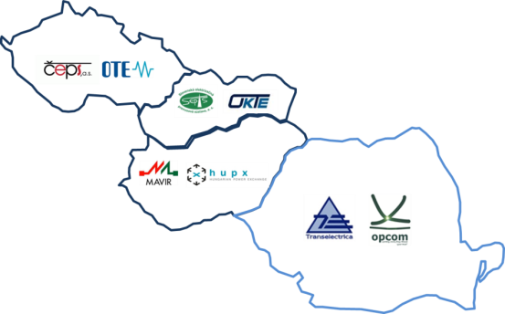

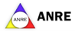
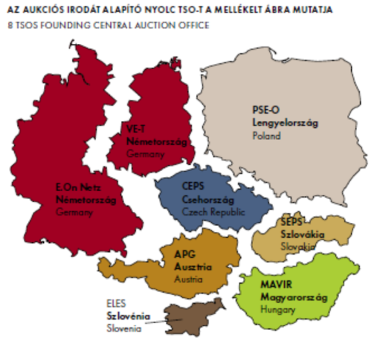
Hungarian Energy and Public Utility Regulatory Authority
Towards the European Power Market
4MMC, 2014 Q4
CEE FBMC, ???

Slide 32
Hungarian Energy and Public Utility Regulatory Authority
Further Possibilities after 4M MC Go-live
CEE
Region
4M MC countries

Slide 33
Hungarian Energy and Public Utility Regulatory Authority
Thank You for Your attention!
Mr. Péter Tilesch
tileschp@mekh.hu

