Slide 1
Sixth Regional Energy Conference Energy Development in South East Europe: energy security, sustainability, investments and growth – 19-20 September 2016, Hotel Balkan, Sofia
Oil and Gas Activities in Bulgaria
Zhecho Stankov, Deputy Minister of Energy

Slide 2
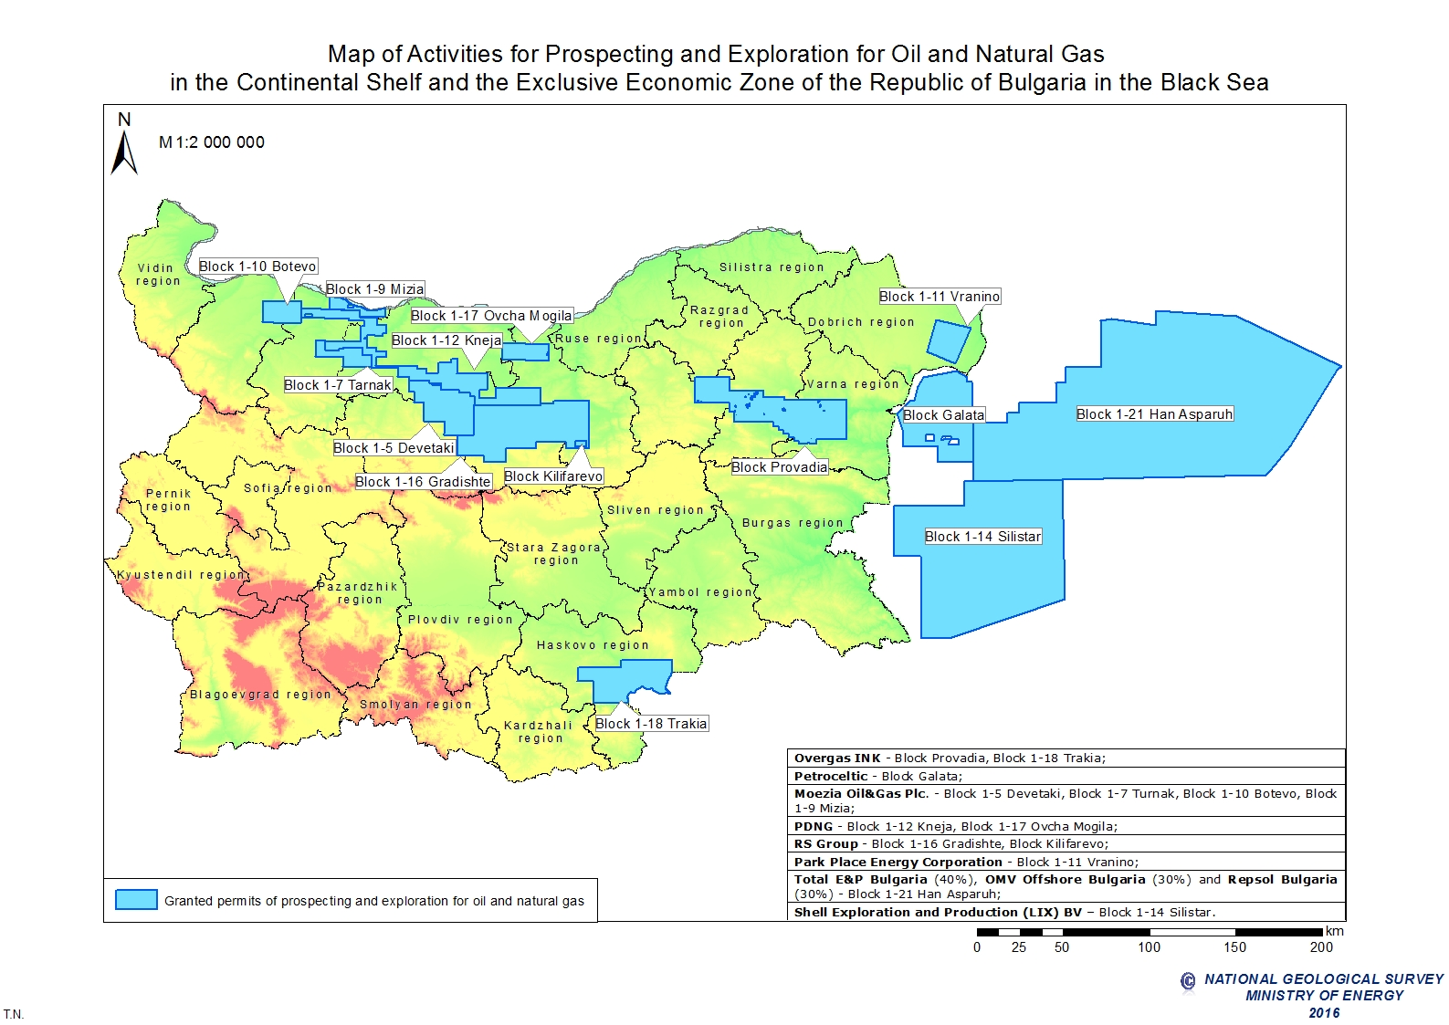
Sixth Regional Energy Conference Energy Development in South East Europe: energy security, sustainability, investments and growth – 19-20 September 2016, Hotel Balkan, Sofia

Slide 3
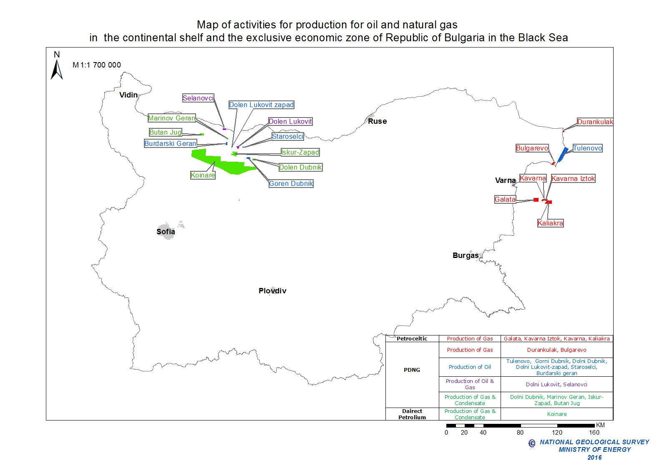
Sixth Regional Energy Conference Energy Development in South East Europe: energy security, sustainability, investments and growth – 19-20 September 2016, Hotel Balkan, Sofia

Slide 4
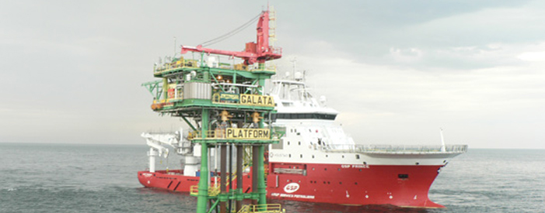
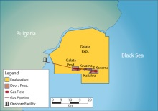
Sixth Regional Energy Conference Energy Development in South East Europe: energy security, sustainability, investments and growth – 19-20 September 2016, Hotel Balkan, Sofia
The offshore producing gas fields were
developed using an unmanned platform
located on the main Galata field, to which
the Kaliakra and Kavarna fields
have been tied-back using
subsea completions.
Source – Petroceltic Website

Slide 5
Sixth Regional Energy Conference Energy Development in South East Europe: energy security, sustainability, investments and growth – 19-20 September 2016, Hotel Balkan, Sofia

Slide 6
Sixth Regional Energy Conference Energy Development in South East Europe: energy security, sustainability, investments and growth – 19-20 September 2016, Hotel Balkan, Sofia

Slide 7
Sixth Regional Energy Conference Energy Development in South East Europe: energy security, sustainability, investments and growth – 19-20 September 2016, Hotel Balkan, Sofia

