Slide 1
Romania:
Advanced steps towards integration in the natural gas regional market

Slide 2
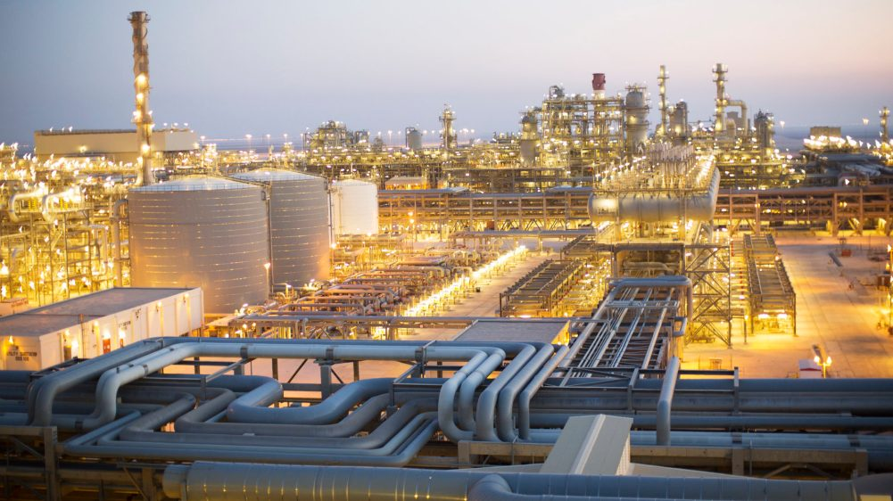
Overview
since 2015 Romania used only 2% of imported natural gas
Romania has the fifth largest reserves of natural gas in Europe
interconnection point with Hungary - imported natural gas
interconnection point with Republic of Moldova - exported natural gas

Slide 3
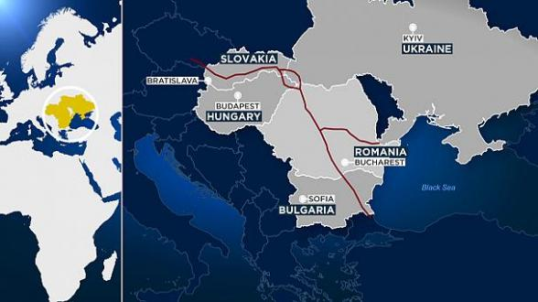
BRUA Project
Route of interconnection Bulgaria – Romania – Hungary – Austria

Slide 4
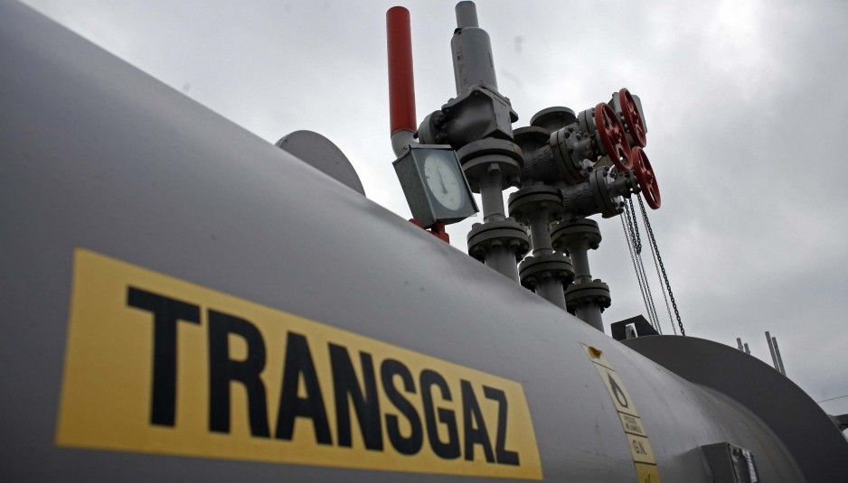
BRUA Project – latest developments 1/2
construction within Romanian territory of a 530 km pipeline between Podisor (Giurgiu) and Horia (Bihor)
will facilitate the natural gas transit between Bulgaria and Hungary and then forward to the Western Europe
included on the EU’s list of projects of common interest
the project received this year EUR 180 million non-refundable grant from the European Union

Slide 5
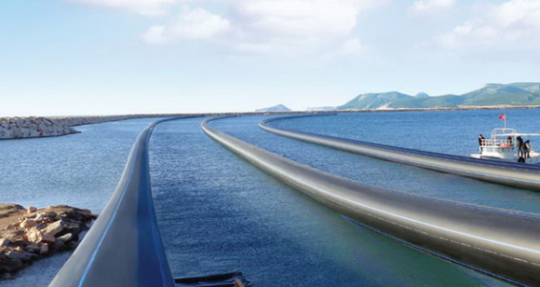
BRUA Project – latest development 2/2
termination of the horizontal directional drilling of the main pipeline Giurgiu-Ruse representing the Danube undercrossing point
project’s deadline is set for the 31st December 2016
in the 2016-2017 “gas year” tenders for booking capacity are expected to be held for the import and export of natural gas on the pipeline Giurgiu-Ruse

Slide 6
Two new transit pipelines – opening of capacity booking
Transit I pipeline - between Negru Voda I and Isaccea I
    opening for the first time after 20 years of Gazprom’s exclusivity
    a total of 169 GWh/day of annual unbundled firm and interruptible capacity offered in both directions at the Romanian/Bulgarian interconnection point
    this month, Transgaz organised the long awaited tenders for booking firm and interruptible capacity, annually or quarterly on the pipeline Transit 1
    this year, Transgaz signed two interconnection agreements with the neighbouring operators Bulgartransgaz and Uktransgaz for establishing the technical operational details corresponding to the interconnection points of the Transit 1 pipeline
    tariffs for firm and interruptible capacity: € 0.18/MWh/h (October 2016-september 2017) [tariffs cheaper than those charged by the Ukrainian gas transmission system operator : point Orklova - Isaccea 1: € 1.93/MWh/h]
Transit II pipeline - between Negru Voda II and Isaccea III
    freeing up capacity to third parties last year after 20 years of Gazprom’s exclusivity
    offers quarterly and monthly standard capacity products between 1 January 2016 and 1 October 2016

Slide 7
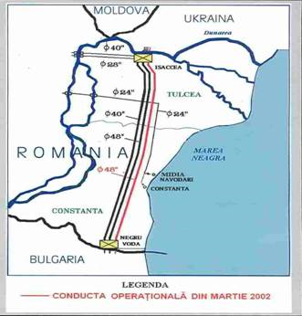

Slide 8
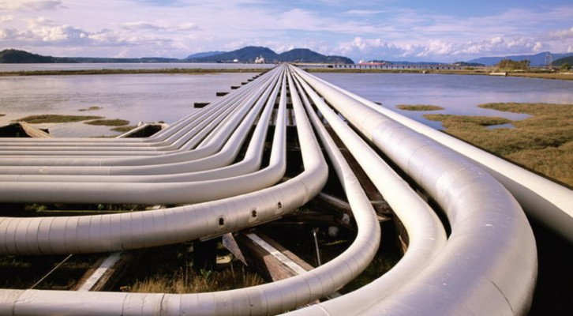
Two new transit pipelines – opening of capacity booking 2/2
Estimated annual profit of EUR 20 – 23 Million per transit pipeline
Pipelines booking capacity – 18 Billion cubic meters

Slide 9

Legislative changes 1/5
Law on the safety of oil offshore operations
  adopted on 28 June 2016 by the Romanian Parliament
  law transposing the Safety of Offshore Oil and Gas Operations Directive
  the first specific regulatory regime adopted for the offshore oil & gas operations in Romania
  aims to establish the minimum requirements necessary to prevent major oil related accidents and limit their consequences
  brings premiere definitions of offshore oil operations as activities related to the installation or the connected infrastructure, including their designing, planning, construction, operation and decommissioning, related to the oil exploration and exploitation, excluding the oil transportation from a coast to another

Slide 10
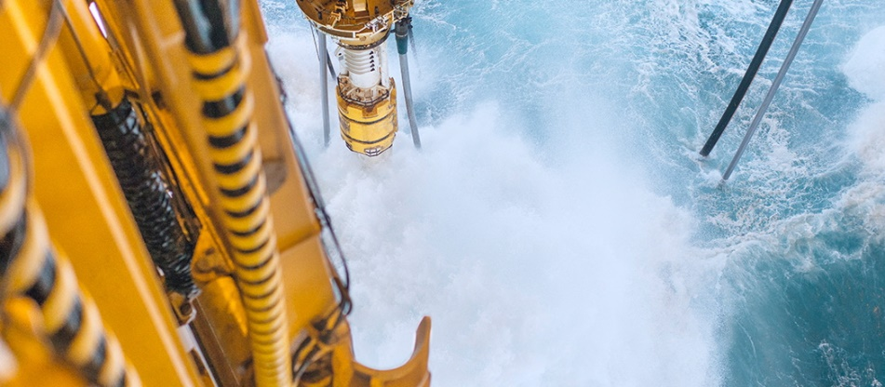
Legislative changes 2/5
Law on the safety of oil offshore operations
  provides mandatory conditions precedent to be met prior to entering into force of petroleum agreements: e.g. elaboration by the operators of internal plans for intervention in case of emergency
  establishes the financial liability of the titleholder in case of damage of the environment caused by the titleholder himself, the operator or by the entity acting in their behalf
  special tax regime for offshore petroleum agreements - “established by law with a view to promote investments“
  does not apply for the exploration works approved before 18 July 2013

Slide 11
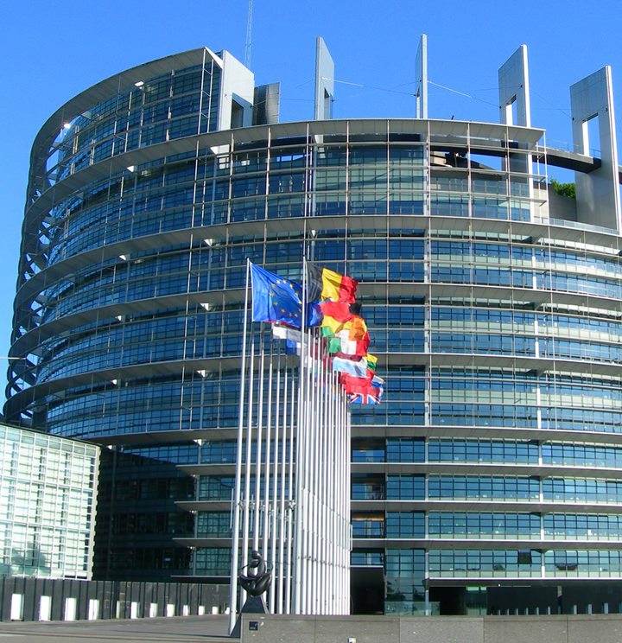
Legislative changes 3/5
Law on the safety of oil offshore operations
  creates a new regulatory authority - the Competent Regulatory Authority for the Black Sea Oil Offshore Operations
  a specialized body functioning under the Romanian Government, funded mainly from the state budget
  received important prerogatives which will influence the operations, their planning and financing
  may prohibit operations at any installation if the measures proposed by the titleholders/operators in their mandatory reports on potential damages or accident remediation are considered not to comply with the legal requirements
  in the case of noncompliance with the Offshore Law, the Competent Authority may demand upgrades of the installations and, if necessary, may even decide to cease the use of exploiting installations which are not considered safe for operations
  may also impose fines ranging from EUR 10,000 to EUR 55,000

Slide 12

Legislative changes 4/5
Petroleum Law – proposed amendments:
  Access to public land/beaches in order to facilitate pipelines construction

Slide 13
Legislative changes 5/5
  Petroleum Law – context:
  The biggest natural gas discovery from the latest years from the Black Sea
  The main challenges for the Romanian state are to ensure an efficient exploitation and development of the natural gas discoveries while supplying the operators a clear predictable legal framework to be able to bring their production to the market
  Romania’s further steps aim to create the framework in order to regulate the access to the sea bed and coastal areas (beaches) for ensuring the link between the offshore activity and the onshore one as well as to secure a stable taxation regime.

Slide 14


Thank you!
CMS Romania
Varinia Radu
Partner | Head of Oil & Gas in CEE
CMS Cameron McKenna SCA
varinia.radu@cms-cmck.com
Tel: +40 21 407 3870
Fax: +40 21 407 3900
www.cms-cmck.com

Slide 15


Your free online legal information service.
A subscription service for legal articles
on a variety of topics delivered by email.
^{www.cms-lawnow.com}
Your expert legal publications online.
In-depth international legal research
and insights that can be personalised.
^{eguides.cmslegal.com}
CMS Legal Services EEIG (CMS EEIG) is a European Economic Interest Grouping that coordinates an
organisation of independent law firms. CMS EEIG provides no client services. Such services are solely
provided by CMS EEIG’s member firms in their respective jurisdictions. CMS EEIG and each of its
member firms are separate and legally distinct entities, and no such entity has any authority to bind any other. CMS EEIG and each member firm are liable only for their own acts or omissions and not those of each other. The brand name “CMS” and the term “firm” are used to refer to some or all of the member firms or their offices.
CMS locations:
Aberdeen, Algiers, Amsterdam, Antwerp, Barcelona, Beijing, Belgrade, Berlin, Bratislava, Bristol, Brussels, Bucharest, Budapest, Casablanca, Cologne, Dubai, Duesseldorf, Edinburgh, Frankfurt, Geneva, Glasgow, Hamburg, Istanbul, Kyiv, Leipzig, Lisbon, Ljubljana, London, Luxembourg, Lyon, Madrid, Mexico City, Milan, Moscow, Munich, Muscat, Paris, Podgorica, Prague, Rio de Janeiro, Rome, Sarajevo, Seville, Shanghai, Sofia, Strasbourg, Stuttgart, Tirana, Utrecht, Vienna, Warsaw, Zagreb and Zurich.
www.cmslegal.com

