Slide 1


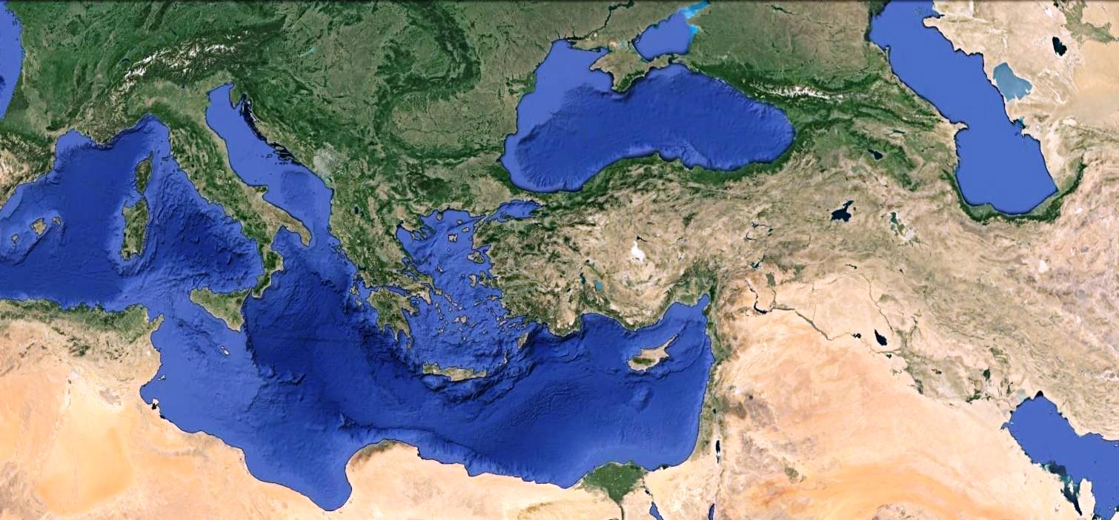
MINISTRY OF ENERGY, COMMERCE
INDUSTRY AND TOURISM OF THE REPUBLIC OF CYPRUS
“Hydrocarbons Exploration Activities Offshore Cyprus”
Sofia, 20 September 2016
H.E. Mr. Stavros Avgoustides
Ambassador of the Republic of Cyprus to Bulgaria

Slide 2

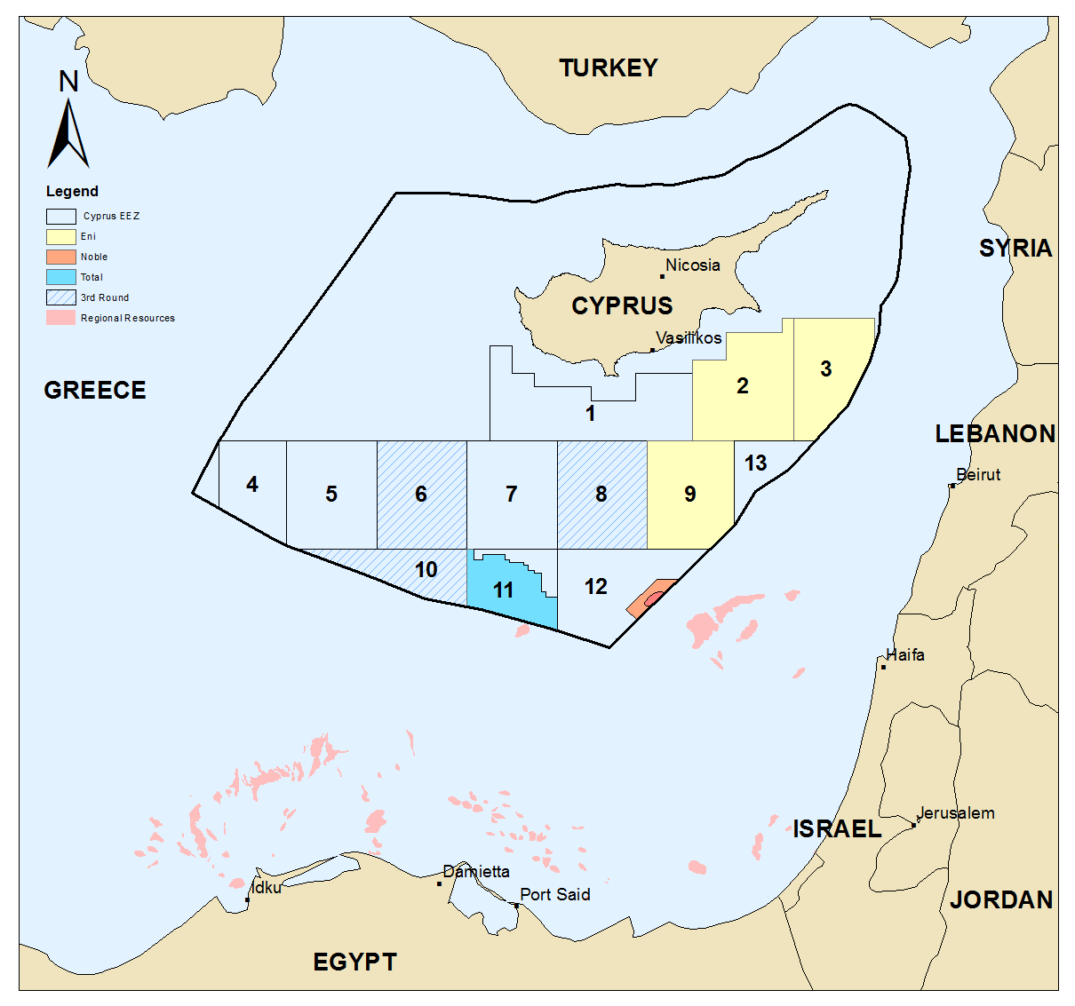














Eastern Mediterranean Hydrocarbons Activities

Slide 3
Major Gas Discoveries in the Eastern Mediterranean
Gas – field | Estimated reserves | Discovery date
Aphrodite – Cyprus | 4,45 tcf | 2011
Tamar – Israel | 10 tcf | 2009
Leviathan – Israel | 22 tcf | 2010
Zohr – Egypt | 30 tcf | 2015

Slide 4
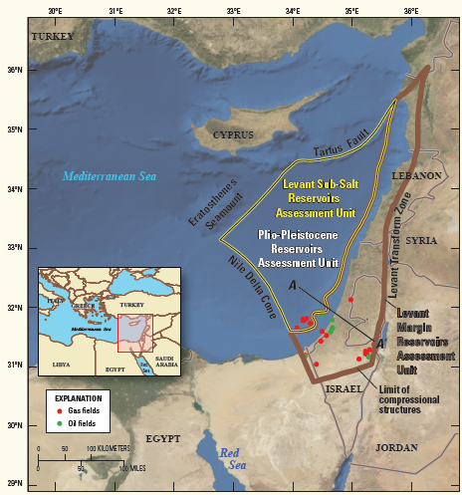
Potential undiscovered resources in Levant Basin
Oil: 1.689 Million Barrels
Gas: 122.378 Bilion Cubic Feet
Source: USGS Fact Sheet 2010-3014, March 2010
USGS: United States Geological Survey

Slide 5
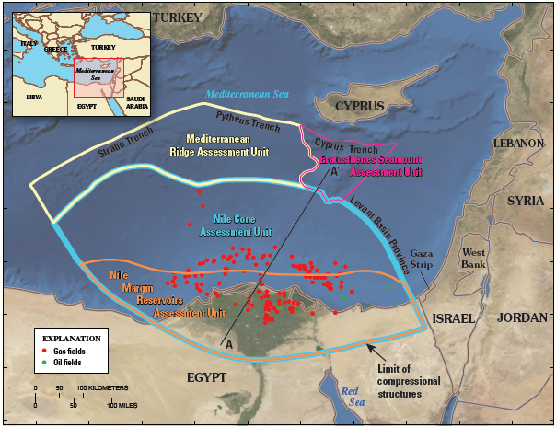
Potential undiscovered resources in Nile Delta Basin
Oil: 1.763 Million Barrels
Gas: 223.242 Bilion Cubic Feet
Source: USGS Fact Sheet 2010-3027, May 2010
USGS: United States Geological Survey

Slide 6
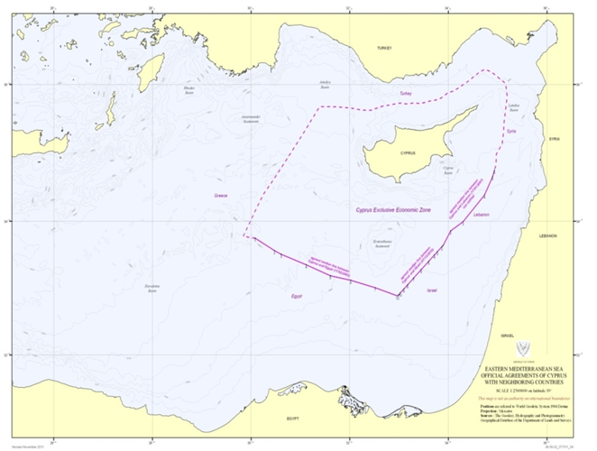
The Exclusive Economic Zone of the Republic of Cyprus
Arab Republic of Egypt
  Delimitation of the EEZ – 2003 (ratified)
  Framework Agreement concerning the development of cross-median line hydrocarbon resources – signed 12/12/2013
  Republic of Lebanon
  Delimitation of the EEZ – 2007
  Agreement concerning the joint development and exploitation of cross-median line hydrocarbon resources – under negotiation
  State of Israel
  Delimitation of the EEZ – 2010 (ratified)
  Agreement concerning the joint development and exploitation of cross-median line hydrocarbon resources – under negotiation

Slide 7
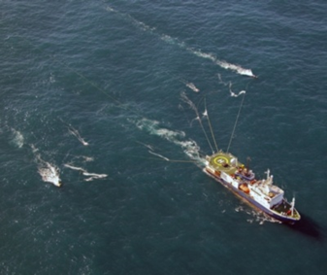
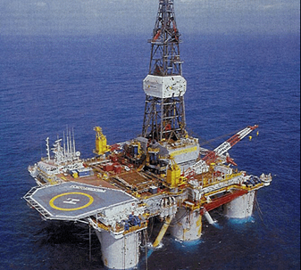
Legal & Regulatory Framework
Legislation
  The Hydrocarbons (Prospection, Exploration and Exploitation) Law L.4(I) of 2007 to 2015
  The Hydrocarbons (Prospection, Exploration and Exploitation) Regulations of 2007 and 2014
Model Agreement
  Exploration and Production Sharing Contract (EPSC)
Hydrocarbon Exploration License
  Granted for up to 3 years; possibility for 2 renewals of up to 2 years each
  Includes obligations for 2D/3D seismic surveys and exploration drilling
  On each renewal, 25% of the initial area is relinquished
  In case of a discovery, the licensee has the right to be granted an exploitation license after the approval of Development & Production Plan
Hydrocarbon Exploitation License
  Granted for an initial period of up to 25 years; ability for one renewal of 10 years

Slide 8
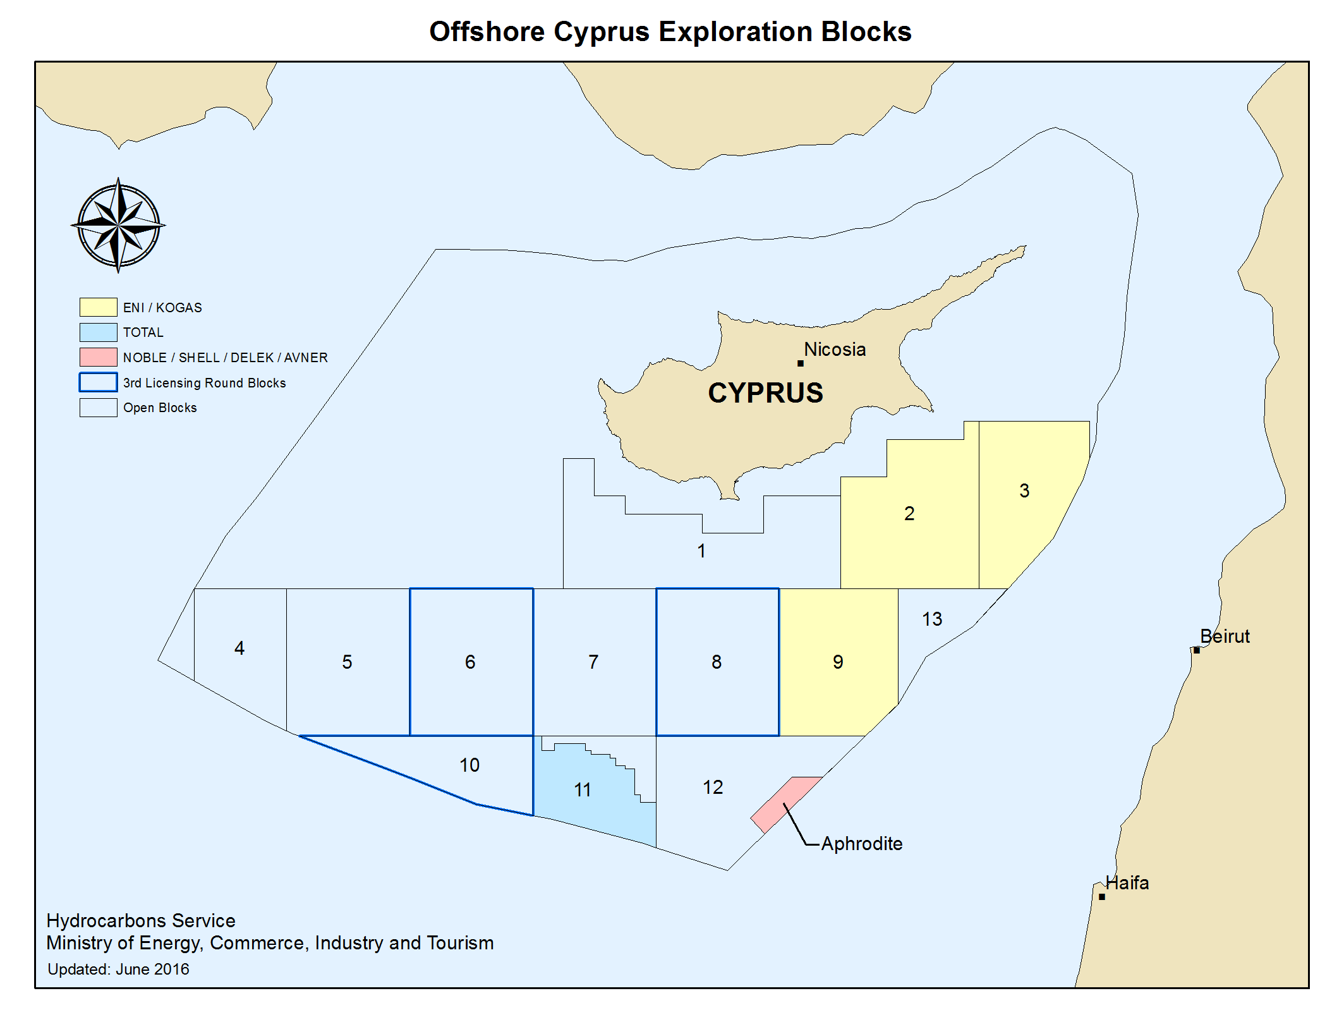
Exploration Licences – Current Status

Slide 9
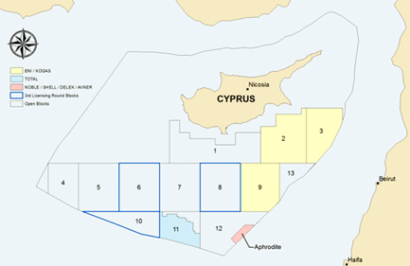
Hydrocarbons Exploration Licences Timeline
February 2013
Award of Hydrocarbon Exploration Licences to Total for Blocks 10 & 11
March 2016
Third Exploration Licensing Round
January 2013
Award of Hydrocarbon Exploration Licences to Eni/Kogas for Blocks 2, 3 & 9
October 2008
Award of Hydrocarbon Exploration Licence to Noble Energy International Ltd for Block 12
January 2016
BG (Shell) Participation in Block 12
February 2013
Delek and Avner Participation in Block 12
February 2012
Second Exploration Licensing Round
February 2007
First Exploration Licensing Round

Slide 10
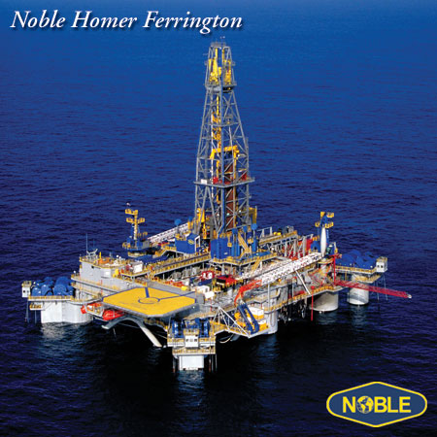
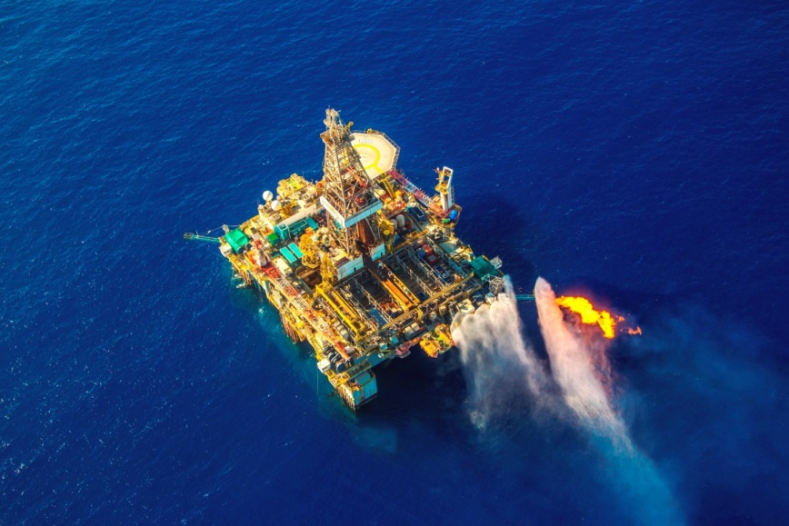
Block 12 – Discovery of Aphrodite Field
January 2016
35% BG (Shell) Participation
June 2015
Commerciality/
Development Plan Submission
September 2013
Drill Stem Test
June 2013
Appraisal Well
December 2011
Natural Gas Discovery
September 2011
First Exploration Well
October 2008
License to Noble Energy International

Slide 11
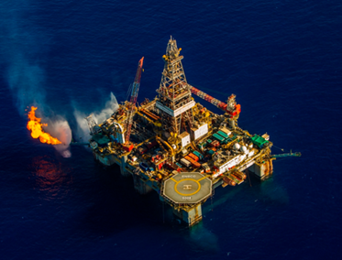
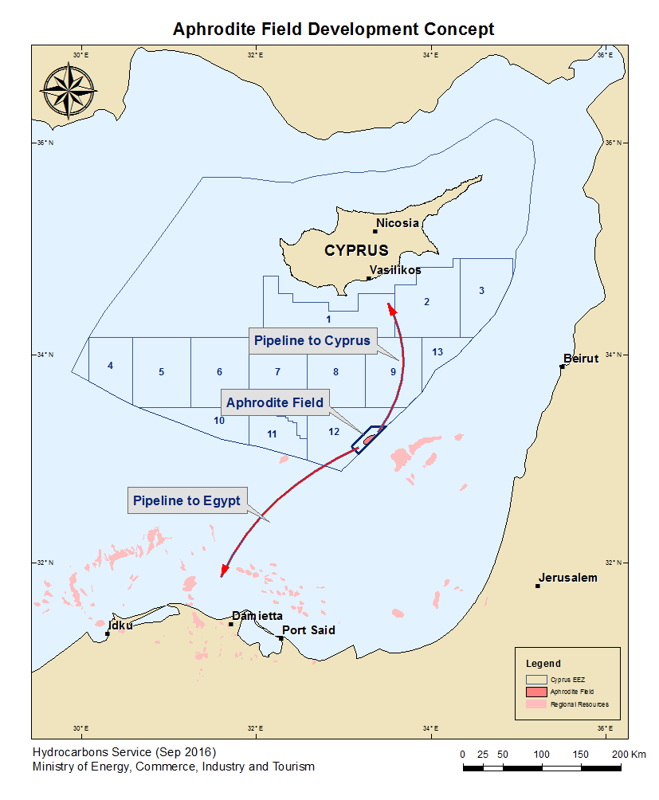
Aphrodite Field
  Aphrodite natural gas discovery current resource estimates are 4.45 Trillion cubic feet*
  High quality dry gas discovery
  Located 168 km of Cyprus shore
  Water depth of approximately 1,700 m
  Monetization concept: Connection of regional markets of Cyprus and Egypt with subsea gas pipelines
  Discussions with potential buyers are underway for Aphrodite gas
  Ongoing discussions on Field Development and Production Plan
*Based on best estimate of Contingent and Prospective Resources of 4.45 Tcf – NSAI Certified (Nov 2014)

Slide 12
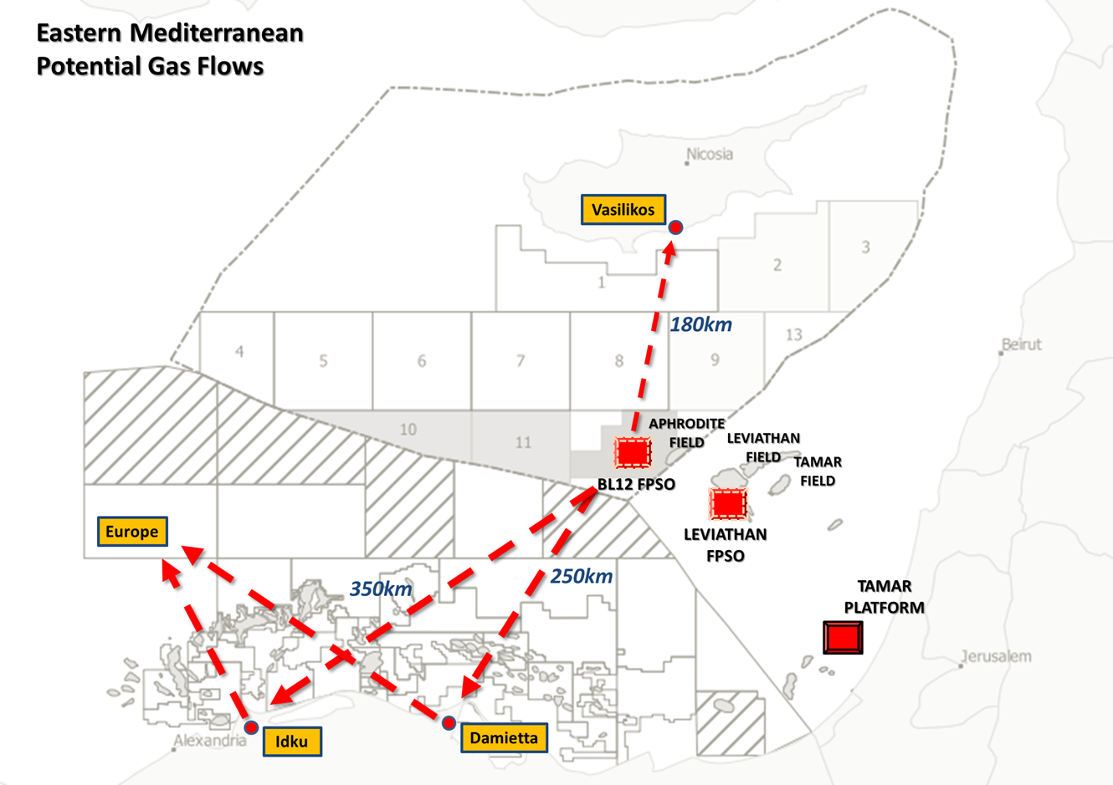
LNG
LNG

Slide 13

3rd Licensing Round
  Announced on 24 March 2016
  Exploration Blocks offered:
  - Blocks 6, 8 and 10
  By 22 July 2016, six (6) applications from a total of 8 companies were submitted to MECIT
  The evaluation process is ongoing and the award of new Licenses is expected to be completed by January 2017.
Block | Min Water Depth (m) | Max Water Depth (m) | Area (sq. km)
6 | 2,002 | 2,619 | 4,561
8 | 730 | 2,588 | 4,562
10 | 1,652 | 2,475 | 2,561

Slide 14
3rd Licensing Round - Applications
Block No | Company or Consortium
6 | Eni Cyprus Limited, Total E&P Cyprus B.V.
8 | Capricorn Oil (Cairn Energy), Delek Drilling, Avner Oil Exploration
 | Eni Cyprus Limited
10 | Eni Cyprus Limited, Total E&P Cyprus B.V.
 | ExxonMobil Exploration and Production Cyprus (Offshore) Limited, Qatar Petroleum International Upstream O.P.C.
 | Statoil Upsilon Netherlands B.V.

Slide 15

EastMed Pipeline Project
  Project promoter: IGI Poseidon S.A,
      Joint Venture DEPA S.A. and Edison S.p.A.
  Supporting parties: Cypriot, Greek, Italian and Israeli Governments
  PCI Southern Gas Corridor
  Design capacity: transport up to 16 Bcm/y (billion cubic meters of gas per year)
  Supply gas resources to EU from Levantine Basin (Cyprus and Israel) as well as from the potential resources in Greece.

Slide 16
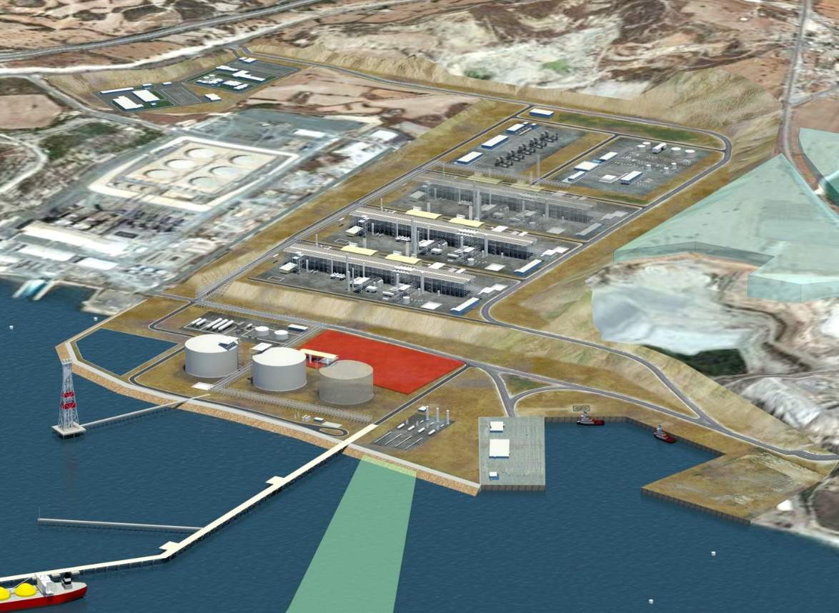
Cyprus Onshore LNG Export Plant
  Project currently on hold (not enough natural gas quantities)
  Allocated land in Vasilikos area for up to five trains of 5 MMTPA (Million Tonnes per Annum) each
  1st phase: 3 trains, 2nd Phase 2 trains
  Prepared a Master Plan for the Vasilikos area

Slide 17
Thank you for your attention

