Slide 1
The low carbon energy strategy and the challenges for the coal power generation in the future
Olivier Marquette
19 September 2016

Slide 2
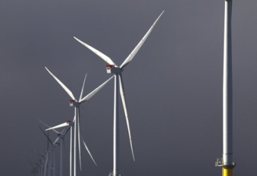
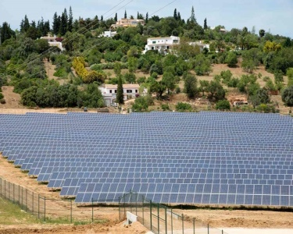
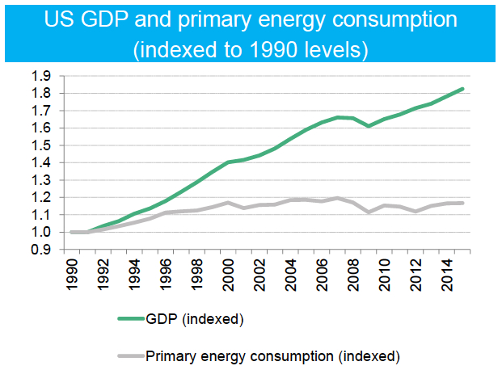
The electricity industry is experiencing rapid and unprecedented changes
UK power prices go negative as renewables boom distorts market
A surge in solar and wind farms has helped drive down UK energy prices so much that power stations have started paying for some of their electricity to be taken off their hands. On one sunny Sunday this month, May 8, when overall power demand was low and there was a glut of electricity, generators paid more than £30 a megawatt hour as prices briefly went negative.
Portugal runs for four days straight on renewable energy alone
Zero emissions milestone reached as country it powered by just wind, solar and hydro-generated…Electricity consumption in the country was fully covered by solar, wind and hydro power in an extraordinary 107-hour run that lasted from 6.45am on Saturday 7 May until 5.45pm the following Wednesday, the analysis says.
U.S. Economic Growth Decouples from Both Energy and Electricity Use
In a stunning trend with broad implications, the U.S. economy has grown significantly since 2007, while electricity consumption has been flat, and total energy demand actually dropped.

Slide 3
Different markets have different needs
Europe
Gas declines after 2027
Renewables become 70% of generation
Middle East
Gas declines to 33% of energy
Renewables are least-cost option after 2030
China
No new coal post-2020
Renewables growth
North America
Gas replaces Coal
Renewables cheaper than thermal
Africa
Access
S.E. Asia
Coal and gas consumption increases
Renewables growth
India
Coal and gas consumption increases
Renewables growth
Latin America
Diversity from Hydro and Oil

Slide 4
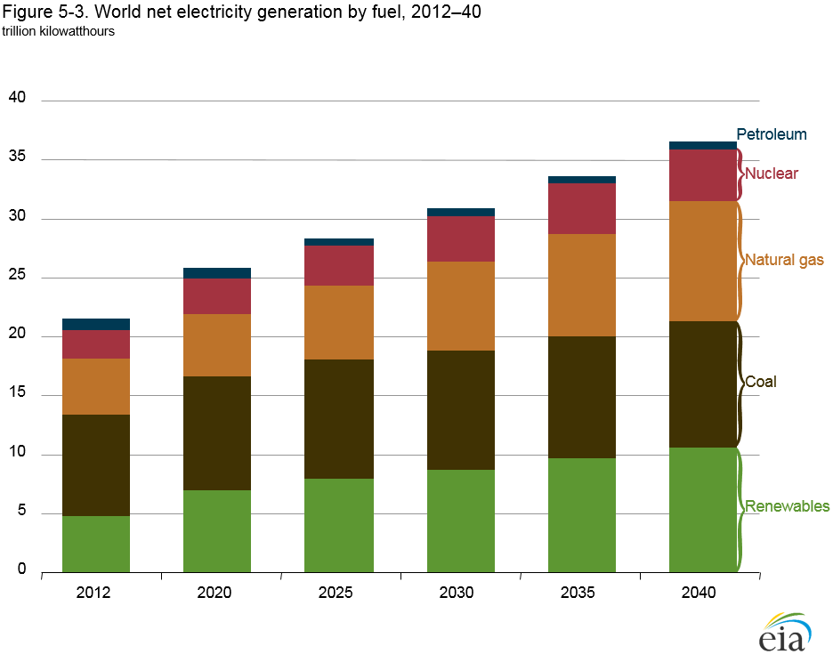
Coal generation will continue to play an important role in power generation …
Source : US Energy Information Administration

Slide 5
… Because it meets market needs
Dispatch flexibility – generate any energy between minimum and maximum load
Firm capacity – no dependence from ambient conditions
Energy independence – if local fuel (like lignite) is used
Diversity of the energy matrix
Affordability
Job creation

Slide 6
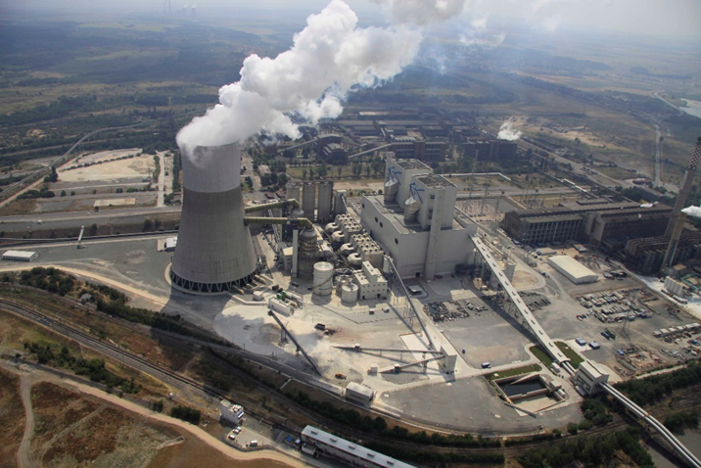
Coal generation needs to be developed in the most efficient, effective and responsible manner
In markets where fossil fuel generation is the right choice for development, we are working to ensure those resources are used in the most efficient, effective and responsible manner.
In Europe, we built and operate coal plants with the most up-to-date equipment which meets all national and European requirements for safety and environmental protection and also conforms to World Bank and European Union environmental standards, to ensure optimal air quality, water management and safe waste storage, soil and groundwater preservation.
Our state-of-the-art Maritza plant is one of the cleanest sources of coal generation in South-Eastern Europe.

Slide 7
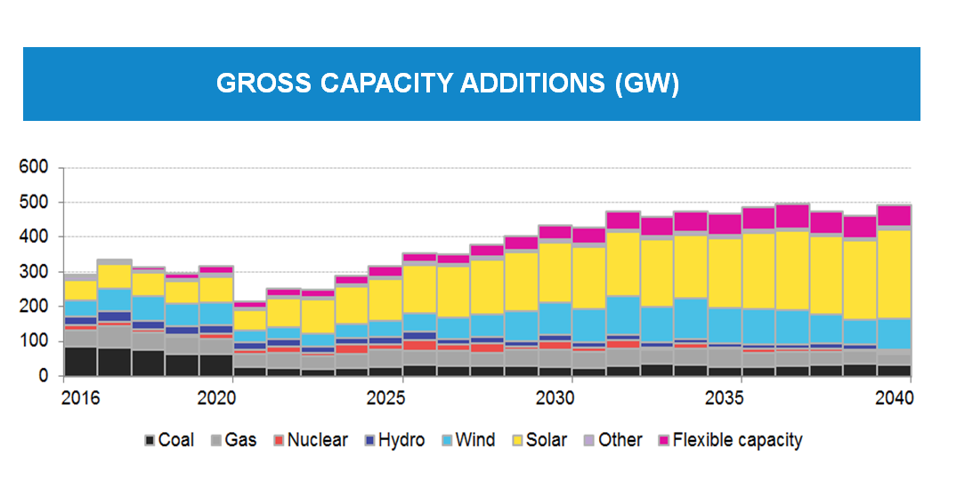
Renewable energy will make up the vast majority of new capacity addition …
Source : Bloomberg New Energy Finance

Slide 8
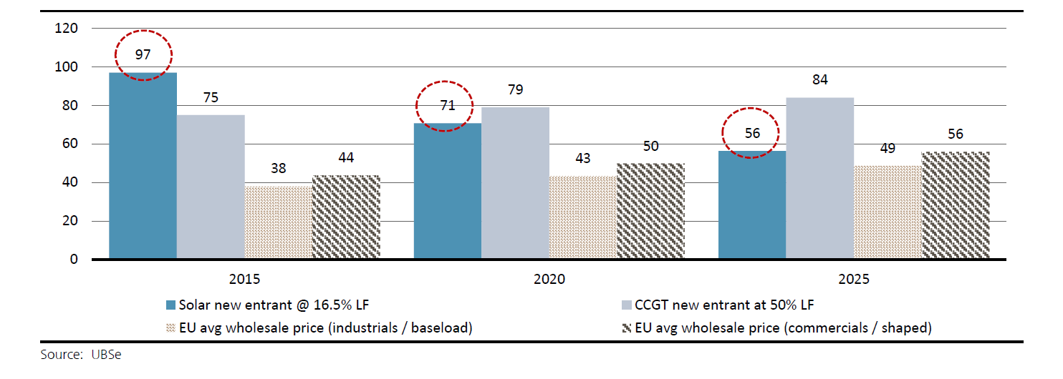
… Due to the substantial decrease in the cost of renewable energy
New entrant cost in EUR/MWh

Slide 9
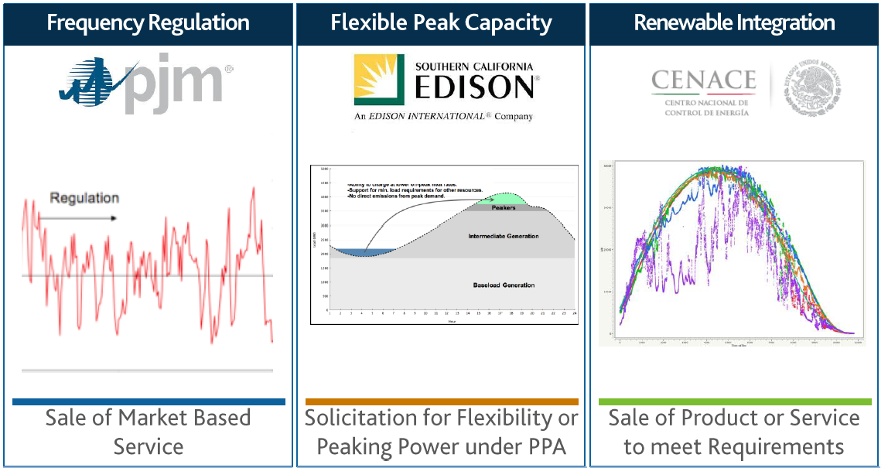
Energy storage will support the development of renewable energy
Source : AES

Slide 10
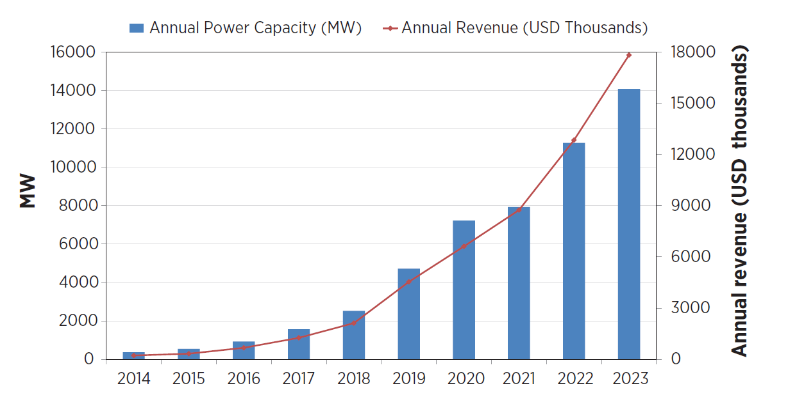
Energy storage is expected to grow exponentially in the next 10 years
Source : Navigant

Slide 11
AES operates the largest fleet of energy storage facilities in the world
Source : AES

Slide 12
AES is developing a wide range of energy solutions
Thermal power
Renewables
Energy Storage
Thermal power
Renewables
Energy Storage
Energy Storage
LNG Terminal and Combined Cycle power plant in the Dominican Republic
Solar in Chile
Energy Storage in the Netherlands

Slide 13
Thank you for the attention!
Questions?

