Slide 1
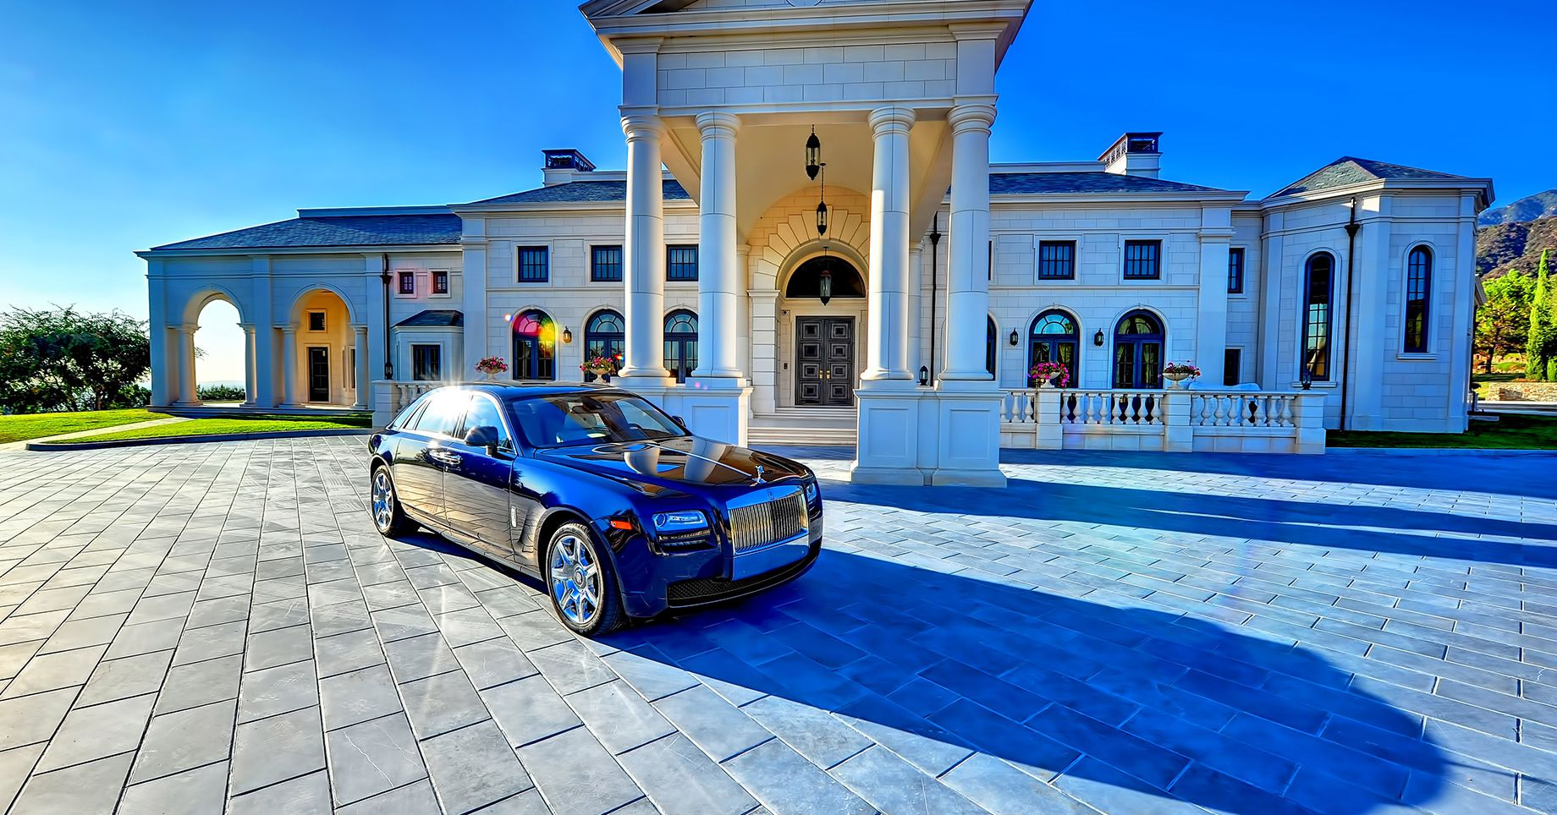
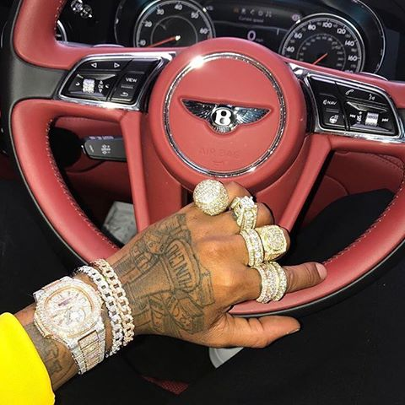
Luxury
Notes:
Images copyrighted to:
http://www.youthincmag.com/lap-of-luxury
http://www.pictame.com/user/the.success.chasers/2324545177

Slide 2
Luxury
Inessential
supplemental
Expensive
=
Dispensable

Slide 3
Cyber Security is No Longer a Luxury

Slide 4
Lyubomir ivanov
Software Engineer @ Paysafe
Technical Trainer
Security Enthusiast

Slide 5
Agenda
Recent Cyber Security Issues
Cyber Security Trends and Threats in Industrial Control Systems
Rules of Thumb

Slide 6
What happened recently?

Slide 7
Denial of Service attacks

Slide 8
GITHUB
Publicly available third party servers used to conduct the attack
In fact you can find 58486 on the link below
https://github.com/SecOps-Institute/memcached-server-iplist/blob/master/memcached-servers.txt

Slide 9
Dyn
Botnet of IoT devices (CCTV cameras, baby phones, toasters, fridges, etc.)
Disrupted major world-wide services such as:
Twitter
Amazon
PayPal
Netflix

Slide 10
Viruses/worms

Slide 11
Wannacry
Ransomware
Not too successful but very popular
Affects outdated Windows machines

Slide 12
Notpetya
Ransomware
Not too successful in terms of profit
Very successful in terms of chaos created
Affects outdated Windows machines
Blocked Chernobyl powerplant, Ukraine’s metro, ministries and banks

Slide 13
Data breaches

Slide 14
Equifax
143 million Social Security Numbers leaked
CFO tried to cover up the story and sell shares before acknowledging publicly

Slide 15
Macron’s and Clinton’s campaigns
Private email communication leaked

Slide 16
Data misuse

Slide 17
Facebook
87 million users enhanced profile information shared without consent
Used for targeted advertisement for election campaign
Arguably turned the tides in the US election

Slide 18
Hardware vulnerabilities

Slide 19
SPECTER & MELTDOWN
Allows for a program to read another program’s operational data on the same physical host
Passwords, encryption keys and other sensitive data can be stolen

Slide 20
Cyber Security
is a Necessity

Slide 21
Cyber Security – main goals
Confidentiality
Integrity
Availability
→ Information is only available to authorized parties
→ Accuracy and completeness of the data and its metadata
→ A system must provide services whenever requested and only to authorized parties
Non-repudiation
→ No party in a transaction can deny its involvement

Slide 22
Cyber Security in Industrial Control Systems (ICS)

Slide 23
ICS - software trends
Mobility
Remote access
Code modernization
Authentication alternatives

Slide 24
ICS – trendy software pitfalls
Weak authorization
No cryptography
Bad cryptography
Infected or vulnerable software hosts
No fallback policies
especially about availability
34 SCADA mobile applications
→ 147 vulnerabilities
94% code tampering
59% insecure authorization
53% reverse engineering
47% insecure data storage
38% insecure communication
Notes:
Research by IOActive and Embedi revealed 147 vulnerabilities in 34 randomly selected SCADA mobile applications. The top five security weaknesses are:
code tampering (94% of apps),
insecure authorization (59% of apps),
reverse engineering (53% of apps),
insecure data storage (47% of apps)
insecure communication (38% of apps).
Source: https://www.helpnetsecurity.com/2018/01/11/security-vulnerabilities-ics-mobile-applications/

Slide 25
Availability
Reliability
issuing a command will lead to its execution or an error report
Idempotence
unintentional duplication of a command should bring the system to a state as if the duplication hasn’t happened
Redundancy
a faulty system component output should be detected and replaced by a running correct one
Fault tolerance
a fail of a number of system components should cause no impact on the core functionality
Resilience
the system should be able to resist a faulty command or a flood of commands
Notes:
Redundancy (mostly the N-version programming paradigm)

Slide 26
Cyber Security – how to do it ?

Slide 27
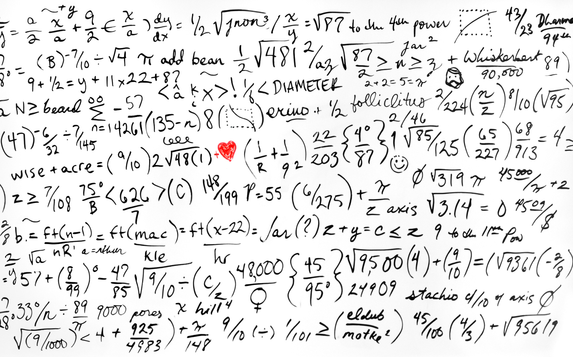

Slide 28
No formula to success

Slide 29
Some good points …
Hire security experts (!)
Cyber security is not only about software
Least privilege principle
What-if analysis
Don’t do your cryptography
N-version programming

Slide 30
Cyber Security is No Longer a Luxury
Thank you!

