Slide 1
EDUCATION, MANPOWER AND NATIONAL SECURITY
The International Conference
Energy Security of South East Europe and the National Security
Prof. Dr. Dimitar Dimitrov,
UNIVERSITY OF NATIONAL AND WORLD ECONOMY,
Sofia, Bulgaria
E-mail: dimdim@unwe.bg
Sofia, Bulgaria, 15 June 2018

Slide 2
Prof. Dr. Dimitar Dimitrov
Dean of Faculty 'Economics of Infrastructure'
Head of Department 'National and Regional Security'
Director of Nuclear Security Support Center
www.e-dnrs.org
Programme Leader of International Master Programme in Nuclear Security
http://www.unwe.bg/nuclear-security/en

Slide 3
My University www.unwe.bg

Slide 4
UNWE – est. 1920
20 000 students
8 Faculties
500 full time teaching staff
1000 part time teaching staff
Economics, Sociology, Political science, Law, Journalism, Management and administration

Slide 5
The department (est.1990) www.e-dnrs.org
10 full time teaching staff
30 part time
60 Bachelor students per year
100 Master students per year
18 PhD students currently
Specialty ‘Security and Defense Economics’

Slide 6
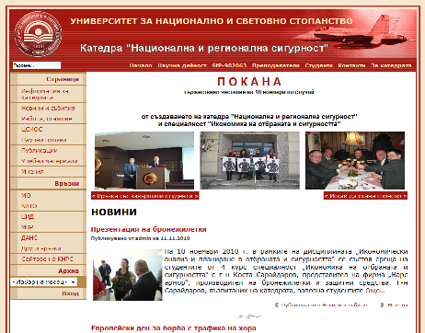
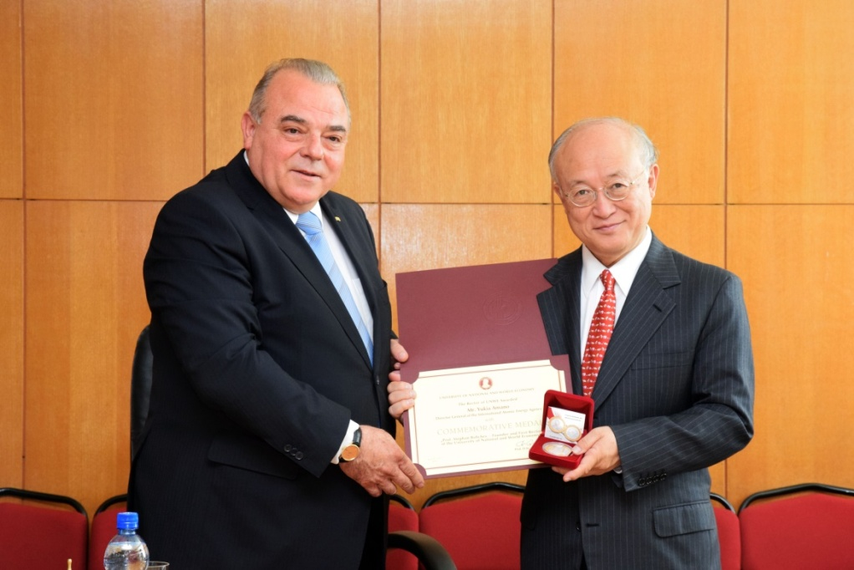
The department www.e-dnrs.org

Slide 7
Nuclear workforce
The nuclear industry is characterized by a requirement for high overall skill levels and a high degree of safety.

Slide 8
Nuclear expansion (?)
Climate changes
CO2 emissions
Decarbonized economy
Electric cars
Growing demand for energy

Slide 9
Issues for concern
By 2021 the UK’s nuclear industry will require a workforce of over 100,000 according to the annual 2017 Nuclear Workforce Assessment
Nuclear Skills Strategy Group’s (NSSG)

Slide 11
Issues for concern
Aging and Retirement of nuclear personnel

Slide 12
Categorization of the competencies necessary to run a nuclear power plant
• “nuclear” people with a specialized formal education in nuclear subjects (e.g. nuclear engineering, radiochemistry, radiological protection, etc.);
• “nuclearized” people with formal education and training in a relevant (non-nuclear) area (e.g. mechanical, electrical, civil engineering, systems) • “nuclear-aware” people requiring nuclear awareness to work in the industry (e.g. electricians, mechanics, and other crafts and support personnel) + NUCLEAR SECURITY

Slide 13
Nuclear professionals
Education in nuclear engineering and/or nuclear physics,
Provided by higher education institutions through bachelor’s or master’s programmes.
In addition, depending on the role, training on simulators (e.g. for reactor operators) and other forms of specific on-the-job training

Slide 14
Education and training – long process
Training on simulators (e.g. for reactor operators) needs at last 2 years
To sum up – fully licensed operator needs
10 years to take this position (bachelor, master, searching for work, training)

Slide 15
Risk of human resource shortages in some countries
Example - Romania

Slide 16
Complex system
Energy security
Safety
Security
Safeguards
Non- proliferation

Slide 17
Need of Nuclear security education
Permanent loss of qualified staff
Technology and procedures are developing very quickly
Therefore, there is a rapidly growing need for highly qualified nuclear security experts at the national level

Slide 18
IAEA efforts in NS education
Issue is recognized in several Nuclear Security Plans
Harmonization of efforts with other stakeholders
During 2002–2012 more than 13 800 persons in some 120 States
Varied audience, ranging from nuclear regulators, facility operators, carriers, customs officers, police and border forces to instructors and research institutions

Slide 19
Master in Nuclear Security
In 2010, with the assistance of the IAEA, the Academic Network on Nuclear Security INSEN was established
130 educational institutions from around the world
Guidance document NSS 12

Slide 20
Pilot project Master in NS
Consortium of 6 universities,
Led by Technical University of Delft, The Netherlands
Support of the IAEA and an ERASMUS grant
European Master of Science in Nuclear Security

Slide 21
Bulgarian timeline in Nuclear Security
April 2014 - INSEN membership
July 2014 – Mr. Amano visit in Bulgaria
November 2015-START of the PROGRAMME

Slide 22
Agreement UNWE – IAEA July 2014

Slide 23
Master programme opening

Slide 24
Master programme on Nuclear Security
- International, in English
In cooperation
Fully based on IAEA NSS 12
22 disciplines
40 lecturers
Among the few in the world

Slide 25
Nuclear Security Master Program’s website
http://www.unwe.bg/nuclear-security/en

Slide 27
We are in Facebook
https://www.facebook.com/nusecUNWE/?ref=aymt_homepage_panel
Google classroom (online materials and communication)

Slide 28
Our teaching consortium - 1
University of National and World Economy- Sofia
Sofia University
Technical University – Sofia
Bulgarian Academy of Sciences, incl.

Slide 29
Our teaching consortium - 2
Institute for Metal Science
Institute for Nuclear Research and Nuclear Energy
Bulgarian Nuclear Regulator
Bulgarian Nuclear Power Plant ‘Kozloduy’
Nuclear business and associations

Slide 30
Our teaching consortium - 3
MIIS at Monterey, California
King’s College London
Lecturers provided by IAEA (Greece, Romania, France, Belgium) , practitioners, visits

Slide 31
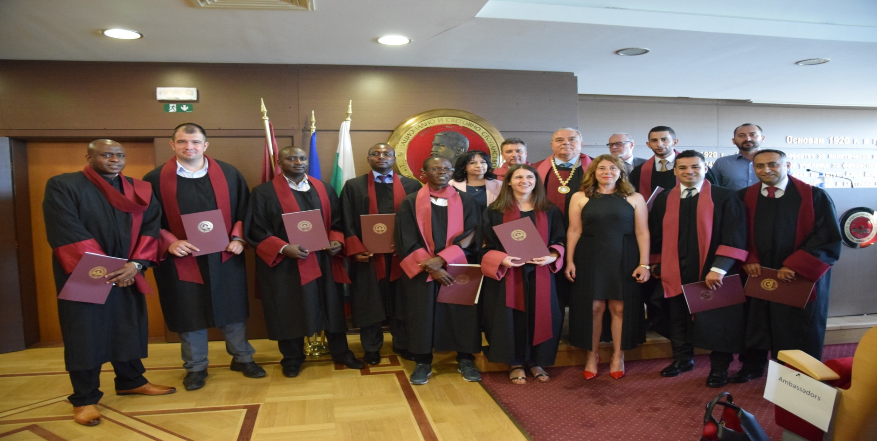
Graduation of the first group 10 students from Lebanon, Jordan, Nigeria, Burkina Faso, Zambia, Bulgaria June 2017

Slide 34
IAEA and INSEN assistance
Lecturers
Training
Teaching materials
Fellowships

Slide 35
UNWE – system integrator
Bulgaria
– cost-efficient place

Slide 36
Visits to NPP Kozloduy, Airports, Border checkpoints, waste disposal facilities, part of our Master programme in Nuclear Security

Slide 37
Second group – New Admission Cycle of the Master's programme in Nuclear Security 2016-2018
17 foreign applicants,
6 succesfully supported by IAEA,
From Sudan, Burkina Faso, DR Congo, Jordan, Mauritania, Uganda

Slide 38
Third group
Students from RSA, Iran, Yemen, Jordan, Bulgaria
Also current Master Programme was mentioned several times in Nuclear Security Reports by the Director General

Slide 39
New admission 2018
Start – June 15, 2018
Follow us:
http://www.unwe.bg/nuclear-security/en
nusec@unwe.bg

Slide 40
New graduation ceremony
4th of July 2018

Slide 42
Problems
Nuclear Security is a Public Good
Nuclear Security is an International Public Good

Slide 43
Unique educational model
Based on interaction between:
international organization (IAEA);
teaching consortium (almost 10 Universities and institutes);
government institutions and business;
national governments (for their nominations and career development).

Slide 44
Success factors of the Programme
well-structured curriculum
the role of IAEA and INSEN as very important facilitating platform for education
legitimacy of the Programme provided mainly by IAEA and involvement of national governments

Slide 45
Problems and perspectives -1
Forthcoming revision of NSS 12
From 4 semesters to 3 semesters
The existing unique educational model should be preserved
Inclusion of new stakeholders – EU for example

Slide 46
Problems and perspectives -1
Smart approach to the Programme
Implementation of project management
INSEN efforts in developing Teaching Materials, Learning Techniques, Case Studies, On-line materials
Training of Trainers (young lecturers) and Internships for students

Slide 47
Implication for the business
Business contacts
Involvement of practitioners
Selection of candidates
Demonstration of equipment, capacity, knowledge
Support for Bulgarian students

Slide 48
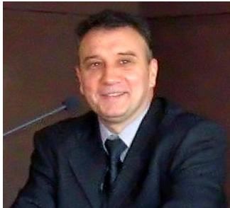
Thank you for your attention!
dimdim@unwe.bg
ddimitrov@e-dnrs.org

