Slide 1

BALKAN GAS HUB EAD
Supporting gas balance while enabling trading

Slide 2
Founding of Balkan Gas Hub EAD – The exchange operator
Balkan Gas Hub EAD
Registered in January 2019 in order to create gas exchange with OTC segment
100% of the capital (500 000 BGN) belongs to Bulgartransgaz EAD, Bulgarian TSO and SSO
Management system - Board of directors (3 members)
Shares of the company can be offered to other legal entities, Wholesales traders/producers, project companies, TSOs, Exchanges and other market participants, with Bulgartransgaz holding the majority of shares.

Slide 3

Balkan Gas Hub EAD - Mission and Vision
Our Mission is to build and operate Electronic platform with segment for bilateral trade which will offer modern physical and financial products & services at the Bulgarian VTP.
Our Vision is fully developed in the context of EU objectives for building a well interconnected and single European gas market and supporting gas infrastructure development plans across Europe. The trading platform of Balkan Gas Hub EAD aims Bulgaria to successfully become the center of liquid physical and commercial gas hub in the region of Southeastern Europe.

Slide 4

Balkan Gas Hub EAD - Strategic Objectives
In connection with its long-term development plans, "Balkan Gas Hub" EAD formulates and acts in pursuance of the following strategic objectives:
• Increasing the transparency and liquidity of the gas market;
• Creating a reliable, stable and unified regional gas market capable of meeting the needs of traders, customers and consumers;
• Creating additional opportunities for diversification of Central and Eastern Europe gas supply and supporting better energy security.

Slide 5
Balkan Gas Hub EAD - Operational Objectives
Ensure a regional exchange platform for trading in natural gas under conditions of competition, transparency and non-discrimination;
Provide environment that will ensure competitive prices for users and traders;
Provide conditions for trading with standardized products with minimized risks for the parties involved;
Ensure transactions transparency and non-discriminatory access to the electronic platform for all market participants.
.

Slide 6
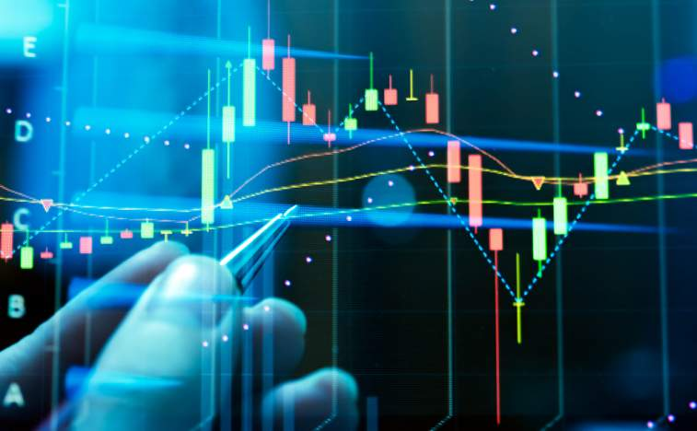
Balkan Gas Hub platform – under construction
  Main features :
  Online based platform;
  English language;
  Anonymous 24/7 trading
  Bilateral trading between market participants
Tradeable products:
  Next hour;
  Within-Day;
  Day Ahead;
  Weekend;
  Individual Day;
  Holiday.

Slide 7

Marginal prices & Imbalances charges
In accordance with art. 22 Reg. 312/2014 the marginal sell price, the marginal buy price and the weighted average price resulting from the STSP-trades on the platform are used for the daily imbalances charges

Slide 8
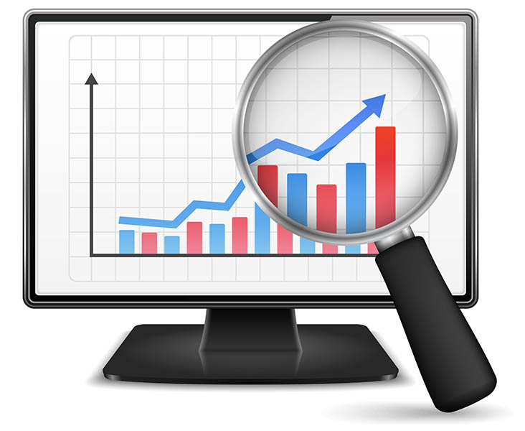
Monitoring and Reporting
The platform should report all transactions to ACER and immediately notify the Bulgarian NRA of any transaction for which there are reasonable grounds to suspect that it violates Art. 3 and Art. 5 of Regulation 1227/2011 (REMIT)

Slide 9
Conclusions
Redounds the process of trading for both sellers and buyers;
Provides trade participants with transparent and equal access to information, trading rules and conditions;
Ensures quick transactions, transparency of negotiated price and customers’ equal opportunities
Enables transparent marginal price formation and as a result market based imbalances charges;
Provides price signals and opportunity to use the indices and the reference price as a pricing element of gas in bilateral trade/contracts.

Slide 10

THANK YOU FOR YOUR ATTENTION

