Slide 1

Cost-competitive renewable energy potential in the South East Europe region
Marcin Scigan – Regional Programme Officer, South East Europe, IRENA
Sofia – 17 May 2019
8th Regional Energy Conference: Today’s Agenda of The Regional Energy Development – Priorities, Technologies, Markets

Slide 2
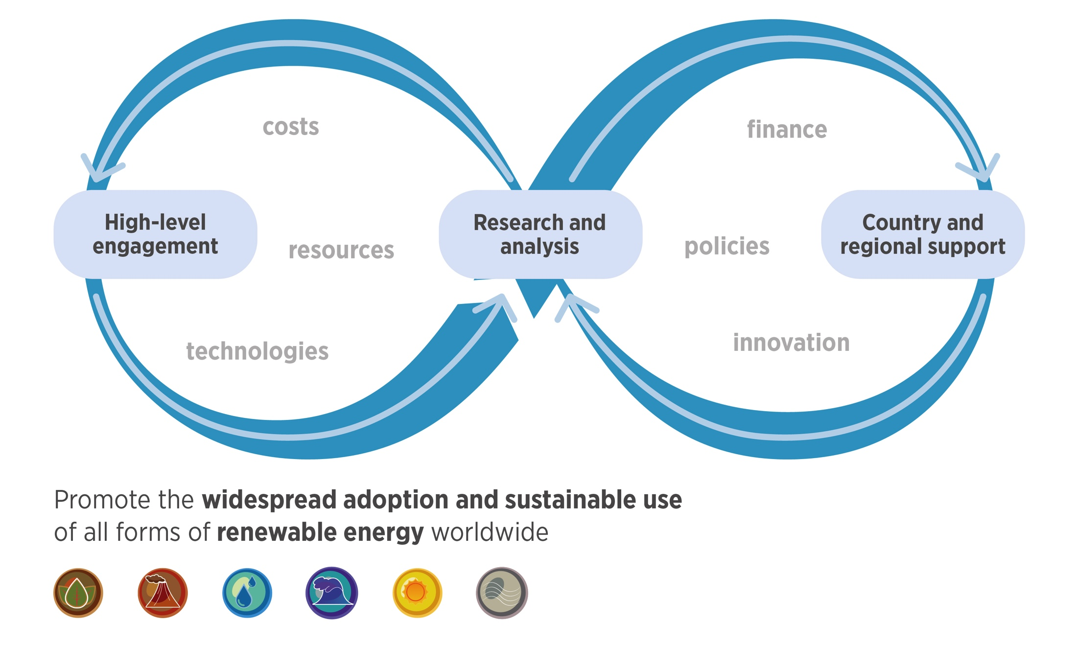
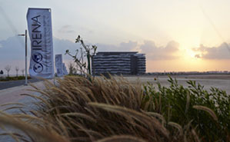
About IRENA
Established in 2011.
Headquartered in
Abu Dhabi, UAE.
160 Members and
23 States in accession.

Slide 3
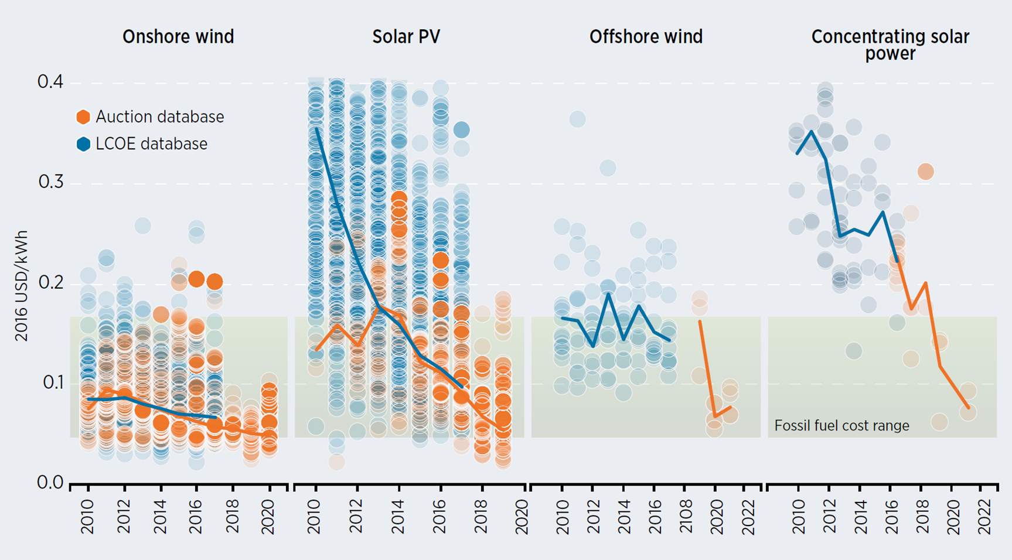



Global Levelised Cost of Electricity
LCOE reduction in the period
2010 - 2018
77%
Solar
PV
30%
Onshore Wind
Notes:
As you can see the cost reductions are impressive.
Our analysis shows that the cost of utility-scale solar PV electricity has fallen by 73% since 2010, and record low prices in Chile, Mexico, Peru, and the UAE have made 3 cents/kWh the new benchmark.
Onshore wind projects are now routinely commissioned at 4 cents/kWh, with the global average of 6 cents/kWh.
Several price records were set on Auctions during 2016: in Chile and the United Arab Emirates for solar PV, in Morocco for onshore wind, and in Denmark for offshore wind.
More importantly, there is still very large potential for further cost improvements. IRENA estimates that the generation costs with solar PV could be reduced an additional 54% from 2015 to 2025.

Slide 4
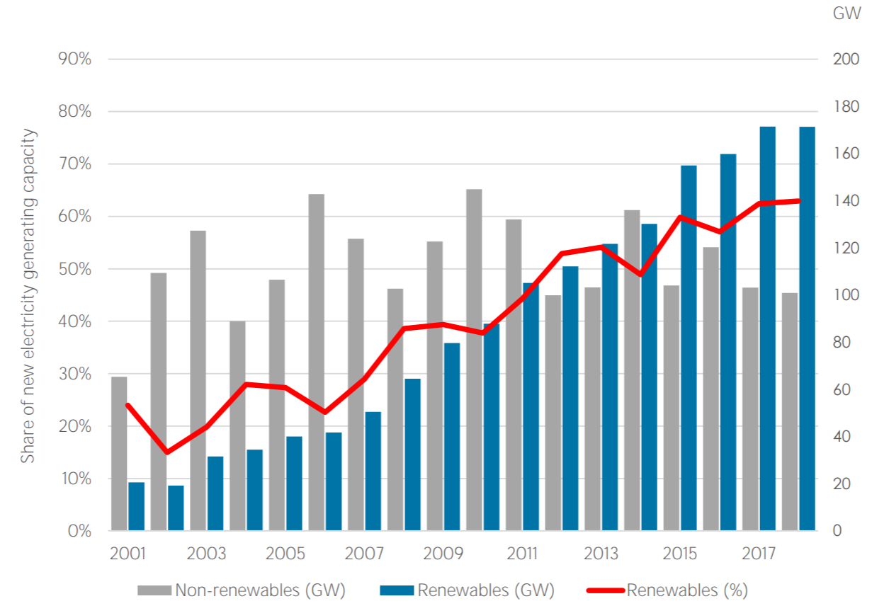

Global power capacity additions
RE power capacity additions constantly exceed conventional power
7.9%
171 GW
Increase in global renewable generation capacity in 2018
63%
Share of renewables in net capacity expansion in 2018
2018
Notes:
Renewables accounted for approximately 70 % of net additions to global power capacity in 2017 (European Environment Agency)
With close to 15% of VRE share in annual electricity generation today, the EU has the highest levels of variable renewables in power systems globally (IRENA, Innovation report 2019)
Renewables overtook coal as Germany’s main source of energy for the first time last year, accounting for just over 40% of electricity production (Reuters, 2019)
Spain is also planning to source 70% of electricity from renewables by 2030, and 100 % by 2050. In 2017 Spain got roughly a third of its power from renewable sources such as sunlight, wind, rain, tides, waves, and geothermal heat. (Independent)
Iceland is the only country in the world which obtains 100% of its electricity and heat from renewable sources. 87% of its electricity comes from hydro-power, and the remaining 13% from geothermal power. Oil-powered fossil fuel power stations are only used as backups to the renewable sources.
Almost 100% of Iceland’s space heating and water heating is obtained from geothermal sources.
2018 Global Capacity Additions:
Solar PV: 109 GW (source: Bloomberg New Energy Finance)
Wind: 51.3 GW (source: Global Wind Energy Council)

Slide 5
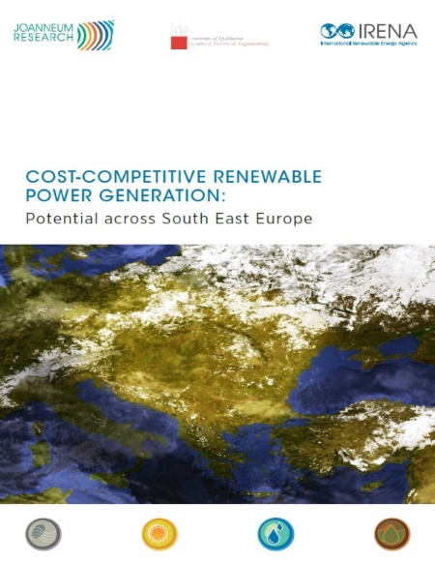
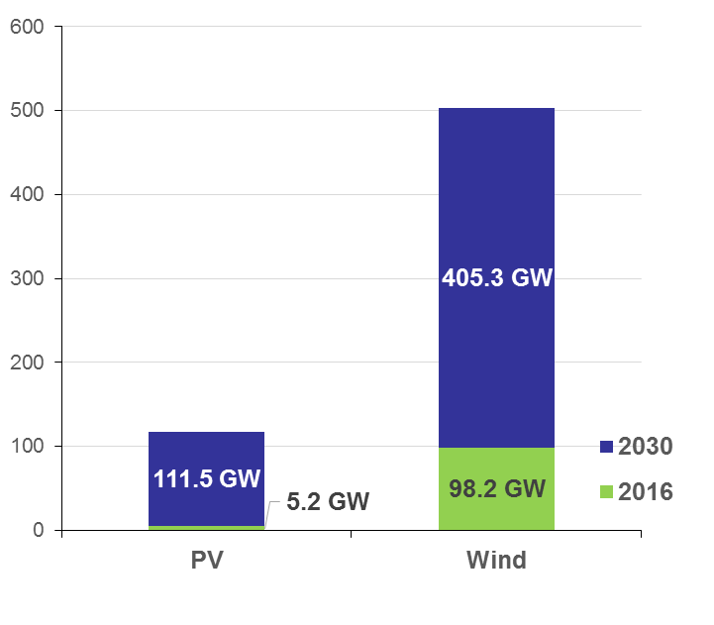
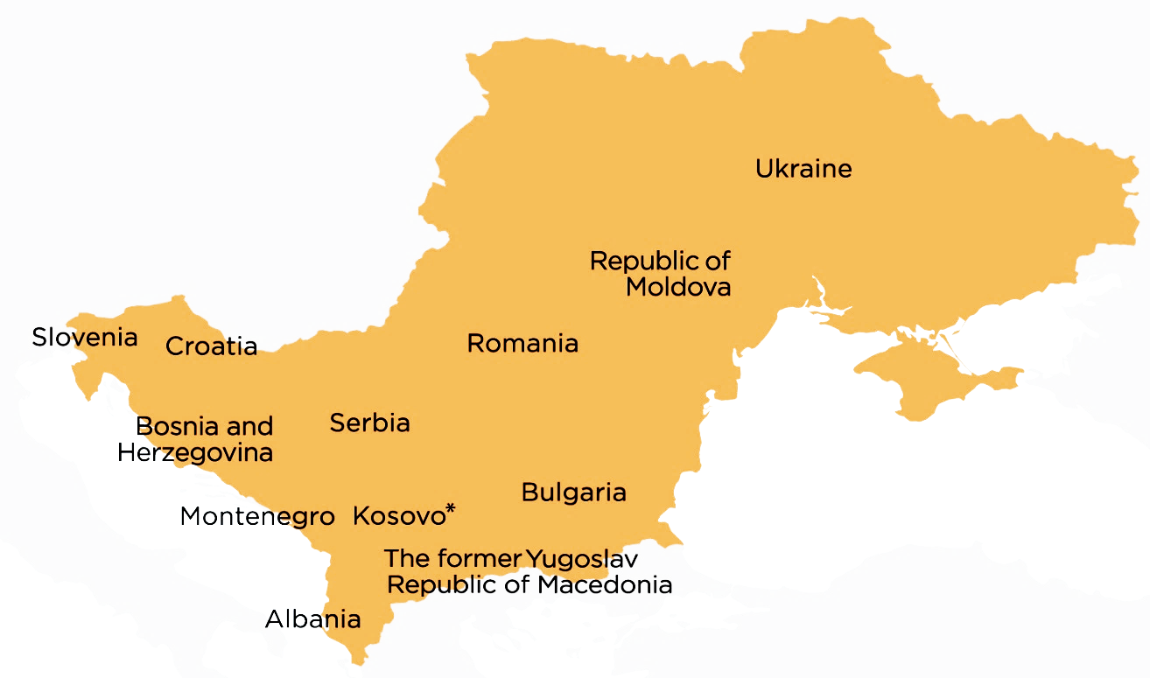
Cost-competitive Solar PV and Onshore Wind Power Potential in South East Europe
127 GW
of RE could be implemented in a cost-competitive way today
620 GW
Wind and Solar PV
cost-competitive potential by 2030

Slide 6
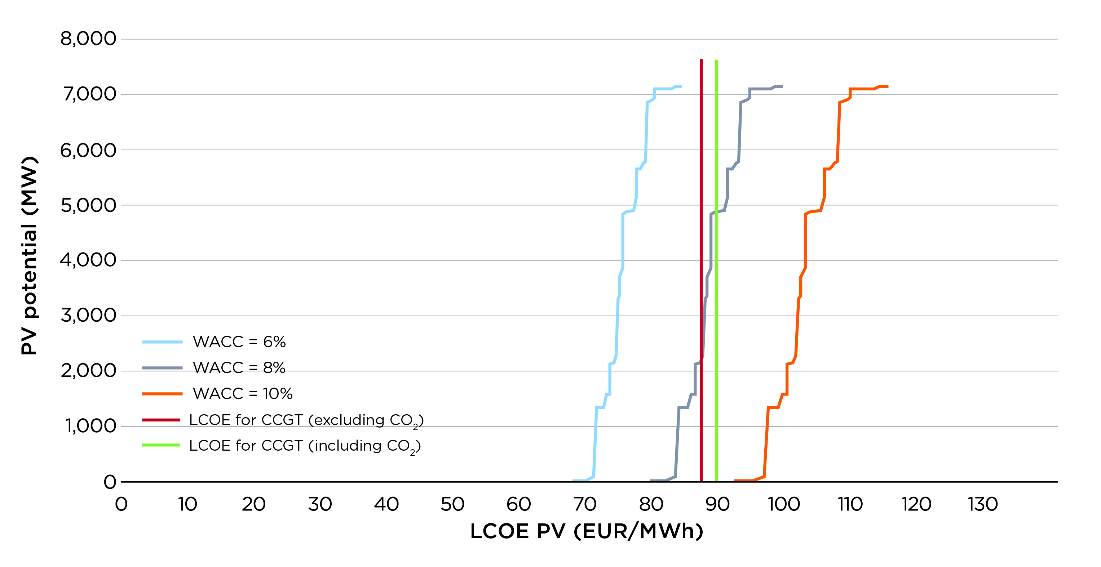
Bulgaria: Up to 6 GW of additional cost-competitive solar PV potential
Notes:
WACC
In the SEE region, investments are considered more costly than in other, EU member countries. Increase of WACCs in the SEE region, compared to other countries, comes from the risk factor, which is considerably higher.
In Ukraine, the WACC was set within the 14-18% range. High rate was set due to economic recession in that period. After a major economic recession, Ukraine’s economy achieved only modest growth during 2015. This recession was also followed by soaring inflation, which reached 44% in 2015. It was also accompanied by high bank interest rates, which reached 20-30% (Mills and Albanese, 2015).
LCOE
The levelized cost of electricity (LCOE) levels of the fossil fuel plants were proposed by Held et al. in the project REScost (Held et al., 2014), by subtracting the price of carbon emissions multiplied by the appropriate carbon factor (VGB PowerTech, 2015). Renewable energy potentials are deemed cost-competitive in this report only if the LCOEs of their generation are within the ranges of cost electricity produced by the fossil fuel supply options.

Slide 7
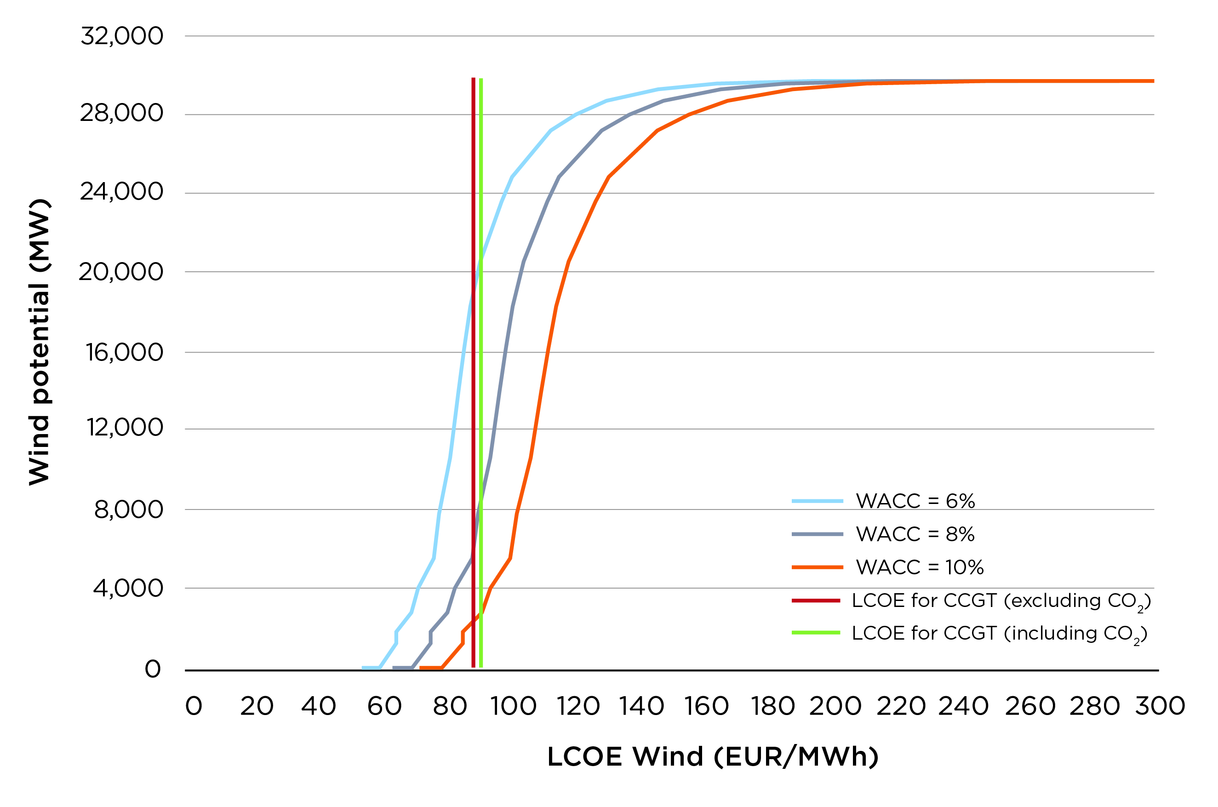
Bulgaria: Up to 18 GW of additional cost-competitive wind potential
Notes:
WACC
In the SEE region, investments are considered more costly than in other, EU member countries. Increase of WACCs in the SEE region, compared to other countries, comes from the risk factor, which is considerably higher.
In Ukraine, the WACC was set within the 14-18% range. High rate was set due to economic recession in that period. After a major economic recession, Ukraine’s economy achieved only modest growth during 2015. This recession was also followed by soaring inflation, which reached 44% in 2015. It was also accompanied by high bank interest rates, which reached 20-30% (Mills and Albanese, 2015).
LCOE
The levelized cost of electricity (LCOE) levels of the fossil fuel plants were proposed by Held et al. in the project REScost (Held et al., 2014), by subtracting the price of carbon emissions multiplied by the appropriate carbon factor (VGB PowerTech, 2015). Renewable energy potentials are deemed cost-competitive in this report only if the LCOEs of their generation are within the ranges of cost electricity produced by the fossil fuel supply options.

Slide 8
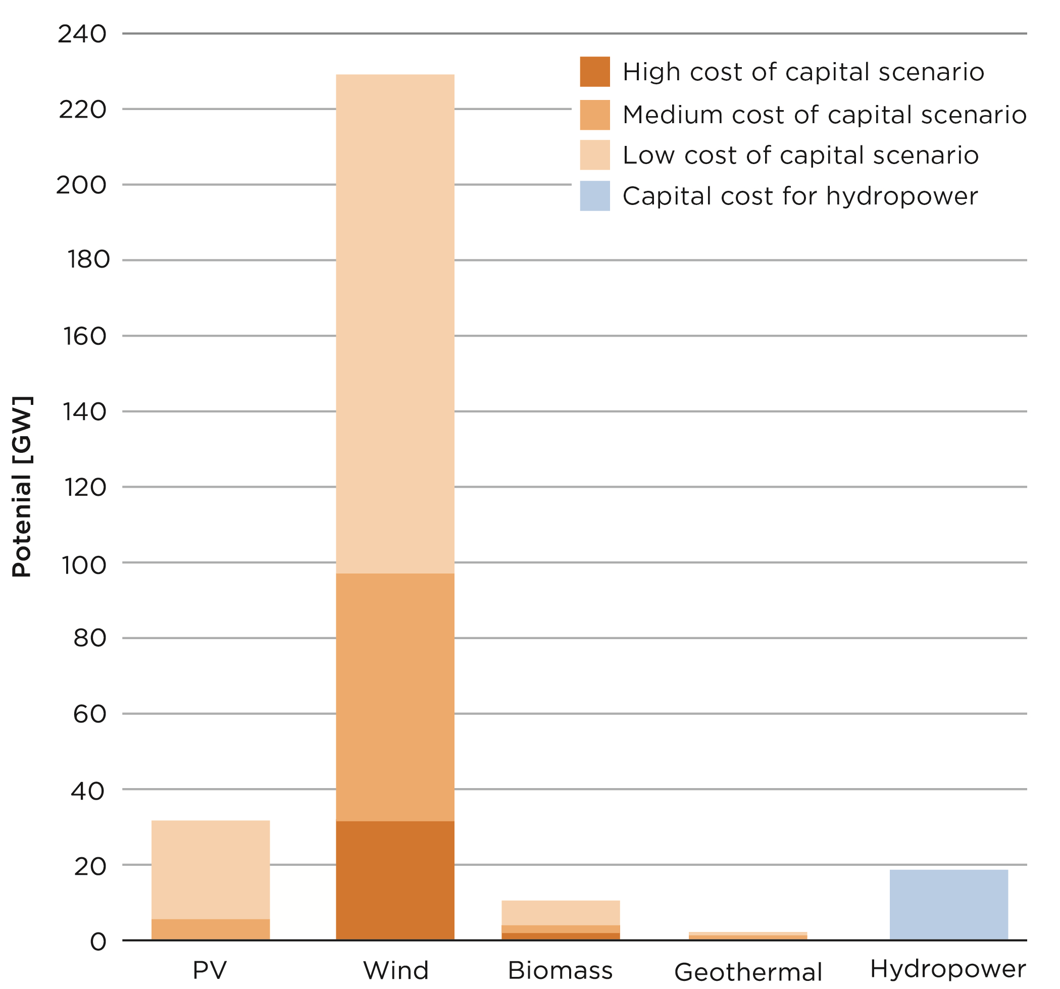
Impact of cost of capital
Additional cost-competitive renewable energy potential in 2016
How to improve the risk perception of the region?
  Eliminate administrative barriers and improve market access
  Create attractive and consistent RE support schemes
  Improve PPA structure
  Address grid integration challenges
  Enhance skills and capacities
  Facilitate access to finance
Notes:
Lower cost of capital could render additional renewable capacities accessible. In most striking example, additional cost-competitive potential of wind may increase from 32.6 GW to 231.7 GW, if the cost of capital will be lower of 4 percentage points [this is a difference between high- and low cost of capital scenario].
Strengthened enabling policy, regulatory and institutional conditions, and strong support schemes for renewables, among other measures, could improve the risk perception of the region.
These would give positive signals to investors in the non-EU part of the region, in particular, and may lead to improvement of financing conditions.
Administrative barriers and market access - In many countries complex administrative procedures and regulations, perceived by the investors as partly non-transparent, hamper investments. Barriers include, among others, involvement of a high number of institutions in the permitting procedure and insufficient availability of information. Most countries in the region have still to implement a One-Stop-Shop. Access to the market is partly reported to work for international investors only with the help of local partners which are aware of the context and have better access to local institutions and procedures.
The design of support schemes in some countries provided limited support to renewables uptake in the region. Retroactive cuts in Romania and Bulgaria led to market uncertainties. There a several cases of over- or under-support of RE technologies due to insufficient know-how to set appropriate support levels and adjust it to changing technology costs.
The design of PPAs and the approval of the PPAs after construction of a power plant is still a problem in some countries (e.g. BiH/FBiH and Ukraine). Large wind energy investments suffer most from such provisions while for hydro the risks, as perceived by international investors, are considered to be lower.
The grid connection issues are common in the region, including the access to the grid and the overall grid capability to integrate wind energy projects. In some countries limitations to RE expansion exist due to the technical inability to integrate renewables into the grid. The transmission system operators (TSOs) tend to be restrictive regarding amount of RE that may be integrated into the grid, as there is insufficient experience
Increased skills in the region are also necessary to allow accelerated uptake of renewables. In particular, to tap the vast cost-effective potential of solar PV, adequate capacities are required to implement the necessary infrastructure. e with non-hydro technologies. Types of skills: academic; technical; planning and operational; entrepreneurial; and policy.
Access to finance - The instability of governments and legislation is an important factor that led to reported low trust of banks in most countries of the region. This includes unpredictable and partly retroactive changes of support systems. In combination with the other presented barriers, it leads to a high risk perception, in particular in the non-EU countries, resulting in difficult and expensive access to capital. Consequently, capital costs are markedly higher in the non-EU as compared to the EU countries. The most extreme example is Ukraine due to the current economic and political crisis which has bank interest rates of up to 30 %.

Slide 9


Energy transition has made progress but acceleration is needed
Costs of renewable energy continue to decline rapidly.
Main drivers:
    Technology
    Competitive Procurement
    Experienced Developers
Expanding electricity use can be the main driver for accelerating the energy transformation: e.g. EV sales surpassed 2 million units in 2018.
Electricity would progressively become the central energy carrier, growing from a 20% share of final consumption to an almost 50% share by 2050,
9

Slide 10
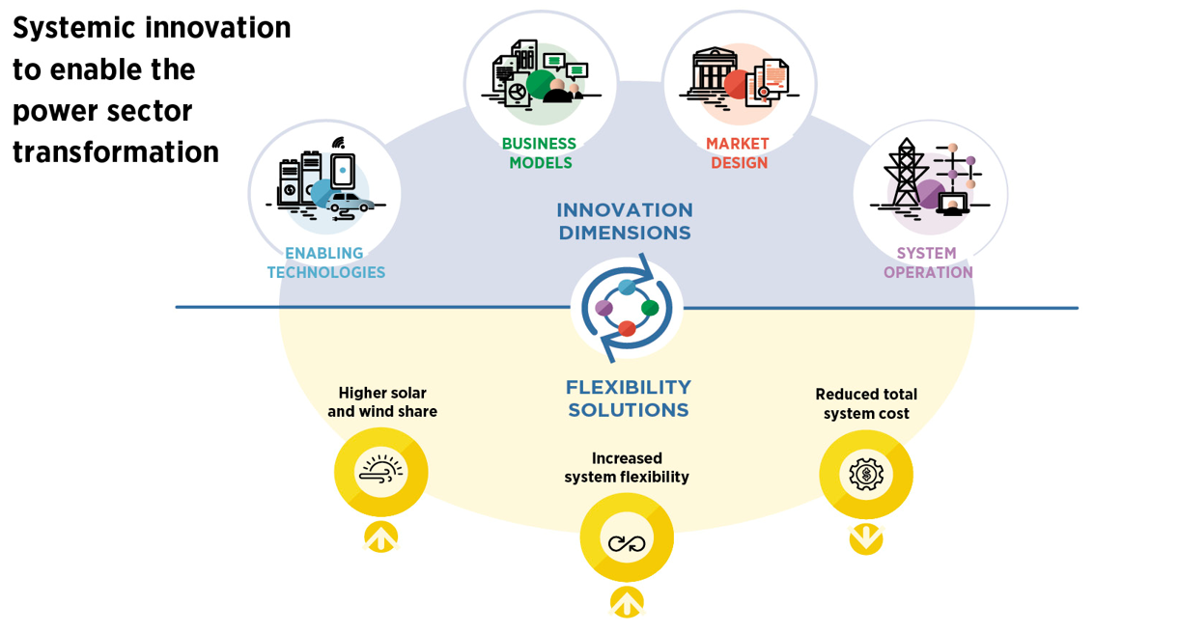
Innovation

Slide 11
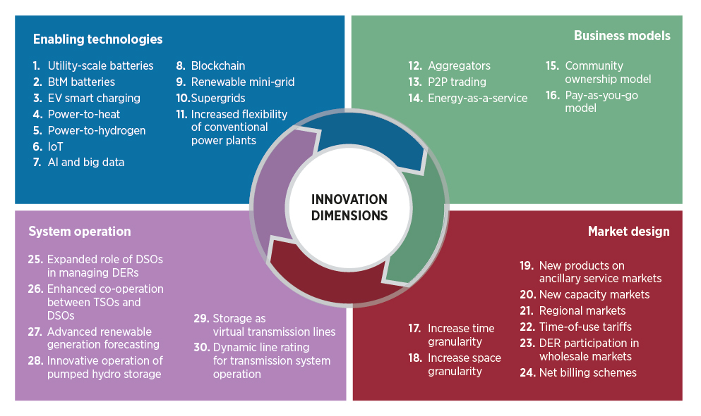
IRENA’s report details 30 innovations from 4 dimensions

Slide 12




Socio-economic benefits of renewable energy
+ 2.5 %
+ 1 %
+ 99 USD trillion
USD 1
PAYOFF
USD 3 - 7
+ 17 %
Every dollar spent in the global energy transformation saves 3 to 7 USD.
Global GDP is boosted by 2.5% in 2050, with a cumulative gain of USD 99 trillion from 2019-2050, largely due to increases in consumer expenditure.
Source: IRENA, Global Energy Transformation: A Roadmap to 2050, 2019

Slide 13







^{www.irena.org}
^{www.instagram.com/irenaimages}
^{www.twitter.com/irena}
www.flickr.com/photos/irenaimages
^{www.facebook.com/irena.org}
^{www.youtube.com/user/irenaorg}

