Slide 1
Development opportunities for coal regions through investments in renewable energy
Dr. Vangelis TZIMAS
Deputy Head of “Knowledge for the Energy Union” Unit
JRC –Directorate C: Energy, Transport & Climate
European Commission
8th Regional Energy Conference – Bulgaria - Sofia
17 May 2019

Slide 2

Towards a climate-neutral economy
A clear vision: Europe needs to achieve net-zero greenhouse gas emissions by 2050 through a fair and cost-effective transition encompassing all sectors of the economy.
The long-term strategic vision shows that the transformation of our economy is possible and beneficial with existing (and sometimes emerging) technologies. It also highlights the challenges of the transformation.
The vision calls for policies and an enabling framework conducive to stimulate change.

Slide 3
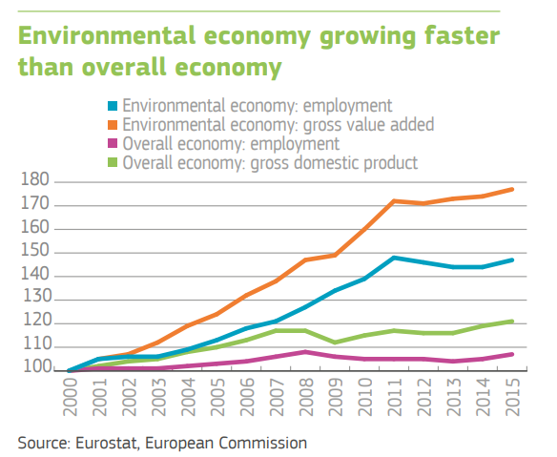
The transition to a climate-neutral economy should be just, spreading benefits evenly
Faster growth of EU clean economy than the overall economy
Struggling traditional, fossil fuel based industries
Growing concerns of lower income society and in specific regions expected to be most affected
Emerging importance of retraining and life-long learning
Urgency to create a global level-playing field

Slide 4
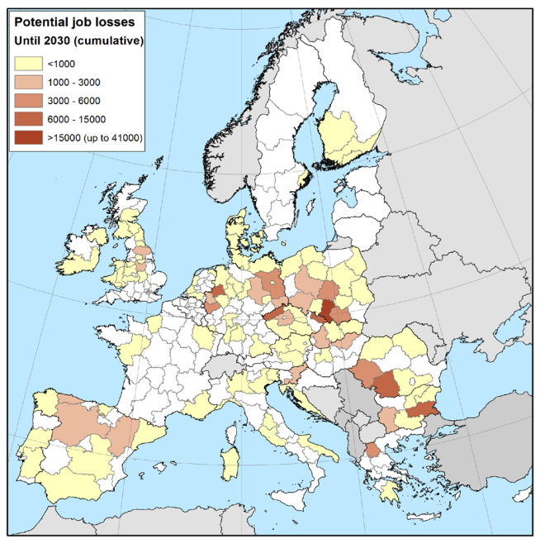
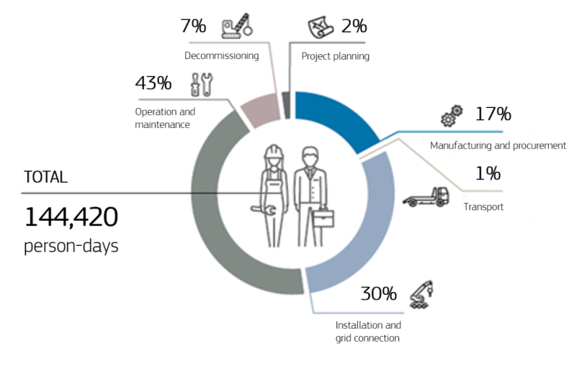
From global to regional action: supporting local employment and economic growth
The European coal sector
Distribution of jobs in the production of a 50 MW wind farm
240 000 direct jobs
  55 000 in power stations
  185 000 in mining
215 000 indirect jobs
Up to 160 000 job losses by 2030
Source: JRC (2018). EU coal regions: opportunities and challenges ahead. Science for Policy report. (left map) and IRENA (right figure)

Slide 5

A need for early action
Alternative business opportunities for employment and economic growth in coal regions, based on regional potential in the context of:
  Broader socio-economic transformation
  Matching skills
  Policies
  Human capital development
New, competitive industries and services: investment in renewable energy technologies as part of portfolio of options

Slide 6
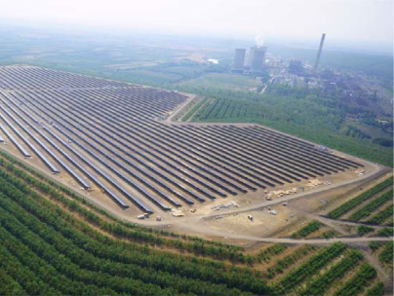
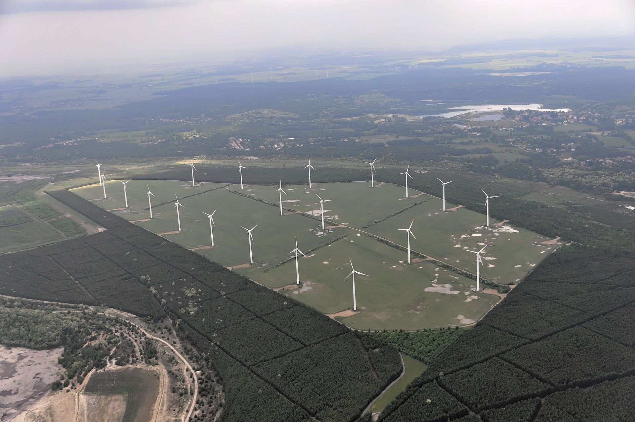
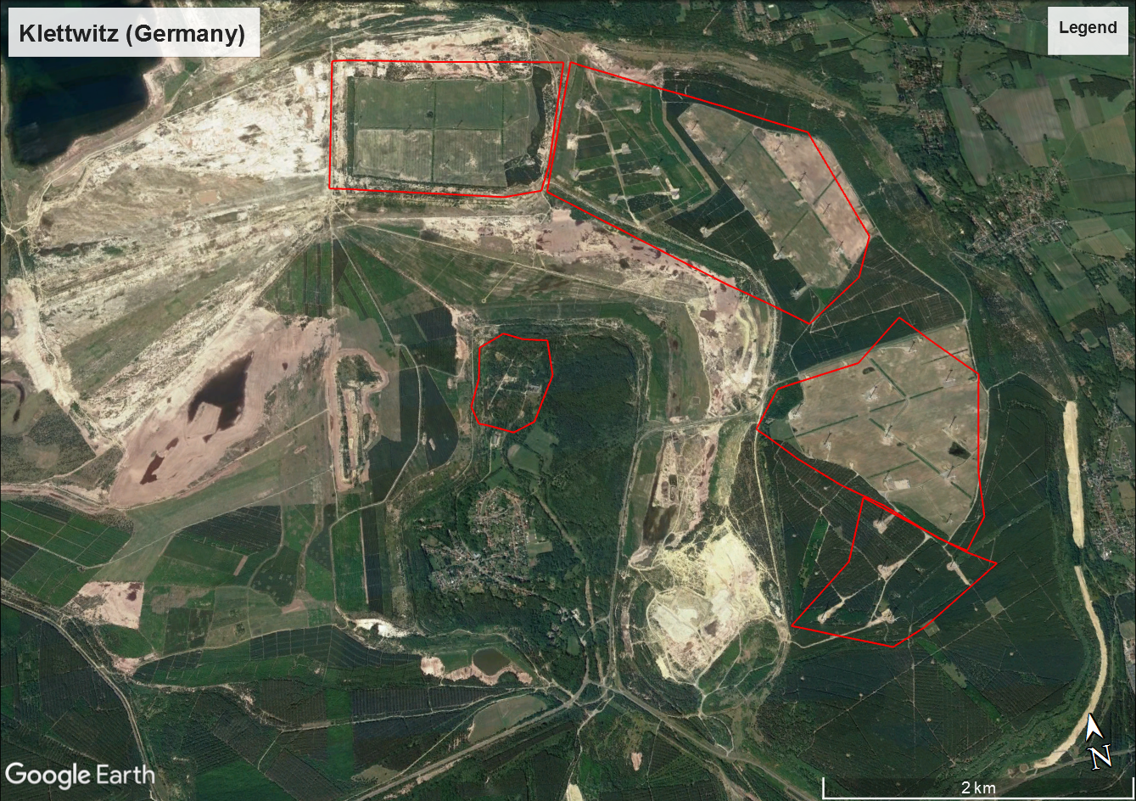
Conversion of coal mines for renewable energy generation is already happening
Solar PV
PV power plant in Visonta (Hungary)
16 MW, 72 500 PV panels
Wind energy
Wind farms in Klettwitz (Germany)
145.5 MW, 5 wind farms
Source: Szabó, S., Bódis, K., Kougias, I., Moner-Girona, M., Jäger-Waldau, A., Barton, G., Szabó, L., 2017, A methodology for maximizing the benefits of solar landfills on closed sites, Renewable and Sustainable Energy Reviews, Volume 76, September 2017, pp. 1291-1300, doi: 10.1016/j.rser.2017.03.117.
Sources: Google Earth; Ra Boe/Wikipedia, 2013, http://www.wikiwand.com/de/Windparks_in_Schipkau

Slide 7
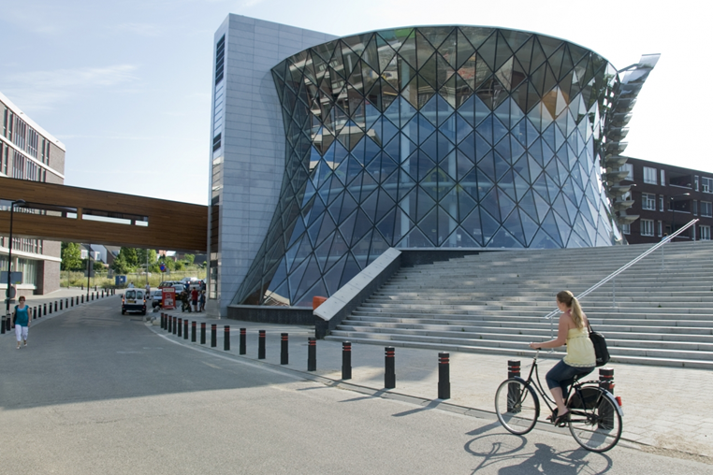
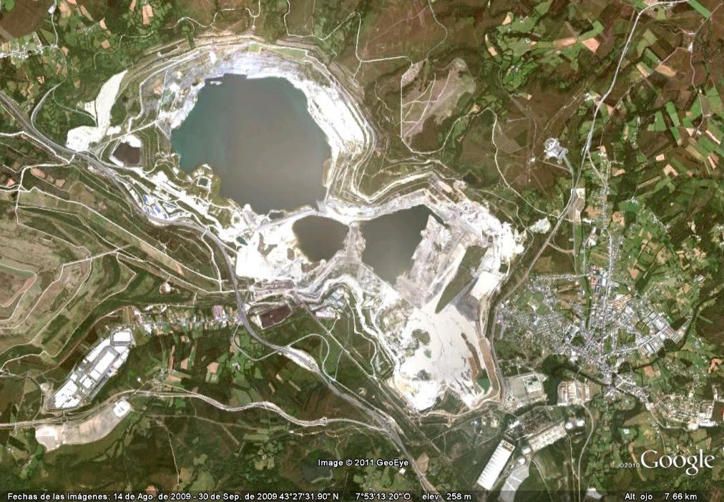
Conversion of coal mines for sustainable heating and energy storage solutions
Geothermal energy
Minewater district heating project Heerlen (The Netherlands)
One of the world's largest geothermal district heating projects
Energy is stored and regenerated in the mine waters servicing 800 000 m²
Hydro energy
As Pontes (Spain)
Hydro power plant project on rivers Eume and Meidelo
Open pit (18 km of perimeter and 205 m of depth) used as accumulation at 330 m elevation 20 km from the coast line
Planned capacity between 300 and 600 MW
Prosper Haniel (Germany)
Pumped hydro storage project
1200 m deep underground mine with a 26km complex of horizontal shafts
Planned capacity around 200 MW to compensate intermittent wind and solar power
Heerlen
As Pontes
Source: JRC (2018). EU coal regions: opportunities and challenges ahead. Science for Policy report. 182p and ongoing work

Slide 8
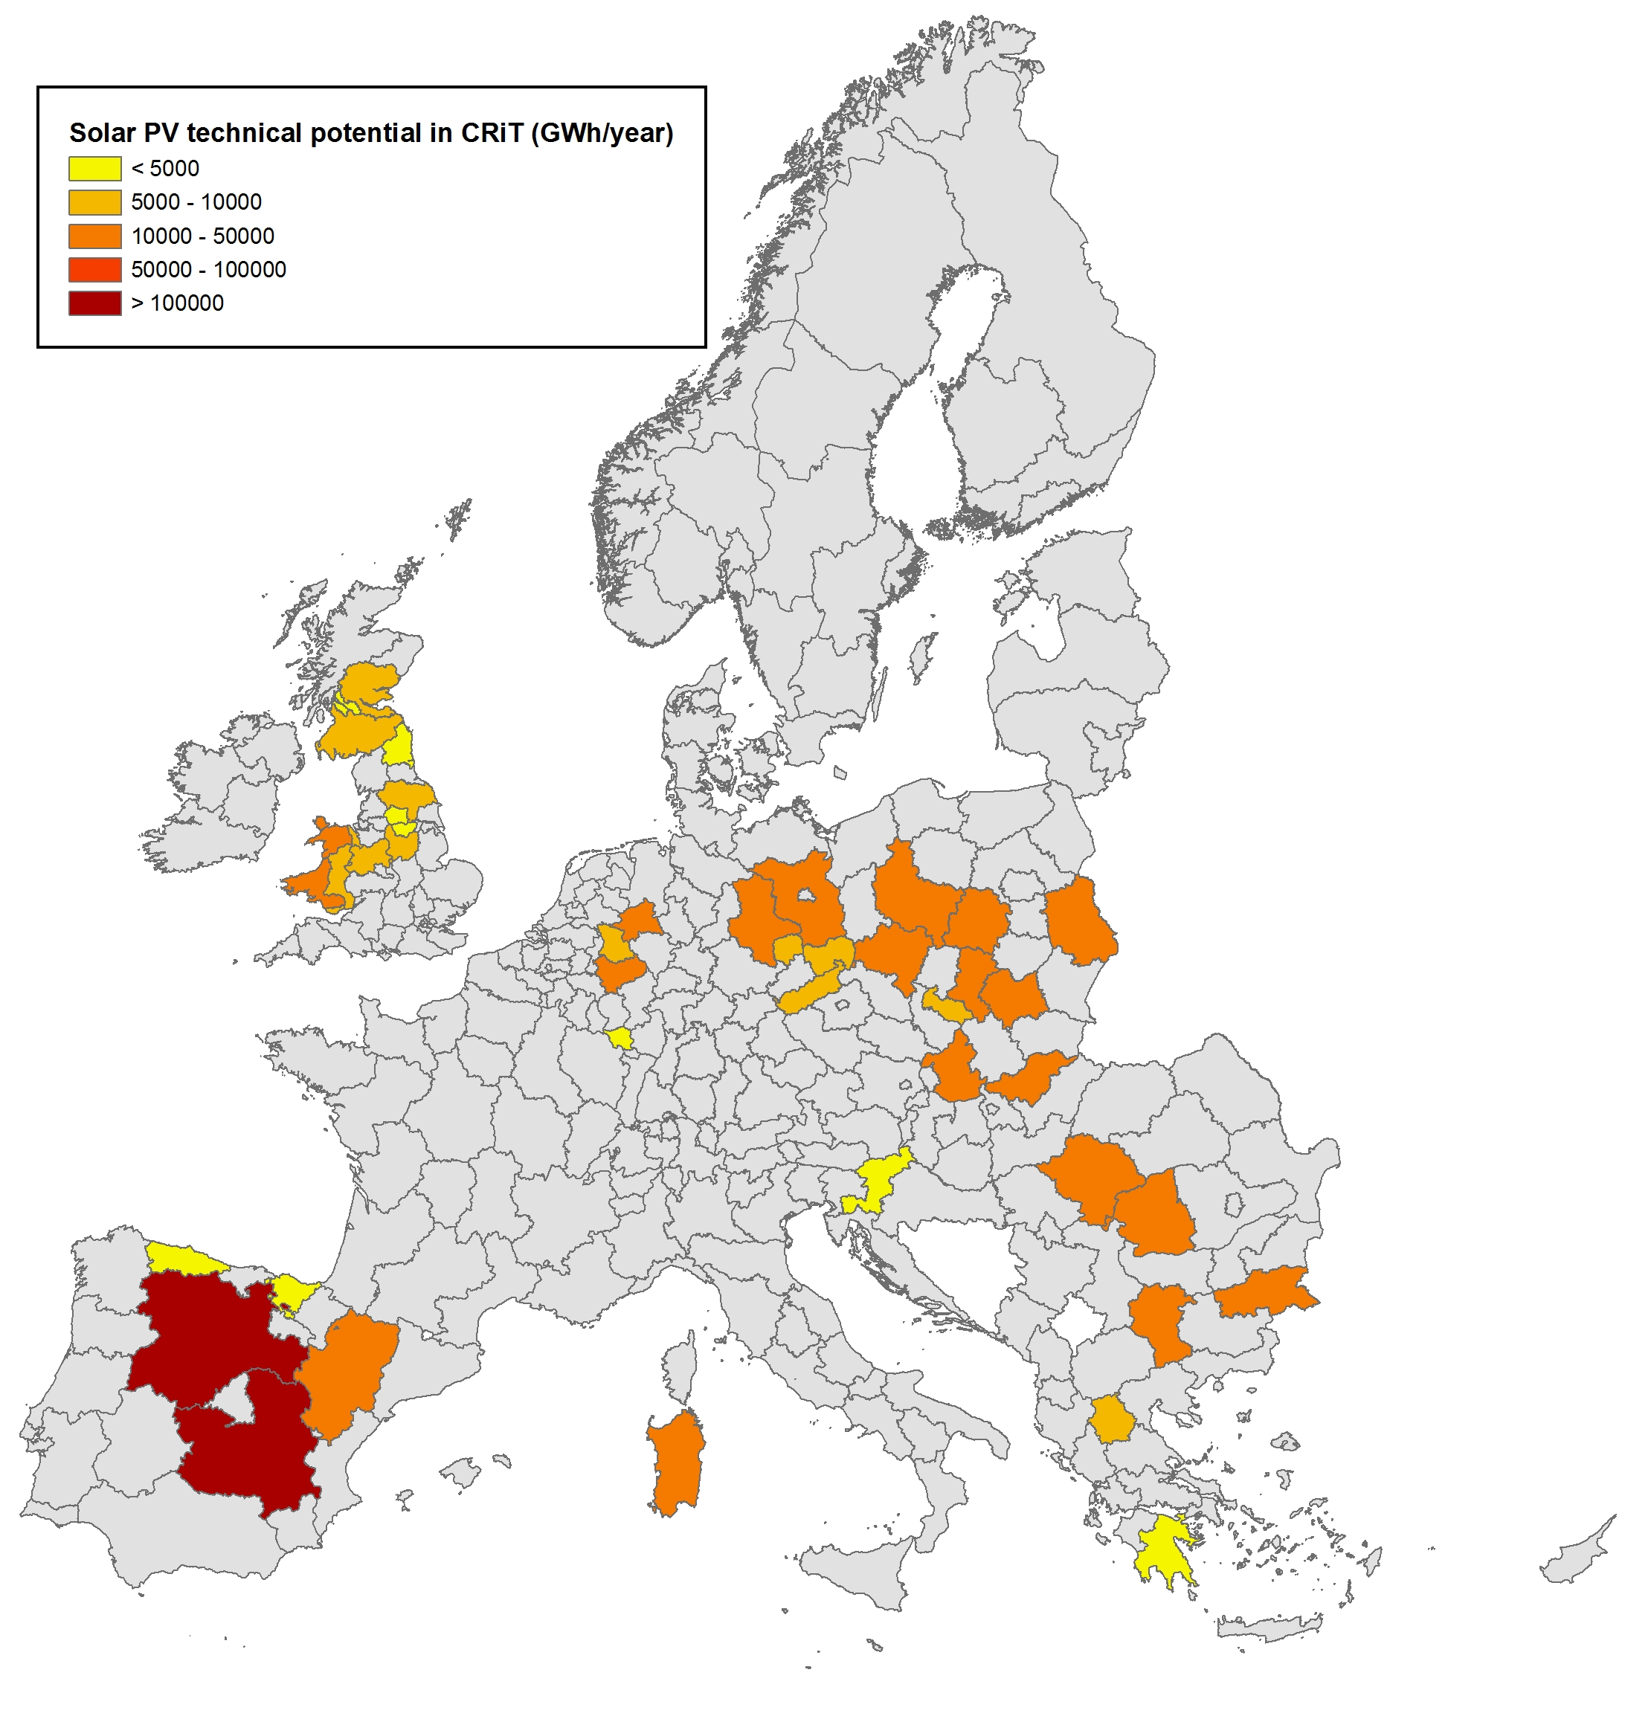
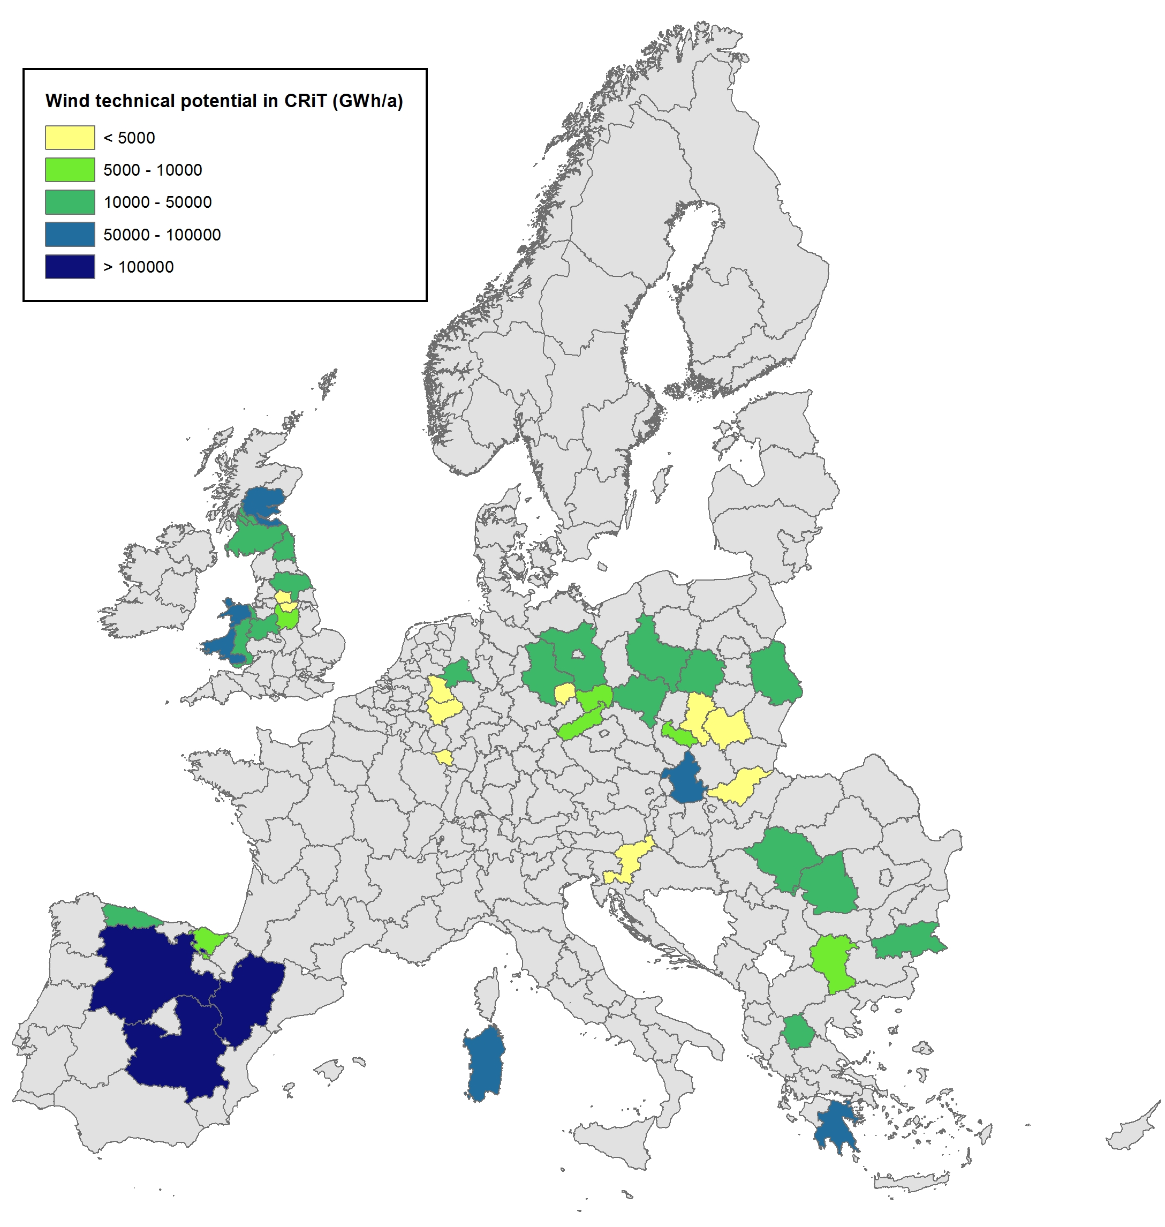
Wind and solar PV energy potential in EU coal regions
Identifying business opportunities for employment and economic growth based on regional potentials
Solar PV technical potential (ground + rooftop systems)
Wind technical potential
Source: JRC (preliminary results)
Source: JRC (preliminary results)
Source: JRC (2018). EU coal regions: opportunities and challenges ahead. Science for Policy report. 182p and ongoing work

Slide 9
Coal regions hold significant innovation potential
0
40
80
120
160
0
30
60
90
120
0
20
40
60
80
Source: Energy R&I financing and patenting trends in the EU. JRC Science for Policy Report, 2017

Slide 10
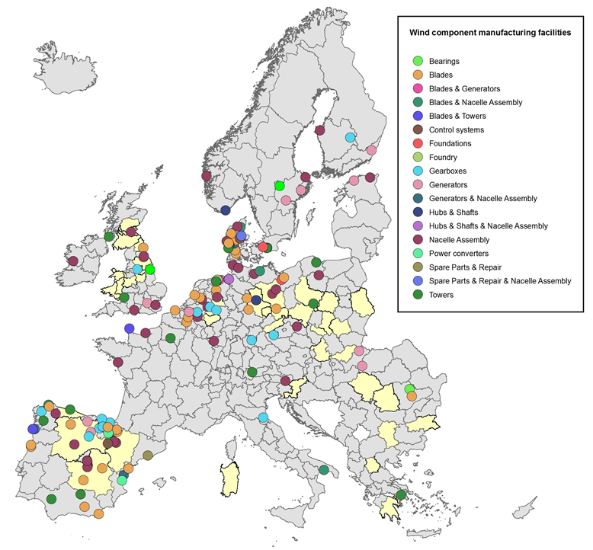
Opportunities in the manufacturing industry
Wind components manufacturing as a source for growth and jobs
Most European OEMs have located their manufacturing facilities in the main wind markets.
The highest number of facilities is estimated to assemble nacelle components followed by blade and tower manufacturing facilities.
14 out of the 42 coal regions have installed manufacturing facilities of wind turbine components.
Source: JRC
Source: JRC
Source: Update of JRC (2017) Supply chain of renewable energy technologies in Europe

Slide 11
Key messages
The deployment of RES in CRiT will contribute to the energy transition and provide economic value and jobs to post-mining communities.
The development of such projects benefits from the availability of infra-structure, land, skills and industrial heritage.
Solutions need to be decided on a case-by-case basis to ensure suitability to local conditions.
Close cooperation between companies, regulators, investors, land-use planners and local communities is essential to identify the most sustainable uses and maximize social and economic development.

Slide 12
Thank you
evangelos.tzimas@ec.europa.eu

