Slide 1
An introduction to
1
FUTURE
CITIES

Slide 2
PROFILE
2
My name is Alex Daw,
I am the ManaGinG Partner for SGI Architects & Masterplanners and I am here in my capacity as a board member of the BGBC and passionate advocate for sustainable desiGn.

Slide 3
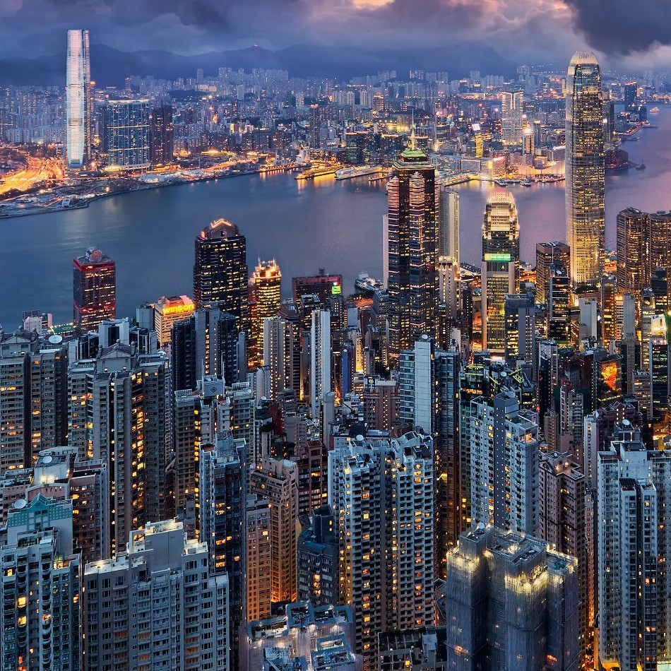
3
The biGGest and overridinG challenGe facinG cities over the next 50 years is actually not enerGy or resources, but increased size & densification of our cities from population growth and migration.

Slide 4
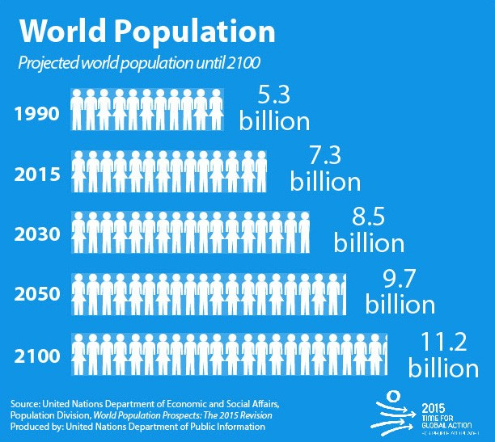
More people are beinG born, nearly another 3 billion projected by 2070 or an extra 37%.
4

Slide 5
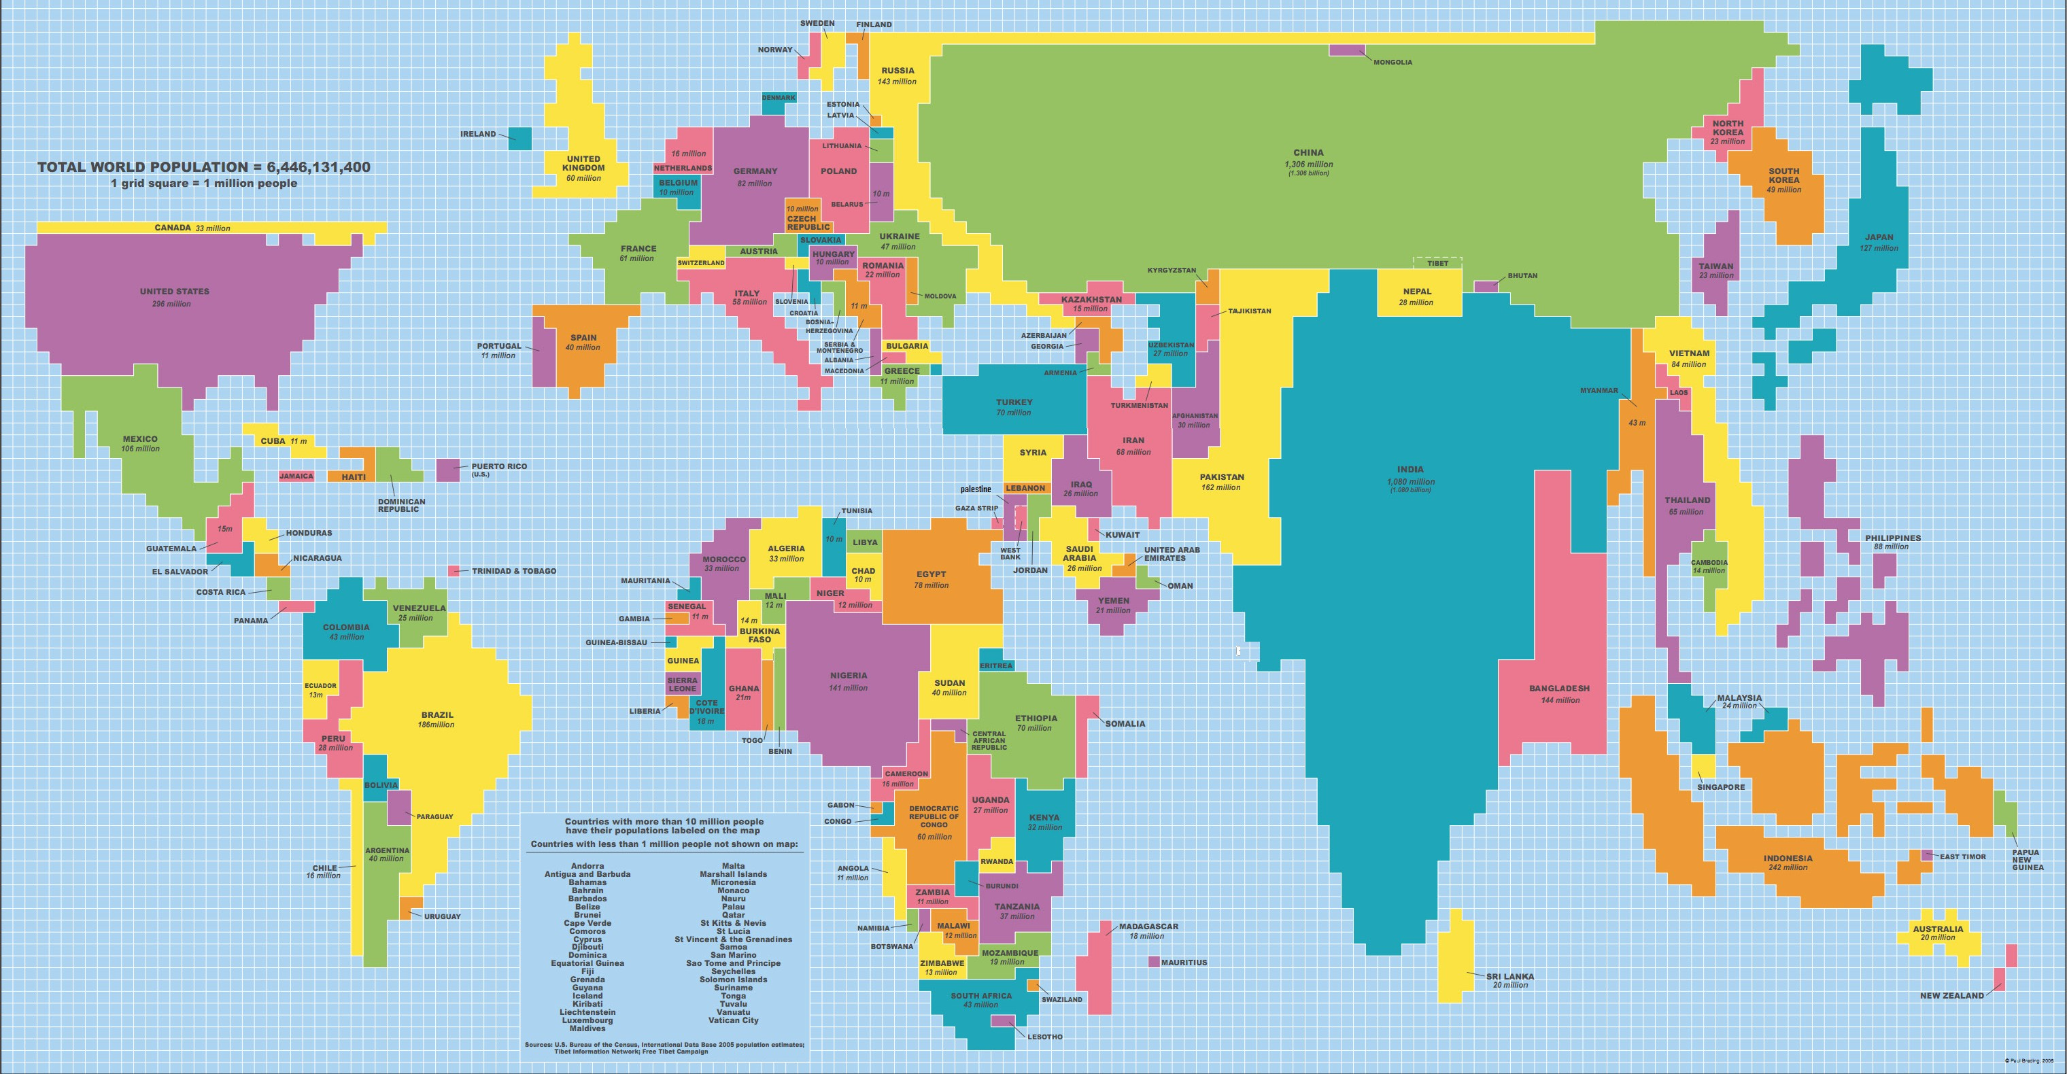
People in the wrong places
5
VaryinG density of populations means that Goods and services are not always in the best place to service the end customer.

Slide 6
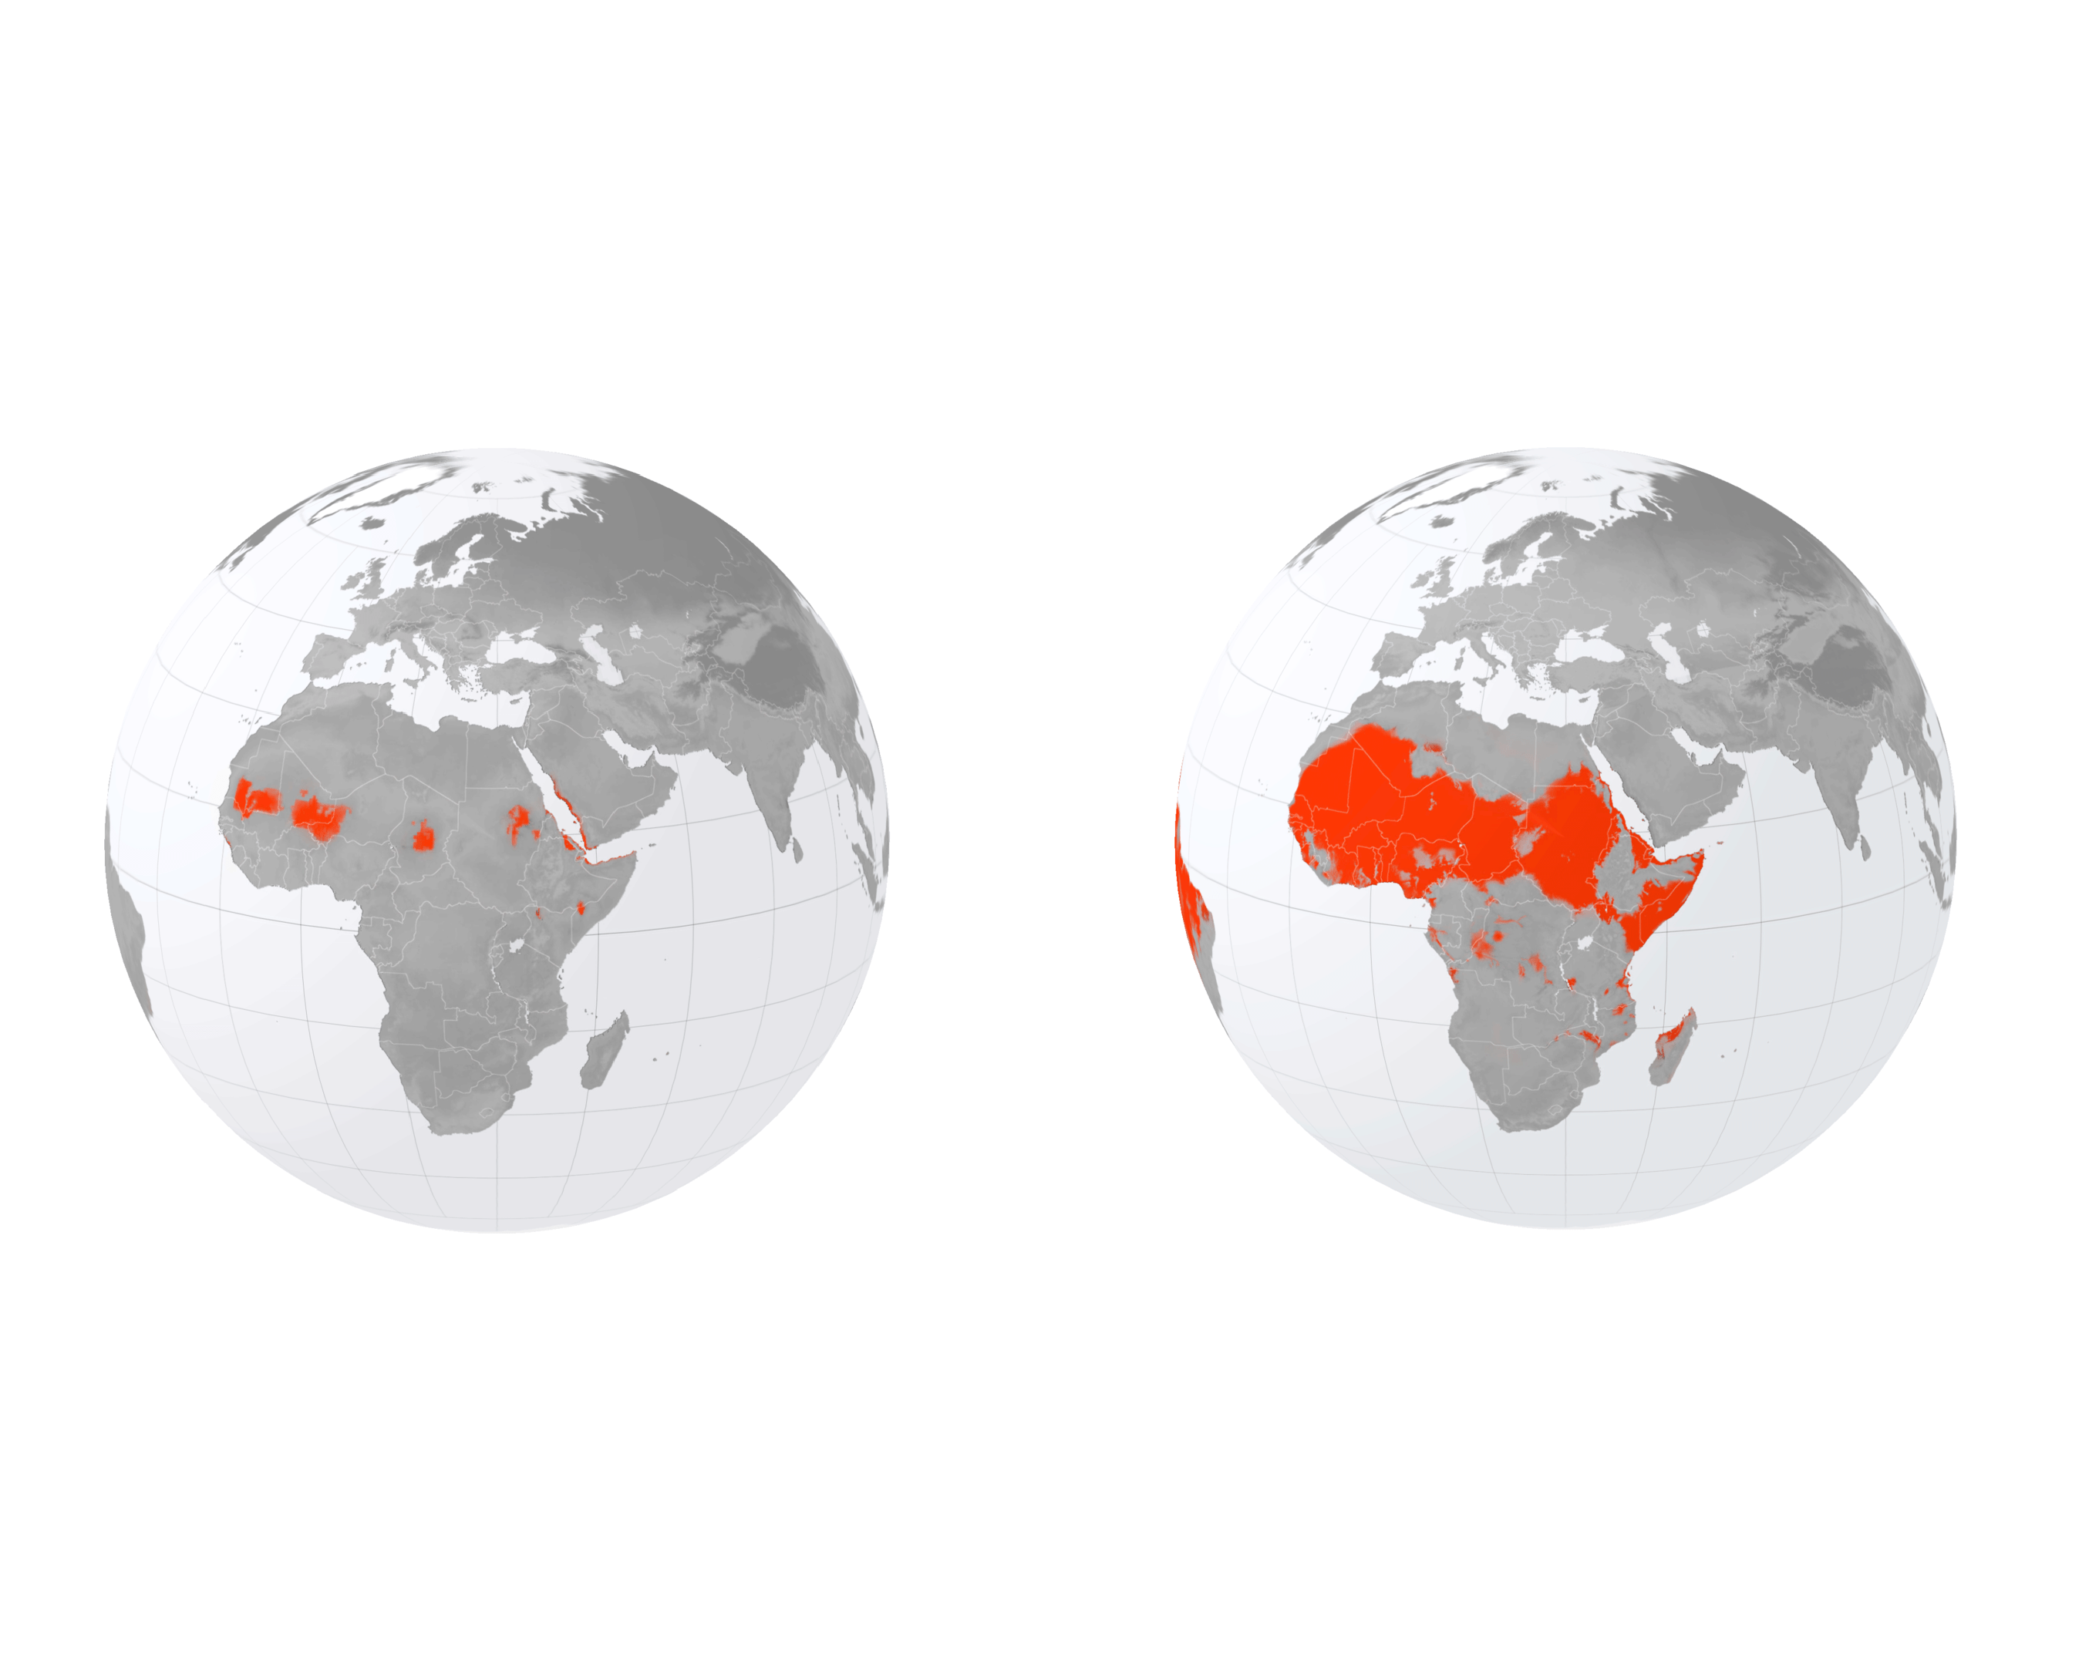
Climate Migration
6
Today 1% of the world is located in a barely habitable hot zone.
By 2070 that portion could Go up to 19% this could displace further 3 billion people.

Slide 7
Migration is often viewed as somethinG neGative, but it should not be.
7
Academics often point out that by removinG the emotional context and viewinG miGration rationally is in fact nature’s way to balance
out problems across the world.

Slide 8
1. Environmental changes and extreme weather
events
8
Aside from population Growth and climate miGration, there are other climate related challenGes cities are havinG to consider because of their potential lonG-term impacts:
---
The control of global carbon emissions
---
Supply chain resilience
---
Aging Populations
---
Inequality between the wealthy and the poor
---
Energy Security
---
The on-boarding of smart technologies

Slide 9
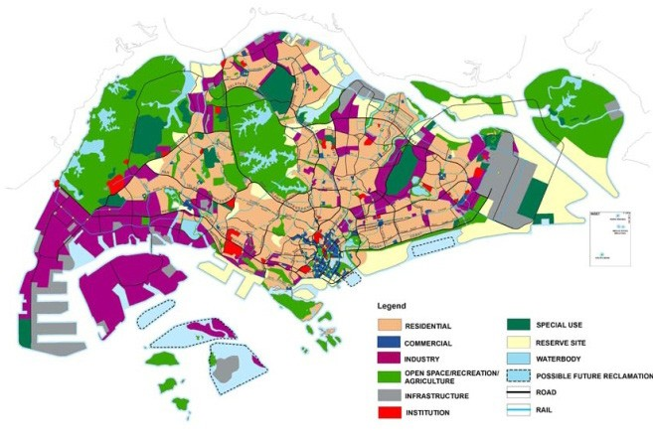
Which cities are dealing with these issues and how?
9
SinGapore is probably one of the only cities that has a master-plan that deals withal these challenGes

Slide 10
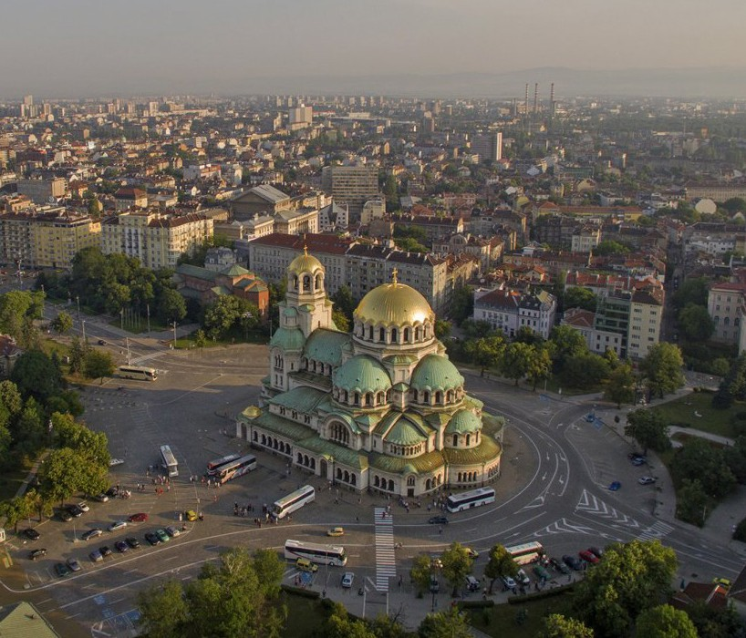
10
WHAT ABOUT SOFIA?

Slide 11
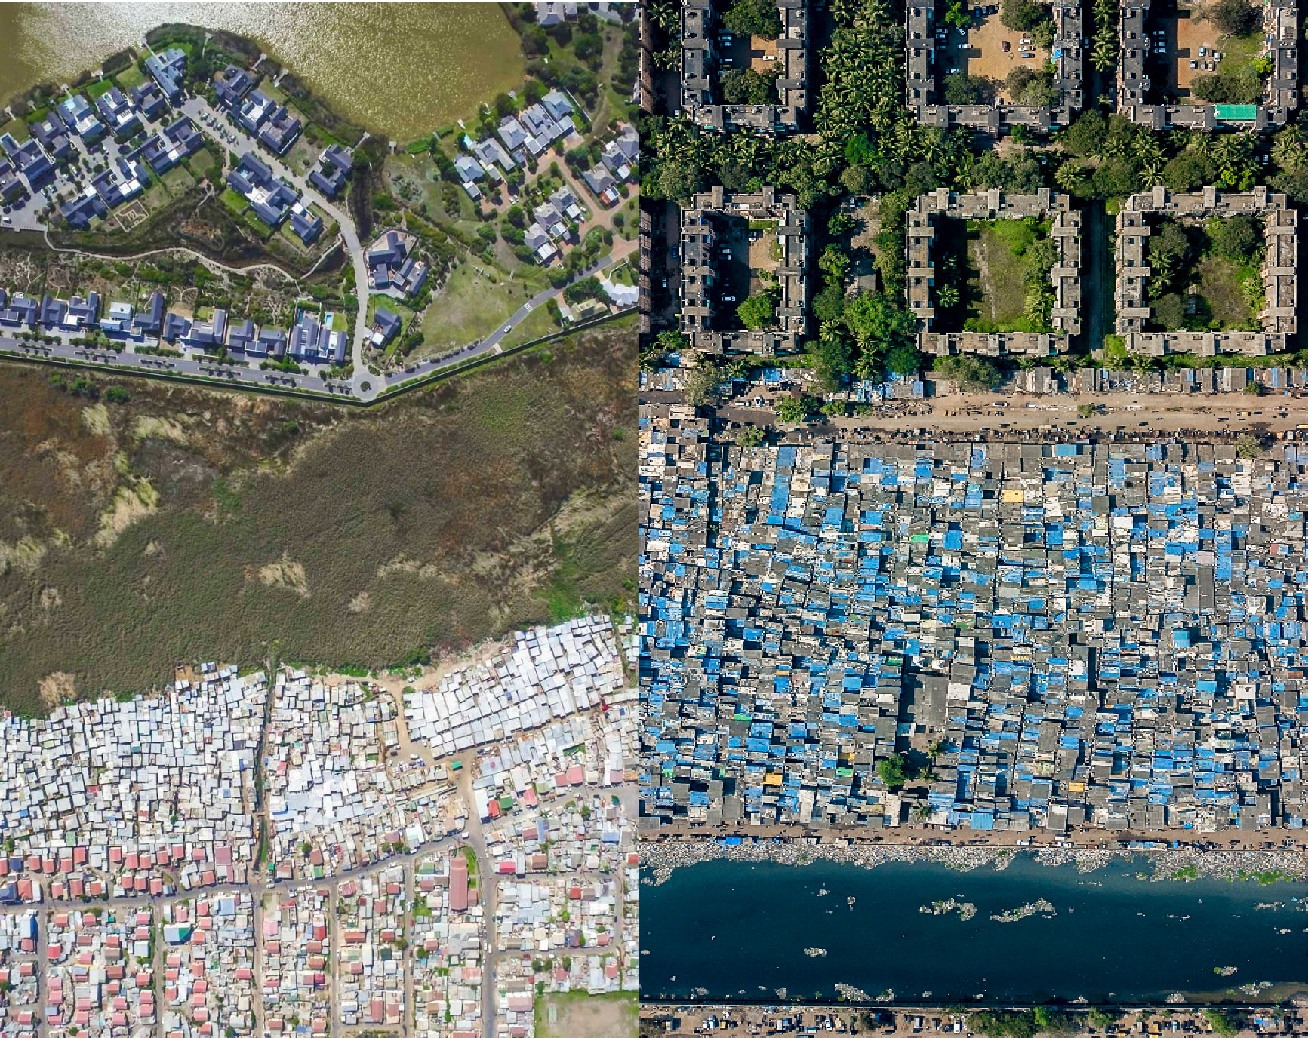
The impact migration can have on unplanned cities
11
The UN recently said that 1/3rd of the world’s population lives in unplanned city environments

Slide 12
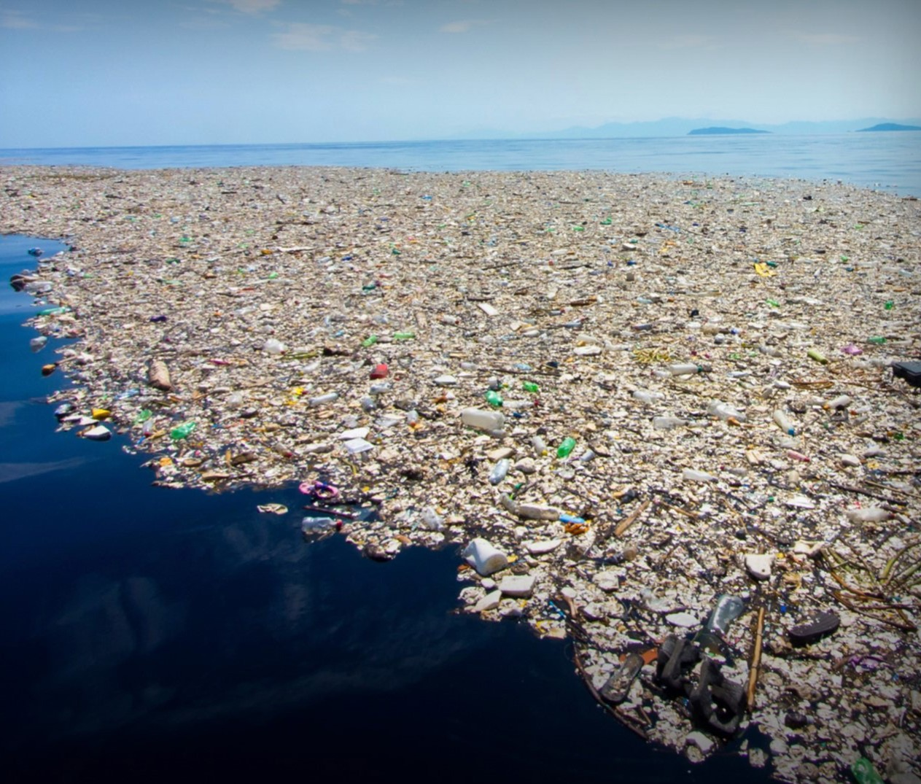
The previous imaGe of Mumbai shows how
unplanned city expansion filters directly into the waterways….. And finds its way into the sea. 90% of sea plastics oriGinate from unplanned cities.
12

Slide 13
Summary of the challenges.......
13
We are hopinG for 2 deGree rise Globally likely we will hit a 4 deGree increase
These people are cominG to our cities and cities are increasinGly unprepared for them
More cities havinG to deal with floodinG, 80% of our cities Globally are on the coast, none of which are really desiGned to float
Insurers are no lonGer insurinG cities like New York or Miami, so the liability is really startinG to fall on the leaders of these cities
Cities face a reality that is layer upon layer of issues that are all linked and all urGent and all need to be mitiGated or resolved

Slide 14
What can we do to try and mitigate these issues that are heading our way?
14
The obvious answer is to focus on master-planninG and expand the scope of what a master-plan really is, incorporatinG multi layered planninG strateGies that work toGether.

Slide 15
1. EnerGy Security
15
Carbon reduction and mitiGation
Climate Resilience Solutions
Education
Provide Good affordable homes with a full ranGe of amenities
Improve and sustain food supply chains
InteGrate Greenery and urban forestry into the livinG environment
Provide Greater mobility with enhanced transport connectivity
SustaininG a vibrant economy with Good jobs
Ensure room for Growth and a Good livinG environment

Slide 16
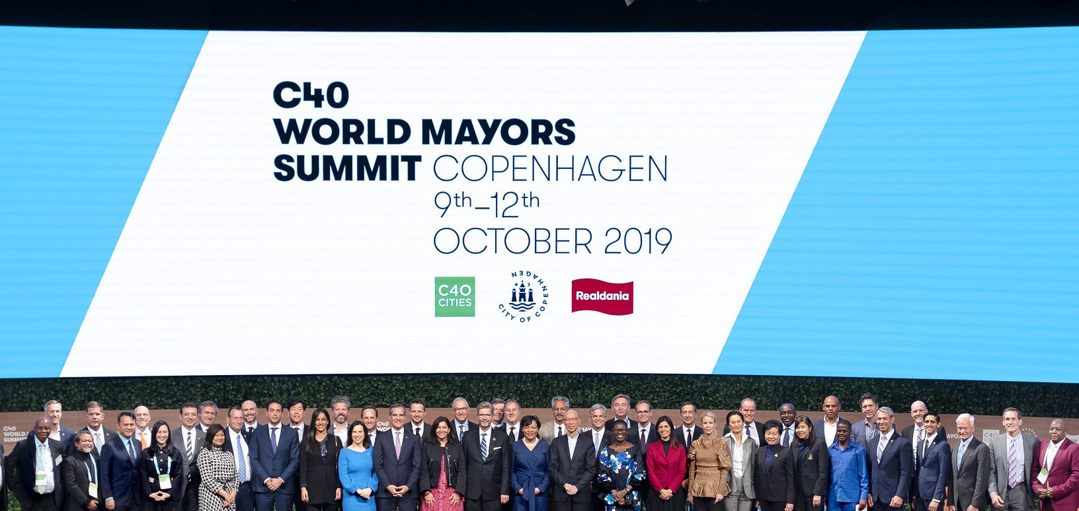
Where are people placing their bets for solutions?
16

Slide 17
