Slide 1
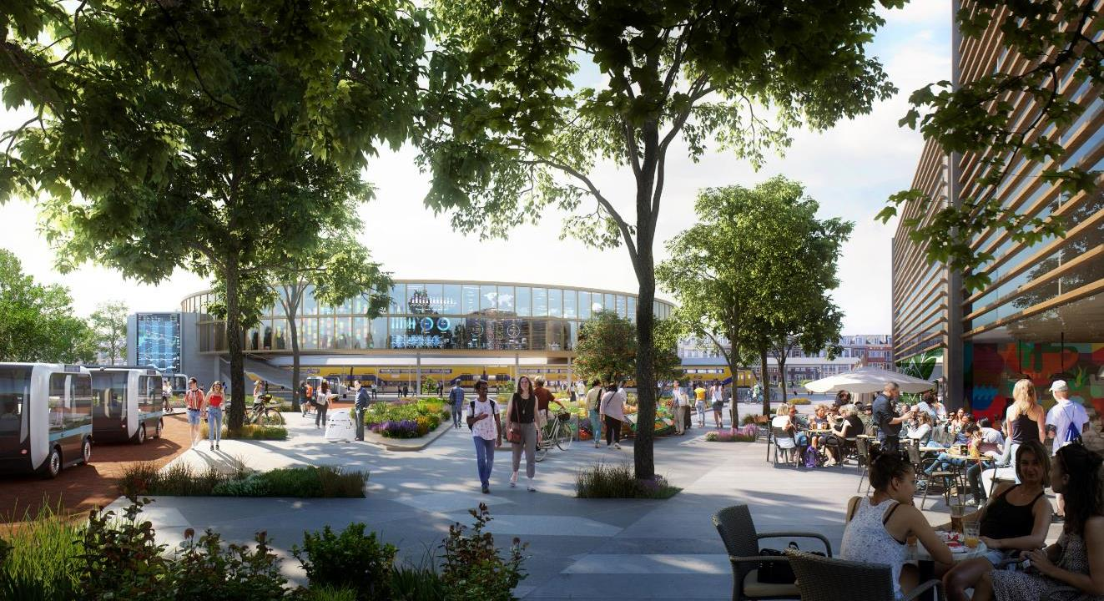
LIVING THE FUTURE
Brainport smart district. Sof
Notes:
The living environment in 2050: sustainable, smart, enhancing quality of life… That is what we at BSD are working toward; we’re developing the district of the future. Not only through smart technology and innovation, but by deliberately involving the people who will live and work there. A strong community, social and collectively responsible.
In BSD, you’re living the future.

Slide 2
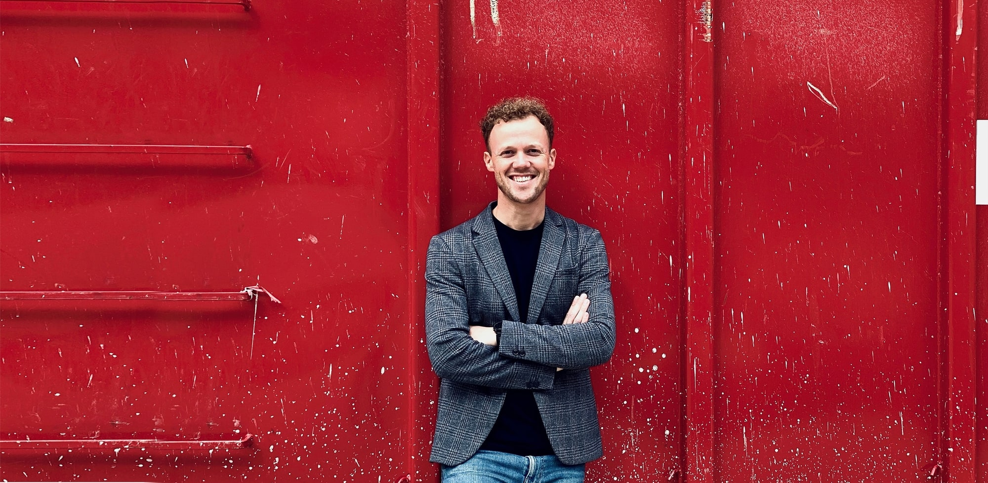
Teun Meulepas
Sociologist
Co-owner Yellowchess (strategy and innovation firm)
Supervisory board Rabobank
Program manager Brainport Smart District (BSD)

Slide 3
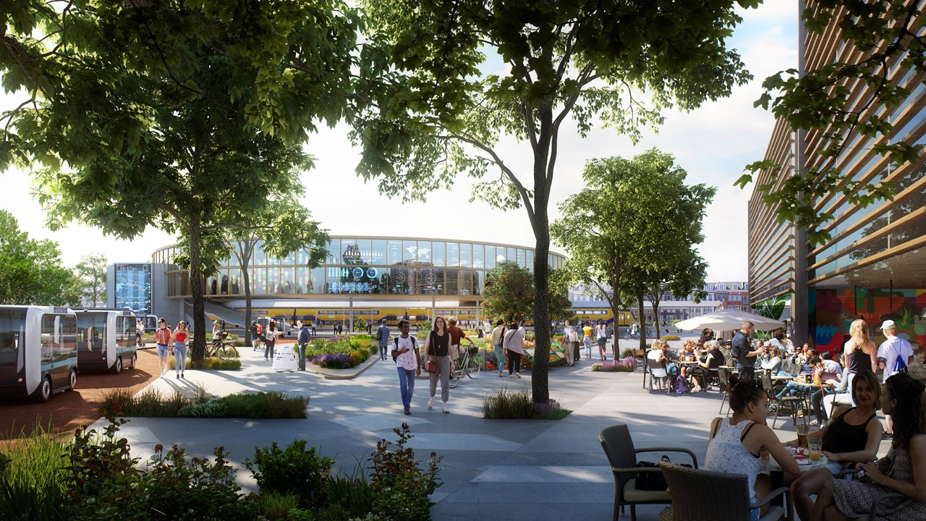
What do we need to start with today to make Brainport Smart District a lighthouse as the most livable, adaptive residential area, using cutting-edge research and technology to enhance socioeconomic development?

Slide 4
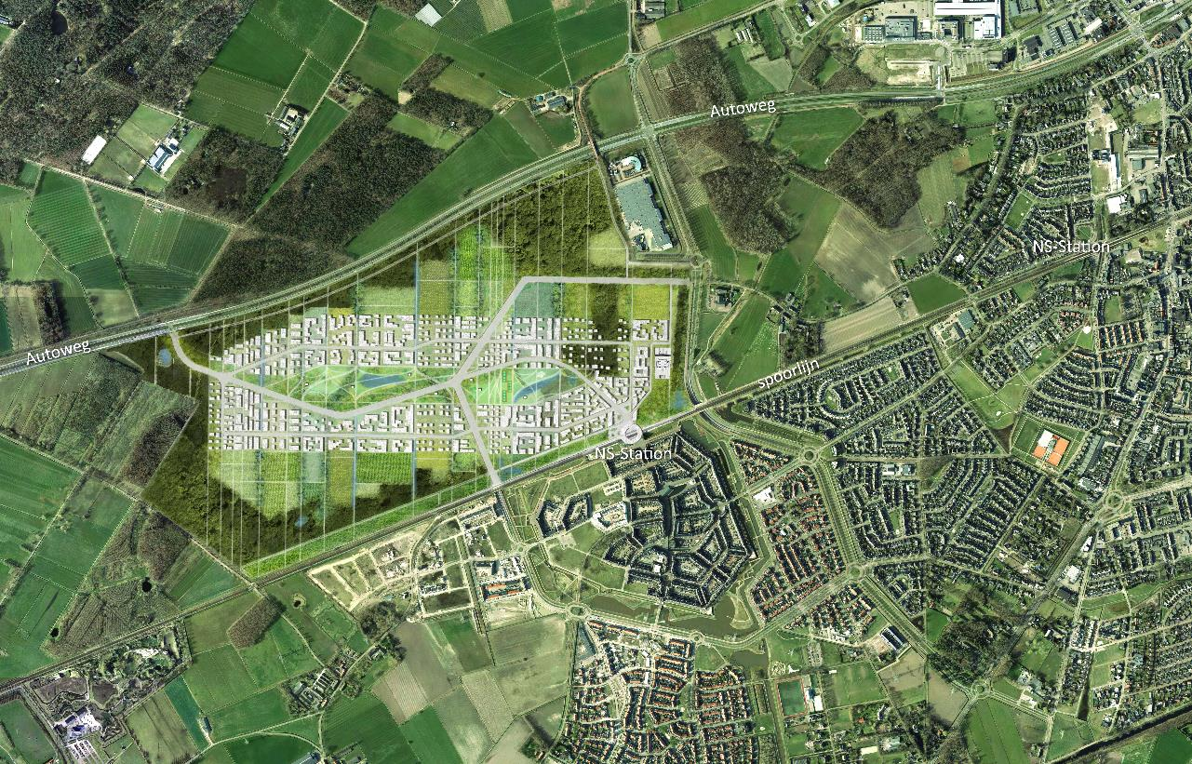
Notes:
We took the first steps in 2019: drafting an urban planning vision.

Slide 5
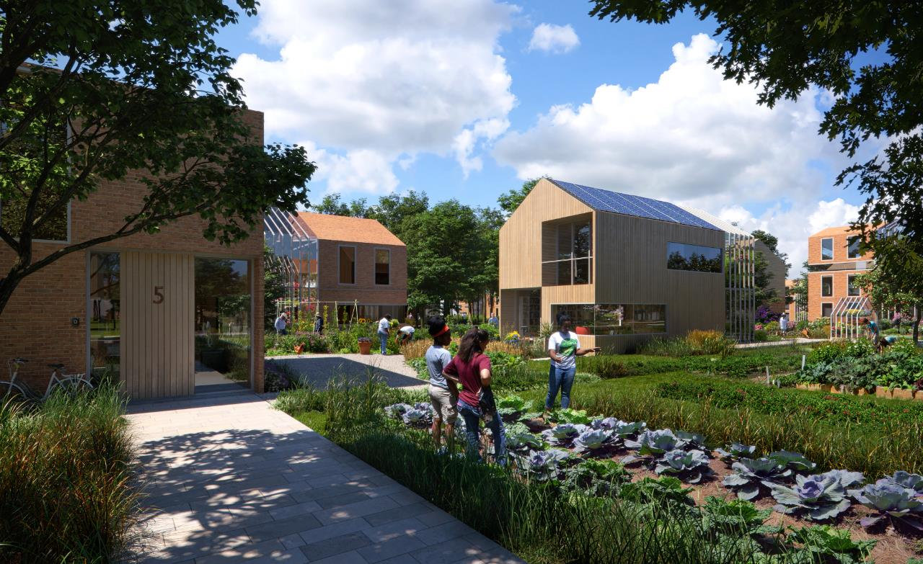
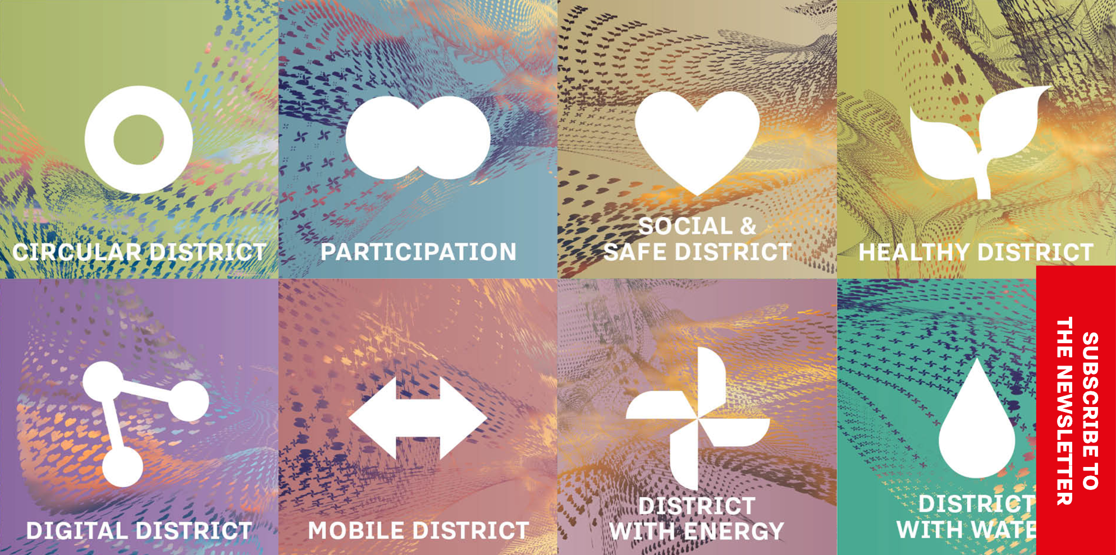
Notes:
Een innovatieve, duurzame wijk waar de toekomstige bewoners centraal staan.
We richten ons op zeven thema’s; participatie, circulariteit, gezondheid, data, mobiliteit, energie en de veilige en sociale leefomgeving. We richten ons op initiatieven die bijdragen aan minstens drie van deze. Waarom? Omdat we de wijk van de toekomst ontwikkelen – daarbij kijken we naar écht innovatie, dus producten en diensten die nog ontwikkeld moeten worden. En dat ontwikkelen: daarvoor zijn wij de aangewezen plek.

Slide 6
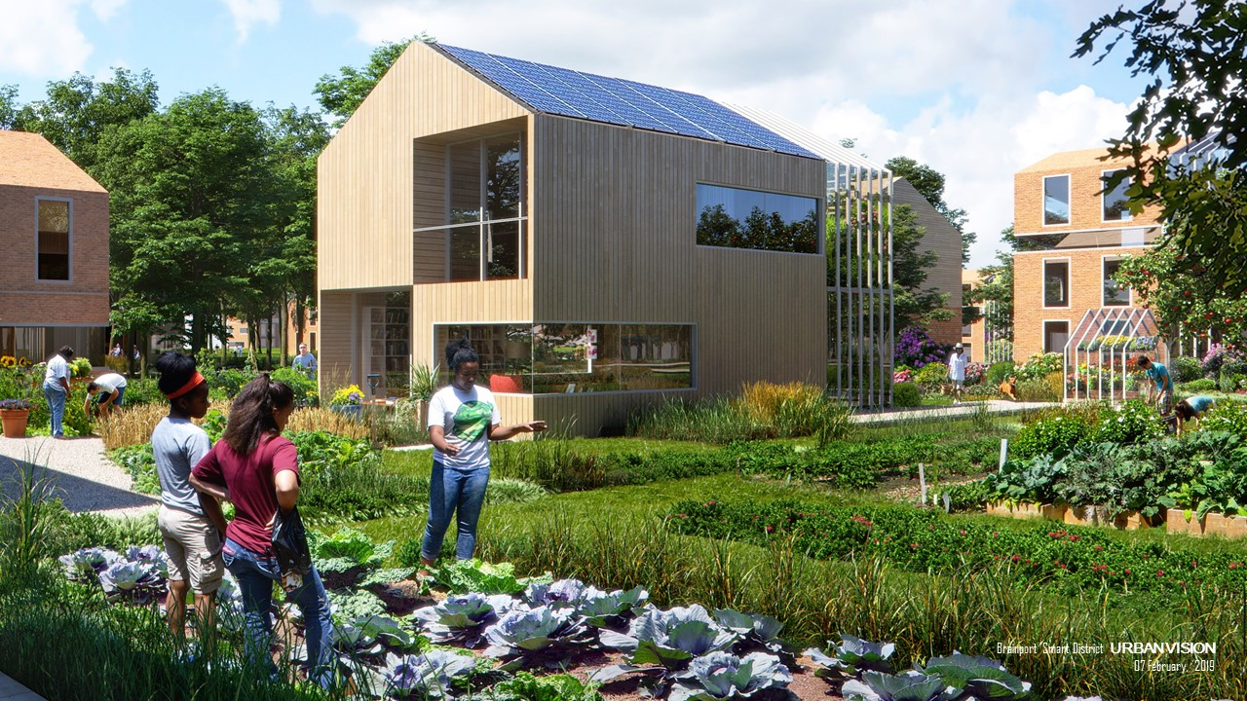

Slide 7
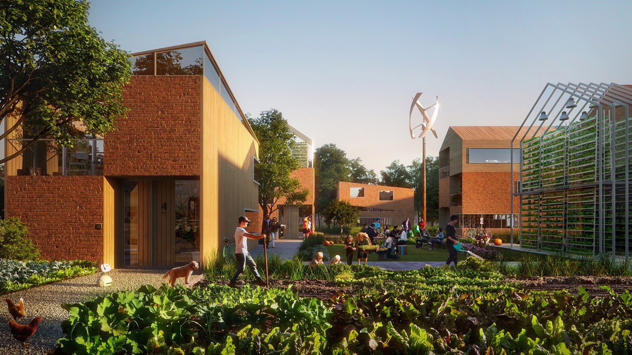
Notes:
Design principles:
BSD and its inhabitants promote quality of life (including happiness, cohesion, and health);
Everyone feels safe, assured, and welcome in the BSD community;
Activities help mitigate global challenges;
Facilities and services are shared by residents and used at will;
BSD produces no emissions of greenhouse gasses or waste;
Only renewable sources of energy are used, which produce surplus energy;
New resources and materials are only used when there is no alternative;
Mobility is accessible to everyone;
Residents are empowered to become self-reliant when it comes to healthcare and illness prevention;
All data generated and any related income are shared and managed by BSD residents;
Developments are implemented through a co-creation process (which includes residents, researchers, businesses, and government agencies) and are adaptable to future change;
Developments are applicable not only to BSD, but also other cities and towns in the Brabant region and elsewhere in the world.

Slide 8
Brainport Smart District Board
Municipality of
Helmond
Province of North Brabant
Brainport
Development
Eindhoven University of Technology
Tilburg
University

Slide 9
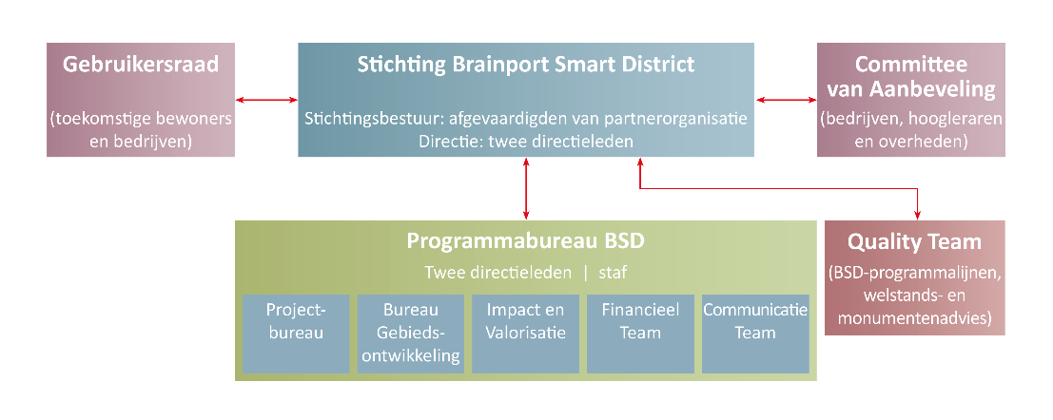
Brainport Smart District Foundation

Slide 10
Partnerships
Government
Municipality of Helmond
Province of North Brabant
Brainport Development
Knowledge Institutes
University of Technology Eindhoven
Tilburg University
Businesses
Business Challenge
Business Network
Residents
40 kavellab
User-counsel

Slide 11
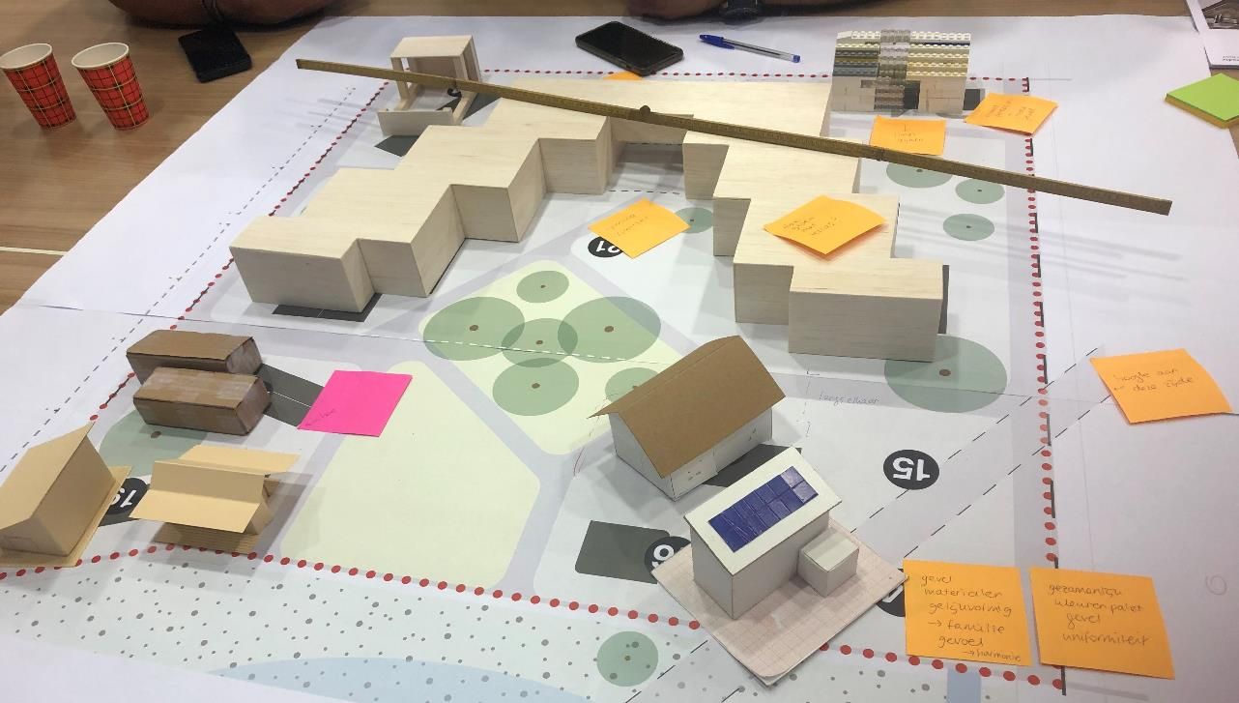
Residents: Kavel LAB
20,000 m²
Future residents help design their own living environment
Joint decisions
Expertise required
Notes:
Kavel LAB
- Future residents collectively design their own living environment
- Living requirements, interests, and levels of knowledge vary
- Joint decisions are difficult → establish an organization/entity
- Expert help required from other quadruple helix parties

Slide 12
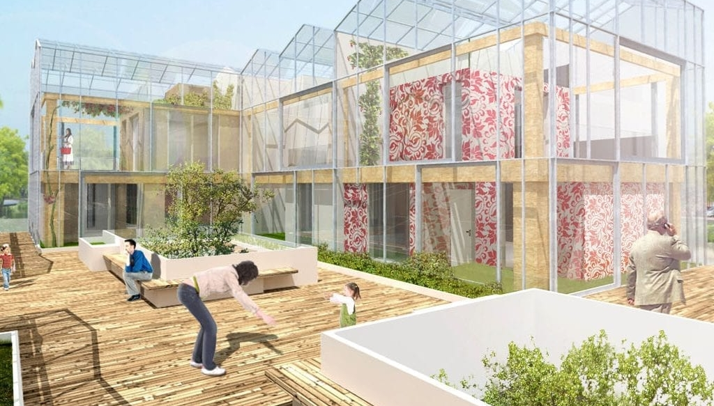
Businesses: KasCo
Energy-conserving homes
In-home production
Structural framing in wood
Customizable and movable
Windproof and waterproof shell (greenhouse)

Slide 13
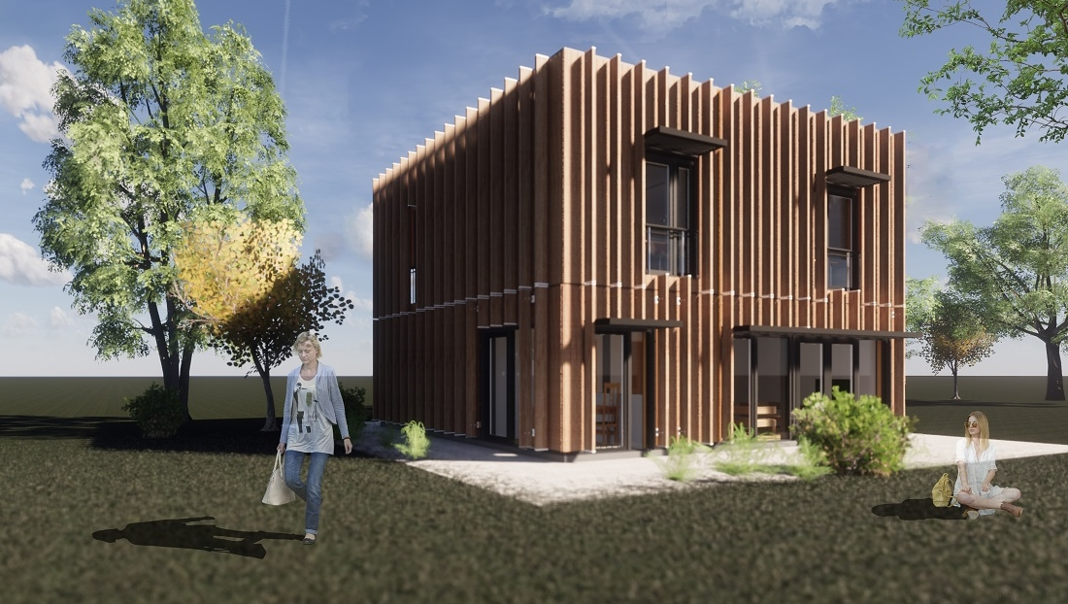
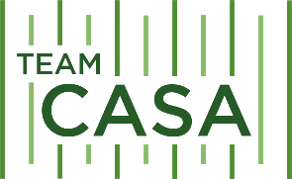
Universities: CASA
Total concept and design by students
Flexibly adaptable and expandable
Sustainable energy generation
Smart climate control (heat and cooling)
Demand-controlled ventilation
Easy to maintain
Monitoring and maintenance predictions

Slide 14
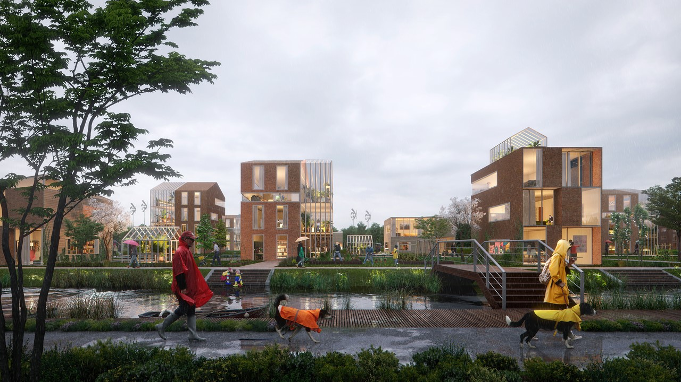
10 Lessons Learned
Knowledge levels differ
Pioneering = uncertainty = unease
Innovations never fit within existing rules
New business models ↔ Existing business cases
Expect the unexpected → PFAS, PAS
Quadruple helix → Surprising partnerships
You win some, you lose some
Innovate based on knowledge/research
Open innovation ↔ Protect IP
Dare to start!
Notes:
Knowledge levels differ Everyone has a different background and their own ideology and assumptions. This can make it sometimes difficult to understand one another. BSD operates in an ecosystem with its own jargon, which can have an inclusive effect (I speak the language, so I belong…), as well as an exclusive one. It is important to be mindful of using language that everyone can understand.
Pioneering = uncertainty = unease We are undertaking something new and deviating from the beaten track; we are innovating. While some people are highly driven to innovate and like it, we still all have a need for certainty, especially when it comes to your own residence or a project that will impact you.
Innovations never fit within existing rules We have discovered that the world we live in is made up of checklists: get enough check marks and you receive a stamp and can proceed. It proves difficult to deviate from those normal processes. It can be done, but it involves establishing another, new, procedure, and that takes time. This has been evident with the CASA homes; they will be built, but we’ve run into some unforeseen processes getting there.
New business models ⬄ Existing business cases
New innovations often require new, innovative funding models, as well. Costs and returns don’t always fall into the logical, customary categories in these. Yet, we have noticed that, invariably, the reflex is to still attempt to structure the new business model so that it will fit in with the old, familiar business case.
Expect the unexpected → PFAS, nitrogen policy Not everything can be planned, so make sure to also anticipate opportunities and risks. You’re bound to encounter some surprises. Just read the papers: PFAS, the government’s nitrogen policy. Sometimes, there’s fortune in misfortune: because of an accident involving PFAS, the city of Helmond now has its affairs in order sooner than many other cities. That means that soil for construction projects can be relocated to places within city limits.
Quadruple helix > Surprising partnerships There are more and more projects in which government agencies, businesses, knowledge institutes, and residents work together. While not everyone may see the added value of this from the outset, we have noticed a growing awareness of the benefits. A quote from an innovative company that uses salt to store energy (how cool): “That collaboration gave me new insights that I really could not have conceived of myself before that.”
You win some, you lose some Innovating, doing new things, is an adventure into the unknown. And that inherently brings with it some risk. Sometimes, that is a good thing, and you need to take a calculated risk in all good conscience. Part of that includes accepting the consequences. We’re working together to achieve innovation, and that means having both lucky breaks and setbacks. You win some, you lose some.
Innovate based on knowledge/research Included in the Quadruple Helix are, of course, the knowledge institutes, eager to perform research and monitor innovations so that we can learn and duplicate what works → widen and deepen. It has proven difficult to clearly formulate the relations in this: what are we going to research (fundamental vs. practical), and how can all of the parties involved benefit? How do you then distribute the assets (possibly IP) and liabilities (cost of the research, etc.)?
Open innovation ⬄ Protect IP The BSD system is compatible with an open innovation system. In practice, though, we have been encountering many requests for NDAs or for making supplementary agreements regarding confidentiality and IP, sometimes accompanied by draconian penalty clauses. We understand how valuable IP is and that companies want to maintain an advantage. But not on every little thing! We are thus taking a critical stance in determining IP, including weighing how great the business interests are versus those of society (open innovation).
Dare to start! This is the final lesson we have learned. At some point, you simply have to start. A single lawyer can list more risks than 10 wise people could ever solve, and then things will never get off the ground. There are some risks you can only tackle by identifying them, communicating about them very transparently and openly, and testing in practice whether they do, in fact, occur. We learned from Ig Snellen, a professor from Rotterdam, that the legal dimension is just one of four dimensions, meaning that that 25% is always in the minority.

Slide 15
Thank you for your attention!
Any questions?
LinkedIn: teunmeulepas
t.Meulepas@brainportsmartdistrict.nl

