Slide 1
INTERNATIONAL NUCLEAR CONFERENCE
STATE-ON-THE ART OF THE MODULAR NUCLEAR REACTORS
FOR THE MARKET OF SOUTH EAST EUROPE 12-13 January 2023
CHALLENGES IN LICENSING AND REGULATING SMRs IN BULGARIA LEGAL AND REGULATORY ASPECTS
INTERNATIONAL NUCLEAR CONFERENCE “STATE-ON-THE ART OF THE MODULAR NUCLEAR REACTORS FOR THE MARKET OF SOUTH EAST EUROPE”, 12-13.01.2023
Notes:
1
1
1

Slide 2
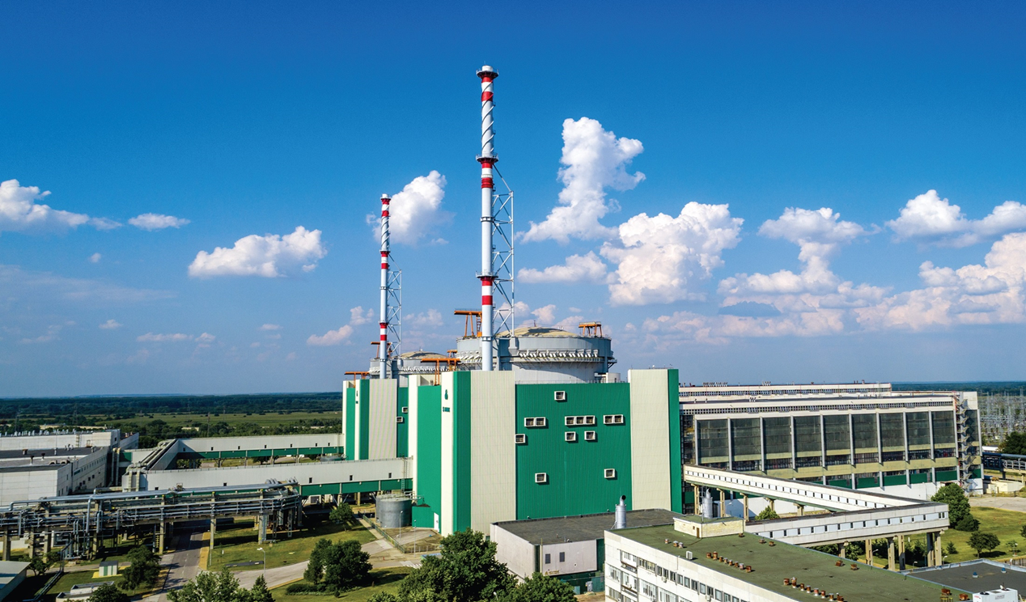
GENERAL OVERVIEW
NUCLEAR PROFILE
Bulgaria is a country with a developed national nuclear program with more than 45 years of experience in the field of nuclear energy
LEGAL FRAMEWORK
A comprehensive legal and regulatory framework has been developed in relation to the safe and peaceful use of nuclear energy
REGULATION
BNRA has extensive experience in assessing the safety and licensing of nuclear power plants

Slide 3
LEGAL INSTRUMENTS
IN THE AREA OF USE OF NUCLEAR ENERGY AND
SF AND RAW MANAGEMENENT
ACT ON THE SAFE USE OF NUCLEAR ENERGY (NUCLEAR ACT)
Adopted in 2002, last amended and supplemented – in 2020
SECONDARY LEGISLATION INSTRUMENTS
22 Regulations on the application of the Nuclear Act
23 Regulatory Guides issued by BNRA
OTHER RELATED PRIMARY LEGISLATION INSTRUMENTS
THE EXISTING LEGAL BASIS IS DEVELOPED FOR THE PURPOSES OF LICENSING OF LARGE NUCLEAR REACTORS
The legal basis is also applicable for other nuclear facilities like National Disposal Facility
3/14
INTERNATIONAL NUCLEAR CONFERENCE “STATE-ON-THE ART OF THE MODULAR NUCLEAR REACTORS FOR THE MARKET OF SOUTH EAST EUROPE”, 12-13.01.2023
Notes:
3
3

Slide 4
CURRENT AUTHORISATION PROCESS
POLITICAL
(PRE-LICENSING) PHASE
Political decision of the Council of Ministers for the construction of the respective facility on a motion by the Minister of Energy;
Decision of the Minister of Environment for the approval of the Environmental Impact Assessment Report
TECHNICAL PHASE
Licenses and permits are granted, amended, suspended, or revoked
by the Chairperson of the BNRA
SITE SELECTION STAGE
permit for site selection and subsequent order for the approval of the selected site
DESIGN STAGE
design permit and subsequent order for the approval of the technical design of the facility
Other state bodies involved in the authorization process:
Ministry of Energy
Ministry of Environment and Waters
Ministry of Regional Development and Public Works
Ministry of Health
Ministry of interior
Energy and Water Regulatory Commission
CONSTRUCTION STAGE
construction permit
COMMISSIONING STAGE
commissioning permit
OPERATIONAL STAGE
operational license
DECOMMISSIONING STAGE
decommissioning license
CLOSURE - FOR A DISPOSAL FACILITY
performed in the frame of the license for operation on the facility on the basis of a Facility Closure Plan
4/14
INTERNATIONAL NUCLEAR CONFERENCE “STATE-ON-THE ART OF THE MODULAR NUCLEAR REACTORS FOR THE MARKET OF SOUTH EAST EUROPE”, 12-13.01.2023
Notes:
4
4
4

Slide 5
TECHNOLOGY
The Bulgarian Nuclear Regulatory Agency (BNRA) is monitoring closely the development of new nuclear technologies especially the efforts in development of SMRs.
BNRA considers that many of the currently developed SMRs conceptual designs meet the expectations for Generation IV reactors safety level.
BNRA notices the growing interest in deployment of SMRs to significantly contribute as clean energy source for decarbonisation of the economies.
They do have their place in the energy mix of every country once the basic design safety is confirmed and once all national requirements for the safety of the particular application are met.
In this process the importance of application of the 3S concept (Safety, Security and Safeguards) should not be underestimated.
5/14
INTERNATIONAL NUCLEAR CONFERENCE “STATE-ON-THE ART OF THE MODULAR NUCLEAR REACTORS FOR THE MARKET OF SOUTH EAST EUROPE”, 12-13.01.2023
Notes:
5
5

Slide 6
REGULATION
Like any innovation, SMRs cause both enthusiasm and mistrust in different parts of society.
The role of the Regulator is to carry out a thorough assessment of the safety of the proposed technologies to ensure the Protection of human life, health and living conditions of present and future generations, and property against harmful impact of ionizing radiation.
In the process of assessment, the Regulator also has to be convinced that every aspects of the SMR life cycle is addressed properly, including human and financial factors.
Bulgarian regulatory frame is rather supportive at earlier stage of concept development and proceeding with proposals.
6/14
INTERNATIONAL NUCLEAR CONFERENCE “STATE-ON-THE ART OF THE MODULAR NUCLEAR REACTORS FOR THE MARKET OF SOUTH EAST EUROPE”, 12-13.01.2023
Notes:
6

Slide 7
BNRA RECENT ACTIVITIES
Over the past three years BNRA has taken a number of steps to assess the potential limitations to the implementation of new technologies from the point of view of Bulgaria's regulatory framework:
General overview of the offered technologies
Review of the national regulatory framework in the light of the available information on various projects
Review of safety assessment approaches of other regulators
Review of the spectrum of the international initiatives related to SMRs
Participation in the discussion of the Safety Reference Levels for SMRs in WENRA
7/14
INTERNATIONAL NUCLEAR CONFERENCE “STATE-ON-THE ART OF THE MODULAR NUCLEAR REACTORS FOR THE MARKET OF SOUTH EAST EUROPE”, 12-13.01.2023
Notes:
7

Slide 8
GENERAL OUTCOME
MAIN RESULTS OF THE REVIEW
The existing regulatory framework is oriented towards light water reactors
Safety requirements in the current regulatory framework do not represent an obstacle to the implementation and effective regulation of projects based on light-water SMRs.
In-depth knowledge of the specific technology by all project stakeholders is required to ensure that safety is not compromised
The large number of MMP technologies do not allow the thorough review and assessment of safety of all of them
Limited human resources do not allow to actively engage in all initiatives
8/14
INTERNATIONAL NUCLEAR CONFERENCE “STATE-ON-THE ART OF THE MODULAR NUCLEAR REACTORS FOR THE MARKET OF SOUTH EAST EUROPE”, 12-13.01.2023
Notes:
8
8

Slide 9
GENERAL OUTCOME
MAIN CONCLUSIONS
A systematic approach to the problem is needed and BNRA is working on the conceptual assessment on the related issue
An action plan should be developed to deal with the issues
Development of specific competences of the BNRA experts is necessary
At this stage only the international cooperation can help us to address the challenges
9/14
INTERNATIONAL NUCLEAR CONFERENCE “STATE-ON-THE ART OF THE MODULAR NUCLEAR REACTORS FOR THE MARKET OF SOUTH EAST EUROPE”, 12-13.01.2023
Notes:
9

Slide 10
BNRA ACTION PLAN
THREE STEPS IN THE INPLEMENTATION OF THE ACTION PLAN
FIRST STEP
(ongoing activity)
Participation in the Regulatory Track Working Group 2 of the NHSI initiative of IAEA
Purpose - to benefit to maximum extend from international
experience and to stimulate the active participation of BNRA
Regulatory Authority capacity building measures in respect of SMRs safety assessment and licensing
Creating a dedicated team
Development of specific competences
Exchange of regulatory experience
10/14
INTERNATIONAL NUCLEAR CONFERENCE “STATE-ON-THE ART OF THE MODULAR NUCLEAR REACTORS FOR THE MARKET OF SOUTH EAST EUROPE”, 12-13.01.2023
Notes:
10

Slide 11
BNRA ACTION PLAN
SECOND STEP
Development of internal rules/procedures for evaluation of innovative projects
Purpose of the procedure – creation of a basis for dialogue
between the applicants and the regulator
Limitation of the subjectivity in defining and discussing the identified problems
In-depth discussion of identified issues
Early detection of showstoppers
11/14
INTERNATIONAL NUCLEAR CONFERENCE “STATE-ON-THE ART OF THE MODULAR NUCLEAR REACTORS FOR THE MARKET OF SOUTH EAST EUROPE”, 12-13.01.2023
Notes:
11

Slide 12
BNRA ACTION PLAN
THIRD STEP
Review and, if necessary, amendments to the regulatory framework
Development of proposals for amendments to the Nuclear Act, the Regulation on nuclear power plants safety and the Regulation on the licensing and permitting procedure.
Review and amendment if necessary to other regulations and the gradual update of the related regulatory guides.
12/14
INTERNATIONAL NUCLEAR CONFERENCE “STATE-ON-THE ART OF THE MODULAR NUCLEAR REACTORS FOR THE MARKET OF SOUTH EAST EUROPE”, 12-13.01.2023
Notes:
12

Slide 13
IMPORTANT ASPECTS
The condition of having a reference project is recommended in the relevant licensing regulation
One of the conditions for licensing any project is the availability of qualified personnel
The requirement is directly related to ensuring safety
Need for investments in the educational field aimed at development of programs related to innovative projects – SMRs. The earlier, the better!
A close interaction between the holders of innovative technologies, the industry and the secondary and higher schools could be the best way to guarantee the development of relevant local know how
13/14
INTERNATIONAL NUCLEAR CONFERENCE “STATE-ON-THE ART OF THE MODULAR NUCLEAR REACTORS FOR THE MARKET OF SOUTH EAST EUROPE”, 12-13.01.2023
Notes:
13

Slide 14
Thank you for your attention!
Notes:
14
14
14

