Slide 1
2023 Bulgarian Energy & Mining Forum
“STATE-OF-THE-ART SMALL MODULAR REACTOR TECHNOLOGIES AND THEIR PREPAREDNESS FOR THE MARKET OF SOUTHEASTERN EUROPE”
Jeff Harper, VP Strategy and Business Development, X-energy
January 2023
jharper@X-energy.com
© 2022 X Energy LLC, all rights reserved
1

Slide 2
The Market for Nuclear is Improving at an Accelerated Rate
 |  | United States |  | Canada |  | United Kingdom |  | Central Europe |  | Middle East
Market Trends |  | Ongoing retirement of coal-fired, baseload generation in favor of cleaner technologies – 59 GWs to be retired by 2035¹ Stakeholder pressure to decarbonize electric grids and company operations Inflation Reduction Act |  | Strong commitment to developing new nuclear by power producers and utilities Western provinces primarily rely on fossil fuel power generation Increased carbon taxes to $170 per ton by 2030 |  | Need for generation capacity to load-follow renewables Delivering new and advanced nuclear power is part of the U.K.’s Ten Point Plan for a Green Industrial Revolution 66 GWe estimated U.K. SMR & AMR deployment by 2050² |  | Reliance on fossil fuel energy production Motivated to increase energy independence rather than rely on imported natural resources Significant operations in energy- intensive industries such as Manufacturing and metals/mining |  | Reliance on fossil fuel energy production / need capacity to load-follow renewables Significant need for clean water in a warming climate environment
Net Zero Policies and Recent Announcements |  | West Virginia, Illinois, Indiana, Montana passed favorable nuclear legislation in the last 6 months |  | Pathways Alliance comprising Canada’s largest oil sands producers announced goal of net zero emissions by 2050 |  | U.K. Government has chosen High-Temperature Gas Reactors (HTGRs) as its preferred technology |  | Several Central European countries aggressively moving to ensure energy security by considering deployment of base load nuclear power |  | Jordan, UAE, Egypt, Saudi Arabia, and Turkey all have nuclear power ambitions
Energy Security Concerns |  | Carbon-free baseload power Industrial applications Oil & Gas use cases |  | Carbon-free baseload power Industrial applications Carbon capture & sequestration |  | Carbon-free baseload power Industrial applications Ukraine |  | Coal plant refurbishment Process heat - heavy industries Ukraine |  | Carbon-free baseload power Desalinization of water
Illustrative Potential Players
Source: EIA.
National Nuclear Laboratory, UK Energy System Modeling: Net Zero 2050 Higher Optimism Case for Gen IV and LWSMR Reactors.

Slide 3
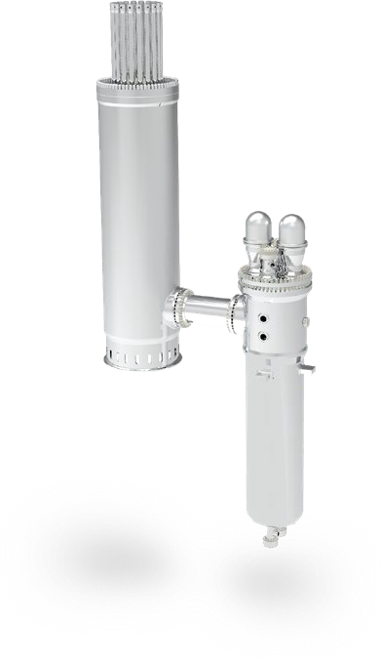
X-energy at a Glance
2009
Company Founded
Rockville, MD
Headquarters
X-energy’s next generation nuclear technology:
Xe-100
400
Employees
$1.2B
Funding secured through ARDP
80 MWe Small Modular Reactor (“SMR”) that can be scaled into a ‘four-pack’ 320 MWe power plant. Capable of delivering electricity and 565°C high-temperature steam
TRISO-X
2028
Xe-100 commercial operation
US DOE Advanced Reactor Development Program
Proprietary fuel designed as cue ball-sized pebble with microscopic kernels of uranium wrapped in indestructible layers of carbon. TRISO-X fuel retains waste and fission products during all conditions and cannot melt

Slide 4
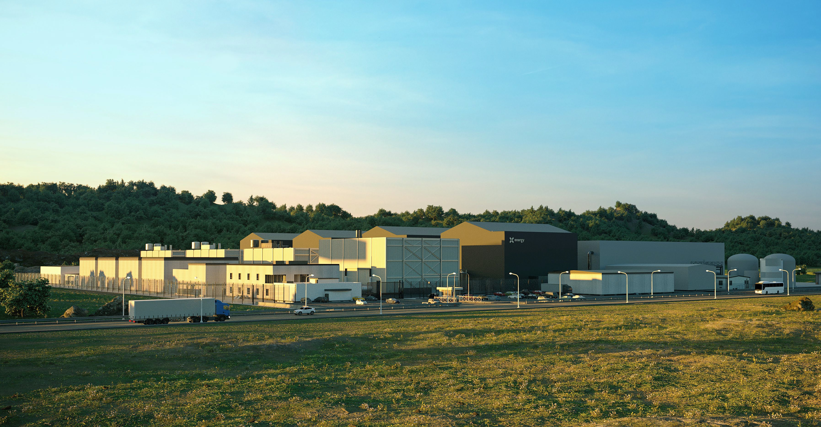
200MWt / 80 MWe pebble-bed helium gas-cooled reactor
Scalable from 1-12 modules per site
No reliance on onsite or offsite power to perform any required safety functions
Highly competitive First-of-a-Kind (FOAK) Levelized Cost of Electricity (LCOE) and significant Next-of-A-Kind (NOAK) cost improvements
1/10th the components of a traditional nuclear plant

Slide 5
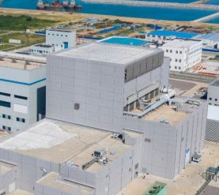
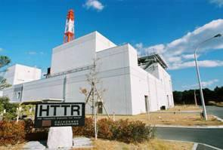
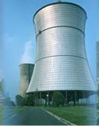
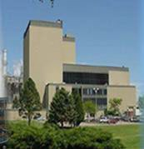
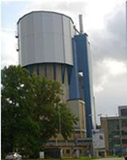
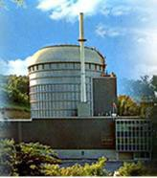
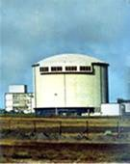
HTGRs Leverage Proven Technology with Novel Flexibility
Continuous innovation to improve safety and economics with a focus on simplicity, reliability, flexibility.
USA
China
China
Japan
Germany
USA
2005 - Present
2021 - Present HTR-PM
HTGR - First SMR Deployment this decade
2000-Present HTR-10
Germany
1998-Present HTTR
1986-1989
THTR
USA
1967-1988
Fort St. Vrain
UK
1967-1988
AVR
The HTGR is the SMR reactor technology nearest deployment that allows for flexibility in siting and application
1966-1974
Peach Bottom
USA
1966-1975
Dragon
Mining / Oil Extraction
Hydrogen Production
Electricity Generation
Process Heat
1944
ORNL

Slide 6
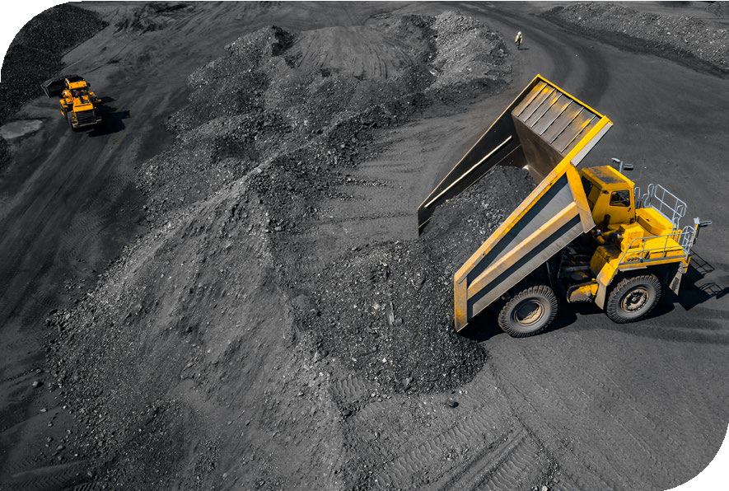
Energy Density for Nuclear Makes It a Desirable Choice
1 pebble:
7g with 15.5% wt Low Enriched Uranium
~ 0.8 metric tons of ash
8.0 metric tons of CO₂
27.4 MWh
2.66 metric tons of coal
Reference: https://www.eia.gov/tools/faqs/faq.cfm?id=667&t=2

Slide 7
Intrinsic Safety: HTGR Fuel
We manufacture our own proprietary TRISO encapsulated fuel (TRISO-X) to ensure supply & quality control.
TRISO Coated Particle
The U.S. DOE describes TRISO fuel as “the most robust nuclear fuel on Earth,” it retains waste and fission products within the fuel during ALL conditions, even worst-case accidents and cannot melt.
Why is this important?
Because TRISO-X Fuel IS the containment vessel we will have no more expensive, gigantic concrete & steel structures to build, maintain and decommission.
UCO kernel Porous Carbon
Pyrolytic Carbon Silicon Carbide
Pyrolytic Carbon
TRISO Fuel has 40+ years of prototype and full-scale demonstration reactors.
This is a proven safety approach.
The low reactor power density and self-regulating core design (i.e., if cooling stops, the core shuts down), ensures the reactor is always ‘walk-away safe.’
Physics, not mechanical systems, ensures 100% safety

Slide 8
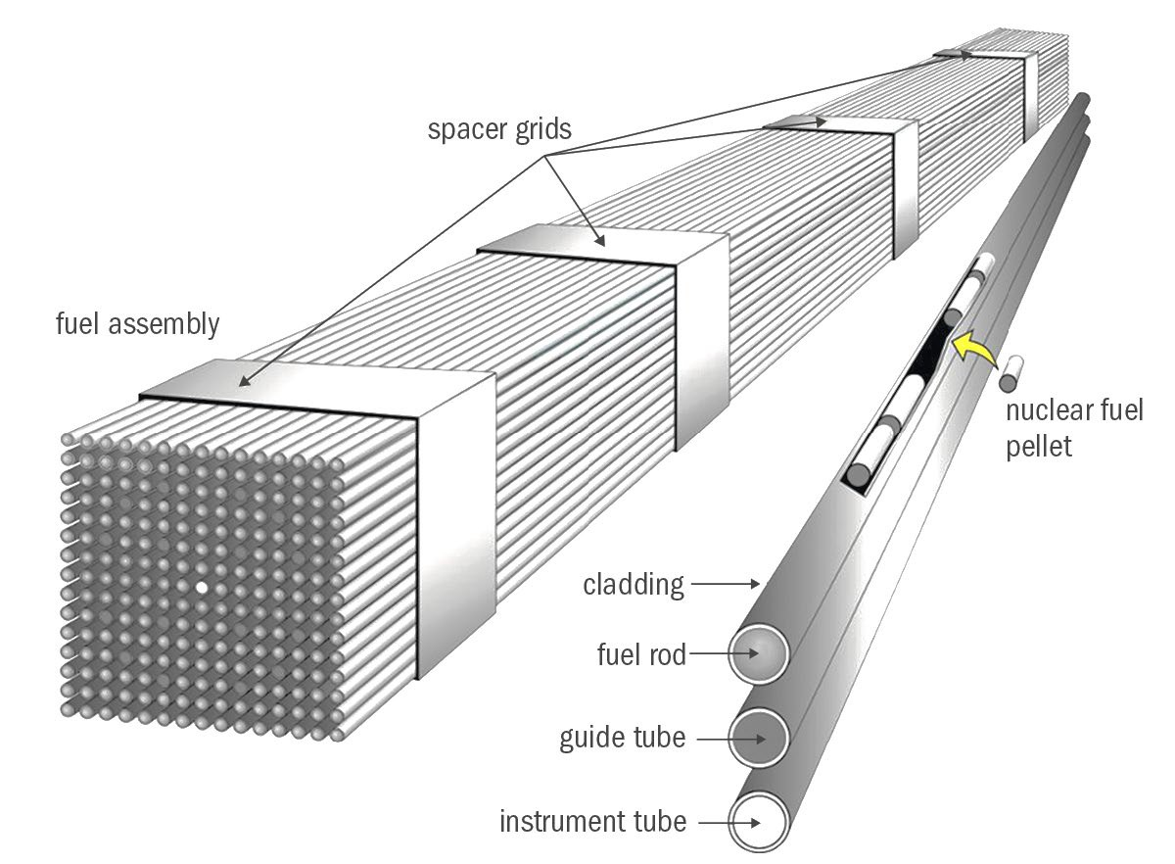
TRISO-based Fuel Comparison
TRISO-coated Fuel
15.5% U-235 Enrichment
Fuel Pellets
5-6% U-235 Enrichment
Average burnup per fuel element is 168,000 MWd/t_{HM}
Average burnup achieved per fuel element is 45,000 MWd/t_{HM}
18 million pellets per reactor, bundled in assemblies
19,000 thousand HALEU particles per pebble (6 cm)
224,000 pebbles per reactor
Fuel can melt in extreme cases and Zirconium cladding reacts to create hydrogen
Graphite pebbles cannot melt
Decay heat per fuel element (1%) is 8 watt
Decay heat per fuel element (1%) is 2.175 kW
Spent fuel is air-cooled
Spent fuel must be cooled down in spent fuel pools for years before being air-cooled
https://physicsworld.com/wp-content/uploads/2021/02/Allen-fig1.png

Slide 9
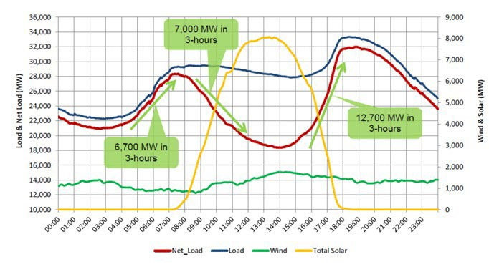
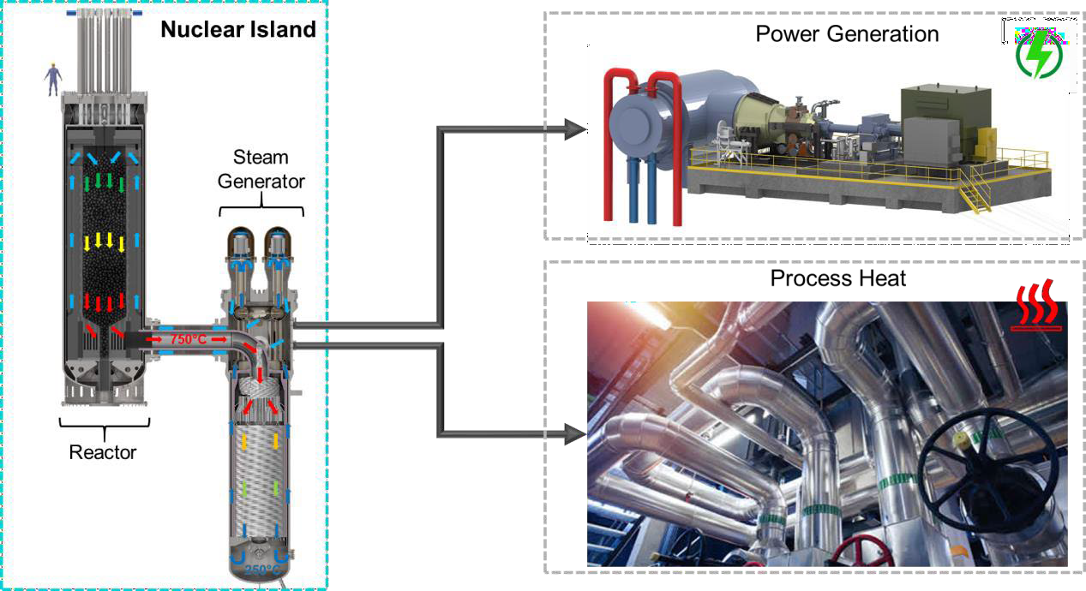
The “Xe-100“- Innovative and Flexible
(1) Right size
(2) Broad range of applications
The reactor size of 200MWt (80MWe) has been designed to address the largest possible market providing a good fit for replacement of existing carbon-based heat sources such as coal and gas.
The nuclear island has been designed to be independent of the end use making our solution deployable for electricity and many other applications that require process heat to replace carbon-based fuels
Hydrogen production
Desalination
Petrochemical industries
District heating ….
Heat is generated in the pebble fuel through fission and transferred to the steam generator using helium that cannot be activated
(3) Flexible power delivery
Designed to be capable of fast and efficient load following thus supporting the intermittency of solar and wind
Steam at 565°C

Slide 10
HTGR’s Thermal Output is Optimal for Most Industrial Applications
100⁰C
200⁰C
300⁰C
400⁰C
500⁰C
600⁰C
700⁰C
800⁰C
900⁰C
1000⁰C
HTSE and Thermo-Chemical
Hydrogen Production
Coal Gasification
Steam Reforming of Natural Gas Biomass Hydrothermal Gasification
Cogeneration of Electricity / Steam
Oil Shale & Oil Sand Processing
Petroleum Refining
Ethanol Concentration
Seawater Desalination
District Heating
800-1000°C
500-900°C
A single modern oil & gas refinery site could have up to 4,000MWt of capacity
– the equivalent of 20 Xe-100 reactors
350-800°C
300
-600°C
250-550°C
80-200°C
LWRs
HTGRs
Future HTGRs

Slide 11
HTGRs are the Most Advanced SMR Technology
Traditional SMR
 | Large-Scale Nuclear | Gen III | HTGRs
Carbon-free Baseload Power | ✓ | ✓ | ✓
Material and Land Use Efficient | ✓ | ✓ | ✓
Emergency Planning Zone at Site Boundary | ✗ | ✓ | ✓
Best-in-Class Safety and Reliability | ✗ | ✗ | ✓
Industrial Heat Use Case | ✗ | ✗ | ✓
Fuel Waste Disposal & Safety | ✗ | ✗ | ✓
Readily Deployable Technology:
The Xe-100 systems are all currently assessed at Technology Readiness Level 7, or above.

Slide 12
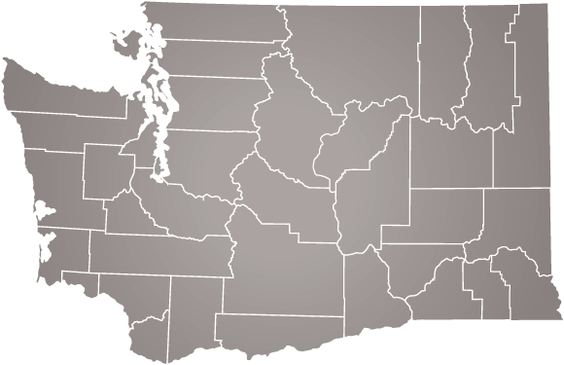
Competitive Position Reinforced by ARDP
X-energy’s selection for the DOE’s Advanced Reactor Development Program (“ARDP”) represents a critical advantage that cannot be replicated
ARDP Overview
What ARDP Selection Means to X-energy
In May 2020, the DOE announced the ARDP to speed the transition of next generation nuclear reactors from concept to demonstration through cost-share partnerships
Recognition from the DOE as an advanced reactor technology of choice
Selected out of ~50 applicants
Secures first customer deployment
In October 2020, X-energy was selected to deliver a commercial a first-of-a-kind advanced nuclear plant with Energy Northwest¹ as well as a commercial TRISO- X fuel fabrication facility
Partnered with Energy Northwest to deploy with one of the public utility districts
Customer also benefits from the 50% cost-share on their development and construction costs
The program provides 50% cost share on all costs to deliver the first plant
Our ARDP Project With Energy Northwest
Provides $1.2 billion in funding from the DOE
Energy Northwest Project
4-reactor Xe-100 Plant (320MW)
Fully funds all remaining design, licensing, and commercialization milestones of the reactor, including overnight CAPEX
Funds the completion of the first TRISO-X fuel fabrication facility
Strengthens DOE’s support of the advancement of TRISO fuel
Exemplifies the DOE’s commitment to scaling TRISO fuel production in the U.S.
We are the only advanced reactor company producing TRISO fuel
1) In negotiation with Grant County PUD, but exact utility under Energy Northwest agreement is still being determined.

Slide 13
Recent Announcements
Dow, X-energy to drive carbon emissions reductions through deployment of advanced small modular nuclear power
Dow and X-energy collaborate on intent to provide process heat and power at one of Dow’s U.S. Gulf Coast facilities by ~2030
Dow is first manufacturer to announce intention to develop small modular nuclear technology options
Dow intends to take a minority equity stake in X-energy
Toronto – Ontario Power Generation (OPG) and X-energy have signed a framework agreement to pursue opportunities to deploy Xe-100 small modular reactors (SMRs) for industrial applications in Canada.
Under the agreement, OPG and X-energy will pursue opportunities to deploy Xe-100 advanced reactors in Ontario at industrial sites and identify further potential end users and sites throughout Canada.

Slide 14
Coal Plant Repurposing
Feasibility study
Western Maryland Generating Station
Technical Assessment
Overall site suitability
Existing site infrastructure
Site plot plan of an Xe-100
Key regulatory considerations
Implementation schedule
Economic Evaluation
Electricity Market Assessment
Consideration of products and revenue beyond electricity
Assess plant investment and operating costs
Key risks and opportunities that can measurably impact economics
© 2022 X-energy Reactor Company LLC, all rights reserved 13

Slide 15
empowering earth
Jeff Harper
VP Business Development jharper@x-energy.com
Clean • Safe • Secure • Affordable

