Slide 1
Overview for Bulgarian Energy & Mining Forum: International Nuclear Conference
January 12, 2023
Scott E. Rasmussen
Director of Sales

Slide 2
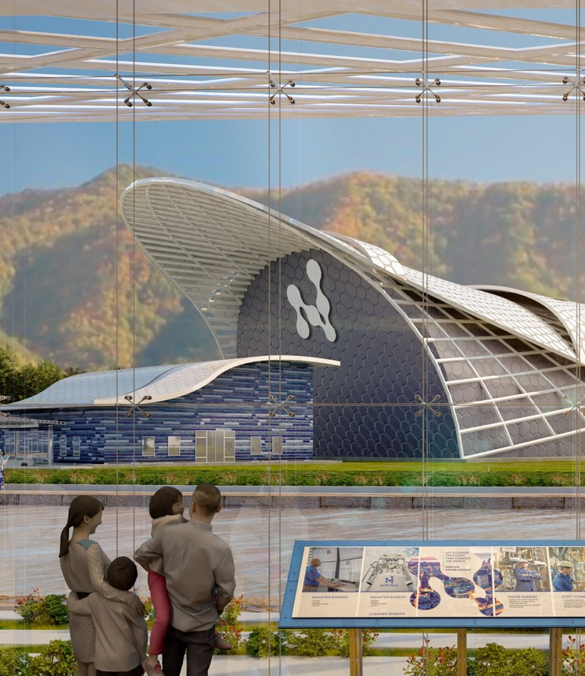




NuScale’s Mission
NuScale Power provides scalable advanced nuclear technology for the production of electricity, heat, and clean water to improve the quality of life for people around the world.
We will achieve this mission by providing technology that is:
SMARTER
CLEANER
SAFER
COST COMPETITIVE

Slide 3









NuScale at a Glance
NuScale at a Glance
1st
And Only SMR to
Receive US NRC Standard
Design Approval
$1.4B
Cumulative Capital
Invested to Date
545
Employees with Unparalleled Nuclear Experience
28
PhDs
180
Masters in Engineering/
Science Degrees
644
Total
Patents
453
Granted
191
Pending
Extensive Trade Secrets
15
Years of R&D
and Testing
Founded in 2007
9
Strategic Investors
Supporting Global
Customer Adoption¹
Smarter
Cleaner
Safer
Cost Competitive
1. Established Supply Chain Network with Continued DOE Support

Slide 4

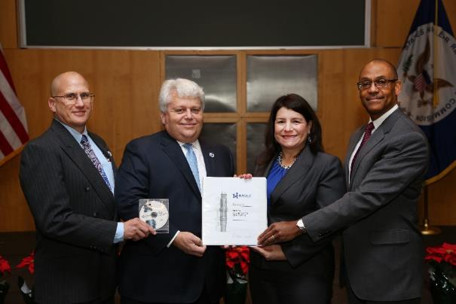


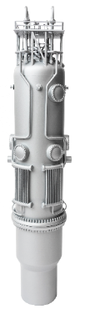
First SMR to Undergo Licensing in the U.S.
Design Certification Application (DCA) for VOYGRTM-12 (50 MWe-per-NPM design) completed in December 2016
Docketed and review commenced by U.S. Nuclear Regulatory Commission (NRC) in March 2017
NuScale received Standard Design Approval (SDA) in September 2020
Commission voted unanimously to approve design certification in July 2022
DCA Statistics
NuScale Power Makes History as the First Ever Small Modular Reactor to Receive U.S. Nuclear Regulatory Commission Design Approval
12,000+ pages
14 topical reports
>2 million labor hours
>800 people
>50 supplier/partners
Over $500M invested to-date on licensing

Slide 5









Company History and Key Milestones
$1.4B Capital Invested¹
2007
2008
…
2011
…
2013
2014
…
2016
…
2019
2020
2021
2022 and Beyond
Formation
of NuScale Power, LLC
UAMPS Site
Selection
$1.4B U.S. DOE cost share
for UAMPS
2024: NRC Approval of 77 MWe 6-module Configuration, Plant Design Ready for Construction and Module Fabrication
2027: Ability to Deploy Modules
Secured First Customer
NuScale and KGHM sign first Task Order and a Statement of Commencement to begin work under Early Works Agreement
Began NRC
Pre-Application
First-Ever SMR
Design Certification Application (DCA) Submitted to NRC
NRC Approval of
Final Safety
Evaluation Report
NuScale Teaming Agreement with Romania
Announced
by U.S. White
House
$226mm U.S. DOE SMR Award Recipient
Merger closed with Spring Valley and company listed on NYSE.
$341 million net proceeds after transaction costs and redemption (37.5%)
NRC Standard
Design Approval of
160 MWth (50 MWe),
12-module plant design
Note: Grey shaded area represents actual capital spend by NuScale over time, including both from private investor capital raised and funds received from the DOE cost sharing program. Logos represent first investment in NuScale.
1. Represents cumulative capital invested through June 30, 2022. Includes funding received from the DOE cost sharing program. Excludes any capital raised as part of a de-spac transaction.

Slide 6


Non-proprietary
Value Proposition
Energy
Hydrogen
Industrial
Plant
Technology
Financing
Ownership
Development/
Execution
Operation
Job
Creation
Localization
Energy Independence
Decarbonization

Slide 7
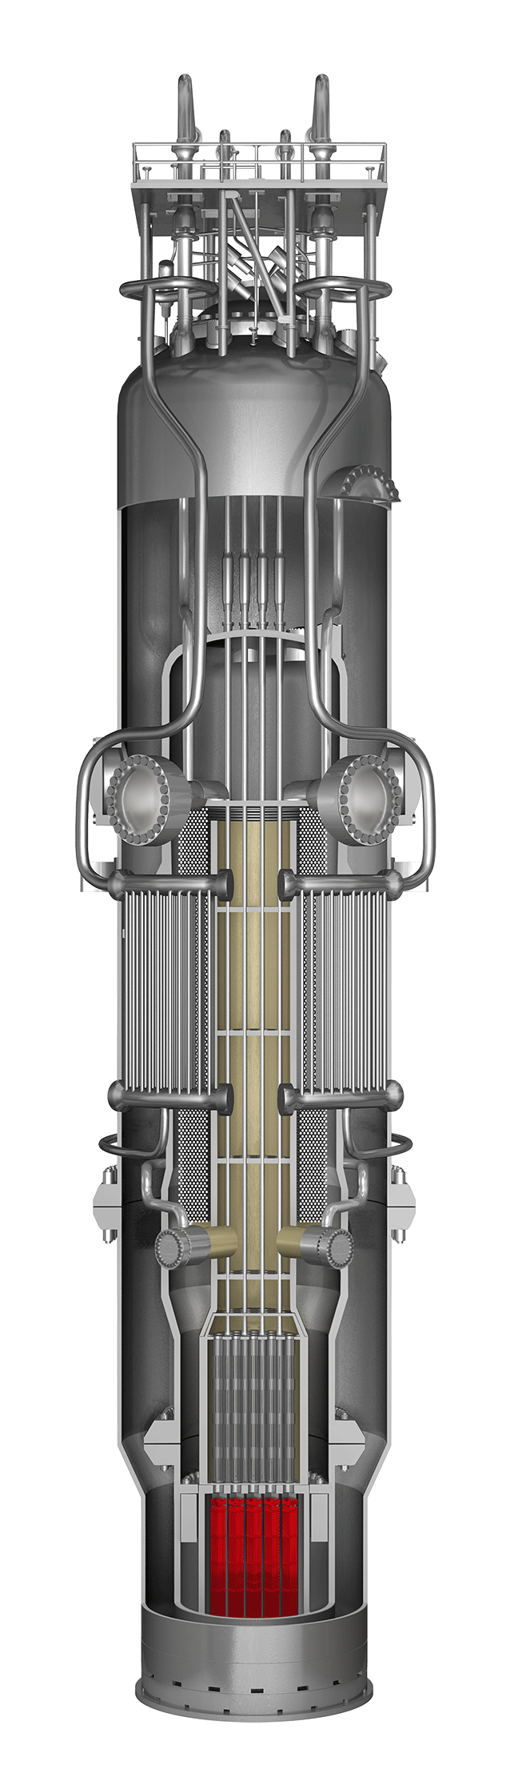

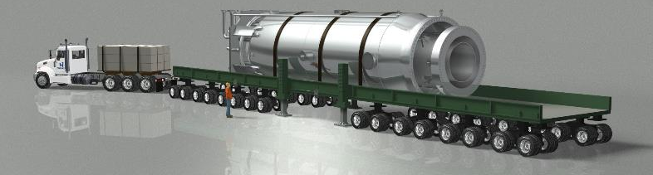
NuScale’s Core Technology: the NuScale Power Module™
Groundbreaking technology features a fully factory fabricated SMR referred to as a NuScale Power ModuleTM consisting of an integral nuclear steam supply system in which the reactor core, steam generators and pressurizer are all contained in a single vessel
Containment
Simple design eliminates reactor coolant pumps, large bore piping and other systems and components found in conventional reactors
Pressurizer
Simplicity results in an extremely strong safety case and reduced capital and operational costs
Steam Generators
76 ft
23.2 m
Reactor
Pressure Vessel
Modules can be incrementally added to match load growth
NuScale Power ModuleTM Specifications
Electrical Capacity | 77 MWe
Modules per Plant | Up to 12 (924 MWe)
Design Life | 60 years
Fuel Supply | Existing light water reactor nuclear fuel
Safety | Walk-away safe
Emergency Planning Zone (EPZ) | Supports site boundary EPZ
Reactor Core
15 ft
4.6 m

Slide 8
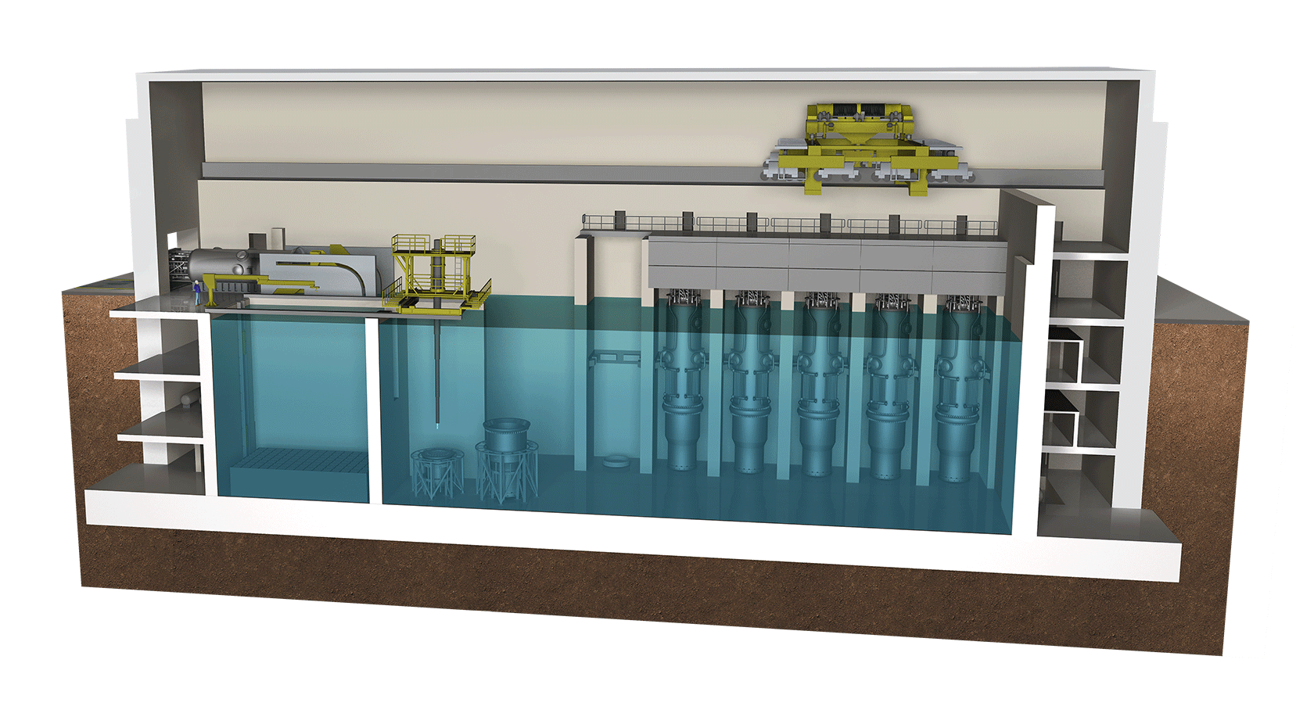
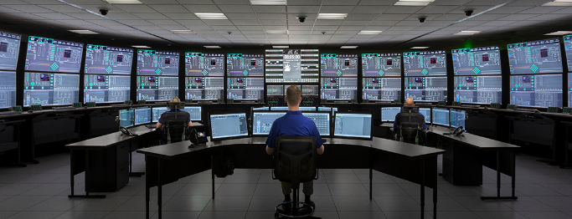
Key Enabling Features Dependent on Patented Technology
5
Scalable Reactor Building Design
1
Evacuated Containment Design
2
Passive Safety System
Cyber-secure FPGA
Based Module Protection
6
7
Digital Multi-Module Control Room
3
Integral Steam Generator
4
Natural Circulation System
NuScale Power ModuleTM
NuScale Plant Control Room

Slide 9
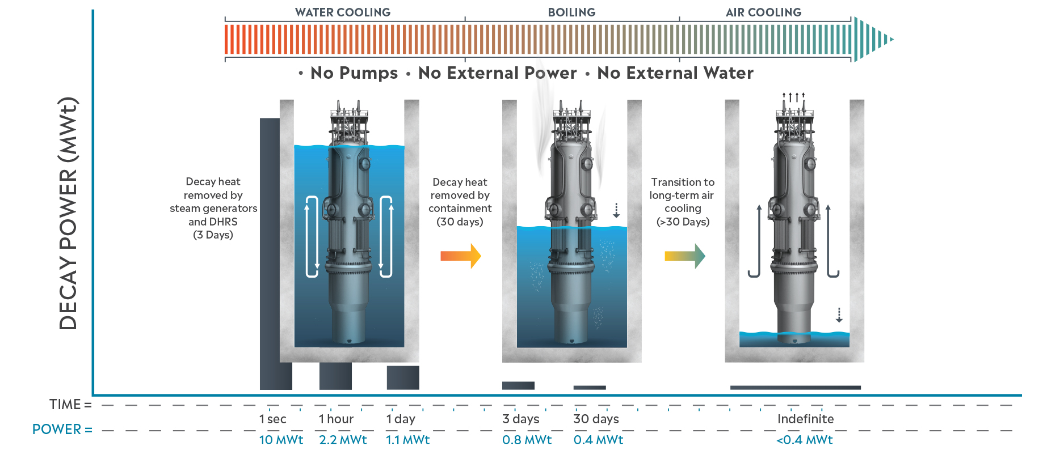
Innovative Advancements to Reactor Safety
Nuclear fuel cooled indefinitely without AC or DC power*
*Alternate 1E power system design eliminates the need for 1E qualified batteries to perform ESFAS protective functions – Patent Granted

Slide 10
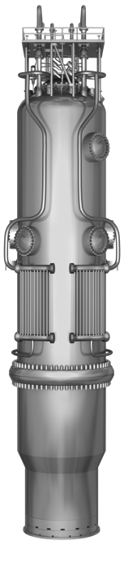
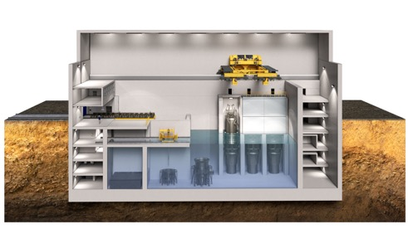
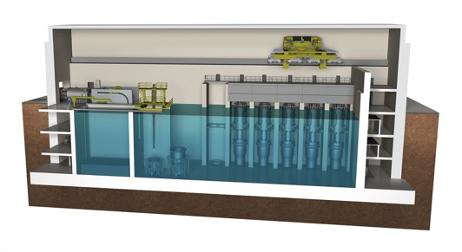

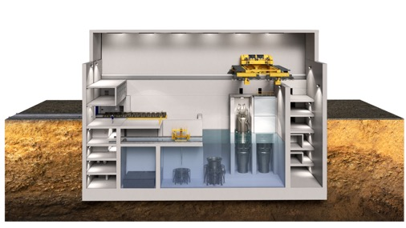
Providing Identical Technology for Every Implementation
6-module VOYGR-6 plant
12-module VOYGR-12 plant
462 MWe (gross)
924 MWe (gross)
4-module VOYGR-4 plant
Flexibility in size and cost advantages, with the same operational flexibility and unparalleled safety case.
Each module feeds one turbine generator train, eliminating single-shaft risk.
Demonstrated resiliency for every configuration (black-start, island mode, seismically robust, cyber secure, etc.)
NuScale Power ModuleTM
77 MWe (gross)
308 MWe (gross)
Notes:
Updated: 7/7/2021

Slide 11
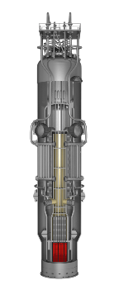
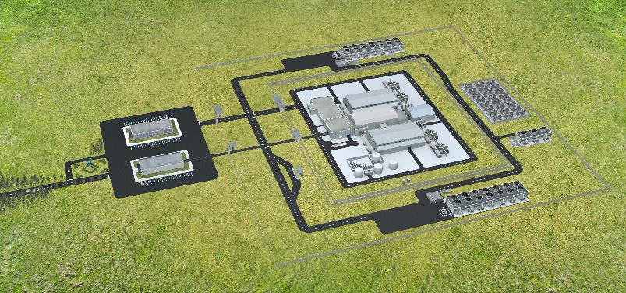
NuScale Advanced Small Reactor Overview
Each module produces up to 77 MWe
Up to 12 modules for 924 MWe gross plant output
Smaller power plant solutions available for 4-module (308 MWe) and 6-module (462 MWe) plants
Triple Crown of Safety
NuScale Plant safely shuts down with:
  No operator or control system actions
  No AC/DC power
  No additional water
Emergency planning zone (EPZ) ends at
site boundary

Slide 12
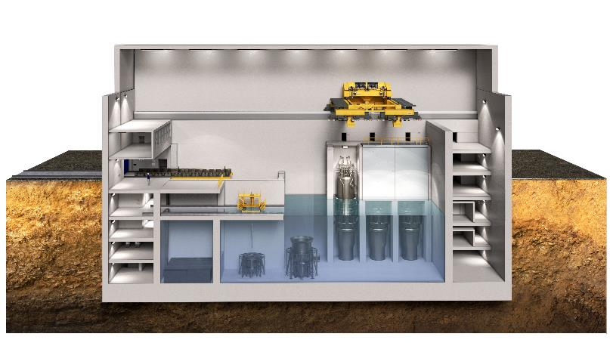
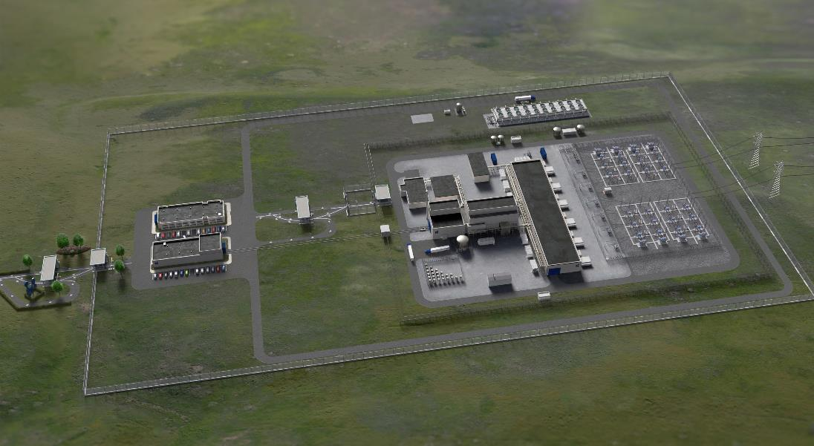
6 Module VOYGR-6 Power Plant
462 MWe gross power output
  Same operational flexibility and unparalleled safety case
  Reduced footprint and construction complexity/duration
Applications:
Small grids
Island nations
Remote off-grid communities
Industrial and government facilities
Coal power replacements

Slide 13
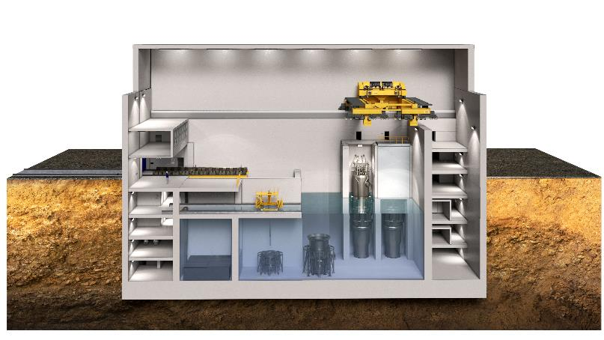
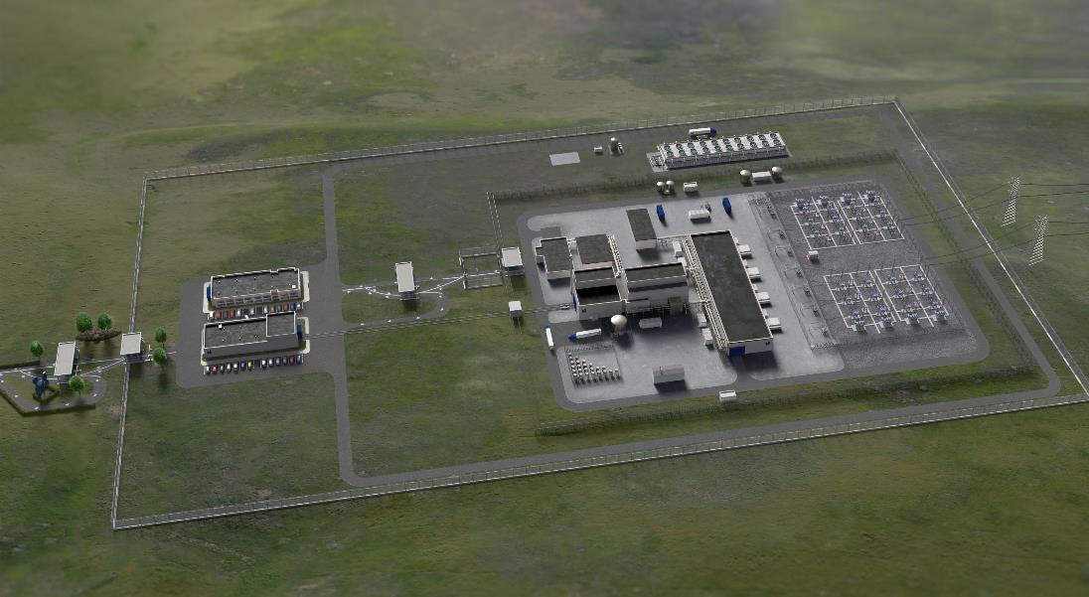
4-Module VOYGR-4 Power Plant
308 MWe gross power output
  Same operational flexibility and unparalleled safety case
  Reduced footprint and construction complexity/duration
Applications:
Small grids
Island nations
Remote off-grid communities
Industrial and government facilities
Coal power replacements

Slide 14


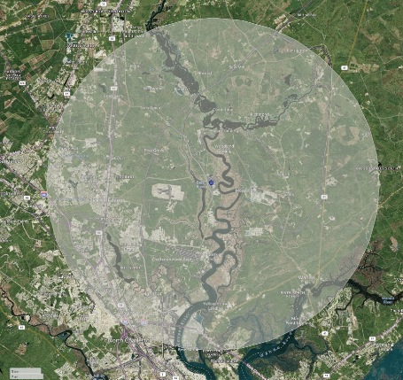




Inherently Safe Design Sets New Industry Standards – Triple Crown of Nuclear Plant Safety™
Unlimited Coping Period for Reactors
Only SMR that Supports U.S. NRC Site Boundary Emergency Planning Zone (“EPZ”)
Unparalleled Capability and Performance
Comparison of Reactor Coping Period Following an Extreme Station Blackout
(loss of both AC and DC power)
The smaller EPZ enables NuScale Plants to
be sited in close proximity to end-users, which
is of particular importance to process heat off-takers and repowering retiring coal-fired generation facilities
Capable of “Black-Start” and Operation in “Island Mode”
A NuScale plant can be started without the need for power from the grid and can operate disconnected from the grid – a first for a nuclear power plant
Generation II Reactors:
4-8 Hours With Significant Operator Actions Required
First Responder Power
A NuScale plant can start-up without power from the grid and can inject power back into the system to support grid restoration
Generation III & III+ Reactors:
Up To 72 Hours With No Operator Actions
NuScale EPZ
(at site boundary)
Generation IV Reactors
Advanced LWR:
8 Hours With No Operator Actions
Typical Large Scale Nuclear EPZ
(10 mile radius)
Deliver Highly Reliable Power
Under a microgrid connection, a 12-module NuScale plant can provide over the 60-yr plant lifetime 154 MWe of power to mission critical installations at 99.95% reliability
UNLIMITED WITH NO OPERATOR ACTIONS OR EXTERNAL SUPPORT
Flexible Siting Options
A NuScale plant can be sited at the “end of the line” with only a single grid connection, or off-grid
Williams Power Station (Coal, 650 MW), S. Carolina
Announced retirement date of 2028

Slide 15


NuScale is Well Suited for a Range of Applications Critical to the Energy Transition
Enhancing the Power Grid
Energy Transition-Specific Opportunities
Grid Resiliency
Coal Plant Replacement
Carbon Capture
& Sequestration (CCS)
Adverse weather conditions do not impact operations for a NuScale Plant
A single module can be black-started and can power the entire plant in case of loss of the utility grid
On loss of offsite grid, all modules in a NuScale Plant can remain at power and be available to provide electricity upon grid restoration
~132 coal plants in the U.S., representing 140+ GW of capacity, are planned for retirement through 2050
Opportunity to preserve 41,500 power plant jobs by repurposing this lost coal capacity with over 150 NuScale plants (12 NPM), and create or preserve nearly 37,000 manufacturing jobs per year
NPMs can power energy-intensive CCS facilities with 100% clean power
Many global decarbonization pathways anticipate significant CCS deployment
Direct air capture
Mission Critical Facilities
Support for Wind and
Solar Development
Hydrogen Production
A NuScale Plant can provide highly reliable power to mission critical micro-grids (e.g., hospitals, data centers) with 99.95% availability over the 60-yr life
Off-grid operations enables a plant to supply power without external grid connection
NuScale's load-following capabilities well-suited to both solar and wind's intermittency
Provides critical ancillary services to support electric
grid stability
NuScale NPMs can produce cost effective, green hydrogen at scale
Hydrogen production by conventional renewables faces challenges of scale and cost

Slide 16

NuScale is Years Ahead of the Competition
Selected Differentiators |  | Small Modular Reactor Competitors¹
 |  | Other Light Water Reactors | Non-Light Water Reactors²
Underlying Technology Track Record | Light water reactor (LWR) (50+ years history) | Same as NuScale | Relatively limited
Fuel Supply Infrastructure | Exists (50+ years history) | Same as NuScale | Does not exist today; Under development
Manufacturing Infrastructure | Multiple suppliers for all critical components | Same as NuScale | Largely in place
Design Approval by NRC | Standard Design Approval received from NRC (42 months after application submission) | None (applications not yet submitted) | None (applications not yet submitted)
Coping Period | Unlimited (confirmed by the NRC) | Varies; Goal of between 7 days and unlimited | Goal of unlimited
Unparalleled Capabilities | Innovations including black-start, island mode, off-grid operation | To be determined | To be determined
Does not include micro reactors
For example; high temperature gas cooled, molten salt, and fast-reactor technologies

Slide 17
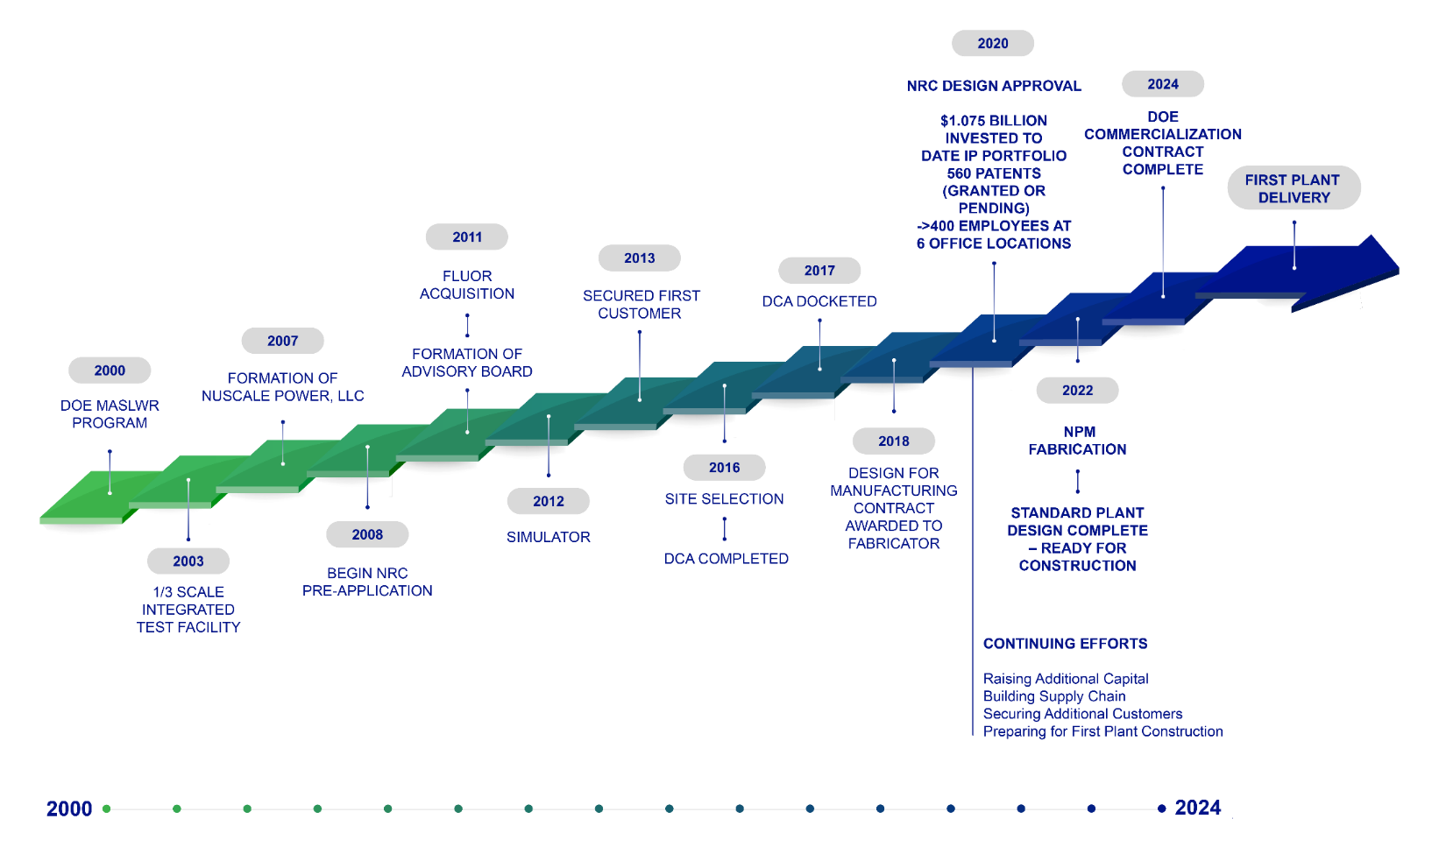
Blazing the Trail to Commercialization
Notes:
*Slide updated: Q1 2021

Slide 18


Non-proprietary
Overview
Overview
ENTRA1 EnergyCo
  ENTRA1 is a leading investment, development and operating platform, backed by Habboush Group (HG), an American asset management group with significant experience in originating, executing, managing, developing and operating energy and infrastructure proprietary investments globally
  We aim to create value by supporting investments and developments in the energy, infrastructure and related technology sectors that bring positive impact to communities around the world with a focus on energy transition, sustainable infrastructure, supply chain security and ESG
  Utilizing a London-based hub with access to numerous local markets our focus is global with an initial focus on North America and Europe
  ENTRA1 EnergyCo, ENTRA1’s initial sub platform, will lead the commercialization effort of NuScale SMR technology based on the strategic alliance formed by NuScale Power and HG
  ENTRA1 EnergyCo is the one-stop-shop and single-hub for the financing, investment, development, execution, and management of NuScale-powered projects
  ENTRA1 EnergyCo’s strategic goal is to become the world’s leading independent clean energy company by completing a current pipeline of ~10GW of SMR projects mainly in North America and Europe
Experience
Structure
  More than 40 years of experience in global energy and infrastructure sectors with projects totaling in excess of $6b
  Strategic partnerships with notable institutions:
ENTRA1
Partner | Relationship | Power | Natural Resources | Infra | Description
 | Asset Manager & Operating Partner | ■ |  | ■ | Management and Operation of international asset portfolio and related infrastructure
 | JV Partner/ Alternative Asset Management | ■ | ■ | ■ | Energy and Infrastructure services and investments
 | JV Partner/ Alternative Asset Management |  | ■ | ■ | Energy and Infrastructure services and investments
ENTRA1 EnergyCo
ENTRA1
SPV 2
ENTRA1
SPV 3
ENTRA1
SPV 4
AssetCo 1
AssetCo 2
AssetCo 3

Slide 19
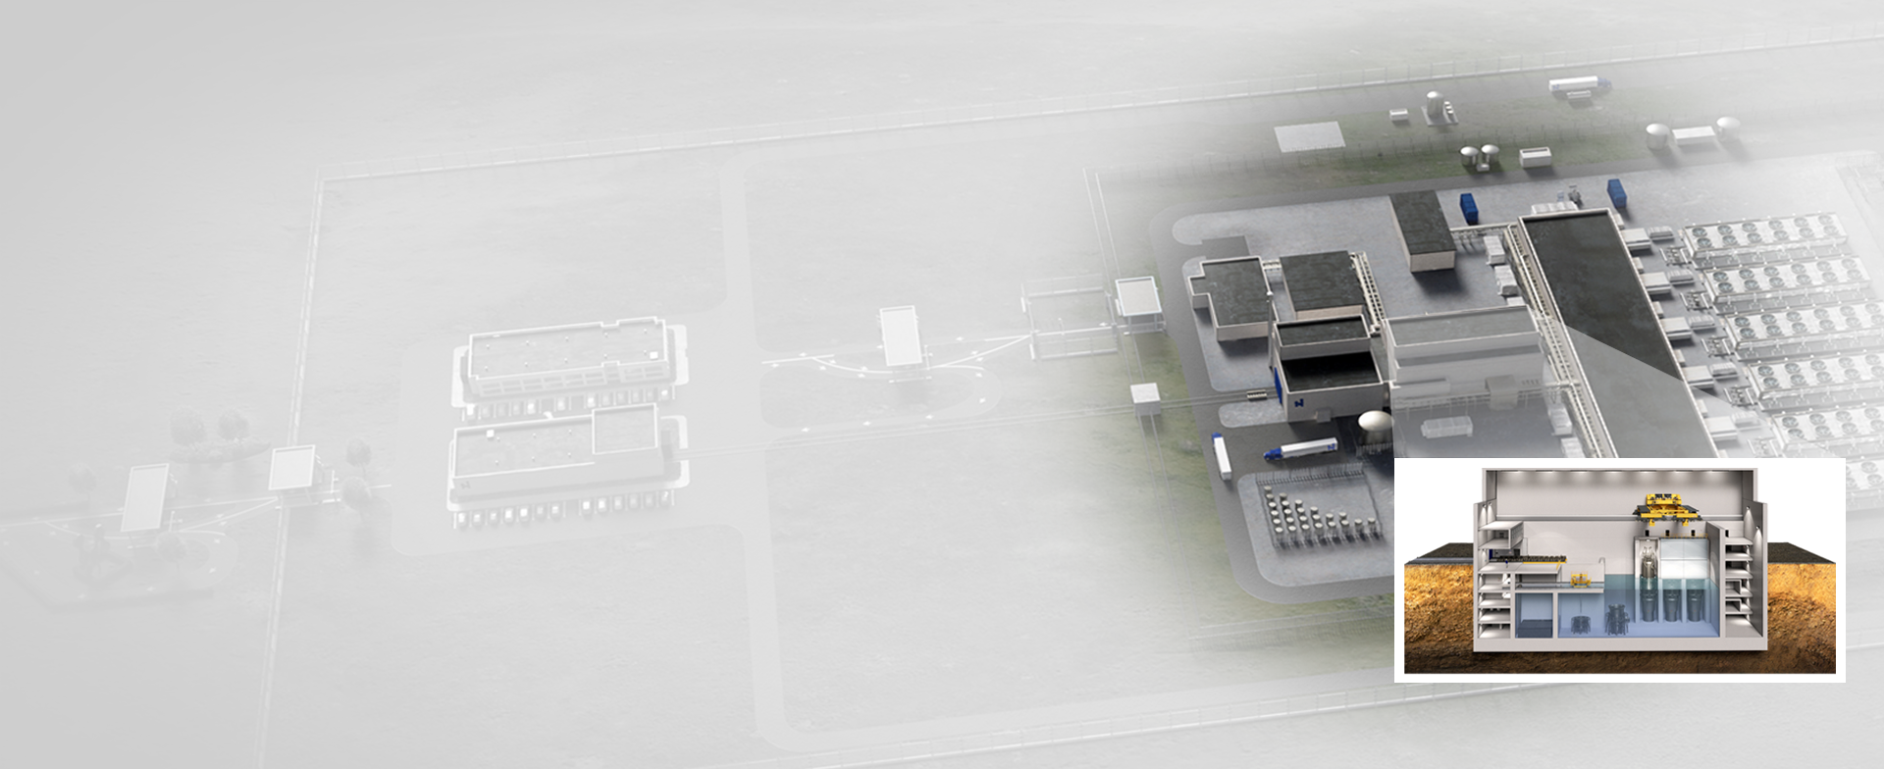
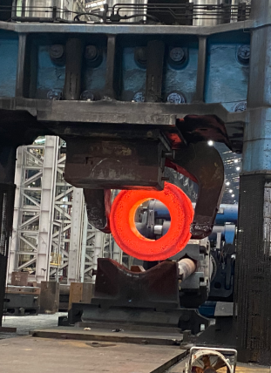
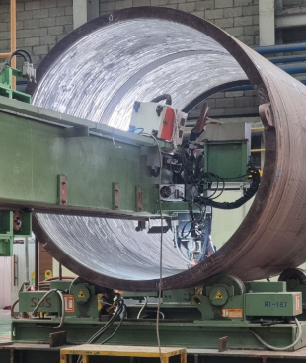
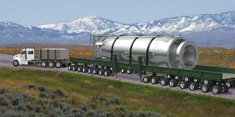

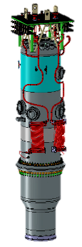
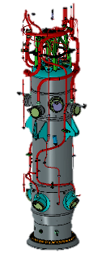
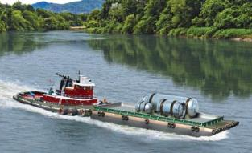

NPM Manufacturing Process Overview
NPM pressure vessel & component manufacturing at various supplier locations
NPM pressure vessel & component transportation to site
Assemble piping, valves, sensors, and cables to pressure vessels
Ingot melt and forging
Plant construction by EPC in parallel
Reactor Building Construction Complete
Manufacturing complete & import to reactor building

Slide 20
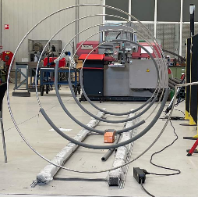
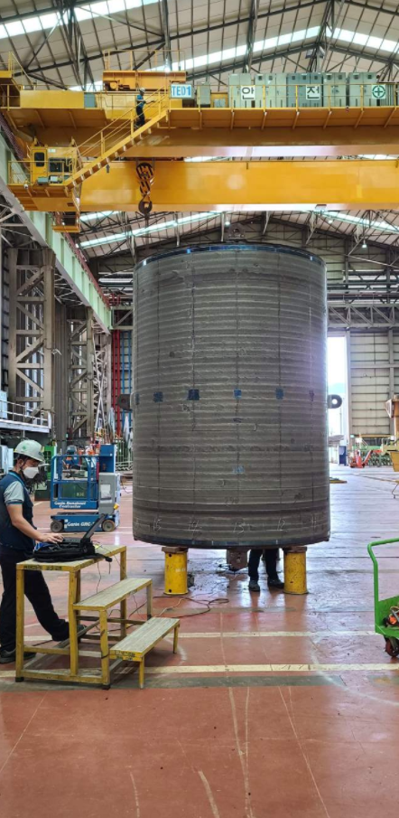

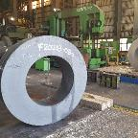
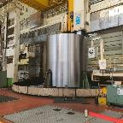
NPM Manufacturing Readiness
Completed Design for Manufacturing
Manufacturer feedback to optimize design and lower costs
Manufacturing plan development
Preliminary drawings
SG Tube Bending
Performed by Doosan and BWXT (performing same scope)
Manufacturing Trials
Reduce risk and increase cost certainty for first-of-a-kind deployment
F6NM Material Forging
Cladding distortion (2 sided) of reactor pressure vessel
Steam generator tube bending
F6NM material (martensitic stainless steel) use for containment vessel
Spent $7.8M proving manufacturing readiness so far, $7.2M additional planned
Cladding Distortion
F6NM Material Forging

Slide 21
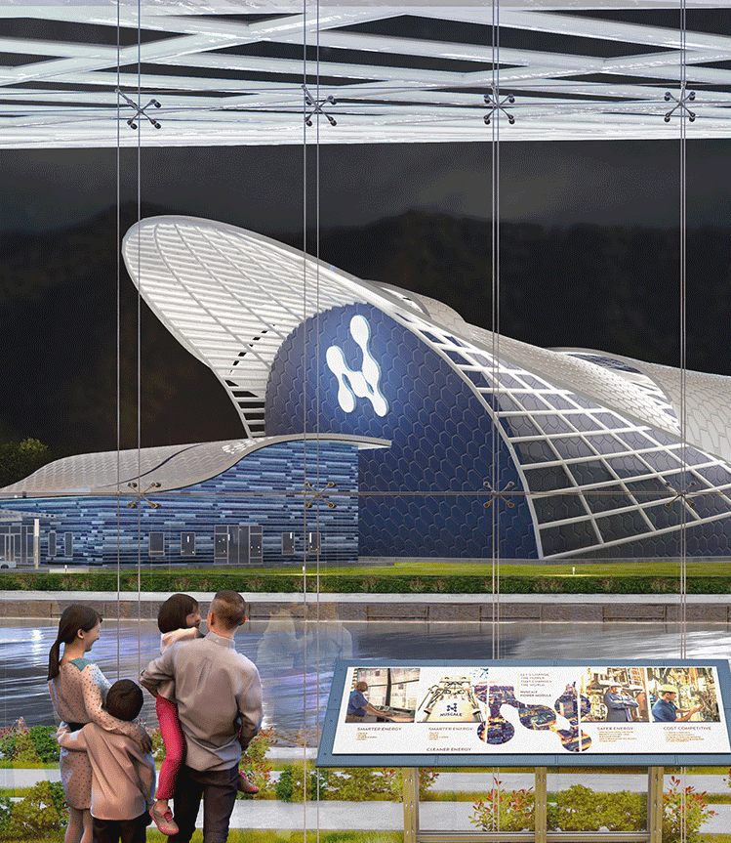
Future Supplier Opportunities
Balance of Plant Equipment
  Turbines
  Heat Exchangers
  Piping and valves
  Electrical OEM Equipment and electrical components
  Packaged modular and skid mounted systems.
  Tanks
Sub-tier Supply to Major Component Manufacturers
  Forgings and other raw material supply
  Penetrations and connectors
  Sensors
Construction Materials
  Concrete
  Steel
  Wire, cable, conduit and cable tray
Artistic concept of the NuScale Power Plant
Notes:
*Slide updated: 2020 or earlier

Slide 22



NuScale Customer Poised to Deploy NPMs in 2029
Utah Associated Municipal Power Systems (UAMPS) will be among the first commercial deployments of NPMs
First commercial deployment will be a VOYGRTM-6 power plant at the Idaho National Laboratory for the UAMPS Carbon Free Power Project (CFPP)
UAMPS provides energy services to community-owned power systems throughout the Intermountain West
27 of UAMPS’s members, representing 7 states, are currently CFPP participants as of October 2022
The CFPP will provide safe, reliable, and cost competitive clean energy to UAMPS members at a target LCOE
of $58/MWh (in 2020 dollars), adjustable for cost indices and changes in inflation and interest rates
In 2020, the DOE awarded a ~$1.4B cost share grant over ten years to UAMPS to build the CFPP
Carbon Free Power Project Timeline
NuScale begins work with UAMPS
DOE Site Use Permit and initial site selection
DOE Cost Share, site- characterization activities began
Combined Operating
License Submittal
Begin construction
Remaining modules installed for full plant operation
2013
…
2015
2016
…
2019
2020
…
2022
…
2024
2025
2026
…
2029
2030
UAMPS formally
launched the CFPP
Final INL site selected
Order NPM long-lead materials
Begin site mobilization
and preparation
First NuScale Power ModuleTM installed

Slide 23







Rapidly Expanding Customer Opportunities
MOU Customers
 |  | Public electric utility | Washington, USA
 |  | Generation and transmission cooperative | Wisconsin, USA
 |  | Associated Electric Cooperative | Missouri, USA
 |  | Utah Associated Municipal Power Systems (UAMPS) | Utah, USA
 |  | Commercial nuclear power producer | Canada
 |  | Canada’s only private sector nuclear power producer | Ontario, Canada
 |  | Ontario Power Generation (OPG) | Canada
 |  | NuScale SMR paired with wind to produce power & H₂ | U.K.
 |  | Jordan Atomic Energy Commission | Jordan
 |  | Energoatom: State-owned nuclear power producer | Ukraine
 |  | State Scientific and Technical Center for Nuclear and Radiation Safety (SSTC NRS) | Ukraine
 |  | Kozloduy Nuclear | Bulgaria
 |  | KGHM Polska & Piela Business Engineering Coal refurbishment & process heat | Poland
 |  | Getka Group & UNIMOT SA: Coal plant refurbishment | Poland
 |  | S.N. Nuclearelectrica: State-owned utility | Romania
 |  | State-owned utility | Czech Republic
 |  | Kazakhstan Nuclear Power Plants (KNPP) | Kazakhstan
 |  | Fermi Energia | Estonia
Suppliers
 |  | Doosan Heavy Industries and Constructions Co., Ltd. (DHIC) | South Korea
 |  | JGC Holdings Corporation (JGC HD) | Japan
 |  | Sargent & Lundy | Illinois, USA
 |  | IHI, Inc. | New York, USA
 |  | Sarens Nuclear & Industrial Services, LLC | Texas, USA
 |  | Ultra Electronics Energy | United States & United Kingdom
 |  | Fluor | Texas, USA
NuScale
MOU
Suppliers

Slide 24
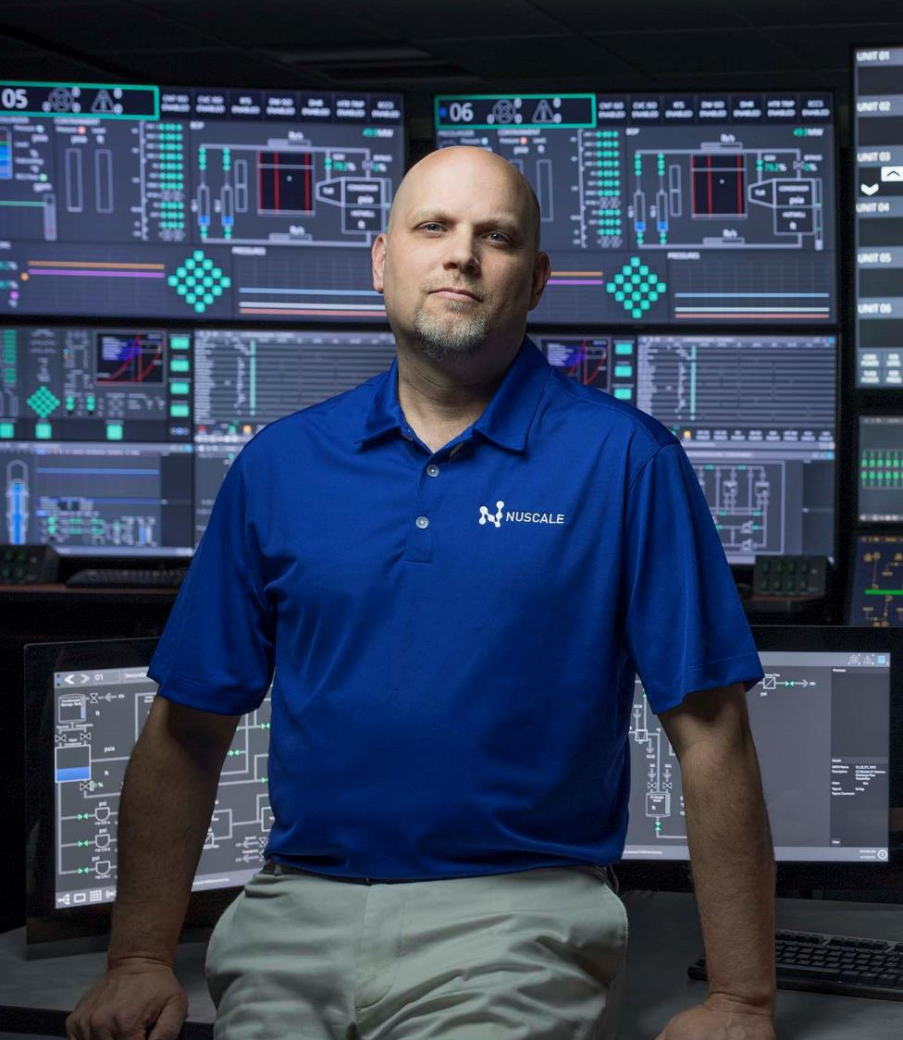
Job Creation
Each VOYGR™-12 power plant will employ about
270 people full-time, in high paying quality jobs.
Examples of types of jobs:
  Plant Operators.
  Nuclear Maintenance Craftsmen.
  Radiation Protection Technicians.
  Training Staff.
  Non-nuclear Craftsmen.
  Security Officers.
  Department Managers.
  Technical Supervisors.
  Engineers.
The domestic supply chain for manufacturing
3 plants per year could generate about 14,172 jobs.

Slide 25
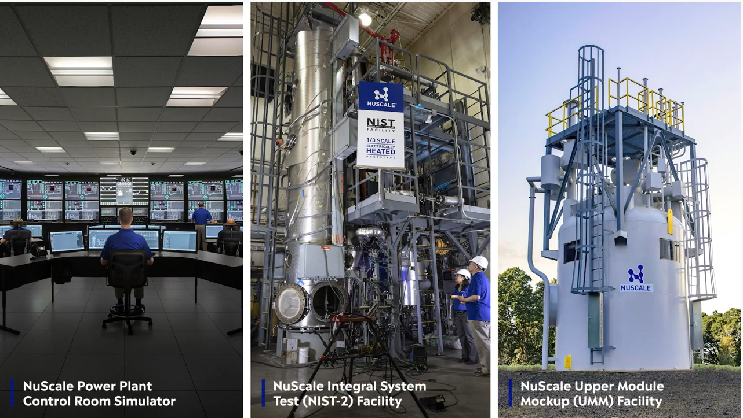
NuScale Facility Tours
Located on NuScale Power You Tube channel: https://www.youtube.com/watch?v=brr5j50umYA

Slide 27
Scott E. Rasmussen
Director of Sales
srasmussen@nusclaepower.com

