Slide 1
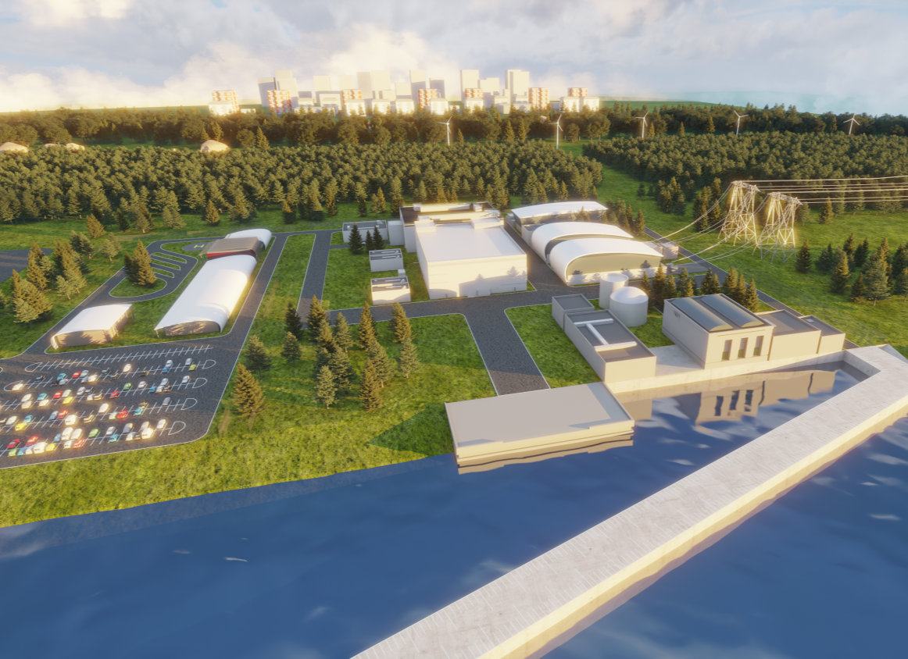
NUWARDTM
International Nuclear Conference
Sofia – 12 January 2023
Sandro Baldi – Commercial Director

Slide 2






EDF reserves all rights to this document and the information it contains.
  NUWARDTM
  Experience Based Technology
Any reproduction, use or disclosure to third parties without express permission is strictly prohibited.
2

Slide 3
What is NUWARD™?

Slide 4
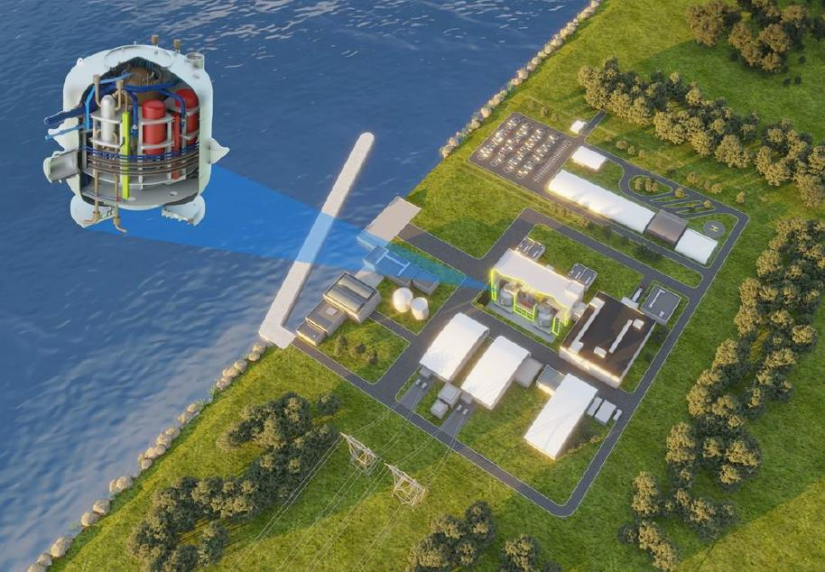








NUWARDTM : a PWR 340MWe power plant
 | A nominal power of 340 MWe from 2 integrated reactors of 170 MWe each >90% availability; compatible with ENTSO-E network requirements; 60 years of operation; load-following capability Safety objectives that meet the best international standards (inc. 0,3g seismic withstand)
 | Modular approach and simple competitive design targeting 40-month construction duration Improved landscape integration
 | Multipurpose by design (H2, district heating, desalination, heat & electricity cogeneration, CO2 capture) Designed for export, allowing adaptation to multiple markets without significant re-design First Nuclear Concrete in France in 2030
EDF reserves all rights in this document and in the information contained therein.
Reproduction, use or disclosure to third party without express authorization is strictly prohibited
4

Slide 5
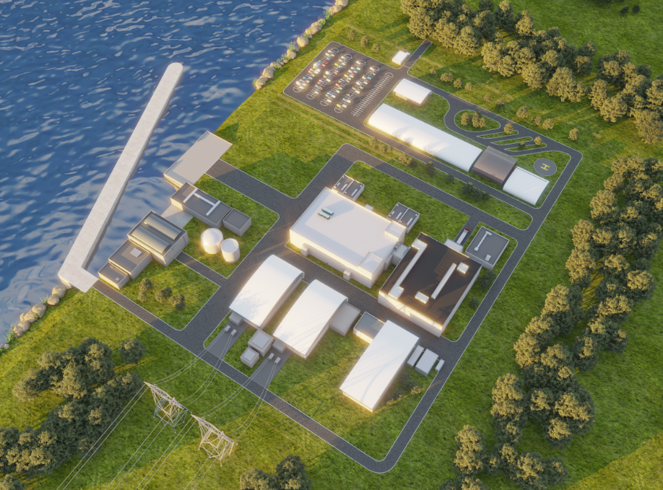
Showing Open Heat Sink Option
Tertiary Buildings
Nuclear Island (NI) Building
Pumping Station
Nuclear Auxiliary Building
Turbine Hall Buildings – one per unit
5

Slide 6
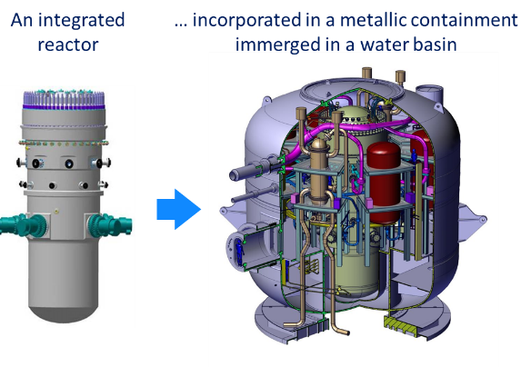
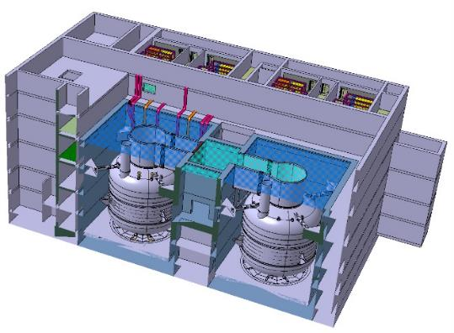
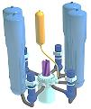
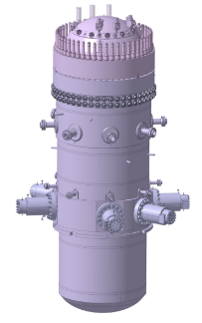
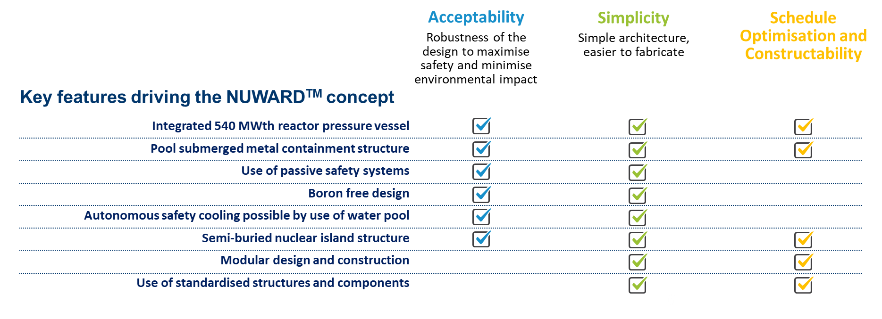
NUWARDTM : safe, simple, affordable.
An integrated
reactor...
...installed in a metallic containment submerged in a water pool
2 independent reactors (2x170MWe)
in the same Nuclear Building
EDF reserves all rights in this document and in the information contained therein.
Reproduction, use or disclosure to third party without express authorization is strictly prohibited
6

Slide 7
When?

Slide 8

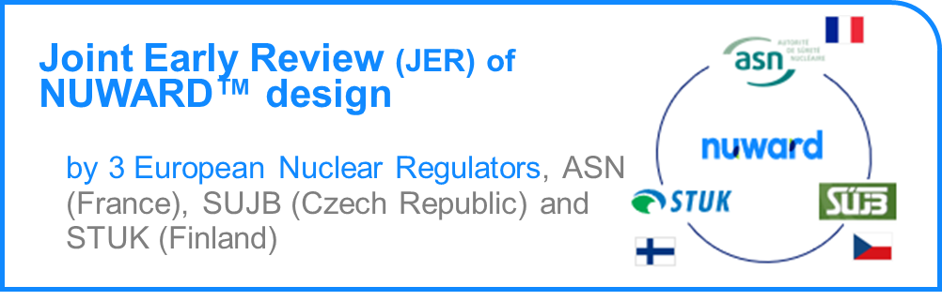
NUWARD™ Timeline
Start FOAK
in France
* Approximate Date
Mid 2019
2022
2026
2029*
2030
Pre-Concept Design
Concept Design
Basic Design
Detailed Design
Construction
Operation
Basic Design
Detailed Design
Construction
Operation
Licensing Timeline
Step 1
Step 2
Preparation for Pre-Licensing
Licensing DAC
Licensing Commissioning
Pre-Licensing
ASN
Safety Options File (DOS) Submission
DAC Application Filed
– Request for authorisation to create a new nuclear facility
DAC Granted
8
EDF reserves all rights in this document and in the information contained therein.
Reproduction, use or disclosure to third party without express authorisation is strictly prohibited
Notes:
NUWARD™ is backed by real tangible French government support to get our FOAK in France built and operating.
Financial support from the French State in the amount of 50 million euros for the Conceptual Design phase, as part of the French recovery plan was announced in December 2020 by the President of the Republic; This support was increased to 500 million euros, confirmed by the President of the Republic during his speech on February 10, 2022;
The NUWARD development itself has been an evolving picture, adding partners since before 2019 : CEA, NG, TA, FRA, TBL

Slide 9
What market?

Slide 10




NUWARD™: Designed for a Carbon-free World
Three main market segments:
  Replacing coal-fired power plants in the 300-400 MWe range,
  Supplying remote municipalities and energy-intensive industrial sites,
  Powering grids with limited capacity for large power plants or demanding small incremental power build-up.
Adapted to multipurpose uses:
  Hydrogen production, heat & electricity cogeneration, district heating, water desalination.
10

Slide 11
Why choosing NUWARD™?

Slide 12
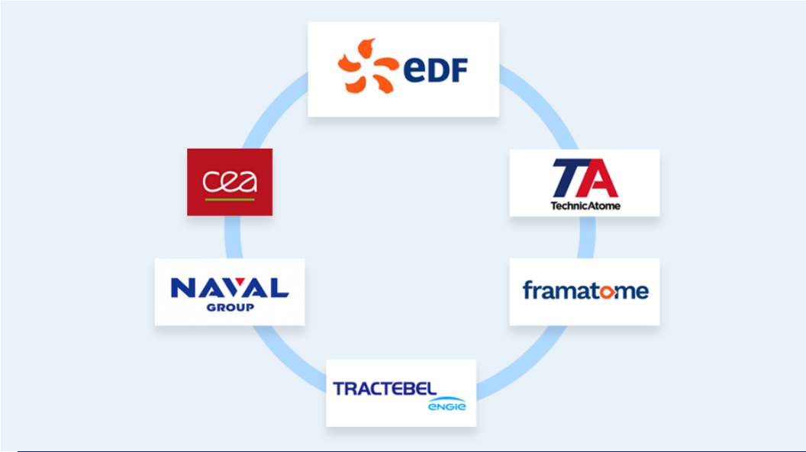
NUWARD™: Experience Based Technology
67 reactors in operation in the world
1 reactor under commissioning
2 reactors in construction
8 new reactors in advanced development phase
+ 2,000 reactor-year of experience
+ 50,000 people working in the nuclear field
EDF, the world’s leading
nuclear operator
Technological research, development and innovation expert in low carbon energies
Specialised in design, construction, commissioning and operational maintenance of compact nuclear reactors
International experts in Naval Defence and owner of the French naval knowledge base, designer and developer of innovative solutions to meet the needs of naval fleets and other advanced technology industries
International leader on the nuclear worldwide market, designer and supplier of nuclear steam supply systems and nuclear equipment, services and fuel delivering the highest levels of safety and performance
Architect engineer and responsible designer for the Belgian nuclear fleet since the 1960’s, civil engineering partner of EDF’s French operating fleet and international engineering consultancy
12

Slide 13

EDF’s value proposition
State-of-the-art technologies
Carbon-free electricity generation
Highest standards of safety
Proximity and long-term local anchoring
OUR KEY ASSETS
Leading industrial capabilities
Training and skills development
Unrivalled operating experience
Financing expertise for major projects
EDF reserves all rights in this document and in the information contained therein.
Reproduction, use or disclosure to third party without express authorization is strictly prohibited
13
Notes:
Nos bénéfices principaux en dénominateur commun à nos 3 offres
13

Slide 14
European proximity and local value: the example of Hinkley Point C
EDF: your European local partner
14
EDF reserves all rights in this document and in the information contained therein.
Reproduction, use or disclosure to third party without express authorization is strictly prohibited

Slide 15
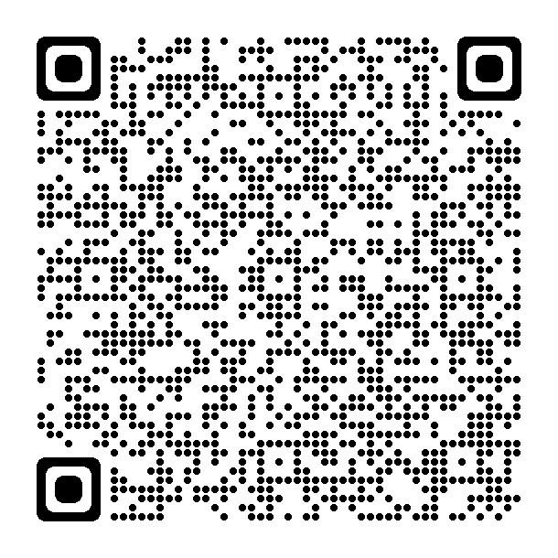
мерси
Thank You
For more information:
Scan me!

