Slide 1
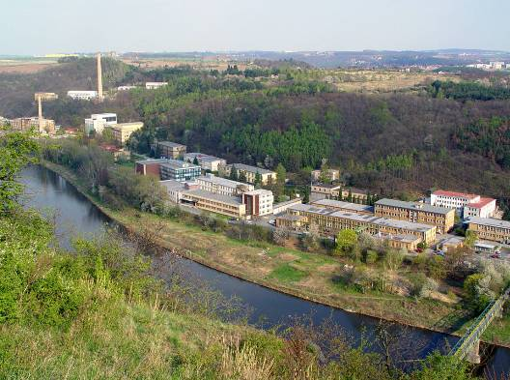
Nuclear Power Program of the Czech Republic
Jozef Misak
International Nuclear Conference
“State of the Art of the Modular Nuclear Reactors for the Market of South-East Europe”
Bulgarian Energy & Mining Forum
12-13 January 2023, Sofia

Slide 2
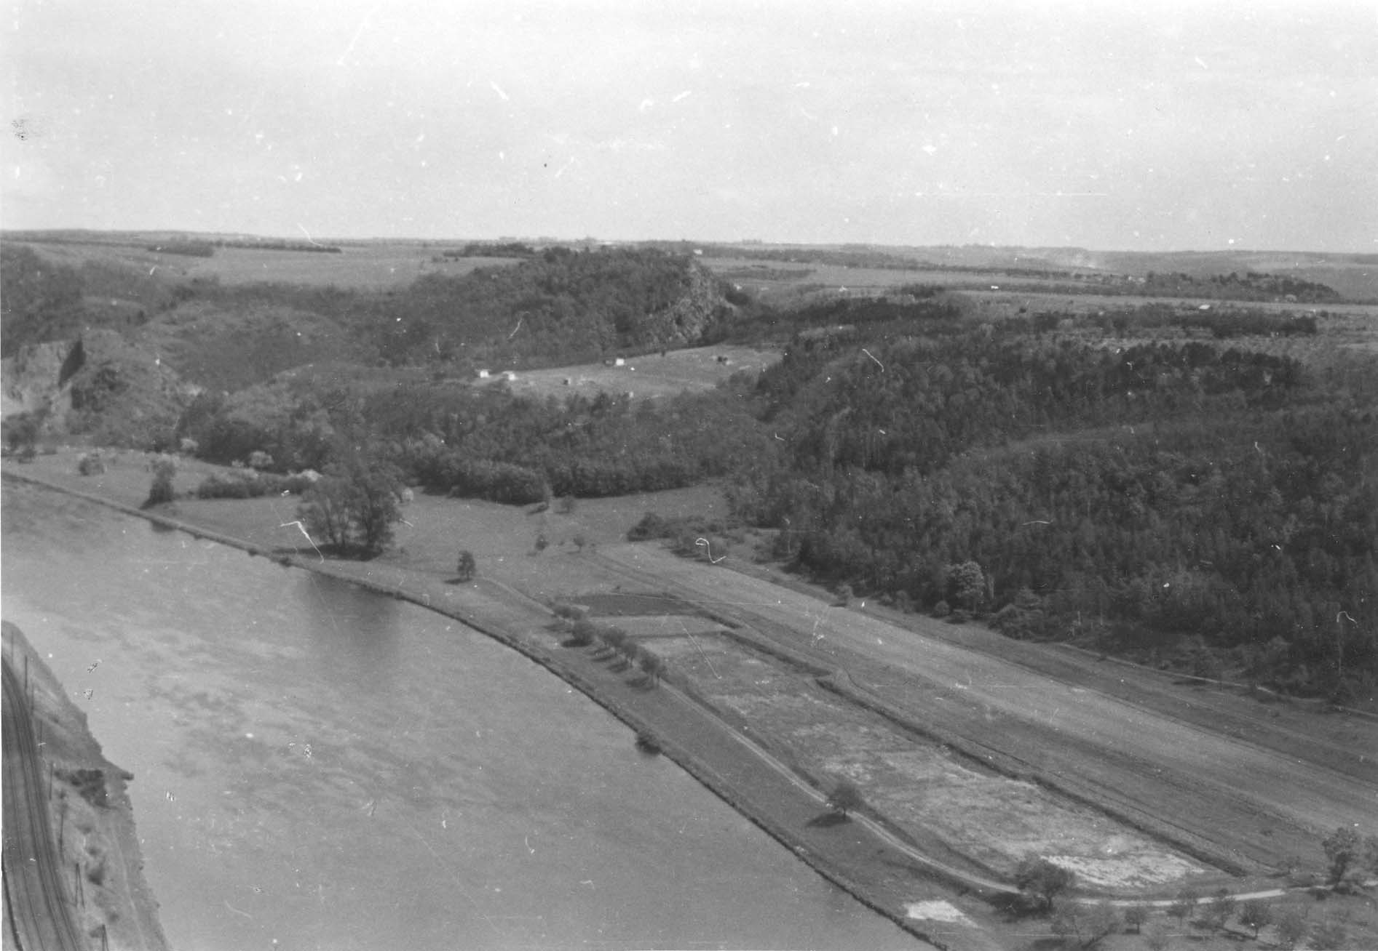
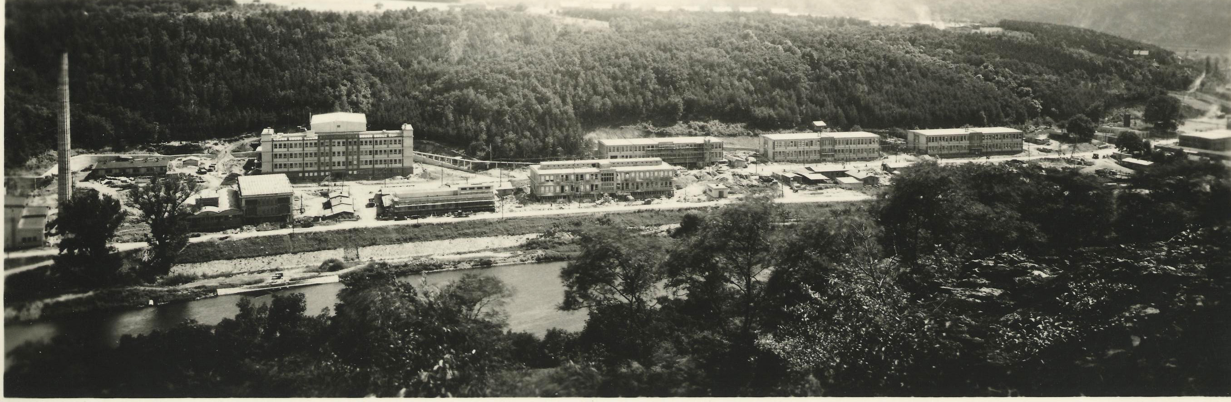
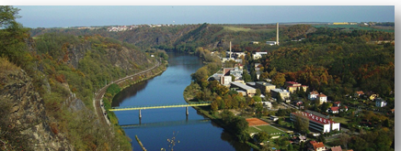
History of the UJV Group
1955 Foundation of the Nuclear Physics Institute in Rez
1957 VVR-S research reactor start-up
1972 Reorganization of the former Institute and formation of the Nuclear Research Institute
1993 The Nuclear Research Institute Rez was privatized to joint-stock company
2000 Acquisition of Institute of Applied Mechanics Brno
2002 Foundation of the Research Centre Rez
2002 Acquisition of part of ENERGOPROJEKT PRAHA (foundation 1949)
2009 Acquisition of the EGP INVEST, Ltd and Research and Testing Institute in Pilsen
2011 Formation of The UJV Group
2012 Change of the company name to UJV Rez, a. s
2017 Merging UJV with EGPI (one of subsidiary companies)
2020 Acquisition of the SKODA Praha as a new subsidiary company
Before construction
2017
2018
17 days
Today
68%
During construction
24 days
35%
34 days
30%
23 days
25%
35 days
22%
31 days
17%
At present

Slide 3
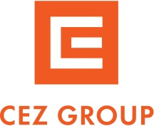

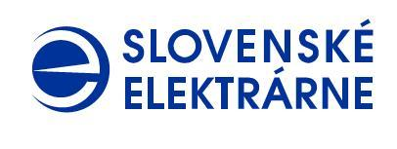



Stable company providing engineering and scientific work since 1955
Shareholders
UJV Group (about 1300 employees) is a group of companies providing research and development, design and engineering services, production of special products and facilities, and expert activities in the power, industry, and health sectors
www.ujv.cz
Subsidiaries
Research Centre Rez
www.cvrez.cz
Research and Testing Institute Plzen
www.vzuplzen.cz
Skoda Praha
www.skodapraha.cz

Slide 4
Content
Recent developments in energy sector
Nuclear power in the Czech Republic
New build plans in the Czech Republic
SMR deployment in the Czech Republic
Development of SMRs in the Czech Republic
Summary

Slide 5
Recent developments

Slide 6
Dramatic events changing the energy outlook
Decommissioning of a number nuclear units not only in Germany, but also coal fired units and low windy weather showed necessity of nuclear sources for a low emission mix
Germany´s Energiewende without adequate electricity storage accumulation resulted in intensive use of natural gas and emissions of greenhouse gases
Russian invasion to Ukraine dramatically increased the need for Europe´s energy independence from fossil sources
The need to delay closing of coal plants and intensive work to implement the transition to nuclear and renewable sources (RES)
Including nuclear into taxonomy, accepting natural gas for transitional use, dramatic reduction in the availability of natural gas and the increase in its price due to war in Ukraine.
A number of EU states have again decided on the path to low emissions by combining nuclear power and RES

Slide 7
Sources of the current energy crisis in Europe
Shutting down nuclear and fossil sources without adequate replacement
Uncontrolled and volatile increase in the price of emission allowances
Transition from coal to gas with increase in requirements for gas
Last year was a less windy year
Recovery of the economy after the decrease due to the COVID 19 pandemic
Reliance on gas not only for heating but also for electricity: high gas consumption
Reduction in gas production in Europe, reduction in investment in fossil sources
Russian invasion to Ukraine

Slide 8
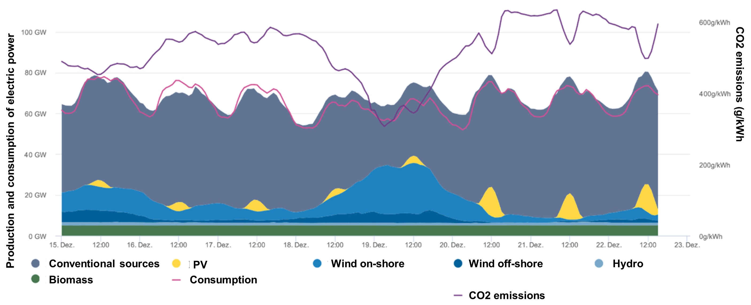
Example of the windless period at the end of last year in Europe

Slide 9
The resulting risks
Very high load on the grid, endangering its stability especially in the winter
Decrease of inertia in rotating machines and in grid stability
Increase in gas and electricity consumption (reduced use of coal and electrification)
High electricity and gas prices, the threat of energy poverty
Strong dependence on gas imports from Russia
Industry leaving out of EU looking for lower energy prices
The risk of decline of the economy and living standard
Threat to the social and political stability

Slide 10
Nuclear power in the Czech Republic

Slide 11
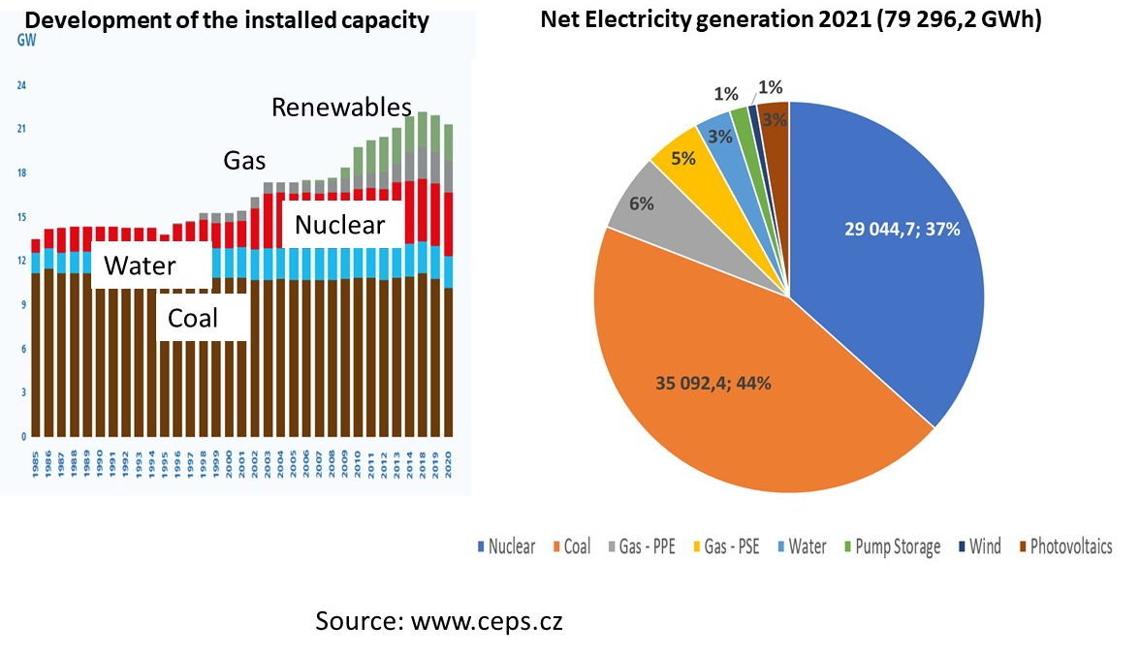
Role of Nuclear power in the Czech Republic
11

Slide 12
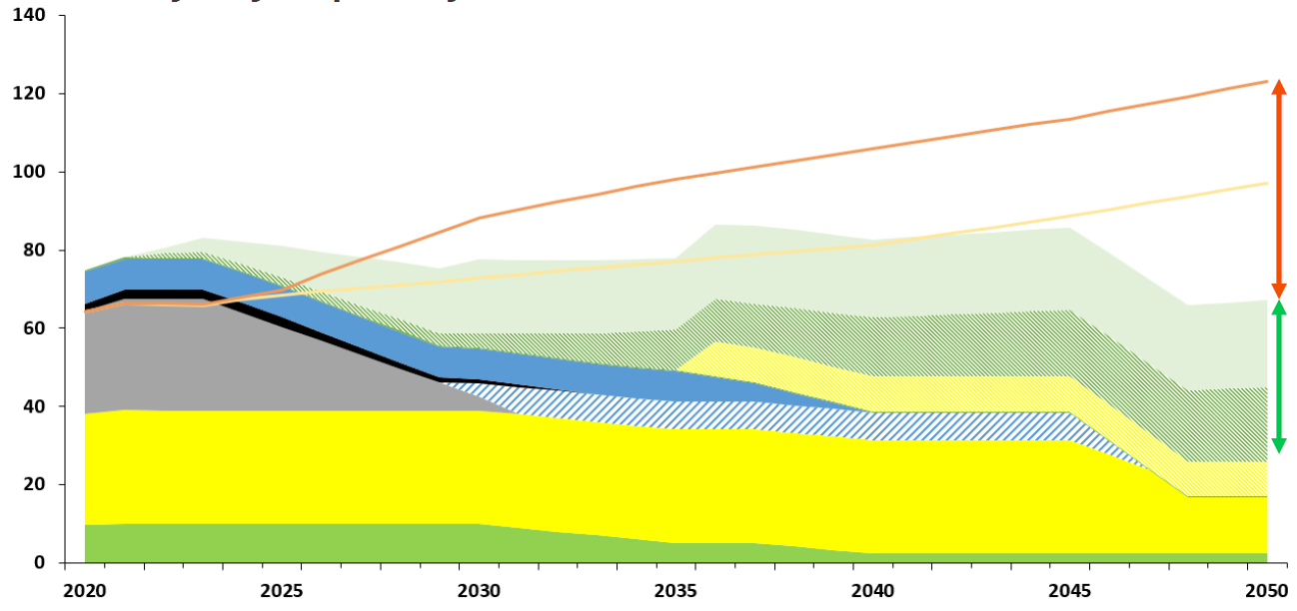
Development of electricity production and consumption (TWh) in the Czech Republic
(CEZ estimate)
NECP-National Energy and Climate Plan 2021-2030` RED II- Renewable Energy Directive-new EU target for RES to be raised to #@ % by 2030
high demand
new nuclear (beyond EDU 5)
~6x1200 MWe or equivalent SMRs
low demand
gas
new RES (RED II)
new RES (NECP)
new RES
~33 %
min. 20 GW ?
brown coal
new nuclear
new cogeneration
nuclear
RES
12

Slide 13
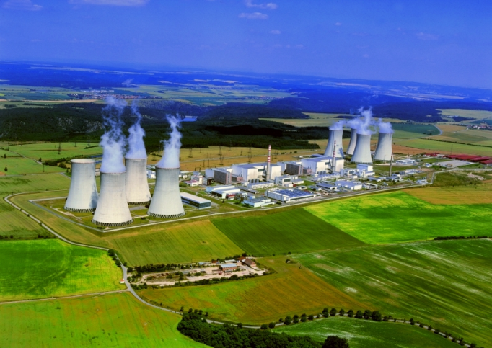
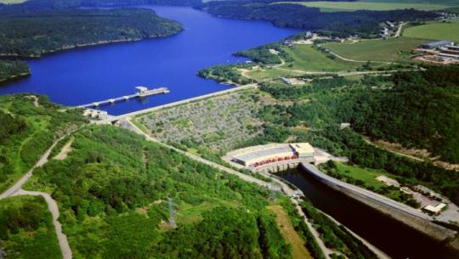
Dukovany Nuclear power plant
In operation since 1985 - 1987
Reactor design: VVER 440 type V213
Nuclear island design – Atomenergoprojekt – Russia
Conventional island design – Energoprojekt Praha
Major suooliers - Czech companies
Skoda (Praha, JS, Doosan Power), Vitkovice, Sigma, etc.
(including reactor vessels, steam generators, turbines, etc..)
Long Time Operation (LTO) till 2045–2047, lifetime 60(+)
Power uprates 440 MW → 500 MW
(104%, efficiency enhancement)
Development program: new nuclear fuel
  16month – fuel cycles
  Power uprate 107+%
Hydro power plant Dalesice uprated to 4 x 120 MW
  Cooling water delivery, pumpstation & backup
13

Slide 14
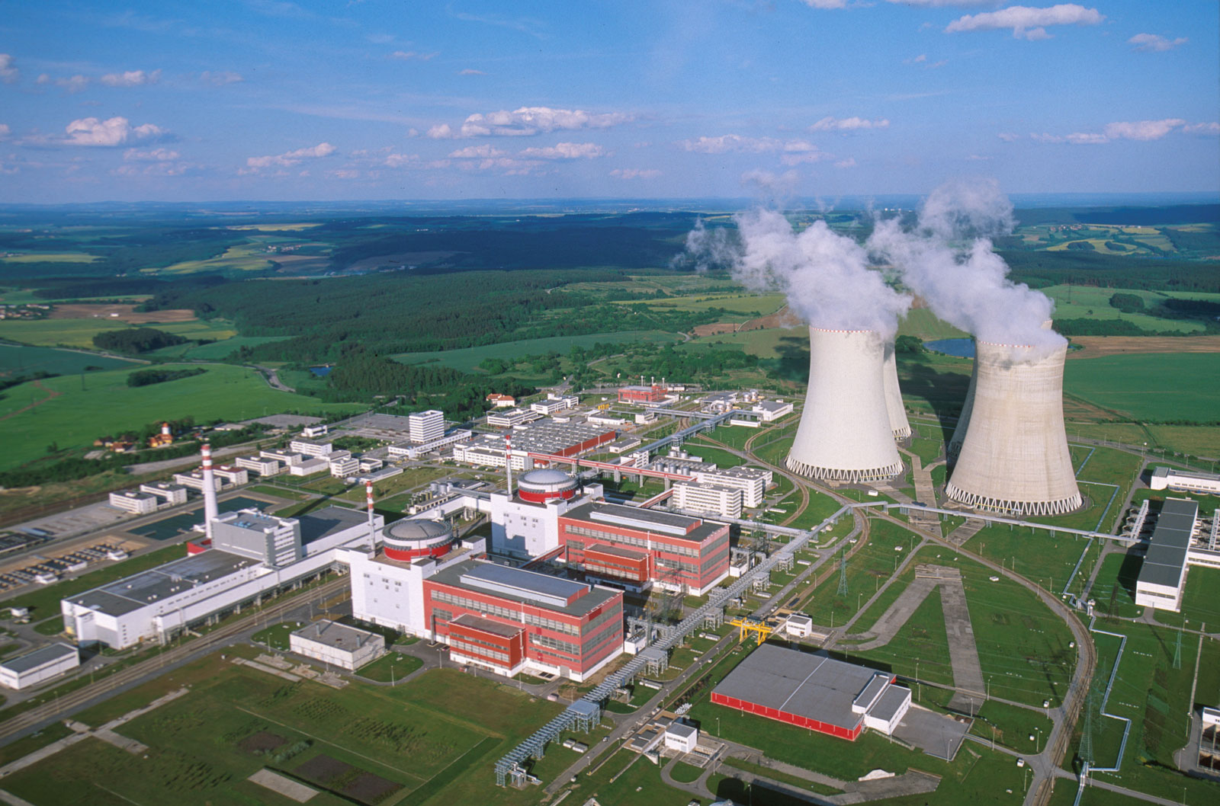
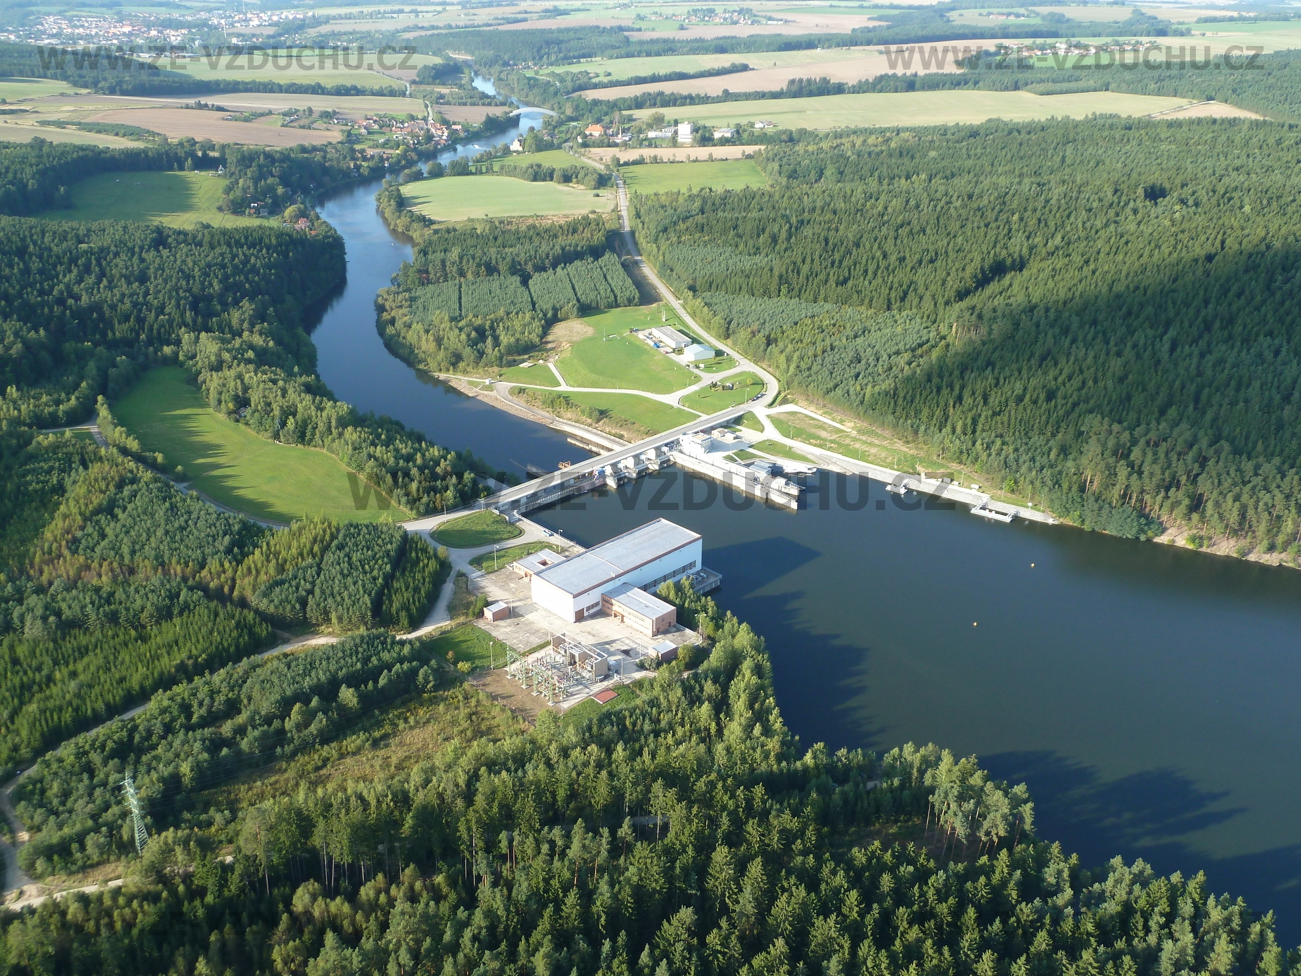
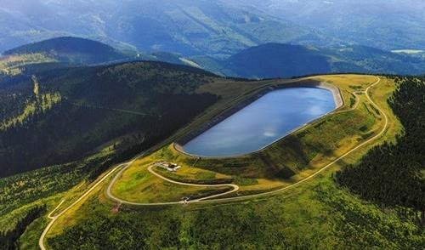
Temelín Nuclear power plant
In operation since 2000 - 2002
Reactor design: VVER 1000 type V320
Nuclear island design – Atomenergoprojekt – Russia
Conventional island design – Energoprojekt Praha
Major suppliers - Czech companies (˃ 90%)
Skoda (Praha, JS, Doosan Power), Vitkovice, Sigma, Etc.
(including reactor vessels, steam generators, turbines, etc..)
Long Time Operation till 2060 – 2062, lifetime 60(+)
Power uprates 981 MW → 1086 MW
(104%, turbine upgrades, efficiency enhancement)
Development program: 18 months – fuel cycles
Hydro power plant Hnevkovice 2 x 4,8 MW
  Cooling water delivery
Dlouhe Strane pumpstation 2 x 325 MW ~ backup
14

Slide 15
Program statement of the government (end of 2021)
Future energy mix – nuclear + decentralized renewables
Long term operation of the current units
Construction of the new nuclear unit in Dukovany (not to be built by Russian or Chinese suppliers)
Assessment of construction of more new units at Dukovany and Temelín site
Strengthening of R&D, international cooperation in the nuclear field
Strategy for implementation of SMRs
Continued works for deep geological repository

Slide 16
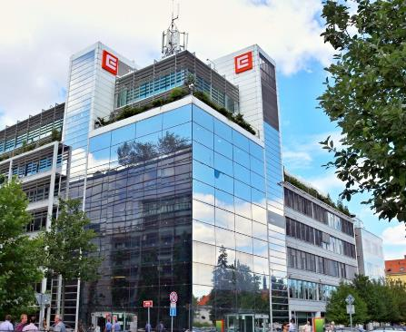
New Nuclear Build
Elektrarna Dukovany II, a. s. (EDU II)
subsidiary company of CEZ, a. s.
established in 2015
over 120 employees
CEZ, a. s. (CEZ Group)
100 %
Dukovany II
focus on 1 reactor unit up to 1200 MWe
60 years projected lifetime
generation III+, PWRs
Elektrarna Temelin II, a. s. (ETE II)
focus on new reactors at Temelin
SMR – Temelin + new sites
16

Slide 17
NPP Dukovany II Project
Investor – NPP Dukovany II, a. s., (EDU II) - 100 % of shares owned by CEZ, a. s. , operator of existing units and owner of the site
1 new unit with capacity up to 1200 MWe
Contractual arrangement between the state and the investor:
First Implementing Contract signed in 2020 – obligation of the parties for the first stage - preparation and selection of the supplier – until 2024
Future contractual arrangement defined in Act 367/2021 Coll. on measures for the transition of the Czech Republic to low-carbon energy
17
17

Slide 18
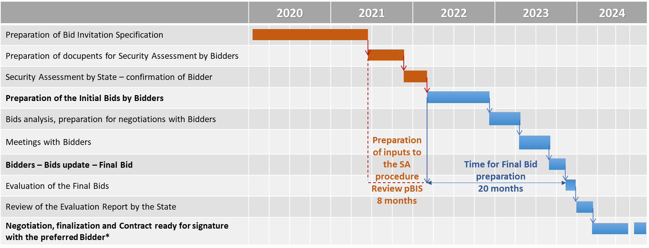
Tender schedule
18

Slide 19
Act 367/2021 Coll. on measures for the transition of the Czech Republic to low-carbon energy
Pillars of Public Aid:
Power Purchase Agreement with mechanism to set and adjust off-take electricity price (cost + reasonable profit usual in the sector concerned)
Investor Agreement – equity commitments + options
Financing mechanism to support low off-take price – Repayable Financial Assistance from the state
Supply Special Purpose Vehicle to be established by the state to supply electricity to the market
19

Slide 20
Tender for EPC Supplier started
Initial Bids submitted by November 30, 2022
Bidder | Country of origin | Type | Installed capacity
Westinghouse Electric Company LLC | USA | AP 1000 | 1200 MW
Korea Hydro & Nuclear Power Company | Korea | APR 1000+ | 1100 MW
Électricité de France | France | EPR 1200 | 1200 MW
20

Slide 21
Dukovany Project – principal milestones
2024 – selection of the EPC supplier
2028 – permitting finalised, start of construction
2030 - first concrete
2035 - start of active testing
2036 – commissioning
21

Slide 22
Additional Units in NPP Dukovany and NPP Temelín
The ongoing tender includes a non-binding option for additional units at Dukovany (1 additional unit) and at Temelín (1-2 additional units)
The government in its program defined the task to prepare necessary analyses for decision regarding construction of additional units). As one of important inputs will be the indicative offer submitted by the Bidders in the Tender for the new Dukovany unit
The government will decide on time schedule, investor, financial and business model in the horizon 2023 – 2024
22

Slide 23
SMR Deployment in the Czech Republic

Slide 24
Nuclear in updated State Energy Policy
  Ministry of Industry and Trade will update the State Energy Policy (SEP) and National Action Plan of Nuclear Energy (NAP) in 2023
      Plan to include construction up to 4 large reactors for electricity generation
      Plan to include SMRs for electricity, heat, and H₂ generation
SMRs are not substitution of large reactors
      Supplementation of energy mix to substitute coal power plants and large central heating plants
Regions are interested to include SMRs in their regional energy policy
      South Bohemian Region (“South Bohemian Nuclear Park”), Moravian-Silesian Region, North Bohemian (Usti and Labem) Region
Objectives
      Commissioning of SMR ETE in 2032
      Commissioning of additional units in non-nuclear sites after 2037

Slide 25
smr development program in Czech Republic
  Project SMR Temelin
      Feasibility study (completion 12/2022)
      Business plan (approval 12/2022)
      Due diligence and follow-up communication with potential suppliers - visits to EdF, KHNP, NuScale, GEH, Holtec, RR, WEC
      Technical information of potential SMR designs
      Site investigation
        Geology
        Water management
        Grid connection
      Preparation for EIA study (2023)
      Initiation of activities for permitting and licensing (2023)
      Decision on supply model, start of selection of SMR technology
  Project SMR in the Czech Republic
      Pre-feasibility study ongoing
      Assessment of suitability of the sites
        Study of available information to assess the suitability of the sites
      Preliminary selected 5 non-nuclear sites for the preparation and construction of SMR
        Collecting the documents and selecting the most suitable non-nuclear sites for the location of SMRs
        Prioritization of sites
      Preparation of preliminary feasibility studies

Slide 26
CEZ smr development program
  Main goal of Program acceleration – implementation of SMR technologies in CR
      Stage I: To put First SMR (pilot) unit in Temelín site into commercial operation till latest 2034
      Stage II: Continue construction of SMRs in other 2-3 sites (owned by CEZ) in CR
MoU signed and used for exchange of information
      CEZ x NuScale
      CEZ x GE Hitachi
      CEZ x Rolls Royce
      UJV Rez x Holtec
      General MoU for cooperation in nuclear field (including SMR) - EdF and KHNP
20 September 2022 –establishment of a company SouthBohemian NuclearPark, s.r.o.

Slide 27
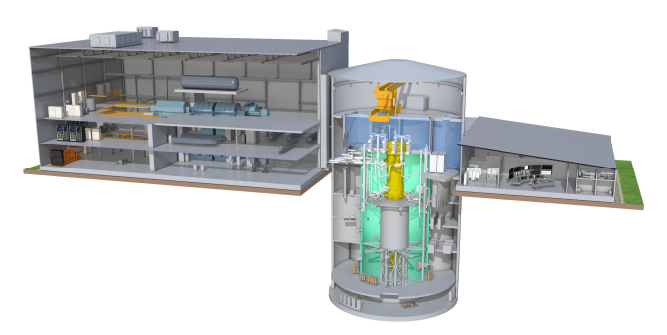
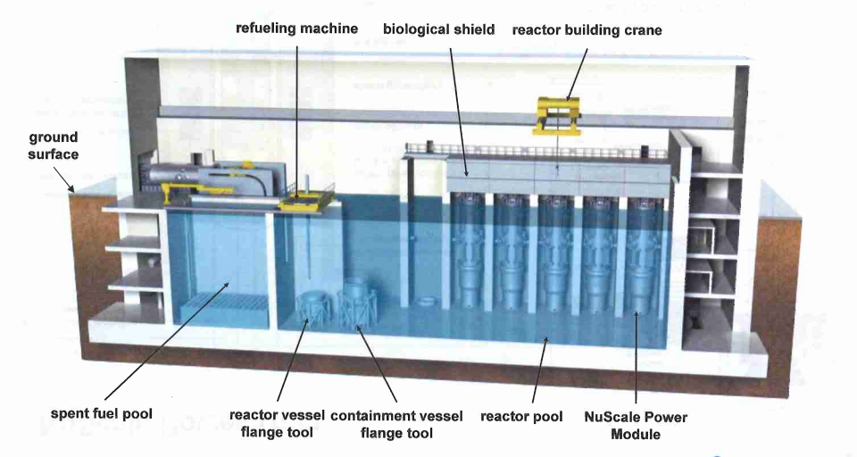
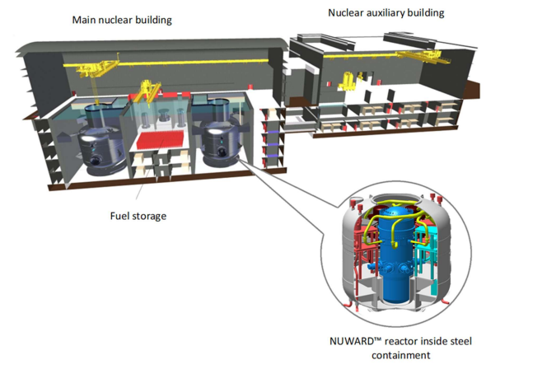
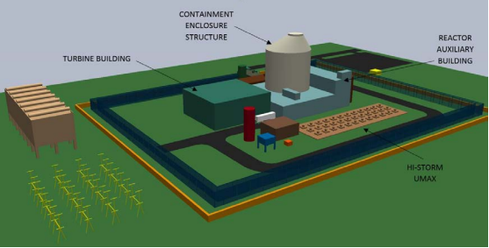
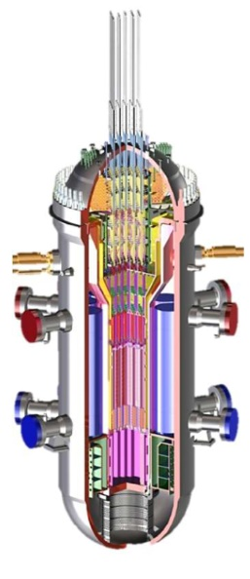
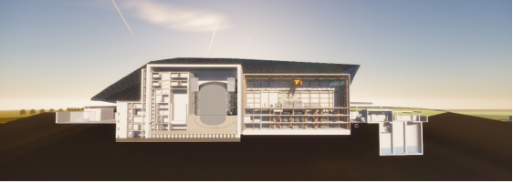
CEZ smr development program
  SMR Designs under evaluation
BWRX-300 (USA, 300/870 MWe/MWt), BWR GE Hitachi
NuScale (USA 12 modules – 600 – 924 MWe), PWR
NuScale
Nuward (2 x 170/ 2 x 540 MWe/MWt), PWR
EdF
SMART100 (Korea, 2x107/2x365 MWe/MWt), PWR
KHNP
SMR-160 (USA, 1x160/525 MWe/MWt), PWR
Holtec
UK SMR (UK, 470/1276 MWe/MWt), PWR
Rolls Royce
  WEC SMR (USA, 1 x 300/900 MWe/MWt), PWR
  Westinghouse

Slide 28
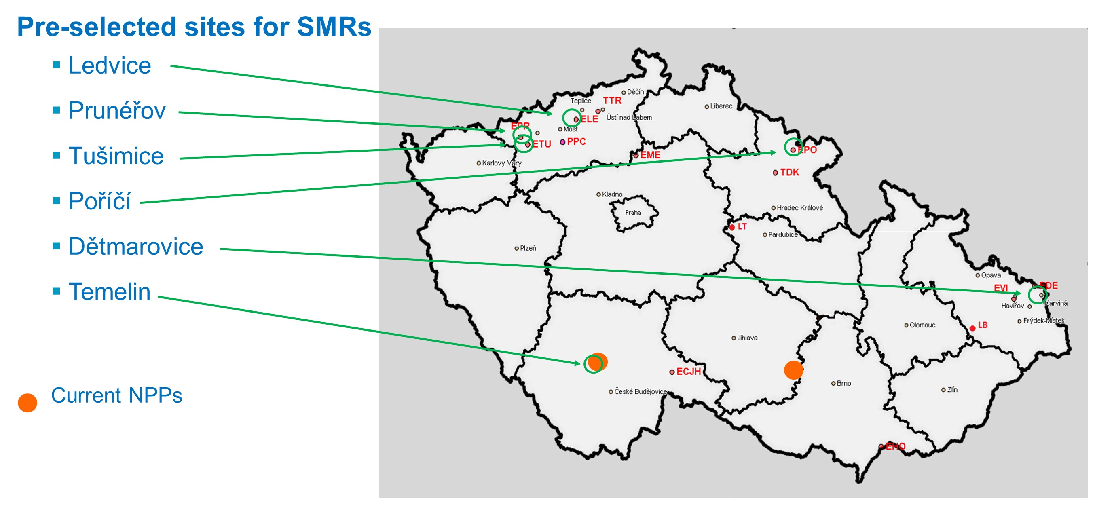
CEZ smr development program

Slide 29
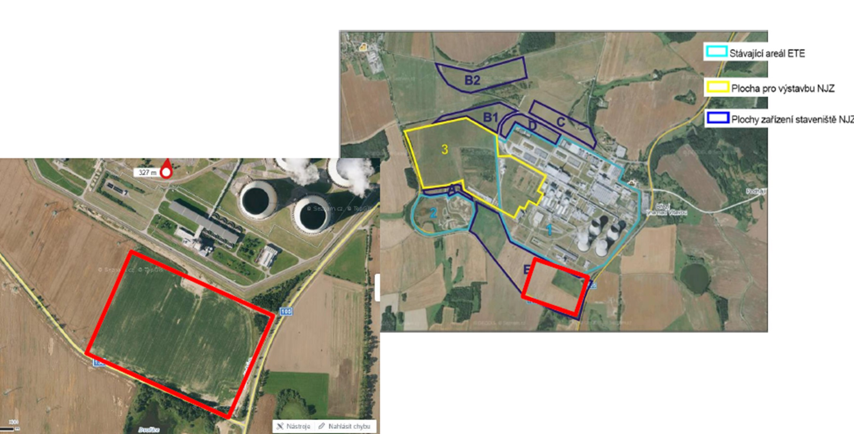
Temelin site for SMR construction
Advantages:
Close vicinity to existing NPP
Available area 19 ha
Convenient geological conditions
Public support
Disadvantages:
Potential collision with construction of ETE 3,4
Limited area

Slide 30
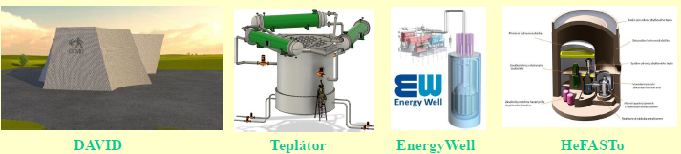
Development of SMR in the czech republic
  Activities on development of Czech own designs of SMR ongoing
      PWR projects
        DAVID (Witkovitz Group), 175 MW, two active zones one on top of other, very compact, fuel change in the central plant
        CR-100 (UJV Group), 100 MWt, SMR based on VVER fuel
      HWR project
        TEPLATOR (West Bohemia University), 200 MW, only heating source, heavy water reactor (use also spent fuel assemblies)
      Advanced Reactors
        Energy Well (CV Rez), 20 MW, cooling by liquid salt, solid fuel
        ALLEGRO / HeFASTo (V4G4 CoE – UJV Rez + CV Rez), 75 / 200 MW, fast helium cooled reactor

Slide 31
Summary
Nuclear power demonstrated the capability of a very efficient transition to low-carbon electricity production
Recent developments demonstrated that without nuclear power there will be strong need of fossil fuels
The ideological campaign caused slowing down the development of nuclear power in EU and CR resulted in lack of energy sources significant loss of industrial capacities
The war in Ukraine have shown the need to restore European (Western) competences in the field of NPP construction with appropriate Western supply chain
The key is to ensure safe long-term operation of existing units and availability of Western fuel also for VVER reactors
The current updated (2015) energy concept of the Czech Republic envisages a roughly half share of nuclear power in electricity production
The political commitment on the long-term development and use of nuclear energy is crucial

Slide 32
Summary
SMRs have significant potential to complement energy mix mainly due to their multipurpose applications
SMRs are not considered in CR as a replacement for large units, but complementing the energy mix as a suitable replacement for coal units and for large central heating plants
The SMR program in CR means not only the construction of NPPs, but also the strong involvement of the Czech industry, research and engineering companies in the supply chain, technology development, engineering, maintenance and training activities
Emphasis will be placed on simplicity, speed of construction and economic parameters of the construction and operation of SMR.
      Critical issue for SMR could be licensing and public acceptance of new non-nuclear sites and development of EU taxonomy

Slide 33
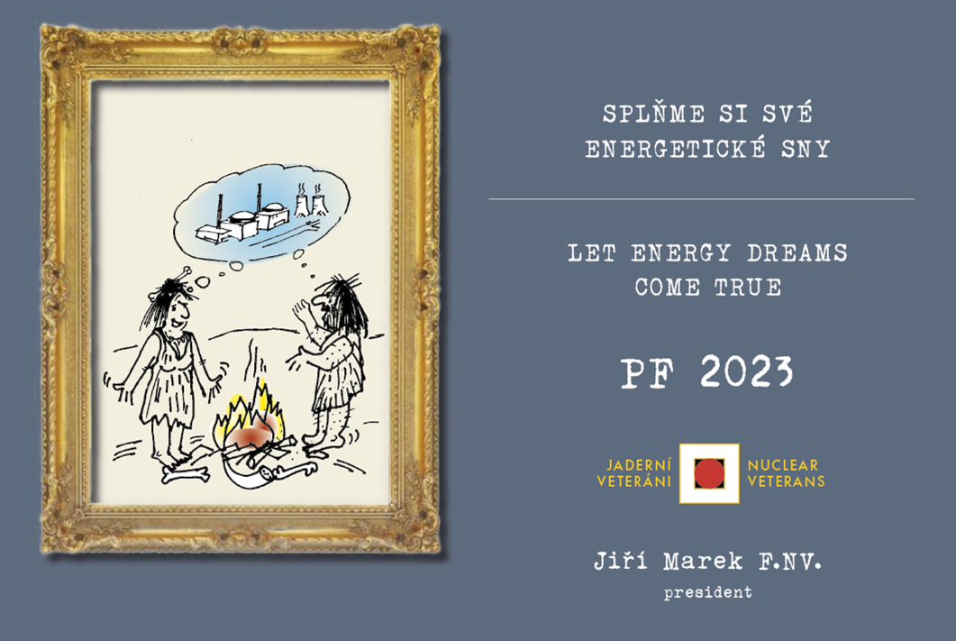
Thank you for your attention
Jozef.Misak@ujv.cz
Phone: +420 602 293 882
www.ujv.cz

