Slide 1
INTERNАTIONAL NUCLEAR ENERGY CONFERENCE
12 JANUARY 2023, SOFIA
Financing of new nuclear projects in Southeastern Europe in a liberalized energy market

Slide 2
The CEE countries and their Nuclear Energy situation
Countries with no operational nuclear power plants (“NPPs”) – Poland, Turkey, Greece, Serbia, etc.
Plans to construct NPPs – Poland, Turkey
Open to joint NPP projects – North Macedonia, Albania
No firm plans for new NPPs (with certain recent changes of policy) – Greece, Serbia
Countries with operational NPPs – Bulgaria (2 Units), Romania (2 Units), Hungary (4 Units), Czech Republic (6 Units), Ukraine (15 Units), Slovakia (4 Units), Slovenia/Croatia (1 Unit)
Light water reactor types:
Pressurized Water Reactors (“PWR”) - Kozloduy Units 5&6 (VVER 1000); Paks Units 1-4 (VVER 440); Temelin Units 1&2 (VVER 1000), Dukovany Units 1-4 (VVER 440); Ukraine – all VVER reactors; Slovakia – all VVER 440 reactors; Krsko – the only Westinghouse PWR in CEE
No Boiling Water Reactor in CEE
Heavy water reactor type: Cherna Voda Units 1&2 (Candu 6 – AECL)

Slide 3
Successfully implemented Nuclear Projects in CEE since the changes
New nuclear
Czech Republic:
Temelin – 2 Units VVER-1000, finished in 2000/2002; 1000 MW
Slovakia:
Mochovce Unit 1, VVER-440, finished in 1998, 436 MW
Mochovce Unit 2, VVER-440, finished in 1999; 436 MW
Mochivce Unit 3, VVER V-213, final stage – the Slovak Nuclear Regulatory Authority has issued the final authorization (2022)
Mochivce Unit 4, VVER V-213, final constructions stage (2023)
Romania:
Chernavoda Unit 1, a CANDU 6 type, finished in 1996 and produces 700 MW of electricity
Chernavoda Unit 2, a CANDU 6 type, finished in 2007 and produces 700 MW of electricity

Slide 4
2022 | a Positive Year for Nuclear Energy | Globally
EDF will restart all its nuclear power reactors this winter
The UK government will provide GBP 700 million (USD 807 million) in funding for the Sizewell C NPP
Hungary's National Atomic Energy Office has granted a construction license for two VVER-1200 reactors at the Paks II NPP site
The Slovak Nuclear Regulatory Authority has issued the final authorization for commissioning unit 3 of the Mochovce NPP
The US Senate has voted to pass the Inflation Reduction Act. The wide-ranging bill includes support for existing and new nuclear
The US Nuclear Regulatory Commission has announced it certifies NuScale's small modular reactor design for use in the USA. The reactor is the first SMR design to be certified by the NRC
Candu signed the first contract for the refurbishment of unit 1 at Cernavoda NPP. The re-tubing of the reactor will take its operational life to 2060
Unit 3 of the Kakrapar NPP in India is expected to enter commercial operation by December 2022
Unit 1 of the Shin Hanul NPP is scheduled to enter commercial operation in September 2022
The IAEA has launched a new initiative aimed at accelerating the safe and secure deployment of advanced nuclear reactors, with a particular focus on SMRs
The Egyptian Nuclear and Radiological Regulatory Authority has issued a construction license to the Nuclear Power Plants Authority for unit 1 of the planned four-unit El Dabaa NPP
The US government, working with NuScale Power, is to provide USD14 million in support for the study for Romania's first-of-its-kind SMR plant

Slide 5
SMR investment in Poland
In February 2022, KGHM signed an agreement with NuScale Power to commence work on the implementation of SMRs in Poland. KGHM hopes to launch the first capacities by 2029
In July 2022, ORLEN Synthos Green Energy submitted an application for an SMR technology assessment to the National Atomic Energy Agency
On the 6 September 2022 in Karpacz, KGHM and the operator of Nuclear Power Plants in Romania signed a memorandum on the implementation of SMR modular nuclear reactors

Slide 6
GE Hitachi, KHNP, EDF investments in Polish nuclear energy
Synthos Green Energy submitted an application to the Office of Competition and Consumer Protection to create a JV together with GE-Hitachi Nuclear Energy International to deal with the development of SMRs
Korea Hydro & Nuclear Power (KHNP) presented Poland with a technical and price offer for the construction of nuclear power plants on the Vistula River

Slide 7
SMR in Romania
In March 2019, Nuclearelectrica and NuScale signed a Memorandum of Understanding (MOU) to evaluate the development, licensing and construction of a NuScale SMR in Romania
In August 2020, NuScale received design approval from the U.S. Nuclear Regulatory Commission – a first to the market in building and deploying SMR technology. NuScale has already signed contracts with Doosan, Samsung and GS Energy Corporation to advance the development of SMR components
In may 2022, during the Small Modular and Advanced Reactors Workshop Planning IV organized in Bucharest by the USTDA in partnership with the US Department of Commerce, NuScale and Nuclearelectrica announced the location of the first Small Modular Reactor (SMR) in Romania - the site of the former Doicești Thermal Power Plant, Dâmbovița County

Slide 8
SMRs in the Czech Republic
CEZ sees small nuclear reactors as potential replacements for coal units (but not as an alternative to planned large NPP units)
Pilot SMR project considered within Temelin NPP:
First projects to be completed after 2030
Considered suppliers include NuScale, GE Hitachi, Rolls Royce, EdF, KHNP and Holtec
In March 2022, the Ministry of Industry created a working group to assess the options for use of SMRs, including:
shortening of permitting procedures
identification of possible locations

Slide 9
Kozloduy NPP | New Units
On 21 February 2020 “Kozloduy NPP-New Builds” PLC received an order approving the site for the deployment of a new Unit. In accordance with national legislation and according to the IAEA guidance documents, the site selection process went through several phases, multiple analyses and studies of proposed sites were conducted, detailed characterisation and ranking of these sites was carried out and the most suitable site and project bases were defined
6 November 2020 – the Government decided to study the opportunities of a new Unit to be built at the Kozloduy NPP site.
20 January 2021 – the Government took a decision for use of the equipment delivered for Belene NPP
17 February 2021 – NuScale and Kozloduy NPP – New Build Plc Sign Memorandum of Understanding to Explore SMR Development in Bulgaria

Slide 10
CAN NPPs GET FINANCED AND SURVIVE IN LIBERALIZED ENVIRONMENT?
There are over 70 reactors under construction today - the largest number in 25 years - but only a few are in a liberalized electricity market;
In the USA, two nuclear power plants operating in liberalized electricity markets were closed a few years back for financial reasons;
The UK electricity market: the difficulty in developing a new nuclear power project is demonstrated by the complex Electricity Market Reform program and controversial incentive package for Hinkley Point C;
The electricity industry has two main models. The traditional model has vertically integrated monopolies subject to economic regulation or government ownership. The new model has a de-integrated and restructured electricity industry with a liberalized electricity market (CfD support);
These two models are based on very different economic principles.
In the traditional model, regulated and government utilities plan and build a portfolio of generation units intended to minimize long-term total cost of the electricity system.
In the new model, liberalized electricity markets use spot market prices to manage system dispatch to minimize short-term marginal cost of wholesale electricity;

Slide 11
Financing of new nuclear in liberalized environment
The generation planning process in the traditional model can consider all relevant generating technology attributes, including long-run cost levels, volatility of costs, environmental impact, power density, controllability, and reliability. There is a century of successful experience with the traditional model. All operating nuclear power plants were built under the traditional model. Almost all nuclear power plants under construction today are in systems using the traditional model, including countries with government-owned electric utilities such as China, India, South Korea, and the UAE.
In the new model, generation assets are divested or privatized and then compete by bidding into the short-term electricity market. The new model relies on market price signals to provide incentives for generation investment instead of the long-term planning and regulated generation investment approach in the traditional model. Liberalized electricity markets manage the dispatch of existing generation units well. However, the new model has not managed new generation investment so well. Market price signals for new generation investment have been blurred and weak, in part due to price caps in some markets.

Slide 12
SMR – HOW ARE THEY DIFFERENT FROM THE TRADITIONAL UNITS IN TERMS OF FINANCING
Financial considerations
Less capital intensive
Application of the “traditional model” of financing is less problematic
Faster deployment leading to shorter recovery period
Greater private participation
Lower operational and decommissioning costs
Lower exposure of Governments guaranteeing the respective risks
Technical and regulatory aspects
Allowing the use of existing thermal and other sites
Faster regulatory and environmental approval periods
First units – licensed and under construction
Less balancing risks
Design, which is much more standardized
Less challenges to the competitive landscape

Slide 13
Staff
> 8,000
Lawyers
> 5,000
Partners
> 1,200
52 new partners in 2021, taking the total to over 1,200
Operating in
Across
73
43
countries
EUR 1.746bn
cities
turnover for 2021
19 Practice and Sector Groups working across offices
Top rankings in M&A league tables by deal count
(Bloomberg, Mergermarket and Thomson Reuters)
#1 Germany, DACH, Austria
#2 Europe, UK, Switzerland, Benelux

Slide 14
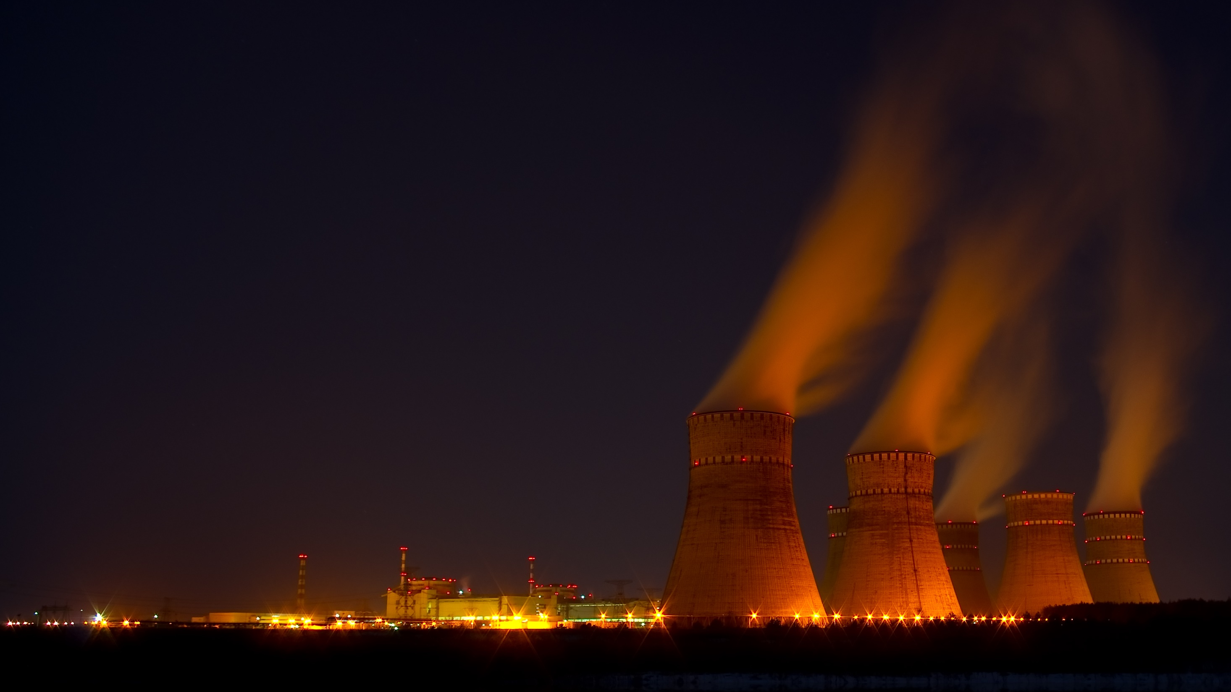
Any questions?

Slide 15
Let’s stay in touch!
Kostadin Sirleshtov Partner
T +359 2 921 9942
E kostadin.sirleshtov@cms-cmno.com
Kostadin Sirleshtov | LinkedIn

