Slide 1


REPUBLIC OF BULGARIA
Ministry of Energy
Nuclear energy in Bulgaria – state-of–the art and future perspective
International Nuclear Conference “State-of-the-art Small Modular Reactor technologies and their preparedness for the market of Southeastern Europe”, Sofia ,12-13 January 2023

Slide 2


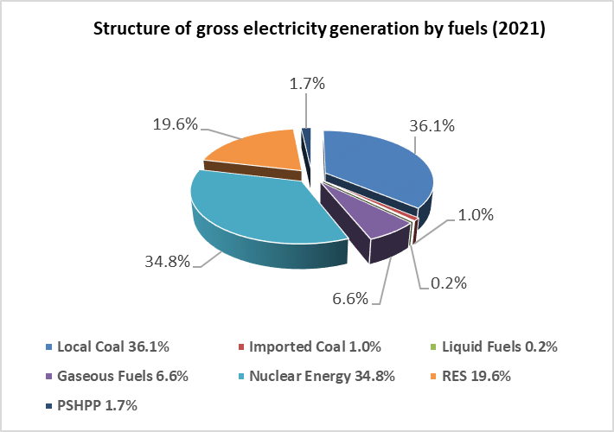
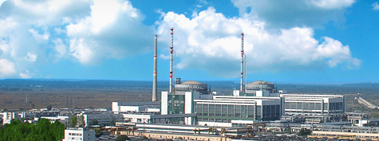
Main characteristics of the energy sector in the Republic of Bulgaria
BG keeps a strong pro-active nuclear approach because nuclear power:
is a major pillar in the current national energy mix;
has a key role to play in the future EU and BG decarbonize energy system (also in the context of the EU Green Deal and REPowerEU, Taxonomy);
provides stable and reliable electricity/heat at affordable and predictable prices.

Slide 3
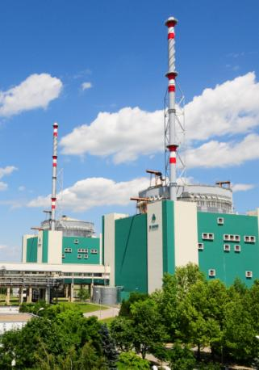
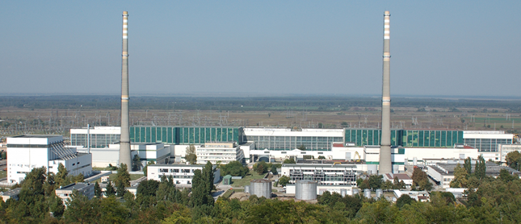
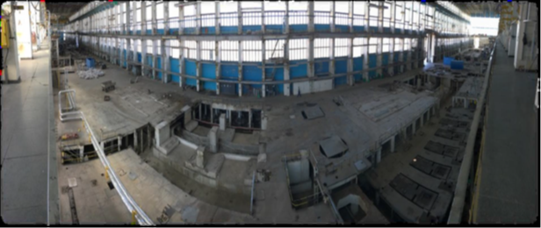
Bulgarian nuclear power program
Name | Type | Status | Gross Electrical Capacity [MW] | First Grid Connection
Kozloduy - 1 | VVER-440/V230 | Decommissioning | 440 | 1974
Kozloduy - 2 | VVER-440/V230 | Decommissioning | 440 | 1975
Kozloduy - 3 | VVER-440/V230 | Decommissioning | 440 | 1980
Kozloduy - 4 | VVER-440/V230 | Decommissioning | 440 | 1982
Kozloduy - 5 | VVER-1000/B-320 | Operational | 1080 | 1987
Kozloduy - 6 | VVER-1000/B-320 | Operational | 1080 | 1991

Slide 4
Main priorities of the Bulgarian nuclear power program
Operational lifetime extension of Units 5 and 6 of Kozloduy NPP to the maximum possible period (up to 30 years);
Diversification of fresh nuclear fuel supplies;
Decommissioning of Units 1-4 of the Kozloduy NPP by 2030;
Construction of the National Radioactive Waste Disposal Facility (NDF);
Construction of new nuclear facilities.

Slide 5

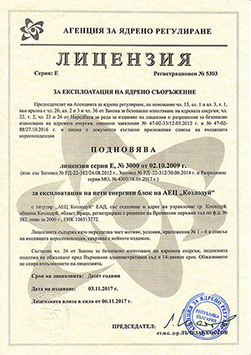
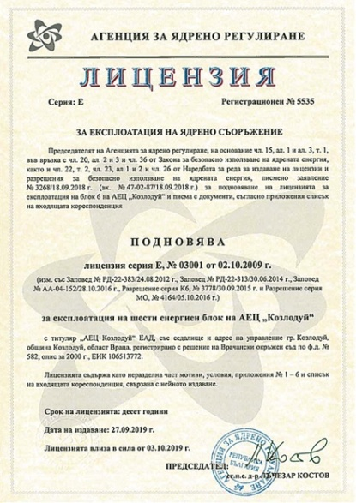
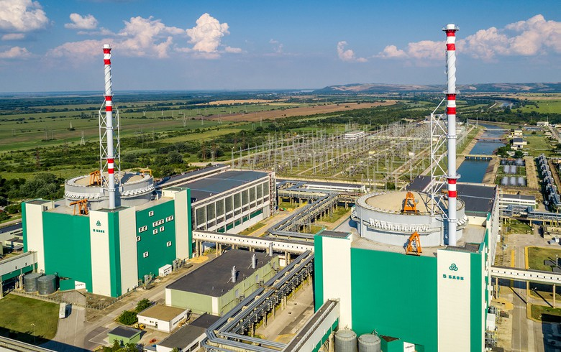
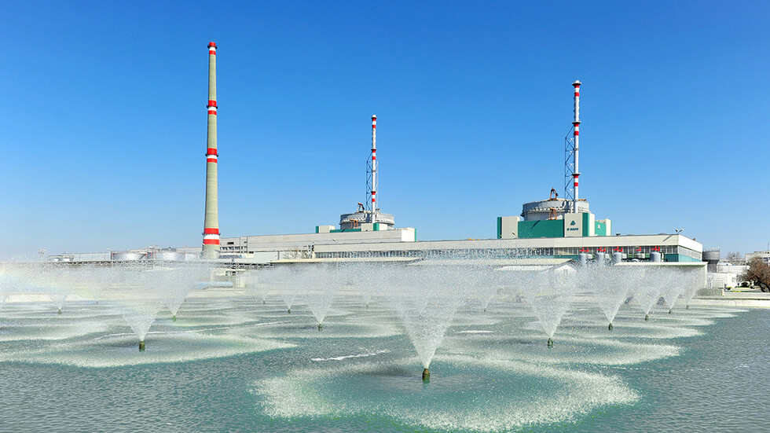
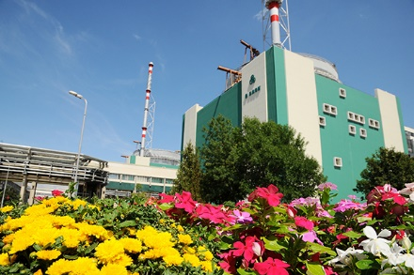
Kozloduy NPP - Units 5 and 6

Slide 6
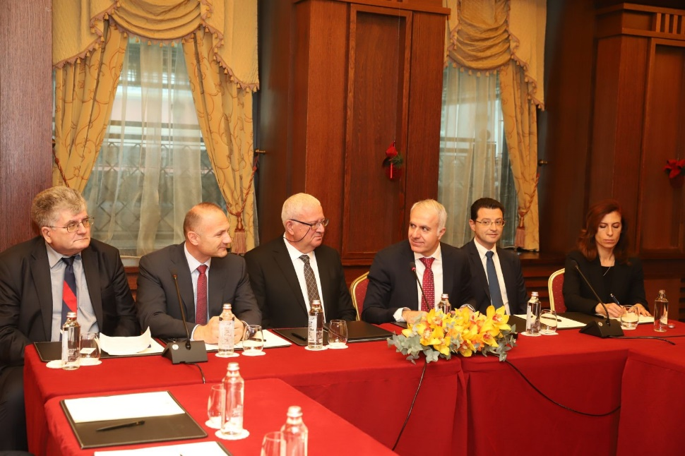
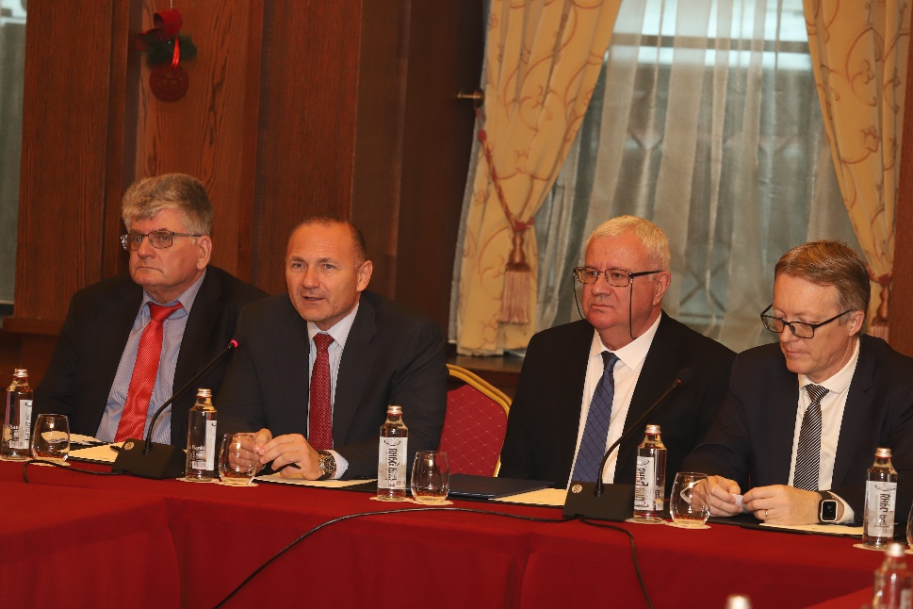
Diversification of fresh nuclear fuel supplies
Programme for Diversification of Fresh Nuclear Fuel Supplies – implemented by Kozloduy NPP and agreed with the Euratom Supply Agency.
A 10-year contract was concluded with Westinghouse concerning the fresh nuclear fuel supplies for Unit 5 – 22 December 2022.
An agreement was signed between Kozloduy NPP and Framatome for the supply of fresh nuclear fuel for Unit 6 - 30 December 2022.

Slide 7
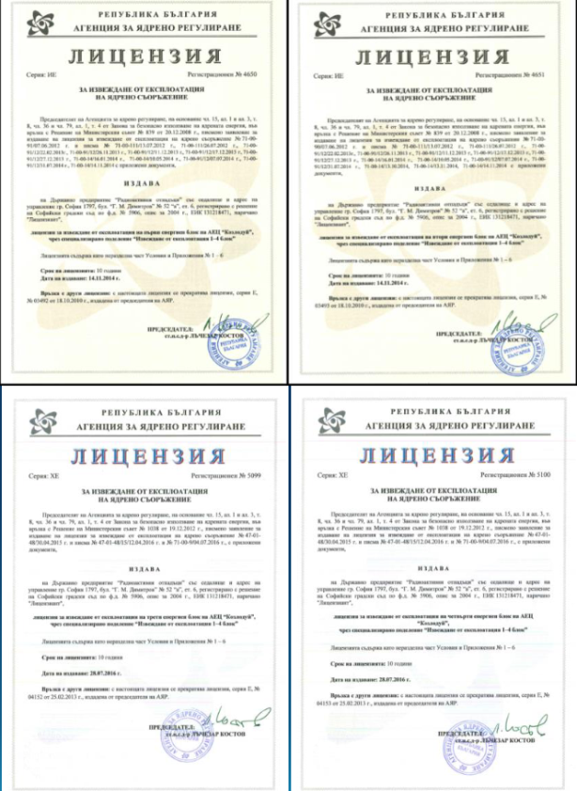
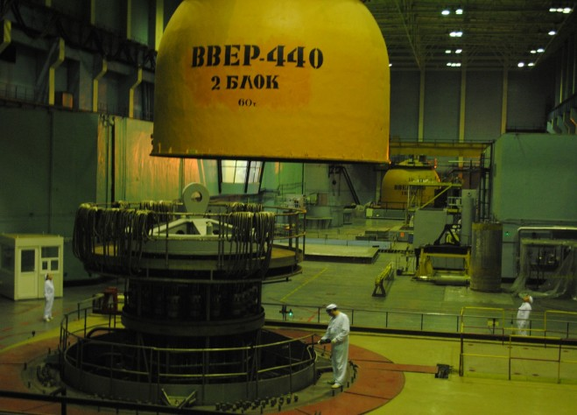
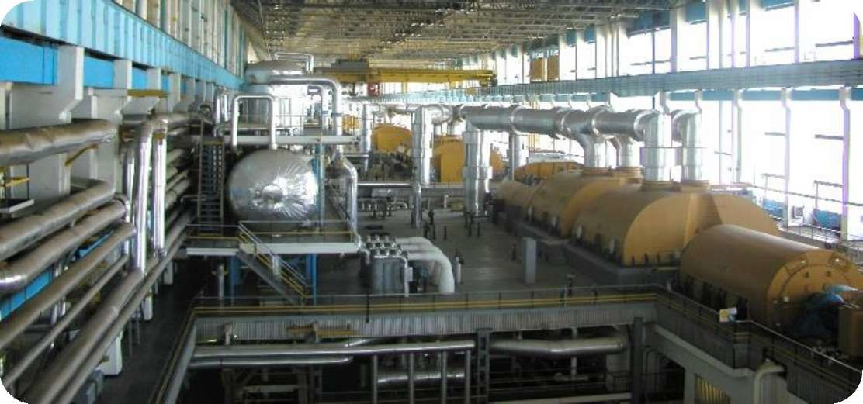
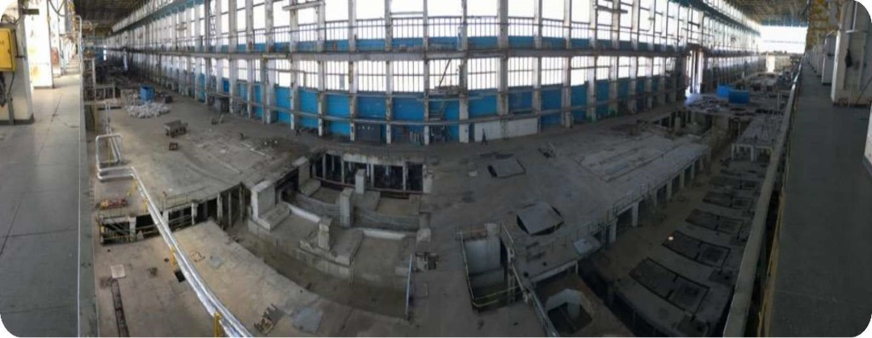
Decommissioning of Units 1-4 of Kozloduy NPP
Turbine Hall – general view at the start/end of dismantling

Slide 8
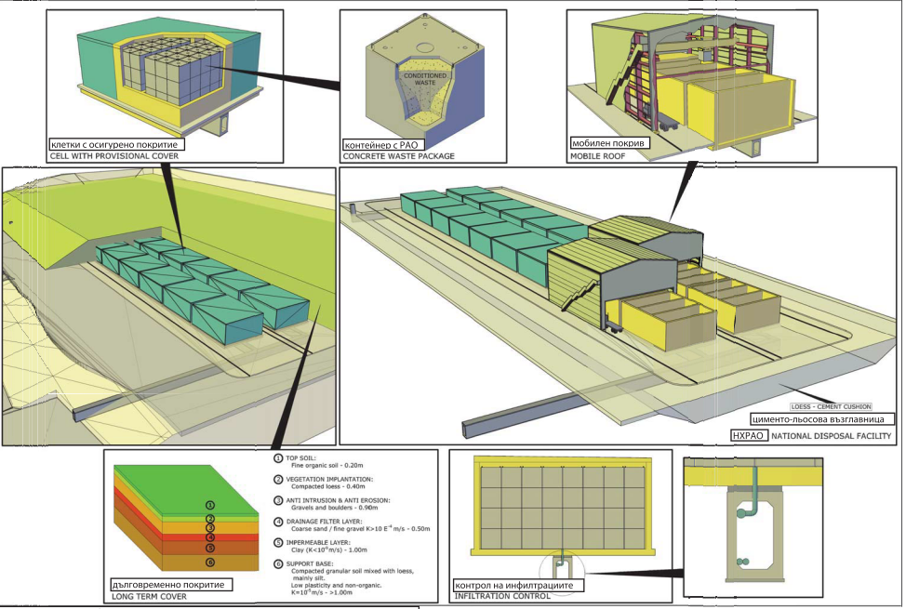
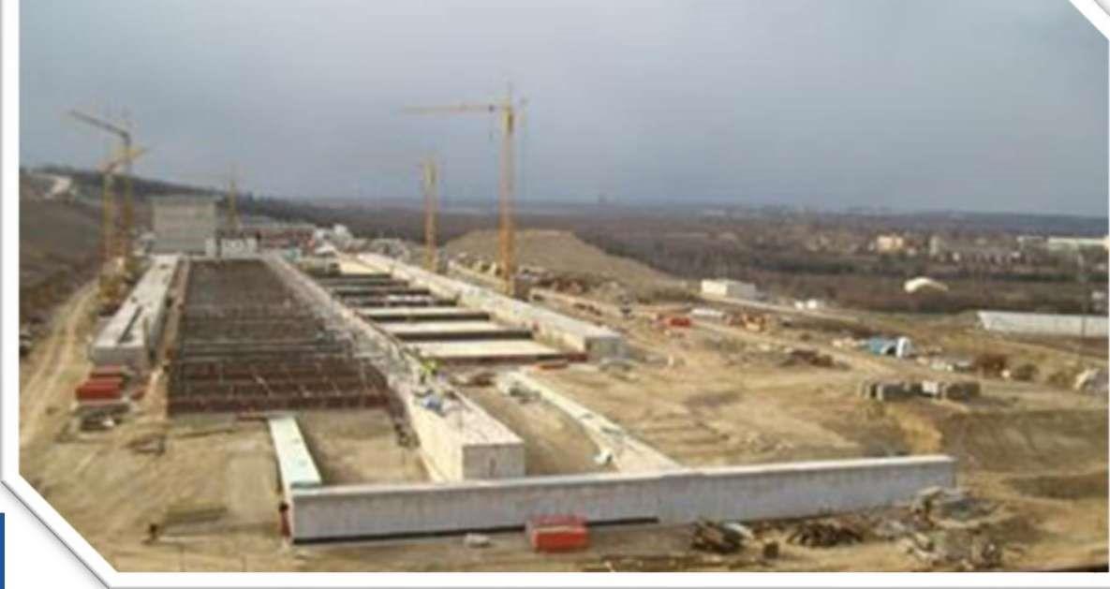
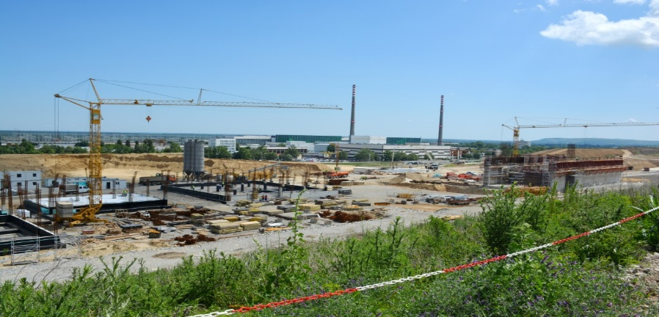
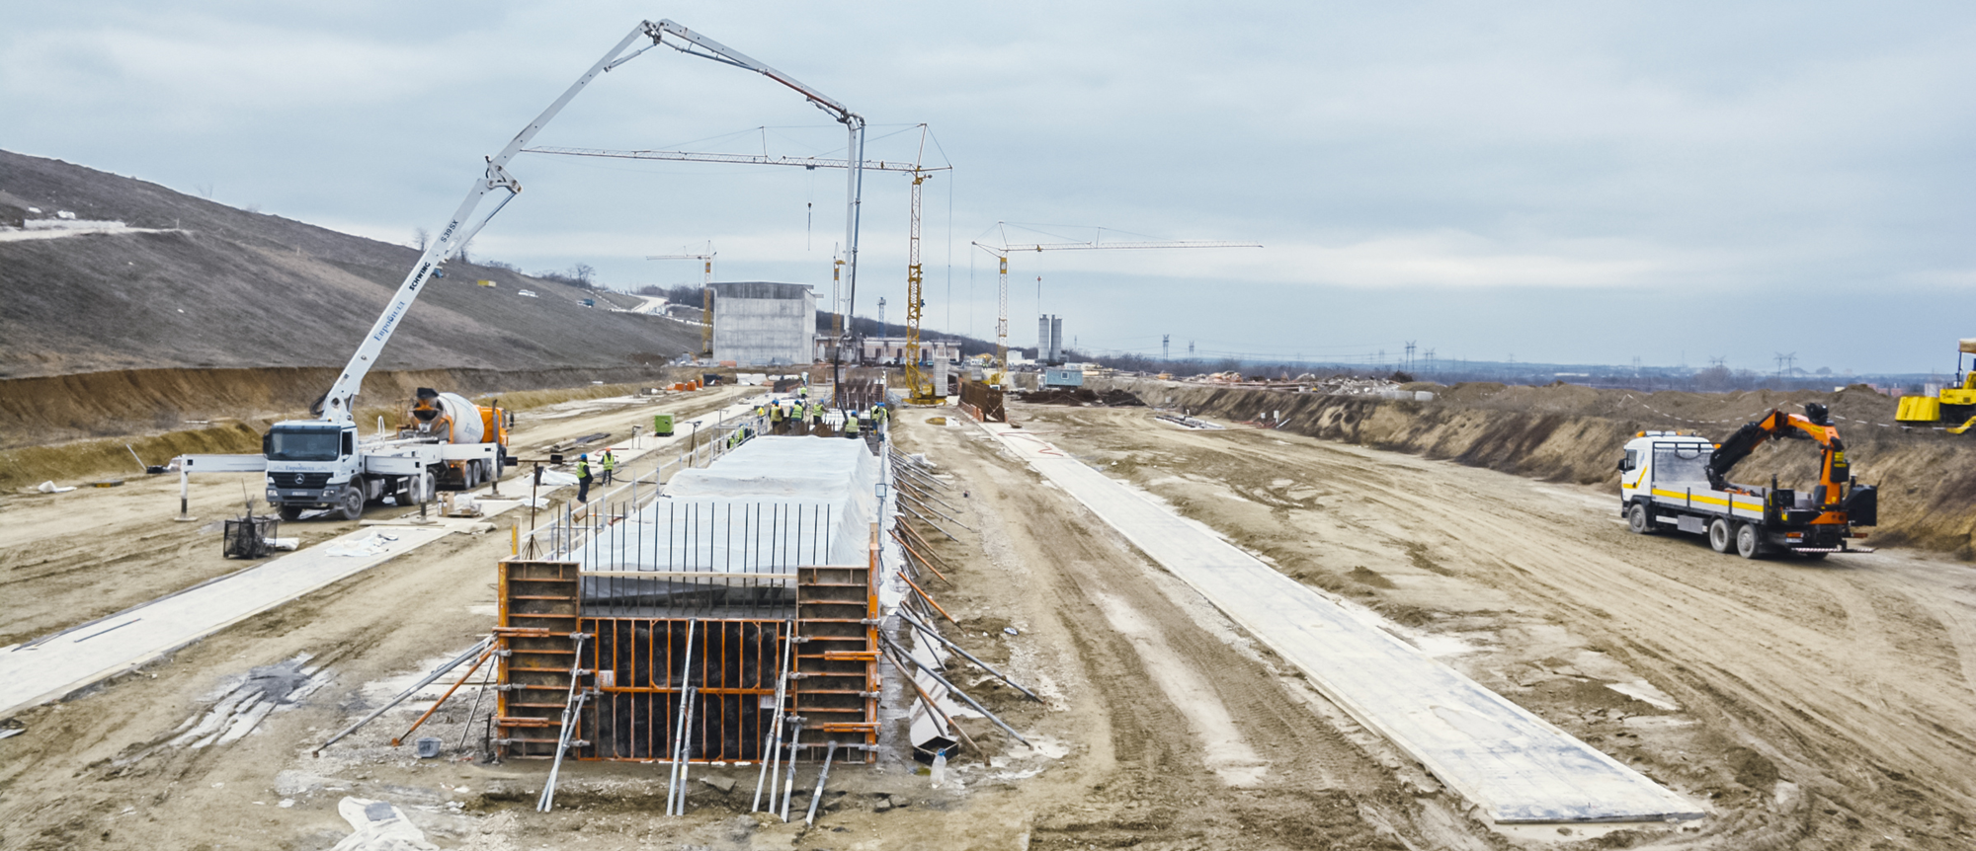
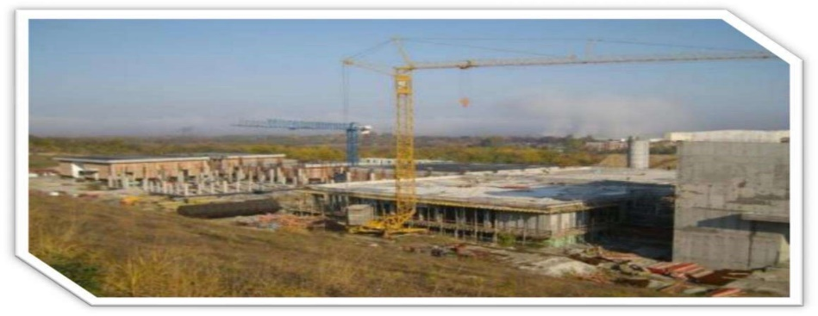
Construction of National disposal facility
Phase 1 of NDF
Official groundbreaking: 29 August 2017.
Expected completion of construction activities – 2023.

Slide 9
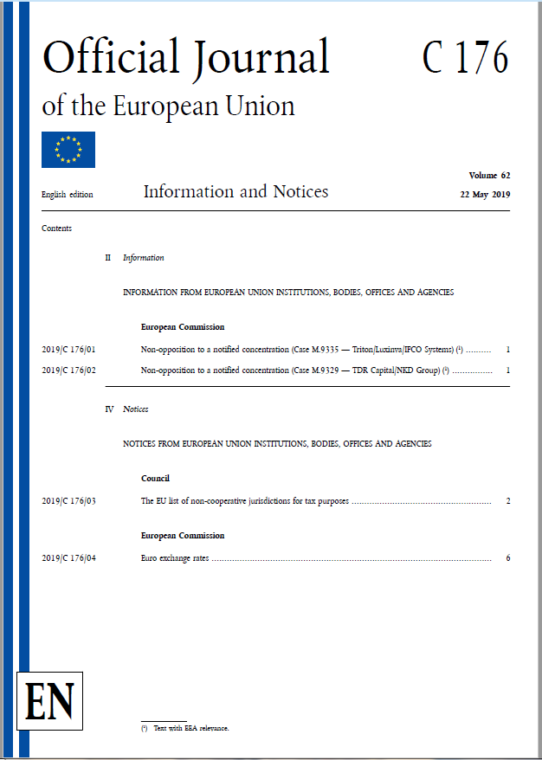
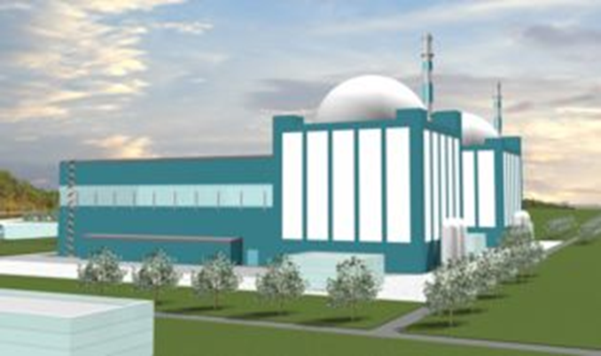
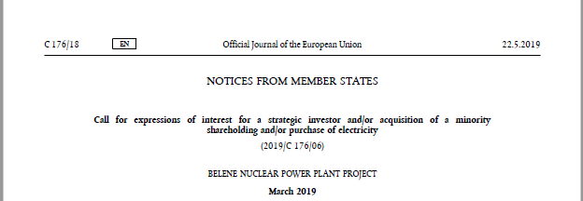
Belene Nuclear Power Plant project
Decisions of the National Assembly and the Council of Ministers for restoration of the actions on searching of possibilities for construction of Belene NPP - 2018 .
Call for the procedure for selecting a strategic investor for the Belene Nuclear Power Plant project – published on 22nd May 2019.
Procedure status - "put on hold“.

Slide 10
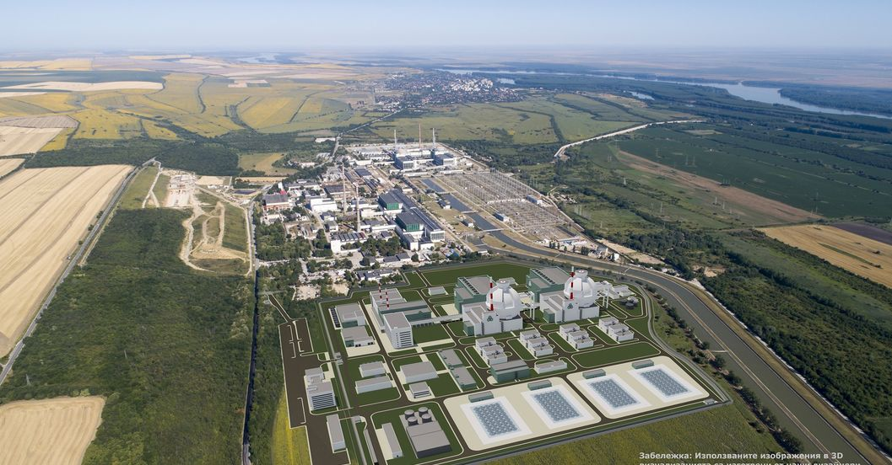
Kozloduy NPP-New Build
11 April 2012 - Council of Ministers’ Decision in principle – construction and commissioning of new nuclear build at KNPP site based on GEN III or III+ technology (LWR with 1200 MWe installed capacity).
9 May 2012 – set-up a dedicated project company Kozloduy NPP-New Build.
Pre-Feasibility Study - two options have been explored (1) maximum utilization of the equipment delivered for Belene NPP project and (2) use of entirely new LWR reactor technology.
Environmental Impact Assessment – issued by national competent authority (Ministry of Environment and Water) in 2015 and re-confirmed by Supreme Administrative Court in 2019.
21 February 2020 – site selection activities completed. Site 2 was approved by issuing an Order by national nuclear regulator.

Slide 11
Future Plans
Construction of 2000 MW capacities at Belene site by 2035/2040.
Construction of 2000 MW replacement capacities by 2045 at Kozloduy site.
Construction and commissioning of a deep geological repository by 2050.

Slide 12

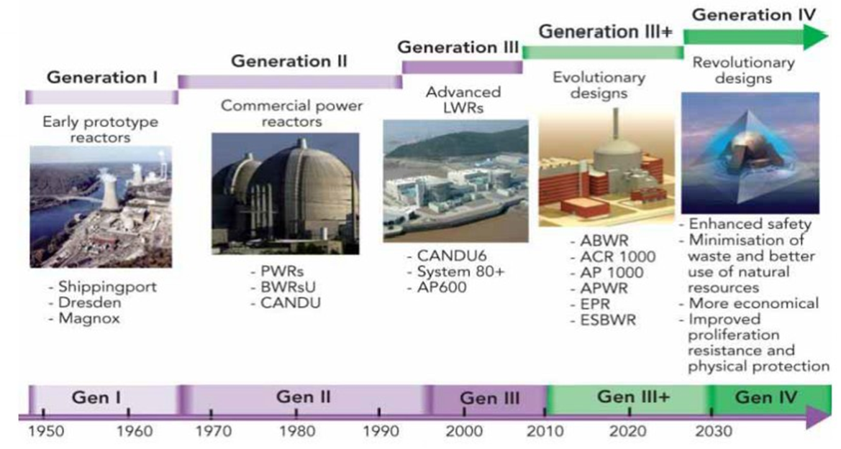
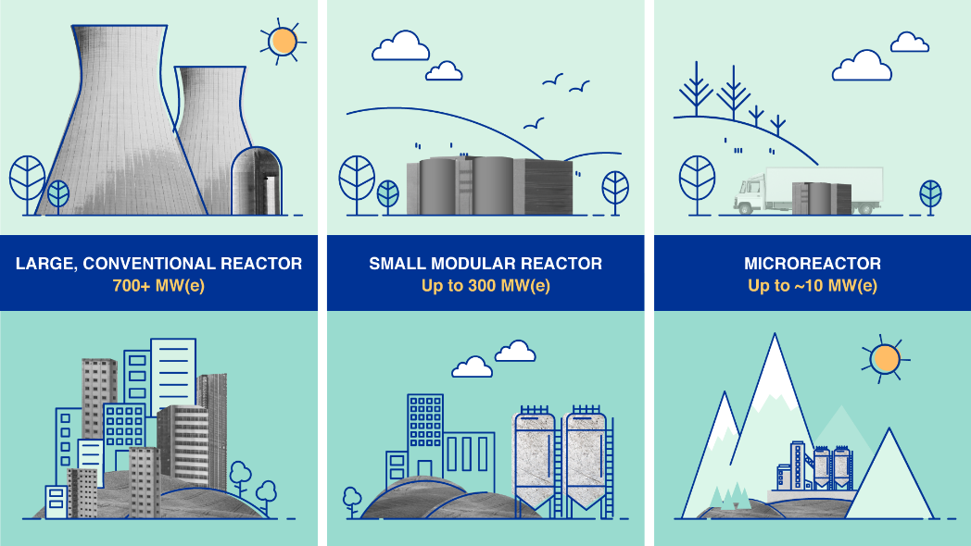
Advanced nuclear technologies
Sustainable political decision for the future development of nuclear energy.
Assessing different options for the future development of the nuclear energy sector.
- SMRs as a complementarity technology to the existing large-scale reactors.

Slide 13
THANK YOU
FOR
YOUR ATTENTION!
Ministry of Energy
www.me.government.bg
© 2023

